Slide 1
Factor Analysis of Work Engagement
Women & Workforce Engagement
EFA & CFA of the 9-Item Utrecht Work Engagement Scale (UWES-9)
in a Multi-Occupational Female Sample
Primary Study:
Willmer, M., Westerberg Jacobson, J. & Lindberg, M. (2019)
Frontiers in Psychology, 10, Article 2771
DOI: 10.3389/fpsyg.2019.02771
Presented by: Lana Jalal Gidan
SSIE-605: Applied Multivariate Data Analysis
Professor Susan Lu
Watson College of Engineering | Binghamton University

Slide 2
Agenda
1. Introduction & Background
2. Literature Review
3. Research Methodology
4. Results: EFA & CFA
5. Discussion
6. Conclusion & Implications
7. References
Introduction | Literature Review | Methodology | Results | Discussion | Conclusion | References

Slide 3
Introduction
Work Engagement & Women in the Workforce
What is Work Engagement?
A positive, work-related state of mind characterized by three dimensions:
Vigor: High energy, mental resilience, willingness to invest effort
Dedication: Sense of significance, enthusiasm, inspiration, pride
Absorption: Being fully engrossed in work, time passes quickly
Why Study Women Specifically?
- Most UWES-9 studies use mixed-gender samples with majority male participants
- Gender may influence how work engagement is structured and experienced
- Only one prior Swedish study existed, using 186 IT consultants (63% male)
- Understanding women's engagement patterns is critical for retention & policy
(Schaufeli et al., 2002; Hallberg & Schaufeli, 2006)
Introduction | Literature Review | Methodology | Results | Discussion | Conclusion | References

Slide 4
Literature Review
The UWES-9 Debate: One Factor vs. Three Factors
The UWES-9 Instrument:
- 9 items rated on 0-6 scale
(Never to All the time)
- 3 theoretical subscales:
Vigor (3 items: 1, 2, 5)
Dedication (3 items: 3, 4, 7)
Absorption (3 items: 6, 8, 9)
The Core Debate:
Kulikowski (2017) review of 21 studies:
- 3 confirmed 1-factor
- 3 confirmed 3-factor
- 4 found both equivalent
- 1 supported neither
No definitive conclusion reached
Key Prior Findings:
Swedish (Hallberg & Schaufeli, 2006):
n = 186 IT consultants (37% women)
Both 1-factor & 3-factor fit equally
RMSEA = 0.13, CFI = 0.97
Norwegian (Nerstad et al., 2010):
n = 1,266 multi-occupational (67% women)
3-factor supported, but factors
highly correlated (suggesting 1 factor)
Finnish (Seppala et al., 2009):
n = 9,404 multi-occupational
Both structures reasonable
Gap: No all-female, multi-occupational
Swedish study existed
Introduction | Literature Review | Methodology | Results | Discussion | Conclusion | References

Slide 5
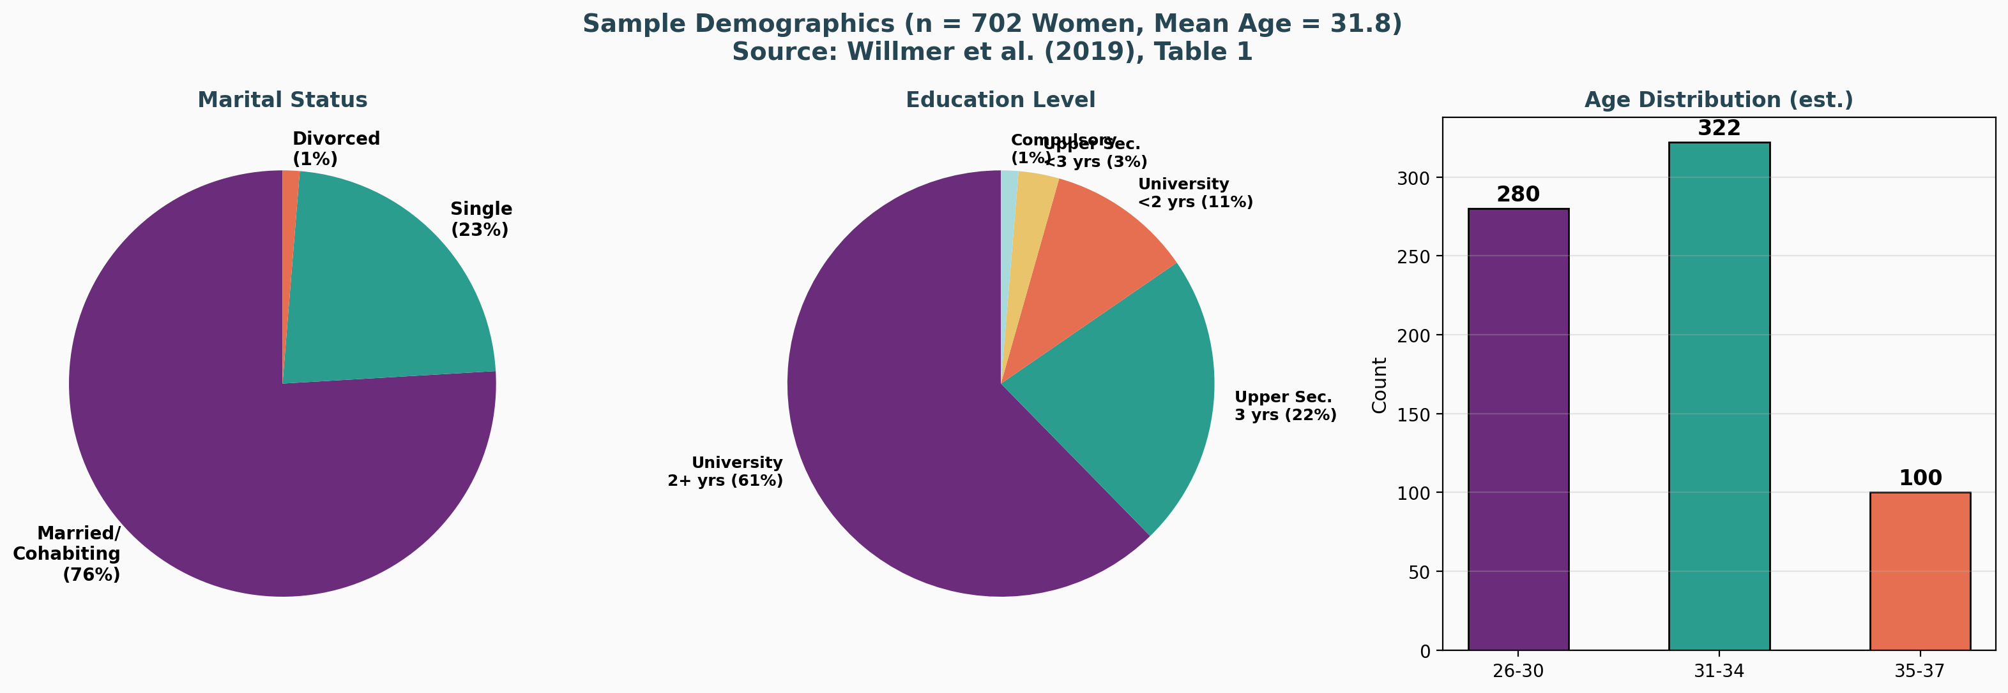
Sample Demographics
n = 702 Women, Aged 26-37, Multi-Occupational Swedish Sample
Introduction | Literature Review | Methodology | Results | Discussion | Conclusion | References

Slide 6
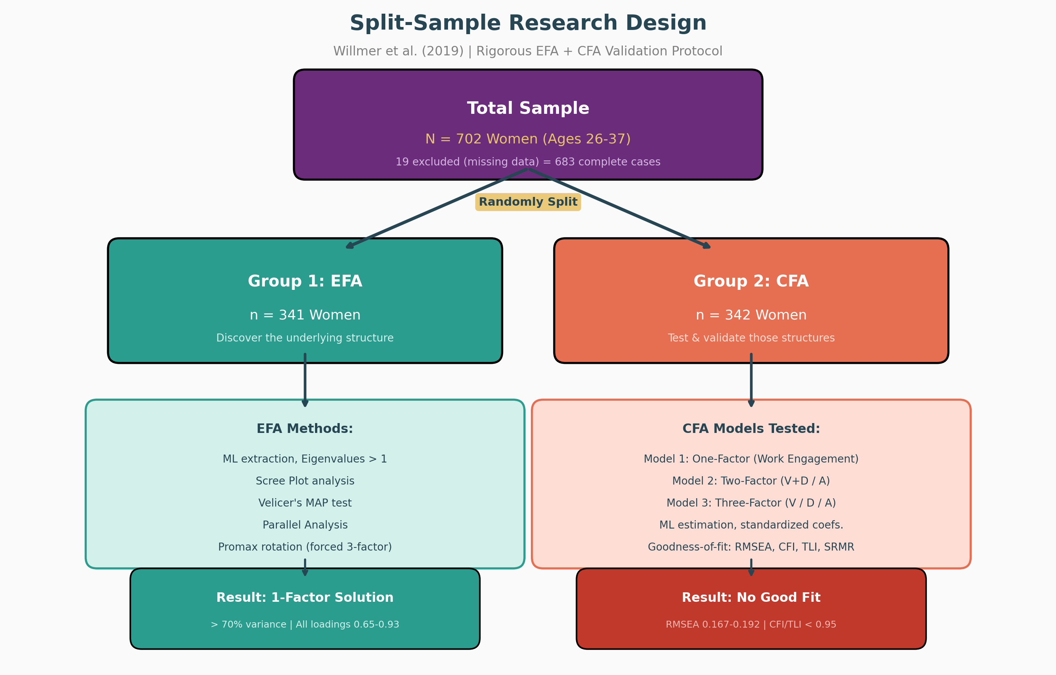
Research Methodology
Split-Sample Design: EFA + CFA
Introduction | Literature Review | Methodology | Results | Discussion | Conclusion | References

Slide 7
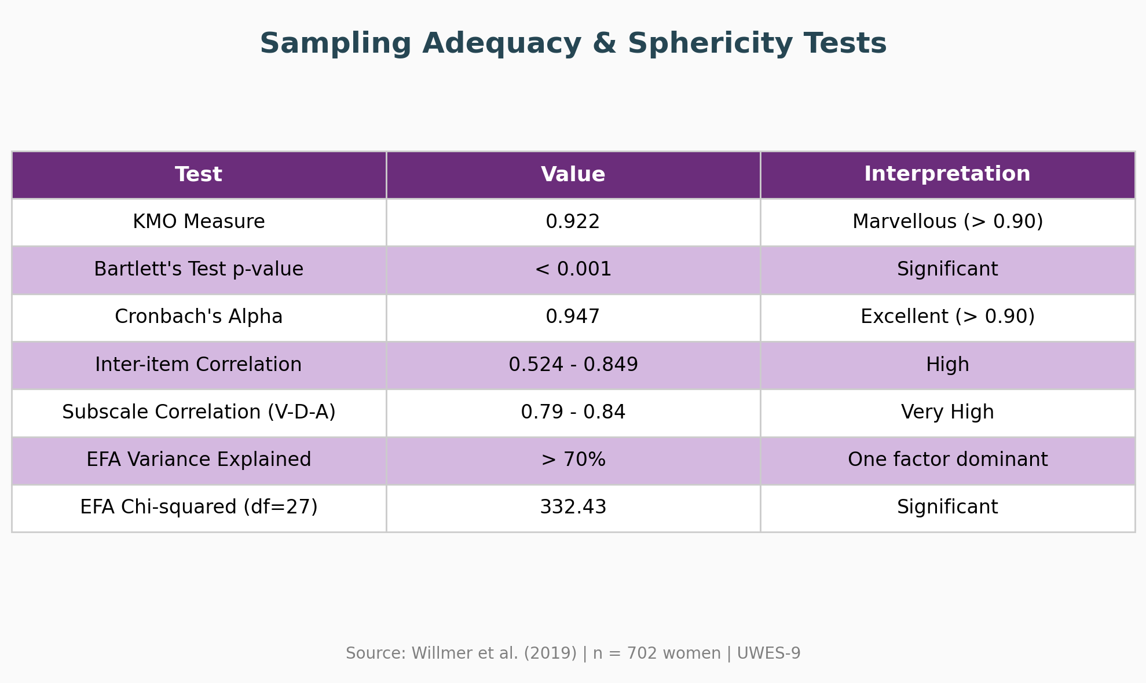
Sampling Adequacy & Reliability
KMO = 0.922 (Marvellous) | Cronbach's Alpha = 0.947
Introduction | Literature Review | Methodology | Results | Discussion | Conclusion | References

Slide 8
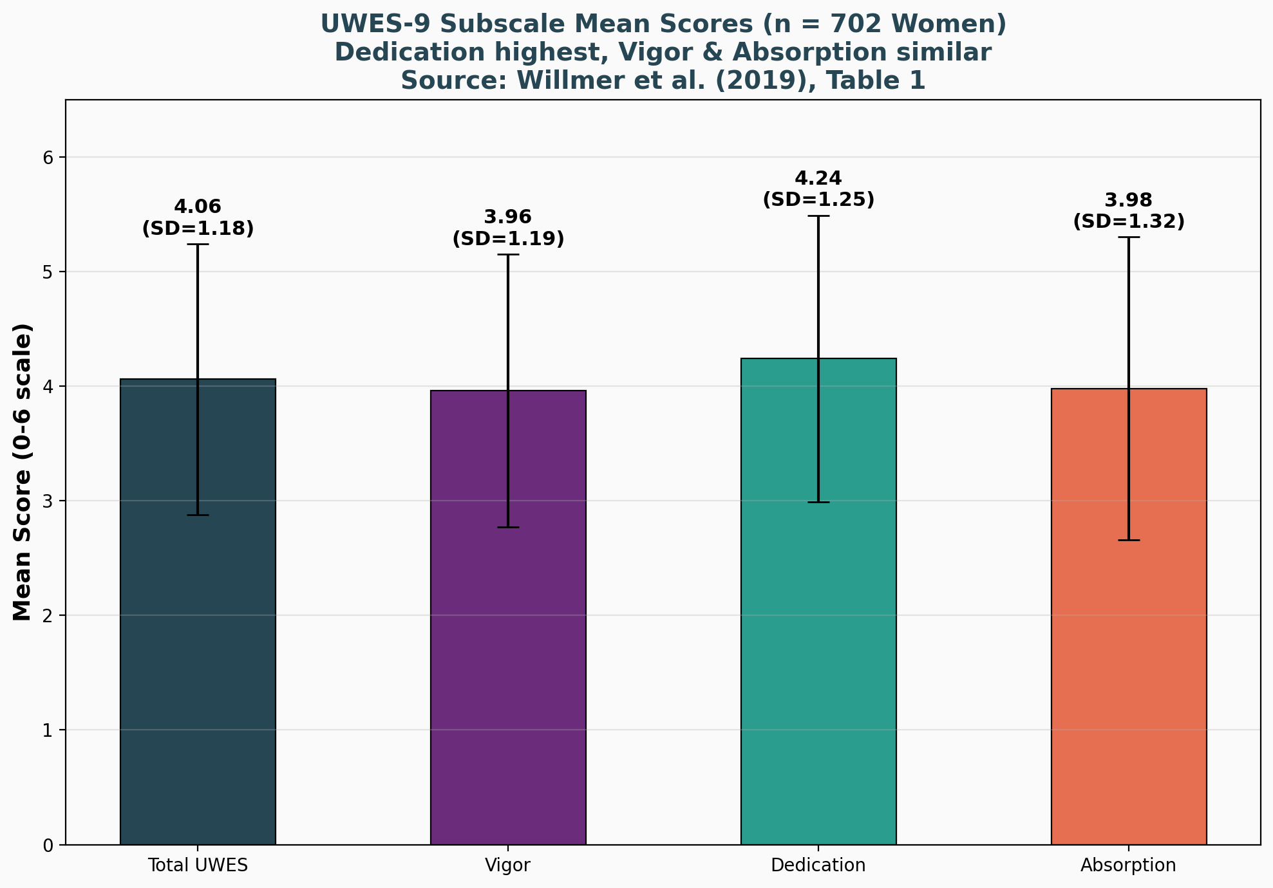
UWES-9 Subscale Scores
Overall Mean = 4.06 | Dedication Highest at 4.24
Introduction | Literature Review | Methodology | Results | Discussion | Conclusion | References

Slide 9
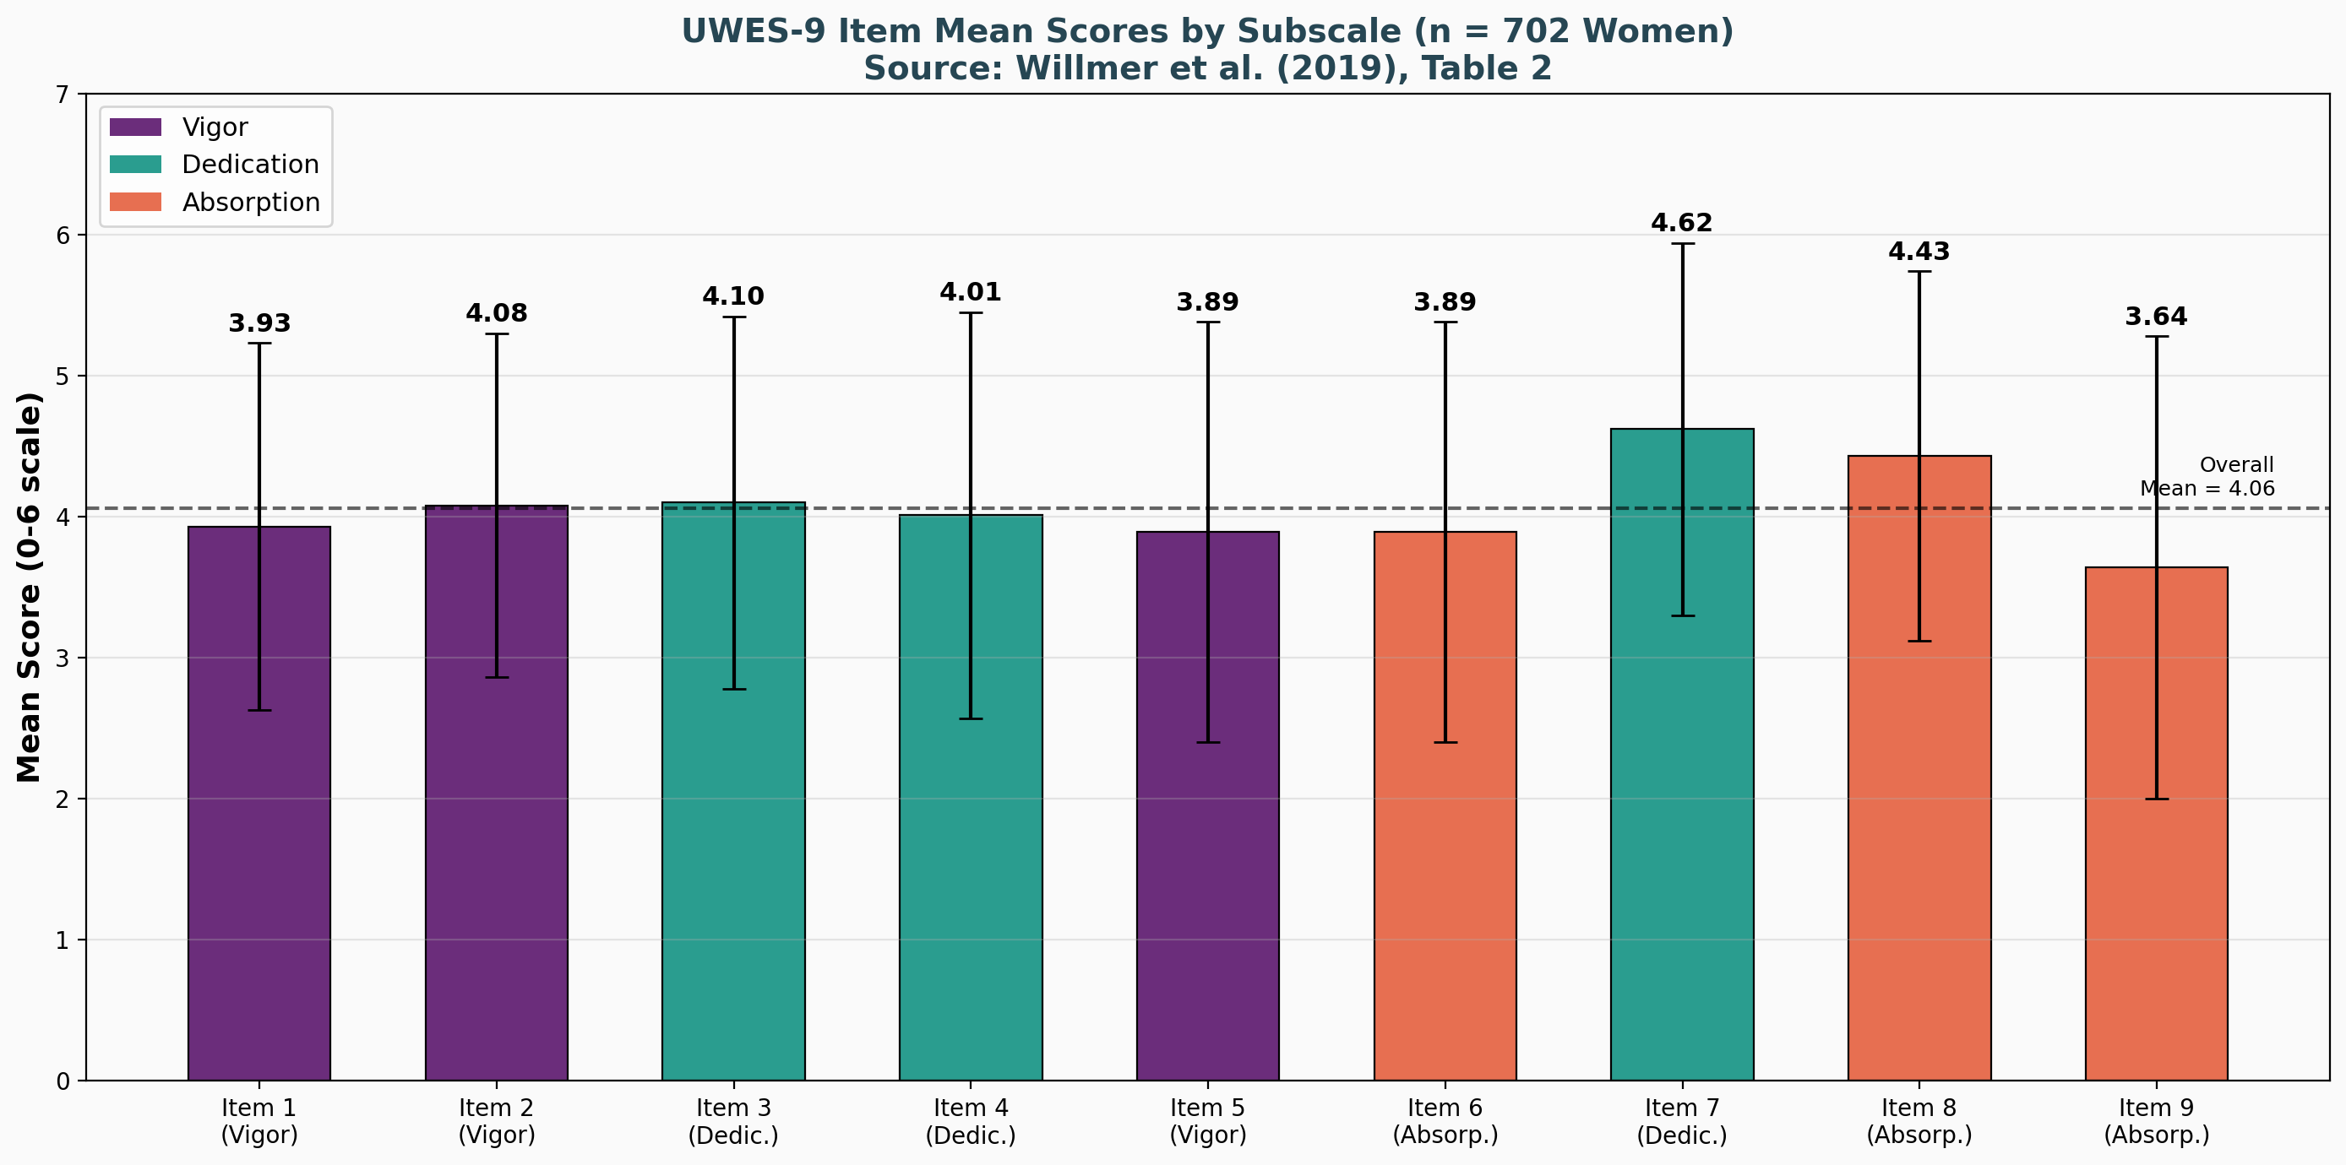
Individual Item Mean Scores
Item 7 (Pride) Highest | Item 9 (Immersion) Lowest
Introduction | Literature Review | Methodology | Results | Discussion | Conclusion | References

Slide 10
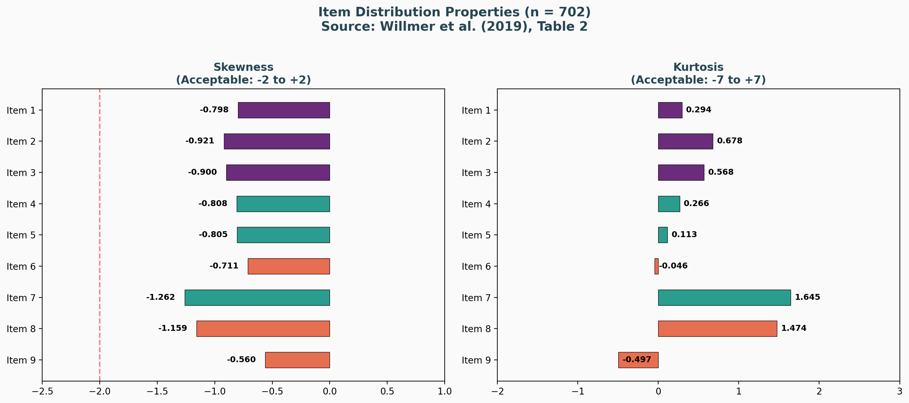
Item Distribution Properties
Skewness & Kurtosis Within Acceptable Range for ML Estimation
Introduction | Literature Review | Methodology | Results | Discussion | Conclusion | References

Slide 11
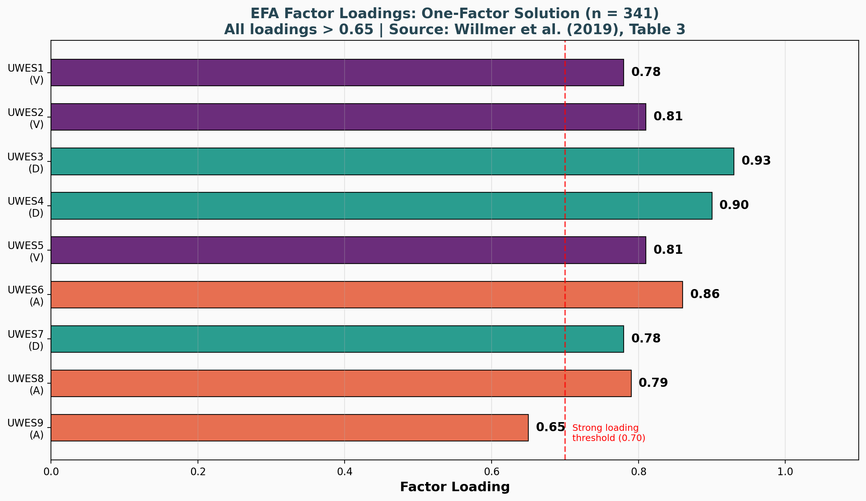
EFA Results: One-Factor Solution
All Loadings > 0.65 | One Factor Explains > 70% Variance
Introduction | Literature Review | Methodology | Results | Discussion | Conclusion | References

Slide 12
EFA Summary
Multiple Tests Converge on One-Factor Solution
EFA Key Findings (n = 341):
1. Unrotated EFA: One factor explains > 70% of variance
- Chi-squared = 332.43 (df = 27), p < 0.001
2. Scree Plot: Strongly favors one-factor structure
3. Velicer's MAP Test: Both original and revised versions point to one factor
4. Parallel Analysis: Raw data eigenvalue exceeded 95th percentile for 4 factors
- This was the only test that disagreed with the one-factor solution
5. Forced 3-Factor Promax Rotation:
- Chi-squared = 45.72 (df = 12), p < 0.001
- Items did NOT load on their expected theoretical factors
- Dedication had 4 items (3, 4, 5, 6) instead of 3
- Vigor had only 2 items (1, 2) instead of 3
Conclusion: EFA strongly supports a single 'Work Engagement' factor
Technical Commentary:
While EFA and MAP tests supported a 1-factor solution, Parallel Analysis suggested 4 factors. This often occurs in multivariate data with high inter-item correlations (0.52-0.85), leading to 'over-factoring' -- a known limitation of Parallel Analysis in highly correlated datasets.
Introduction | Literature Review | Methodology | Results | Discussion | Conclusion | References

Slide 13
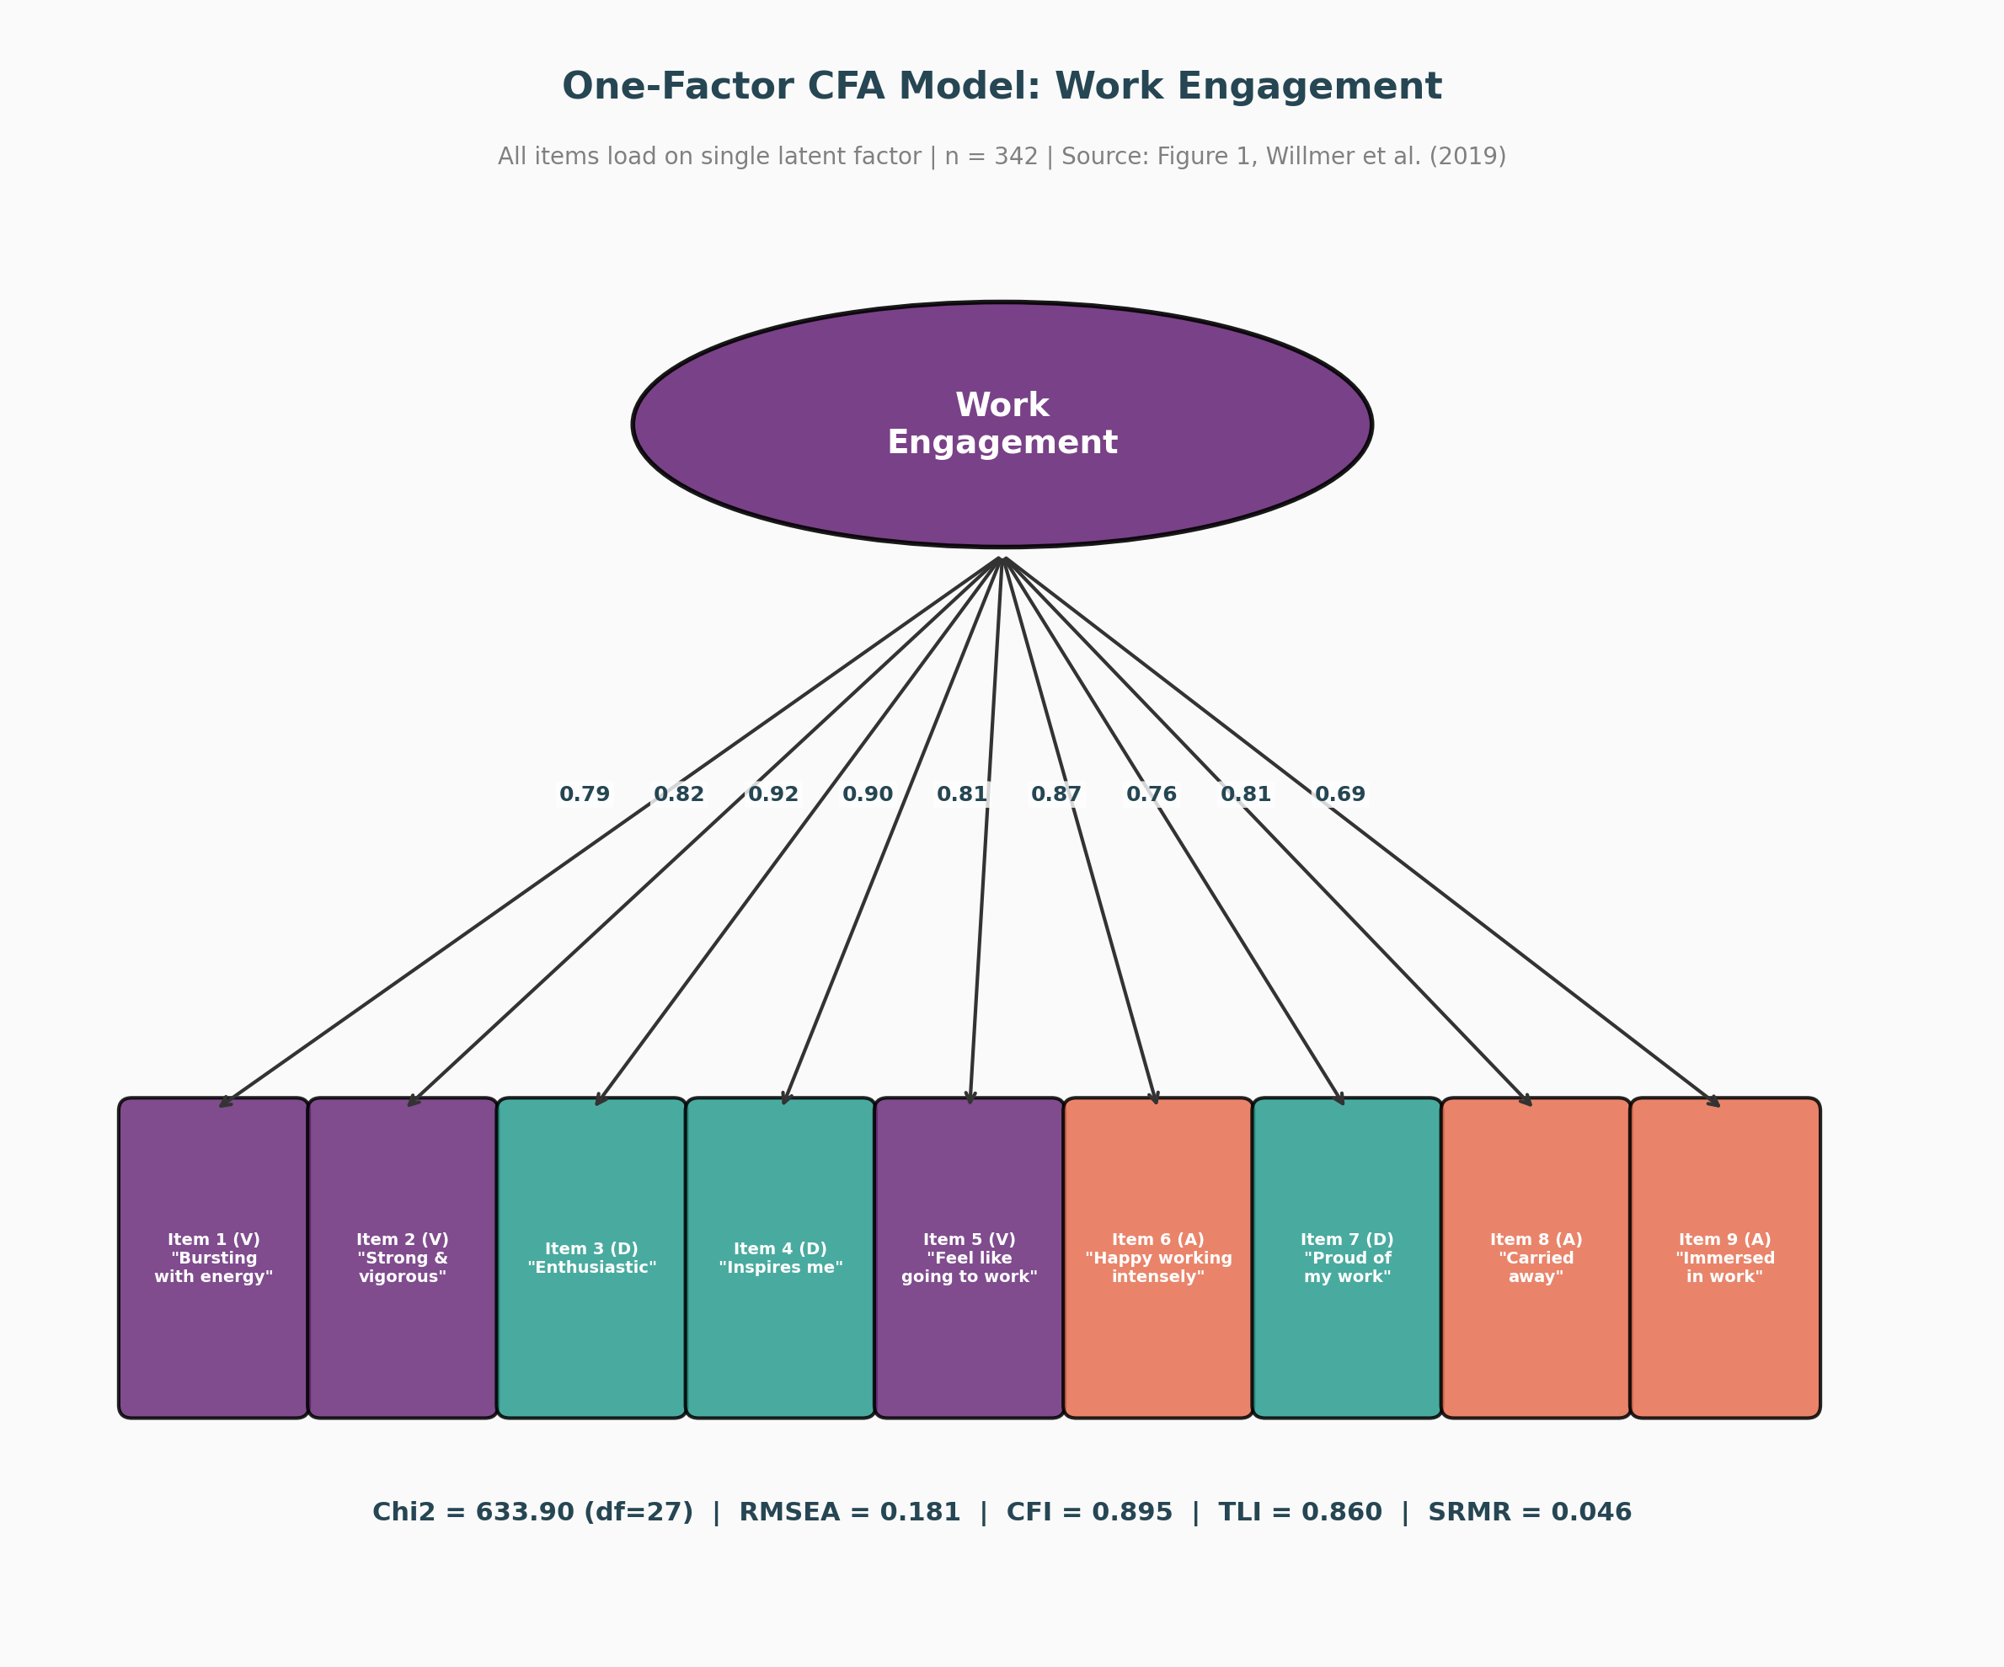
CFA Model 1: One-Factor Structure
Single Latent Factor: Work Engagement (Figure 1)
Introduction | Literature Review | Methodology | Results | Discussion | Conclusion | References

Slide 14
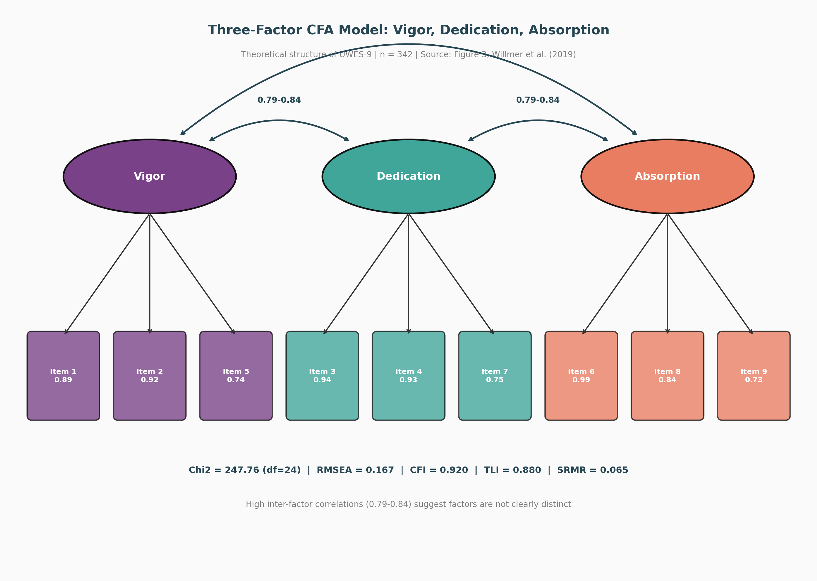
CFA Model 3: Three-Factor Structure
Vigor, Dedication, Absorption (Figure 3)
Introduction | Literature Review | Methodology | Results | Discussion | Conclusion | References

Slide 15
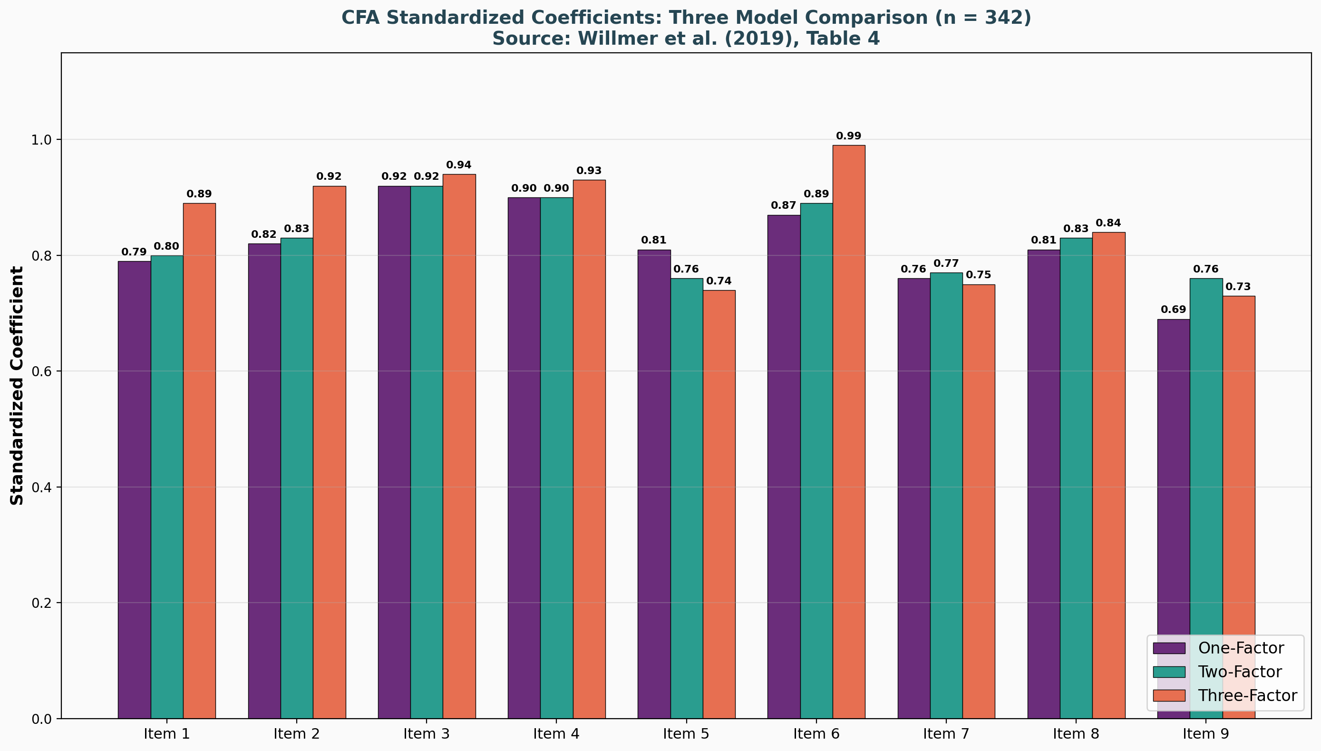
CFA Standardized Coefficients
All Three Models Compared (Table 4)
Introduction | Literature Review | Methodology | Results | Discussion | Conclusion | References

Slide 16
CFA Coefficients: Detailed Results
All p-values < 0.0001 (Table 4)
Item | Subscale | 1-Factor Coef. | 2-Factor Coef. | 3-Factor Coef. | z-value (1F)
Item 1 | Vigor | 0.79 | 0.80 | 0.89 | 50.42
Item 2 | Vigor | 0.82 | 0.83 | 0.92 | 59.95
Item 3 | Dedication | 0.92 | 0.92 | 0.94 | 132.99
Item 4 | Dedication | 0.90 | 0.90 | 0.93 | 109.15
Item 5 | Vigor | 0.81 | 0.76 | 0.74 | 55.85
Item 6 | Absorption | 0.87 | 0.89 | 0.99 | 83.55
Item 7 | Dedication | 0.76 | 0.77 | 0.75 | 44.83
Item 8 | Absorption | 0.81 | 0.83 | 0.84 | 57.54
Item 9 | Absorption | 0.69 | 0.76 | 0.73 | 33.19
Introduction | Literature Review | Methodology | Results | Discussion | Conclusion | References

Slide 17
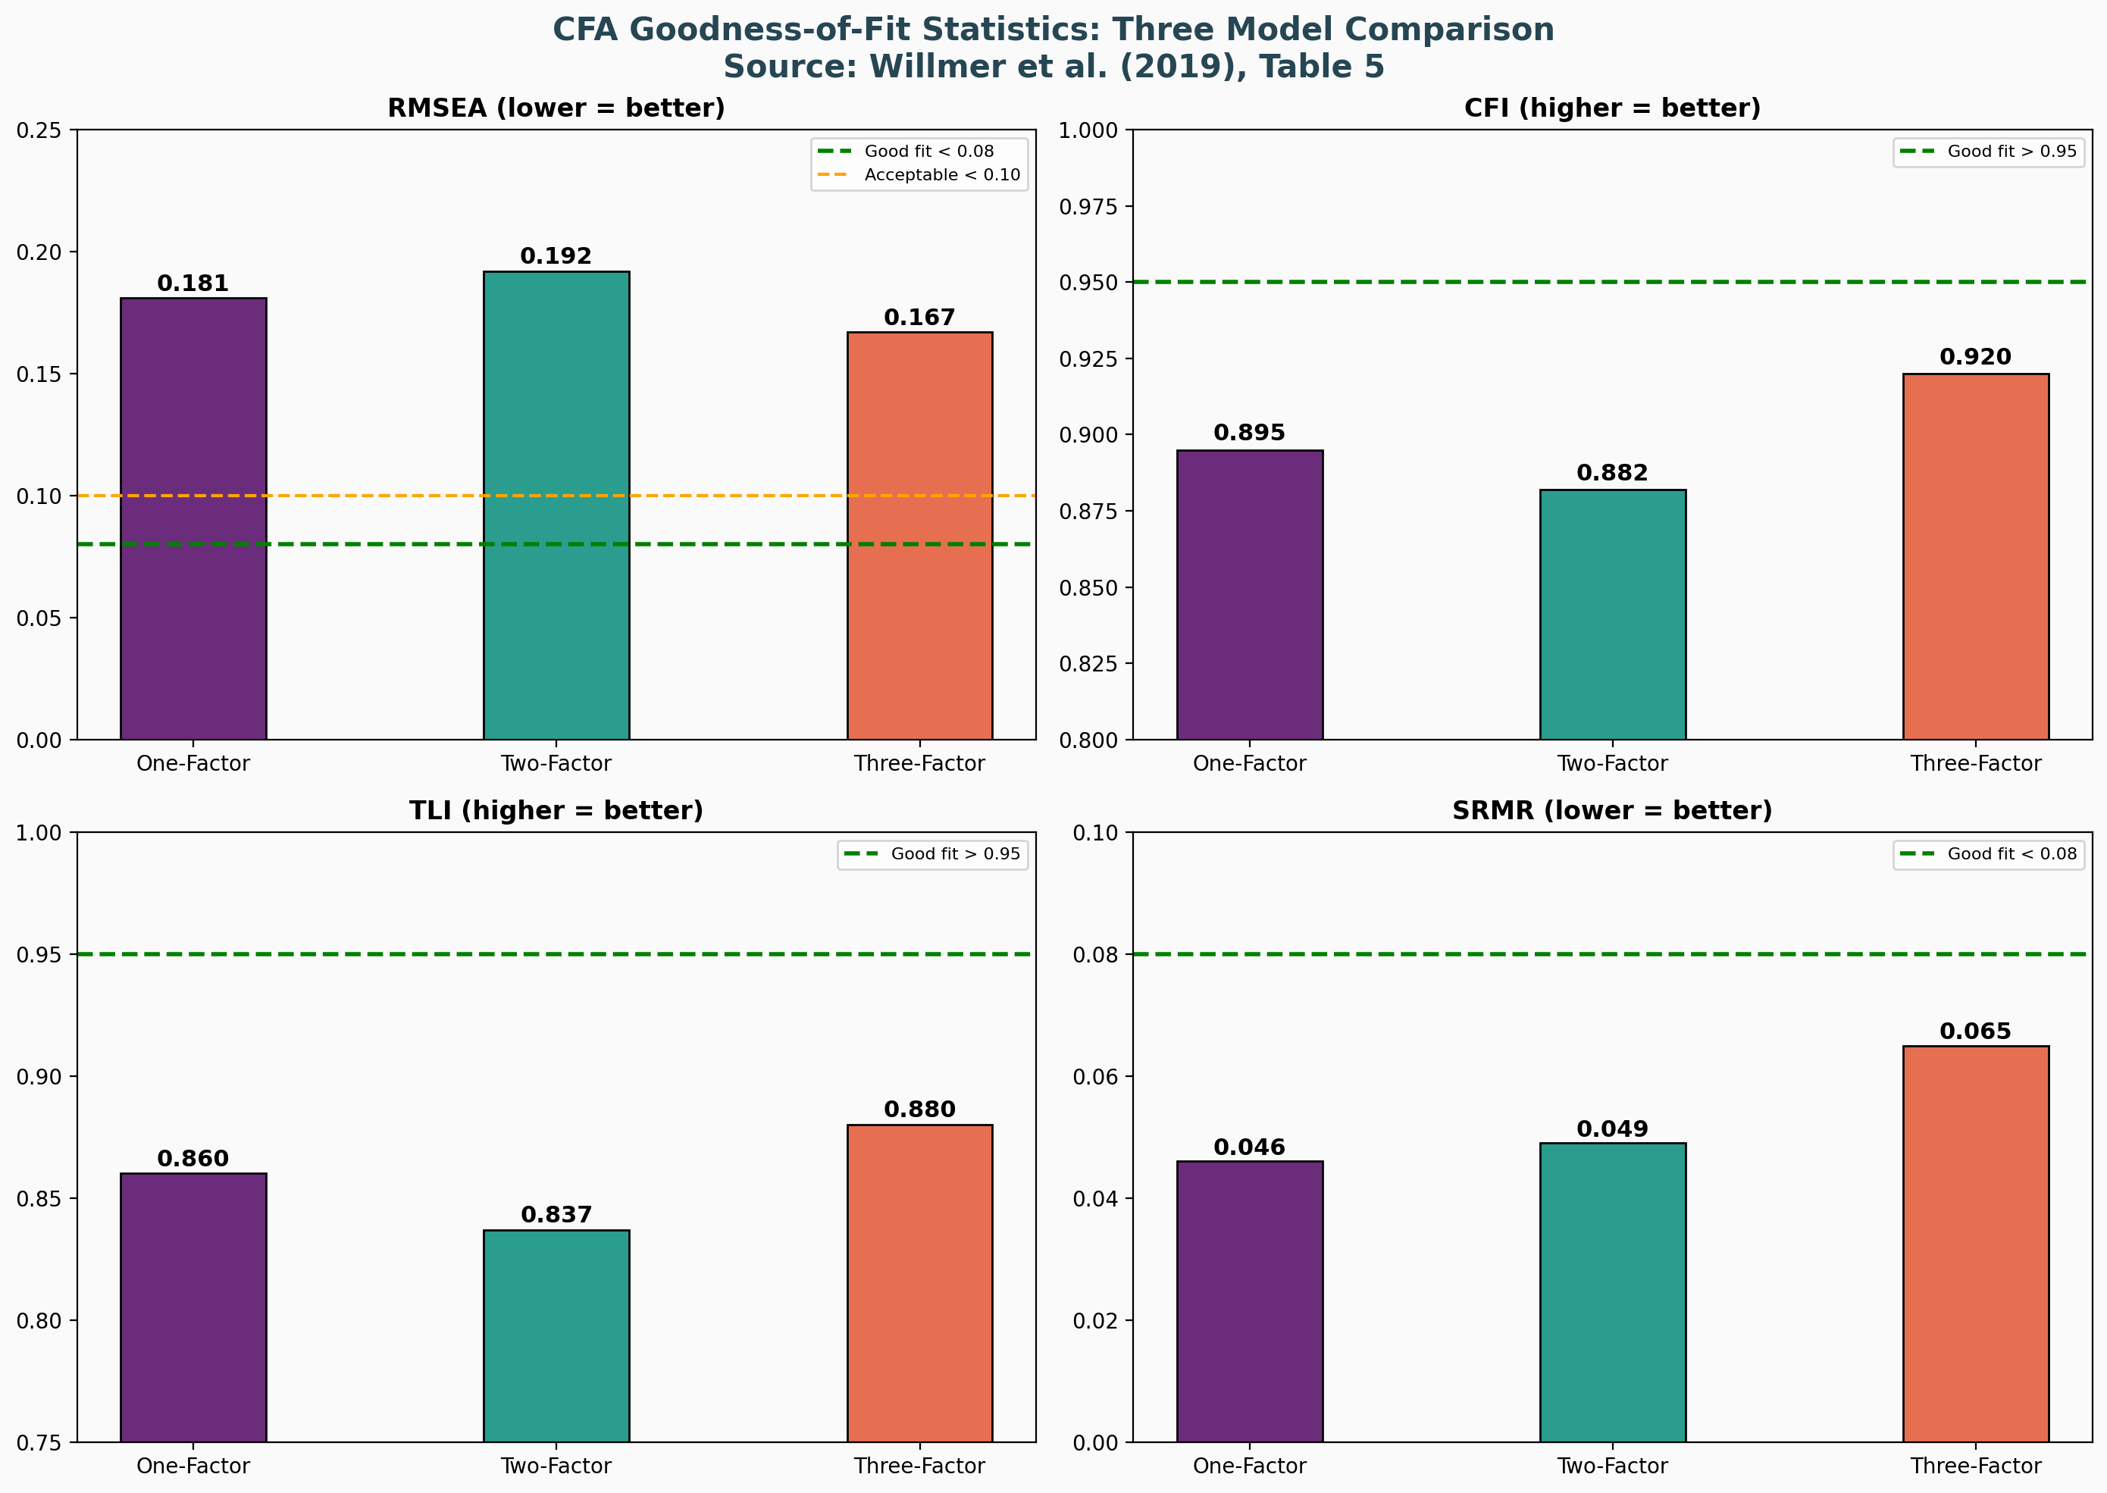
CFA Goodness-of-Fit Statistics
None of the Three Models Achieved Good Fit
Introduction | Literature Review | Methodology | Results | Discussion | Conclusion | References

Slide 18
Goodness-of-Fit: Full Table with Thresholds
Table 5 | Red = Failed to Meet Acceptable Threshold
Fit Statistic | One-Factor | Two-Factor | Three-Factor | Good Fit Threshold
Chi2 (df) | 633.90 (27) | 354.49 (26) | 247.76 (24) | Non-significant
RMSEA | 0.181 | 0.192 | 0.167 | < 0.05 (pref.) / < 0.08
RMSEA 90% CI | 0.169-0.194 | 0.175-0.192 | 0.154-0.180 | --
AIC | 16221.47 | 8246.29 | 8143.56 | Lower = better
BIC | 16343.70 | 8353.66 | 8258.60 | Lower = better
CFI | 0.895 | 0.882 | 0.920 | > 0.95
TLI | 0.860 | 0.837 | 0.880 | > 0.95
SRMR | 0.046 | 0.049 | 0.065 | < 0.08
Red values = Failed to meet acceptable fit thresholds. Only SRMR met the < 0.08 criterion for all models.
Introduction | Literature Review | Methodology | Results | Discussion | Conclusion | References

Slide 19
Key Findings Summary
EFA vs. CFA Results
EFA Results
One factor explains > 70% variance
KMO = 0.922 (Marvellous)
All loadings: 0.65 - 0.93
MAP test: 1-factor
Forced 3-factor: items misload
CFA Results
RMSEA: 0.167 - 0.192 (poor)
CFI: 0.882 - 0.920 (below 0.95)
TLI: 0.837 - 0.880 (below 0.95)
SRMR: 0.046 - 0.065 (acceptable)
No model shows good overall fit
Interpretation
EFA supports 1-factor structure
CFA cannot confirm any model
3 subscales highly correlated
Possible gender/culture effects
Further research needed
Introduction | Literature Review | Methodology | Results | Discussion | Conclusion | References

Slide 20
Discussion
Why Did CFA Fail to Confirm the EFA Results?
Possible Explanations:
1. Gender Effects: All-female sample may experience work engagement differently
than mixed-gender samples used in original UWES validation
2. Cultural Context: Swedish work culture emphasizes egalitarianism and
work-life balance, potentially affecting how engagement manifests
3. Subscale Overlap: Inter-factor correlations of 0.79-0.84 suggest the three
dimensions are not clearly distinct -- they may be measuring the same thing
4. Instrument Limitation: Shirom (2003) argued the three UWES dimensions
were not theoretically deduced and overlap conceptually
Comparison with Similar Studies:
- Wefald et al. (2012): Similar sample size (n = 382), similar education level,
RMSEA = 0.18 and 0.16 -- almost identical to our 0.181 and 0.167
- This suggests the issue may be with the UWES-9 instrument itself,
not specific to this sample
Introduction | Literature Review | Methodology | Results | Discussion | Conclusion | References

Slide 21
Women & Work Engagement
Implications for Workforce Policy & Research
What This Study Tells Us About Women's Engagement:
- Women in this sample reported moderately high engagement (Mean = 4.06/6.0)
- Dedication (meaning, pride, enthusiasm) scored highest at 4.24
- Item 7 'I am proud of the work that I do' had the highest individual score (4.62)
- This suggests pride and purpose are strongest drivers for women's engagement
Practical Implications:
- Organizations should focus on meaningfulness and purpose to engage women
- Standard 3-subscale UWES-9 scoring may not be appropriate for all-female populations
- Total score (1-factor) may be more reliable than subscale scores for women
- Work engagement instruments may need gender-specific validation
Limitations:
- No data on specific occupations (only education level)
- Swedish-speaking women only (though 21.6% had immigrant background)
- Age range limited to 26-37 years
- University-educated majority (61%) may not represent all working women
Introduction | Literature Review | Methodology | Results | Discussion | Conclusion | References

Slide 22
Technical Improvements to the UWES-9 Framework
Proposed Methodological Enhancements
Bifactor Modeling
Since the three subscales (Vigor, Dedication, Absorption) are highly correlated (0.79-0.84), a Bifactor Model would allow for:
- A general 'Engagement' factor accounting for shared variance across all 9 items
- Specific sub-factors capturing unique variance of each subscale
- Better separation of general vs. specific engagement components
- This addresses the core problem: are the subscales truly distinct?
Multigroup CFA & Invariance Testing
Future research should use Multigroup CFA to determine if the factor structure is invariant across:
- Gender: Compare all-female vs. mixed-gender samples
- Nationality: Test across Swedish, Norwegian, Finnish populations
- Occupation: Compare engagement structure across professions
- This would reveal whether poor fit is due to instrument or sample
Introduction | Literature Review | Methodology | Results | Discussion | Conclusion | References

Slide 23
Conclusion
Study Summary:
- EFA on n = 341 women: One-factor solution best fits the data
(KMO = 0.922, > 70% variance explained, all loadings 0.65-0.93)
- CFA on n = 342 women: Could NOT confirm any model (1-, 2-, or 3-factor)
(RMSEA never below 0.167, CFI/TLI below 0.95 for all models)
Key Takeaway:
The optimal factor structure of the UWES-9 remains unresolved.
Further research is needed to understand how gender, nationality,
and occupation influence the measurement of work engagement.
Future Directions:
- Test UWES-9 in larger all-female samples across different cultures
- Develop gender-specific engagement instruments
- Investigate whether a shorter version (UWES-3) performs better
- Examine the role of occupation type in factor structure
Introduction | Literature Review | Methodology | Results | Discussion | Conclusion | References

Slide 24
Factor Analysis Methods Applied
EFA & CFA Techniques Used in This Study
Method | Purpose | Key Finding
KMO Test | Sampling adequacy | 0.922 (Marvellous)
Bartlett's Test | Sphericity | p < 0.001 (Significant)
EFA (ML extraction) | Identify factor structure | 1 factor, > 70% variance
Scree Plot | Visual eigenvalue analysis | Supports 1-factor
Velicer's MAP | Minimum average partial | Supports 1-factor
Parallel Analysis | Compare with random data | Suggested 4 factors
CFA: 1-Factor | Test unidimensional model | RMSEA = 0.181 (poor)
CFA: 2-Factor | Test V+D / A split | RMSEA = 0.192 (poor)
CFA: 3-Factor | Test V / D / A structure | RMSEA = 0.167 (poor)
Cronbach's Alpha | Internal consistency | 0.947 (Excellent)
Introduction | Literature Review | Methodology | Results | Discussion | Conclusion | References

Slide 25
References
Primary Study:
Willmer, M., Westerberg Jacobson, J. & Lindberg, M. (2019). Exploratory and Confirmatory Factor
Analysis of the 9-Item UWES in a Multi-Occupational Female Sample. Frontiers in Psychology, 10, 2771.
DOI: 10.3389/fpsyg.2019.02771
Supporting References:
Schaufeli, W.B., Salanova, M., Gonzalez-Roma, V. & Bakker, A.B. (2002). The measurement of
engagement and burnout. Journal of Happiness Studies, 3, 71-92.
Kulikowski, K. (2017). Do we all agree on how to measure work engagement? Factorial validity of
UWES-9 and UWES-17. Polish Psychological Bulletin, 48(3), 350-360.
Hair, J.F., Black, W.C., Babin, B.J. & Anderson, R.E. (2019). Multivariate Data Analysis (8th Ed.).
Cengage Learning.
Introduction | Literature Review | Methodology | Results | Discussion | Conclusion | References

Slide 26
Thank You!
Questions?
Lana Jalal Gidan
SSIE-605 | Professor Susan Lu
Watson College of Engineering | Binghamton University

