Slide 1
SSIE-605: Applied Multivariate Data Analysis
Factor Analysis:
Social Media Influence on Consumer
Purchase Decisions
A Factor Analytical Study of Rural Consumers in Uttar Pradesh
Based on: Ahmad et al. (2026) — Intl. Review of Management & Marketing
Lana Jalal Gidan
Binghamton University | Professor Susan Lu

Slide 2
Presentation Agenda
1. Introduction to Factor Analysis
2. Why Factor Analysis in Marketing?
3. Study Overview: Social Media & Purchase Decisions
4. Research Methodology & Likert Scale Design
5. Demographic Profile of Respondents
6. Step 1: Data Adequacy — KMO & Bartlett's Test
7. Step 2: Reliability Analysis (Cronbach's Alpha)
8. Step 3: Exploratory Factor Analysis (EFA)
9. Step 4: Confirmatory Factor Analysis (CFA)
10. Step 5: Structural Equation Modeling (SEM)
11. Key Findings & Marketing Implications
12. Strengths, Limitations & Conclusion

Slide 3
What is Factor Analysis?
Simplifying Complex Survey Data
Definition:
Factor Analysis is a statistical method that reduces many survey questions into a
smaller number of meaningful groups (called 'factors' or 'dimensions').
In Simple Terms:
• Imagine you ask consumers 25 questions about social media shopping
• Factor Analysis finds that these 25 questions really measure just 5 big themes
• Each theme groups together questions that consumers answer in similar ways
Two Main Types:
• Exploratory Factor Analysis (EFA) — discovers hidden patterns in data
• Confirmatory Factor Analysis (CFA) — tests if those patterns hold up
Key Steps:
• Check if data is suitable (KMO & Bartlett's Test)
• Extract factors (using eigenvalue > 1 criterion)
• Rotate factors for clearer interpretation (Varimax rotation)
• Validate the structure (CFA / SEM)

Slide 4
Why Factor Analysis in Marketing?
Applications in Consumer Analytics
Marketing researchers use Factor Analysis to:
• Identify what really drives consumer purchase decisions
• Understand brand perception dimensions
• Measure customer satisfaction across multiple touchpoints
• Evaluate the effectiveness of marketing channels
• Build reliable measurement scales for surveys
Why Questionnaires & Likert Scales?
• Likert scales (e.g., 1 = Strongly Disagree to 5 = Strongly Agree) capture
consumer attitudes in a structured, measurable way
• Factor Analysis groups correlated Likert items into meaningful dimensions
• This helps marketers focus on key drivers rather than individual questions
Today's Study: How does social media influence rural consumer purchase
decisions? Which social media roles matter most?

Slide 5
Study Overview
Ahmad et al. (2026) — Intl. Review of Management & Marketing
Aspect | Details
Title | Identifying Determinants of Social Media Influence on Purchase Decisions
Authors | Ahmad, A., Singh, N.K., Ahmad, S., Fatima, R., Alam, A. & Ghani, U.
Journal | International Review of Management & Marketing, Vol. 16, No. 2 (2026)
DOI | 10.32479/irmm.21497
Sample | n = 241 rural consumers across 5 districts of Uttar Pradesh, India
Instrument | 25-item structured questionnaire, 5-point Likert scale (1=Strongly Disagree to 5=Strongly Agree)
Methods | EFA (PCA + Varimax), CFA, SEM
Software | SPSS and AMOS

Slide 6
Research Context
Social Media and Rural Consumer Markets
Why Study Social Media's Role in Rural Markets?
• Rural India represents ~65% of the total population (Census of India, 2011)
• Rapid smartphone adoption: 62.2% of rural respondents now use smartphones
• 67.2% of respondents have already purchased products via social media
• Social media is replacing traditional word-of-mouth in rural areas
Research Gap:
• Most studies focus on urban consumers; rural behavior is under-researched
• The multidimensional nature of social media influence (trust, emotions, peer
recommendations, content quality) is rarely explored in rural contexts
Research Objective:
• Identify the key factors (dimensions) of social media that influence rural
consumers' purchase decisions using Exploratory Factor Analysis
• Validate the factor structure using CFA and test causal relationships via SEM

Slide 7
Five Constructs Measured
25 Likert-Scale Items Across 5 Dimensions
Factor | Items | α | What It Measures
Content & Informativeness | 5 | 0.84 | Product info quality, updates, comparisons on social media
Trust & Credibility | 5 | 0.88 | Influencer recommendations, verified accounts, real reviews
Peer & Community | 5 | 0.86 | Family/friend recommendations, shares, community feedback
Emotional Engagement | 5 | 0.85 | Entertainment, emotional storytelling, regional content appeal
Convenience | 5 | 0.87 | Ease of buying, click-to-buy, reduced decision time
Overall Cronbach's Alpha = 0.92 | All constructs adapted from validated scales (Table 2)

Slide 8
Questionnaire Design
5-Point Likert Scale Structure
5-Point Likert Scale Used:
1 = Strongly Disagree 2 = Disagree 3 = Neutral 4 = Agree 5 = Strongly Agree
Questionnaire Structure:
• Part 1: Demographic information (age, gender, education, occupation, income,
mobile type, internet usage, district)
• Part 2: 25 scale-based items measuring five social media influence constructs
Sampling Design:
• Stratified random sampling + purposive sampling
• 5 districts: Lucknow, Kanpur, Agra, Jhansi, Gorakhpur
• 241 valid responses from rural consumers with social media experience
• Both offline paper-based and online survey methods used
Items adapted from validated scales:
• Bhatt & Joshi (2021), Kapoor & Dwivedi (2022), and others

Slide 9
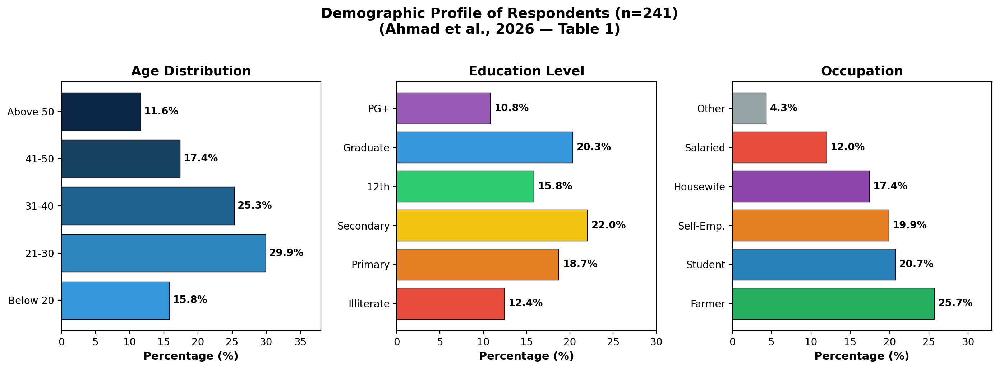
Demographic Profile
Sample Characteristics (Table 1, n=241)
Majority: Age 21-30 (29.9%) | Secondary+ education (58.1%) | Diverse occupations (Table 1)

Slide 10
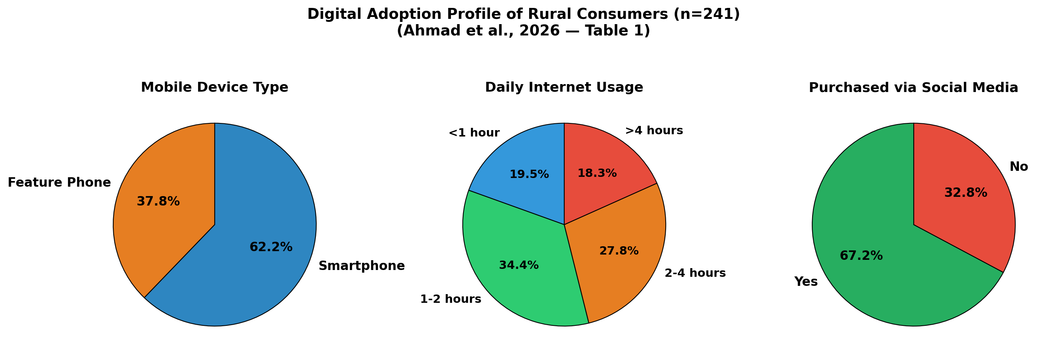
Digital Adoption Profile
Technology Usage Among Rural Consumers (Table 1)
62.2% use smartphones | 80%+ spend >1 hour online daily | 67.2% have purchased via social media

Slide 11
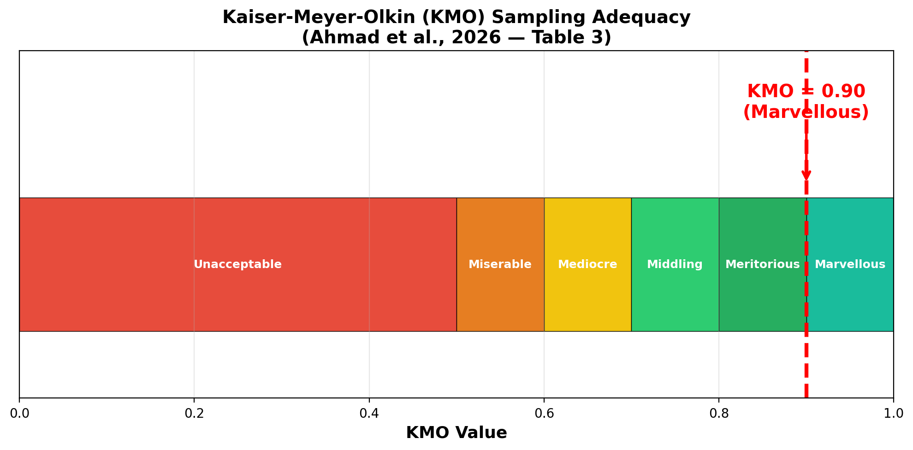
Step 1: KMO Sampling Adequacy
Is the Data Suitable for Factor Analysis? (Table 3)
KMO = 0.90 (Classified as 'Marvellous' by Hair et al., 2019)
• Well above the 0.60 minimum → Excellent sampling adequacy for factor analysis
• This means the survey items share enough common patterns to extract meaningful factors

Slide 12
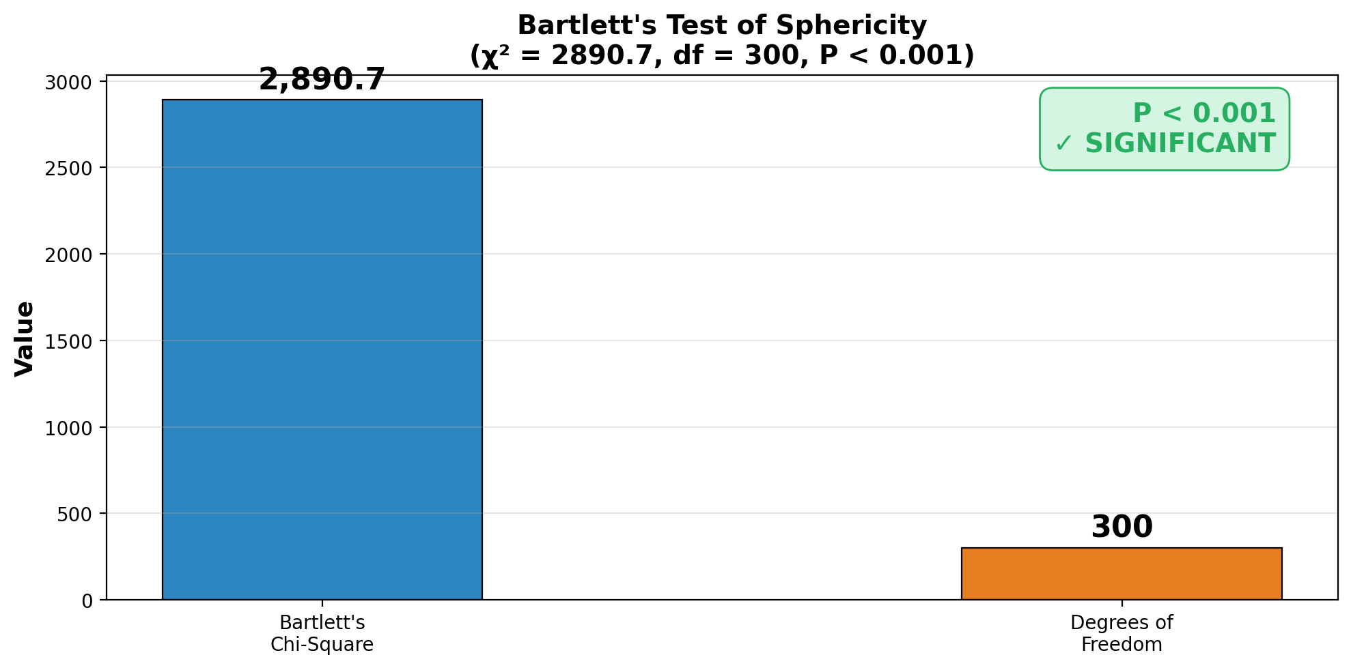
Step 1: Bartlett's Test of Sphericity
Testing for Sufficient Correlations (Table 3)
Bartlett's Test: χ² = 2890.7, df = 300, P < 0.001 (Table 3)
• Highly significant → The variables are sufficiently correlated for factor analysis
• Rejects the null hypothesis that the correlation matrix is an identity matrix

Slide 13
Data Adequacy Summary
Both Tests Confirm Suitability for Factor Analysis
Test | Statistic | Value | Threshold | Result
KMO | Sampling Adequacy | 0.90 | ≥ 0.60 | ✓ Marvellous
Bartlett's | Chi-Square (χ²) | 2890.7 | P < 0.05 | ✓ P < 0.001
Bartlett's | Degrees of Freedom | 300 | — | —
Interpretation:
• KMO = 0.90 is classified as 'Marvellous' (Hair et al., 2019)
• This is the highest rating on the Kaiser adequacy scale
• Bartlett's test confirms that the 25 survey items are sufficiently inter-correlated
• Both tests strongly support proceeding with Factor Analysis
• The data patterns are meaningful, not random noise

Slide 14
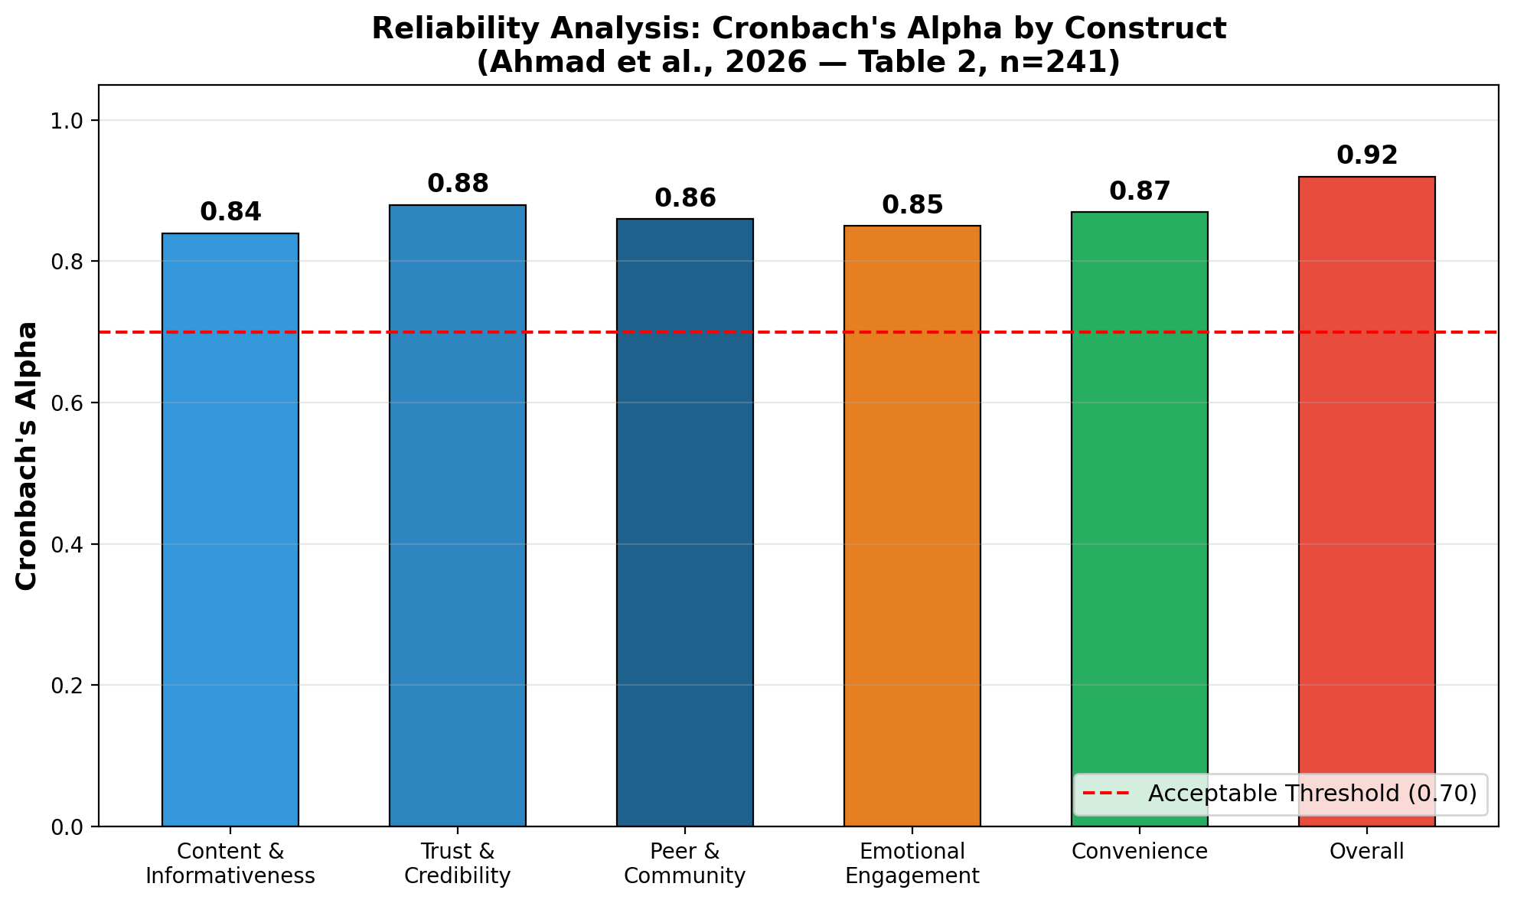
Step 2: Reliability Analysis
Cronbach's Alpha by Construct (Table 2)
All constructs exceed 0.70 threshold (Nunnally, 1978) | Overall α = 0.92 (Excellent)

Slide 15
Reliability Interpretation
What Cronbach's Alpha Tells Us (Table 2)
Construct | Items | α | Rating
Content & Informativeness | 5 | 0.84 | Good
Trust & Credibility | 5 | 0.88 | Very Good
Peer & Community | 5 | 0.86 | Good
Emotional Engagement | 5 | 0.85 | Good
Convenience | 5 | 0.87 | Very Good
Overall Scale | 25 | 0.92 | Excellent
What This Means:
• Reliability = how consistently the questions measure the same concept
• α ≥ 0.70 = acceptable | α ≥ 0.80 = good | α ≥ 0.90 = excellent
• All five factors and the overall scale pass reliability checks ✓

Slide 16
Step 3: Exploratory Factor Analysis
Extracting the Underlying Factors (Table 4)
EFA Method:
• Extraction: Principal Component Analysis (PCA)
• Rotation: Varimax with Kaiser Normalization
• Criterion: Eigenvalue > 1 (Kaiser Criterion)
Results:
• Five latent factors were extracted from 25 questionnaire items
• All factor loadings are above 0.74 (well above the 0.50 threshold)
• Strong construct validity confirmed
Factor Loading Ranges (from Table 4):
• Content & Informativeness: 0.74 – 0.81
• Trust & Credibility: 0.81 – 0.85 (strongest loadings)
• Peer Influence: 0.76 – 0.80
• Emotional Engagement: 0.79 – 0.85
• Convenience: 0.79 – 0.84

Slide 17
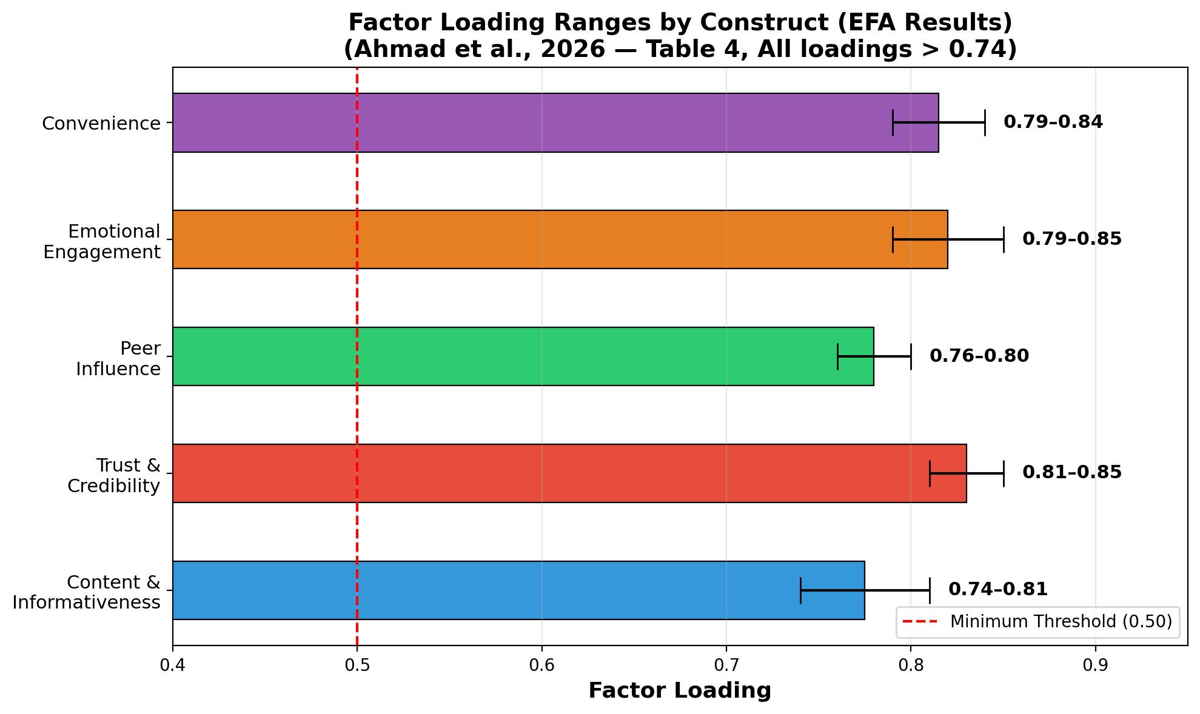
Factor Loading Ranges
EFA Rotated Component Matrix Summary (Table 4)
All 25 items load above 0.74 | Well above 0.50 minimum | Trust & Credibility has the strongest loadings

Slide 18
Interpreting the Five Factors
What Each Factor Represents
Factor 1: Content & Informativeness (Loadings: 0.74–0.81)
• Product details, price comparisons, new launch updates on social media
Factor 2: Trust & Credibility (Loadings: 0.81–0.85)
• Verified accounts, influencer recommendations, authentic user reviews
Factor 3: Peer Influence (Loadings: 0.76–0.80)
• Family/friend opinions, shares, likes, community-based recommendations
Factor 4: Emotional Engagement (Loadings: 0.79–0.85)
• Entertaining ads, emotional storytelling, culturally relevant regional content
Factor 5: Convenience (Loadings: 0.79–0.84)
• Easy access, click-to-buy options, reduced shopping time, direct purchase links

Slide 19
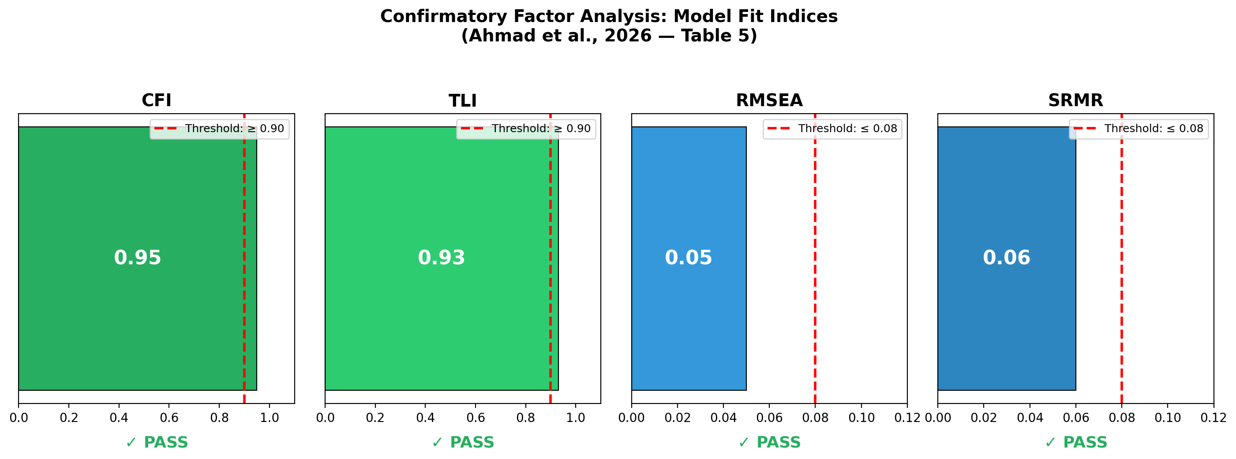
Step 4: Confirmatory Factor Analysis
Validating the Five-Factor Structure (Table 5)
All four fit indices meet or exceed recommended thresholds (Byrne, 2016)
• CFI=0.95, TLI=0.93 (≥0.90) | RMSEA=0.05, SRMR=0.06 (≤0.08) → Excellent model fit

Slide 20
CFA Model Fit Interpretation
Confirming Convergent & Discriminant Validity
Index | Value | Threshold | Interpretation
CFI | 0.95 | ≥ 0.90 | Excellent fit
TLI | 0.93 | ≥ 0.90 | Good fit
RMSEA | 0.05 | ≤ 0.08 | Close fit (minimal error)
SRMR | 0.06 | ≤ 0.08 | Acceptable residuals
What This Means:
• The five-factor structure identified by EFA is statistically confirmed
• Convergent validity: Items within each factor measure the same concept
• Discriminant validity: The five factors are distinct from each other
• The model accurately represents how social media influences purchase decisions

Slide 21
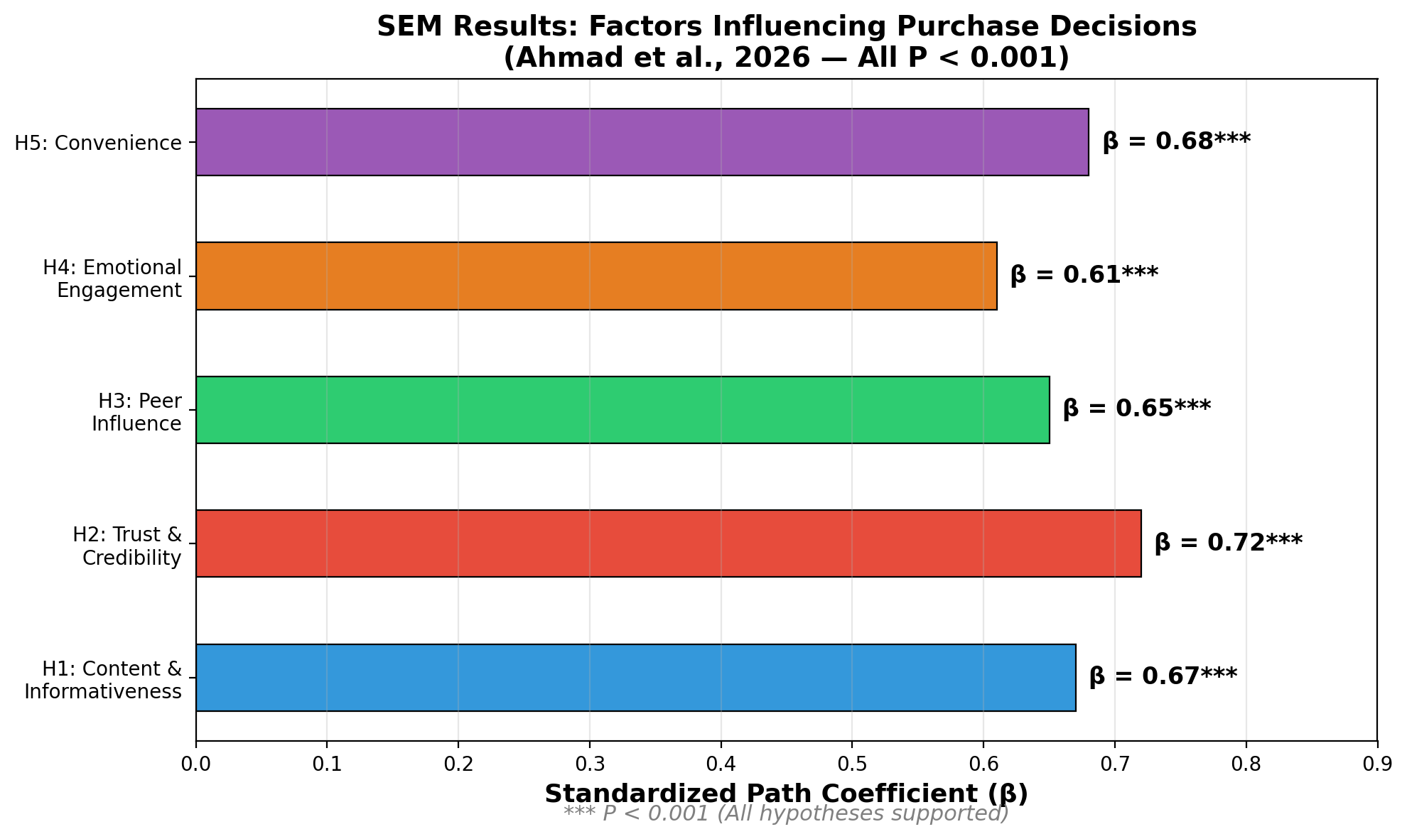
Step 5: Structural Equation Modeling
Testing Causal Relationships (SEM Results)
All five hypotheses supported | All paths significant at P < 0.001 | Trust has strongest effect (β=0.72)

Slide 22
Hypothesis Testing Results
All Five Hypotheses Supported
Hypothesis | Path | β | P-value | Result
H1 | Content & Inform. → Purchase | 0.67 | < 0.001 | ✓ Supported
H2 | Trust & Credibility → Purchase | 0.72 | < 0.001 | ✓ Supported
H3 | Peer Influence → Purchase | 0.65 | < 0.001 | ✓ Supported
H4 | Emotional Engage. → Purchase | 0.61 | < 0.001 | ✓ Supported
H5 | Convenience → Purchase | 0.68 | < 0.001 | ✓ Supported
Key Takeaway:
• All five social media dimensions significantly influence purchase decisions
• Trust & Credibility is the strongest predictor (β = 0.72)
• Emotional Engagement, while significant, has the smallest effect (β = 0.61)
• These findings support the Theory of Reasoned Action (Ajzen, 1991)

Slide 23
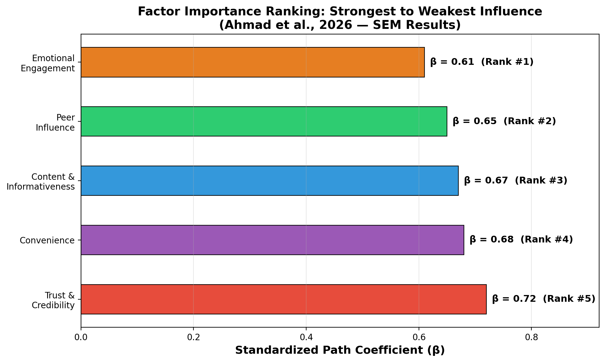
Factor Importance Ranking
Which Social Media Roles Matter Most?
Trust (β=0.72) > Convenience (β=0.68) > Content (β=0.67) > Peer (β=0.65) > Emotional (β=0.61)

Slide 24
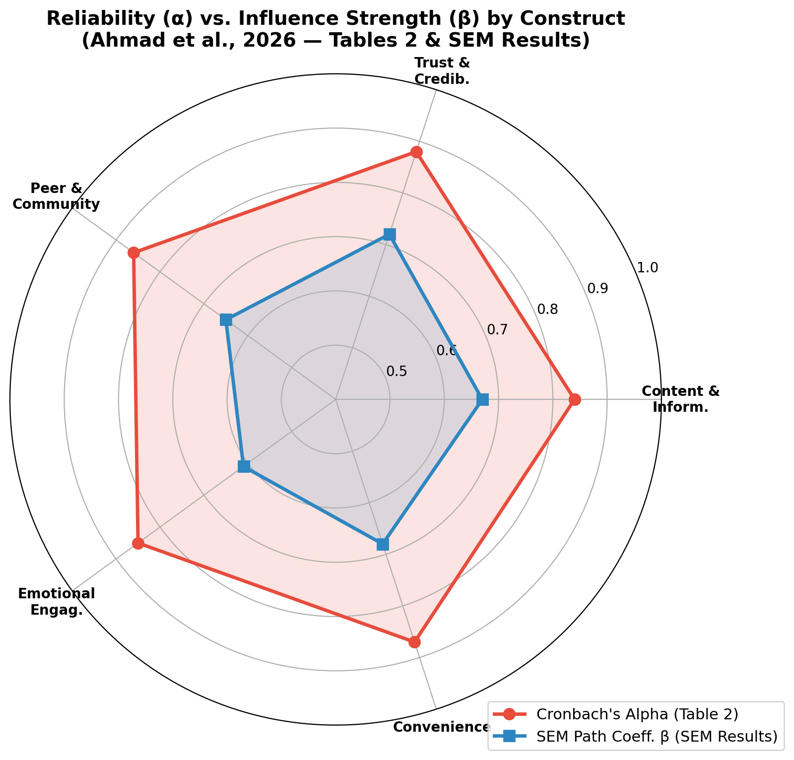
Reliability & Validity Overview
Combined View of All Constructs (Tables 2 & 4)
All constructs show strong reliability (α = 0.84–0.88) and significant SEM influence (β = 0.61–0.72)

Slide 25
Marketing Implications
Practical Takeaways for Digital Strategists
Based on the factor analysis results, marketers should:
1. Build Trust First (β = 0.72 — Strongest Factor)
• Use verified accounts, authentic reviews, and credible influencers
• Trust is the single most important driver of purchase decisions
2. Maximize Convenience (β = 0.68)
• Simplify the path from social media content to actual purchase
3. Invest in Quality Content (β = 0.67)
• Provide clear product information, comparisons, and updates
4. Leverage Peer Networks (β = 0.65)
• Encourage sharing, community reviews, and family-oriented campaigns
5. Create Emotional Connections (β = 0.61)
• Use culturally localized, emotionally engaging content and regional language

Slide 26
Strengths & Limitations
Evaluating the Study
Strengths:
• Strong KMO (0.90) and highly
significant Bartlett's test
• Excellent overall reliability
(Cronbach's α = 0.92)
• Both EFA and CFA used
(comprehensive validation)
• All CFA fit indices pass
• SEM confirms all 5 hypotheses
• Addresses under-researched
rural consumer segment
Limitations:
• Geographically limited to 5
districts of Uttar Pradesh
• Cross-sectional design (single
time point, no trends)
• Moderate sample size (n=241)
• Self-reported data may have
social desirability bias
• Individual eigenvalues and
total variance not reported
in the published tables

Slide 27
References
1. Ahmad, A., Singh, N.K., Ahmad, S., Fatima, R., Alam, A. & Ghani, U. (2026).
Identifying Determinants of Social Media Influence on Purchase Decisions:
A Factor Analytical Study of Rural Consumers. IRMM, 16(2), 111-119.
DOI: 10.32479/irmm.21497
2. Hair, J.F., Black, W.C., Babin, B.J. & Anderson, R.E. (2019).
Multivariate Data Analysis (8th Ed.). Cengage Learning.
3. Nunnally, J.C. (1978). Psychometric Theory (2nd Ed.).
McGraw-Hill, New York.
Thank You!
Lana Jalal Gidan
Binghamton University | SSIE-605 | Professor Susan Lu

