Slide 1
SSIE-605: Applied Multivariate Data Analysis
Factor Analysis in Financial Performance Evaluation
Evaluating Listed Real Estate Companies Using Exploratory Factor Analysis
Lana Jalal Gidan
Binghamton University | Professor Susan Lu

Slide 2
Presentation Overview
1. Introduction | Why factor analysis matters in financial performance evaluation
2. Study Background | Real estate industry challenges and research context
3. Research Design | Sample selection, variables, and methodology
4. Factor Analysis Methodology | Step-by-step EFA procedure
5. Suitability Testing | KMO and Bartlett's test results
6. Factor Extraction & Rotation | Eigenvalues, variance explained, and factor loadings
7. Factor Interpretation | Naming and understanding the three extracted factors
8. Company Scoring & Evaluation | Comprehensive financial performance scores
9. Key Findings & Implications | Practical takeaways for industry and investors
10. Conclusion | Summary and significance of factor analysis in finance

Slide 3
What is Factor Analysis?
Reducing Complexity in Financial Data
Definition
Factor Analysis is a statistical method that reduces many observed variables into
a smaller number of underlying 'factors' that explain shared patterns in the data.
Why Use It in Finance?
Financial performance involves many correlated indicators (profitability, debt ratios, growth, etc.)
Factor analysis identifies the key underlying dimensions that drive company performance
Reduces 9+ financial indicators into 2-3 core factors for clearer evaluation
Two Main Types
Exploratory Factor Analysis (EFA): Discovers the underlying factor structure
Confirmatory Factor Analysis (CFA): Tests a pre-specified factor structure
This Study
Uses EFA with Principal Component Analysis to evaluate 100 real estate companies (Wang & Song, 2025)

Slide 4
Study Background
China's Real Estate Industry Context
The Problem
Real estate is a critical economic driver in China, linked to employment and related industries
The Evergrande Group crisis (2021) exposed severe financial risks across the sector
The pandemic (2022) caused dramatic market contraction and broken capital chains
Why This Research Matters
Traditional single-indicator analysis cannot capture the complexity of financial health
Real estate companies face intertwined pressures: market fluctuations, capital turnover,
cost control, regulatory policies, and misappropriation risks
Scientific multi-dimensional evaluation is needed for corporate managers and investors
Research Goal
Use factor analysis to identify the core dimensions driving financial performance
of listed real estate companies and evaluate their relative standings

Slide 5
Research Design
Sample, Data Sources, and Approach
Aspect | Details
Sample Size | 100 listed real estate companies
Data Period | 2023 financial year data
Data Sources | CSMAR database, Wind database, company reports
Exclusions | ST-labeled companies; incomplete data removed
Coverage | Multiple regions, sizes, and development stages
Variables | 9 financial indicators across 4 dimensions
Method | Exploratory Factor Analysis (PCA extraction)
Rotation | Varimax (orthogonal rotation)
Software | SPSS and Stata

Slide 6
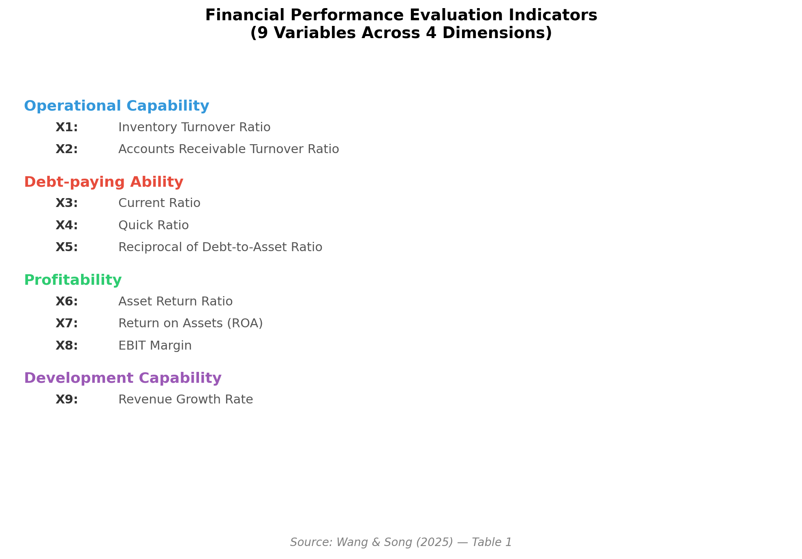
Financial Performance Indicators
9 Variables Across 4 Dimensions (Table 1)

Slide 7
Variable Definitions — Detail
Table 1: Wang & Song (2025)
Dimension | Variable | Name | Formula
Operational Cap. | X1 | Inventory Turnover | COGS / Ending Inventory
Operational Cap. | X2 | A/R Turnover | Revenue / Ending A/R
Debt-paying | X3 | Current Ratio | Current Assets / Current Liabilities
Debt-paying | X4 | Quick Ratio | Quick Assets / Current Liabilities
Debt-paying | X5 | Debt-to-Asset (R) | Total Assets / Total Liabilities
Profitability | X6 | Asset Return Ratio | (Profit + Fin. Exp.) / Total Assets
Profitability | X7 | ROA | Net Profit / Total Assets
Profitability | X8 | EBIT Margin | (Net Profit + Tax + Fin. Exp.) / Revenue
Development | X9 | Revenue Growth Rate | (Current Rev. - Prior Rev.) / Prior Rev.

Slide 8
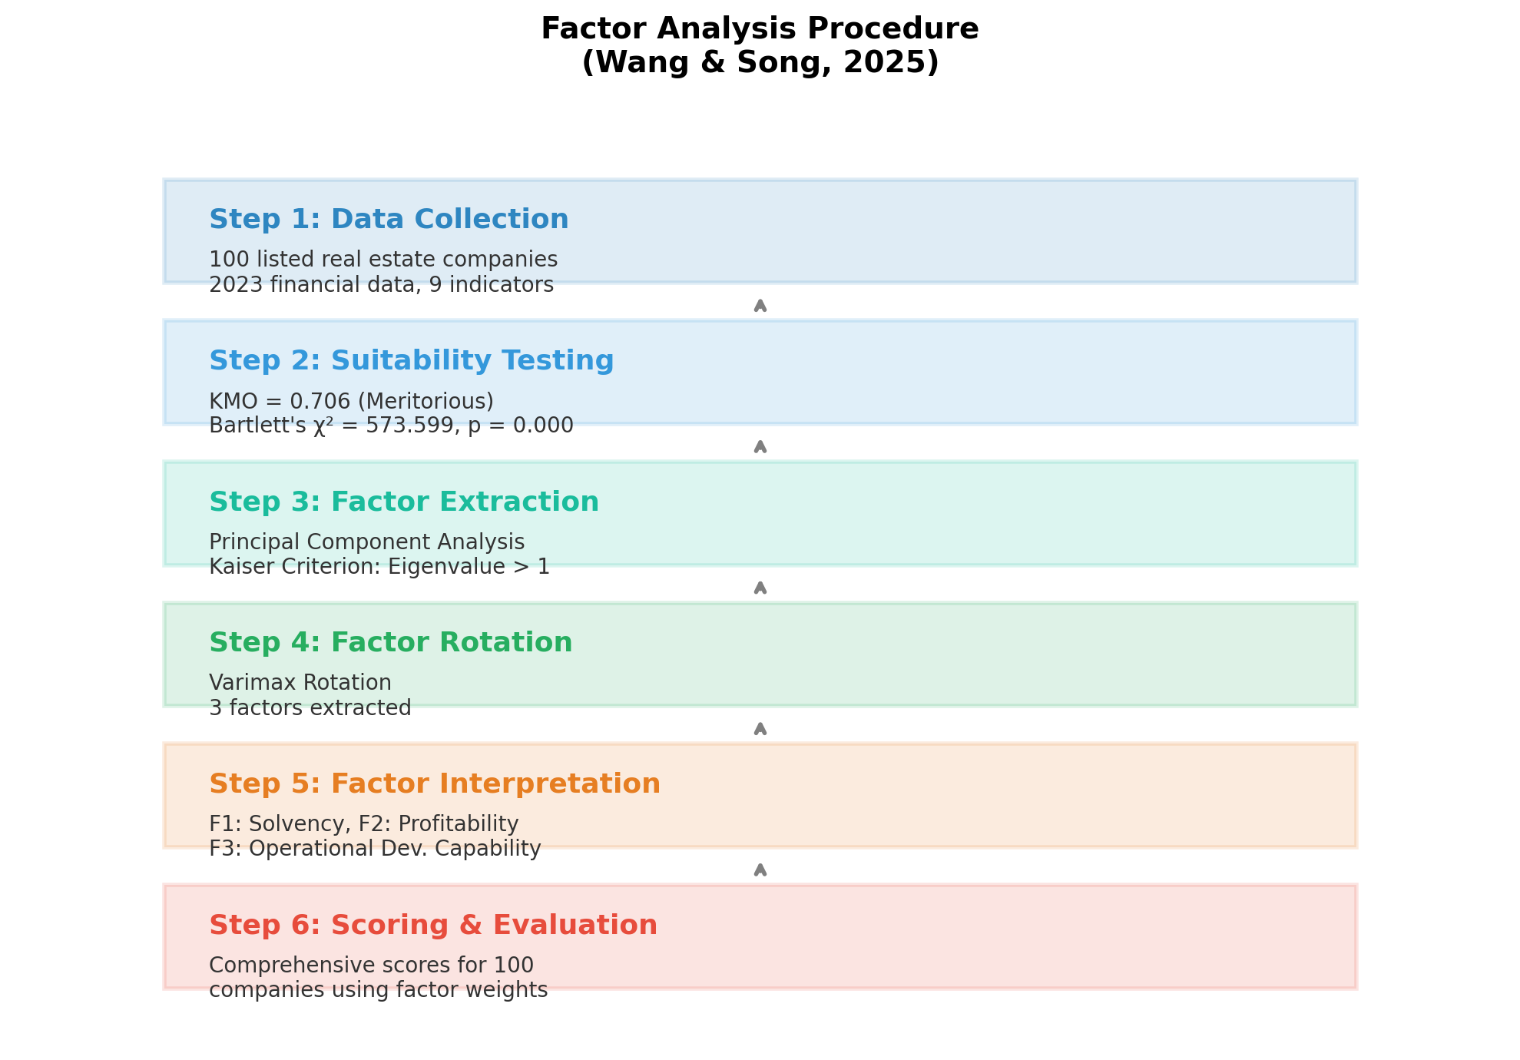
Factor Analysis Procedure
Step-by-Step Methodology

Slide 9
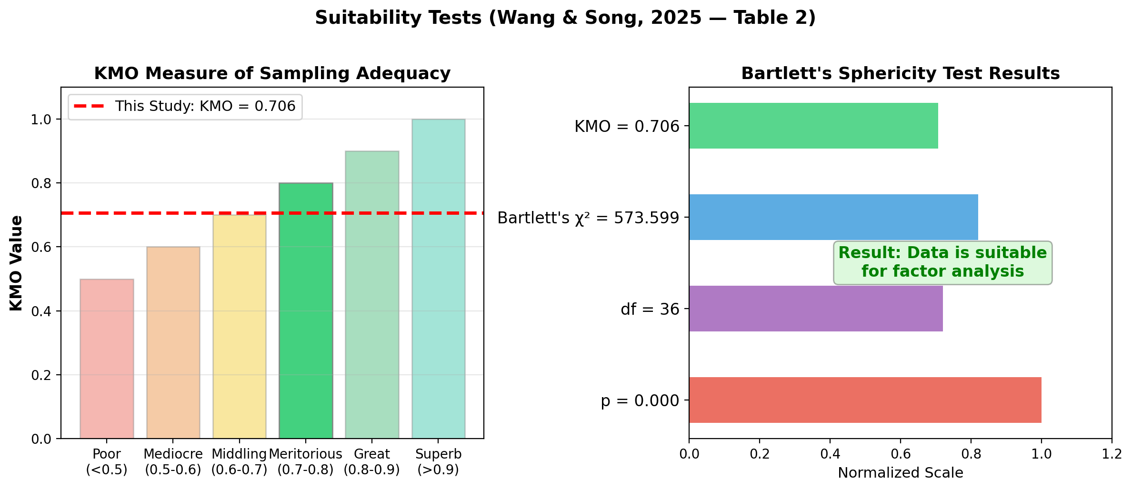
Suitability Testing
KMO and Bartlett's Sphericity Test (Table 2)
KMO = 0.706 (Meritorious) confirms sampling adequacy; Bartlett's p = 0.000 confirms variable correlations

Slide 10
Suitability Test Results — Table
Table 2: Wang & Song (2025)
Test | Measure | Value
KMO | Sampling Adequacy | 0.706
Bartlett's Test | Approx. Chi-Square | 573.599
Bartlett's Test | Degrees of Freedom | 36
Bartlett's Test | Significance | 0.000
Interpretation:
• KMO > 0.7 indicates the data is suitable for factor analysis (Kaiser, 1974)
• Bartlett's test significance (p < 0.05) confirms variables are correlated
• Both tests confirm factor analysis is appropriate for these 9 financial indicators

Slide 11
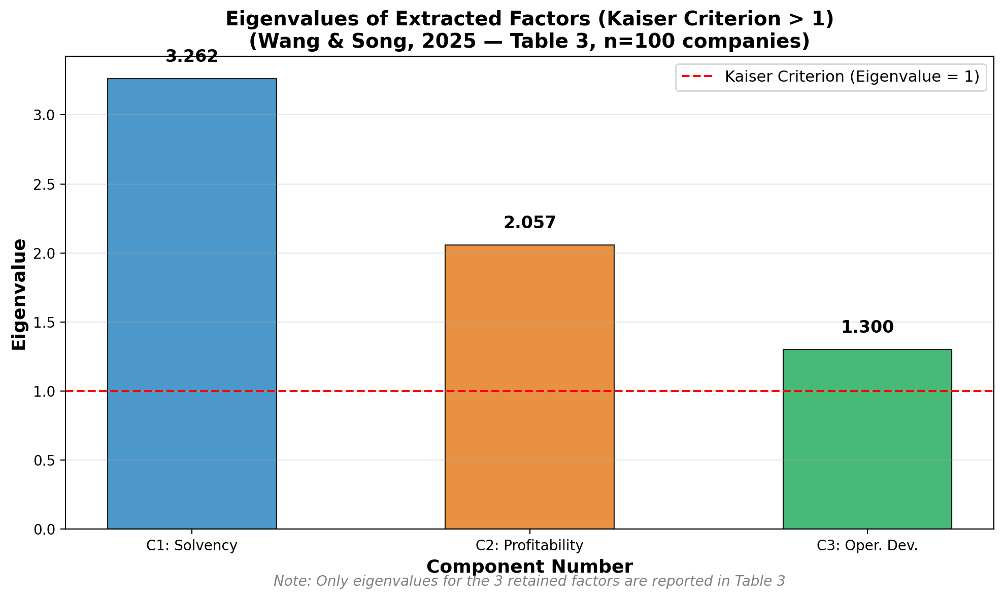
Scree Plot
Eigenvalue Analysis for Factor Extraction (Table 3)
3 factors retained with eigenvalues > 1: 3.262, 2.057, 1.300 (only retained factors reported in paper)

Slide 12
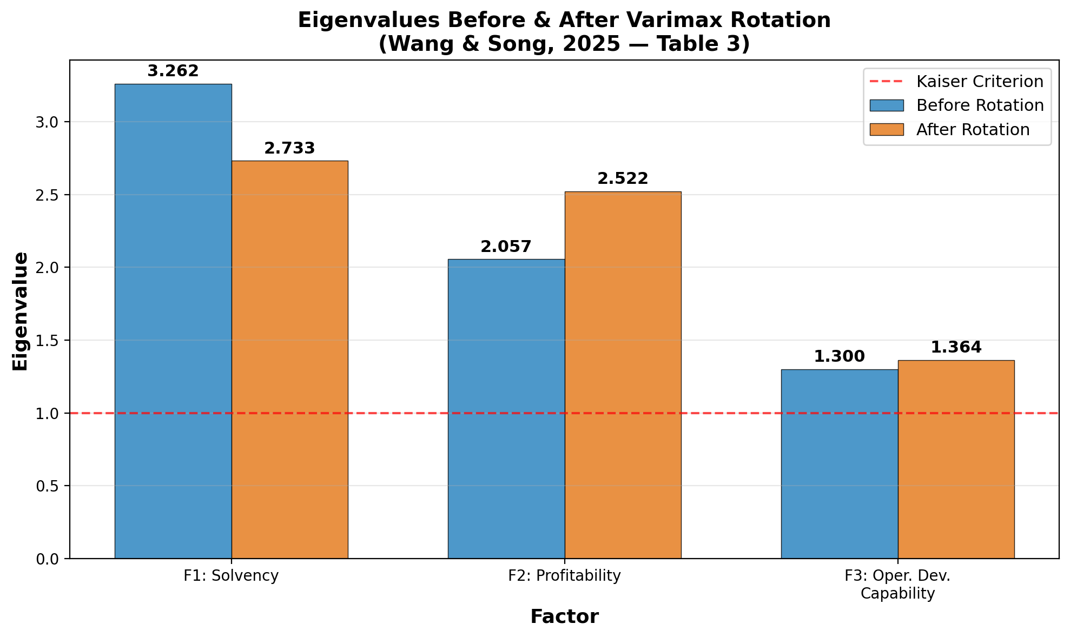
Eigenvalues: Before vs. After Rotation
Effect of Varimax Rotation (Table 3)
Rotation redistributes variance more evenly: F1 decreases (3.262 to 2.733), F2 increases (2.057 to 2.522)

Slide 13
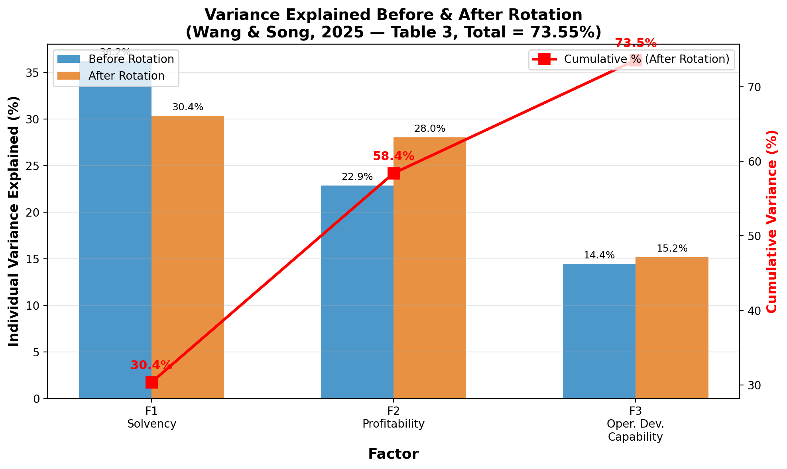
Total Variance Explained
Before and After Rotation (Table 3)
3 factors explain 73.55% of total variance in financial performance indicators

Slide 14
Variance Explained — Full Table
Table 3: Wang & Song (2025)
Component | Eigenvalue (Before) | Variance % (Before) | Cumul. % (Before) | Eigenvalue (After) | Variance % (After) | Cumul. % (After)
1 | 3.262 | 36.248% | 36.248% | 2.733 | 30.369% | 30.369%
2 | 2.057 | 22.852% | 59.101% | 2.522 | 28.025% | 58.395%
3 | 1.300 | 14.449% | 73.550% | 1.364 | 15.155% | 73.550%
Key Observations:
• Before rotation: F1 dominates with 36.25% variance; uneven distribution
• After Varimax rotation: Variance is redistributed more evenly across factors
• F1 drops from 36.25% to 30.37%; F2 rises from 22.85% to 28.03%
• Total cumulative variance remains unchanged at 73.55%
• This redistribution makes factor interpretation clearer and more meaningful

Slide 15
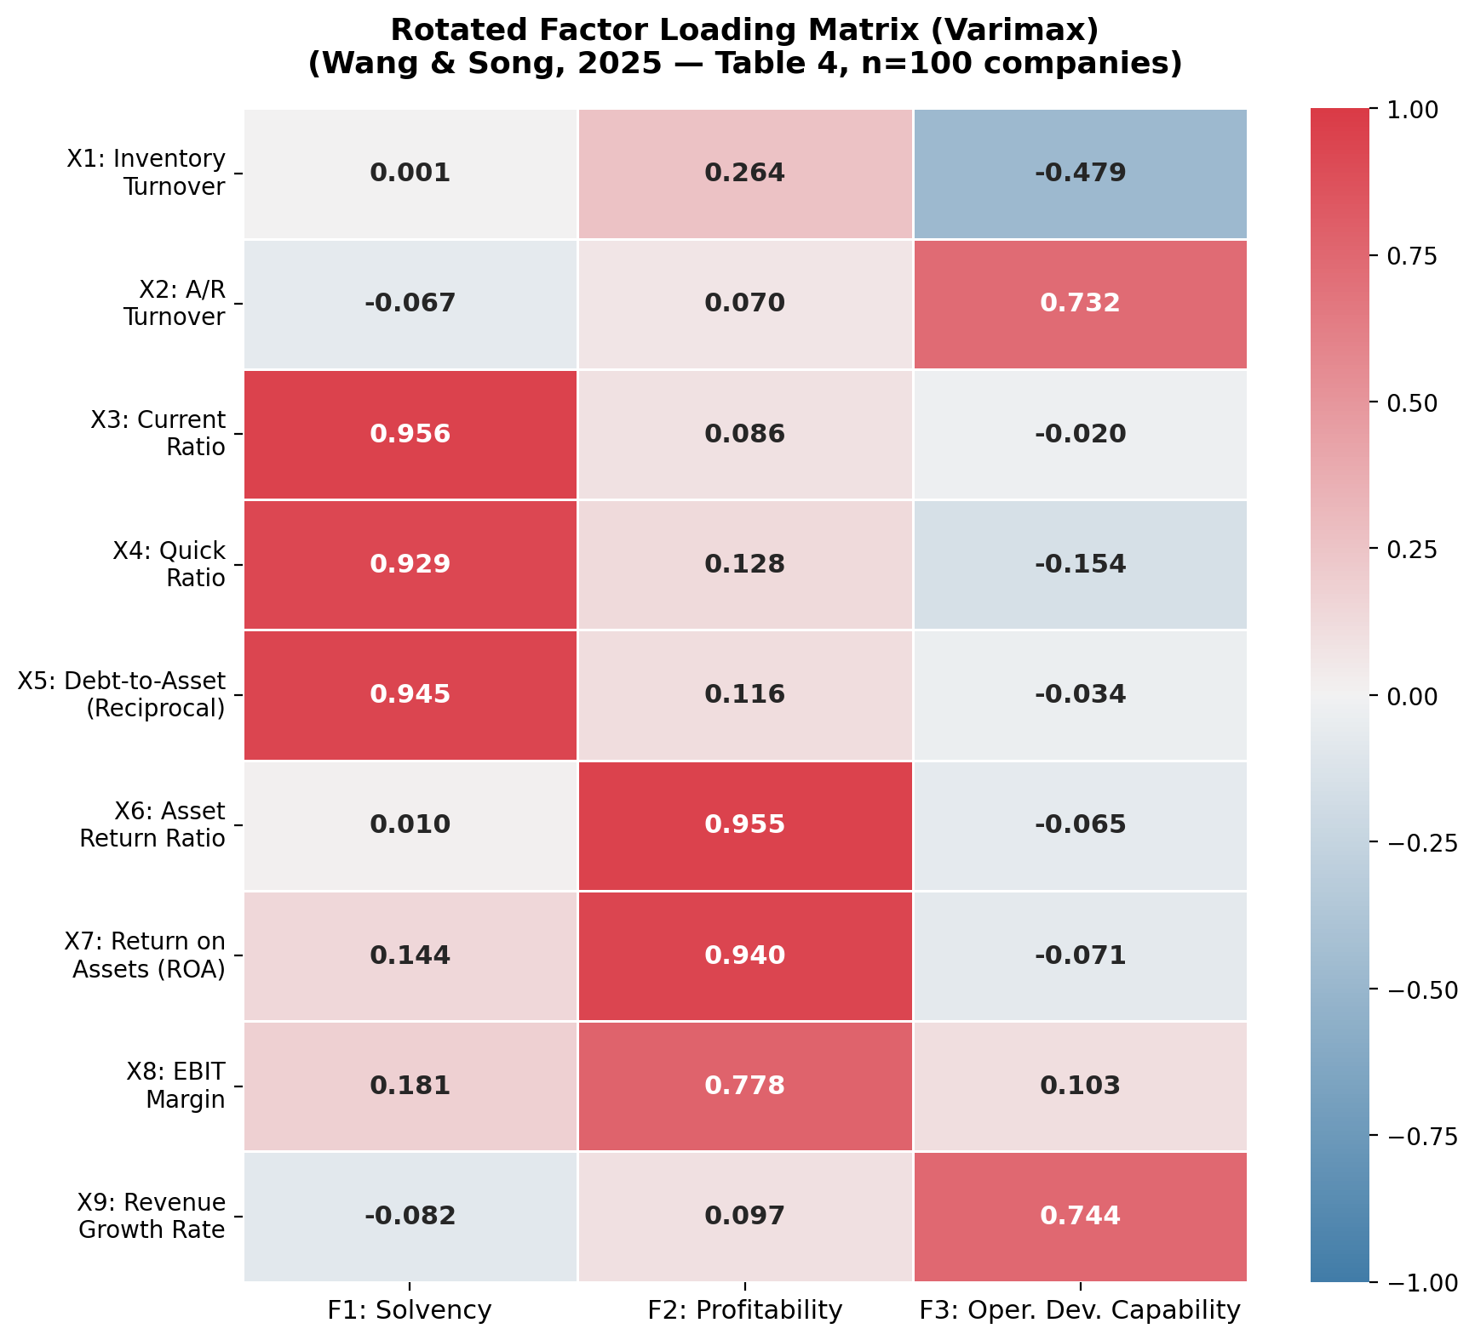
Rotated Factor Loading Matrix
Varimax Rotation Results (Table 4)

Slide 16
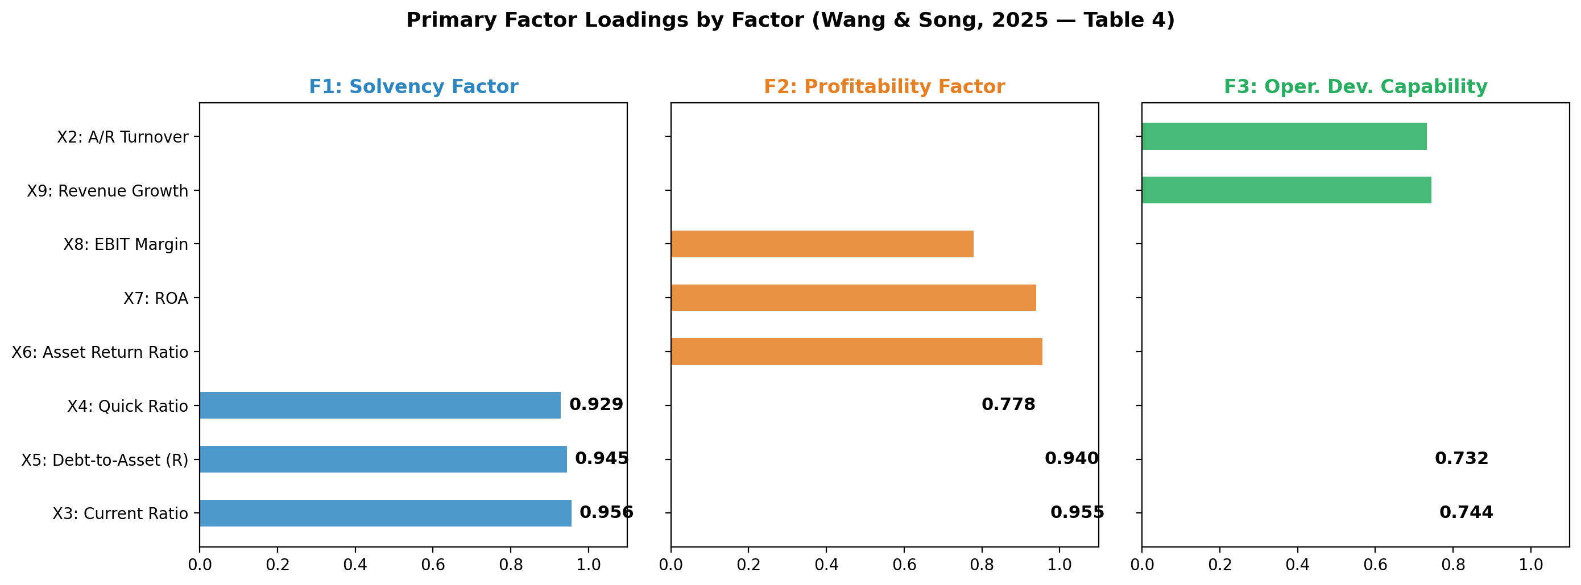
Primary Factor Loadings
Which Variables Define Each Factor (Table 4)
F1: Solvency (0.929-0.956) | F2: Profitability (0.778-0.955) | F3: Oper. Dev. (0.732-0.744)

Slide 17
Rotated Component Matrix — Table
Table 4: Wang & Song (2025)
Variable | F1: Solvency | F2: Profitability | F3: Oper. Dev.
X1: Inventory Turnover | 0.001 | 0.264 | -0.479
X2: A/R Turnover | -0.067 | 0.070 | 0.732
X3: Current Ratio | 0.956 | 0.086 | -0.020
X4: Quick Ratio | 0.929 | 0.128 | -0.154
X5: Debt-to-Asset (R) | 0.945 | 0.116 | -0.034
X6: Asset Return Ratio | 0.010 | 0.955 | -0.065
X7: ROA | 0.144 | 0.940 | -0.071
X8: EBIT Margin | 0.181 | 0.778 | 0.103
X9: Revenue Growth | -0.082 | 0.097 | 0.744

Slide 18
Factor Interpretation
Understanding the Three Extracted Factors
Factor 1: Solvency Factor (30.37% variance)
Loaded by: Current Ratio (0.956), Debt-to-Asset Reciprocal (0.945), Quick Ratio (0.929)
Measures the company's ability to repay debts and meet financial obligations
Reflects short-term liquidity and overall financial stability
Factor 2: Profitability Factor (28.03% variance)
Loaded by: Asset Return Ratio (0.955), ROA (0.940), EBIT Margin (0.778)
Measures the company's capacity to generate profits from its assets and operations
Reflects long-term earning power and market competitiveness
Factor 3: Operational Development Capability (15.16% variance)
Loaded by: Revenue Growth Rate (0.744), A/R Turnover (0.732)
Measures the company's growth trajectory and operational efficiency
Reflects expansion momentum and asset utilization effectiveness

Slide 19
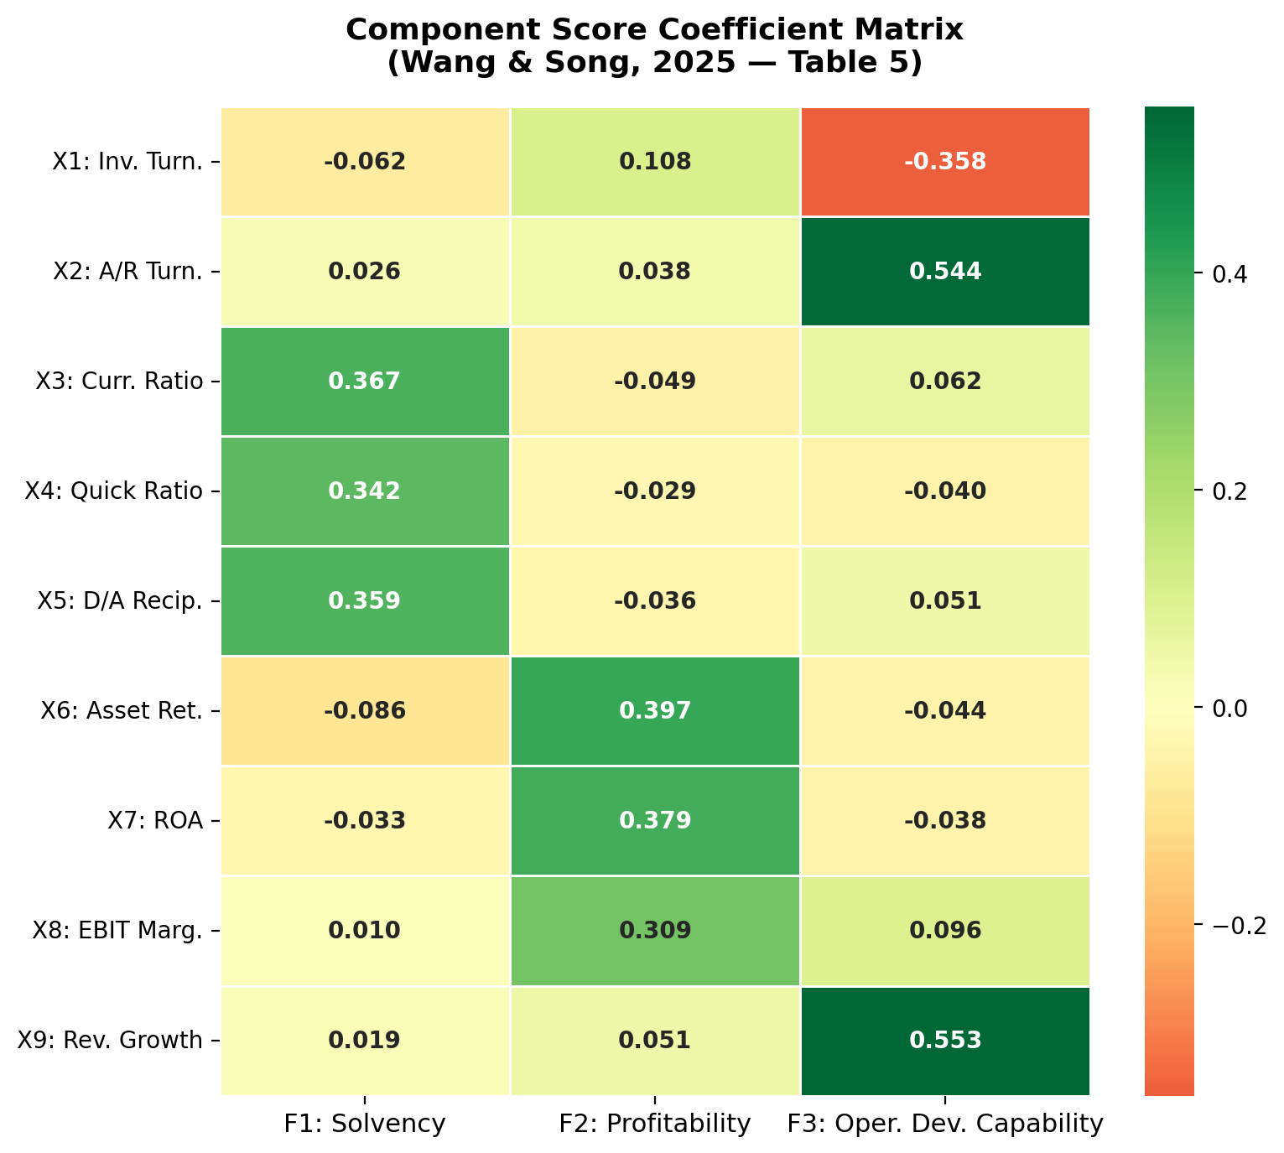
Component Score Coefficients
Building the Scoring Equations (Table 5)

Slide 20
Factor Scoring Equations
From Table 5 Coefficients
Factor Score Equations (from Table 5):
F1 = -0.062X1 + 0.026X2 + 0.367X3 + 0.342X4 + 0.359X5
- 0.086X6 - 0.033X7 + 0.010X8 + 0.019X9
F2 = 0.108X1 + 0.038X2 - 0.049X3 - 0.029X4 - 0.036X5
+ 0.397X6 + 0.379X7 + 0.309X8 + 0.051X9
F3 = -0.358X1 + 0.544X2 + 0.062X3 - 0.040X4 + 0.051X5
- 0.044X6 - 0.038X7 + 0.096X8 + 0.553X9
Comprehensive Score:
F = (30.369/73.550) x F1 + (28.025/73.550) x F2 + (15.155/73.550) x F3
F = 0.413 x F1 + 0.381 x F2 + 0.206 x F3

Slide 21
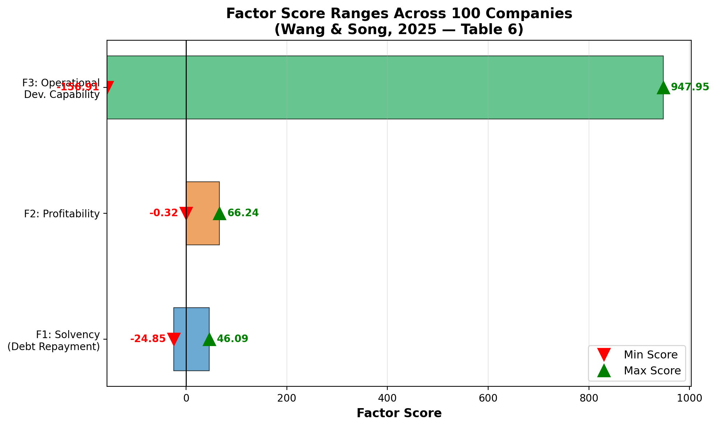
Factor Score Ranges
Performance Distribution Across 100 Companies (Table 6)
Wide score ranges indicate significant differentiation in financial performance among companies

Slide 22
Key Findings
What the Analysis Revealed
1. Three Core Dimensions Drive Financial Performance
Solvency, Profitability, and Operational Development Capability explain 73.55% of variance
2. Significant Differentiation Among Companies
Solvency scores range from -24.85 to 46.09 — some companies face serious debt risk
Profitability scores range from -0.32 to 66.24 — large gap between top and bottom performers
Operational development scores range from -156.91 to 947.95 — extreme variation in growth
3. Debt Risk is a Major Concern
Some companies have very low solvency scores, indicating capital chain vulnerabilities
This aligns with the post-Evergrande industry reality
4. Factor Analysis Provides Superior Evaluation
Reduces 9 indicators into 3 interpretable factors for clearer assessment
Weighted comprehensive scoring enables fair cross-company comparison

Slide 23
Practical Implications
Recommendations from the Study
For Company Managers:
Strengthen profitability through better cost control and revenue diversification
Improve operational development capability via faster asset turnover
Pay close attention to debt risks and maintain healthy capital chains
Use multi-dimensional evaluation (not just single metrics) for strategic decisions
For Investors:
Look beyond simple profit metrics — solvency and growth are equally important
Companies with balanced scores across all 3 factors are more financially stable
Low solvency scores signal potential bankruptcy or capital chain risks
For Policy Makers:
The significant differentiation highlights need for industry-level risk monitoring
Factor analysis can serve as an early warning system for sector-wide financial stress

Slide 24
Why Factor Analysis Works for Finance
Advantages of the Method
Advantages:
• Handles multicollinearity — financial ratios are often highly correlated
• Reduces dimensionality — 9 variables condensed into 3 interpretable factors
• Objective weighting — factor weights come from data, not subjective judgment
• Comprehensive scoring — enables fair ranking of companies on multiple dimensions
Limitations:
• Requires sufficient sample size (this study uses 100 companies)
• Results depend on variable selection (only 9 indicators used here)
• Historical data — reflects past performance, not predictive of future
• Cross-sectional analysis — captures one year (2023) only
Broader Applications in Finance:
• Portfolio risk assessment and diversification analysis
• Credit scoring and loan default prediction
• Stock return factor models (e.g., Fama-French factors)
• Macroeconomic forecasting using latent factor models

Slide 25
Summary: All Real Published Data
Data Source Verification
Data Element | Value | Source
Sample Size | 100 companies | Wang & Song (2025)
KMO | 0.706 | Table 2
Bartlett's Chi-Square | 573.599 (df=36, p=0.000) | Table 2
Eigenvalues (before rot.) | 3.262, 2.057, 1.300 | Table 3
Eigenvalues (after rot.) | 2.733, 2.522, 1.364 | Table 3
Total Variance Explained | 73.550% | Table 3
Factor Loadings | 9 variables x 3 factors | Table 4
Score Coefficients | 9 variables x 3 factors | Table 5
Score Ranges | Min/Max per factor | Table 6

Slide 26
References
Primary Study:
Wang, Y. & Song, X. (2025). "Research on the Financial Performance Evaluation of
Listed Companies in the Real Estate Industry Based on Factor Analysis Method."
Academic Journal of Business & Management, 7(5), 78-84.
DOI: 10.25236/AJBM.2025.070510
Supporting References:
Kaiser, H.F. (1974). "An Index of Factorial Simplicity." Psychometrika, 39, 31-36.
Hair, J.F., Black, W.C., Babin, B.J. & Anderson, R.E. (2019). Multivariate Data
Analysis, 8th Ed. Cengage Learning.
Shrestha, N. (2021). "Factor Analysis as a Tool for Survey Analysis."
American Journal of Applied Mathematics and Statistics, 9(1), 4-11.
DOI: 10.12691/ajams-9-1-2

Slide 27
Thank You!
Factor Analysis in Financial Performance Evaluation
Lana Jalal Gidan
SSIE-605 | Binghamton University | Professor Susan Lu

