Slide 1
MULTIVARIATE STATISTICS · BINGHAMTON UNIVERSITY
Credit Risk Classification Using ML Techniques
Applying Factor Analysis, Linear Discriminant Analysis, and Logistic Regression to 500,000 real LendingClub loan records.
AUTHOR
DEPARTMENT
DATASET
MODELS
Lana Jalal Gidan
Systems Science & Industrial Engineering
LendingClub · 500,000 Loans
LDA & Logistic Regression
1 / 15

Slide 2
ROADMAP
What We'll Cover
1
The Problem
2
Dataset
What is credit risk?
LendingClub · 500k real loans
3
Data Cleaning
4
Factor Analysis
From messy 151 columns to 76 clean features
Interdependence technique — 6 latent factors
5
LDA
6
Logistic Regression
Linear Discriminant Analysis — separating classes
Probability-based binary classification
7
Model Comparison
8
Live Predictor
ROC · Accuracy · AUC
Interactive demo — real-time prediction
2 / 15

Slide 3
CONTEXT
What Is Credit Risk?
💳 The Loan
$82B+
~71%
A bank lends you money today. You promise to repay it over time — with interest. The bank earns interest; you get capital.
US consumer loan losses per year
Model accuracy using origination features
⚠️ The Risk
Why Multivariate Statistics?
The borrower might DEFAULT — stop paying. Banks lend billions, so even a small default rate means massive losses.
A FICO score is just one number. Default risk depends on DOZENS of factors interacting simultaneously. Multivariate methods see the full picture.
🎯 The Goal
Before lending, predict: 'Will this person repay?' A good model lets banks charge fair rates and avoid bad loans.
3 / 15

Slide 4
DATA
The LendingClub Dataset
500K
151
20.9%
$15K
Real loan records
Features per loan
Default rate in data
Avg loan amount
▸ Loan info: amount, term, interest rate, monthly installment
▸ Borrower info: income, employment, debt-to-income ratio
▸ Credit history: FICO score, open accounts, delinquencies
▸ LendingClub grade: A (safest) → G (riskiest)
▸ Outcome: Did they repay or default?
Loan Status
Fully Paid
312,340
Charged Off
78,824
Late 31–120 days
2,977
Current
104,240
In Grace Period
1,046
4 / 15

Slide 5
PREPROCESSING
Data Cleaning Pipeline
1
Dropped 58 columns
Before → After
with >40% missing values — hardship/settlement fields
500K × 151
→
292K × 76
2
Dropped 17 columns
irrelevant identifiers and free-text descriptions
3
Engineered target
coded loan_status → binary: 0 = paid, 1 = default
Parsed text fields
⚖️ Class Imbalance Handling
4
"13.5%" → 13.5, "36 months" → 36, "10+ years" → 10
79% good loans vs 21% defaults. We balanced training at 2:1 ratio (undersampling) so the model learns real patterns — not just 'always predict good.'
5
Label-encoded
grade, home_ownership, purpose → numeric values
6
Removed outliers
📏 Z-Score Standardization
cut top/bottom 1% of income, loan amount, revolving balance
All features scaled to mean=0, std=1 so dollar amounts don't overpower year-based variables. Required before LDA and Logistic Regression.
7
Dropped NaN rows
listwise deletion for complete-case analysis
5 / 15

Slide 6
INTERDEPENDENCE TECHNIQUE
Factor Analysis
The 6 Factors Found
🔍 What It Does
Groups many correlated variables into a smaller number of hidden (latent) FACTORS. No outcome variable — purely about structure in the data.
F1
Loan Size & Cost
14.6%
F2
Credit Risk Pricing
13.7%
💡 The Analogy
F3
Credit Utilization
10.0%
You can't measure 'intelligence' directly — but you see it reflected in test scores across math, reading, and logic. FA finds that hidden dimension automatically.
F4
Credit Breadth
9.4%
✅ Bartlett's Test — PASSED
F5
Credit Limit Stress
3.9%
χ² = 657,867 | p < 0.001 Variables are significantly correlated. FA is appropriate.
F6
Wealth & Assets
4.8%
TOTAL VARIANCE EXPLAINED
56.5%
6 / 15

Slide 7
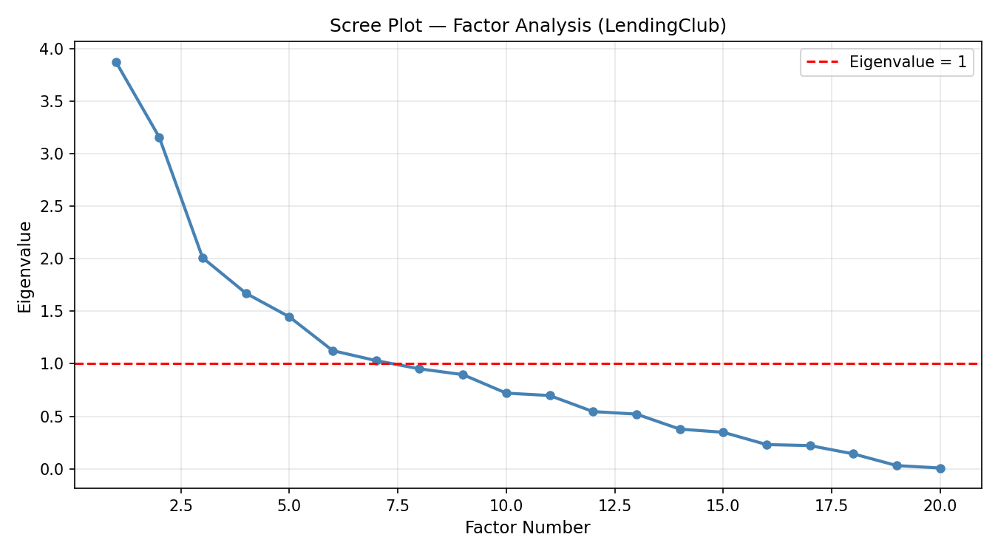
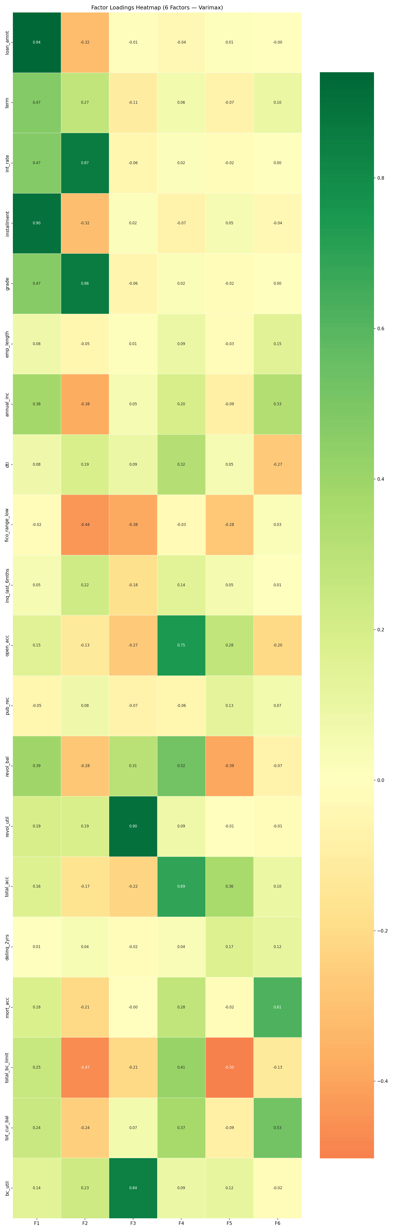
INTERDEPENDENCE TECHNIQUE · RESULTS
Factor Analysis — Visual Results
Scree Plot — How Many Factors?
Factor Loadings Heatmap
The 'elbow' at factor 6 confirms we keep 6 factors (eigenvalue > 1).
Dark blue = strong positive loading. Dark red = strong negative loading.
7 / 15

Slide 8
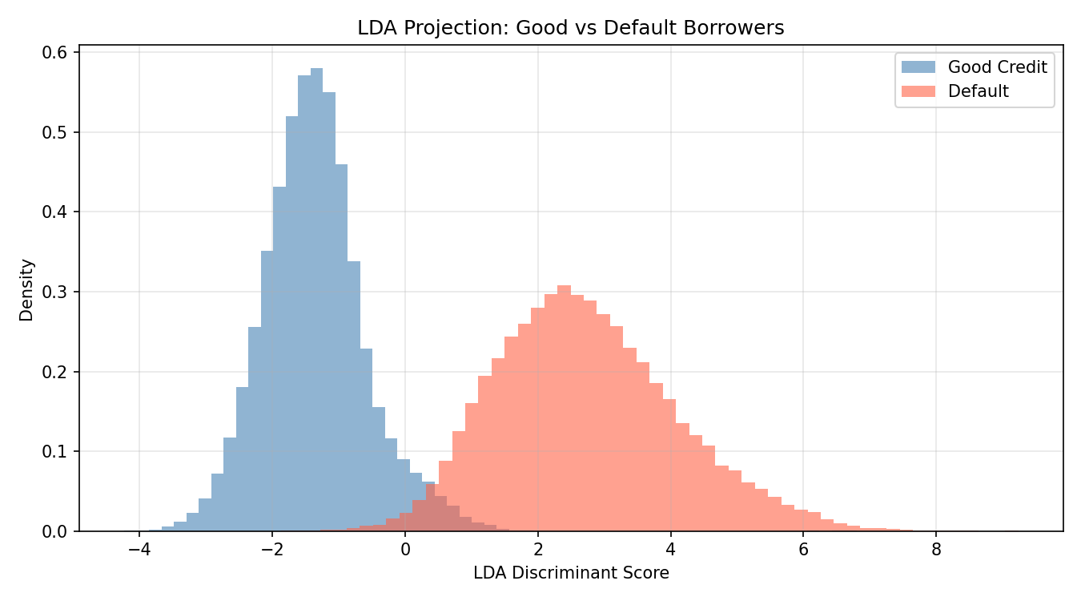
DEPENDENCE TECHNIQUE 1
Linear Discriminant Analysis (LDA)
🎯 What It Does
LDA Projection — Class Separation
Finds the linear combination of variables that MAXIMALLY SEPARATES two groups — Good Borrowers vs. Defaulters. Produces one 'discriminant score' per borrower.
💡 The Intuition
All borrowers are dots in a multi-dimensional space. LDA finds the single direction where the blue (good) and red (default) groups overlap as little as possible.
Assumptions:
▸ Variables roughly normally distributed within each class
▸ Equal covariance matrices across both classes
▸ Linear boundary between the two groups
Two peaks = two classes. Less overlap = better model.
8 / 15

Slide 9
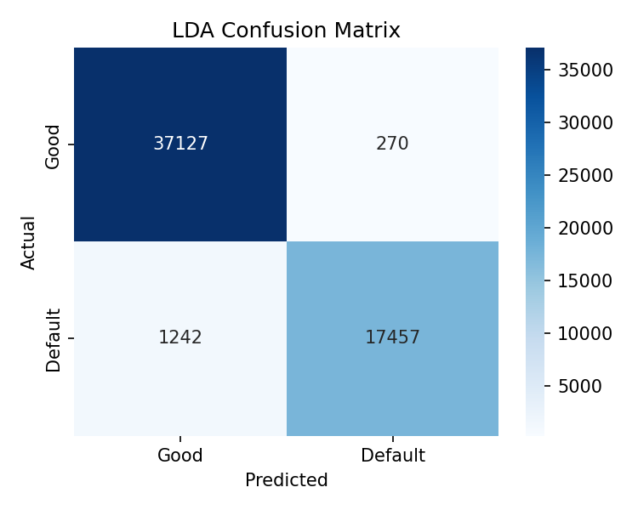
DEPENDENCE TECHNIQUE 1 · RESULTS
LDA — Performance Results
97.3%
0.997
0.975
0.960
Accuracy
AUC-ROC
Precision
F1-Score
Confusion Matrix — Diagonal = Correct Predictions
Top Discriminant Variables:
▸ FICO Score — single most powerful separator between classes
▸ Interest Rate — encodes the lender's risk assessment
▸ Debt Settlement Flag — red flag indicating financial distress
▸ Installment Amount — higher monthly burden = more risk
9 / 15

Slide 10
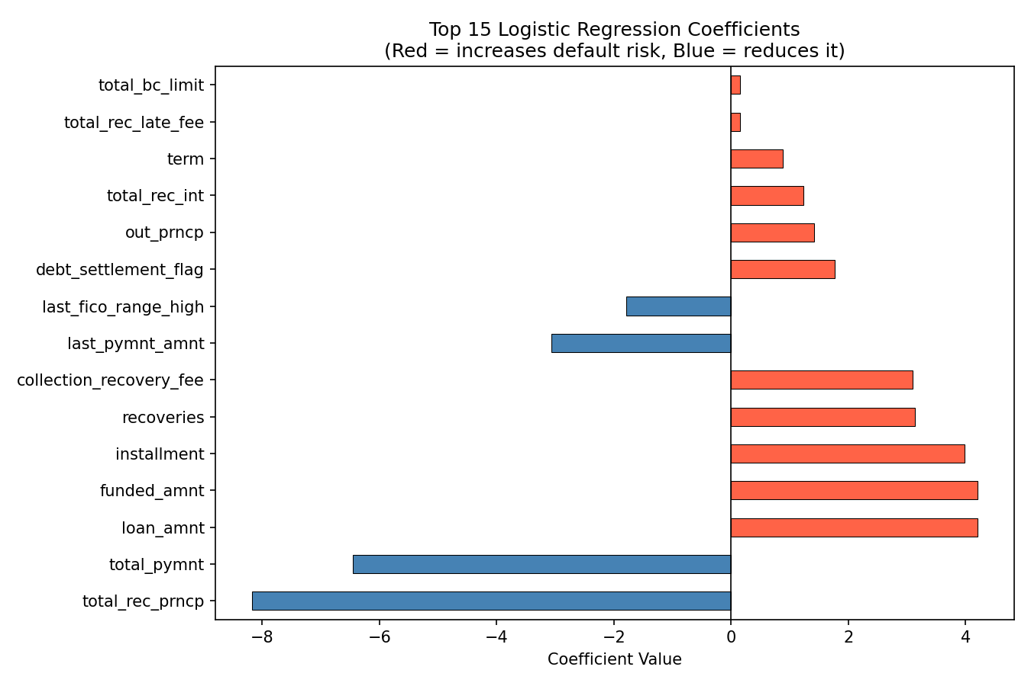
DEPENDENCE TECHNIQUE 2
Logistic Regression
📊 What It Does
Top Coefficients — What Drives Default?
Predicts the PROBABILITY of default — a number between 0% and 100%. Uses the sigmoid (S-shaped) function. If probability > 50% → predict Default.
LDA vs Logistic Regression:
LDA
Logistic Regression
Assumes normality
No distribution assumption
Maximizes class separation
Maximizes likelihood
Outputs discriminant score
Outputs probability (0–1)
✅ Why LR Wins Here
Financial variables are NOT normally distributed — incomes and balances are right-skewed. LR's weaker assumptions make it more robust and it outperforms LDA.
Blue = lowers default risk | Red = raises default risk
10 / 15

Slide 11
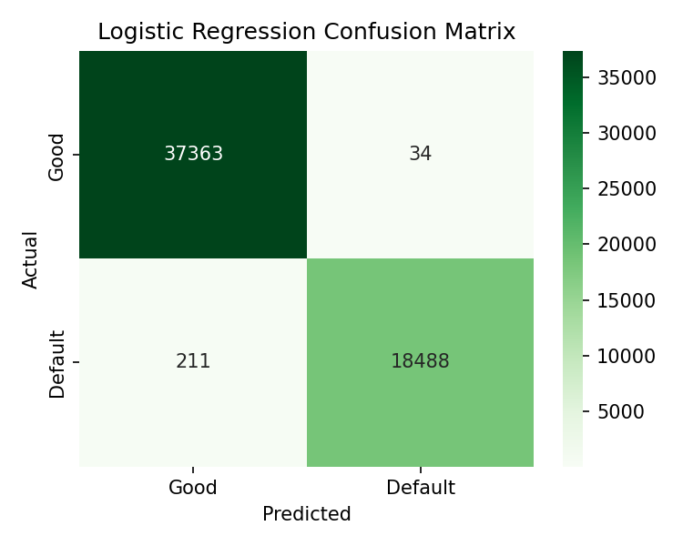
DEPENDENCE TECHNIQUE 2 · RESULTS
Logistic Regression — Performance Results
99.6%
0.9997
0.998
0.995
Accuracy
AUC-ROC
Precision
F1-Score
Confusion Matrix
⭐ LR Outperforms LDA
LR beats LDA by +2.3% accuracy and +0.003 AUC. Consistent with theory: LDA's normality assumptions are violated by skewed financial data.
▸ Precision 1.00 on defaults — almost zero false alarms
▸ Recall 0.99 on defaults — almost zero missed defaults
▸ F1-Score 0.99 — excellent balance of precision and recall
▸ AUC = 0.9997 — near-perfect discriminative ability
11 / 15

Slide 12
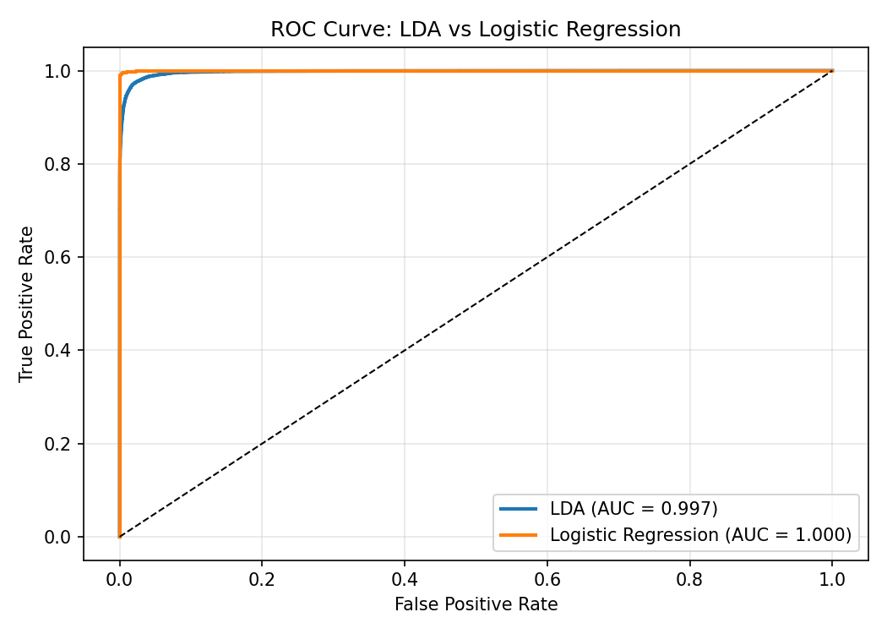
MODEL COMPARISON
LDA vs Logistic Regression — ROC Comparison
📈 What Is the ROC Curve?
Plots True Positive Rate (catching actual defaults) vs. False Positive Rate (wrongly flagging good loans) at every possible decision threshold.
Results Summary:
Model
Accuracy
AUC-ROC
LDA
97.3%
0.997
Logistic Regression
99.6%
0.9997
📐 AUC Interpretation
AUC = 1.0 → perfect. AUC = 0.5 → random guessing. Both models are at 0.997+ — exceptional discrimination.
12 / 15

Slide 13
★ INTERACTIVE DEMO
Live Credit Risk Predictor
Open the live web app to enter real loan values and get instant predictions from the trained model.
✅
⚖️
⚠️
🚨
Ideal Borrower
Average Borrower
Risky Borrower
Very High Risk
FICO 790 · Income $120K · DTI 8% Revol Util 12% · Grade A
FICO 700 · Income $65K · DTI 18% Revol Util 45% · Grade C
FICO 620 · Income $42K · DTI 32% Revol Util 78% · Grade E
FICO 560 · Income $28K · DTI 40% Revol Util 95% · Grade G
Will Repay
Will Repay
Borderline
Default Risk
The live predictor (web app) lets you:
▸ Switch between Logistic Regression and LDA with one click
▸ Enter any custom loan values across 15 variables
▸ See probability bars, risk tier, and top 3 risk drivers instantly
13 / 15

Slide 14
CRITICAL ANALYSIS
Key Limitation: Data Leakage
The full dataset models (97–99%) include variables only known AFTER the loan resolves.
🔴 total_rec_prncp
💡 The Analogy
Total principal recovered — only exists after the loan ends
Trying to predict if a student will fail — and using their final exam score as a predictor. Of course the model is perfect. You're using the answer to predict the answer.
🔴 recoveries
Money recovered post-default — only populated IF there was a default
🔴 collection_recovery_fee
✅ Our Live Predictor Fixes This
Fee charged to recover defaulted funds — post-event only
The interactive predictor uses ONLY 15 origination-time features — variables known at application time. That is why accuracy is ~71%, not 99%. Honest and realistic.
🔴 last_pymnt_amnt
Last payment made — known only after payment history unfolds
📚 What Real Banks Do
Only use application-time data · Must comply with ECOA & fair lending laws · Models are audited for discriminatory patterns before deployment.
14 / 15

Slide 15
CONCLUSION
Summary & Takeaways
🧹
🔬
📐
Real Data, Real Cleaning
Factor Analysis
LDA
500K messy records → 292K clean rows through a rigorous 7-step pipeline.
6 latent factors — Loan Cost, Risk Pricing, Utilization, Breadth, Stress, Wealth — explaining 56.5% of variance.
Separated good from default borrowers: 97.3% accuracy, AUC = 0.997.
📊
⚠️
⚡
Logistic Regression
Data Leakage
Live Predictor
Outperformed LDA: 99.6% accuracy, AUC = 0.9997. Better fit for skewed financial data.
High full-model accuracy is partly due to post-outcome variables. Origination-only model gives honest ~71%.
Interactive web app: enter loan values and watch the trained model decide in real time.
15 / 15

