Slide 1
Factor Analysis in Supply Chain Management
Green Supply Chain Management Practices & Sustainability
Based on: Gupta, P., Sharma, Y., Chauhan, A., Parewa, B., Rai, P. & Naik, N. (2025)
Scientific Reports, 15, 14909
DOI: 10.1038/s41598-025-95940-9
Presented by: Lana Jalal Gidan
SSIE-605: Applied Multivariate Data Analysis
Binghamton University — Professor Susan Lu

Slide 2
Presentation Outline
• 1. Introduction to Green Supply Chain Management (GSCM)
• 2. Research Context & Study Overview
• 3. Methodology: Sample & Survey Design
• 4. Demographic Profile of Respondents
• 5. PCA Eigenvalue Decomposition & Scree Plot
• 6. Total Variance Explained by Components
• 7. Measurement Model: Factor Loadings
• 8. Reliability Analysis: Cronbach's Alpha
• 9. Convergent Validity: CR & AVE
• 10. SEM: Hypothesis Testing & Path Coefficients
• 11. Variance Explained (R²) & Effect Sizes
• 12. Key Findings & Practical Implications
• 13. Conclusions & Future Research Directions

Slide 3
Introduction to Green Supply Chain Management
Integrating Environmental Sustainability into Supply Chains
What is Green Supply Chain Management (GSCM)?
GSCM integrates environmental thinking into supply chain management
Encompasses procurement, manufacturing, distribution, and end-of-life management
Aims to minimize ecological footprint while maintaining competitive advantage
Why Factor Analysis in GSCM Research?
Identifies underlying dimensions that drive green practices adoption
Reduces complex multi-item questionnaires to interpretable factors
Validates measurement instruments for organizational sustainability
Enables Structural Equation Modeling (SEM) for hypothesis testing

Slide 4
Research Context & Study Overview
Gupta et al. (2025) — Scientific Reports
Study Focus:
Examines the impact of GSCM practices on top management performance,
low-carbon performance, sustainable manufacturing, and sustainable society
Research Setting:
Indian bag-manufacturing firms implementing GSCM practices
Data collection: March–September 2020 via structured questionnaire
480 responses received; 389 valid after screening (81% response rate)
Analytical Approach:
Principal Component Analysis (PCA) for dimensionality assessment
Confirmatory Factor Analysis (CFA) via SmartPLS for measurement model
Structural Equation Modeling (SEM) for hypothesis testing

Slide 5
Methodology: Sample & Survey Design
Rigorous Data Collection from Manufacturing Sector
Parameter | Details
Sample Size | n = 389 valid responses (from 480 collected)
Population | Managers in Indian bag-manufacturing firms
Respondent Levels | Junior (42.67%), Middle (34.70%), Top (25.19%)
Scale | 5-point Likert (Strongly Disagree to Strongly Agree)
Total Items | 41 items across 8 constructs
Sampling Method | Convenience + Snowball sampling
Data Platform | Google Forms (mandatory fields, no missing data)
Analysis Software | SmartPLS (SEM analysis)

Slide 6
Eight GSCM Constructs Measured
41 Items Across 4 GSCM Practices + 4 Outcome Variables
Construct | Abbr. | Items | Role
Green Procurement | GP | 6 | GSCM Practice
Green Logistics | GL | 5 | GSCM Practice
Green Product & Product Design | GD | 5 | GSCM Practice
Regulatory Framework | RF | 6 | GSCM Practice
Top Management Performance | TMC | 5 | Mediator
Low Carbon Performance | CP | 7 | Mediator
Sustainable Society | SS | 5 | Outcome
Sustainable Manufacturing | SM | 2 | Outcome

Slide 7
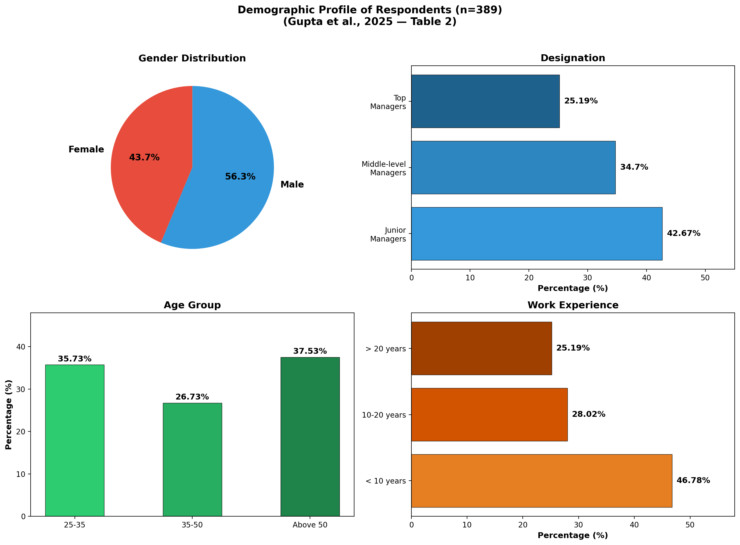
Demographic Profile of Respondents
Table 2: n=389 Manufacturing Managers from India

Slide 8
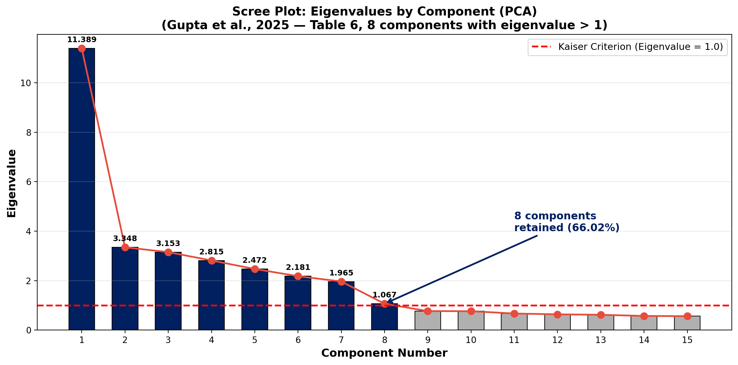
PCA Eigenvalue Decomposition
Table 6: 8 Components with Eigenvalue > 1.0

Slide 9
Eigenvalue Details: Kaiser Criterion
Table 6: Initial Eigenvalues from PCA
Component | Eigenvalue | % Variance | Cumulative %
1 | 11.389 | 26.485% | 26.485%
2 | 3.348 | 7.785% | 34.271%
3 | 3.153 | 7.332% | 41.603%
4 | 2.815 | 6.546% | 48.149%
5 | 2.472 | 5.750% | 53.899%
6 | 2.181 | 5.071% | 58.970%
7 | 1.965 | 4.570% | 63.539%
8 | 1.067 | 2.481% | 66.020%
8 components retained explaining 66.02% of total variance

Slide 10
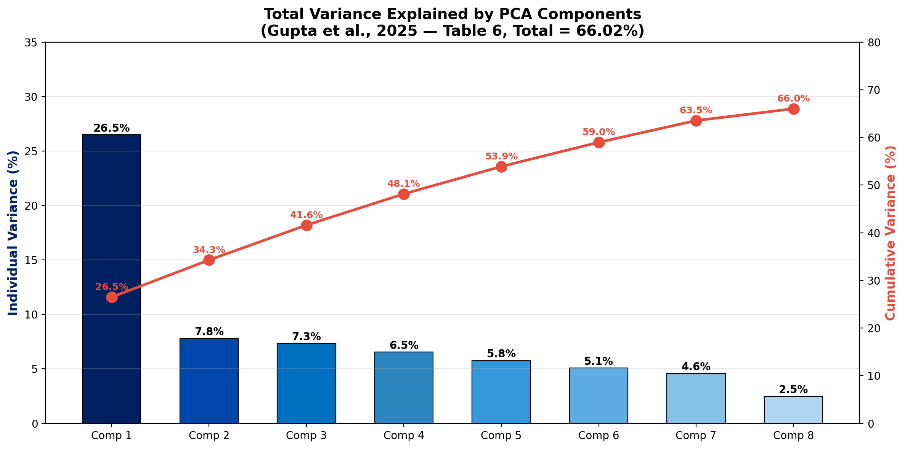
Total Variance Explained
Table 6: Individual & Cumulative Variance by Component

Slide 11
Measurement Model: Factor Loadings
Table 3: Standardized Factor Loadings (CFA)
Construct | Items | Loading Range | Highest | Lowest
Green Procurement (GP) | 6 | 0.681–0.767 | GP2: 0.767 | GP1: 0.681
Green Logistics (GL) | 5 | 0.604–0.781 | GL3: 0.781 | GL1: 0.604
Green Product & Design (GD) | 5 | 0.780–0.819 | GD1: 0.819 | GD3: 0.780
Regulatory Framework (RF) | 6 | 0.673–0.771 | RF2: 0.771 | RF6: 0.673
Top Mgmt. Performance (TMC) | 5 | 0.736–0.844 | TMC4: 0.844 | TMC3: 0.736
Low Carbon Perf. (CP) | 7 | 0.622–0.786 | CP5: 0.786 | CP7: 0.622
Sustainable Society (SS) | 5 | 0.738–0.792 | SS4: 0.792 | SS1: 0.738
Sustainable Mfg. (SM) | 2 | 0.682–0.841 | SM2: 0.841 | SM1: 0.682

Slide 12
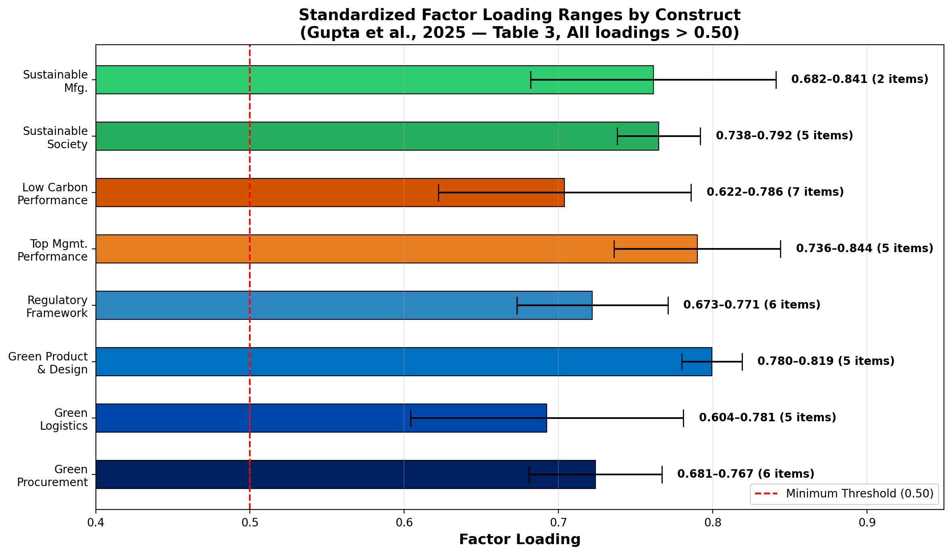
Factor Loading Ranges Visualization
Table 3: All Loadings Above 0.50 Threshold

Slide 13
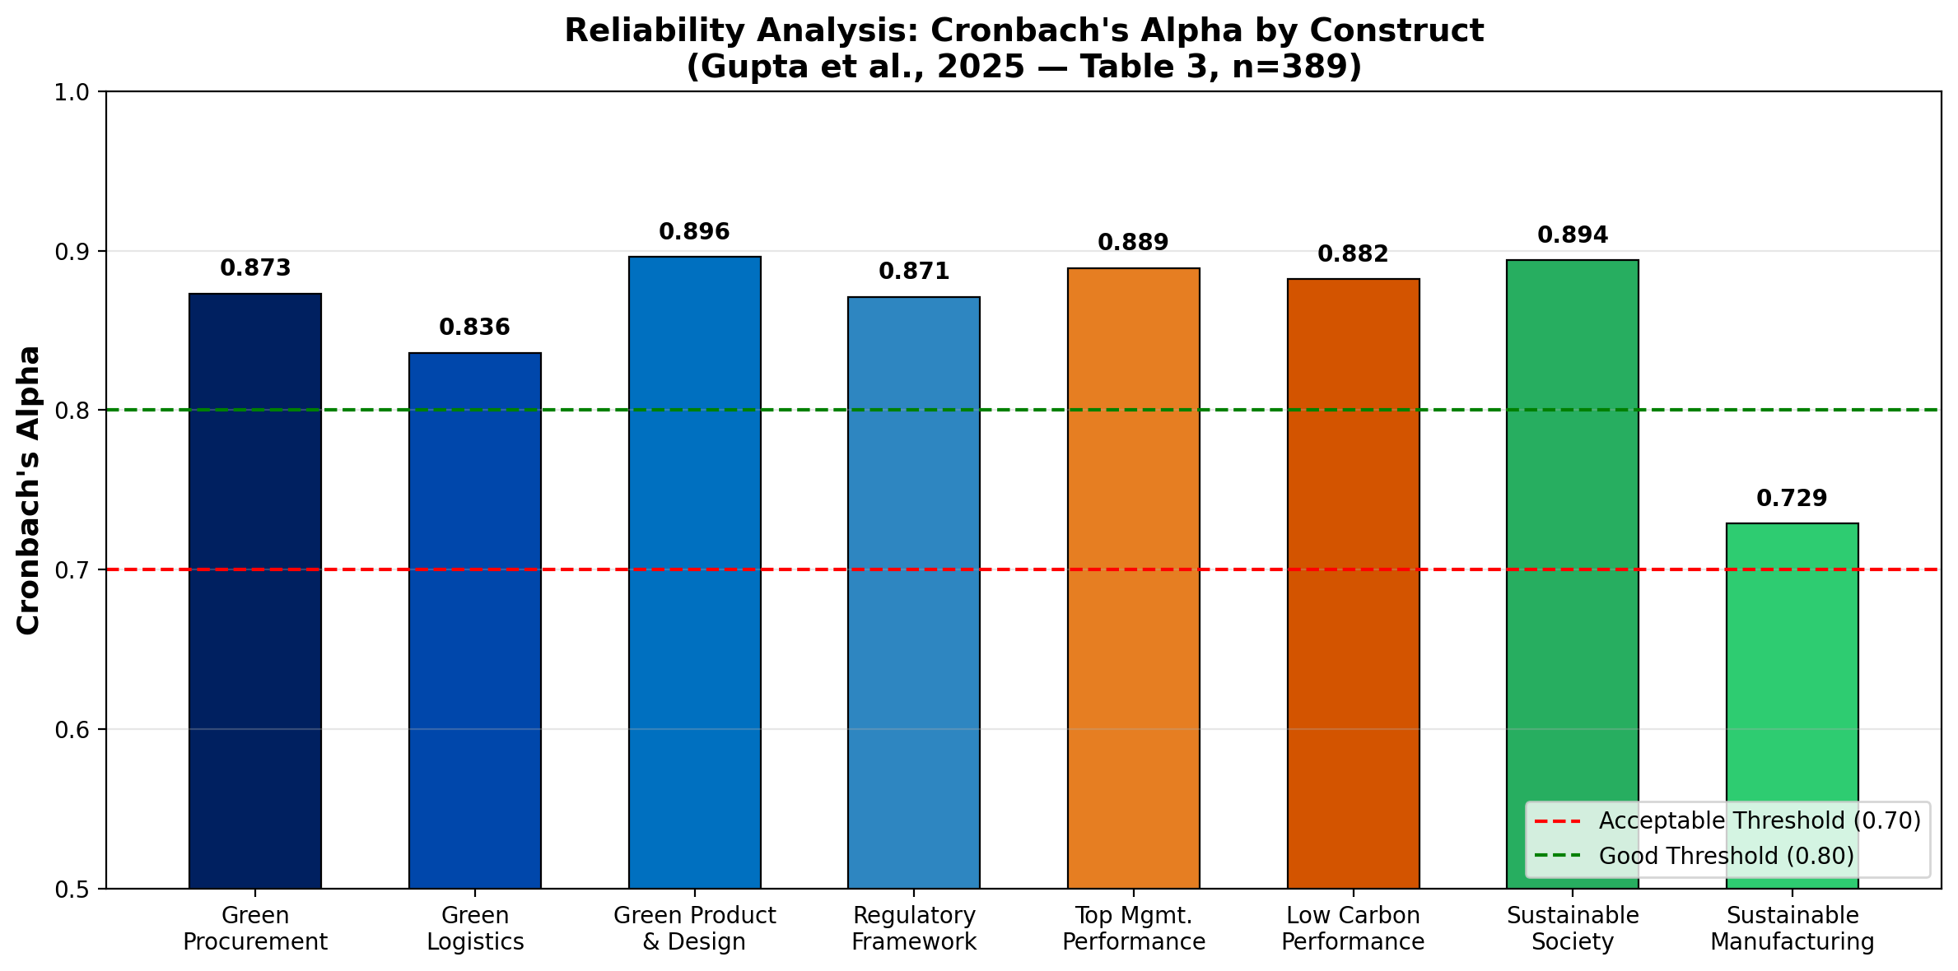
Reliability Analysis: Cronbach's Alpha
Table 3: Internal Consistency by Construct

Slide 14
Reliability & Validity Summary
Table 3: Cronbach's α, Composite Reliability, AVE
Construct | Cronbach's α | C.R. | AVE | Assessment
Green Procurement | 0.873 | 0.874 | 0.531 | Good
Green Logistics | 0.836 | 0.832 | 0.502 | Good
Green Product & Design | 0.896 | 0.898 | 0.633 | Good
Regulatory Framework | 0.871 | 0.871 | 0.531 | Good
Top Mgmt. Performance | 0.889 | 0.887 | 0.613 | Good
Low Carbon Performance | 0.882 | 0.874 | 0.505 | Good
Sustainable Society | 0.894 | 0.892 | 0.582 | Good
Sustainable Manufacturing | 0.729 | 0.730 | 0.576 | Acceptable

Slide 15
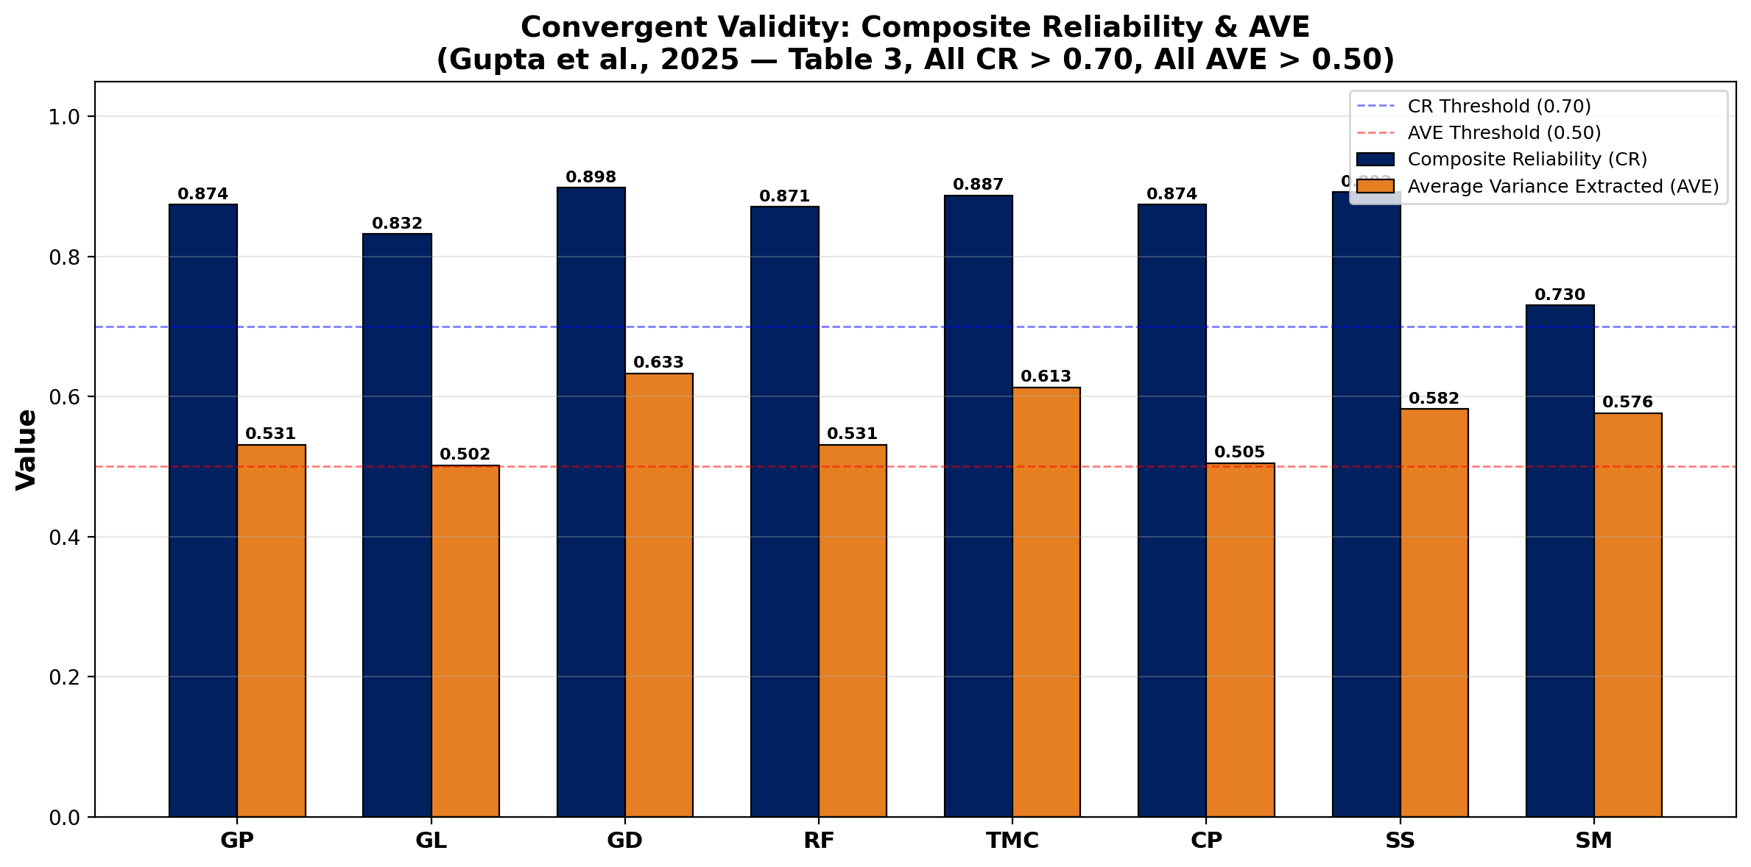
Convergent Validity: CR & AVE
Table 3: All Constructs Exceed Minimum Thresholds

Slide 16
Common Method Bias Assessment
Harman's Single-Factor Test & PCA Validation
Harman's Single-Factor Test (Table 6):
All 41 items subjected to unrotated Principal Component Analysis
First component explains only 26.48% of total variance
Below the 50% threshold → No common method bias detected
Additional Safeguards:
Anonymous survey responses to reduce social desirability bias
Mandatory fields in Google Forms eliminated missing data issues
Mixed positive/negative items to reduce acquiescence bias
Conclusion: Data is free from significant common method bias

Slide 17
Structural Equation Model: Research Hypotheses
7 Hypothesized Relationships Tested via SmartPLS SEM
Hypothesis | Path | Direction
H1 | Green Procurement → Top Mgmt. Performance | Positive
H2 | Green Logistics → Top Mgmt. Performance | Positive
H3 | Green Product & Design → Top Mgmt. Performance | Positive
H4 | Regulatory Framework → Top Mgmt. Performance | Positive
H5 | Top Mgmt. Performance → Low Carbon Performance | Positive
H6 | Low Carbon Performance → Sustainable Society | Positive
H7 | Low Carbon Performance → Sustainable Mfg. | Positive

Slide 18
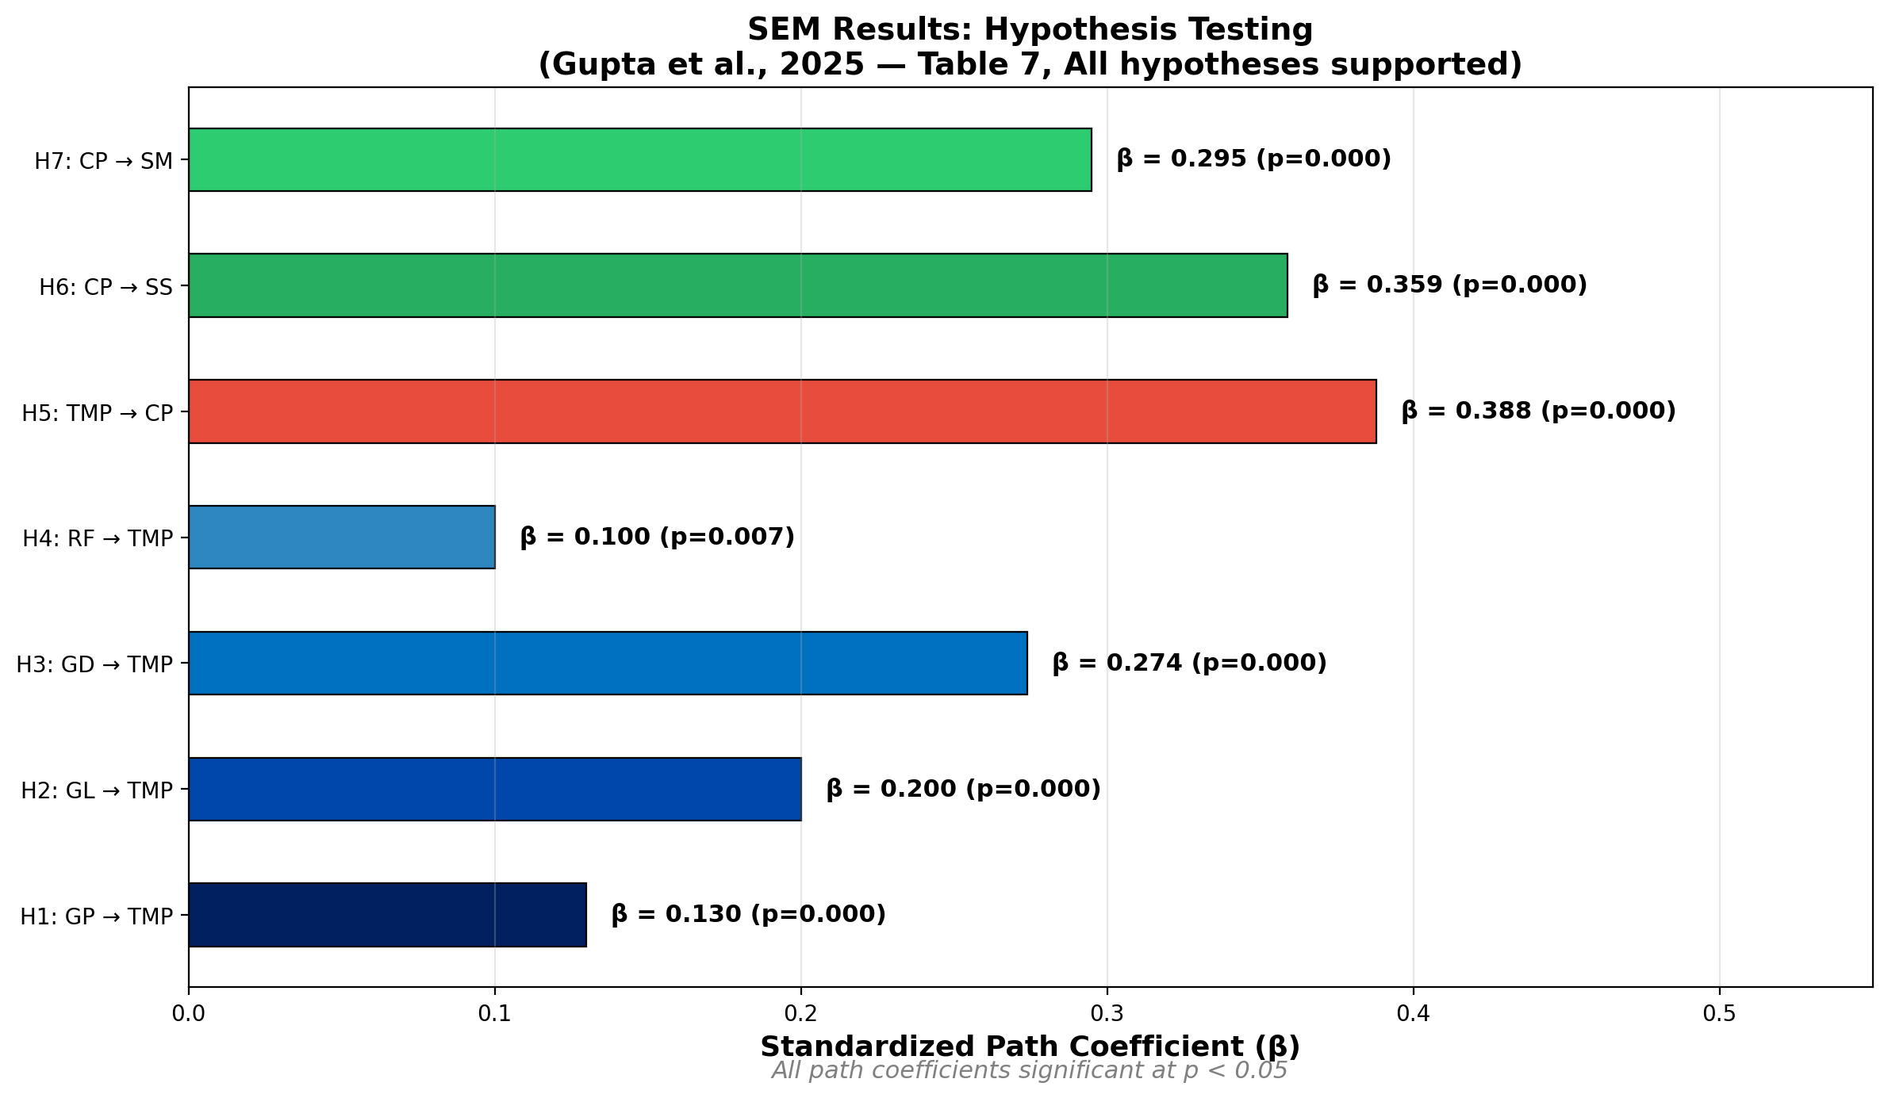
SEM Results: Path Coefficients
Table 7: All 7 Hypotheses Supported (p < 0.05)

Slide 19
SEM Hypothesis Testing: Complete Results
Table 7: Path Coefficients, Standard Errors, and R²
Path | β | SE | p-value | R² | Result
GP → TMP | 0.130 | 0.038 | 0.000 | 20.7% | Supported
GL → TMP | 0.200 | 0.046 | 0.000 | — | Supported
GD → TMP | 0.274 | 0.044 | 0.000 | — | Supported
RF → TMP | 0.100 | 0.037 | 0.007 | — | Supported
TMP → CP | 0.388 | 0.036 | 0.000 | 19.5% | Supported
CP → SS | 0.359 | 0.032 | 0.000 | 16.1% | Supported
CP → SM | 0.295 | 0.037 | 0.000 | 14.7% | Supported

Slide 20
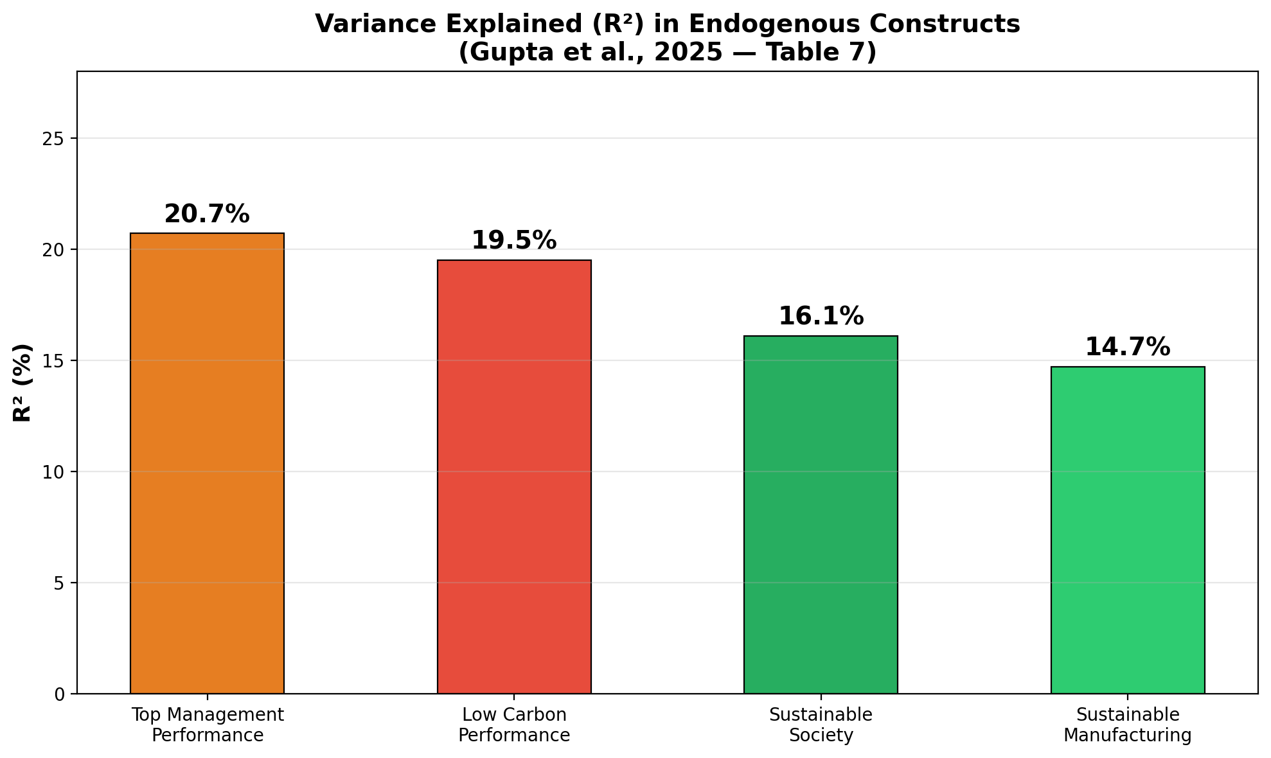
Variance Explained (R²) in Outcome Variables
Table 7: Predictive Power of the SEM Model

Slide 21
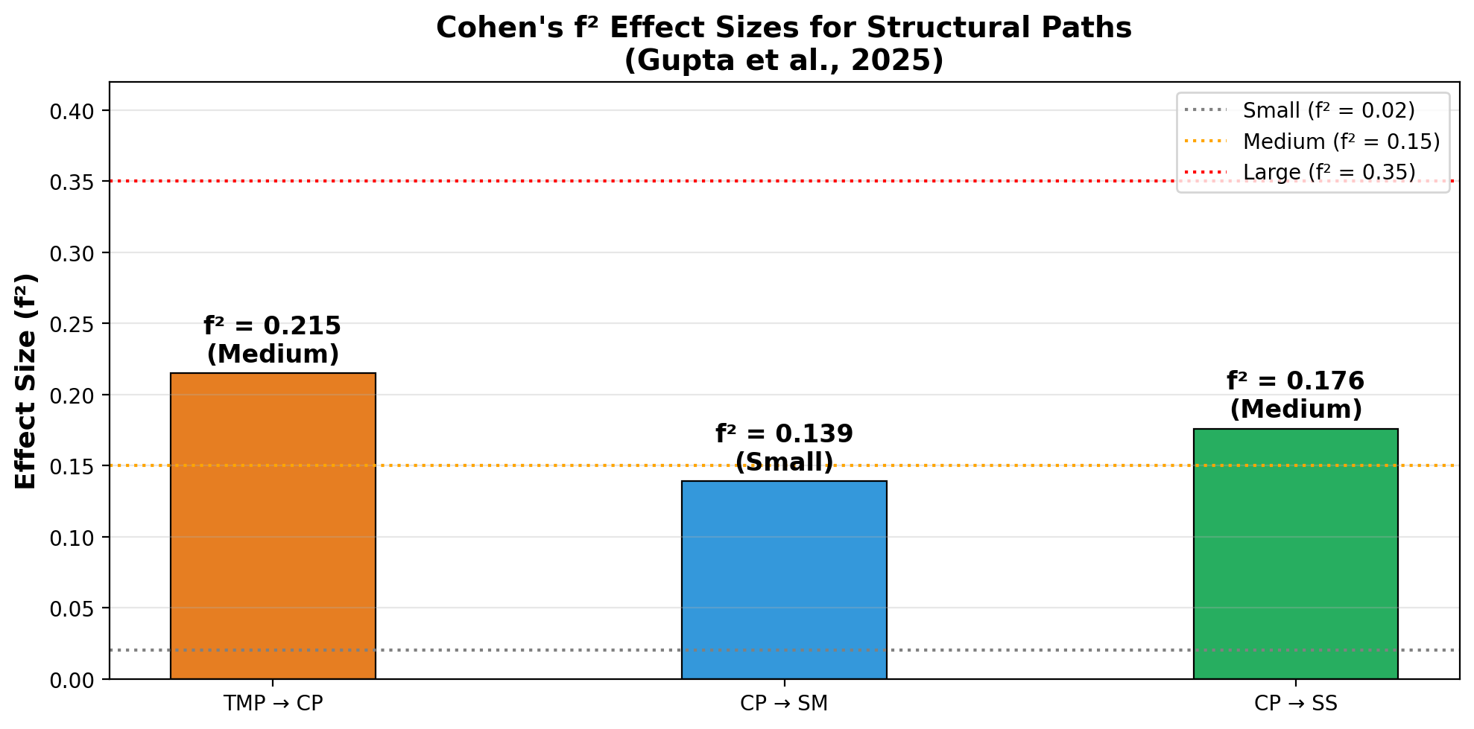
Effect Size Analysis: Cohen's f²
Practical Significance of Structural Relationships

Slide 22
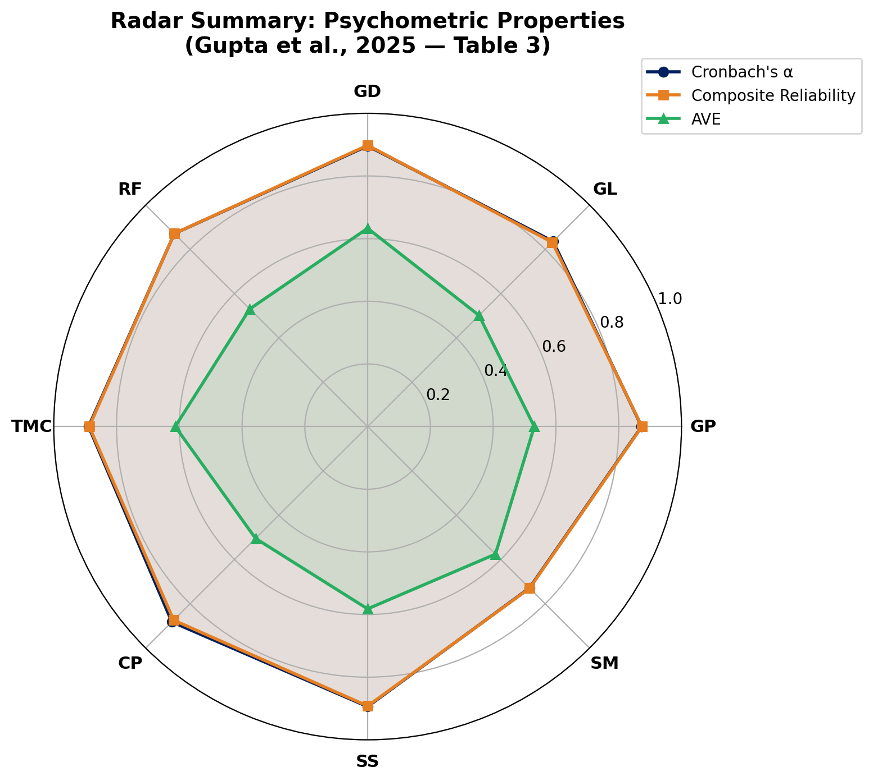
Psychometric Properties: Radar Summary
Table 3: α, CR, and AVE Across All Constructs

Slide 23
Key Findings: GSCM Practice Effects
Which Green Practices Matter Most?
Ranking of GSCM Practices on Top Management Performance:
1. Green Product & Design (β = 0.274) — Strongest influence
Product innovation and eco-design drive leadership commitment
2. Green Logistics (β = 0.200) — Second strongest
Efficient transportation and distribution practices matter
3. Green Procurement (β = 0.130) — Moderate influence
Sustainable supplier selection contributes to performance
4. Regulatory Framework (β = 0.100) — Significant but smallest
Government regulations play a supporting role (p = 0.007)

Slide 24
Key Findings: Sustainability Outcomes
Cascading Effects from Management to Society
Cascading Impact Chain:
GSCM Practices → Top Management Performance (R² = 20.7%)
Top Management → Low Carbon Performance (β = 0.388, medium effect)
Low Carbon → Sustainable Society (β = 0.359, medium effect)
Low Carbon → Sustainable Manufacturing (β = 0.295, small effect)
Critical Insight:
Top management commitment is the key mediator between
green supply chain practices and environmental outcomes
Organizations with strong senior leadership support are more
likely to achieve carbon reduction and sustainability goals

Slide 25
Practical Implications
Actionable Insights for Manufacturing Firms
For Manufacturing Organizations:
Prioritize green product design and eco-innovation initiatives
Invest in green logistics to reduce environmental footprint
Develop sustainable procurement policies with green suppliers
For Policymakers:
Regulatory frameworks support GSCM adoption (β = 0.100, p = 0.007)
Subsidies and green labels facilitate smoother green product rollout
For Researchers:
41-item instrument with 8 constructs shows acceptable-to-good reliability
SmartPLS SEM effectively models complex GSCM relationships

Slide 26
Limitations & Future Research
Opportunities for Further Investigation
Study Limitations:
Single industry focus (bag manufacturing) limits generalizability
Cross-sectional design; longitudinal studies would capture trends
Self-reported data from managers may introduce response bias
Indian context may not generalize to other economies
Future Research Directions:
Extend to other manufacturing sectors (automotive, electronics)
Include financial performance as an additional outcome variable
Conduct multi-country comparative studies on GSCM adoption
Explore moderating effects of firm size and industry type

Slide 27
References
Primary Study:
1. Gupta, P., Sharma, Y., Chauhan, A., Parewa, B., Rai, P. & Naik, N. (2025).
"Investigation of green supply chain management practices and sustainability
in Indian manufacturing enterprises using a structural equation modelling approach."
Scientific Reports, 15, 14909. DOI: 10.1038/s41598-025-95940-9
Supporting References:
2. Hair, J.F., Black, W.C., Babin, B.J. & Anderson, R.E. (2019).
Multivariate Data Analysis (8th Ed.). Cengage Learning.
3. Kaiser, H.F. (1974). "An Index of Factorial Simplicity."
Psychometrika, 39, 31–36.

