Slide 1
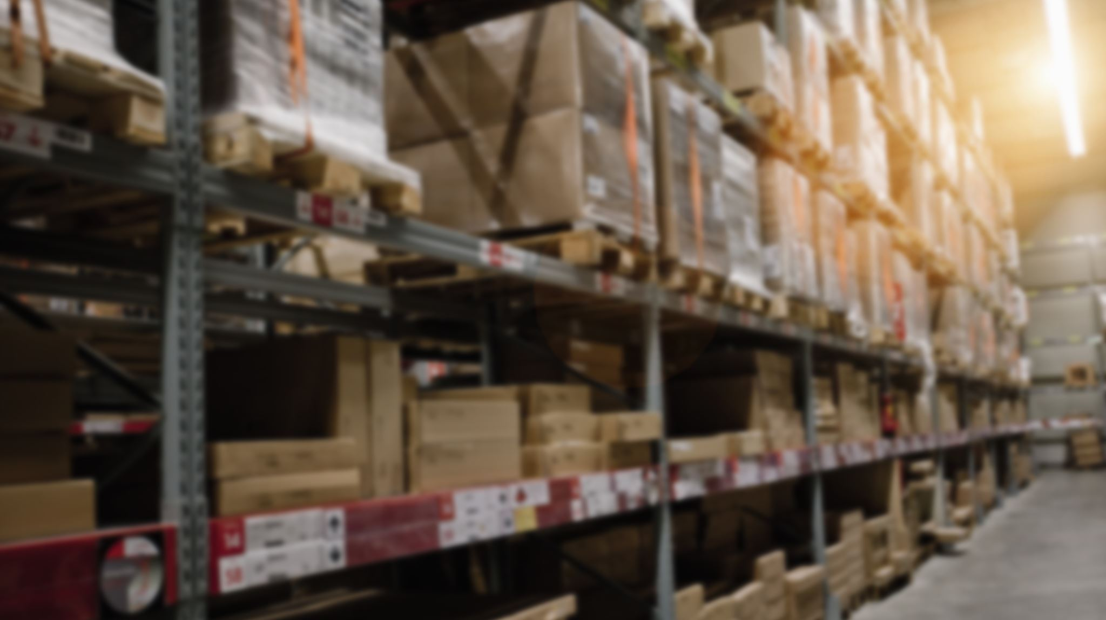
Inventory Management System
Secure, Simple and easy to use

Slide 2

Introduction
Streamlined management system
Secured with hashed password
Role based authorization
Simple and intuitive UI

Slide 3

Objectives
To explore different features of C++ programming language,
To apply the concepts of ObjectOriented Programming in practical application,
To implement external libraries for UI,
To understand the dynamics of working in a group,
To be familiar with git and Github for collaborating on a project in a team,
To solve a real-world problem.

Slide 4

Authentication and Password Hashing
Password Hashing
Password hashed using bcrypt library
Bcrypt library uses blowfish algorithm to hash password

Slide 5
Authorization
Admin
Buyer
Seller

Slide 6
User Interface
Simple and easy to use
Different views according to the roles
Excel like spreadsheet to view the items
Order form to take orders from buyers
Supply form to take supply offer from the suppliers

Slide 7
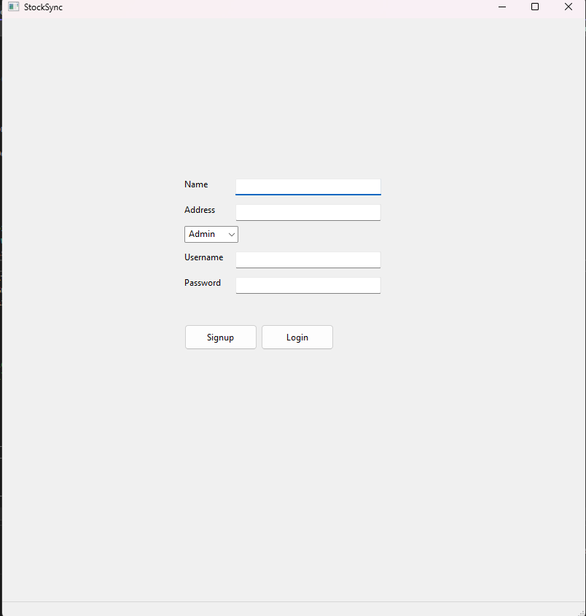
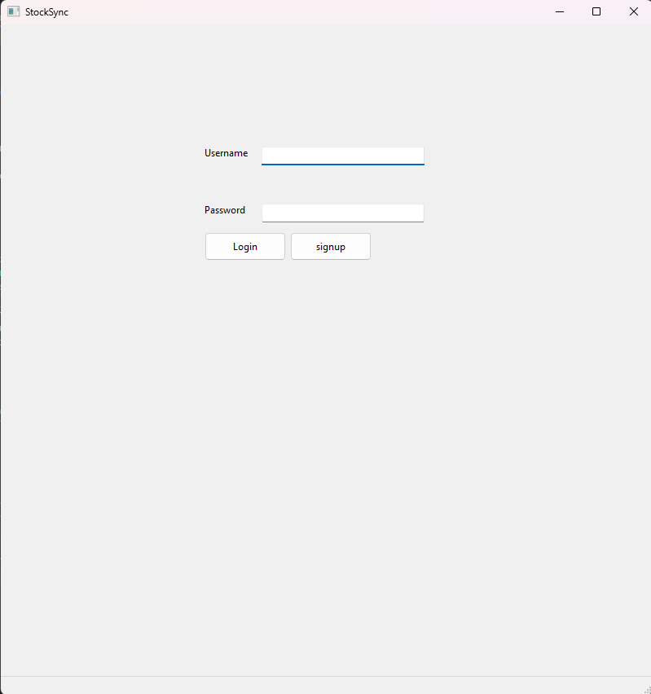
LOGIN Window

Slide 8
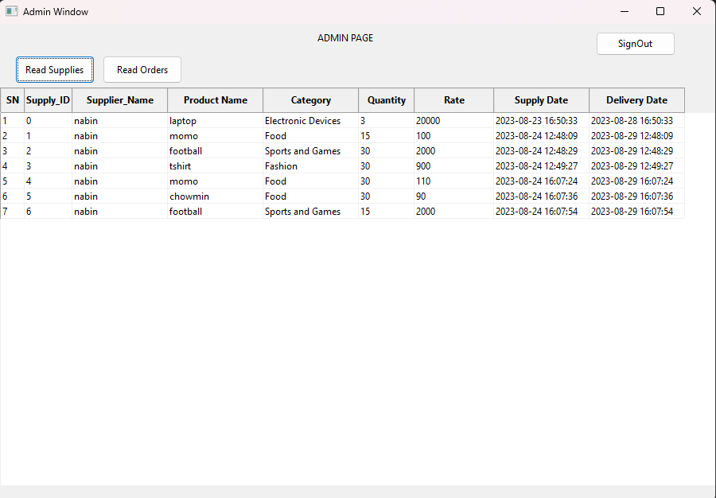

Slide 9
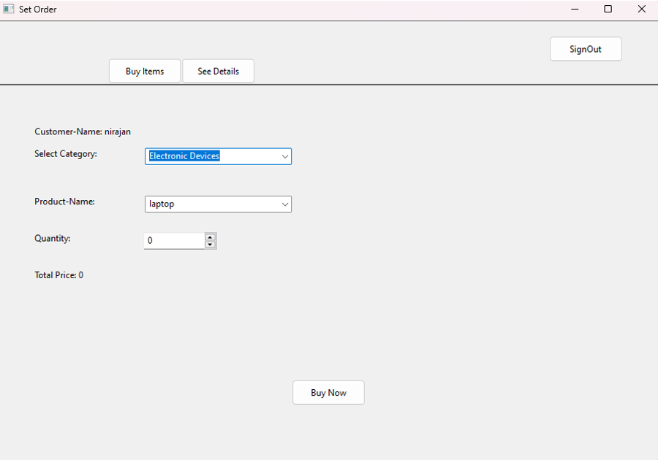
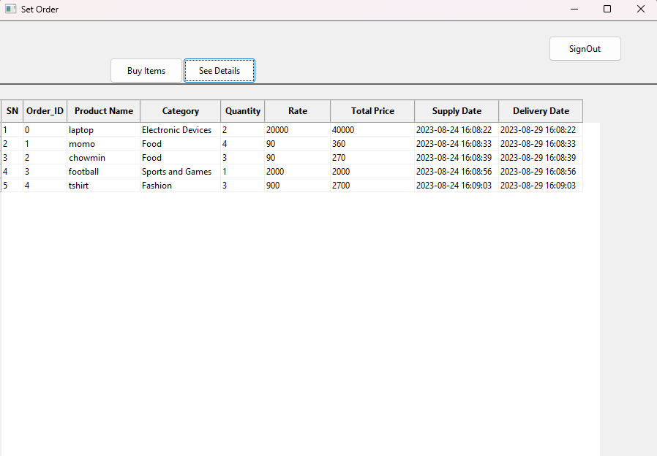
Client Window

Slide 10
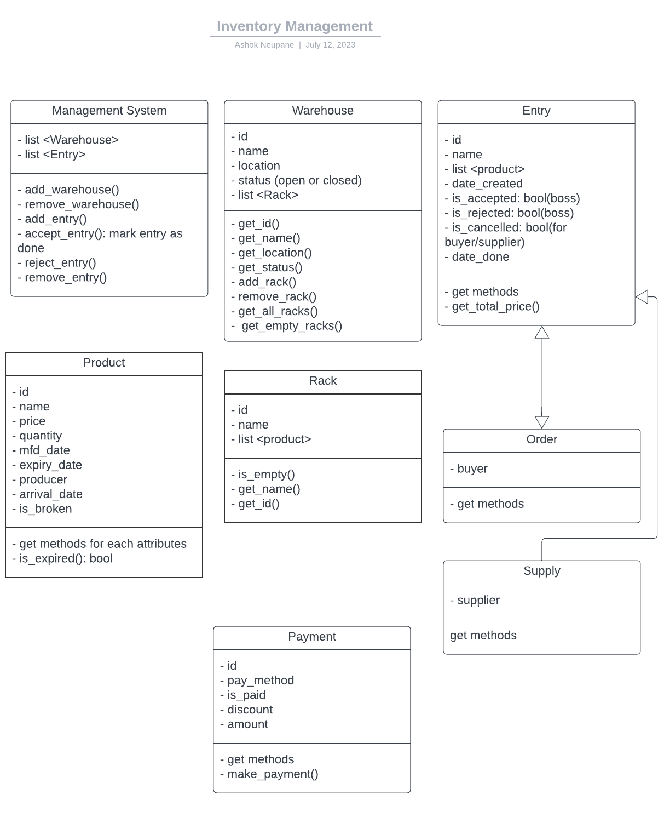
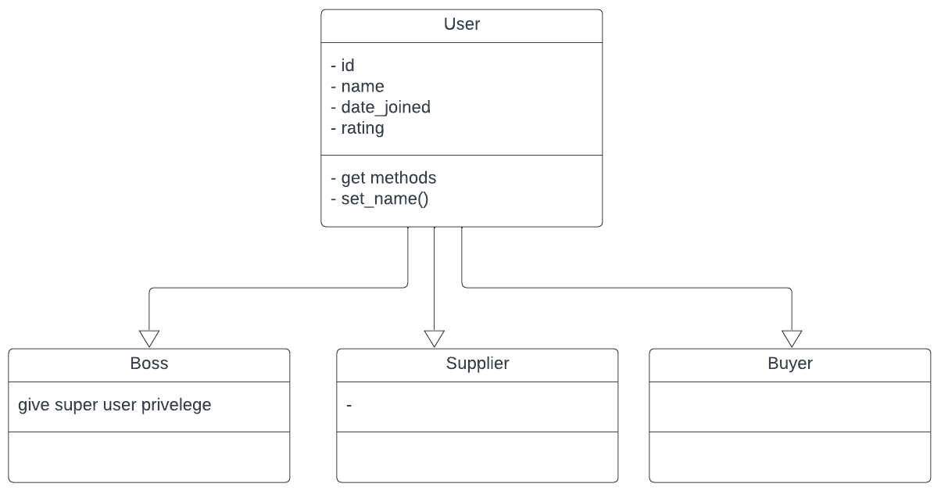
Block daigram
BLOCK DIAGRAM

Slide 11
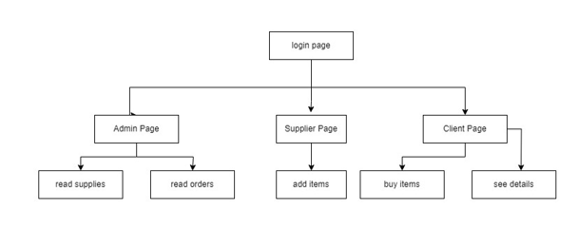
APPLICATION BLOCK DIAGRAM

Slide 12
The program is broken down into:
Order management system
Supply management system
Warehouse managements system

Slide 13
File I/O
All entities are save as objects of classes
To avoid the possible errors while reading object from file: first the size of the string is saved and then the actual string is stored
Reinterpret_cast is used to convert the c++ strings to array of characters

Slide 14

Significance
Efficient Operations & Time Savings​
Robust Data Security & Privacy​
Customized Access Control for Different Roles​
Enhanced User Experience & Adoption​

Slide 15
Future Enhancements
Billing
Cart
Expandability
User Friendly Interface
Recommendation of Products

Slide 16

What we learned?
C++ Language Fundamentals
OOP Principles: Encapsulation, Inheritance, Polymorphism
Classes, Objects, Abstraction
Exception Handling
Operator Overloading
Practical Project Experience

Slide 17
OOP design
Password encryption
Third party libraries
Collaboration with friends
The world of Inventory management system

Slide 18

Any Queries??

