Slide 1

A BLOCKCHAIN MONEY TRANSFER AND PAYMENTS SYSTEM

Slide 2

A Network By:

Slide 3
Table of contents
PROBLEM
01
INTRODUCTION
02
03
04
KEY FEATURES
SOLUTION

Slide 4
BENEFITS
DAY-TO-DAY USE
04
05
VALUE PROPOSITION
CALL TO ACTION
06
04

Slide 5
01. INTRODUCTION

Slide 6
What is ShamwariPay?
ShamwariPay is a blockchain money wallet system built on the Munhumutapa Africa Blockchain that offers a range of financial services, including cross-border payments, remittances, banking services and digital wallets.
The system aims to simplify and streamline financial transactions across Africa, making it easier for individuals and businesses to pay for goods and services as well as send, receive, and manage money.

Slide 7
Digital banking worldwide
Recently
Expansion
Actually in use

Slide 8
02. PROBLEM STATEMENT

Slide 9
Expensive, Inefficient Banking Systems
High Transaction Fees
Limited Accessibility
Slow Transaction Processing

Slide 10


Slide 11
03. OUR SOLUTION

Slide 12
A Blockchain-hosted Payments System
ShamwariPay
Server 1
Server 2
Server 3
Network User
Corporate Network User
Network Service Probiders

Slide 13
Advantages Vs Banking Systems
Cheap
Fast
Accessible
Faster Transaction Processing
Cheaper Transactions
Self-service & Customisation

Slide 14
FLEXIBLE FEES
What Makes Us Cheaper?
Users are not forced to pay set fees but instead offer the fees they are willing to pay for their submitted transaction which depends on the market.

Slide 15
Transaction
Batching
Because transactions on ShamwariPay are batched before processing, the cost of service is shared between the initiators of each included transaction and thus the final fees paid by each account is ultimately a fraction of the cost of an alternative system.

Slide 16
1 - 100
1000
Transaction
Processing
Up to 100 transactions can be included in a single batch
Transactions Per Second Throughput

Slide 17
04. FEATURES

Slide 18
Accounts
Transactions
Online
User accounts are secured by a passphrase and private key
All transactions are verified, validated by the network making them highly secure
Because of the underlying distributed network, uptime is as reliable as can be.

Slide 19
Messaging Service
Encrypted Billing
Phased Transactions
Distributed Applications
Voting System
Public API
Customers can send and receive messages which can be either encrypted or plain.
Customers can create Blockchain bills which can be used by the receiver as a transaction template
These are transactions executed depending on the outcome of a vote conducted on the Blockchain
These are hard-coded smart contracts on the Blockchain e g.
Digital Asset System
Digital Certificate
Accounts have access to a decentralized polling system
Customers can create custom applications for use by their organizations or customers

Slide 20
05. KEY BENEFITS

Slide 21
Cheap
Easy-to-use
Secure
Transparent
Fast

Slide 22
06. SERVICES

Slide 23


Slide 24
International Transfers
Since Munhumutapa blockchain is a multi-chain, each market country will have its own chain on which users from that particular country use to transact on ShamwariPay.
So in essence, one user can send money from one country, to a recipient in another but the recipient will only be able to transact with the received funds if they are registered to ShamwariPay in their own country.
Registration thus plays a key role for users of the platform.

Slide 25
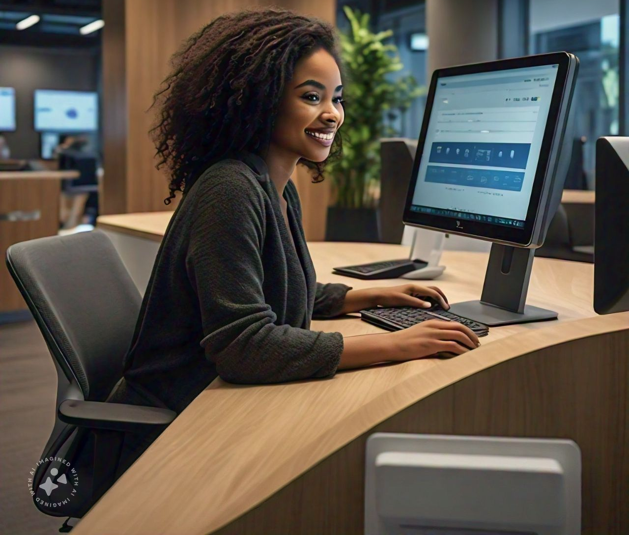

Slide 26
Peer-To-Peer Transfers
Users can send money to each other from anywhere to anyone with funds immediately available for the recipient's use.
Transfers also include cross-border send-home money transfers including to remote areas under-served by existing financial institutions.

Slide 27


Slide 28
Payments
Both individuals and organizations can use ShamwariPay to pay and receive payments for goods and services bills. By accepting bill settlement through the ShamwariPay system, businesses can increase online sales volumes and revenues all of which are facilitated by the system.

Slide 29


Slide 30
Munhumutapa Account Services
Money Transfers
Currency Exchange
Bill And Order Payments
Customer can send and receive money from other customers
Customers can pay or receive payments for goods and services from other customers.
Customers can access a p-2-p currency exchange system.

Slide 31
Transaction Tracking
Account Control
De-fi Services
Customers can access account transaction history, pending transactions and account balances.
Customers can create multi-signatory and approval-based account controls.
Customers can create self-service applications that can execute transactions autonomously

Slide 32
07. VALUE PROPOSITION

Slide 33
Unlocking Value
Secure, cost-effective and flexible payment processing.
Streamlined transactions for businesses
Enhanced security and control for organizations.
Accessible and convenient money management and use for individuals

Slide 34
08. CALL TO ACTION

Slide 35
Get Started With ShamwariPay
Individual
Financial Institution
Commercial
Integrate ShamwariPay with your sales department and enjoy revolutionary digital payments services.
Use ShamwariPay for your payments and transfers and have that extra cash to spend on your day-to-day needs.
Partner with us to provide your customers and clients with a cheaper and faster gateway to their financial management.

Slide 36
Thanks!
Website: munhumutapaalpha.js.org
Email: munhumutapaalpha@outlook.com
Please keep this slide for attribution

Slide 37


Slide 38


