Slide 1
Crop Disease Predictor
Team Id : 4078
College Name : ITM Universe
Team Leader : Aditya Gujjar
Members : Akash Prajapati
Madhvesh Patel

Slide 2
AGENDA
Project overview
Problem statement
Solution
Uniqueness
The crux part
Modelling of project
End users
Wow factor in solution (Uniqueness)
Observations, results and conclusion

Slide 3
PROJECT OVERVIEW
Problem Statement
Solution
Uniqueness
Project Keywords: Plant Disease Detection, Deep Learning, Convolution Neural Network, Python.

Slide 4
PROBLEM STATEMENT
Plant diseases have turned into a dilemma as it can cause significant reduction in both quality and quantity of agricultural products.
Agriculture is an integral part of the Indian economy. The Indian agriculture sector employs nearly half of the country's workforce.
Farmers' economic growth is determined by the quality of the goods they make, which is dependent on plant growth and yield.
As result automated detection of plant diseases is an essential research topic to work on as it may prove benefits in monitoring large fields of crops, and thus automatically detect the symptoms of diseases as soon as they appear on plant leaves.
Reference : https://pure-good-heroes.fandom.com/wiki/WALL-E

Slide 5
SOLUTION
This project is focused on the identification of plant diseases.
Different classification techniques are used to detect plant diseases.
Photos of leaves from various plants are taken with a digital camera or similar unit, and the images are used to classify the affected region in the leaves.
To detect plant disease, we use a Convolution Neural Network (CNN) in the proposed framework.

Slide 6
Uniqueness
Easy to use, efficient and low cost at the same time.
As this project is machine learning and deep learning based, therefore we can use all its related libraries in this project and that will make it more robust.
Since this project is easy to use and adaptable, therefore we can add more functionalities as the project progresses.
In our project with detection of diseases, it can also give remedies like which pesticides and insecticides to use for that specific disease.

Slide 7
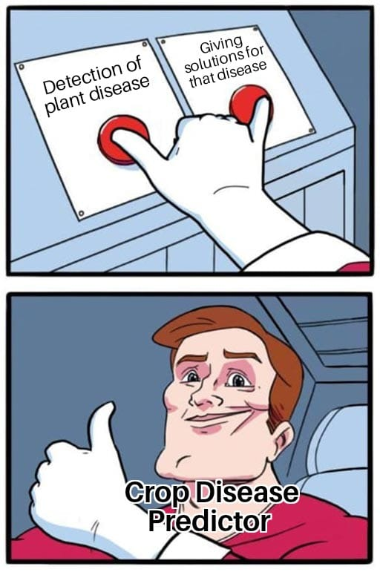

Slide 8
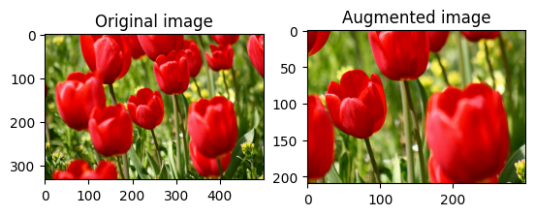
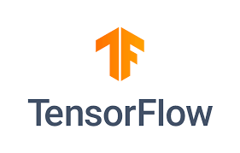

MODELLING
List of modules
Keras
TensorFlow
CNN (convolution neural network)
Image augmentation
Image pre-processing
Adam (optimization algorithm)

Slide 9
Keras
Keras is a high-level, deep learning API developed by Google for implementing neural networks.
It is written in Python and is used to make the implementation of neural networks easy. It also supports multiple backend neural network computation.
Keras has features such as :
It runs smoothly on both CPU and GPU.
It supports almost all neural network models.

Slide 10
TensorFlow
TensorFlow is an open-source library developed by Google primarily for deep learning applications. It also supports traditional machine learning.
TensorFlow was originally developed for large numerical computations without keeping deep learning in mind. However, it proved to be very useful for deep learning development as well.
TensorFlow accepts data in the form of multi-dimensional arrays of higher dimensions called tensors.
Multi-dimensional arrays are very handy in handling large amounts of data.

Slide 11
CNN (convolution neural network)
A Convolutional Neural Network (CNN) is a type of Deep Learning architecture commonly used for image classification and recognition tasks.
Convolutional neural networks are distinguished from other neural networks by their superior performance with image, speech, or audio signal inputs. They have three main types of layers, which are:
Convolutional layer
Pooling layer
Fully-connected (FC) layer

Slide 12
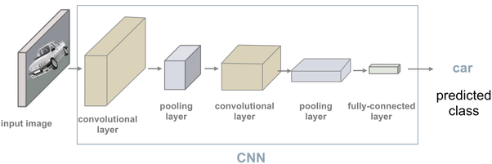
CNN (convolution neural network)
With each layer, the CNN increases in its complexity, identifying greater portions of the image.
Earlier layers focus on simple features, such as colors and edges.
As the image data progresses through the layers of the CNN, it starts to recognize larger elements or shapes of the object until it finally identifies the intended object.

Slide 13
Image Augmentation
Image augmentation is a technique of applying different transformations to original images which results in multiple transformed copies of the same image.
Each copy, however, is different from the other in certain aspects depending on the augmentation techniques you apply like shifting, rotating, flipping, etc.
These image augmentation techniques not only expand the size of your dataset but also incorporate a level of variation in the dataset which allows your model to generalize better on unseen data.
Also, the model becomes more robust when it is trained on new, slightly altered images.

Slide 14
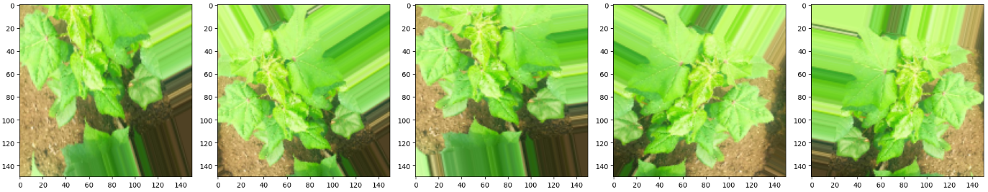
Image Augmentation

Slide 15
Image Pre-processing
The use of computer algorithms to perform image processing on digital images is known as image pre-processing.
We can detect the plant by analyzing the image with a specific algorithm.
We use a similar approach for image processing and detection with a specific algorithm.
The image quality is critical in this process; we can't use the algorithm if the image isn't clear.

Slide 16
Adam (optimization algorithm)
Adam is an optimization algorithm that can be used instead of the classical stochastic gradient descent procedure to update network weights iterative based in training data.
The algorithm is called Adam. It is not an acronym and is not written as “ADAM”. The name Adam is derived from Adaptive Moment Estimation.
The attractive benefits of using Adam are as follows:
Straightforward to implement.
Computationally efficient.
Little memory requirements.

Slide 17
WHO ARE THE END USERS?
End users are as follows:
Farmers
Gardener
Government agriculture department
Researchers

Slide 18
THE WOW FACTOR IN OUR SOLUTION
There are multiple wow factors in our project and those are as follows:
This project helps to detect disease at an early stage.
It is machine learning and deep learning based project and efficient enough to predict plant disease on its own.
Cost effective, time saving and easily scalable at the same time.

Slide 19
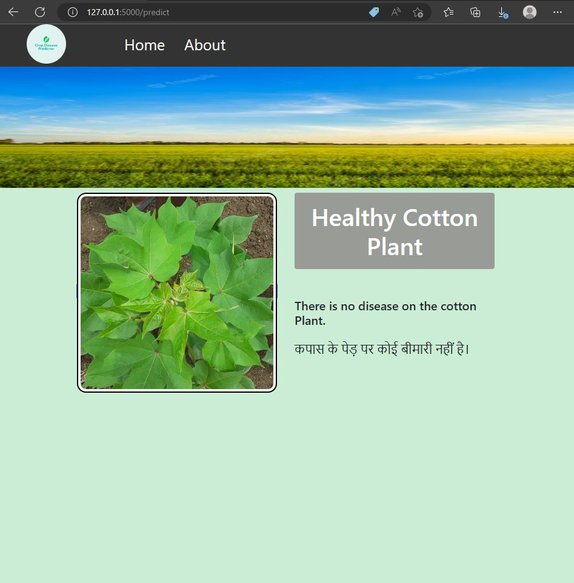
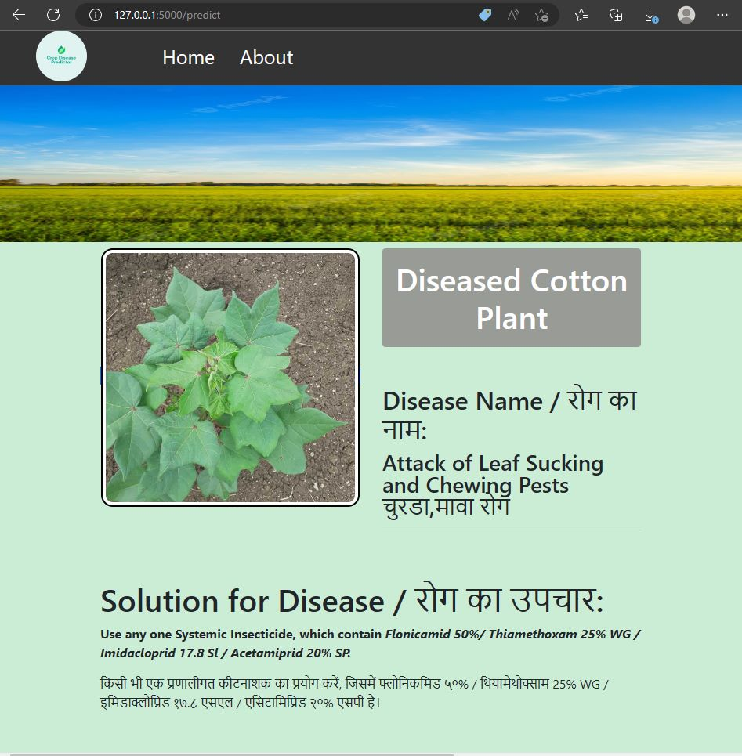
RESULTS
GitHub Link

Slide 20
CONCLUSION
With the help of the proposed system one can track the cultivated field on a regular basis.
The CNN and other related algorithms are used to identify crop diseases at an early stage.
Machine learning methods are used to train the model, which aids in making appropriate disease decisions.
To contain infected diseases, the farmer is advised to use pesticides as a cure. In the future, the proposed scheme could be expanded to provide additional facilities such as nearby government markets, pesticide price lists, and a nearby open market, among others.

Slide 21
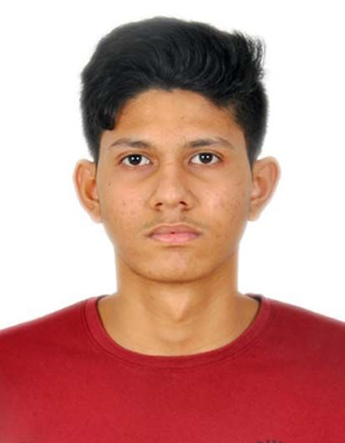


MEET OUR TEAM
Madhvesh Patel
Aditya Gujjar
Akash Prajapati

Slide 22
Thanks!!

