Slide 1
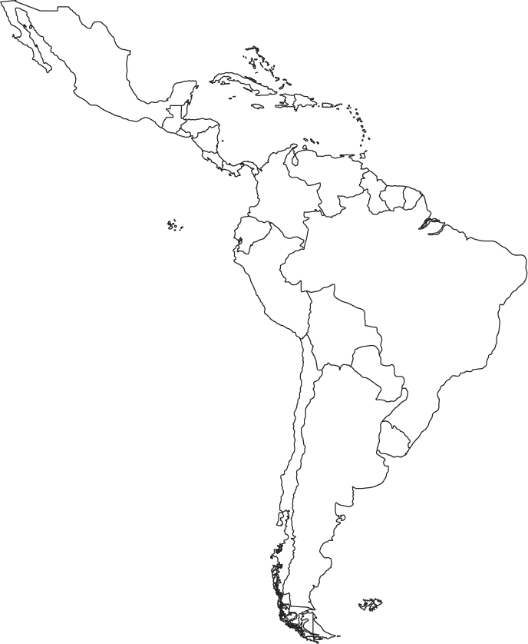
Conserving Nature for Water Security: Prioritizing Cities in Latin America
FLOOD MITI
REGIONAL MAP
CITY POPULATION
_____________________ People
SOURCE WATERSHEDS: QUANTITY & QUALITY
Urban water sources
[however you decide to do the groundwater/surface/other metrics]
Water quantity risk metrics
_____________________ Annual Water Stress
_____________________ Seasonal Water Stress
Water quality risk metrics
_____________________ Annual Phosphorous Yield
_____________________ Annual Sediment Yield
Water quality opportunity metrics
_____________________ Return on Investment
_____________________ Forest Protection: Phosphorous
_____________________ Forest Protection: Sediment
_____________________ Reforestation: Phosphorous
_____________________ Reforestation: Sediment
_____________________ Riparian Restoration: Phosphorous
_____________________ Riparian Restoration: Sediment
FLOOD MITIGATION
_____________________ Riverine Flood Mitigation City Ranking
_____________________ Urban Population Exposed to Riverine Flooding
_____________________ Biophysical Opportunity to Mitigate Riverine Flooding
_____________________ Stormwater Flood Mitigation City Ranking
Dropdown to display metrics like you showed me
To highlight a single city, click a dot on one of the graphs or map, or select from the dropdown below. To compare two cities, select with the dropdowns.
Highlight LACC Priority Cities
EXPLORE RISKS & OPPORTUNITIES
Select variables using dropdowns below to plot metrics for all cities.
I like the idea of dotted lines to show median, but this won’t make much sense for most of our data since they should be considered categorical results first. Any thoughts about what to do here other than just not put in any dotted lines?

