Slide 1

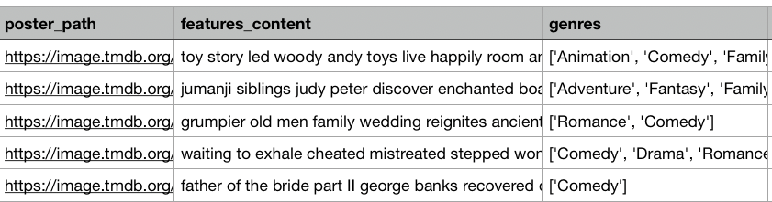
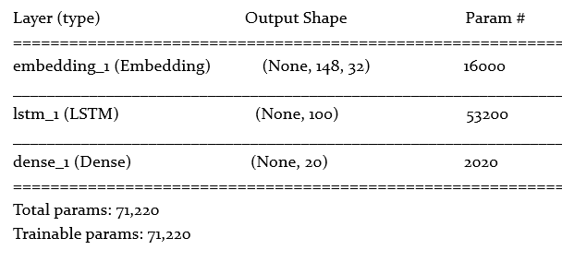
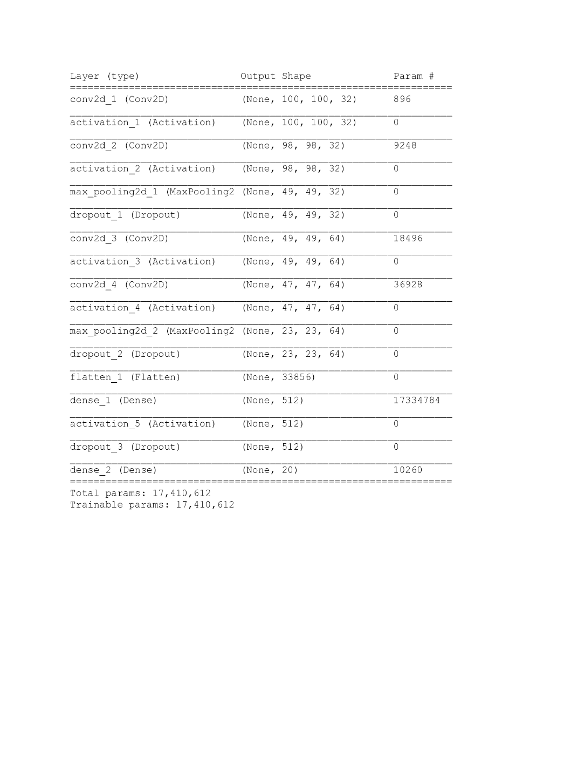

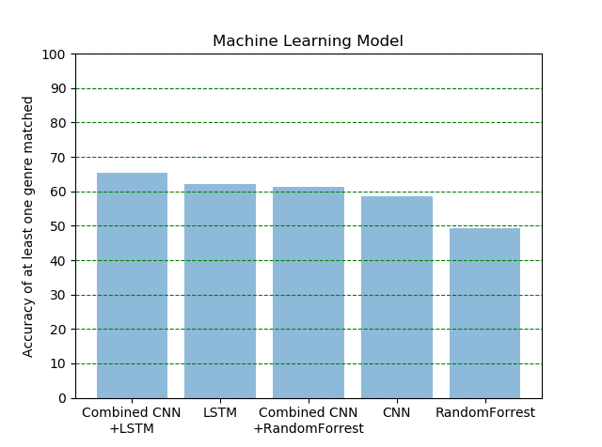
Movie Genre Classification by Its Poster and Overview
Nattapat Juthaprachakul, Siyu Wu, Rui Wang, Yihan Lan
Simon Fraser University
MOTIVATION
Sometimes, one sheet is all it takes to pique your interest in a film: a dazzling color scheme, a clever concept, an arresting image.
Poster and overview of a movie are undeniably good marketing materials that convey theme and genre to attract a wide variety of people as many as possible.
Our project attempted to train a model that could learn from movie posters and overviews to predict the movie's genres.
DATA AND FEATURES
The dataset we used is from Kaggle which consists metadata for 45000 movies
listed in the Full MovieLens Dataset (combination of GroupLens and TMDB).
The dataset file consists of 45,466 entries. Each entry include 13 features of a movie such as movie id, overview, poster, cast, crew, and etc.
The main features that we used are movie posters (500 x 700 x 3 pixels) and movie overviews .
Image features: download the original movie poster images with 700x500x3 resolution image expressed in term of RGB values and rescaled them into 100x100x3 resolution image and the genres are encoded in one-hot vector.
Text features: remove non-alphabetical characters and stop words; format all words into lower case; put title and overview into the same column.
Led by Woody, Andy's toys live happily in his room until Andy's birthday brings Buzz Lightyear onto the scene. Afraid of losing his place in Andy's heart, Woody plots against Buzz. But when circumstances separate Buzz and Woody from their owner, the duo eventually learns to put aside their differences.
Animation/
Adventure
Figure 1: A visualization of our problem with an example poster and overview
Figure 2: A sample of our features and labels
METHODS AND MODELS
Convolutional Neural Network Architecture (CNN)
Use one-hot encoding schema to represent genres.
Use CNN layers such as Maxpool and Dropout
Use the sigmoid activation function for the output layer
and ReLU activation function in other non-output layers.
Use Binary Cross Entropy for loss function and Adam for optimizer.
Random Forest
Set maximum number of trees to be 10.
Convert a cleaned sequence of words into numerical feature vectors.
Utilize Tf-idf vectorizer for text features.
Long-term Short-term Memory(LSTM)
Use LSTM models with 100 units.
Use GloVe 6B to implement the word transformation.
Use Sigmoid activation function to output the probabilities of a
movie belonging to each of 20 genres.
Use Binary Cross Entropy for loss function and Adam for optimizer.
Figure 3: LSTM model
Binary Cross Entropy Loss
Figure 4: Custom model architecture of CNN
EXPERIMENTS AND RESULTS
30000/8000/4000 train/validation/test sets;
Use Hamming loss, percentage of predicting
at least one genre, and percentage of
predicting all genres to evaluate our model.
Calculate F1, Recall, and Precision metric
to analyze which genres that our model
performed well on.
Compare performance of our models.
Combined Model: LSTM + CNN
Genre | F1 | Recall | Precision | Number
Comedy | 0.43 | 0.29 | 0.89 | 13131
Drama | 0.26 | 0.30 | 0.23 | 20176
Action | 0.18 | 0.43 | 0.11 | 6582
Animation | 0.07 | 0.45 | 0.04 | 1919
Documentary | 0.05 | 0.43 | 0.03 | 4668
Combined Model: RF + CNN
Genre | F1 | Recall | Precision | Number
Comedy | 0.40 | 0.29 | 0.64 | 13131
Drama | 0.32 | 0.29 | 0.35 | 20176
Action | 0.18 | 0.21 | 0.16 | 6582
Animation | 0.07 | 0.18 | 0.04 | 1919
Adventure | 0.05 | 0.08 | 0.04 | 3486
Models | Accuracy of at least one genre matched | Accuracy of every genre matched | Hamming loss
Combined CNN+LSTM | 65.464% | 5.364% | 0.121
LSTM | 62.188% | 3.477% | 0.126
Combined CNN+Random Forest | 61.346% | 5.411% | 0.146
Custom CNN | 58.484% | 10.384% | 0.110
Random Forest | 49.407% | 4.236% | 0.146
FUTURE WORK
The dataset is relatively small and highly unbalanced. For future study, it is reasonable to train and test these models on a balanced dataset.
When combining models, we arbitrarily give a 0.5 weight to each of two models. Further study could explore the weights assigned to each model.

