Slide 1
Q-Search: Designing Neural Network Architectures using Reinforcement Learning
Author: Nattapat Juthaprachakul
MSc Computing Science
Supervisor: Professor Wayne Luk

Slide 2
Introduction
Convolutional Neural Network(CNN) architectures
Applications: image recognition/classification, speech recognition,
machine translation and etc.
Models: AlexNet, VGGNet, GoogleNet, ResNet, etc.

Slide 3
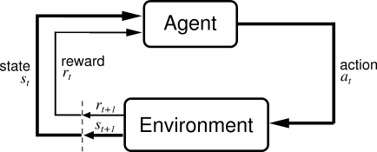
Reinforcement Learning

Slide 4
Q-Search Approach
Layer type and Number of Layer
Layer Selection Procedure
Q-Learning
Epsilon-Greedy(ε)
Experience Replay

Slide 5
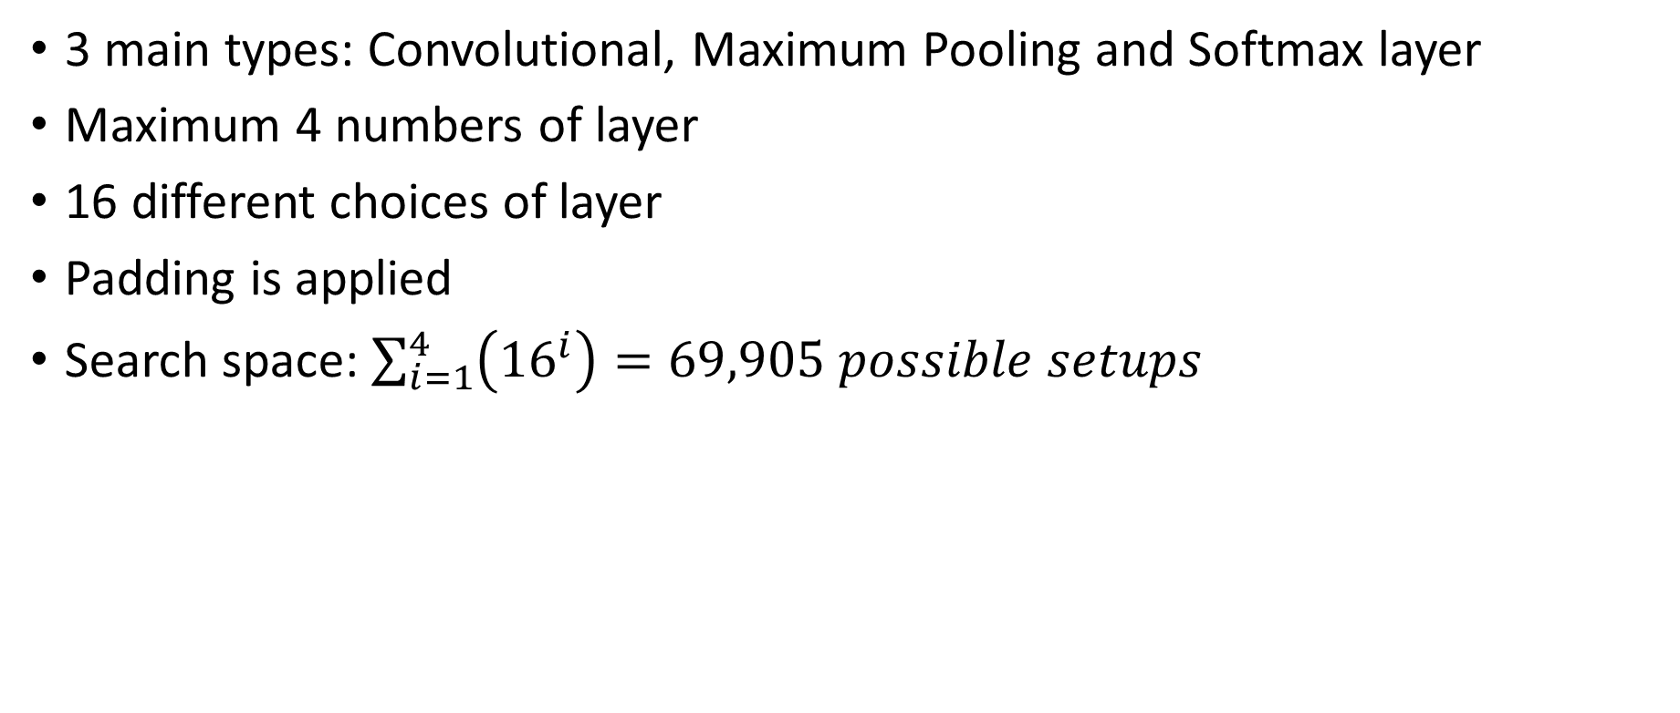
Layer Type and Number of layer
3 main types: Convolutional, Maximum Pooling and Softmax layer
Maximum 4 numbers of layer
16 different choices of layer
Padding is applied
Search space: $\sum_{i=1}^{4}{\left({16}^{i}\right)=69,905 possible setups}$

Slide 6
Layer Name | Layer Type | Filter Number | Kernel Size | Stride Number
c1 | Convolution | 32 | 3x3 | 1
c2 | Convolution | 32 | 4x4 | 1
c3 | Convolution | 32 | 5x5 | 1
c4 | Convolution | 36 | 3x3 | 1
c5 | Convolution | 36 | 4x4 | 1
c6 | Convolution | 36 | 5x5 | 1
c7 | Convolution | 48 | 3x3 | 1
c8 | Convolution | 48 | 4x4 | 1
c9 | Convolution | 48 | 5x5 | 1
c10 | Convolution | 64 | 3x3 | 1
c11 | Convolution | 64 | 4x4 | 1
c12 | Convolution | 64 | 5x5 | 1
m1 | Maximum Pooling | - | 2x2 | 2
m2 | Maximum Pooling | - | 3x3 | 2
m3 | Maximum Pooling | - | 3x3 | 3
s | Softmax | - | - | -

Slide 7

Q-Learning
Model-free reinforcement learning algorithm
Q-Table
Q-learning rate(α) = 0.01
Discount factor(γ) = 1
Environment: Partially observable
State = 4 Layers
Action: 16 types of layer
Q-Table

Slide 8
Epsilon-Greedy Strategy(ε)
Random action with probability = ε
Greedy action (argmax Q(s,a)) with probability = 1 – ε
Epsilon(ε) | 1.0 | 0.9-0.7 | 0.6-0.1
Number of model trained | 1500-2500 | 500-1000 | 500-800

Slide 9
Experience Replay
Store name, topology and validation accuracy.
Ways of using Experience Replay in Q-Search
Not using Experience Replay
Sample models from Experience Replay to update Q-table every time the agent finishes train new model.
Sample models from Experience Replay to update Q-table every 100 episodes.

Slide 10
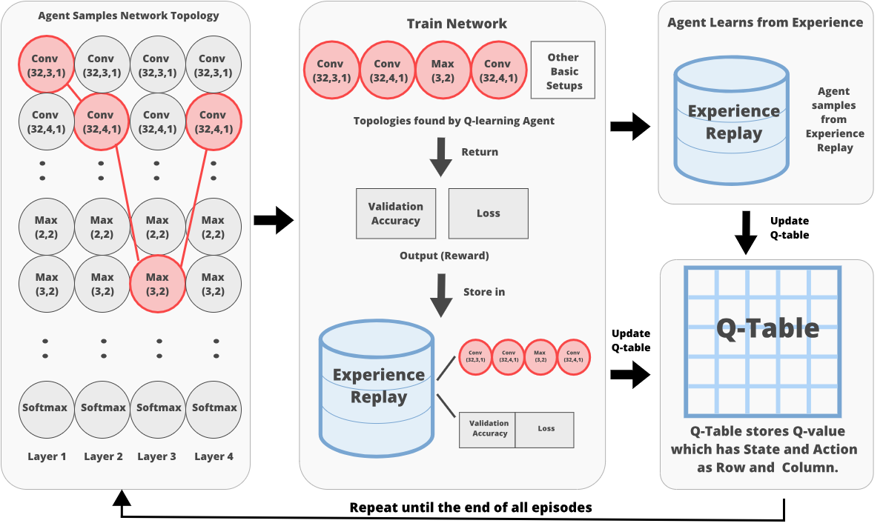

Slide 11
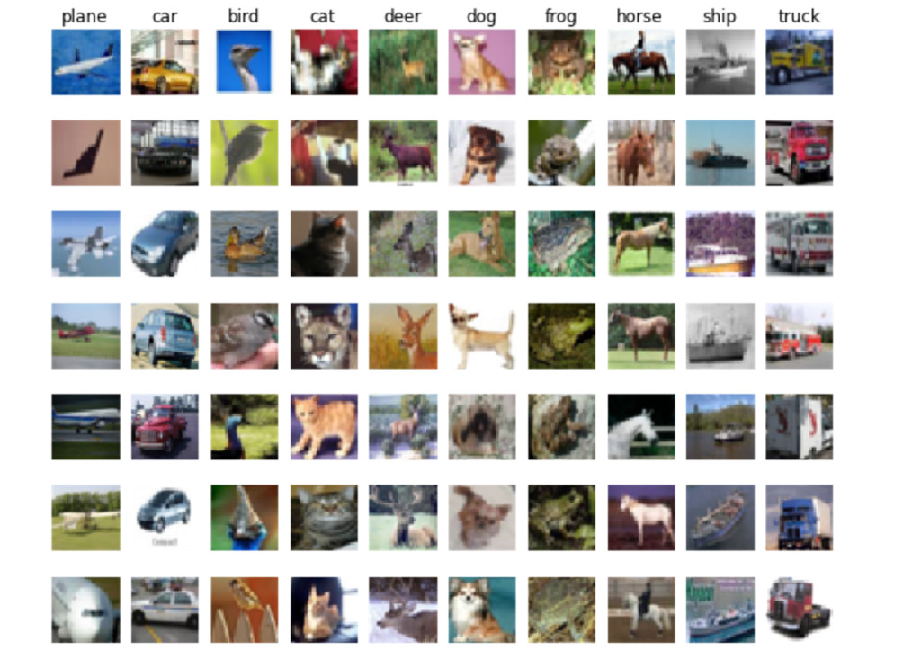
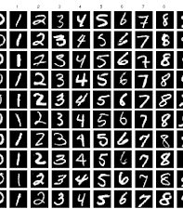
Datasets
MNIST
CIFAR-10

Slide 12
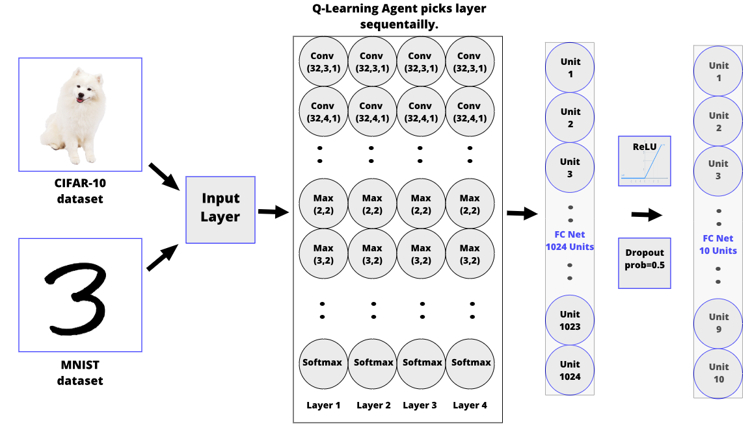

Slide 13
Q-Search: MNIST Dataset

Slide 14
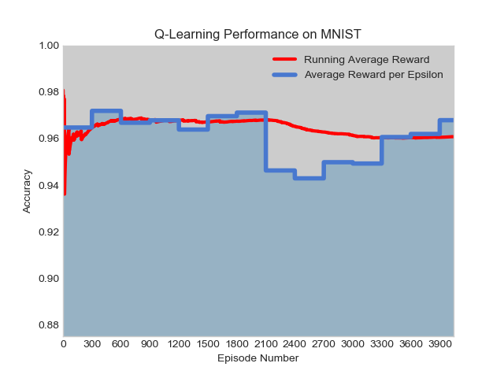
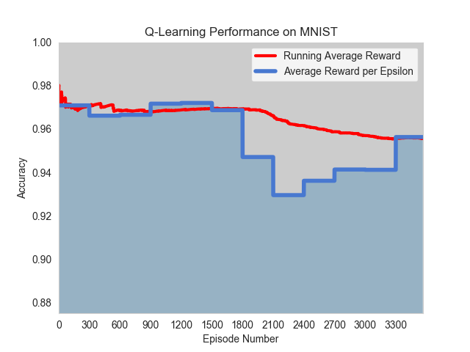
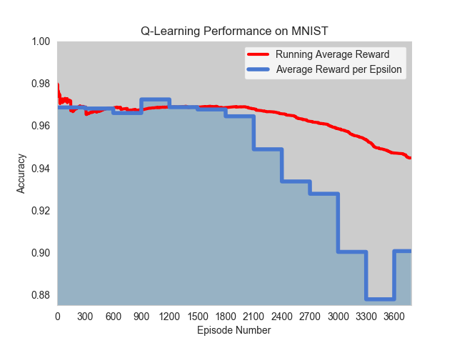
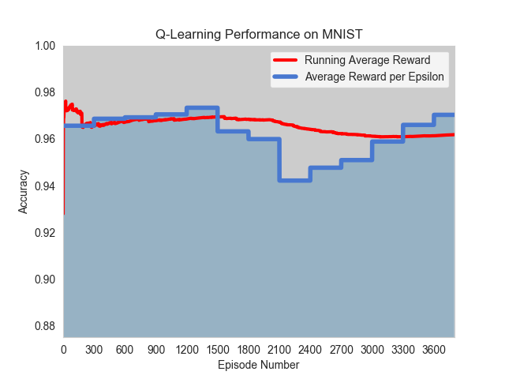
Result of Q-Search on MNIST of all experiments
Experiment No. | Total Episode | No. of model sampled to update Q-table/ Experience Replay Technique | Training Time | Best Accuracy
1 | 3800 | - | 5 days | 97.66%
2 | 3500 | 10 / After finish training new model | 5 days | 97.65%
3 | 3800 | 50 / After finish training new model | 6 days | 97.59%
4 | 3800 | 50 / Update Q-table every 100 episodes | 3 days | 97.67%
1
2
3
4

Slide 15
Q-Search: CIFAR-10 Dataset

Slide 16
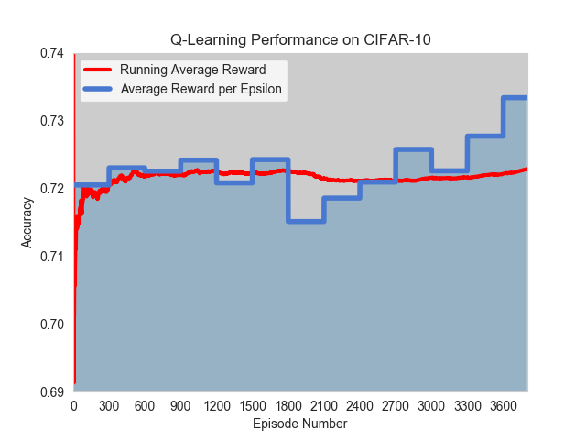
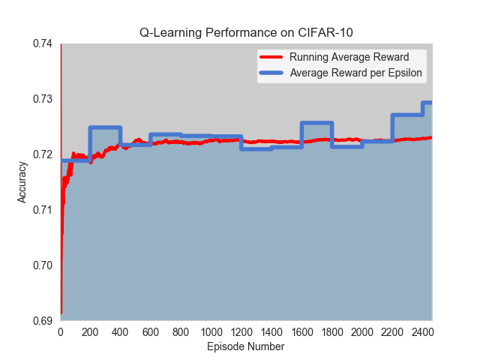
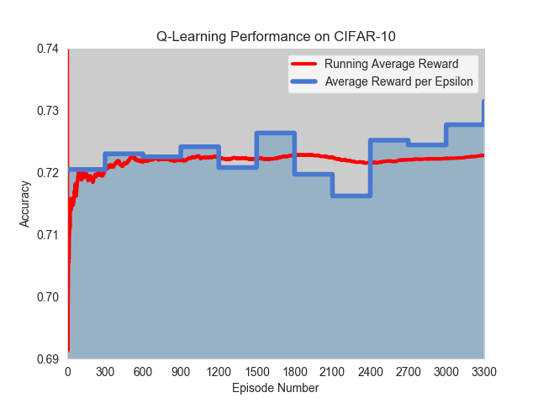
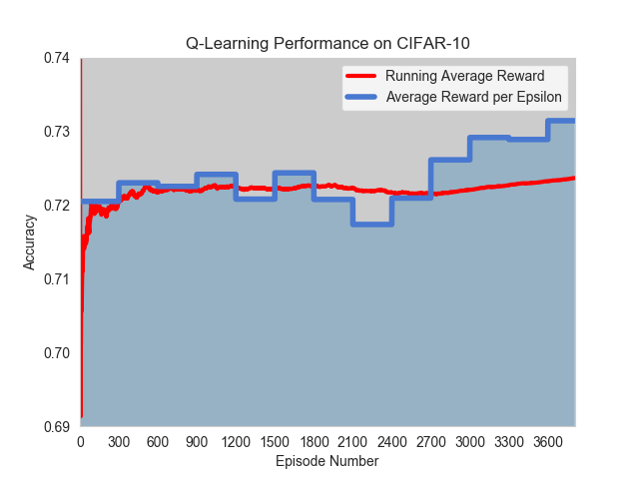
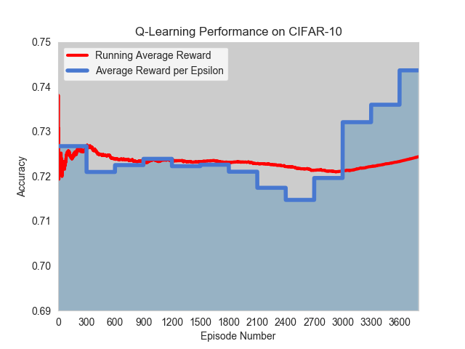
Result of Q-Search on CIFAR-10 of all experiments
Experiment No. | Total Episode | No. of model sampled to update Q-table/ Experience Replay Technique | Training Time | Best Accuracy
1 | 3600 | - | 11 days | 80.09%
2 | 2500 | 5 / After finish training new model | 8 days | 79.12%
3 | 3300 | 5 / After finish training new model | 10 days | 80.00%
4 | 3800 | 5 / After finish training new model | 11 days | 79.41%
5 | 3800 | 50 / Update Q-table every 100 episodes | 6 days | 80.17%
1
2
3
4
5

Slide 17
Conclusion
Periodic Experience Replay Update

Slide 18
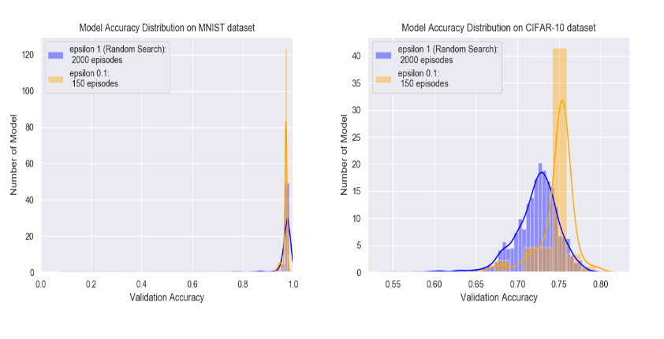
Conclusion
Algorithm / Dataset | Accuracy for MNIST | Accuracy for CIFAR-10
Random Search | 98.13% | 80.18%
Layerwise Search | 97.46% | 75.72%
Q-Search | 97.67% | 80.17%

Slide 19
Appendix

Slide 20
Experimental Setups
Random Search
Layerwise Search
Q-Search

Slide 21
Experiment 1
Epsilon | 1.0 | 0.9-0.7 | 0.6-0.1
Episode | 2000 | 1000 | 800
Total episode: 3800
Not using Experience Replay updating technique
Training time: 5 days

Slide 22
Experiment 2
Epsilon | 1.0 | 0.9-0.7 | 0.6-0.1
Episode | 2500 | 500 | 500
Total episode: 3500
Sample 10 models from Experience Replay after finish training new model to update Q-table.
Training time: 5 days

Slide 23
Experiment 3
Epsilon | 1.0 | 0.9-0.7 | 0.6-0.1
Episode | 2000 | 1000 | 800
Total episode: 3800
Sample 50 models from Experience Replay after finish training new model to update Q-table.
Training time: 6 days

Slide 24
Experiment 4
Epsilon | 1.0 | 0.9-0.7 | 0.6-0.1
Episode | 2000 | 1000 | 800
Total episode: 3800
Sample 50 models from Experience Replay every 100 episodes to update Q-table.
Training time: 3 days

Slide 25
Experiment 1
Epsilon | 1.0 | 0.9-0.7 | 0.6-0.1
Episode | 1800 | 1000 | 800
Total episode: 3600
Not using Experience Replay updating technique
Training time: 11 days

Slide 26
Experiment 2
Epsilon | 1.0 | 0.9-0.7 | 0.6-0.1
Episode | 1500 | 500 | 500
Total episode: 2500
Sample 5 models from Experience Replay after finish training new model to update Q-table.
Training time: 8 days

Slide 27
Experiment 3
Epsilon | 1.0 | 0.9-0.7 | 0.6-0.1
Episode | 2000 | 800 | 500
Total episode: 3300
Sample 5 models from Experience Replay after finish training new model to update Q-table.
Training time: 10 days

Slide 28
Experiment 4
Epsilon | 1.0 | 0.9-0.7 | 0.6-0.1
Episode | 2000 | 1000 | 800
Total episode: 3800
Sample 5 models from Experience Replay after finish training new model to update Q-table.
Training time: 11 days

Slide 29
Experiment 5
Epsilon | 1.0 | 0.9-0.7 | 0.6-0.1
Episode | 2000 | 1000 | 800
Total episode: 3800
Sample 50 models from Experience Replay every 100 episodes to update Q-table.
Training time: 6 days

