Slide 1
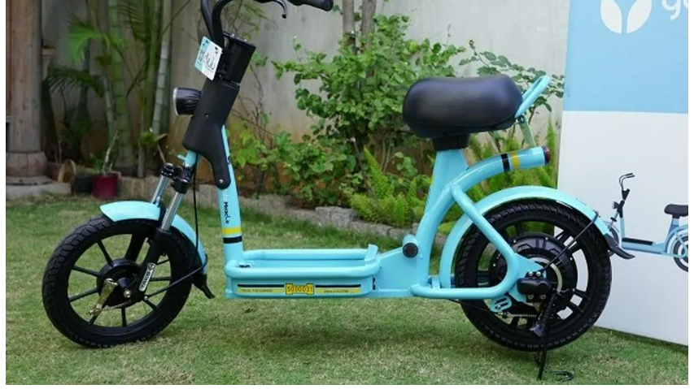
Analysis of factors that affect Yulu’s Market

Slide 2
Overview and problem statement
Yulu has recently suffered considerable dips in its revenues. We want to understand the factors affecting the demand for these shared electric cycles in the market.
The company wants to know :-
Which variables are significant in predicting the demand for shared electric cycles in the market ?
How well those variables describe the electric cycle demands ?

Slide 3
Data analyzed
Approximately 11k orders from Jan 2011 – Dec 2012
Data includes
datetime: The date and time of bike rentals
season: spring, summer, fall, winter
holiday: indicating if the day is a holiday.
Working day: indicating if the day is a working day.
weather: Describing the weather conditions.
temp: temperature in Celsius.
atemp: 'feels like' temperature in Celsius.
humidity: percentage humidity.
Windspeed
count of casual users.
count of registered users.
total count of rented bikes
Raw data available here

Slide 4
Approaches
Check Working Day has effect on number of electric cycles rented
Check No. of cycles rented similar or different in different seasons
Check No. of cycles rented similar or different in different weather

Slide 5
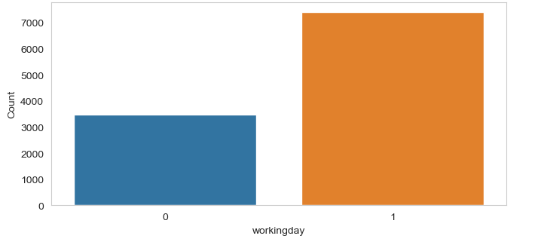
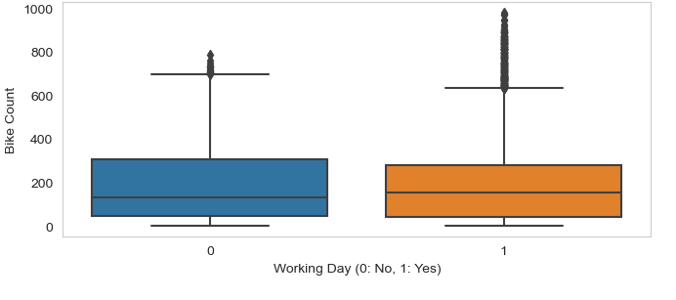
Working Day
Rented Bikes vs Working Day
Bikes Rented vs Working Day: The distribution of bike counts on working days and non-working days appears to be somewhat similar. However, there's a slightly higher median and more variability in bike counts on working days, suggesting more usage.

Slide 6
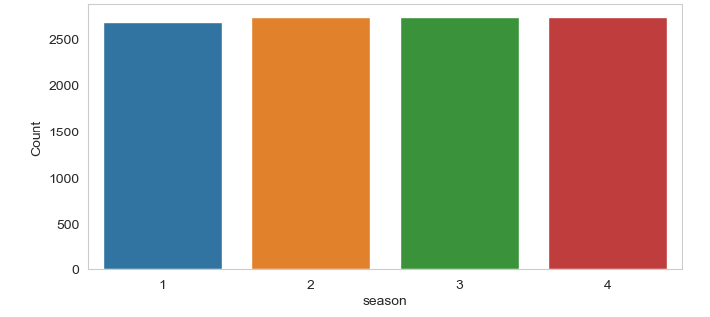
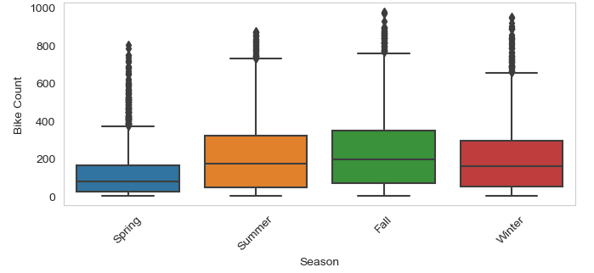
Season
Rented Bikes vs Season
Bikes Rented vs Season: There's a noticeable variation in bike counts across different seasons. The median bike count is highest in season 3 (fall), followed by summer and winter, with spring showing the lowest median count. This indicates a strong seasonal influence on bike usage.

Slide 7
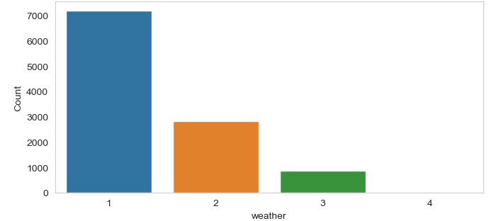
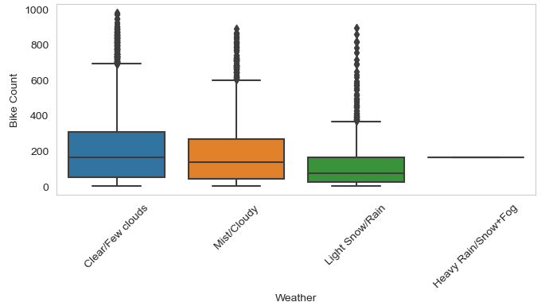
Weather
Rented Bikes vs Weather
Rented Bikes vs Weather: The bike counts vary with weather conditions. Clear and partly cloudy conditions (Weather 1) show the highest median bike usage. As the weather conditions worsen (Weather 2 and 3), the median count decreases, with the least usage observed in the most adverse weather conditions (Weather 4).

Slide 8
Final Conclusions and Recommendations:
Seasonal and Weather Considerations: Yulu should consider seasonal and weather variations in their operational and marketing strategies. For example, increasing fleet availability during favorable seasons and weather conditions could boost usage.
Focus on Working Days: While working days did not show a significant difference in rentals statistically, operational focus during these days might still be beneficial given the slightly higher usage trends.
Data-Driven Decisions: The insights from this analysis should be utilized to make data-driven decisions for resource allocation, marketing campaigns, and strategic planning.
Continuous Monitoring: Ongoing analysis of usage patterns, especially in response to changes in weather, urban infrastructure, and customer preferences, is recommended.

Slide 9
Questions?
This provided valuable insights into the factors affecting bike-sharing demand. The application of various statistical tools and EDA techniques has helped in understanding the complex interplay of factors like weather, season, and day type on bike usage. These findings can guide Yulu in optimizing its services and strategies for better alignment with customer needs and market dynamics.

Slide 10
Thank You

