Slide 1
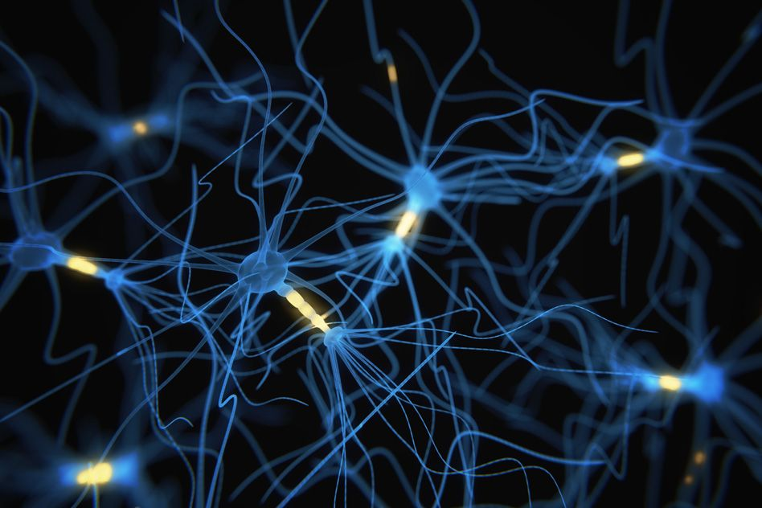
Emotional Intensity Prediction
Paper:
Emotion Intensity Prediction with Affective Norms, Automatically Extended Resources and Deep Learning
Authors:
Maximilian Koper, Evgeny Kim & Roman Klinger
Submitted by: Team Synapse
Ronak Ramesh Chabukswar
Amin Dhruvil Rameshchandra
Naladala Jeshwanth
Prachuryya Kaushik

Slide 2
Introduction to the Problem
Twitter has a large and diverse user base which entails rich textual content, including nonstandard language such as emoticons, emojis, creatively spelled words and hashtagged word
The degree of any emotion felt by the speaker should be reflected as real-valued score between 0 and 1
A score of 1 means that the speaker feels the highest amount of a particular emotion and a score of 0 means that the speaker feels the lowest amount of that particular emotion
Human annotations were used at first to infer this intensity of emotion from a tweet including sarcastic tweets
First dataset of tweets (Tweet Emotion Intensity Dataset) was annotated for anger, fear, joy, and sadness intensities using a technique called best–worst scaling (BWS)
The performance of the teams were determined based on Pearson correlation value of each emotion separately as well as a macro average over all emotions
The Shared Task competition was held on a CodaLab website on Emotion Intensity in the 8th Workshop on Computational Approaches to Subjectivity, Sentiment and Social Media Analysis (WASSA-2017), September 2017, Copenhagen, Denmark. It helped in improving our understanding on expression of emotions by dimensional nature to model of basic emotions, which has traditionally been viewed as categorical
Automatically detecting emotion intensities in tweets is especially beneficial in multiple applications such as: tracking brand and product perception, disaster/crisis management etc.

Slide 3
Dataset Preparation
Query Term: Specific 50-100 words associated with particular emotion at different intensity levels (used Roget’s Thesaurus)
Master Set: Total 7097 tweets include:
Hashtag Query Term (HQT) tweets: 1030 tweets in with #<query term>
No Query Term (NQT) tweets: Same 1030 tweets as above with hashtags removed
Query Term (QT) tweets: 5037 tweets with either no #<query term> or #<query term> followed by at least one non-hastagged word
Distribution: 50% for training, 5% for development (Gold rating, annotated by authors) and 45% for testing (not disclosed to participants before evaluation)
Annotation with Best-Worst Scalling: (e.g. A,B,C,D,E,F,G,H,I,J,K,L are different tweets)
Distinct 4-tuples of tweets are randomly generated so that no pair of tweets occur in more than 1 tuple (e.g. ABCD, AEFG, AHIJ be 4-tuples but AKLB cannot included as AB repeated)
Every tweet occurs in 8 different 4-tuples
Human annotators (total 3 chosen) mark the most intense (e.g. A) and least intense (e.g. C) tweet for a particular emotion in every 4-tuple (e.g. in ABCD)
For each tweet, intensity score is measured as = % most intense - % of least intense
The intensity score was transformed linearly from –100 to 100 to range 0 to 1
If a human annotators accuracy fell below 70% to gold ratings, all the annotations were rejected
Tweet Emotion Intensity Dataset was created for the emotions anger, fear, joy, sadness

Slide 4
Methods applied by the authors
Feature Sets
Baseline Features AffectiveTweets
Extending and Adding Norms
Tweet Regression CNN-LSTM
Additional Features
Provided to participants a base of processed data (labeled tweets with human annotations)
1. To extend lexicons to out of vocabulary words
2. To learn new rating for every word
3. To learn new rating category
1. To capture sequential information in compact way
2. To predict a numerical value for each tweet
1. To represent the presence of exclamation mark
2. To represent the overall number of tokens in a tweet.
Why?
Combined features in a random forest classifier (weka)

Slide 5
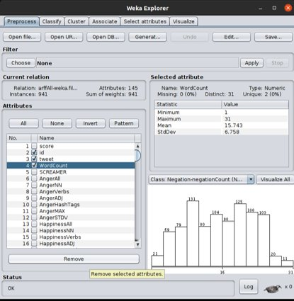
Data Preprocessing: to use in weka
Original data: Plain text (txt) files were shared in official competition website separately for training, development (with and without intensity) and testing for all the emotions viz. anger, joy, fear & sadness.
Each row consists of ID, tweet, emotion label & annoted score and hence the top row is edited in the txt files to create the headings in the CSV files to be created.
Python code created to convert to CSV (Comma-separated values) files.
The generated CSV files are converted to arff formatted with simple editing (by adding @relation at first, @attribute for respective attributes and @data before all the data).
These arff files are opened in the weka->explorer and respective filters were applied as suggested by the authors.
After application of the filters, many attributes are formed as the tweets are tokenized. Then the original tweet strings can be deleted. [Fig. 1]
Fig 1: After applying the filters on tweet (string), the unnecessary attributes are removed

Slide 6
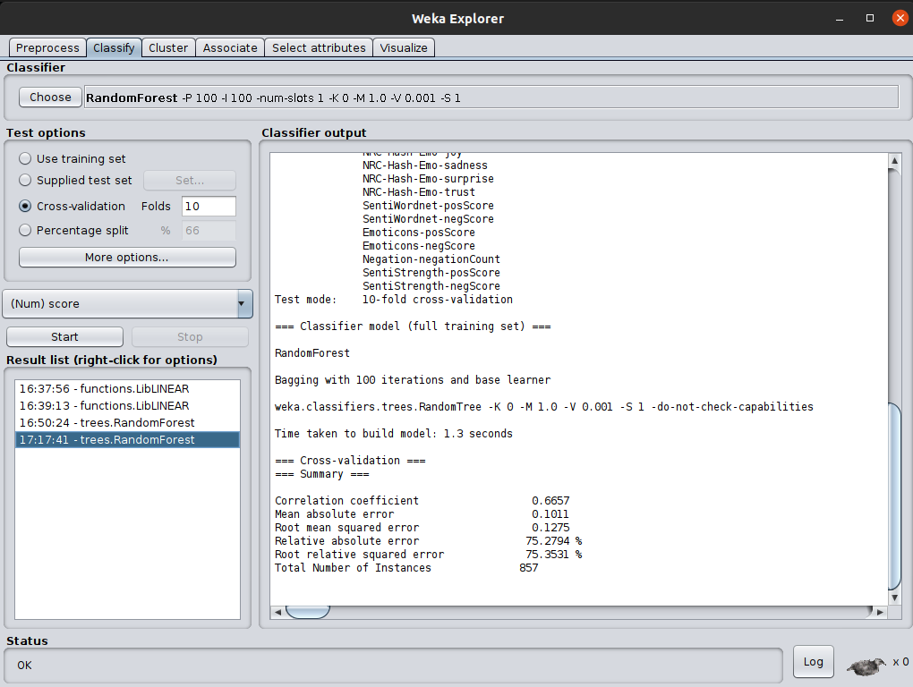
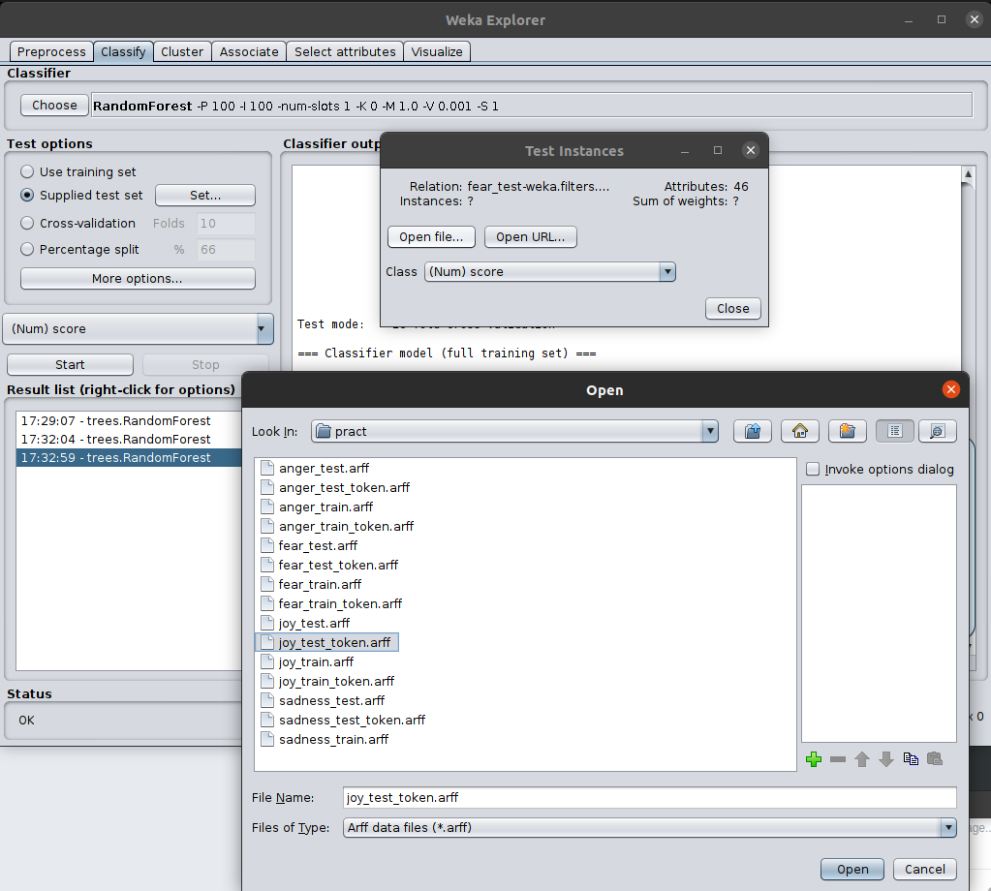
Implementation: Baseline Feature in weka
As per the authors, only two unsupervised filters are considered which uses TweetNLP library for tokenization: TweetToSentiStrengthFeatureVector and TweetToLexiconFeatureVector
Training data is loaded (e.g. anger_train.arff) and unnecessary fields such as id, tweet and WordCount are removed. [Fig. 1]
Then the training data is trained [10 folds cross validation, RandomForest regression]. As shown in [Fig. 2], the correlation coefficient achieved is 0.6657
Now, the trained data are tested by supplying separate test set [Fig. 3]
After running the test with the test set, correlation coefficient achieved for anger is 0.6334
Steps 2-5 are repeated for other emotions and results are obtained as follows:
Fear : correlation coefficient= 0.6465
Joy : correlation coefficient= 0.6006
Sadness : correlation coefficient= 0.6955
Fig 2: Training of data
Fig 3: Insertion of test data

Slide 7
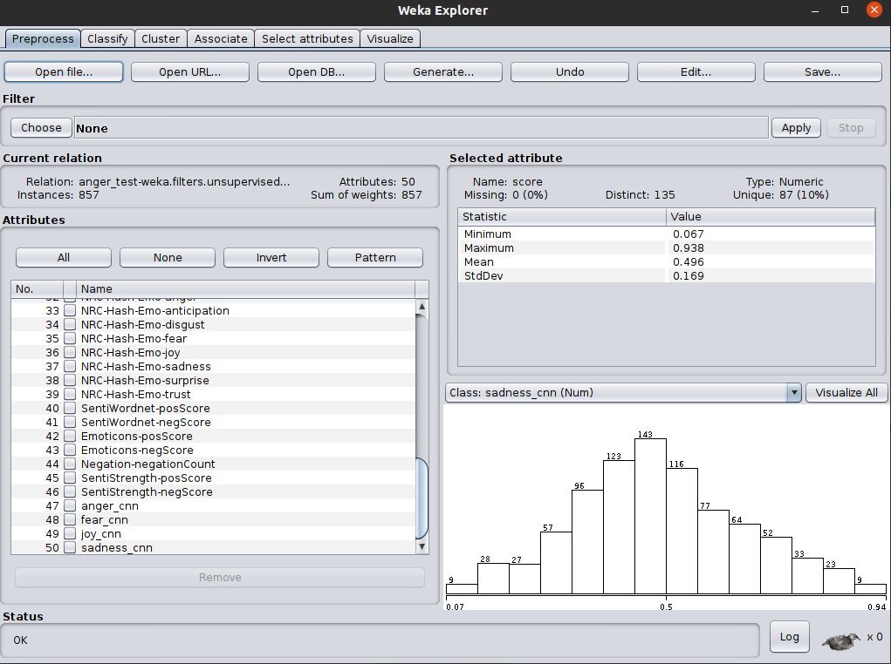
GRU model for additional attributes
We use Keras to create a Nerual Network for each emotion
Every Neural network contains one Embedding layer, one Dropout layer, one GRU layer, followed by Dense layer and it's activation[sigmoid].
We use GRU, as it is less complex than LSTM[2 gates in GRU as compared to three in LSTM], and leads to a better performance overall.
This is particularly beneficial for shorter sequences.
The output of the model is cosidered as the additional attributes. [Fig. 4]
Similar to the baseline features, the arff files were preprocessed after adding additional features generated from GRU model to the baseline features and opened in weka-> explorer for testing.
Fig 4: Outputs from GRU model added as additional attributes

Slide 8
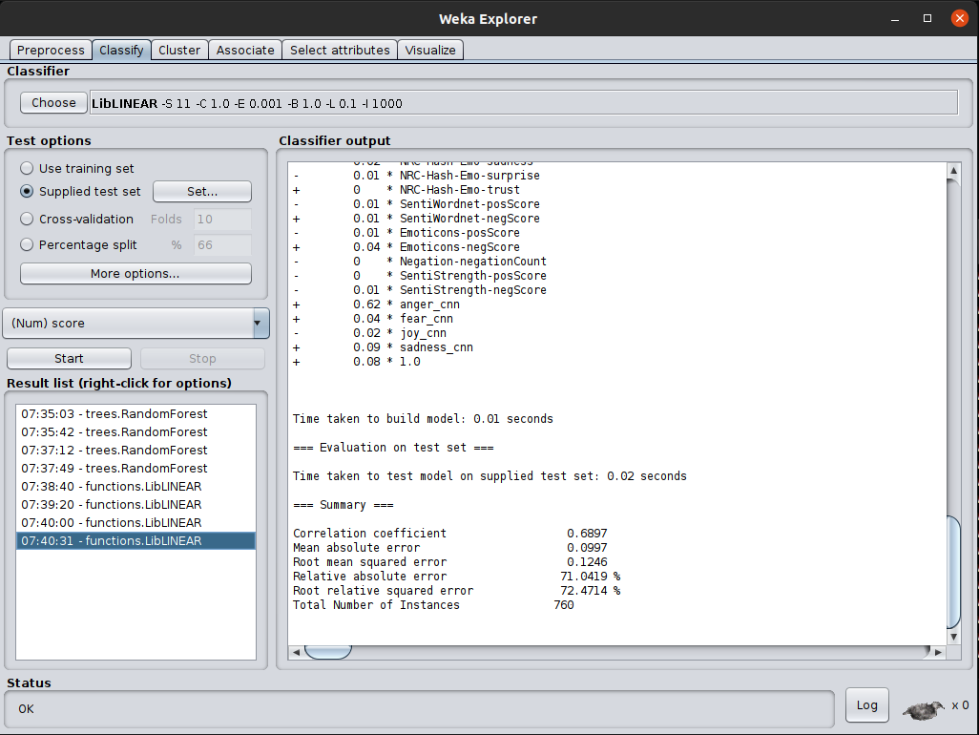
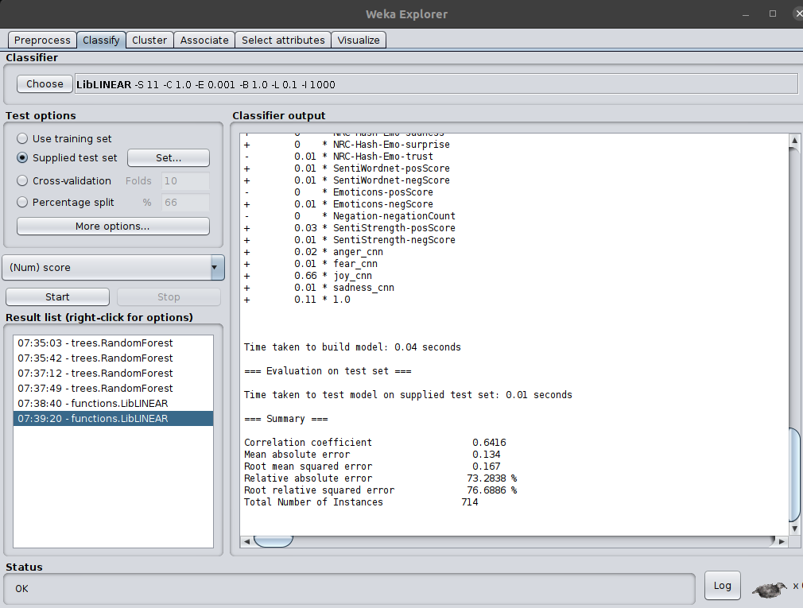
Final Implementation in weka & Results
Fig 5: Sample output (Anger)
Fig 6: Sample output (Joy)

Slide 9
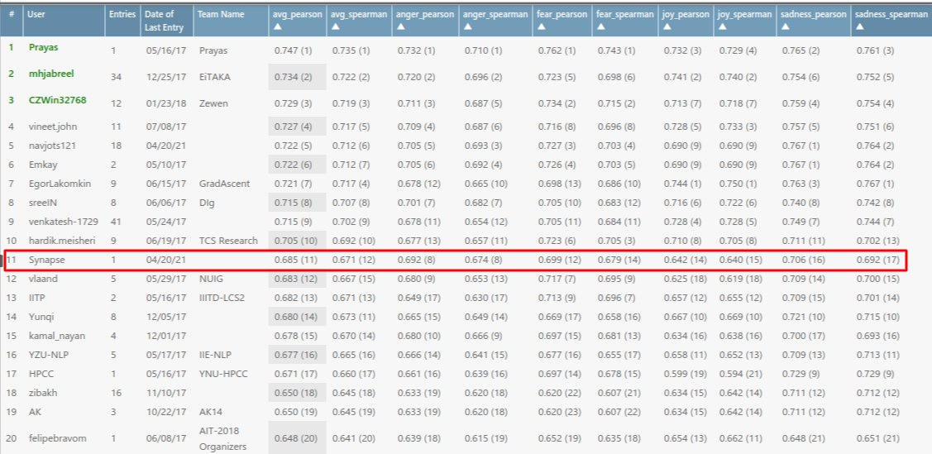
Official result in CodaLab competition
Exact implementation of authors method could not be completed since a major component of the project was removed due to Twitter Copyright issues.
The inclusion of additional features generated from GRU model enhanced the predictions manifold
As per the guidelines given in the CodaLab official website the txt files with predicted values are uploaded for evaluation.
Internationally the submission of "Synapse" is ranked 11th overall [Fig. 9] (https://competitions.codalab.org/competitions/16380#results)
Fig 9: Screenshot of result website

