Slide 1
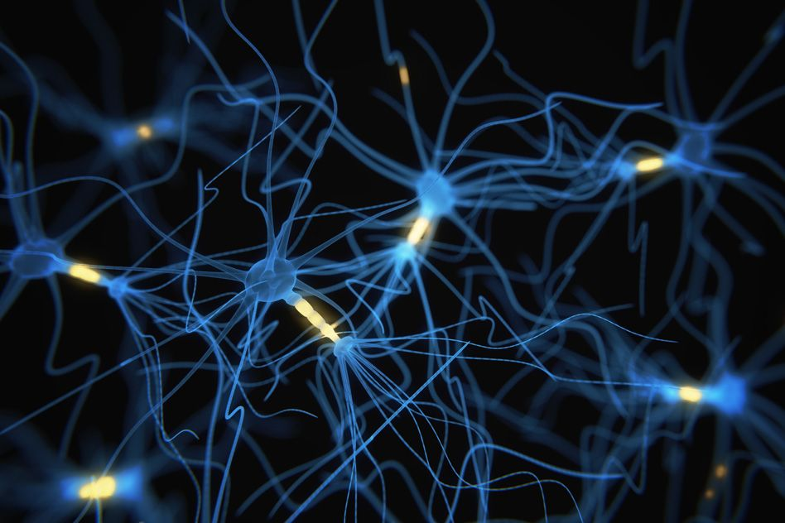
Phase 2: Methodology Understanding
Paper:
Emotion Intensity Prediction with Affective Norms, Automatically Extended Resources and Deep Learning
Authors:
Maximilian Koper, Evgeny Kim & Roman Klinger
Submitted by: Team Synapse
Ronak Ramesh Chabukswar
Amin Dhruvil Rameshchandra
Naladala Jeshwanth
Prachuryya Kaushik

Slide 2
Overall Flow
plain_tweets.txt
run_lemmaPOS.sh
plain_parsed.txt
CNN_LSTM_input.txt
run_CNN_LSTM.py
pred/emo.txt

Slide 3
Overall Flow
plain_parsed.txt
pred/emo.txt
rating.gz
afjs.out.txt
createarff.jar
plain_txt_parsed.arff
Random_Forest_regressor
Out.txt

Slide 4
Baseline System: Dataset Preparation
Query Term: Specific 50-100 words associated with particular emotion at different intensity levels (used Roget’s Thesaurus)
Master Set: Total 7097 tweets include:
Hashtag Query Term (HQT) tweets: 1030 tweets in with #<query term>
No Query Term (NQT) tweets: Same 1030 tweets as above with hashtags removed
Query Term (QT) tweets: 5037 tweets with either no #<query term> or #<query term> followed by at least one non-hastagged word
Distribution: 50% for training, 5% for development (Gold rating, annotated by authors) and 45% for testing (not disclosed to participants before evaluation)
Annotation with Best-Worst Scalling: (e.g. A,B,C,D,E,F,G,H,I,J,K,L are different tweets)
Distinct 4-tuples of tweets are randomly generated so that no pair of tweets occur in more than 1 tuple (e.g. ABCD, AEFG, AHIJ be 4-tuples but AKLB cannot included as AB repeated)
Every tweet occurs in 8 different 4-tuples
Human annotators (total 3 chosen) mark the most intense (e.g. A) and least intense (e.g. C) tweet for a particular emotion in every 4-tuple (e.g. in ABCD)
For each tweet, intensity score is measured as = % most intense - % of least intense
The intensity score was transformed linearly from –100 to 100 to range 0 to 1
If a human annotators accuracy fell below 70% to gold ratings, all the annotations were rejected
Tweet Emotion Intensity Dataset was created for the emotions anger, fear, joy, sadness

Slide 5
Feature Sets
Feature Sets
Baseline Features AffectiveTweets
Extending and Adding Norms
Tweet Regression CNN-LSTM
Additional Features
Provided to participants a base of processed data (labeled tweets with human annotations)
1. To extend lexicons to out of vocabulary words
2. To learn new rating for every word
3. To learn new rating category
1. To capture sequential information in compact way
2. To predict a numerical value for each tweet
1. To represent the presence of exclamation mark
2. To represent the overall number of tokens in a tweet.
Why?
Combined features in a random forest classifier (weka)

Slide 6
Baseline System: AffectiveTweets
Package AffectiveTweets is implemented for the Weka machine learning workbench for sentiment classification
It uses the TweetNLP library for tokenization.
AffectiveTweets includes five filters for converting tweets into feature vectors:
TweetToSparseFeatureVector filter: Sparse features are calculated such as word n-grams, character n-grams etc.
TweetToLexiconFeatureVector filter: Calculates features from a fixed list of affective lexicons
TweetToInputLexiconFeatureVector filter: Calculates features from any input lexicons which facilitates experimentation
TweetToSentiStrengthFeatureVector filter: Positive and negative intensities of tweets can be calculated
TweetToEmbeddingsFeatureVector filter: Calculates a tweet-level feature representation using pre-trained word embeddings.

Slide 7
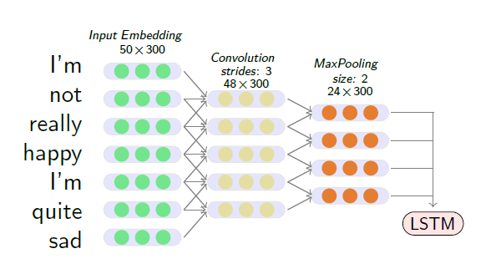
Mathematical Equations
CNN

Slide 8
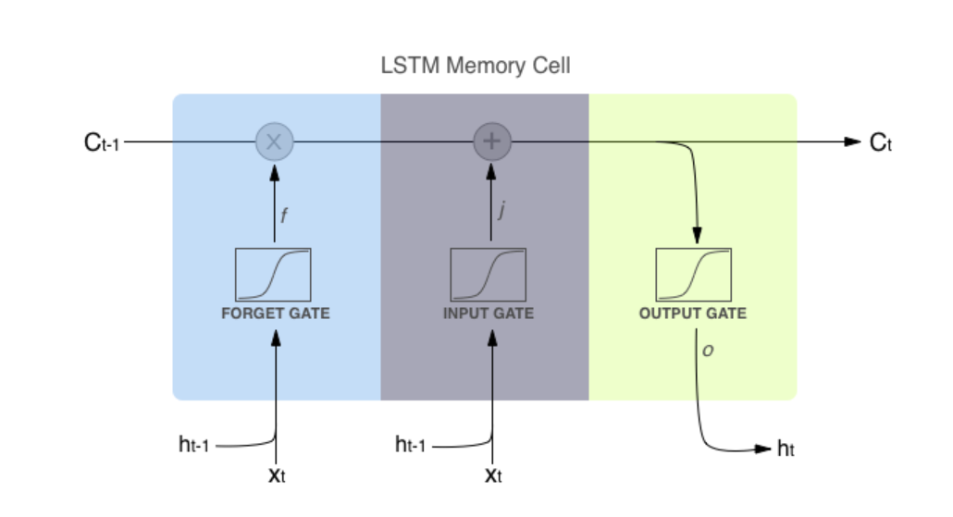
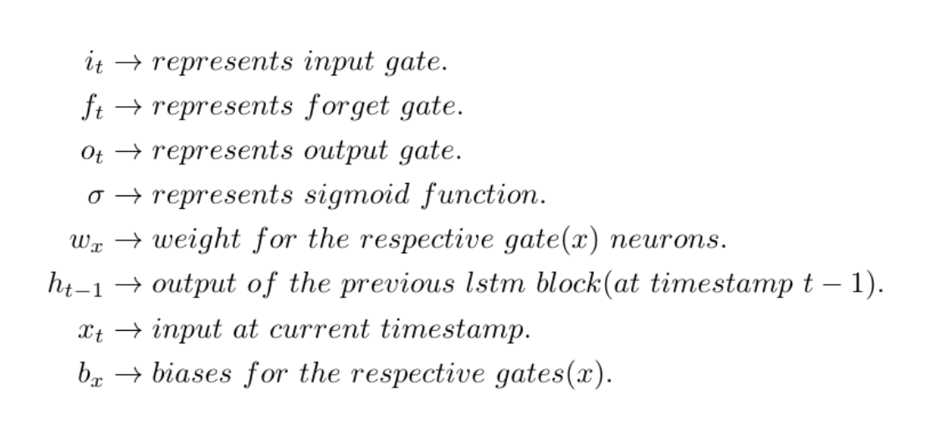
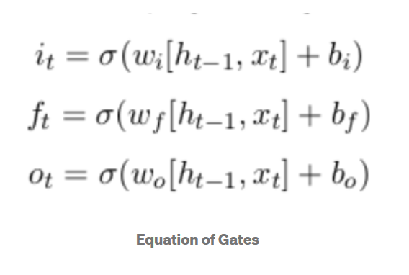
Mathematical Equations
LSTM

Slide 9
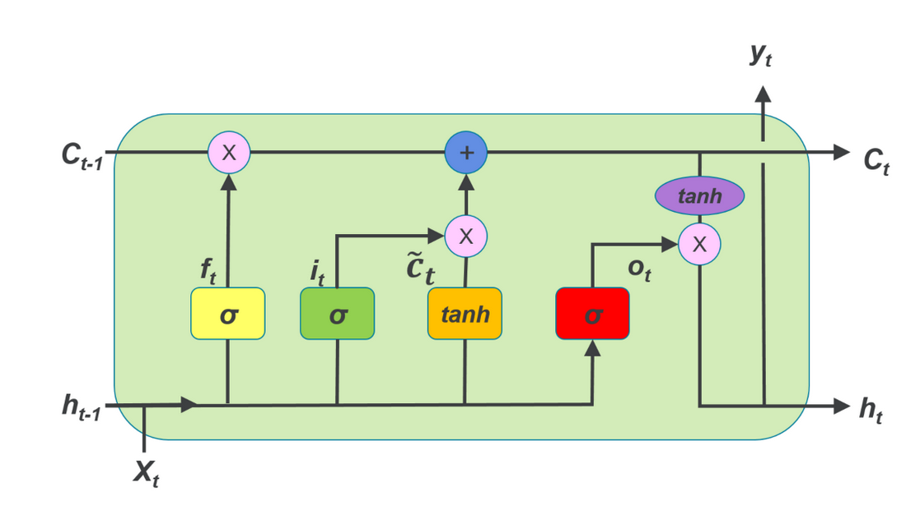
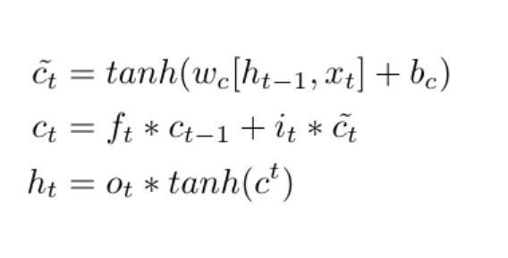
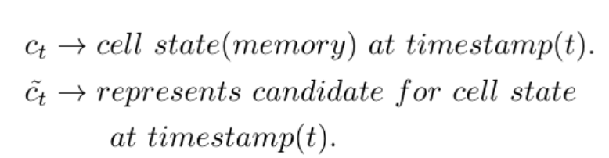
Mathematical Equations
LSTM

Slide 10
Thank You

