Slide 1
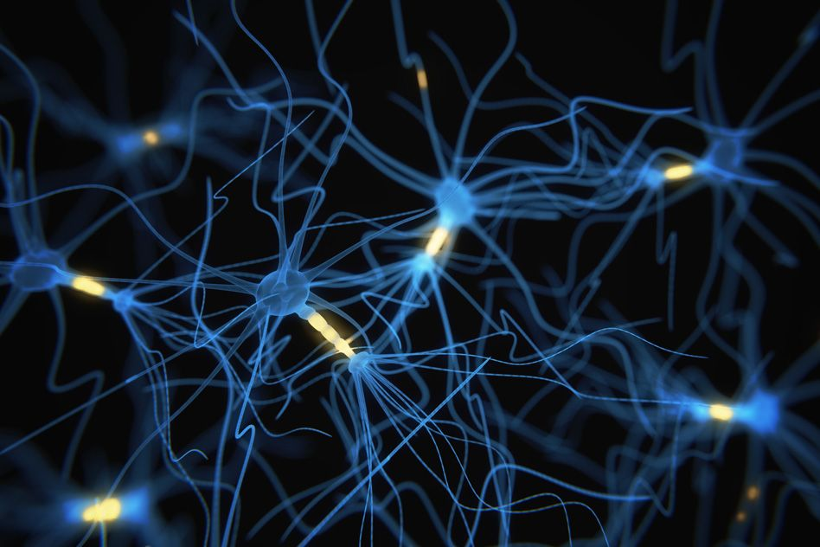
Phase 1: Theorical Understanding
Paper:
Emotion Intensity Prediction with Affective Norms, Automatically Extended Resources and Deep Learning
Authors:
Maximilian Koper, Evgeny Kim & Roman Klinger
Submitted by: Team Synapse
Ronak Ramesh Chabukswar
Amin Dhruvil Rameshchandra
Naladala Jeshwanth
Prachuryya Kaushik

Slide 2
Introduction to the Problem
Twitter has a large and diverse user base which entails rich textual content, including nonstandard language such as emoticons, emojis, creatively spelled words and hashtagged word
The degree of any emotion felt by the speaker should be reflected as real-valued score between 0 and 1
A score of 1 means that the speaker feels the highest amount of a particular emotion and a score of 0 means that the speaker feels the lowest amount of that particular emotion
Human annotations were used at first to infer this intensity of emotion from a tweet including sarcastic tweets
First dataset of tweets (Tweet Emotion Intensity Dataset) was annotated for anger, fear, joy, and sadness intensities using a technique called best–worst scaling (BWS)
The performance of the teams were determined based on Pearson correlation value of each emotion separately as well as a macro average over all emotions
The shared task helped in improving our understanding on expression of emotions by dimensional nature to model of basic emotions, which has traditionally been viewed as categorical

Slide 3
Importance of the Problem
With huge influx of data every second - round the year, it becomes an incredibly mammoth task to keep a track of all the tweets manually.
An automated system, that checks the emotion of conveyer, could help significantly in the aggregation process
Automatically detecting emotion intensities in tweets is especially beneficial in applications such as:
Tracking brand and product perception
Tracking support for issues and policies
Tracking public health and well-being
Disaster/crisis management.
This not only ensures that businesses target customer needs, but also helps in finding the traits of a person
Automated blocking of user accounts that spread emotion of anger
Automated deletion of tweets that spread hate

Slide 4
Overview & Objectives
Shared Task competition was held on a CodaLab website on Emotion Intensity in the 8th Workshop on Computational Approaches to Subjectivity, Sentiment and Social Media Analysis (WASSA-2017), September 2017, Copenhagen, Denmark
This paper works on building a discrete emotional detecting model which determines the intensity of a given emotion(anger, fear, joy, sadness) from a particular tweet
This model, through the use of modern Natural-Language-Processing tools, aims to convert a sequence of words into a real valued score that can describe the Intensity of emotion, as felt by the speaker
In this model, dimensional nature to model of basic emotions are attempted compared to previous studies on categorical analysis of emotions
Beyond the baseline feature engineering, the authors developed and implemented deep-learning based sentence regressor, the authors introduced couple of manually defined additional features to improve the results

Slide 5
Methods Applied
Supervised method is used for the analysis in which the baseline features are obtained from the system AffectiveTweets
The authors introduced couple of manually defined additional features
to represent the presence of exclamation mark
To represent the overall number of tokens in a tweet
To address the lexical variations and out-of-vocabulary words, the authors addressed 3 approaches:
Application of supervised method to extend lexicons to larger vocabulary
Learning of novel rating score for every word
Inclusion of new rating categories to provide complementary and potentially useful information

Slide 6
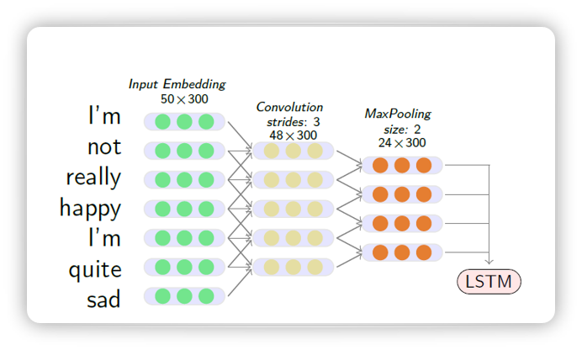
Methods Applied
Supervised learning method with extended lexicons of affective norms
Authors combine three main information sources in a random forest regressor:
manually created resources
automatically extended lexicons
the output of a neural network (CNN-LSTM) for sentence regression
Below is the final architecture used by the IMS.
Model: CNN-LSTM
Each word into 300d vector
Max 50 vectors per tweet
Followed by Conv1D, stride=3
Followed by MaxPooling, stride=2
Followed by LSTM

Slide 7
Methods Applied
Each tweet is represented by a matrix of size 50 * 300.
Dropout rate applied is 0.25
The matrix is given as input to convolutional layer, followed by maxpooling layer and an LSTM to predict the numerical output for each tweet.
The CNN-LSTM model can be described using the following layers in sequential oder:
Embedding layer
Dropout layer
Convolution[Conv1D followed by Maxpooling(stride of 2)]
LSTM
Dense layer
Activation[Sigmoid]

Slide 8
Implementation Details
The text corpus used was retrieved from Twitter streaming in 2016 containing around 50 million tweets and 800 million tokens
The authors removed the words which occurred less than 10 times which reduced the dataset to 1.6 million word types
Word2vec was used to obtain 300 dimensional word representation
Publicly available GoogleNews-vectors were used for training the model
Word embedding are used to extend the emotion lexicons as well as input embeddings in tweet regression model.
TweetNLP is used as tokenizer and in case of out of vocabulary words(no ratings available) the score is set to median value.
Pearson correlation of 0.65 using the baseline lexicon features and a random forrest classifier. However, the inclusion of extended resources and CNN-LSTM regression architecture increased the performance by +0.05 points.
The final combination of all the features (feature names) gives an estimated performance of 0.72 on training data

Slide 9
References
Köper, M., Kim, E., & Klinger, R. (2017, September). IMS at EmoInt-2017: Emotion intensity prediction with affective norms, automatically extended resources and deep learning. In Proceedings of the 8th Workshop on Computational Approaches to Subjectivity, Sentiment and Social Media Analysis (pp. 50-57).
Mohammad, S. M., & Bravo-Marquez, F. (2017). WASSA-2017 shared task on emotion intensity. arXiv preprint arXiv:1708.03700.

Slide 10
Thank You

