Slide 1
S.W.Q.S.
Zef, Taliah, and Oscar

Slide 2
Analysis stage

Slide 3
Empathy map
SAYS | THINKS
"Is this tap water actually safe?" | "I don't want to ruin my trip by getting sick."
"Should I buy bottled water instead?" | "I wish there was an easy way to know if this water is clean."
"The locals drink it, but can I?" | "Can I trust what people are telling me?"
"I don't want to waste money on bottled water if I don't have to." | "What if the water looks clean but still has harmful bacteria?"
DOES | FEELS
Buys bottled water whenever possible. | Anxious about drinking unfamiliar water.
Asks locals or hotel staff if the water is safe. | Uncertain because there is no clear evidence.
Boils water before drinking when possible. | Frustrated by conflicting advice.
Avoids drinking as much water as possible. | Relieved when they know the water is safe.
Avoids drinking tap water in unfamiliar places. | Worried about food poisoning or stomach illnesses.

Slide 4
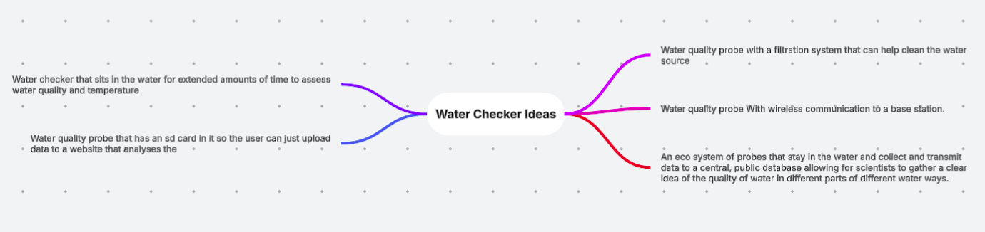
Ideate

Slide 5
Filter
Our choices
Creating a device that detects the cleanliness of bodies of water
It directly addresses the concerns people have about water safety.
It helps reduce the risk of drinking contaminated water.
The device can detect contamination that cannot be seen with the naked eye.
Creating a portable submersible water quality surveyance probe.
It allows people to test water quickly and accurately wherever they are.
Because it is portable, it is ideal for travellers, campers, hikers, emergency workers, and people living in areas where water quality is uncertain.
Overall, the probe improves health and safety, provides reliable information, and helps people make informed decisions about the water they use.

Slide 6
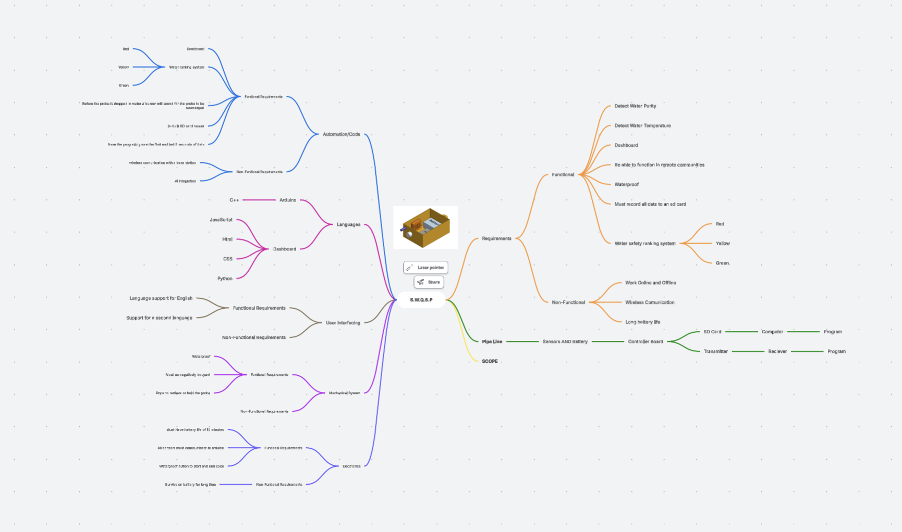
Final decision
We chose to create a portable submersible water quality surveillance probe because many people are unsure whether the water around them is safe to drink or use. Travelers, campers, hikers, and people in remote areas often worry about getting sick from contaminated water and cannot always trust what they are told or judge the water by its appearance.
Our probe provides a quick and reliable way to test water quality on the spot. It helps users make informed decisions, reduces the risk of waterborne illness, and can save money by avoiding unnecessary purchases of bottled water. We believe this solution will improve health and safety while giving people confidence and peace of mind wherever they are.
Functional Requirements:
Detect Water Purity
Detect Water Temperature
Dashboard
Be able to function in remote communities
Waterproof
Must record all data to a SD card
Water safety ranking system
Non-Functional Requirements:​
Work Online and Offline​
Wireless Communication​
Long battery life​

Slide 7
Design Stage

Slide 8
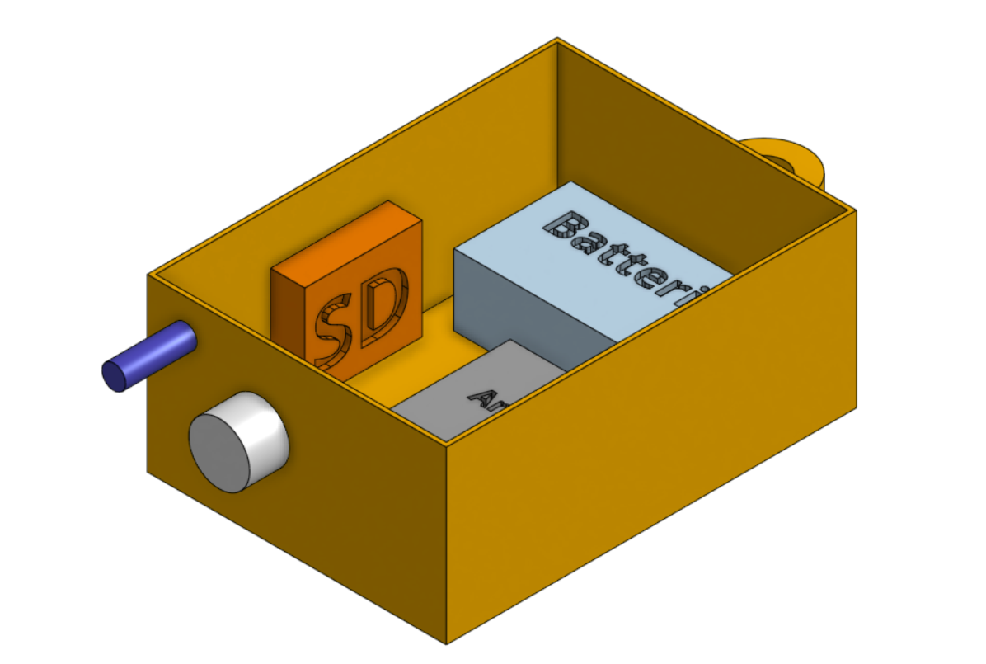








Oscar's 3d Mockup

Slide 9
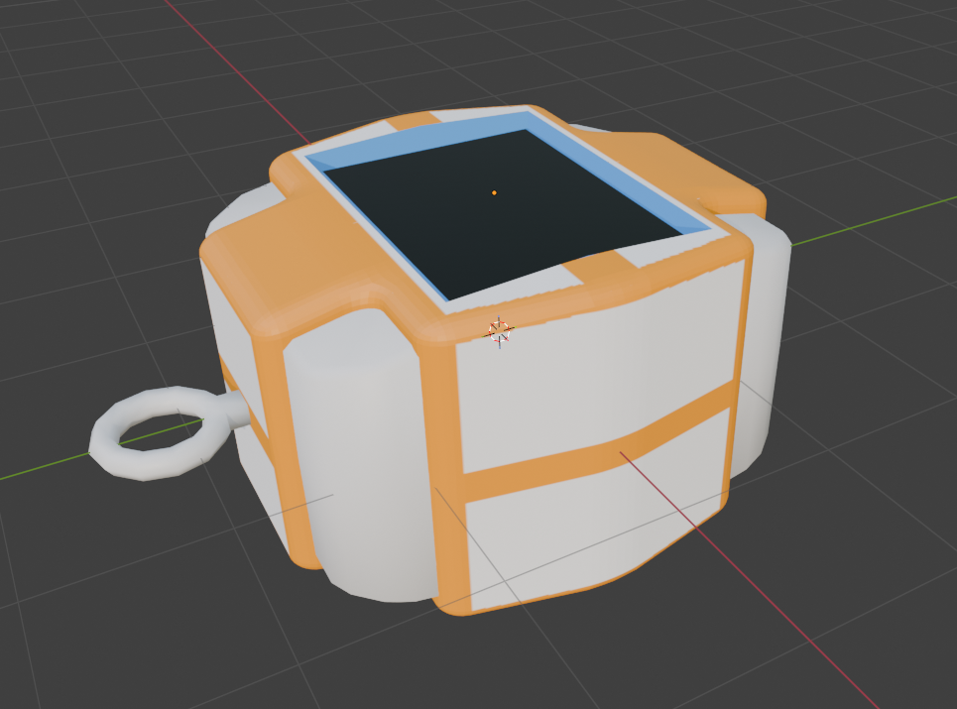



Zef's 3D mockup

Slide 10
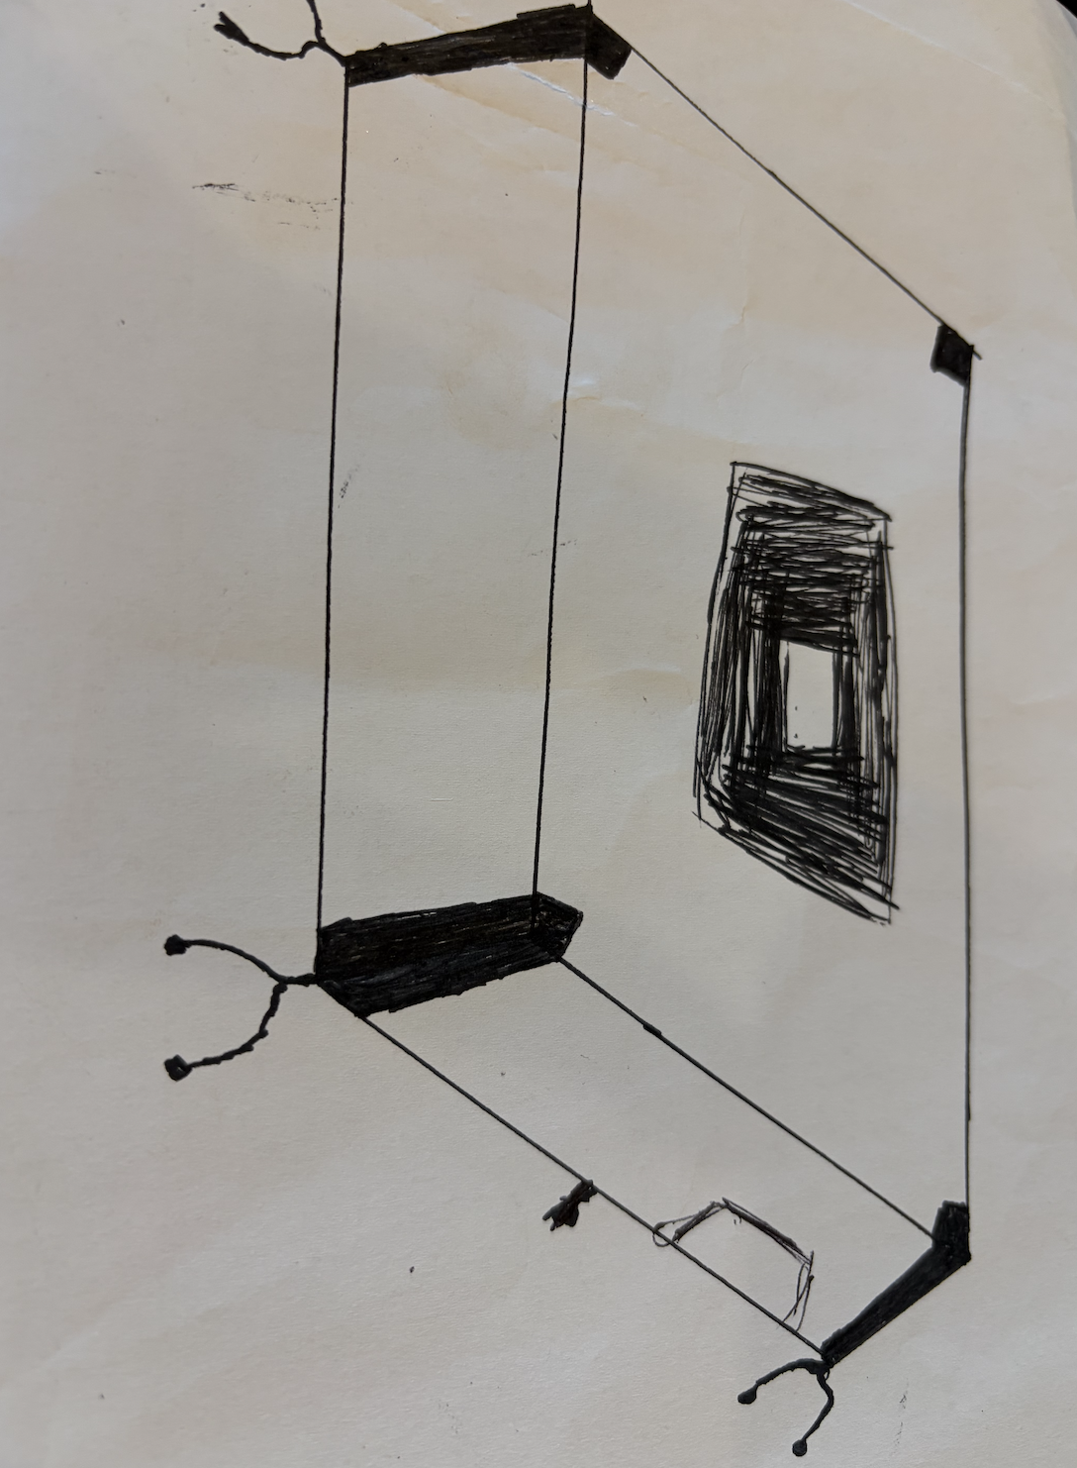

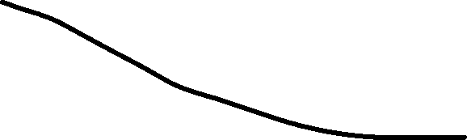

Taliahs 3d Mockup
Battery
Claws to help with stability
Temperature probe
SD card

Slide 11
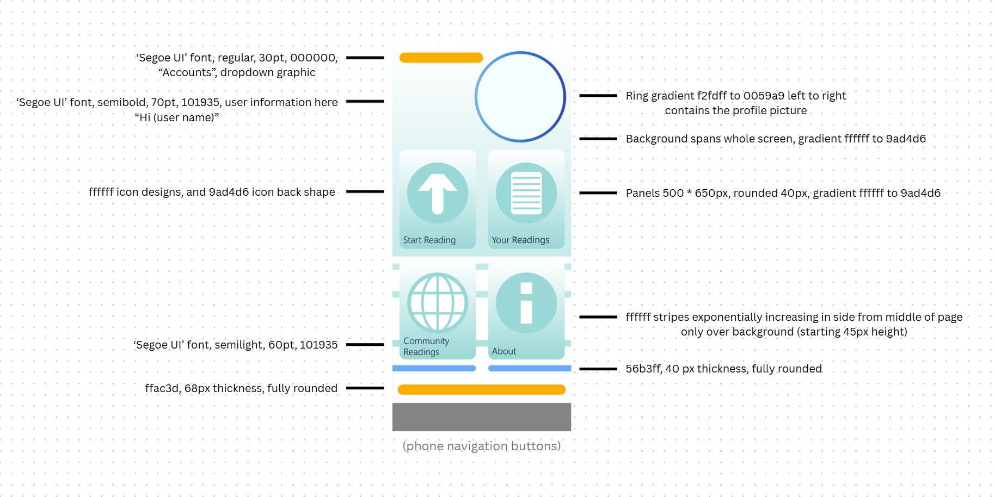
Zef's Website Mockup

Slide 12
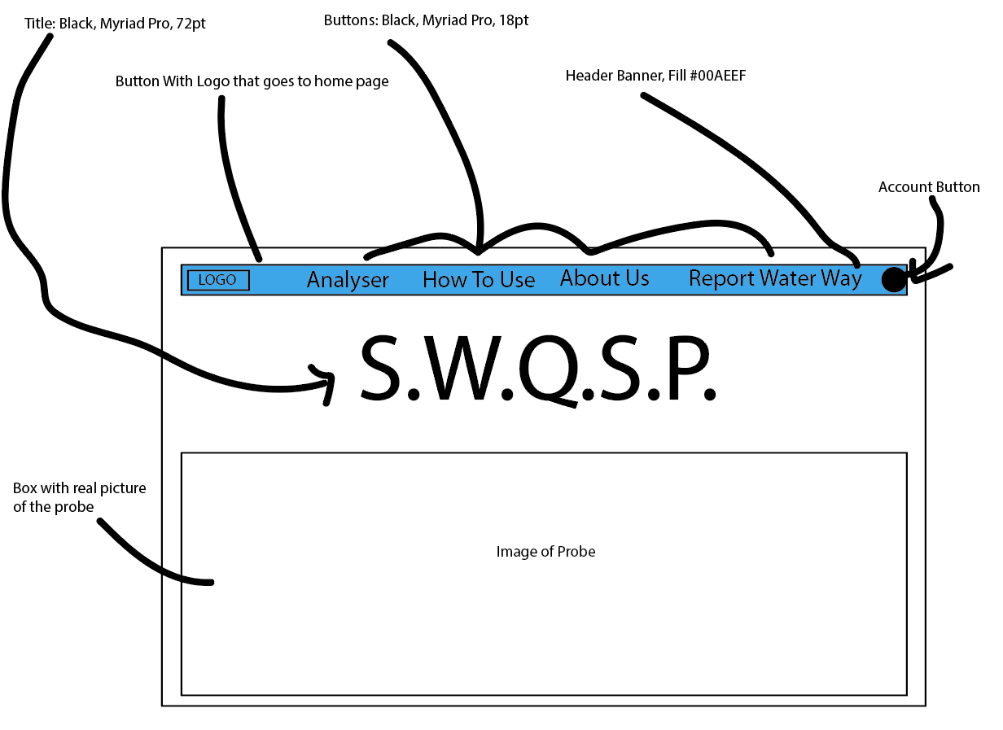
Oscar's Website Mockup

Slide 13
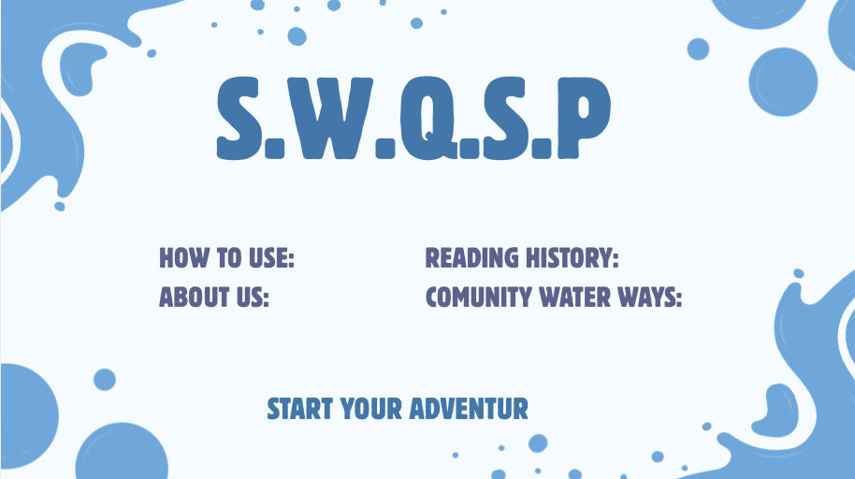





Taliahs Website Mockup
Our name in a blue colour scheme to represent the water
Clicks onto another page
Clicks onto a page were users can buy the probe

Slide 14

Zef's Logo Mockup

Slide 15
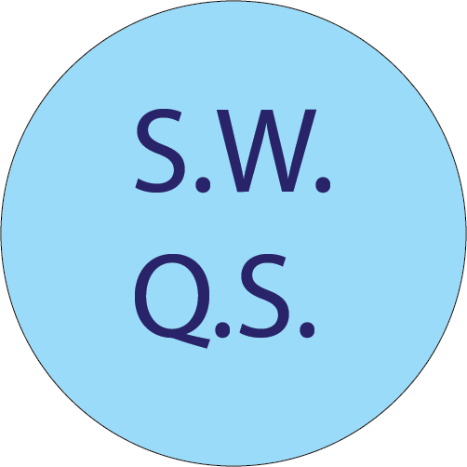
Oscar's Logo Mockup
Blue to represent the water it works in

Slide 16

Taliah's logo Mockup

Slide 17
Evaluation Criteria
The user can easily identify where to find instructions to use the probe (30 seconds at most).
The instructions is clear and concise enough that the average user can understand how to use the probe and upload a reading within 10 minutes
The reading interface is clear enough so that the average user can easily analyze and understand the results of a reading (high/low turbidity, dangerous/safe, etc.)
The user can figure out where to find their previous readings within 30 seconds.
The website is intuitive enough that the user is easily aware of which part of the website they are in and how to navigate to other pages

Slide 18
Evaluation Criteria
Evaluation Criterion | Efficiency or Effectiveness | Method
The user can easily identify where to find instructions to use the probe (30 seconds at most). | Efficiency – Objective
The instructions are clear and concise enough that the average user can understand how to use the probe and upload a reading within 10 minutes. | Efficiency/Effectiveness - Objective
The reading interface is clear enough so that the average user can easily analyze and understand the results of a reading (high/low turbidity, dangerous/safe, etc.) | Effectiveness - Subjective
The user can figure out where to find their previous readings within 30 seconds. | Efficiency - Objective
The website is intuitive enough that the user is easily aware of which part of the website they are in and how to navigate to other pages | Effectiveness - Subjective

Slide 19
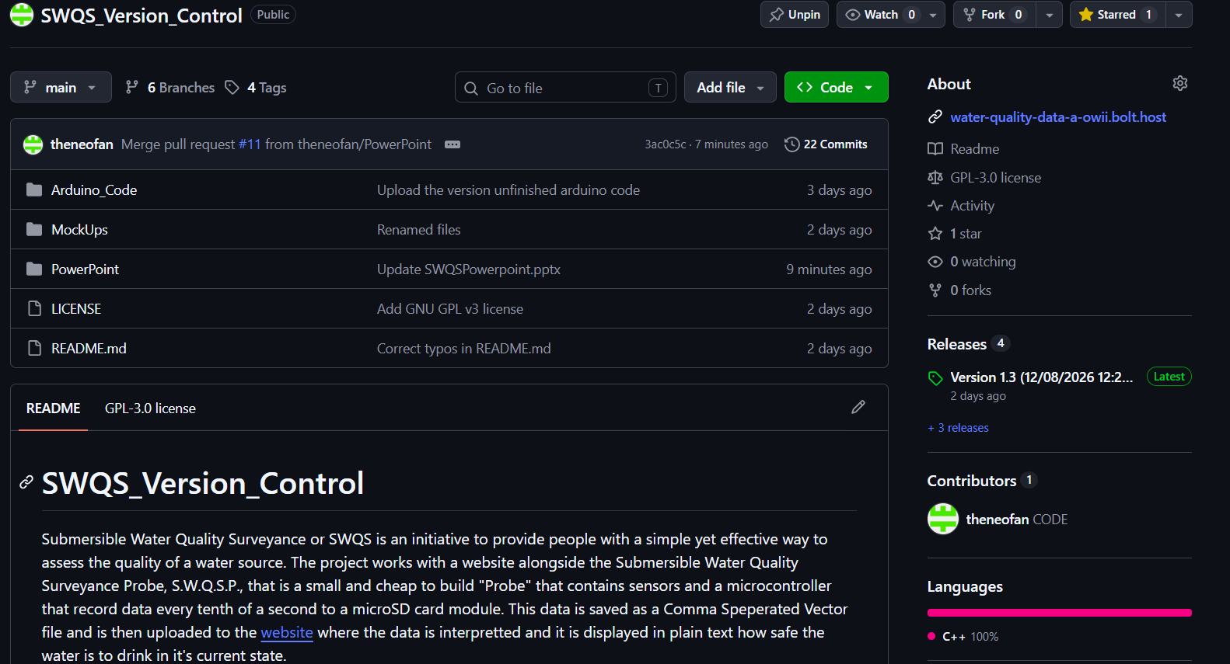
Version Control
The version control is maintained on GitHub primarily by Oscar. It is used to keep track of all versions of the project and who made what changes. If a problem arises the version can be reverted to an older, working version of the project.

Slide 20
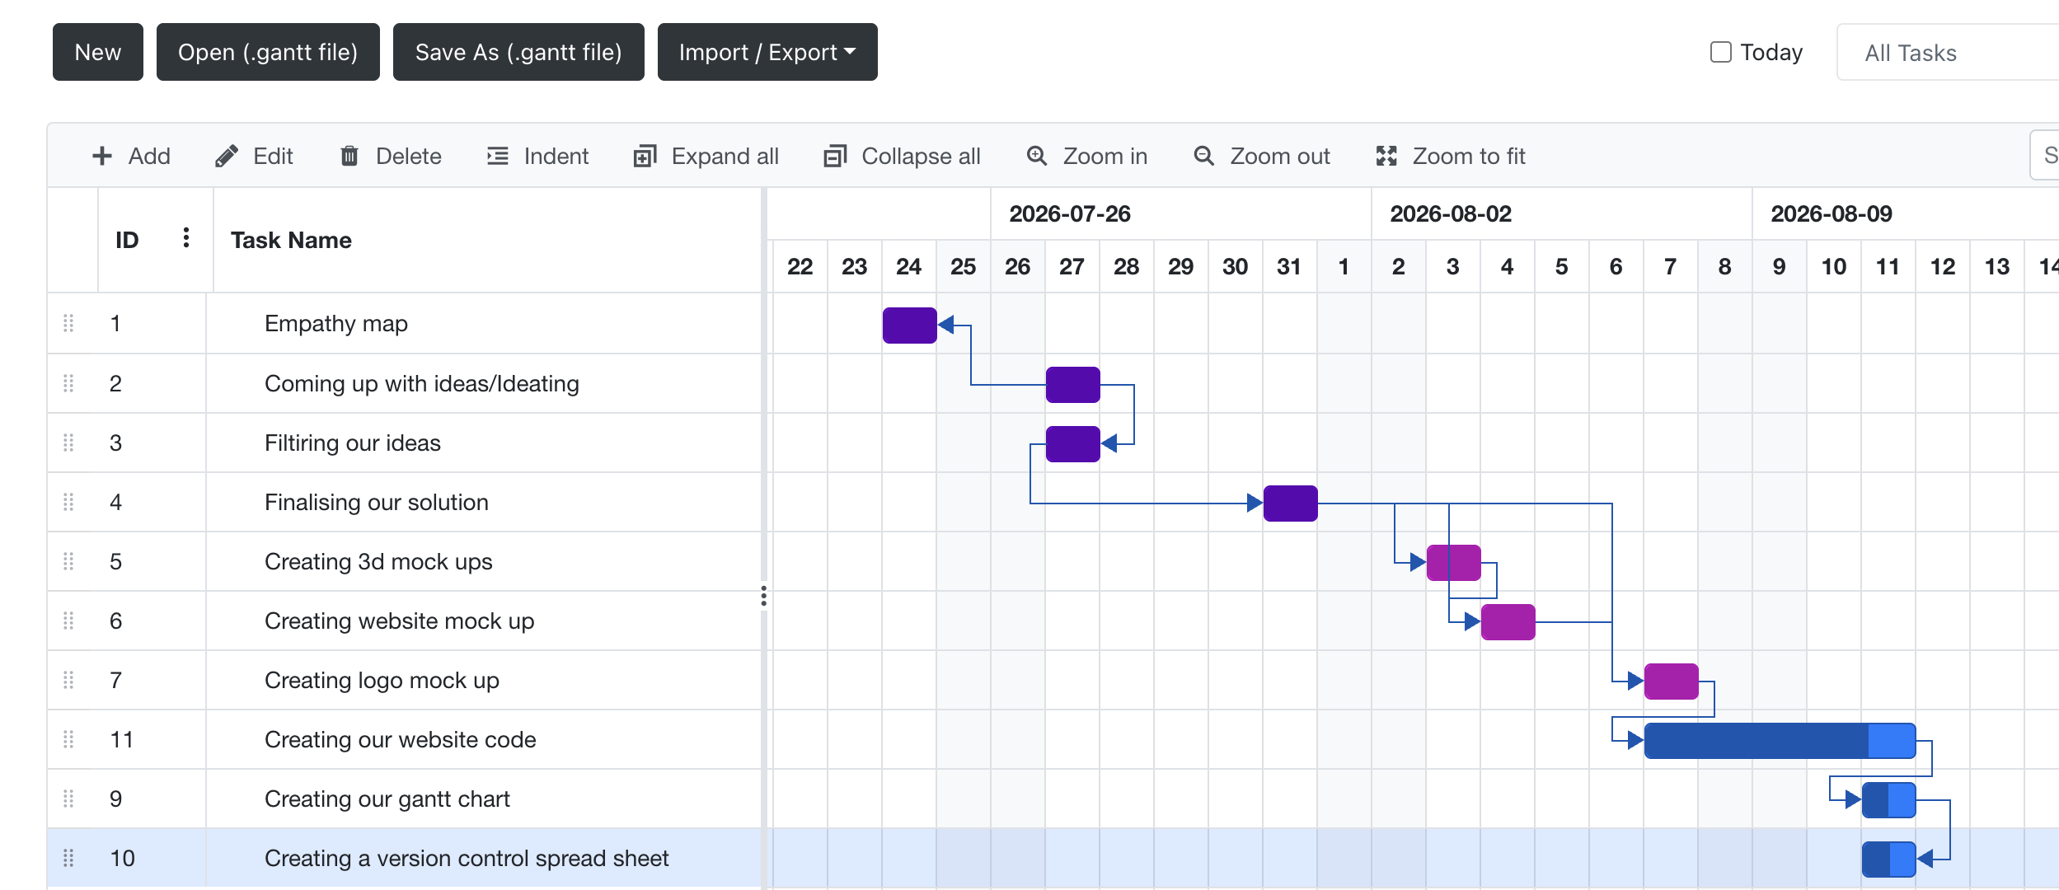
Gantt Chart

Slide 21
Test Cases
Feature | Method | Test Data | Expected Result | Actual Result | Passed Testing?

