Slide 1
SWQS
Zef, Taliah, and Oscar

Slide 2
Analysis stage

Slide 3
Empathy map
SAYS | THINKS
"Is this tap water actually safe?" | "I don't want to ruin my trip by getting sick."
"Should I buy bottled water instead?" | "I wish there was an easy way to know if this water is clean."
"The locals drink it, but can I?" | "Can I trust what people are telling me?"
"I don't want to waste money on bottled water if I don't have to." | "What if the water looks clean but still has harmful bacteria?"
DOES | FEELS
Buys bottled water whenever possible. | Anxious about drinking unfamiliar water.
Asks locals or hotel staff if the water is safe. | Uncertain because there is no clear evidence.
Boils water before drinking when possible. | Frustrated by conflicting advice.
Avoids drinking as much water as possible. | Relieved when they know the water is safe.
Avoids drinking tap water in unfamiliar places. | Worried about food poisoning or stomach illnesses.

Slide 4
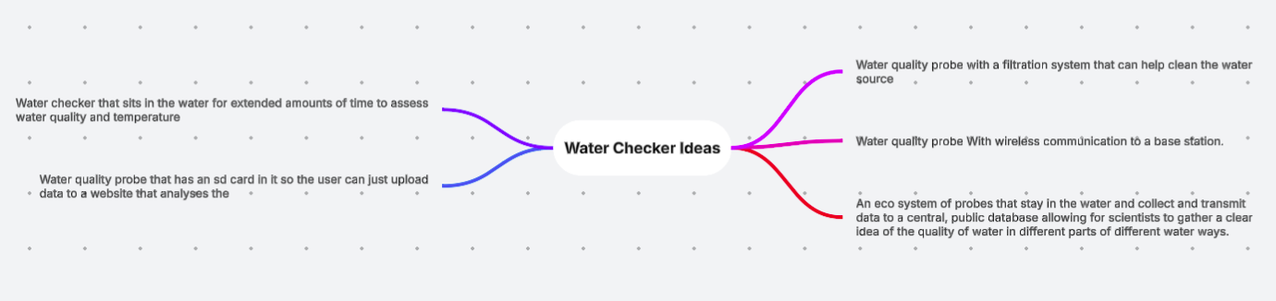
Ideate

Slide 5
Filter
Our choices
Creating a device that detects the cleanliness of bodies of water
It directly addresses the concerns people have about water safety.
It helps reduce the risk of drinking contaminated water.
The device can detect contamination that cannot be seen with the naked eye.
Creating a portable submersible water quality surveyance probe.
It allows people to test water quickly and accurately wherever they are.
Because it is portable, it is ideal for travellers, campers, hikers, emergency workers, and people living in areas where water quality is uncertain.
Overall, the probe improves health and safety, provides reliable information, and helps people make informed decisions about the water they use.

Slide 6
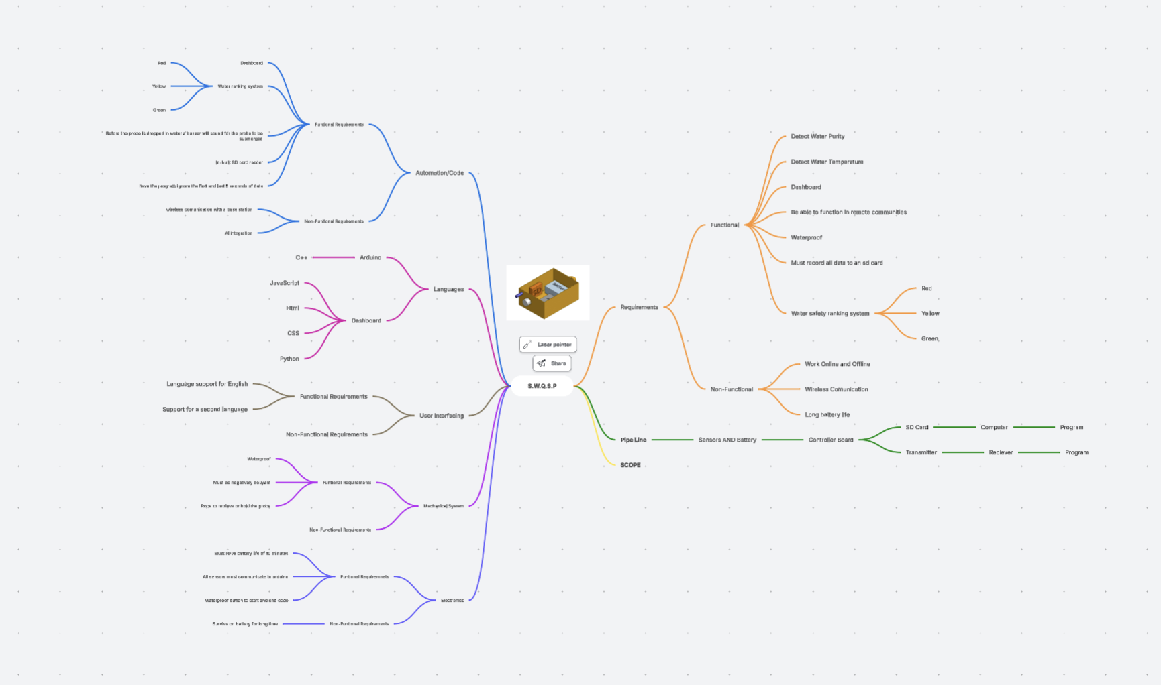
Final decision
We chose to create a portable submersible water quality surveillance probe because many people are unsure whether the water around them is safe to drink or use. Travelers, campers, hikers, and people in remote areas often worry about getting sick from contaminated water and cannot always trust what they are told or judge the water by its appearance.
Our probe provides a quick and reliable way to test water quality on the spot. It helps users make informed decisions, reduces the risk of waterborne illness, and can save money by avoiding unnecessary purchases of bottled water. We believe this solution will improve health and safety while giving people confidence and peace of mind wherever they are.
Functional Requirements:
Detect Water Purity
Detect Water Temperature
Dashboard
Be able to function in remote communities
Waterproof
Must record all data to a sd card
Water safety ranking system
Non-Functional Requirements:
Work Online and Offline
Wireless Communication
Long battery life

Slide 7
Design

Slide 8
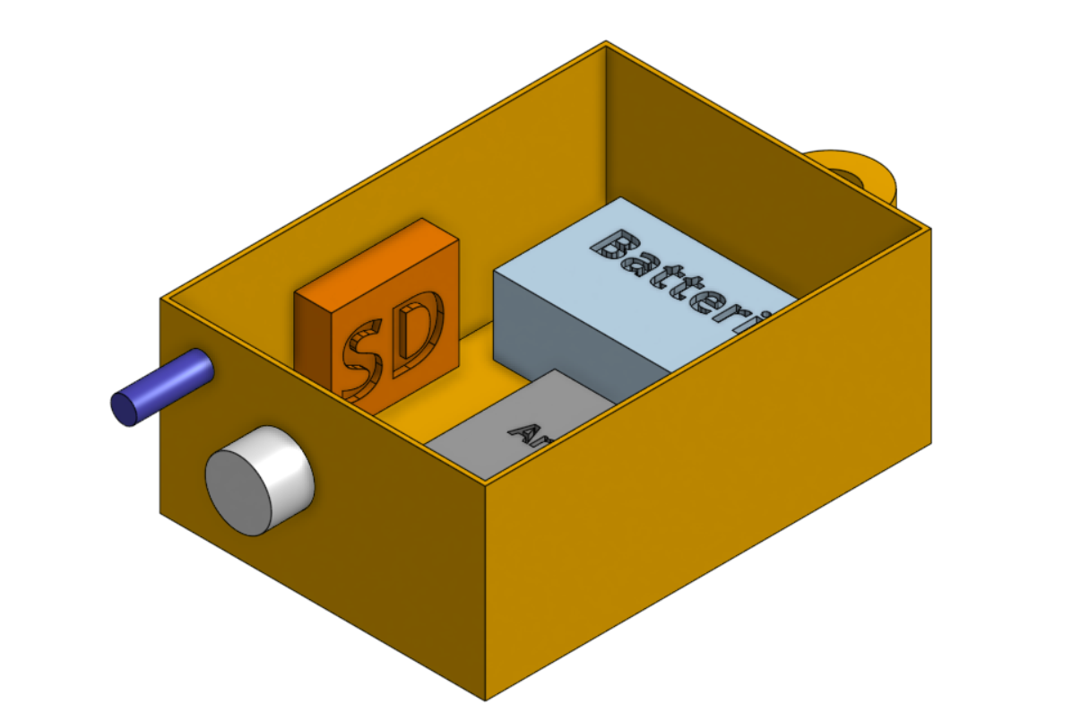








Oscar's 3d Mockup

Slide 9
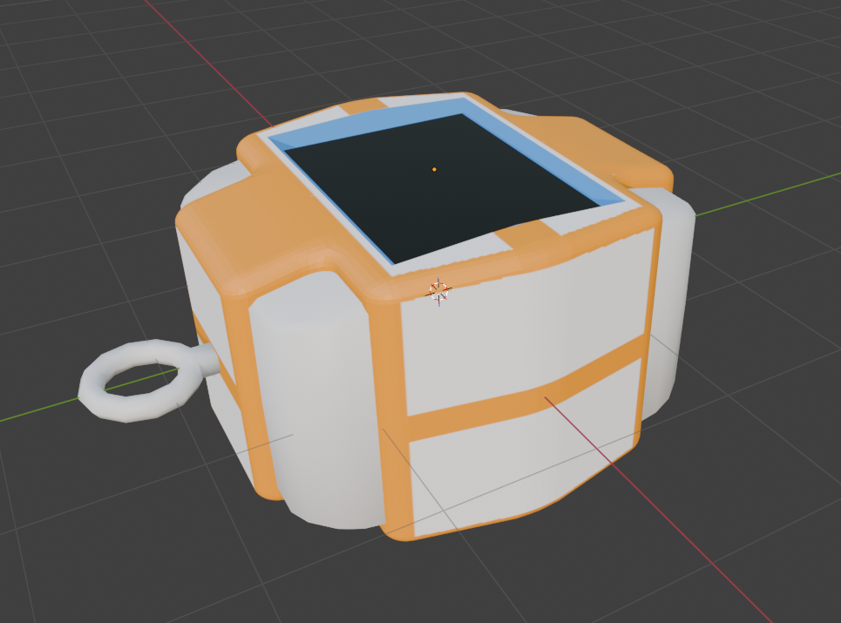



Zef's 3D mockup

Slide 10
Taliahs 3d Mockup

Slide 11
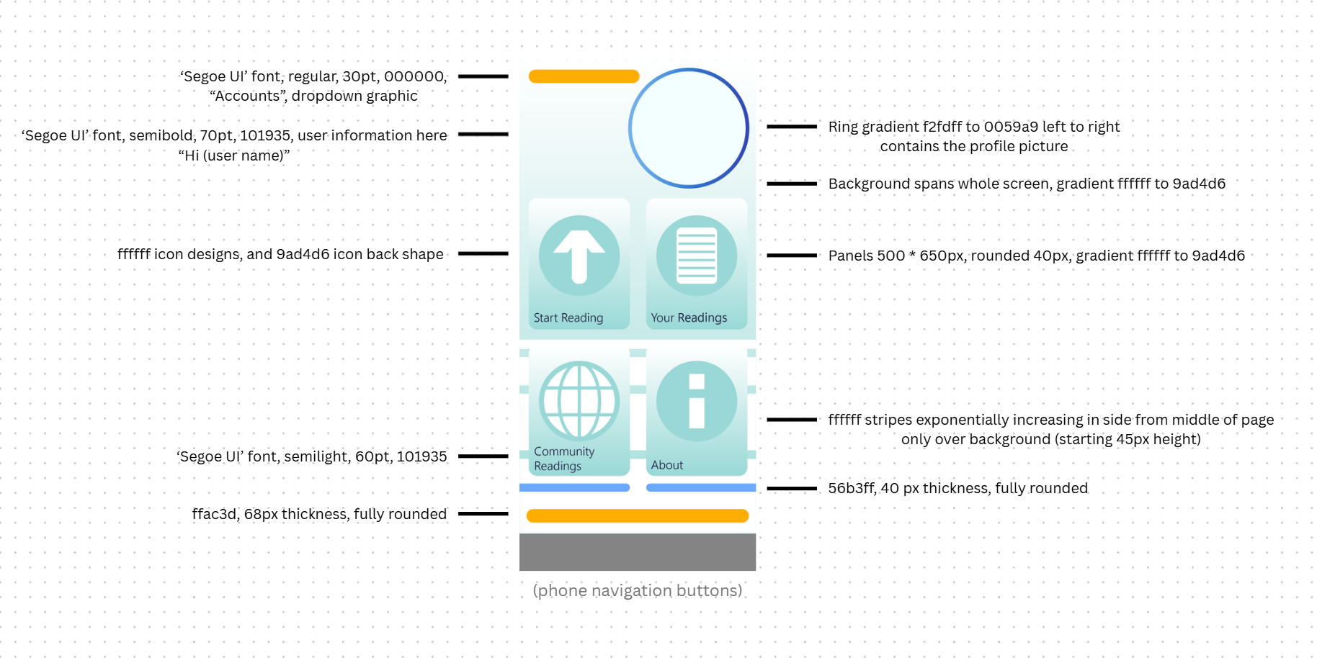
Zef's Website Mockup

Slide 12
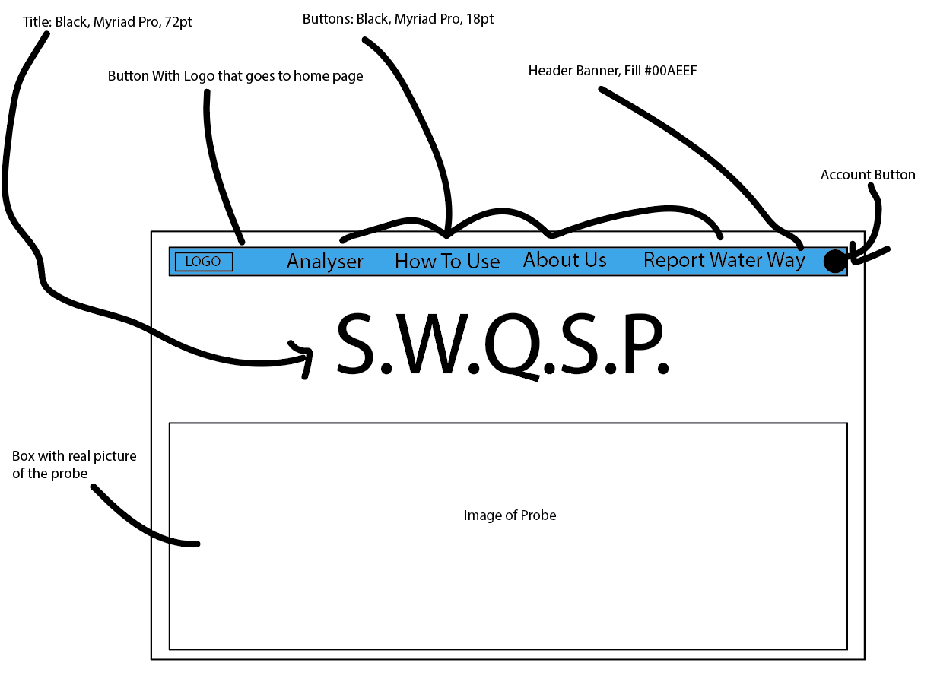
Oscar's Website Mockup

Slide 13
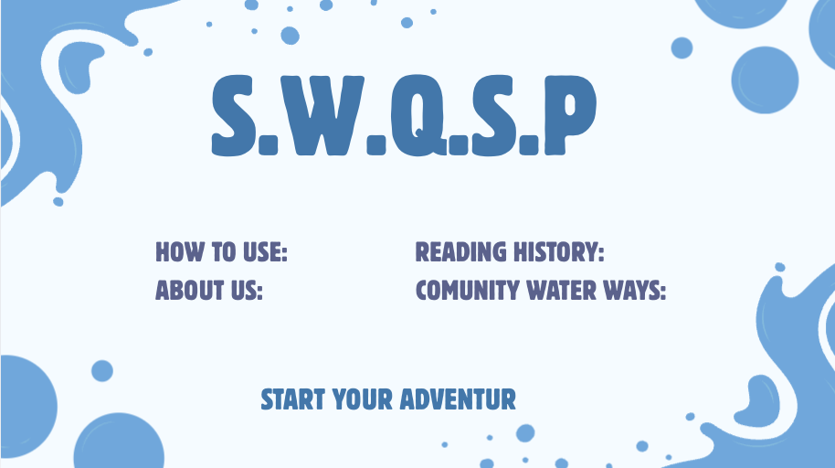





Taliahs Website Mockup
Our name in a blue colour scheme to represent the water
Clicks onto another page
Clicks onto a page were users can buy the probe

Slide 14

Zef's Logo Mockup

Slide 15
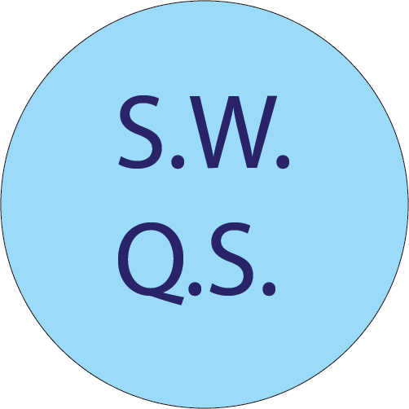
Oscar's Logo Mockup
Blue to represent the water it works in

Slide 16

Taliah's logo Mockup

Slide 17
Evaluation Criteria
The device is able to record water turbidity
This is the main function of the product
Users are shown water turbidity
The water turbidity provides the user with information that will signify how, and how much the water needs to be treated
The website has an interpretable dashboard and summary
Most users would not have the education necessary to interpret raw data from a reading
Users can determine whether water is safe or not for consumption
Records of readings and locations are saved and are reviewable

