Slide 1


TypeScript In-Depth:
Intro

Slide 2
Course Overview
Intro
Types
Functions
Interfaces
Classes
Modules
Generics
Decorators
Asynchronous Patterns

Slide 3

History
2012
Anders Hejlsberg (TypeScript, Delphi, C#)
Microsoft
Open Source
Flexibility and High Performance

Slide 4
TypeScript
…
ES2016
ES2015
ES5
TypeScript

Slide 5

How It Works
TypeScript – language with static type checking and compilation to JavaScript
We can set JavaScript version in TypeScript configuration (tsconfig.json: --target)
TypeScript supports compilation to the following JavaScript versions:
ESNext
ES2015 - ES2020
ES5
ES3 (default)

Slide 6

TypeScript Compiler
first.ts/.mts/.cts
first.js/.mjs/.cjs
tsc
var x: number;
class HelloWorld {}
var x;
function HelloWorld {}

Slide 7
TypeScript → JavaScript
TypeScript
JavaScript (ES5)
class Greeter {
greeting: string;
constructor (message: string) {
this.greeting = message;
}
greet() {
return “Hello, ” + this.greeting;
}
}
var Greeter = (function() {
function Greeter(message) {
this.greeting = message;
}
Greeter.prototype.greet = function() {
return “Hello, ” + this.greeting;
};
return Greeter;
})();
Encapsulation
Static Typing

Slide 8
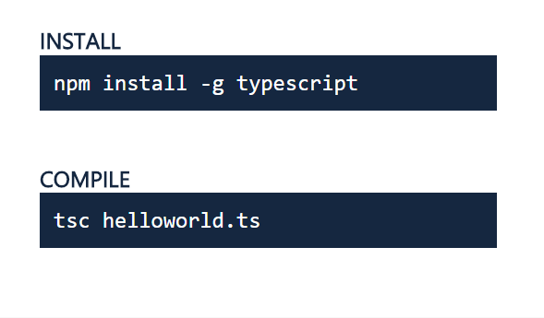
Get TypeScript

Slide 9
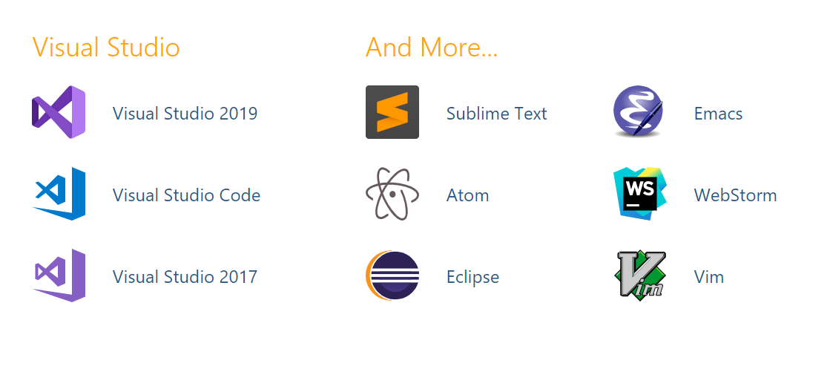
IDE with TypeScript Support

