Slide 1
Graphs, trees and more…
in a photonic architecture!

Slide 2
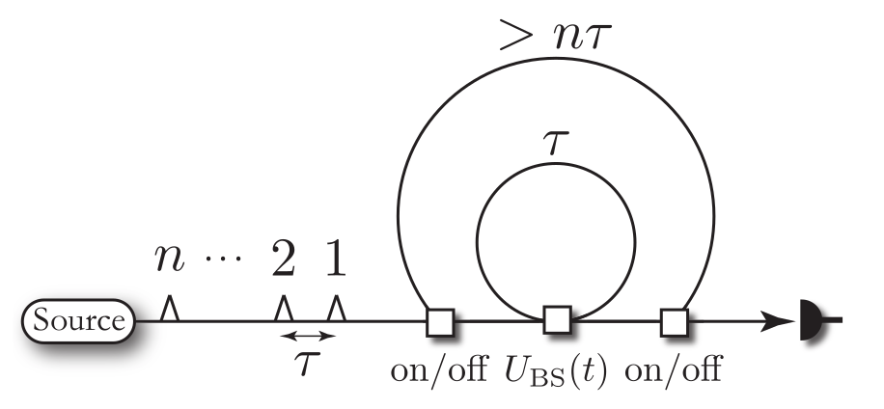
Review: the loop architecture.

Slide 3
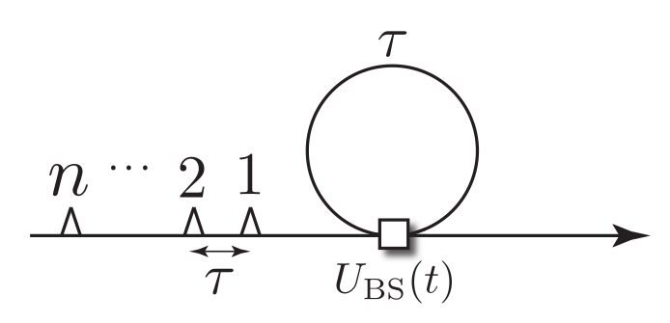
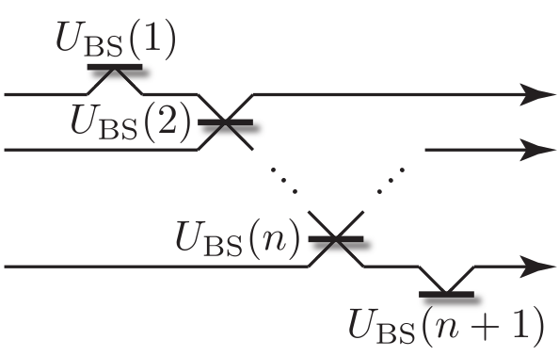
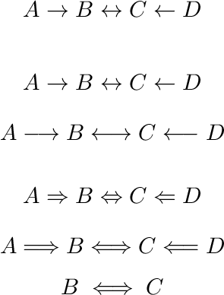
What can we do with just one loop?
Clearly, this is not universal!

Slide 4
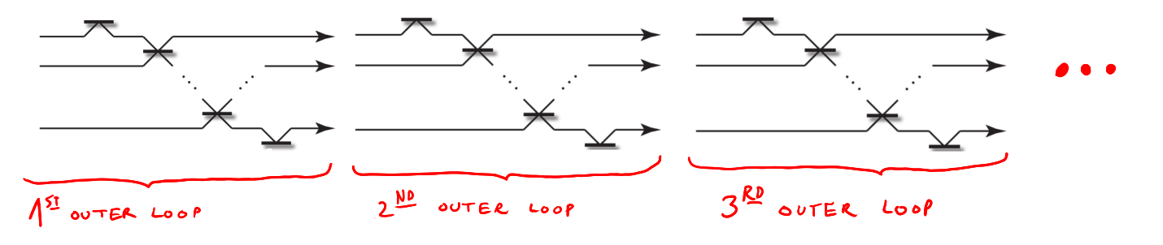
Trick: add a big outer loop!
Now we are universal!

Slide 5
Peter Rodhe presented a constructive proof of the universality of this setup using the naive unitary decomposition presented in Reck et al.
This decomposition allows us to decompose a U(d) unitary in d² beam-splitter unitaries U(2), where d is the dimension of the Hilbert space. Clearly, this doesn’t scale well, in fact d = 2^{n} for a system of n qubits.
We can do much better!

Slide 6
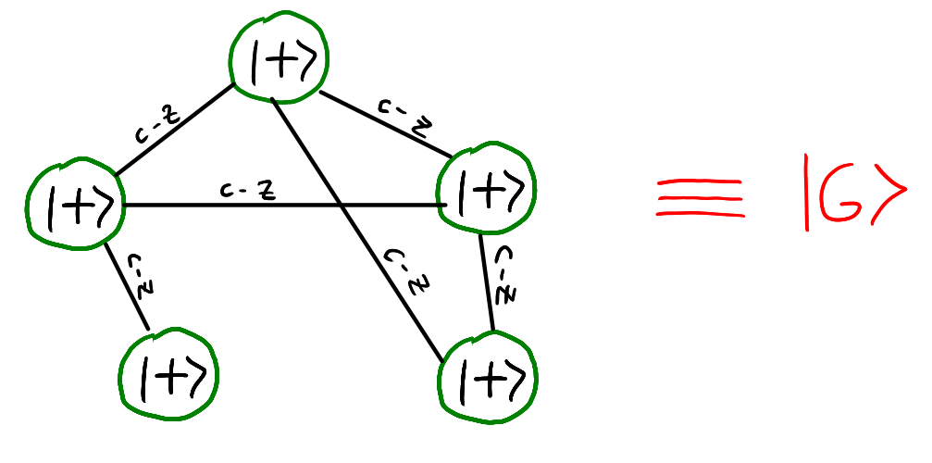
Review: Graph states

Slide 7
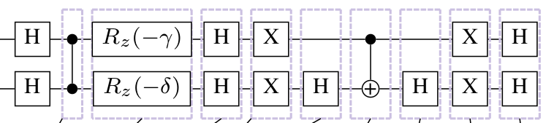
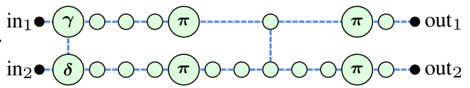
Review: Measurement Based Quantum Computation (MBQC)

Slide 8
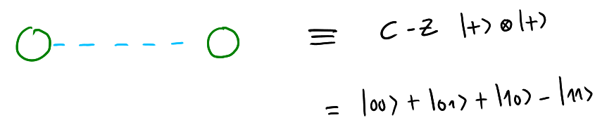
We want to build big graph states.
Two vertices graph states will be the building block of our computation:
We can generate them in an heralded way or in the computational basis.

Slide 9
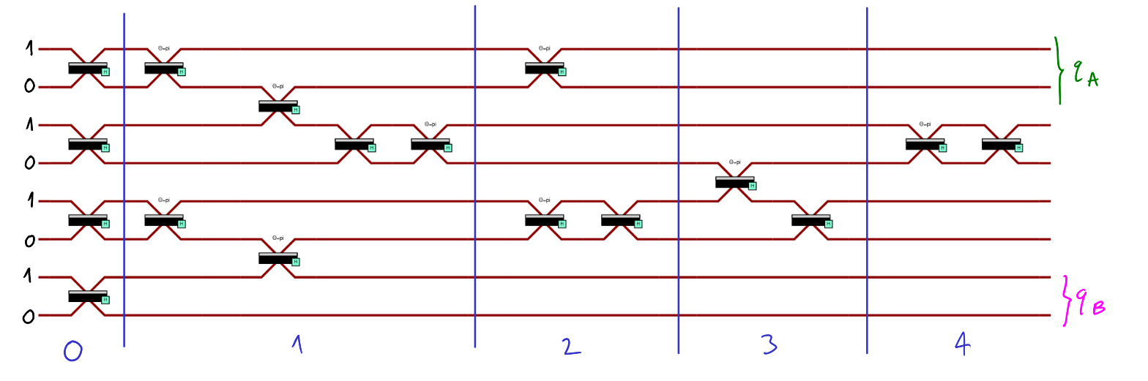
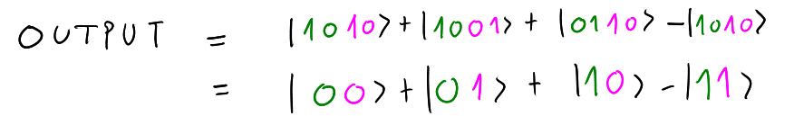
Heralded generation.

Slide 10
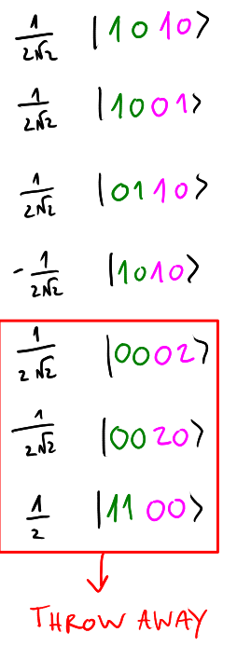
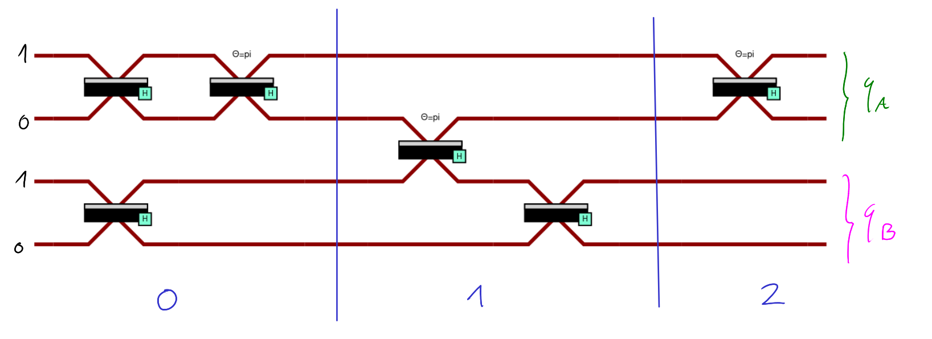
Generation in the computational basis.
Just 4 time slots (instead of 8) and 2 outer loops (instead of 4)….

Slide 11
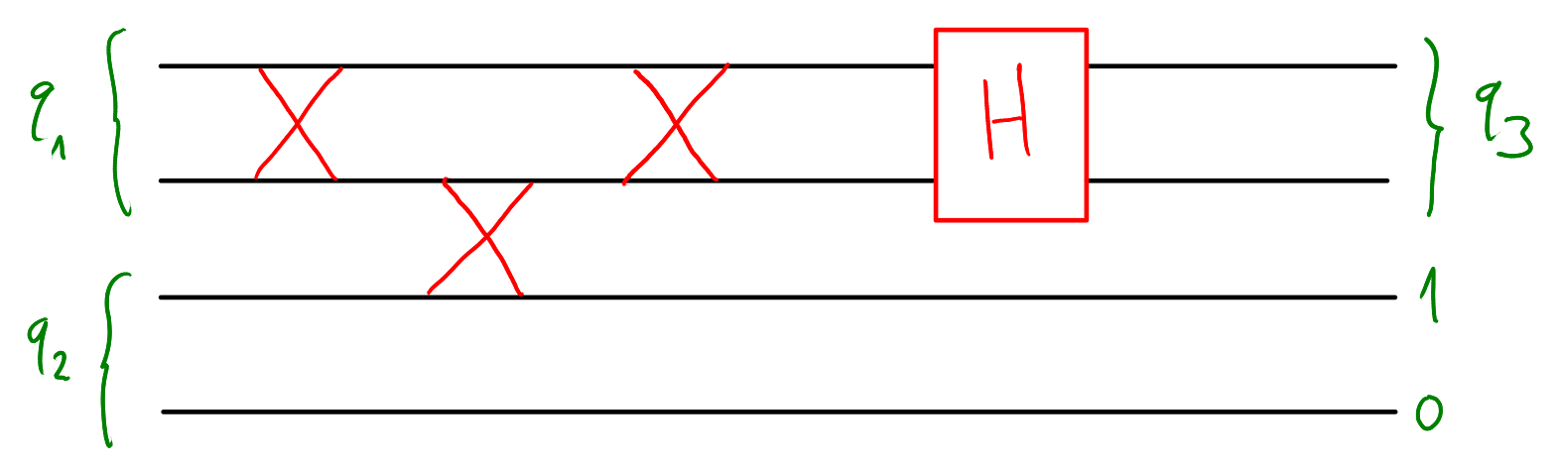
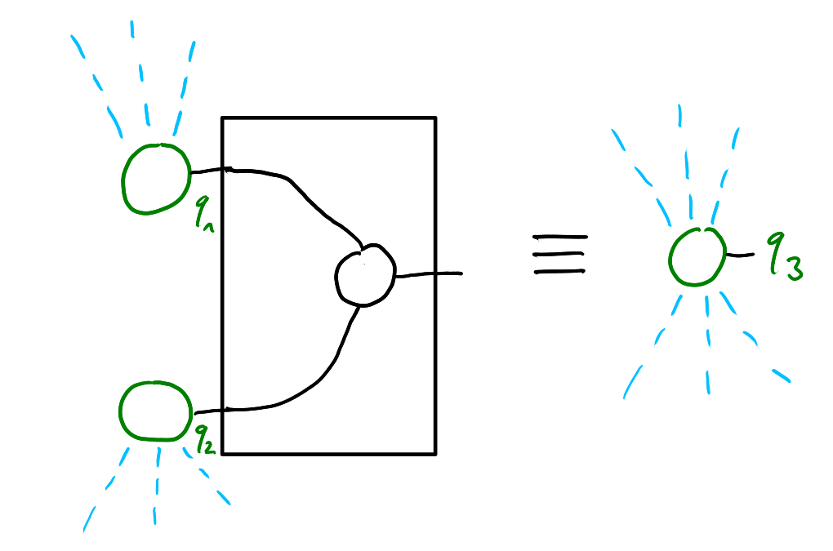
Gluing things together: Fusion
In the ZX-formalism, this is just the three legs spider node:

Slide 12
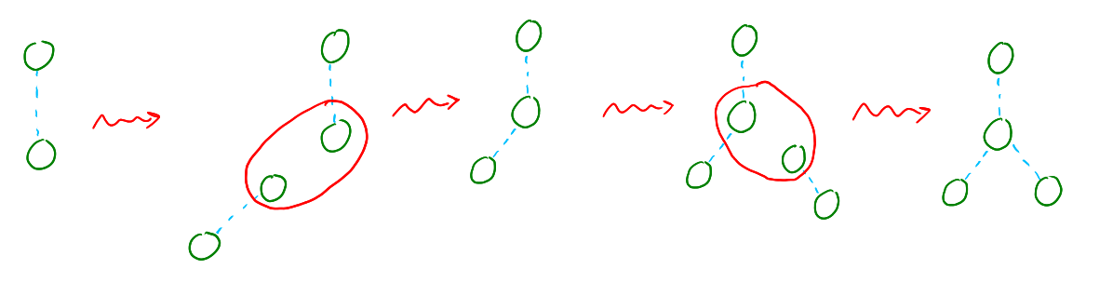
A simple example: three Bell pairs and two fusions.

Slide 13
WARNING!
Fusing heralded pairs is always safe.
Instead, fusing pairs generated in the computational basis doesn’t always work.
This observation motivates the first general result we proved: it’s general because it works for every architecture that uses the computational basis, not just the loop architecture.

Slide 14
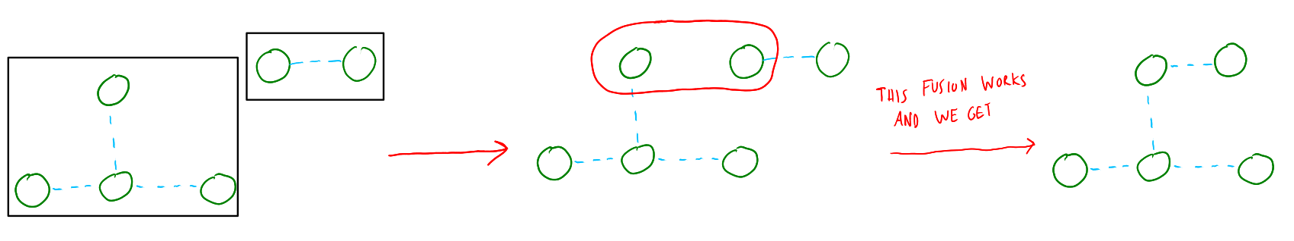
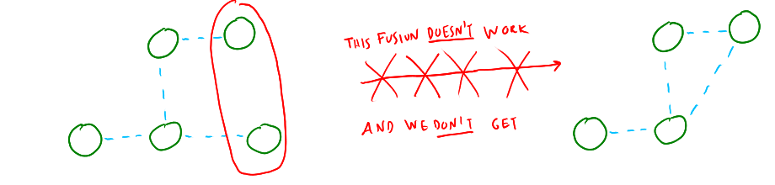
Theorem. Two states generated in the computational basis can always be fused together to get a new state in the computational basis.

Slide 15
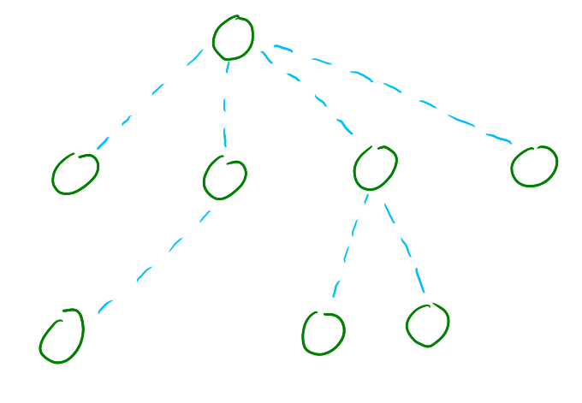
Easy corollary. We can build tree-like graph states with just Bell pairs in the computational basis and fusion.

Slide 16
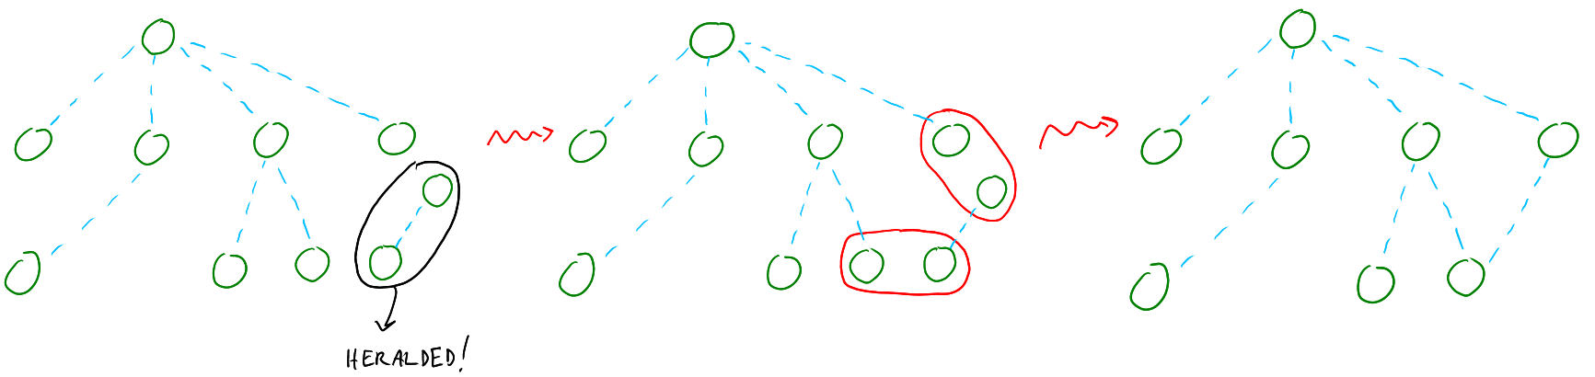
What if we want to add cycles to our graph state?
Result. To add an edge inside a graph state in the computational basis we can use an heralded pair and the following procedure:

Slide 17
Interesting question. Up to local Cliffords, can we build every possible graph state (also with cycles) with just pairs in the computational basis and fusion?
Short answer. No.

Slide 18
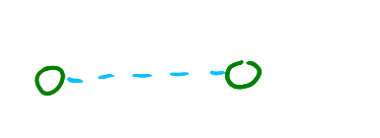
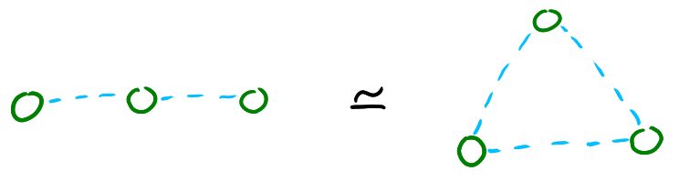
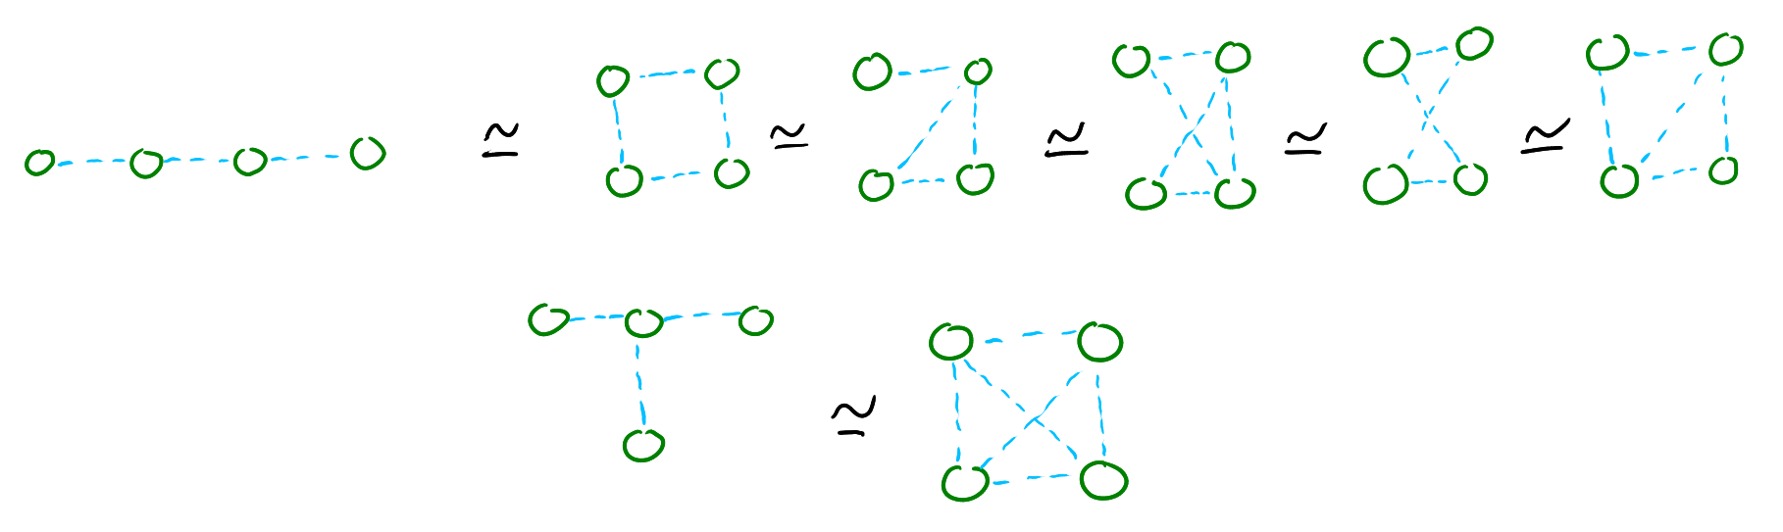
Longer answer. It depends on the number of qubits N.
N = 2 : yes, trivially
N = 3 : yes
N = 4 : yes

Slide 19
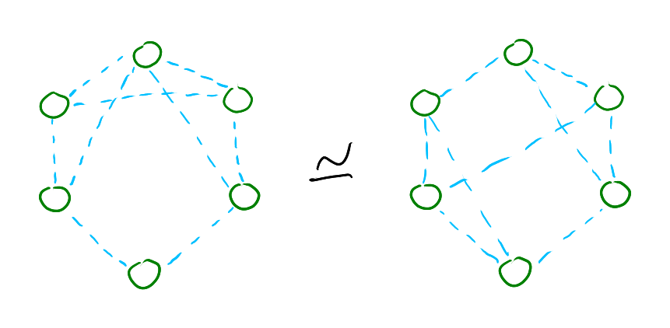
N = 5 : I’m not really sure
N = 6 : nope!

Slide 20
Another interesting question. Up to local unitaries, can we build every possible graph state (also with cycles) with just pairs in the computational basis and fusion? Equivalently. Are tree universal for QC?
Answer. No.
Proof. Up to seven qubits, if two graph states are LC-equivalent they are also LU-equivalent.
Fact. Also stochastic local operations and classical communication (SLOCC) can’t help us, because interestingly two graph states are LU-equivalent iff they are SLOCC-equivalent.

Slide 21
Back to the origins.
Review: the loop architecture.

Slide 22
Question. Given a tree T, how many outer loops do I need to implement it?
Answer. It depends on the order O in which I add the vertices of T.
We will study the function C(T, O)

Slide 23
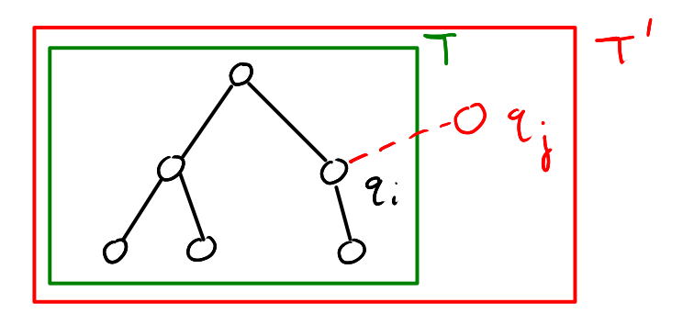
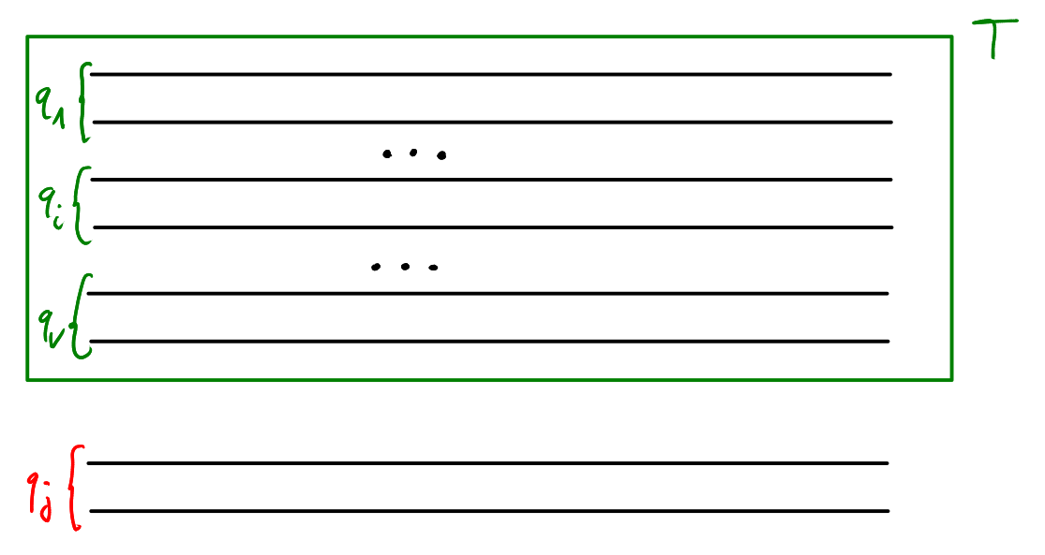
General algorithm to add a node.

Slide 24
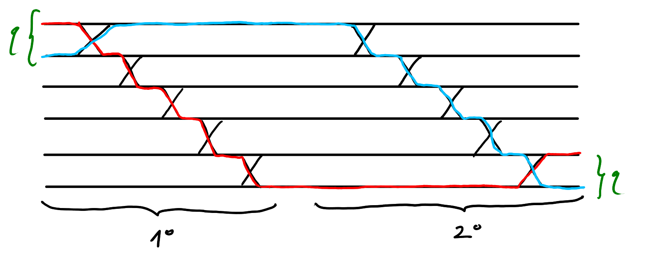
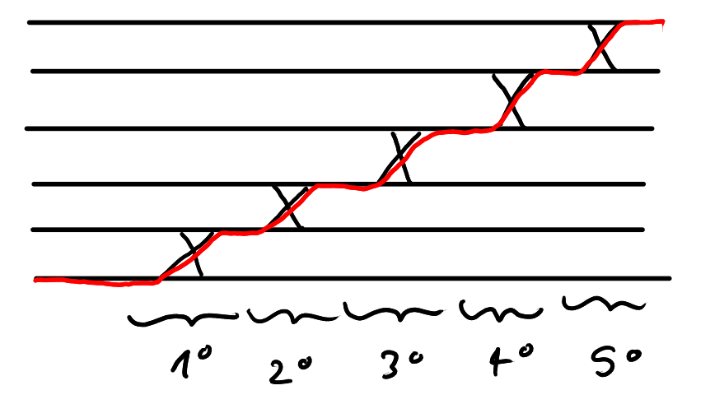
sinking :)
sinking :)
lifting :(

Slide 25
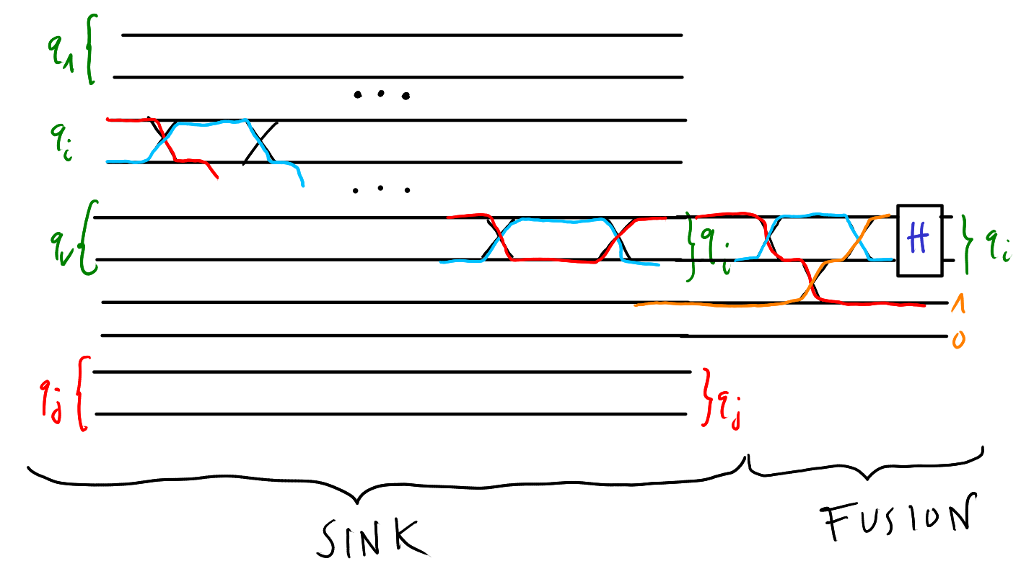
add_edge(i, j):
sink i to the end of the circuit
fuse i and j

Slide 26
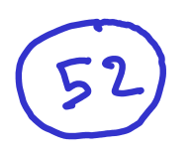

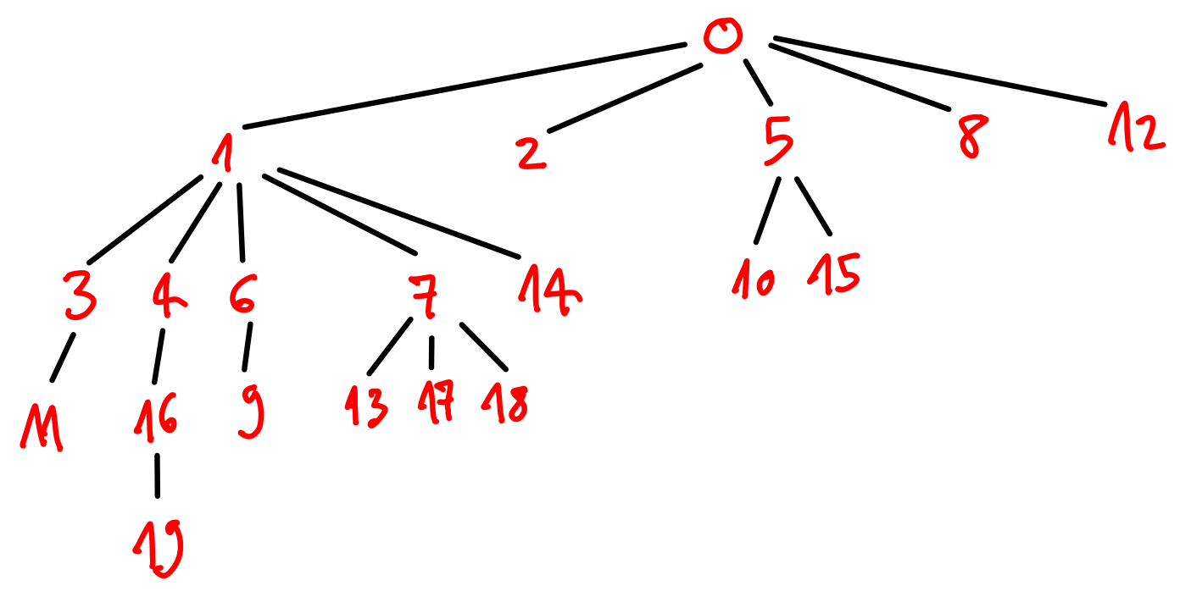

Slide 27
A good class of orders:
DFS-orders

Slide 28
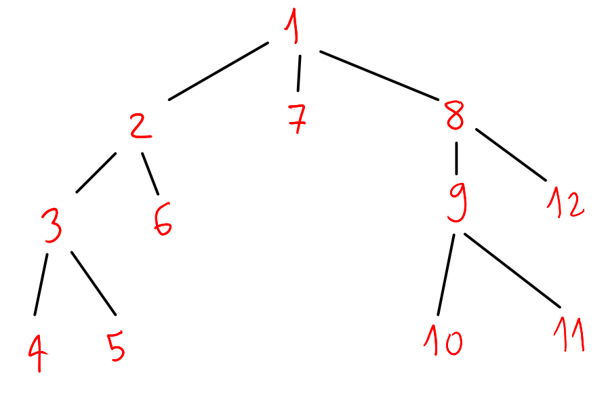
Review: the DFS algorithm
1 → 2 → 3 → 4 → 5 → 6 → 7 → 8 → 9 → 10 → 11 → 12

Slide 29
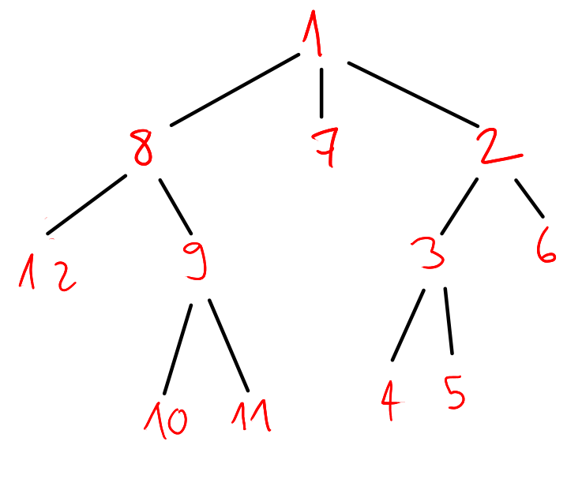
The DFS algorithm gives us a possible order on the tree. But we are left with some freedom:
we can decide in which vertex to start the DFS algorithm;
given a vertex, we can move around it’s children.
≈
1 → 2 → 3 → 4 → 5 → 6 → 7 → 8 →
9 → 10 → 11 → 12
1 → 8 → 12 → 9 → 10 → 11 → 7 → 2 →
3 → 4 → 5 → 6

Slide 30
Optimizing on the starting vertex is easy: it takes O(V).
Optimizing on the children order is an nightmare: exploring all the possibilities would take exponential time.
Thankfully recursion and the DFS algorithm are best friends!

Slide 32
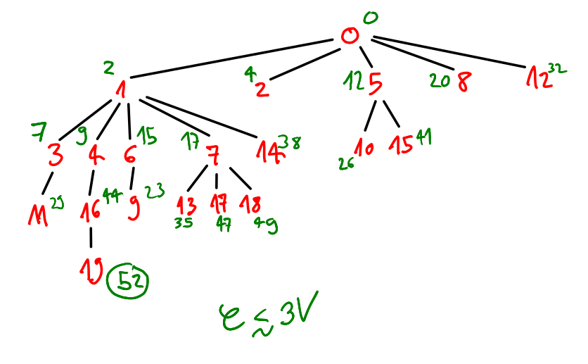
At what loop do we fuse?
Easy bound valid for every order: every time we add a vertex we add at most 3 outer loops.

Slide 33
The optimal DFS-order
How to find it
(recursively)

Slide 34
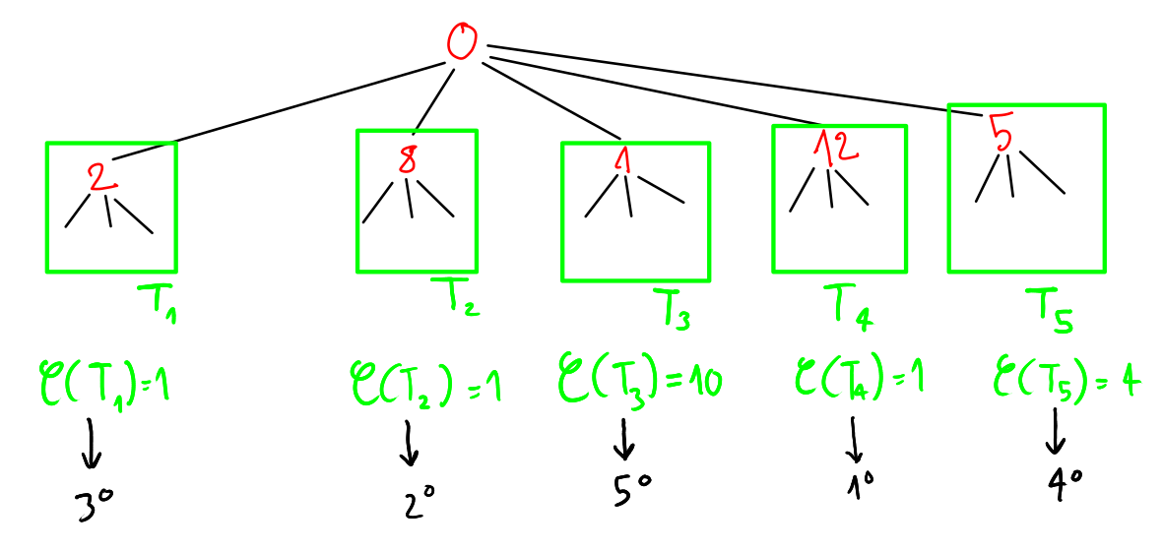

Slide 35
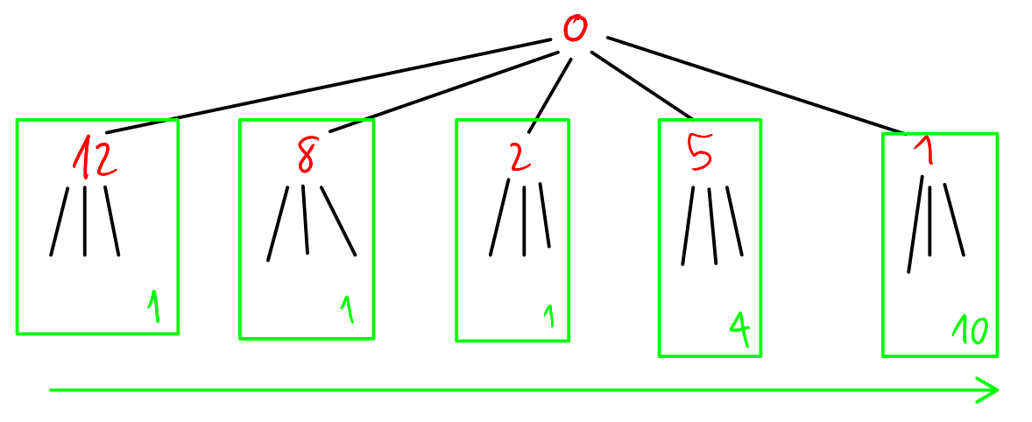

Slide 36
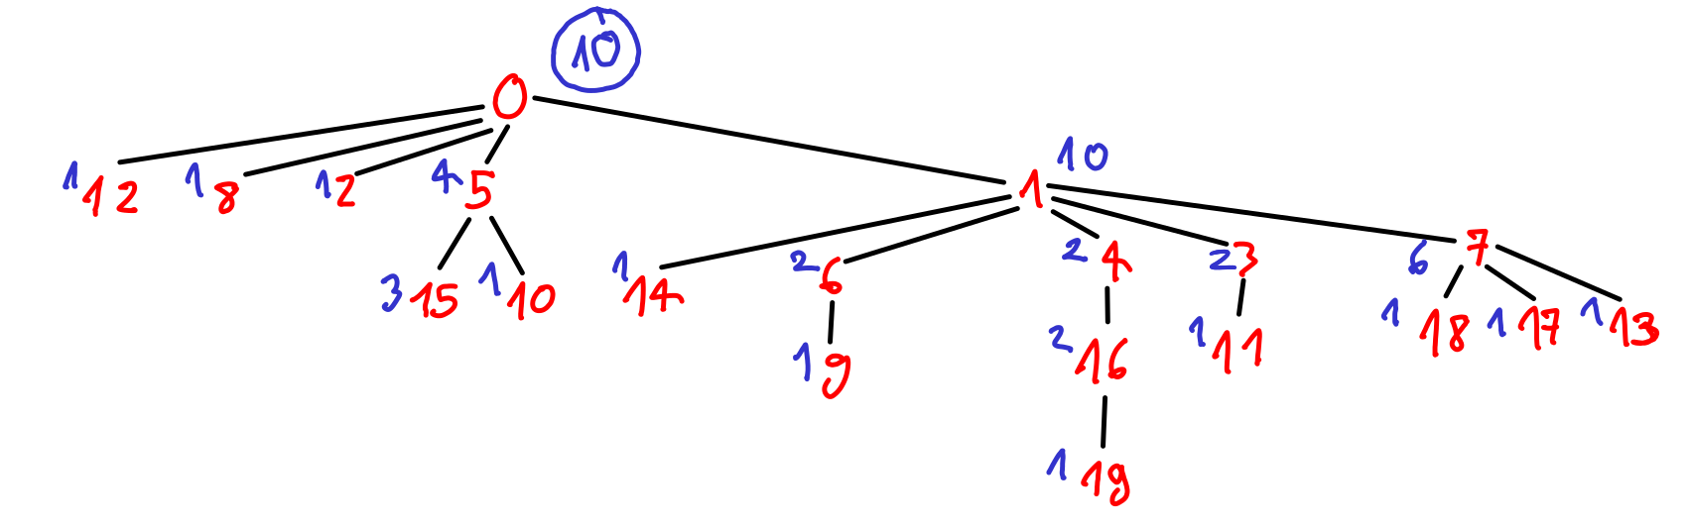

Recursive steps?

Slide 37
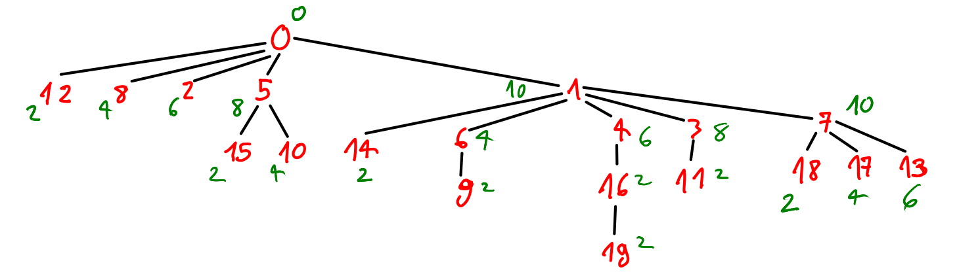
At what loop do we fuse?

Slide 38


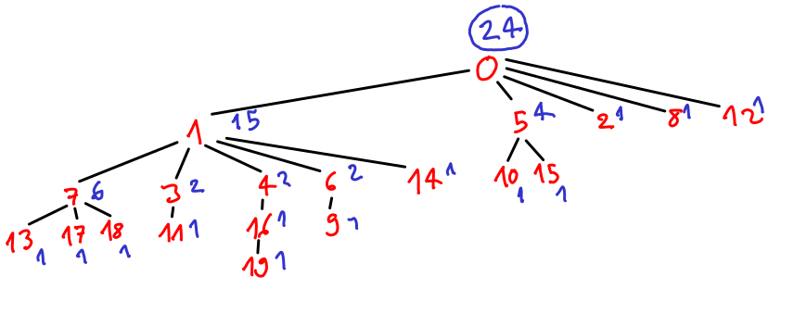
What happens if a devil puts a mirror aside the DFS-optimal ordered tree? We get the worst DFS-order!
In general the worst DFS-order is still better than the random order with started with!

Slide 39
To recap:
52 ≫ 24 ≫ 10
random
worst DFS
best
DFS
We found our optimal answer. It depends on the tree T and the starting vertex v from which we start our recursion: C(T, v).
Notice that this function C takes O(V) time to be computed.

Slide 40
Recursion is a really powerful tool:
we reduced the complexity of the optimization problem;
it helps us also from a formal point of view, to write proofs and analytic bounds.
And of course analytic bounds are not just some kind of overthinking that mathematicians like to do: a nice analytic bounds assure us that the algorithm we found is reasonable or even optimal!

Slide 41
Theorem. Given a tree T and a DFS-order O on T that starts from the vertex h, we have the following bounds for the function C(T, O):
C(T, O) ≤ max{b(p)} on all the possible paths from h to a leaf
≤ (d-1)(max{c(v)} – 1)+3 for all the vertices v in the tree
where d is the tree depth, c(v) is the number of children of the vertex v and b(p) is the sum of c(v) – 1 for all the vertices v on the path.

Slide 42
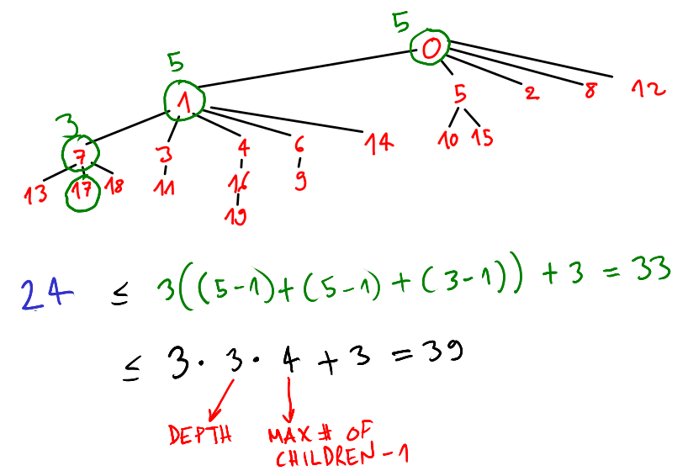
C(T, O) ≤ max{b(p)} on all the possible paths from 0 to a leaf
≤ ( d-1 )( max{c(v)} – 1 )+3 for all the vertices v in the tree

Slide 43
( d-1 )(max{c(v)} – 1)+3
This last bound is really important, because it tells us that all the DFS-orders are in some sense really good orders. In fact the depth of the tree usually grows as ln(V), while the maximum number of children is a constant.

Slide 44
Given a tree T, we understood how to build the optimal circuit from it. Let’s go back to the original problem.
Question. Given a graph state G, how many outer loops do I need to implement it?
Answer. It depends on what tree we extract from the graph.

Slide 45
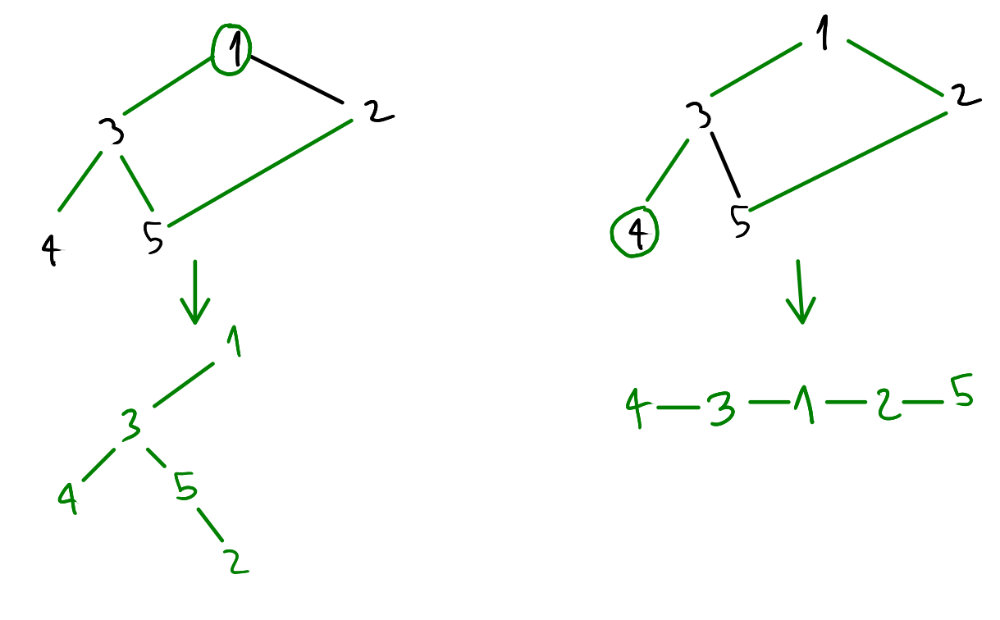
Review: the DFS algorithm to extract a tree from a generic graph.
The topology of the extracted tree depends on the starting vertex!
We need to iterate on all the possible starting vertices to extract V possible trees (O(V) )

Slide 46
optimal_circuit(given a graph state G):
answer = ∞
for every vertex v in G:
extract tree T given by a DFS starting from v
for every vertex v’ in T:
answer = min(answer, C(T, v’ ))
It takes O(V³)

Slide 47
One last step: some ZX-calculus optimization
Now we just have to optimize on all the ZX-graphs that are ZX-equivalent to our original unitary U. For example, this allows us to play with local complementation (and thus pivoting) to get a smaller optical circuit in the end. In other words we are interested in
min optimal_circuit(G) on all G that are ZX-equivalent to U

Slide 48
Future developments.
Introducing the concepts of gflow and time cones in our MBQC gives us the possibility to have a variable number of inner loop, because we can “measure on the way”.
For now, the number of inner loop is fixed by the number of vertices of the graph state, so we just seek the smallest number of outer loops.
The ZX-optimization is more challenging, because we want to restrict ourself to the subset of ZX-graphs with a gflow and nowadays is still an active area of research to characterize the ZX-operations that preserve gflow.

