Slide 1
Graphs, trees and more…
in a photonic architecture!

Slide 2
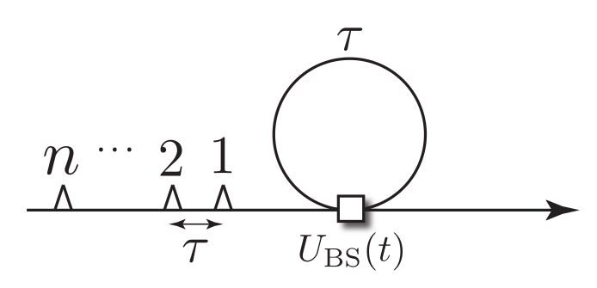
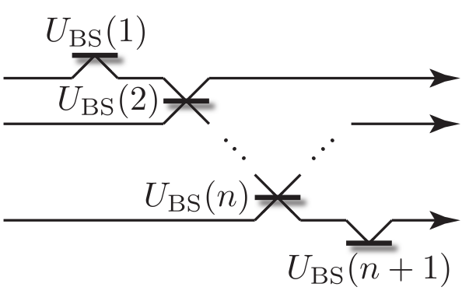
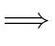
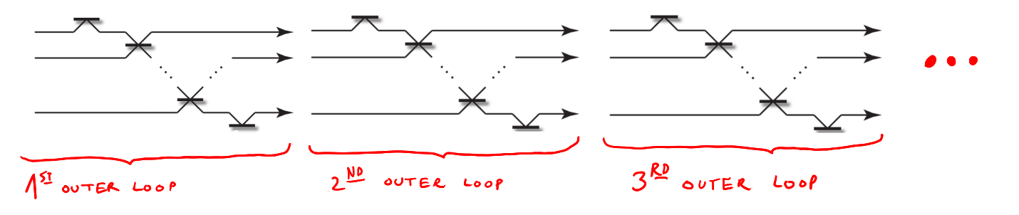
What can we do with just the small loop? And with the outer one?

Slide 3
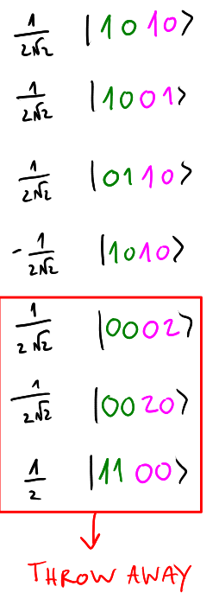
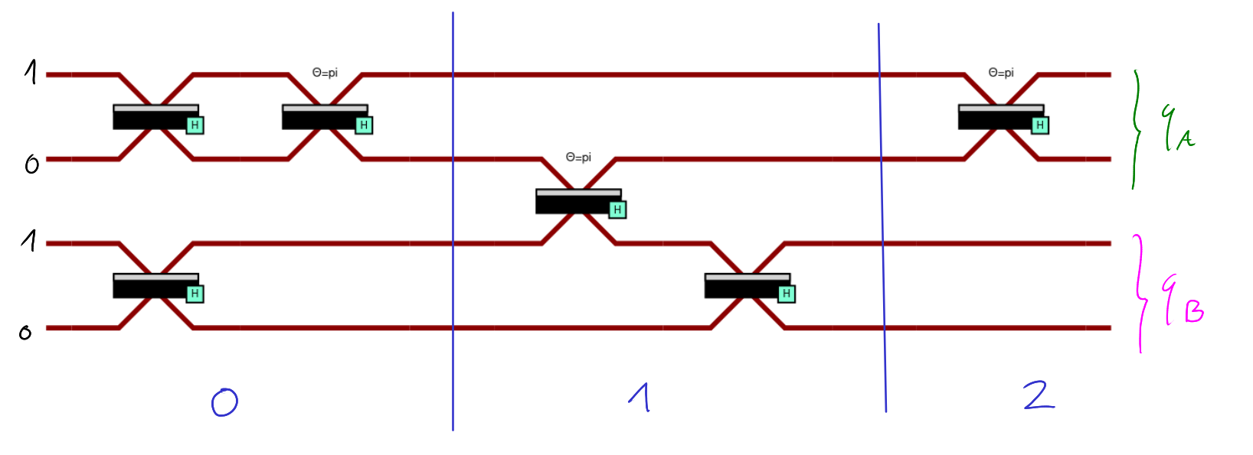
Generation in the computational basis.
Just 4 time slots (instead of 8) and 2 outer loops (instead of 4)….

Slide 4
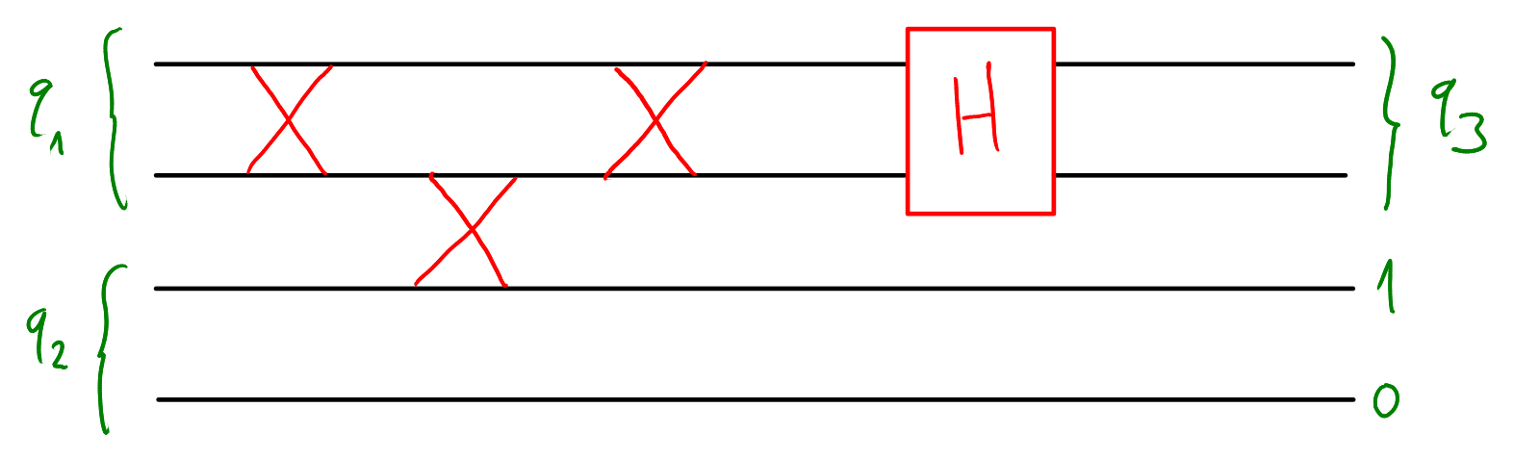
Gluing things together: Fusion

Slide 5
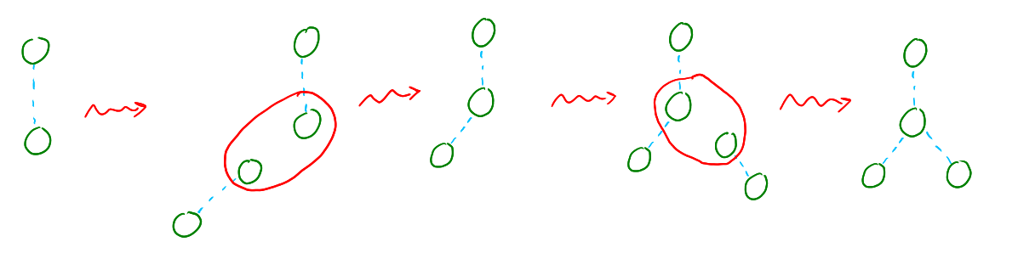
A simple example: three Bell pairs and two fusions.

Slide 6
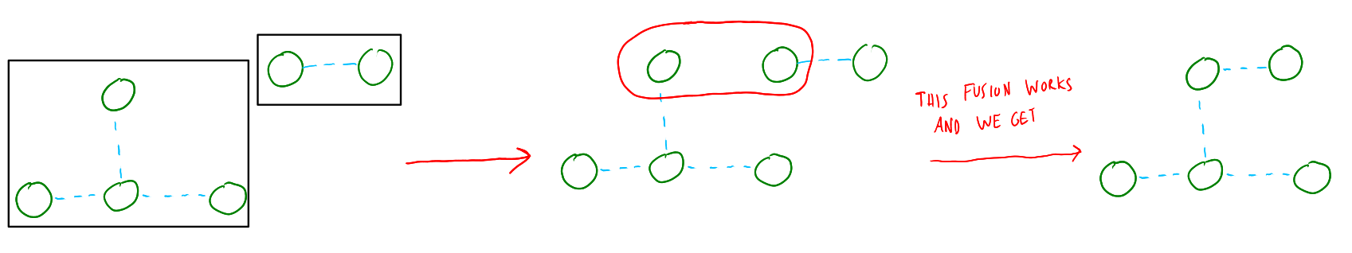
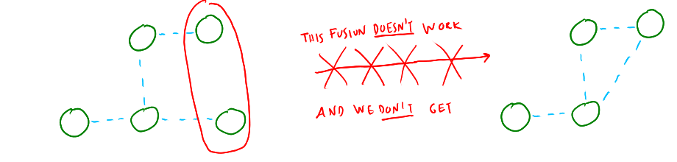
Theorem. Two states generated in the computational basis can always be fused together to get a new state in the computational basis.

Slide 7
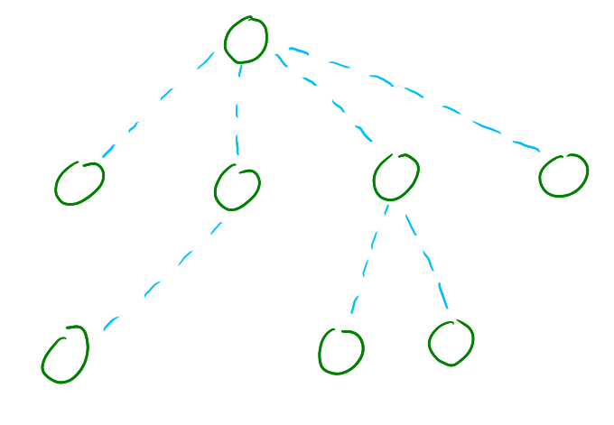
Easy corollary. We can build tree-like graph states with just Bell pairs in the computational basis and fusion.

Slide 8
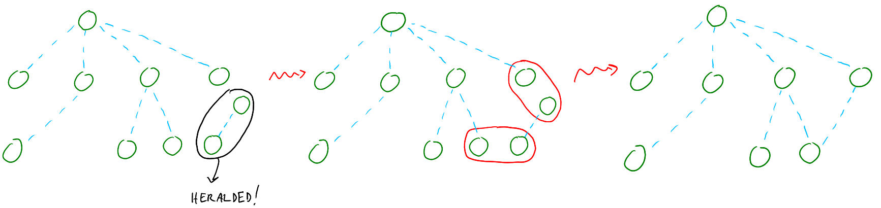
What if we want to add cycles to our graph state?
Result. To add an edge inside a graph state in the computational basis we can use an heralded pair and the following procedure:

Slide 9
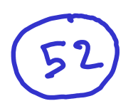
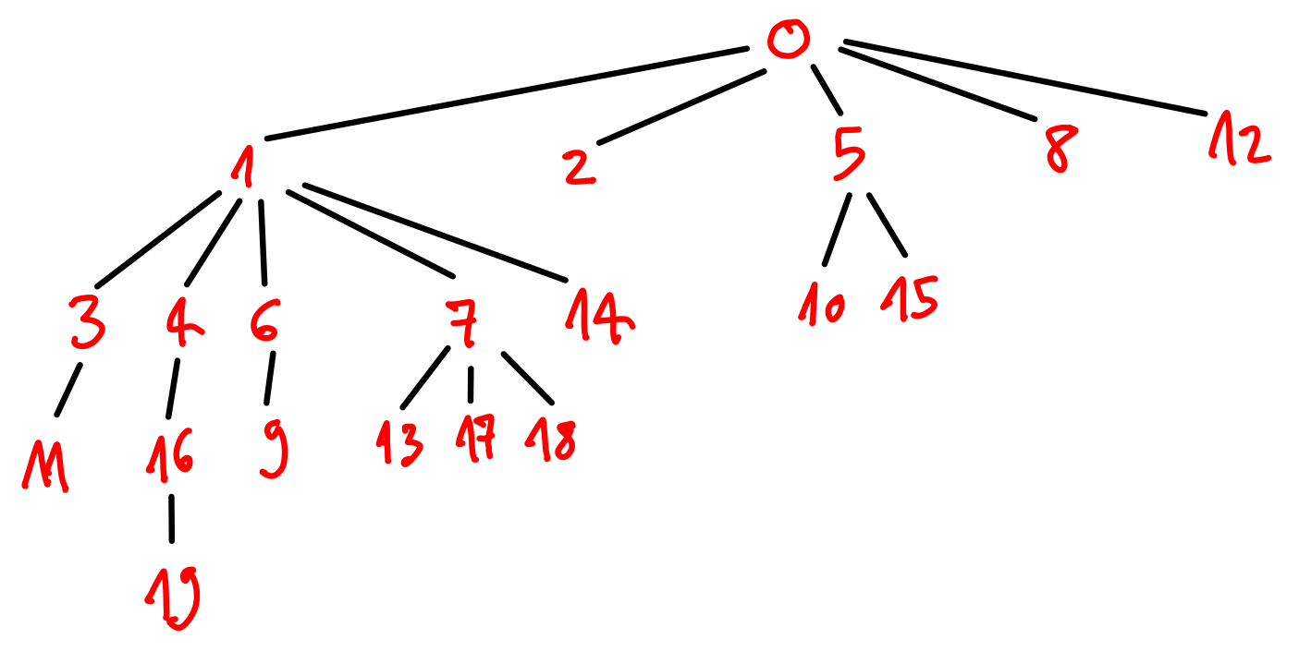
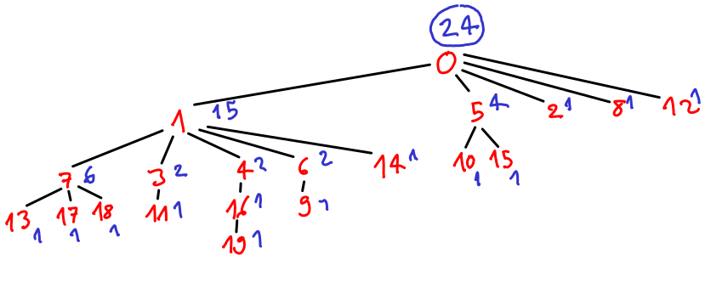
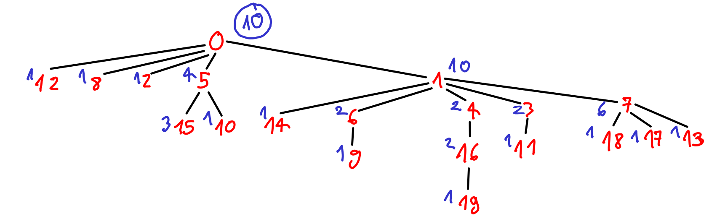
52 ≫ 24 ≫ 10
random
worst DFS
best DFS

Slide 10
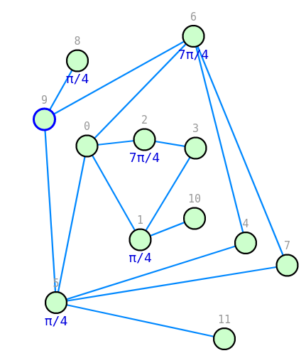
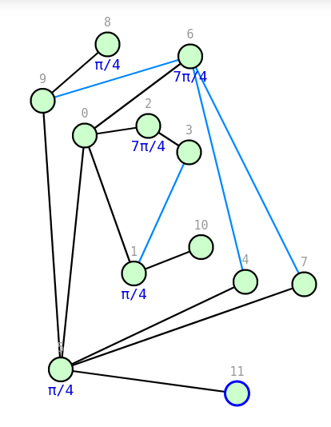
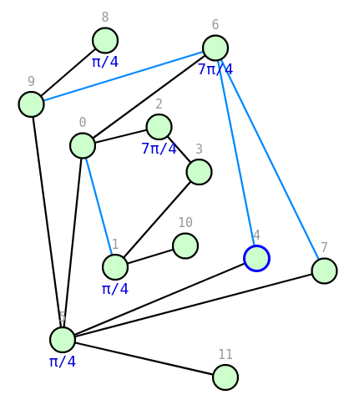
Tree extraction...

Slide 11
Future developments.
ZX-optimization to get the smallest circuit;
introducing the concepts of gflow and time cones in our MBQC gives us the possibility to have a variable number of inner loop.

