Slide 1

Managing the Evolution of Software Product Lines
Cheng Thao & Michael Haufe {chengt,mlhaufe}@uwm.edu

Slide 2
Software Product Line Engineering (SPLE) is a systematic approach to software reuse
Developers produce a set of core assets that are intended to be shared by multiple products
Product 1
Product 1
Product 1
Core Assets
Core Assets
Core Assets
A
A
A
A
A
A
B
B
B
B
B
B
Product 2
Product 2
Product 2
C
C
C
B
B
B
C
C
C

Slide 3
Each of the products has some of its own product specific code
All of this code can evolve over time for the normal reasons of maintenance and evolving functionality.
Product 1
Core Assets
A
A
B
B
Product 2
C
B*
C

Slide 4
Reuse is a central theme of product line engineering
Our approach uses shared components to enable reuse.
Product 1
A
Core Assets
B
A
B
C
Product n
B
D
C

Slide 5
Managing the evolution of a product line is challenging because of the independent evolution of products, core assets, and their interactions
We think of product line evolution as a two dimensional problem where one dimension is time (artifacts changing over time) and the other is space (artifacts varying between products).

Slide 6
Evolution

Slide 7
Product Version Space
Core Assets Version Space
Shares
a
Cv1
Pv1
a
a
Cv2
Pv2
a
Shares
a
Cv3
Shared component
Core asset
In the example above, the product is using shared component "a" from the core assets. However, as the product moves from version "Pv1" to version "Pv2", the version of the shared component changes from "Cv1" to "Cv3"

Slide 8
Product A Version Tree
Core Assets Version Tree
Product B Version Tree
PAv1
CAv1
PBv1
PAbv1
PAv2
CAv2
PBbv3
PBv2
PAbv2
PAv3
CAv3
PBv3
The larger black arrows indicate the main development trunk while the smaller arrows indicate branches. The dotted lines indicate a merge.

Slide 9
Product Versioning Model
Version 0
Version 1
Version 2
A
A
A
B
B
C
B
C
D
A version represents a state of the project tree and its artifacts. Each box represents a file or directory. A colored box indicates a file or directory that has changed since the previous version.

Slide 10
Evaluation

Slide 11
We evaluate our prototype using the Graph Product Line (GPL)
Since graphs are well understood data structures, they are a prime candidate for representing an abstraction of a Product Line
Our goals are to determine if our prototype can model a realistic software product line, capture its evolution, and evaluate change propagation between core assets and products.
Notes:
GPL: a standard problem for evaluating product line technologies

Slide 12
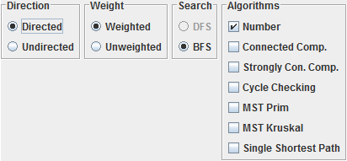
GUI screenshot of a GPL program option screen which provides a means of specifying the implementation of a variety of GPL instances.
Notes:
GPL: a standard problem for evaluating product line technologies

Slide 13
Results

Slide 14
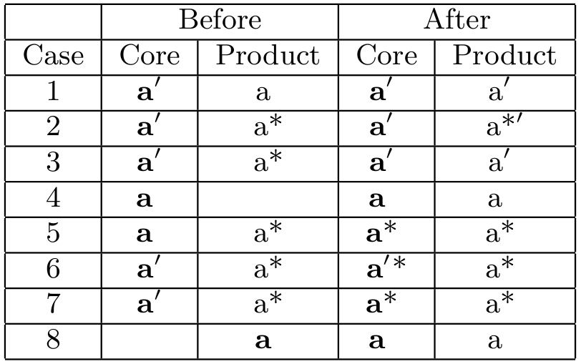
We evaluate our prototype with the GPL to confirm different change propagation cases. The prototype supports all the cases listed in the table below. Bold items are concrete components, while items in non-bold characters are shared components. The ' and * represent different changes.

Slide 15
CONCLUSION
We have described an approach that is capable of versioning multiple types of product line projects including Graph Product Lines. It has a versioning model for a product line consisting of a single core assets project and multiple product projects where core assets are shared among the products through the use of shared components. Using the shared component data structure and the branching of the core assets project, we are able to support independent development of core assets and products and change propagation between them.

