Slide 1



Versioned Lexical Search
Alex Garcia & Michael Haufe {adgarcia,mlhaufe}@uwm.edu
Version Control
Lexical Search
Design
GUI
Back end
SD
SVN
Versioned Lexical Search
Version 1
Version 2
Version 3

Slide 2
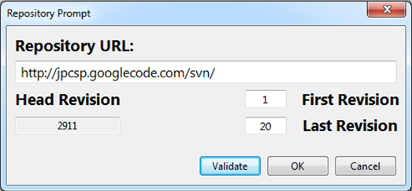
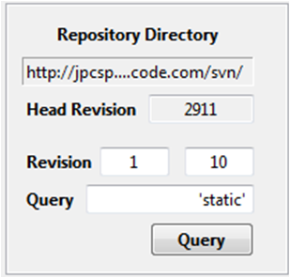
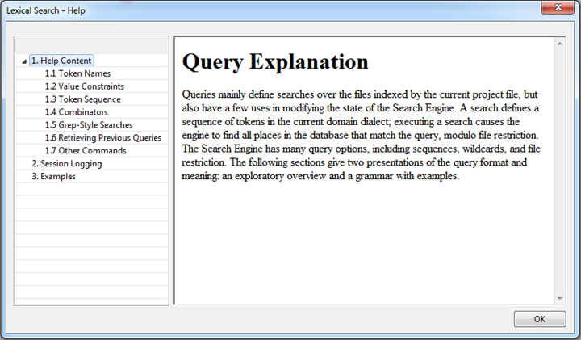
Implementation
Choose a Repo. + Revision
Execute a Query
Integrated Help

Slide 3
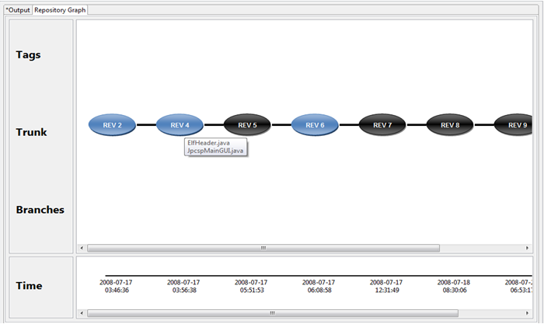
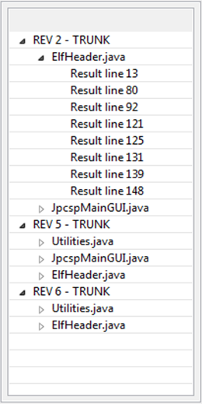
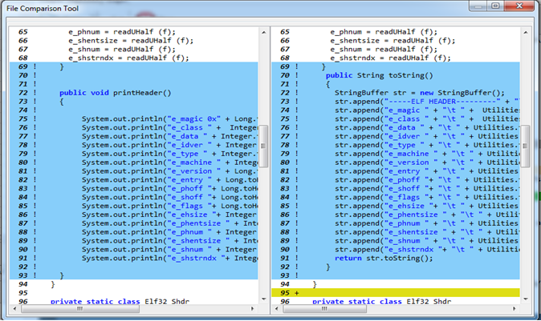
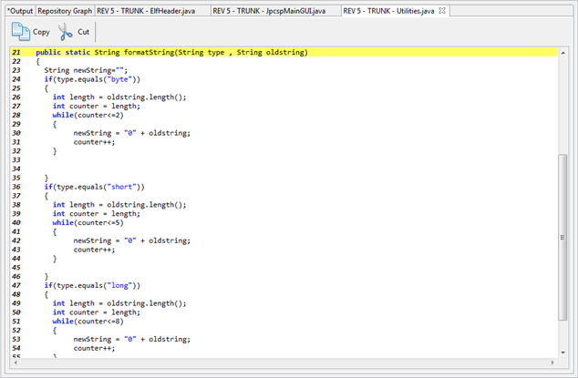
Implementation (cont.)
Individual results
Revision Graph
Compare Files
File Editor

