Slide 1
RWTH AACHEN UNIVERSITY
ML4CE · SEMESTER PROJECT · TOPIC 2
VEHICLE
COUNTING
A detector built from scratch, and a counting pipeline for traffic video.
THE VINH NGUYEN TRONG · ALI AWADA · REXHEP AZEMI
PART 1 DETECTOR FROM SCRATCH · PART 2 COUNTING IN VIDEO
Notes:
~30 SEC. - Question first, then the names. Short pause after 'It is not.'
A camera looks at a street. How many cars just drove past? ... Sounds trivial. It is not.
Hello! We are Vinh, Ali and Rexhep. This is our ML4CE semester project, Topic 2.
Two parts: first we build a car detector ourselves, from scratch. Then we use it to count traffic in a video.
One thing up front: we show you the numbers that worked - and the ones that did not.
(Straight on to slide 2.)

Slide 2
THE TASK
Two parts, one pipeline
Detect vehicles in images, then count them in a video
IMAGES
1001 dashcam frames
DETECTOR
our own head
VIDEO
60 s of an intersection
TRACKER
IoU + Hungarian, ours
COUNT
per direction
→
→
→
→
01 Part 1 - build a detector by hand
Per cell of a 16 x 16 grid: one objectness score, four box values. Then NMS.
02 Part 2 - count vehicles in a video
Fine-tuned YOLO-nano, our tracker for stable IDs, one counting line.
GRADED ON: WHAT WE TRIED · WHAT WORKED · WHAT DID NOT · WHICH METHOD IS BEST, AND WHY
VEHICLE DETECTION & COUNTING · ML4CE · SEMESTER PROJECT · TOPIC 2
2
Notes:
~45 SEC.
Quick context: the task sheet asks for two things.
Part 1: a detector. Image in, boxes out. Not a library - our own head on a pretrained backbone. The point is to understand what a detector actually does inside.
Part 2: counting. Same street, but in a video. And that is a different problem, because the count depends on three stages, not one: detect, track, count.
And the grade is not only the final number. It is: what did you try, what worked, what did not - and why.

Slide 3
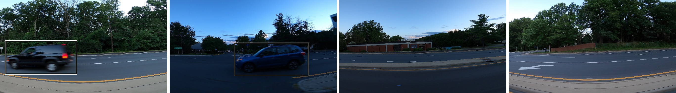
THE DATA
1001 images - and one video
Kaggle car-object-detection, 676 x 380 px, one vehicle class
Two labelled frames, two frames of empty road - the empty ones are kept as negatives
1001
IMAGES
559
BOUNDING BOXES
64.5%
FRAMES WITH NO VEHICLE
1.59%
MEDIAN BOX AREA
2 / 559
BOXES LOST TO THE GRID
All 1001 images are frames of a single video, about 0.67 s apart - so neighbours are near-duplicates.
VEHICLE DETECTION & COUNTING · ML4CE · SEMESTER PROJECT · TOPIC 2
3
Notes:
~50 SEC.
1001 images, 559 boxes, 676 by 380 pixels. One class: vehicle.
Two thirds of the frames show empty road. We keep them - they teach the model what 'no car' looks like.
The cars are small: half of them cover less than 1.6 percent of the image. Remember that number, it comes back later.
And now the sentence that decides everything after it: all 1001 images are frames of one single video. Two thirds of a second apart. So two neighbouring images are almost the same picture.
(Say the last line slowly.)

Slide 4
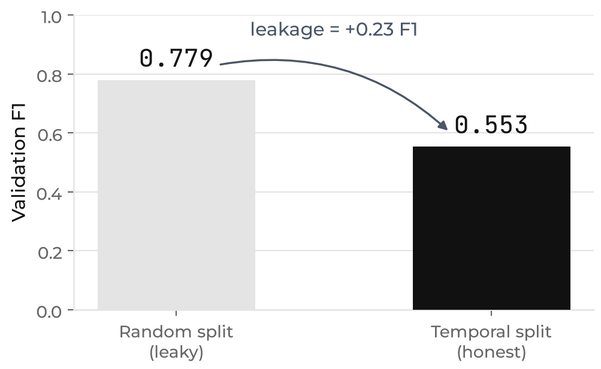
FINDING 1 · METHODOLOGY
A random split leaks
Same model, same hyperparameters - only the split changed
WHY IT HAPPENS
A random split puts a frame in train and its twin 0.67 s later in test.
The model is scored on cars it has already memorised.
We split on time instead: 80 / 15 / 5, earliest to latest.
EVERY NUMBER FROM HERE ON IS THE TEMPORAL SPLIT
VEHICLE DETECTION & COUNTING · ML4CE · SEMESTER PROJECT · TOPIC 2
4
Notes:
~60 SEC.
So what happens if you split that randomly? One frame goes into training, its twin goes into the test set. Then you are not testing the model any more - you are testing its memory.
Same model, same settings, only the split changed: validation F1 reads 0.78 instead of 0.55. A difference of 0.23 - and it is pure illusion.
We split along time instead: earliest 80 percent train, next 15 validation, last 5 test. Nothing else changed.
Everything you see from here on is the honest number.
[short pause]

Slide 5
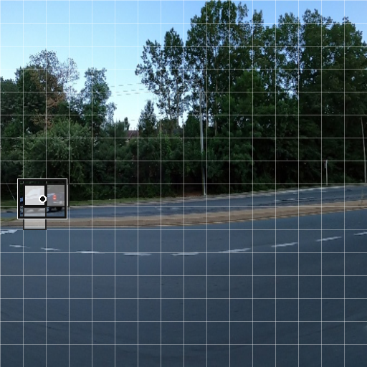
PART 1 · ARCHITECTURE
What the head predicts
One objectness score and four box values, per cell of a 16 x 16 grid
PER CELL
objectness
is there a vehicle centre in this cell?
off_x, off_y
where in the cell the centre sits, 0 to 1
w, h
box size as a fraction of the image
All five values live in 0 to 1 - a plain sigmoid produces them, no anchors needed.
A unit test asserts encode - decode returns the original boxes at IoU 1.0.
Network input 512 x 512. Bright cell holds the box centre; the pale cells are our multi-cell rule
STRIDE 32 · 16 x 16 GRID · 1280 NUMBERS PER IMAGE
VEHICLE DETECTION & COUNTING · ML4CE · SEMESTER PROJECT · TOPIC 2
5
Notes:
~55 SEC.
So how does the detector work? A network has a fixed output size. But an image can contain zero cars, or seven. You cannot simply 'output a list'.
The trick: cut the image into a grid, 16 by 16. And ask every cell one small question - is there a car centre inside you? If yes: where exactly, and how big?
That is five numbers per cell. All between 0 and 1, so a simple sigmoid can produce them. No anchor boxes needed.
And one detail that saved us: encoding and decoding are exact opposites, and a test proves it. If those two disagree, the loss still looks perfectly healthy and every box is quietly wrong.

Slide 6
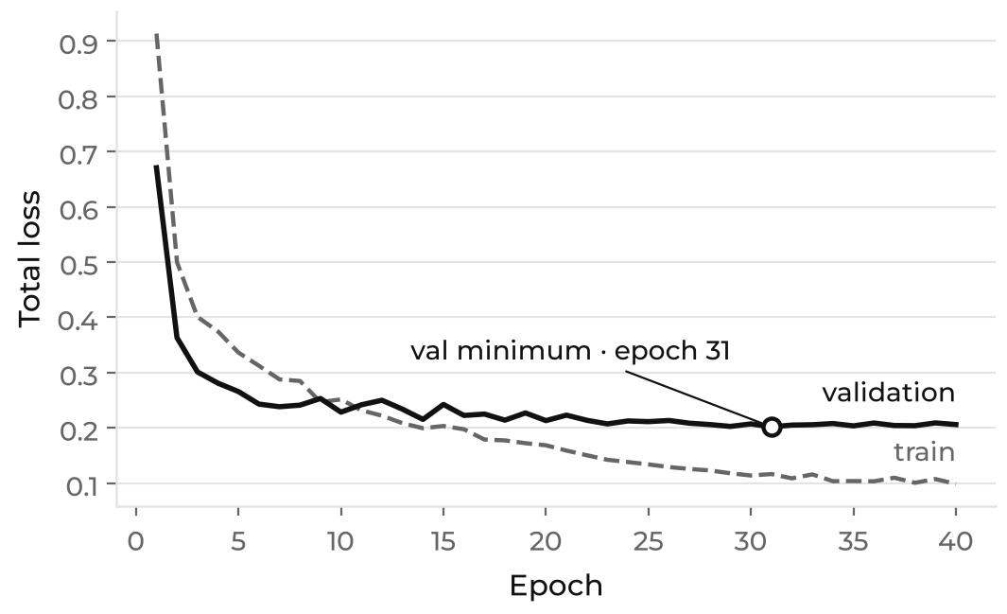
PART 1 · BASELINE
The configuration the task sheet prescribes
Frozen ResNet18, one positive cell per box, L1 box loss, 40 epochs
SPLIT
PRECISION
RECALL
F1
AP50
NOTES
Validation (150 images)
0.679
0.559
0.613
-
threshold and NMS tuned here
Test (50 images)
0.455
0.395
0.423
0.213
38 boxes only
The test split is too small to carry the argument alone.
50 images, 38 boxes - one bad frame moves F1 by several points. The 80/15/5 ratio is the task sheet's, so validation is our primary number.
TRAINING STOPS HELPING AT EPOCH 17 - MORE DATA, NOT MORE EPOCHS
VEHICLE DETECTION & COUNTING · ML4CE · SEMESTER PROJECT · TOPIC 2
6
Notes:
~50 SEC.
This is the configuration the task sheet prescribes: ResNet18 frozen, one positive cell per car. We built exactly that first, so every later gain belongs to one specific change.
F1 0.423. Honestly: not good.
Two caveats we say out loud. The test set is 50 images with 38 boxes - one bad frame moves F1 by several points, so validation is the number we trust.
And the curve on the right: after epoch 17 the validation loss stops improving while the training loss keeps falling. More training cannot help here. Only more data, or more varied data.

Slide 7
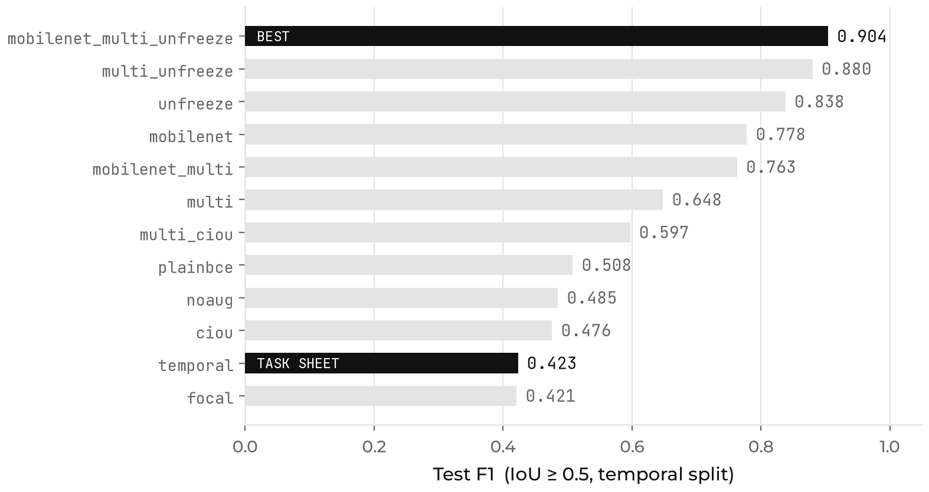
PART 1 · WHAT WE TRIED
Twelve configurations, one change at a time
Test F1 at IoU 0.5, temporal split, threshold and NMS tuned per run
THE GAP
0.423
TASK-SHEET BASELINE
0.904
OUR BEST RUN
AP50 goes 0.213 to 0.871 - four times. Two changes account for almost all of it.
VEHICLE DETECTION & COUNTING · ML4CE · SEMESTER PROJECT · TOPIC 2
7
Notes:
~55 SEC.
So we changed one thing at a time. Twelve runs.
Do not read the whole chart - look at the two black bars. At the bottom the task sheet's configuration, 0.423. At the top ours, 0.904. AP50 goes from 0.213 to 0.871, four times better.
Everything in between differs from the baseline in exactly one thing: another backbone, another loss, another assignment rule.
And two of those changes explain almost the whole jump. That is the next slide.

Slide 8
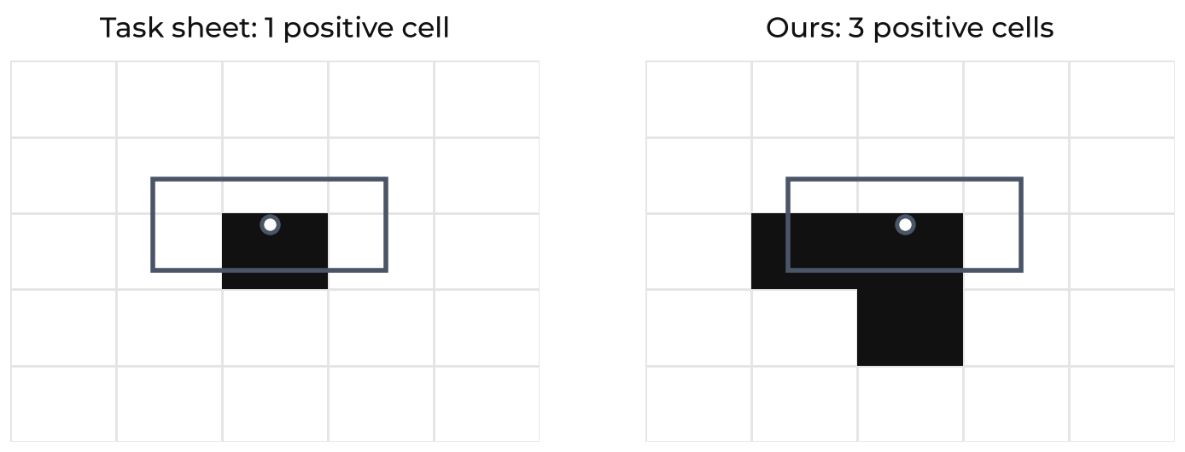
PART 1 · WHAT WORKED
Two changes, almost all of the gain
Each was measured on its own before they were combined
LEVER 1 · UNFREEZE THE BACKBONE + 0.42 F1
LEVER 2 · MULTI-CELL ASSIGNMENT + 0.23 F1
The frozen features were the bottleneck, not the head.
ImageNet is object-centric photography; our vehicles are small, blurred and shot from a dashcam.
One positive cell per box is 453 signals in the whole training set.
Neighbouring cells fire anyway but were never taught which box to emit, so they emit fragments.
Train the centre cell plus its two nearest neighbours on the same box.
They become agreeing votes that NMS merges. False positives on test: 18 to 10.
VEHICLE DETECTION & COUNTING · ML4CE · SEMESTER PROJECT · TOPIC 2
8
Notes:
~75 SEC.
Lever one: unfreeze the backbone. Plus 0.42 F1 on its own.
Why? The backbone was pretrained on ImageNet - object photos, one big sharp dog in the middle. Our cars are small, motion-blurred, filmed from a moving car. Those features simply do not fit, and no head can repair a bad input. The task sheet says you do not need to train the backbone - that is permission, not prohibition. So we report both versions.
Lever two: multi-cell assignment. Plus 0.23.
The rule says only the centre cell is positive. That gives 453 positive signals in the entire training set. But the neighbouring cells fire anyway - they were simply never told which box to predict, so they emit fragments. One car, two errors: a false alarm and a miss at the same time.
We train the centre cell plus its two neighbours on the same box. Now they agree with each other, and NMS merges them. False positives on the test set drop from 18 to 10.

Slide 9
PART 1 · WHAT DID NOT WORK
The negative results, kept on purpose
Each was a reasonable idea before it was measured
ATTEMPT
RESULT
WHY IT FAILED
CIoU box loss
0.476 / 0.597
unstable gradients on tiny targets; L1 is the easier optimisation
Focal loss
0.421
built for dense anchor detectors; it starved the head
Plain BCE
0.508
collapsed to 'no vehicle' - 99% cell accuracy, useless detector
Flip + colour jitter
0.485 vs 0.423
the data lacks scale and viewpoint, not colour
Larger input, 640 / 768 px
0.917 / 0.889
finds the same 33 vehicles - one false positive fewer
Finer grid, stride 16
0.822
resolution bought, semantic depth paid - that is what an FPN solves
WE GOT THIS TABLE WRONG TWICE OURSELVES: A CHECKPOINT READ MID-TRAINING, BOX AREA IN INPUT PIXELS
VEHICLE DETECTION & COUNTING · ML4CE · SEMESTER PROJECT · TOPIC 2
9
Notes:
~55 SEC.
And these are the ideas that lost. We keep them on the slide on purpose.
CIoU loss - in theory better, because it optimises exactly what we measure. It was worse. Focal loss - the worst run of all. Our augmentation, flip and colour jitter - changed nothing, because this data does not lack colour. It lacks scale and viewpoint.
The interesting row is the fourth one: 640 pixels has the better F1, but it finds exactly the same 33 cars. One false positive fewer, that is all. So we kept the 512 the task sheet specifies - claiming an improvement on one single box would be dishonest.
And the last line: we got this table wrong twice ourselves before it was right.

Slide 10
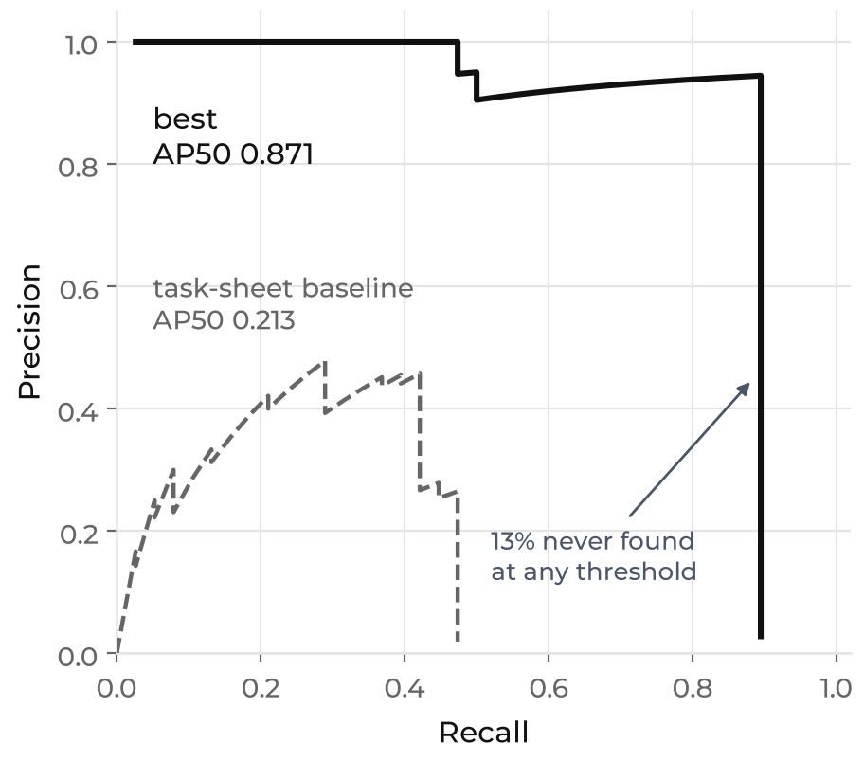
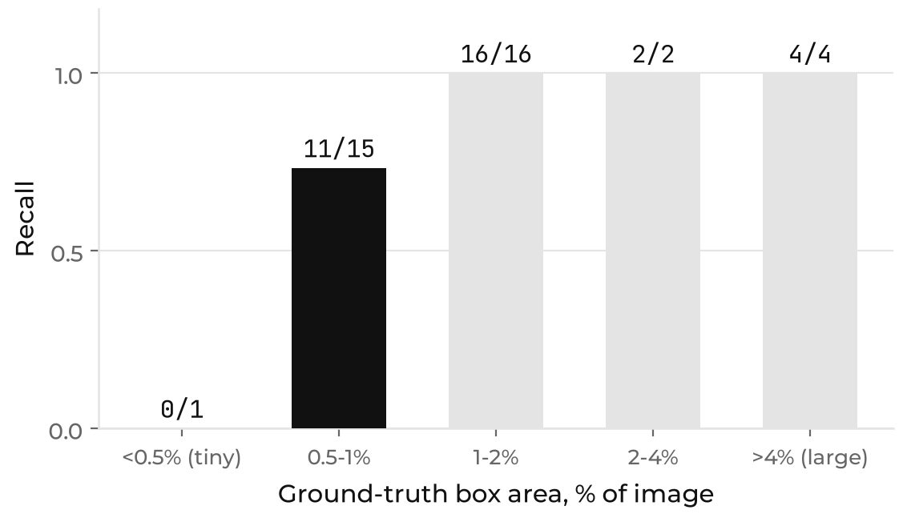
PART 1 · ERROR ANALYSIS
Every miss is a small, distant vehicle
Precision holds above 0.95 out to recall 0.87, then the curve falls off a cliff
Above 1% of image area, recall is 22 / 22.
The fix is a feature pyramid or more data - not more pixels.
VEHICLE DETECTION & COUNTING · ML4CE · SEMESTER PROJECT · TOPIC 2
10
Notes:
~50 SEC.
So where are the misses? On the left: precision stays above 0.95 up to recall 0.87 - and then the curve falls off a cliff. About 13 percent of the cars are never found, at any threshold.
On the right: recall by car size. Above one percent of the image we find every single one, 22 out of 22. Below that we start losing them.
So every miss is a small, distant car. That reads like a resolution problem - which is why we tested bigger inputs. It is not one. The real fix is a feature pyramid, or more data.

Slide 11
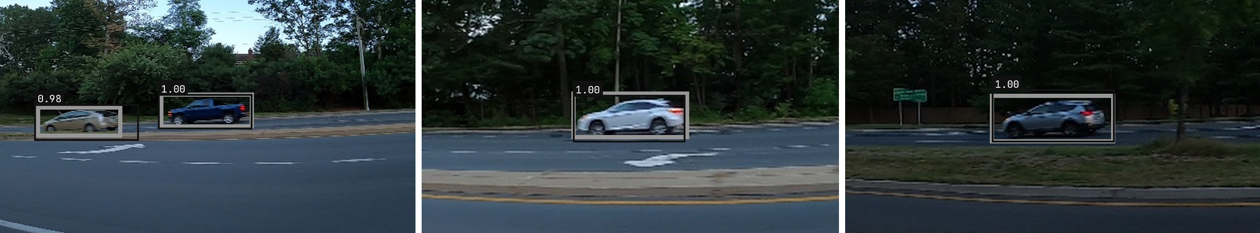
PART 1 · RESULT
Test precision 0.943, recall 0.868
MobileNetV3, multi-cell assignment, backbone fine-tuned - 512 px as specified
0.943
PRECISION
0.868
RECALL
0.904
F1
0.871
AP50
33 / 2 / 5
TP / FP / FN
Test frames. Grey = ground truth, black = prediction with its confidence
Precision is a lower bound - some frames leave visible cars unboxed.
VEHICLE DETECTION & COUNTING · ML4CE · SEMESTER PROJECT · TOPIC 2
11
Notes:
~45 SEC.
So this is Part 1: precision 0.943, recall 0.868, F1 0.904. Measured on frames from the end of the video that the model has never seen.
Grey is the ground truth, black is our prediction - they sit right on top of each other.
And one honest caveat: some frames label one car and leave other clearly visible cars unlabelled. A correct detection there counts against us as a false alarm. So our precision is a lower bound, not the true value.
(Hand over to Part 2 here.)

Slide 12
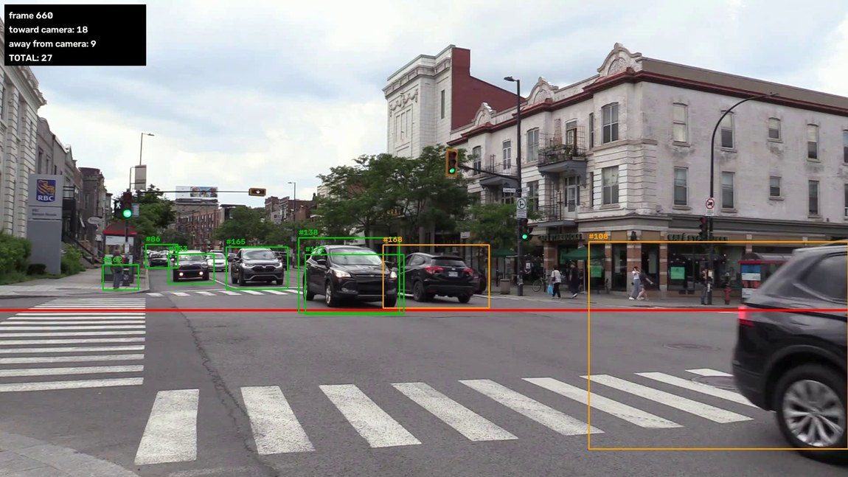
PART 2 · THE PIPELINE
Detect, track, count
Three stages - the count depends on all three, not just the detector
FRAME
1798 frames, 60 s
→
YOLO11n
fine-tuned, one class
→
TRACKER
IoU + Hungarian, ours
→
LINE COUNTER
centre crosses, once per ID
WHAT YOU SEE
Green box + #ID
a confirmed track
Orange box
already counted
Red line
the counting line, y = 0.65
Panel
running count per direction
Counted when the centre crosses - not when it appears.
VEHICLE DETECTION & COUNTING · ML4CE · SEMESTER PROJECT · TOPIC 2
12
Notes:
~40 SEC.
Part 2. Same street, new problem.
Three stages: the detector finds boxes in every frame, the tracker gives them an identity, and the counter watches one line.
Green box with a number is a tracked car. Orange means already counted - it cannot count a second time. The red line is the counting line.
And the rule, this one matters: a car is counted when its centre crosses the line. Not when it appears. The manual count uses exactly the same rule, otherwise human and machine answer different questions.

Slide 13
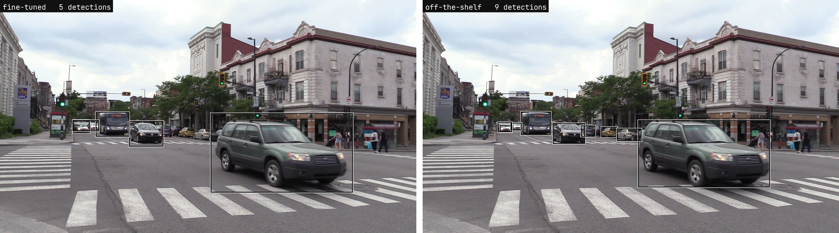
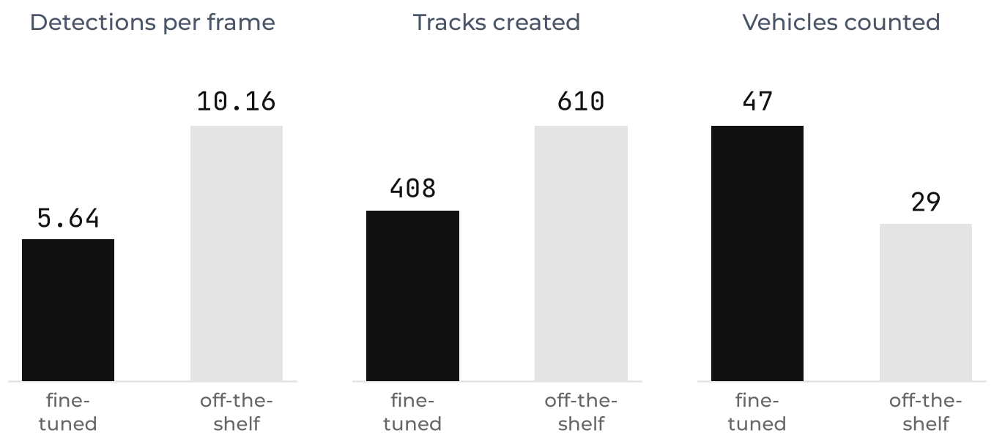
PART 2 · COMPARING DETECTORS
Twice the detections, fewer vehicles counted
Same frame, same tracker, same line - only the detector changes
A typical frame: the off-the-shelf model adds parked cars far from the line
Fine-tuning helped - we predicted it would hurt.
Unstable boxes fragment tracks: 21.0 tracks per counted vehicle against 8.7.
VEHICLE DETECTION & COUNTING · ML4CE · SEMESTER PROJECT · TOPIC 2
13
Notes:
~55 SEC.
First question: which detector? We fine-tuned YOLO11n on our own data and compared it against the off-the-shelf COCO model.
Look at the two frames - same moment in the video. Ours finds 5 cars, the standard model finds 9.
And now the surprise: the model with twice as many detections counts fewer cars. 29 against 47.
Why? It spends its detections on parked cars and pedestrians that never cross the line. And its boxes jump around, so tracks break apart - 21 tracks per counted car instead of 8.7.
More detections is not better. And by the way, we predicted the opposite: we thought fine-tuning on dashcam images would hurt on a static street camera.

Slide 14
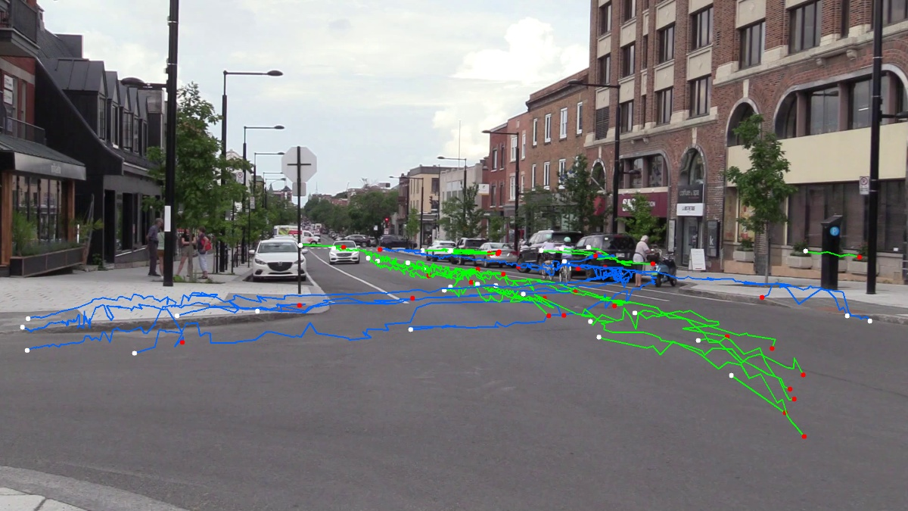
PART 2 · THE TRACKER
IoU association, written from scratch
Hungarian against a greedy baseline, both unit-tested on synthetic boxes
01 Associate detections to tracks by IoU, above 0.3
Hungarian is optimal over the whole frame; greedy takes the best pair first.
02 Confirm before counting, forget after 0.33 s unseen
Thresholds in seconds, scaled by the video's own frame rate.
03 Count when the centre crosses, once per ID
A proper segment intersection, so the line's infinite extension does not count.
A bug the unit tests caught, and the video never would have.
A centre landing exactly on the line was a third state, so the crossing vanished. On screen that looks like nothing at all - just a count that is too low.
Every tracked path in the clip - 408 tracks for 47 counted vehicles
VEHICLE DETECTION & COUNTING · ML4CE · SEMESTER PROJECT · TOPIC 2
14
Notes:
~55 SEC.
The tracker is ours, not a library.
It matches boxes between frames by overlap - a car barely moves in one thirtieth of a second, so its box overlaps itself. Hungarian matching solves that optimally for the whole frame, greedy simply takes the best pair first. On this video: exactly the same result, 47 to 47.
The thresholds are in seconds, not frames. Sounds like a detail - but 10 frames means 0.33 seconds at 30 fps and 0.17 at 60. On someone else's video the same setting would quietly behave differently.
And my favourite: a car whose centre landed exactly on the line was treated as a third state, and the crossing disappeared. On the video that looks like nothing at all - just a count that is too low. A unit test found it, the video never would have.

Slide 15
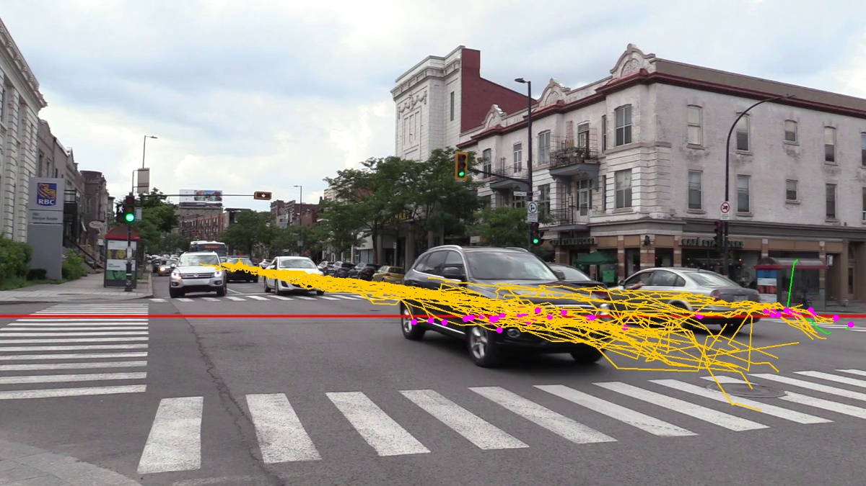
PART 2 · THE HARD PART
Choosing the video, not writing the tracker
The binding requirement is invisible in a still frame
CANDIDATE
DET/FRAME
MOVING TRACKS
BEST LINE
VERDICT
Dual carriageway, dusk
18.7
8
3 crossings
too dense to hand-count
US freeway
16.2
-
-
licence forbids redistribution
Daylight, free-flowing
7.4
22
12 / 0
one direction only
T-junction
9.2
34
15 (14 one way)
looked perfect - traffic disperses
Intersection (chosen)
8.8
93
42 = 31 / 11
one line, both flows
"Both directions are visible" is not the requirement.
One line has to exist that both flows cross - and that is only visible in the trajectories.
VEHICLE DETECTION & COUNTING · ML4CE · SEMESTER PROJECT · TOPIC 2
15
Notes:
~50 SEC.
Honestly, the hardest part of Part 2 was not the tracker. It was choosing the video.
Four things have to be true at the same time: static camera, both directions, countable by a human, daylight.
We picked the T-junction clip. Static, daylight, both directions visible - every check passed. Then we tracked it and it fell apart: the traffic disperses, only 15 of 34 moving cars cross any line at all, and 14 of them the same way.
The requirement was never 'both directions are visible'. It is: one line exists that both flows cross. And you cannot see that in a still image - only in the trajectories.

Slide 16
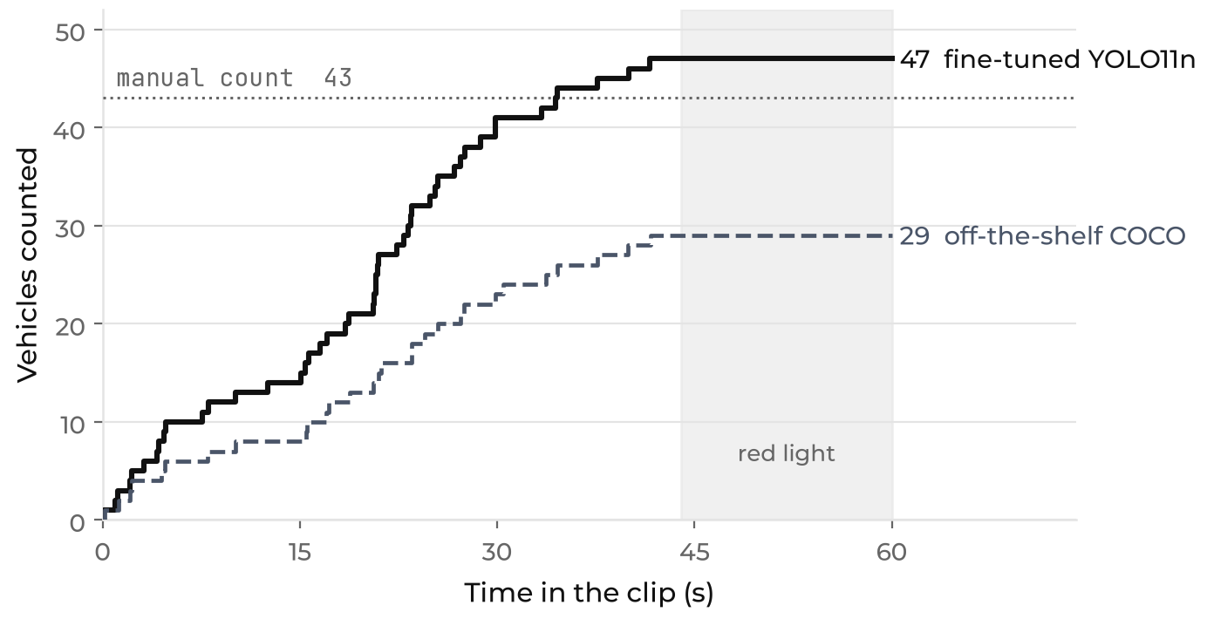
PART 2 · THE COUNT
47 counted against a manual 43
Same 60 s, same counting rule for the human and the machine
RESULT
+9.3%
NET OVER-COUNT, 4 VEHICLES
Hungarian and greedy tie: 47 and 47, 29 and 29.
Without a Kalman filter a dropped frame ends a track, the vehicle returns with a new ID and crosses twice - so the error goes up, as theory says.
STILL OPEN: THE MANUAL COUNT HAS A TOTAL, NOT A PER-DIRECTION SPLIT
VEHICLE DETECTION & COUNTING · ML4CE · SEMESTER PROJECT · TOPIC 2
16
Notes:
~45 SEC.
The result: 47 cars automatically, 43 counted by hand. Plus four - 9.3 percent over.
The flat part after 44 seconds is the red light, not a failure.
And we over-count for a reason we can name: our tracker has no motion model. One missed frame ends the track, the car comes back with a new ID - and crosses the line a second time.
What is still open, and we say it openly: the manual count has a total, but not the split per direction. So we do not claim any per-direction accuracy yet.

Slide 17
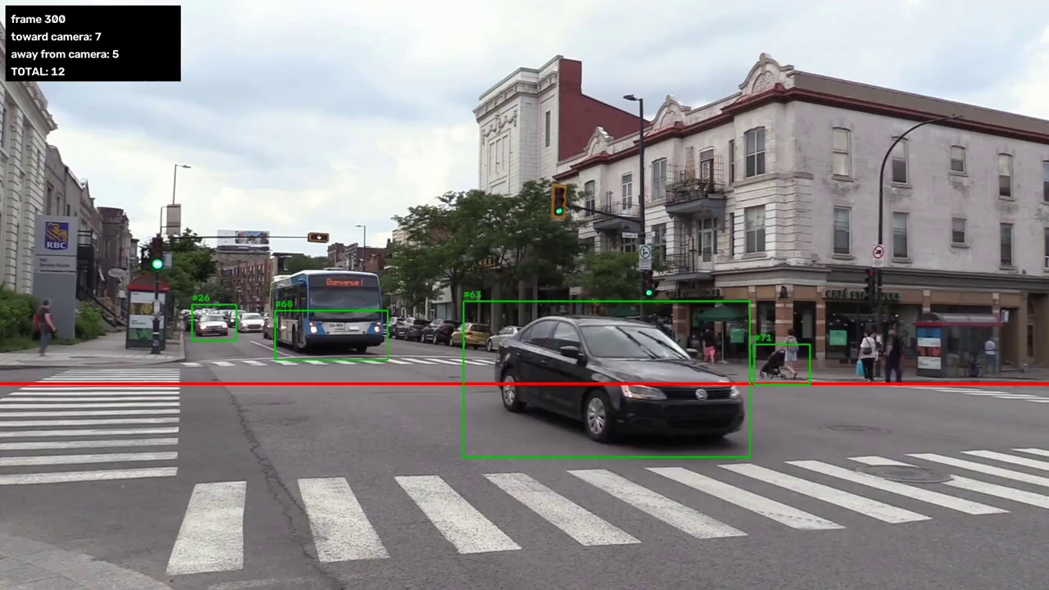
CLICK TO PLAY
PART 2 · RESULT
30 SECONDS OF THE COUNTED OUTPUT · BOXES, TRACK IDS, THE LINE AND THE RUNNING COUNT
VEHICLE DETECTION & COUNTING · ML4CE · SEMESTER PROJECT · TOPIC 2
17
Notes:
~40 SEC. - Play the video, talk over it.
[START VIDEO - let it run]
Watch one car crossing the red line, and the counter stepping up.
And look at the orange boxes: those are already counted. They can drive around all day, they will not count again.
(After 10-15 seconds, move on.)

Slide 18
PART 2 · IN CONTEXT
9.3% is where a street-level camera lands
Published counting errors, split by camera height
SYSTEM
CAMERA
COUNT ERROR
SOURCE
YOLO + visual rhythm
top view
0.85-1.4%
Ribeiro 2025
YOLOv5 + DeepSORT
CCTV, 15 m up
1.9%
Tashkent 2023
YOLOv3 + SORT, 6 intersections
14-40 m
5.5%
Khazukov 2020
Ours: YOLO11n + IoU/Hungarian, no Kalman
street level
9.3%
this project
Best method at low vantage
under 5 m
9.9-11.0%
Pakdamansavoji 2025
IoU tracker without Kalman, same ablation
DOT cameras
over 37%
Mandal 2021
Camera height explains more than the algorithm does.
The same footage scores 1.81% top-down against 28.58% in perspective view. On our clip 43.5% of detections overlap another one.
VEHICLE DETECTION & COUNTING · ML4CE · SEMESTER PROJECT · TOPIC 2
18
Notes:
~25 SEC.
Is 9.3 percent good or bad? That depends on where the camera hangs.
From above, published systems reach about one percent. From a low camera like ours: around ten.
Same footage, same detector, only the viewing angle changed: 1.8 percent from above against 28 in perspective view. Camera height explains more than the algorithm does.
So our number is normal for a street-level camera - and for a tracker without a Kalman filter, the literature would have predicted far worse.

Slide 19
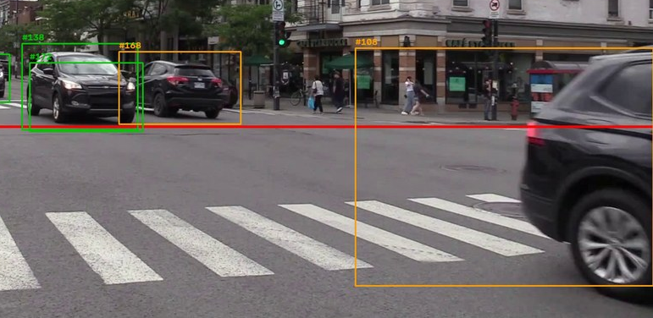
LIMITS AND NEXT STEPS
What we would fix first
Measured limits, not a wish list
KNOWN LIMITS
NEXT, IN ORDER OF EXPECTED PAYOFF
OCCLUSION
43.5% of detections overlap another one
01 A Kalman filter, or DeepSORT
the published ablation of our exact design says the error lives here
OVERSIZED BOXES
a box up to 22.7% of the frame - its centre crosses too early
02 A feature pyramid for Part 1
every remaining miss is a vehicle under 1% of the image
NET HIDES GROSS
+4 could be 6 double counts and 2 misses
03 Scale and viewpoint augmentation
flip and jitter changed nothing; the data lacks scale
ONE CLIP
no confidence interval; one vehicle is already 2.3%
04 Finish the per-direction manual count
the only external ground truth the project has
One box spanning a vehicle and the background - its centre crosses the line at the wrong moment
VEHICLE DETECTION & COUNTING · ML4CE · SEMESTER PROJECT · TOPIC 2
19
Notes:
~20 SEC.
Where does our error actually live? Cars hide each other - 43.5 percent of our detections overlap another one. That is geometry, not code.
Next steps, in order of effect: a Kalman filter or DeepSORT against the broken tracks. Then a feature pyramid for the small cars in Part 1. And finish the manual count per direction.

Slide 20
THANK YOU · QUESTIONS
IT RUNS ON DATA
WE HAVE NEVER SEEN
Part 1, any folder of images
python -m src.part1.predict --images <dir> [--csv ground_truth.csv]
Part 2, any video
python -m src.part2.suggest_line --video new.mp4 then run_count --video new.mp4
Everything reproducible
one config file, 33 unit tests, weights and the output video ship with the code
VEHICLE DETECTION & COUNTING · ML4CE · SEMESTER PROJECT · TOPIC 2
20
Notes:
~15 SEC. + questions.
One last point, and it matters after submission: the model gets tested on data we have never seen. Both parts already run on new data - one command for a folder of images, one for a new video. No code changes needed.
Weights, the output video and 33 unit tests ship with the code.
Thank you! Questions are very welcome.
LIKELY QUESTIONS
- Why build a detector if YOLO exists? The task asks for it - and we compare: our head 0.904 F1, fine-tuned YOLO 0.984 on the same split.
- Is 47 the correct number? The manual total is 43, so we are 9.3 percent over. That is net, not gross - the per-direction split is not recorded yet.
- Why only 60 seconds? Because a human has to count it once, reliably. Longer clips are not hand-countable.
- Would it work on your video? Yes, one command - but the counting line has to be measured again, that is what suggest_line does.
- Why no Kalman filter? Not required by the task. And we can name exactly what it would fix: the broken tracks that cause our over-count.

