Slide 1
bischack
A business activity check command server for Nagios

Slide 2
Business application monitoring - BAM
The goals of business activity monitoring are to provide real time information about the status and results of various business related operations, processes, and transactions.
The main benefits of BAM are to enable an enterprise to make better informed business decisions, quickly address problem areas, and re-position organizations to take full advantage of emerging opportunities.
Wikipedia
Notes:
The need to surveillance of business critical aspects of the applications.
Different needs and impact that the normal IT monitoring
Different stack holders to notify

Slide 3
Next step in IT surveillance
Network monitoring
IT infrastructure
Applications
&
Business processes

Slide 4
Has nothing to do with IT
Warning if the delivery of goods is lower then 80% of ready to ship.
If the number of orders drop below my daily/weekly estimate
Warning if the delivery of goods is lower then 80% of ready to ship.
If the number of orders drop below my daily/weekly estimate
If the ratio between web and phone orders are higher then ...
If the ratio between web and phone orders are higher then ...
If the number of errors in incoming EDI messages are higher then 5% of total
My route planning must be least 90% of my received orders
If the number of errors in incoming EDI messages are higher then 5% of total
My route planning must be least 90% of my received orders
If the number of international shipment is above 10000 at 17:00 I need to give gateway a warning
If the number of international shipment is above 10000 at 17:00 I need to give gateway a warning

Slide 5
What can BAM mean for you?
Get real measurement on what is going on inside our applications from a business perspective
Get out of the "IT-blindness"
Understand application to application dependencies and effects of a process disturbance
Define thresholds on business related events
SLA by meaningful numbers
Business trends in real time
Notification to the business - not just IT
IT resource utilization in business numbers

Slide 6
How can this be achieved?
What to monitor and measure
  Business processes of importance
  Applications involved
  Measurable entities
Thresholds level - alarm
People/groups to notify
Monitoring infrastructure
Connecting to applications
  "None intrusive" probing of the application events

Slide 7
What is different from normal monitoring?
Business events is dynamic to it nature
  "The numbers of orders are different depending of time of day and day in week"
Business events is dependent to other events
  "The number of invoices that should be created are depending on the number of received orders"
Capability relate to multiple events
  "The percentage between "web orders" and "all orders" should not be lower then 80%"

Slide 8
Example 1 – Monitor the number of orders received during the day
The order management application receive order 24 hours a day during Monday to Friday.
The total aggregated number of orders are different depending on time of the day. The business expect to have a total numbers of orders of 1500 at 13:00, at 14:00 the order count should be 2300, at 15:00 it should be 3400, etc. Between every hour we interpolate that the order rate are according to a linear equation. This means that the threshold at 13:20 is (2300-1500)*20/60+1500 = 1767.
The warning alarm level should be triggered between 90% and 70% of the threshold and a critical alarm if the measured value is below 70% of the threshold.

Slide 9
Example 2 – Monitor the number of created invoices in relation to the number of received orders
The invoice system should invoice at lest 80% of the daily incoming orders in the same day with one hour delay.
This means that the measured value of orders with one hour delay must be used as a threshold for the number of created invoices.

Slide 10
Example 3 – Monitor the current number of orders and if the inflow is zero we need an alarm.
The order system have a table with all received orders, but the requirement is that we need to monitor how many that has been received during the last 10 minutes.
If this value is zero an alarm must be generated since its an indication that the sales system are not generating orders. To achieve this monitoring we use the last and the previous sample of the total number of orders from example 1 and create the difference between the two to get a new virtual entity to measure, with an threshold level of 0.

Slide 11
What is the same?
Connectivity to applications and systems
Define responsible groups
Notification
Escalation process
Presentation of status and graphing
Historical data
.... all the features you are used to with NOC systems

Slide 12
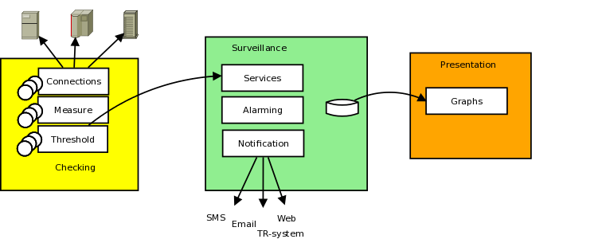
BAM architecture

Slide 13
bischeck – a Nagios plugin
An application surveillance and monitoring tool
Focus on application and business related measuring and threshold management.
Integrate with the Nagios plattform with passive checks over the Nagios integration protocol NSCA
bischeck are license under GPL2
  All other software used are open source license like GPL, Apache, etc
Run as a linux service/deamon

Slide 14
Who is using bischeck – what we know?
DHL Freight Sweden
  BAM for the whole forwarding and logistic process

Slide 15
Features
Different threshold values depending of time of the day and day of month or week and holiday calender.
Dynamic threshold based on measured value from other monitored services.
Multiple scheduling schema per service. This enable a fine grain control of when a service should be monitored.
Configure services that are based on multiple measured entities, what could be described as "virtual" services.
Caching of historical data to provide creation of virtual services and advanced thresholds.
Date macros in execution statements of measured services, typical used in a where clause when selecting from databases.
Multitude of ways to connected to a the services to measure by allowing custom service connection methods.
Support for custom threshold and connection classes

Slide 16
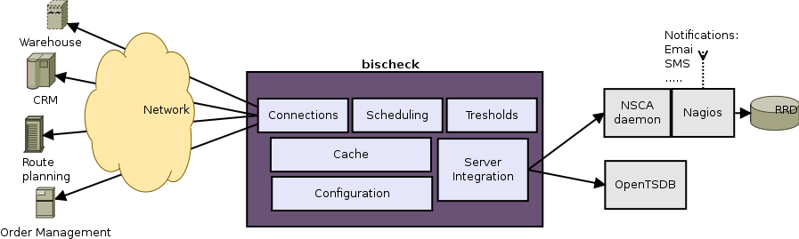
Overview
*
* Scheduled for version 0.3.3

Slide 17
Host, service and service items
Primary configuration objects
Host
  Name equivalent with Nagios Host configuration
Service
  Define a name, same Nagios Service configuration
  Connection method, e.g. jdbc
  Schedule(s) - when to execute the service, cron style
Service Item
  Execution specification, e.g. SQL statement
  Threshold specification, the threshold class to use.

Slide 18
What is a threshold
Defines some logic that the measured value is compared against to define if an alarm should be triggered
In business that threshold are often dynamic and/or the threshold source(s) is some other service we measure.
Example
  Measured value is 112 at time 13:45
  Threshold configuration returns that the threshold value should be 140 at 13:45 for this service.
  Threshold warning level is defined to be 10% of the threshold and critical level to be 30%.
  A warning state will be set

Slide 19
bischeck threshold
Threshold is the definition for a service item that alarm triggered by. 3 different configuration are available:
  Over the threshold
  Under the threshold
  Interval of the threshold
Warning/Critical is set as a percentage of the threshold
Threshold logic is implemented as a java class and configured for each service item
  Threshold classes can easily be custom developed

Slide 20
bischeck cache
Cache for all the historical data in an LRU structure
  Number in cache is configurable
  host-service-servicitem[index] where index 0 is the latest measured
Cache is used for “virtual” services and as threshold source
  Virtual services and thresholds can be created based on mathematical expression on “real” measured services.
  Example – to get an incremental value of a counter
    host1-service1-servicitem1[0] - host1-service1-servicitem1[1]
  Mathematical expressions is based on JEP open source version 2.3.1

Slide 21
Architecture - bischeck
Java 6 based with internal JMX based surveillance
Integrate with nagios over nsca protocol for passive checks.
Parallel service execution through thread pool
Run as a linux service.
Can run on same server as nagios or a dedicated server.
Configuration topics are host, services, service items and threshold
  XML based configuration
  Host and service name must be same as in nagios

Slide 22
Graphing
Through pnp4nagios
Bischeck has a pnp4nagios templates to plot measured and threshold value

Slide 23
System requirements
CentOS +5.5 or RedHat +5.5 server (Linux)
  Will be support on other platforms on community demand
Java 6 or later

Slide 24
Future road map – not final
More integration protocols then NSCA
  E.g OpenTSDB
Cache distribution, cache persistent
Installation support for other linux distributions
  Windows ?

