Slide 1
OSINT Tool
Design and Development of a Web-Based OSINT Tool for Identifying and Tracing Individuals via Phone, Aadhaar, Email, and Name
STUDENT NAME
ENROLLMENT NUMBER
Himanshu Bhardwaj
CS-23411194
PROGRAM & SEMESTER
ORGANIZATION NAME
B.Tech CSE (Cybersecurity), 7th Semester
Indian Cyber Crime Coordination Centre (I4C), Ministry of Home Affairs
School of Computer Science and Engineering (Cybersecurity) | IILM University, Greater Noida, U.P.

Slide 2
PROJECT OVERVIEW
Introduction
This project was built for a national cybercrime investigation unit. Its tools, data, and interface are confidential, so no screenshots or photographs of the actual system appear anywhere in this deck — all figures are original illustrative diagrams.
This deck covers three independent projects completed during a 31-week internship at the Indian Cyber Crime Coordination Centre (I4C). Each was scoped, built, and delivered separately — they are standalone efforts and none of the three depends on, is integrated with, or shares functionality with the others.
Project 1
Project 2
Project 3
OSINT Tool
APK Malware Analysis Tool
1930 Call-Taker Training Module
Rule-based tool to identify and trace individuals from a phone number, Aadhaar number, email address, or name.
AI-assisted tool that inspects a submitted Android application and produces a behavioural summary.
Training content developed for staff at the national cybercrime helpline.
OSINT Tool
2

Slide 3
PROJECT 1 — OSINT TOOL (STANDALONE)
Problem Statement & Objectives
Problem Statement
A phone number, Aadhaar number, email address, or name is often the only lead investigators start with.
Tracing the person behind it means manually checking many separate public sources — slow and hard to scale.
The OSINT tool addresses this directly: given a single identifier, it searches public sources and returns a structured profile for analyst review.
Objectives
Design and build the backend and API layer of a web-based OSINT tool to identify and trace individuals via phone number, Aadhaar, email, and name.
Keep identifier search fast and resource-efficient using DuckDB and an ART index.
Build the production deployment tooling for the OSINT tool.
Ensure every finding is presented for analyst review before it is treated as final.
OSINT Tool
3

Slide 4
PROJECT 1 — OSINT TOOL (STANDALONE)
Scope & Technologies Used
Technology | Use | Purpose
Python | OSINT backend logic (rule-based) | Core application logic
Flask | REST API and web backend framework | Serves API endpoints consumed by the dashboard
DuckDB | Embedded analytical database for the case dataset | Fast, resource-efficient storage & querying
ART Index | Indexing for phone / Aadhaar / email / name lookups | Fast identifier search at scale
In Scope
Identifier-based person search: phone number, Aadhaar, email, name
Backend & API development, backed by DuckDB + ART index
Production deployment tooling
Out of Scope
Direct, unsupervised action on findings
Collection from non-public / unlawful sources
Linking or correlating different individuals — each search is a single identifier lookup
OSINT Tool
4

Slide 5
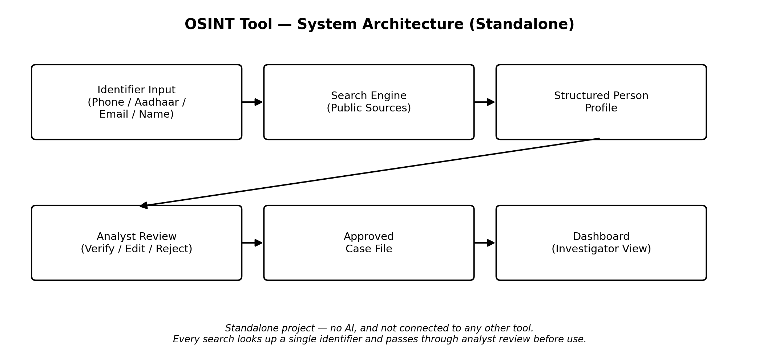
PROJECT 1 — OSINT TOOL (STANDALONE)
System Architecture
My personal contribution was the backend, the API layer, and the production deployment tooling; the investigator dashboard front-end was developed by a teammate.
OSINT Tool
5

Slide 6
PROJECT 2 — APK MALWARE ANALYSIS TOOL (STANDALONE)
Problem Statement & Objectives
Problem Statement
The volume of Android apps flagged during cybercrime investigations makes manual, line-by-line APK inspection difficult to scale.
Analysts need a faster way to triage a submitted APK and identify likely risk indicators.
This is a standalone project, separate from the OSINT tool and the 1930 training module.
Objectives
Contribute to a web-based APK malware analysis tool that produces an AI-generated behavioural summary to support analyst triage.
Ensure every AI-generated finding is presented for analyst review before it is treated as final.
OSINT Tool
6

Slide 7
PROJECT 2 — APK MALWARE ANALYSIS TOOL (STANDALONE)
Scope & Technologies Used
Technology | Use | Purpose
Python | APK analysis pipeline and AI summary generation | Core analysis logic
In Scope
APK static/behavioural indicator extraction
AI-based summary generation
This tool is the only place AI is used across the three projects — for the behavioural summary only. No verdict is applied automatically.
Out of Scope
Fully automated malware verdicts without analyst confirmation
OSINT Tool
7

Slide 8
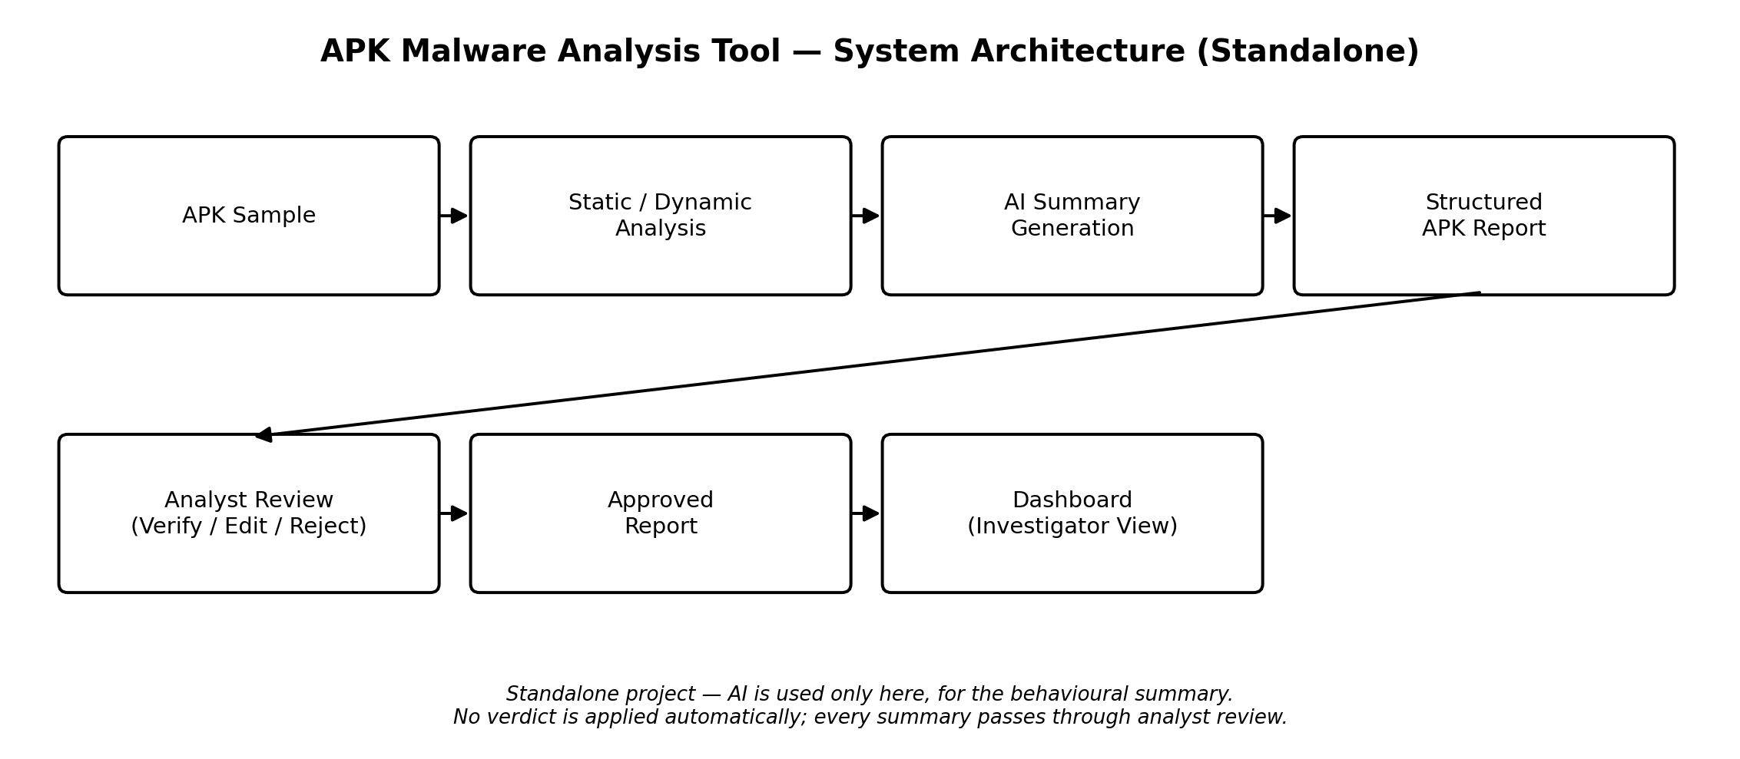
PROJECT 2 — APK MALWARE ANALYSIS TOOL (STANDALONE)
System Architecture
Status: In Progress — the core static-analysis pipeline was functional at internship close; dynamic analysis and summary refinement continue as future work.
OSINT Tool
8

Slide 9
PROJECT 3 — 1930 CALL-TAKER TRAINING MODULE (STANDALONE)
Problem, Objectives, Scope & Outcomes
Problem Statement
Call-taker staff at the 1930 national cybercrime helpline need structured onboarding material to handle citizen complaints consistently.
This is a standalone project, separate from the OSINT tool and the APK malware analysis tool.
Outcomes
Status: Completed
Training content was developed and handed over to the 1930 call-taker center.
Objectives & Scope
Develop training content for the 1930 cybercrime helpline call-taker center.
Out of scope: live delivery or certification of training, which remained with I4C/NCR&IC staff.
OSINT Tool
9

Slide 10
RESPONSIBLE USE
Responsible Use & Human Oversight
OSINT Tool
APK Malware Analysis Tool
Findings are presented as leads to verify, not confirmed facts, and are limited to publicly available sources.
Sensitive identifiers such as Aadhaar numbers are handled carefully and used only for lawful, case-relevant search.
This tool does not use AI.
AI-generated behavioural summaries are advisory and are checked by an analyst before they inform a case decision.
No verdict is applied automatically.
OSINT Tool
10

Slide 11
REFLECTION
Skills & Learning Outcomes
OSINT investigation techniques and identifier-based search
Backend development and API integration
1
2
Resource-efficient database design using DuckDB and an ART index
Production deployment tooling
3
4
Fundamentals of APK/malware static analysis and AI-assisted summarization
Training-content development and technical documentation
5
6
Responsible, human-in-the-loop use of AI in an investigative context
7
OSINT Tool
11

Slide 12
WRAPPING UP
Limitations & Future Scope
OSINT Tool
APK Malware Analysis Tool
1930 Training Module
Source coverage reflects the sources integrated during this engagement. Future work could expand to additional identifier types and public sources.
Dynamic-analysis and AI-summary components were not fully completed. Future work: complete these, integrate threat-intel feeds, and formalize accuracy evaluation.
Future work could extend the module with scenario-based exercises.
OSINT Tool
12

Slide 13
WRAPPING UP
Conclusion
This internship comprised three independent projects at a national cybercrime unit:
OSINT Tool
APK Malware Analysis Tool
1930 Training Module
Identifying and tracing individuals from a phone, Aadhaar, email, or name identifier.
AI-assisted behavioural summaries to support analyst triage.
Training content for the national cybercrime helpline call-taker center.
Each was scoped, built, and delivered separately, with automated or AI-generated findings always subject to analyst review rather than treated as final. The engagement offered practical exposure to cybersecurity, digital investigation, backend development, and responsible use of AI in a sensitive operational setting.
OSINT Tool
13

