Slide 1
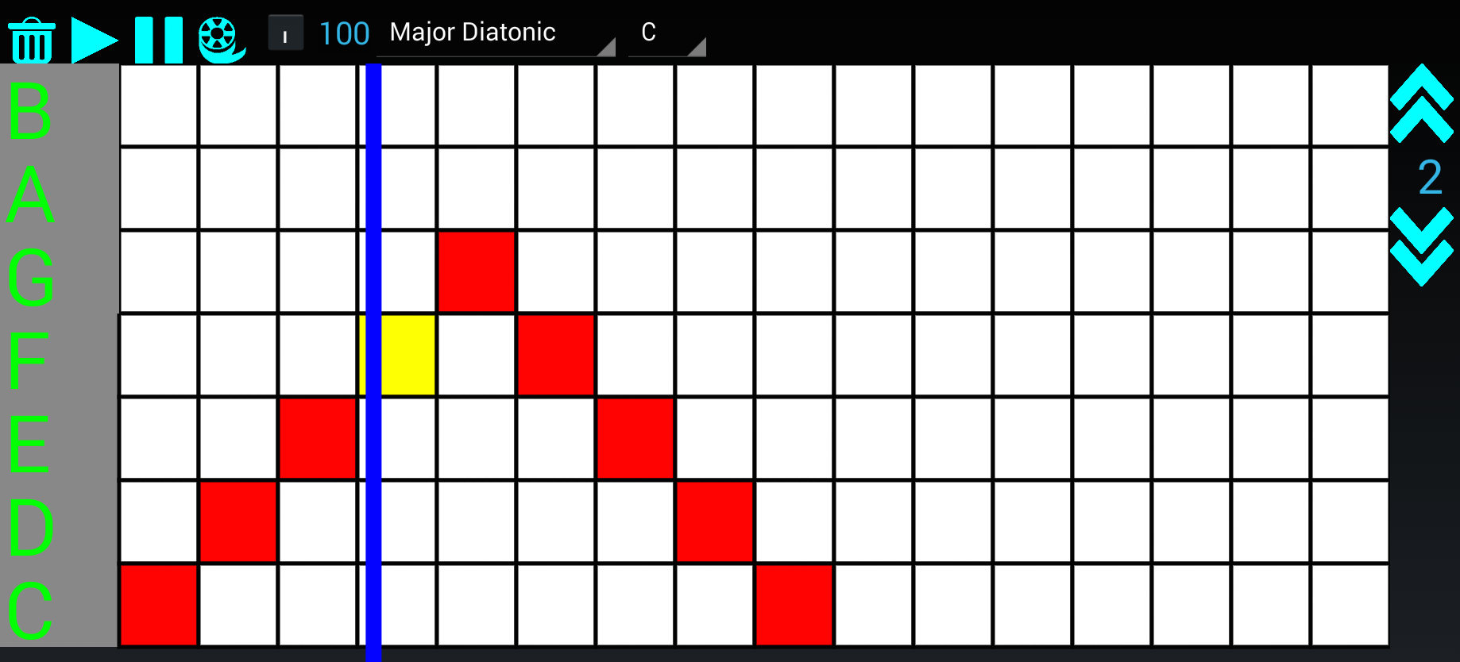

Synthotron: Live Android Synthesizer
Michael Nye and Michael Ryan
Background
Synthotron Package
Android OS has the majority of the smartphone market share but no music production applications suitable for live performance.
Differences in hardware and software from each manufacturer and service provider mean that devices have wildly different latency times.
Response times can be as high as 250 ms from the user pressing a button to the speaker emitting sound, which is unacceptable for responsive performance with traditional keyboard instruments.
We created a music performance app for Android with an interface suited to higher input latency
Two synthesizer instruments:
  Subtractive Synthesizer with two source oscillators using antialiased waveforms
  FM Synthesizer with adjustable carrier and modulating waveforms
  Both with included adjustable effects:
    LFOs for vibrato and tremolo
    ADSR envelopes
    Adjustable filters
  Tone settings can be saved on device
A sample-based drum machine:
  Ring modulator to adjust tone frequencies
  Compressor for reducing dynamic range
Mastering channel
  Reverb filter for naturalness
  Limiter to prevent clipping
  Four point EQ for tone control
A piano roll for loop creation
  Schedule notes in each octave of a scale
  Hear playback and save for sequencing
  Loops can be saved on device
Sequencer for loop playback
  Schedule loops on both synthesizers and drum machine for percussion, pads, and melody
  Schedules can be saved on device
Design
Sound processing done in native C++ code
  Composes processing blocks that pass audio between each other with circular buffers
  OpenSL ES handles embedded audio
Java interface to the native code is used to change tones and trigger notes
  Schedulers run in Java and pass MIDI messages to the processing backend
Future work
Optimize audio processing to lower CPU usage
Design additional instruments and effects
Extra MIDI samples (piano, guitar, etc)
Cleaner and more beautiful user interface

