Slide 1
VOCAL MUSIC SYNTHESIS
Michael Nye
11-752 Spring 2014
Final Project

Slide 2
GOALS
To create a singing synthesizer featuring…
MIDI control for performance
English-like voicing of vowels and consonants
Neutral tone
Expressive control of volume, vibrato, etc.

Slide 3
OPERATION
Note attacks with a consonant
Supports H, F, V, S, Z, T, D, P, B, K, G, L, M, N
Note holds on a consonant
Supports A, E, I, O, U
Held and attack sounds are changed by MIDI keys
Glides between pitches without rearticulating
Variable Volume, vibrato, tremolo, attack/release time
Adjustable with MIDI sliders

Slide 4
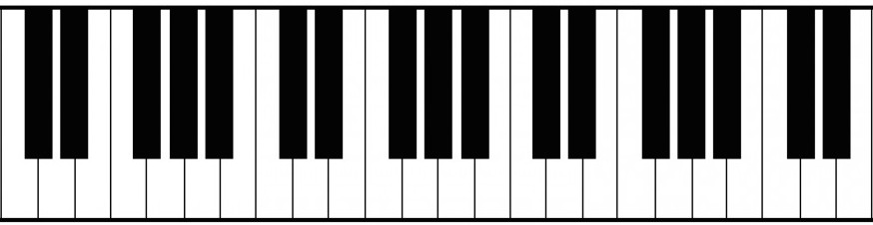
CONTROLS
Volume
Vibrato
Tremolo
Attack
Release
Glide
Interpolate
A
E
I
O
U
S
Z
P
B
K
G
N
H
T
D
F
V
L
M
Sung notes (C2-E3)

Slide 5
DATA COLLECTION
Source: me!
Recorded ascending chromatic scales
Each note held for 2-3 seconds
Each note is separated by silence
One recording for each sound
Saved as wav files for training

Slide 6
MODEL SELECTION
Linear Predictive Coding
Trains a filter with the same resonances as its source
Good for simulating formants
Lattice Filter Representation
Different form of the same filter
Lattice coefficients are less sensitive to numerical errors, and allow for interpolation between sounds

Slide 7
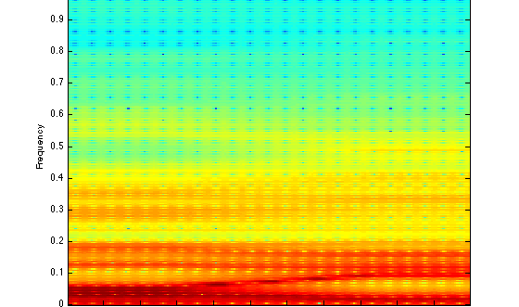
MODEL SELECTION
Lattice Coefficient Interpolation from A to I

Slide 8
TRAINING PROCEDURE
Training is done in MATLAB
For each sound…
Read in a recorded wave file
Segment the recording to remove silence
Train a single LPC model for the entire scale
Normalize the gains between each filter
Export a data file with the coefficients

Slide 9
SYNTHESIZER IMPLEMENTATION
Implemented in C++ using MIDI
Generates a pulse train and white noise
Pulse train is used for voicing
White noise is used for consonants
Lots of hand-tuning was used for mixing durations for different consonants

Slide 10
EVALUATION
Individual sounds were built one at a time
Primary evaluation was my own subjective appraisals while listening to performed notes
Secondary evaluation was performed by my roommate and a friend
Only when I felt I had made substantial progress

Slide 11
FINAL PERFORMANCE
Playability is very high
But live parameter adjustment requires practice
Could be programmed
Vowel sounds are great
Some consonants are great, while others are hard to distinguish

Slide 12
DEMO

Slide 13
QUESTIONS?

