Slide 1
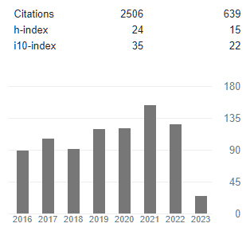

Theo Allnutt – Skills and Experience
Ph.D. Plant molecular genetics 1996
Post-doc University of Edinburgh – tree conservation genetics
Crop genetics – John Innes Centre: molecular mapping and transposons /GMO
Fera (DEFRA, UK) – senior molecular biologist / bioinformatics
CSIRO – bioinformatics / microbiology / metagenomics
Deakin University – bioinformatics
WEHI – metagenomics of T1D
RBGV – bioinformatics, GAP project

Slide 2



Theo Allnutt – Skills and Experience
RBGV – Principal Bioinformatician, GAP project
Australia – wide:

Slide 3

Theo Allnutt – Skills and Experience
RBGV – GAP project
~27 Reference genomes
2000 species in phylogenomics for AAToL (Angio353 target capture)
~8 species in conservation genetics (DARTseq, other reduced capture methods)

Slide 4
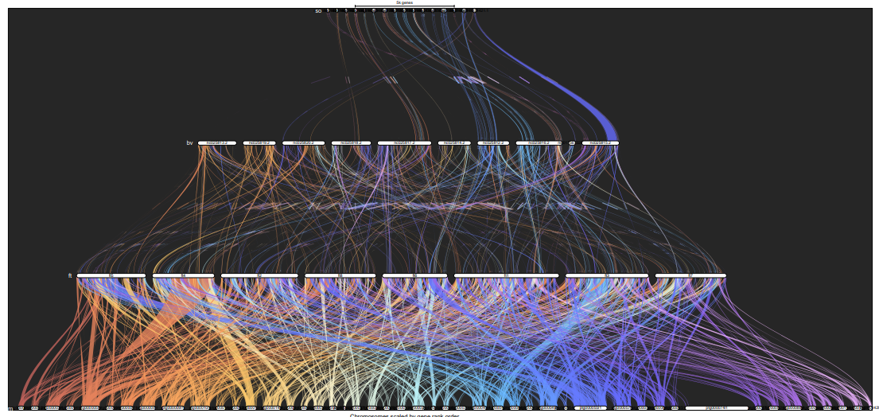
Theo Allnutt – Skills and Experience
RBGV – GAP project – Caryophyllales genomics
Genespace
Spinacea oleracea
Beta vulgaris
Fagopyrum tataricum
Nepenthes mirabilis

Slide 5
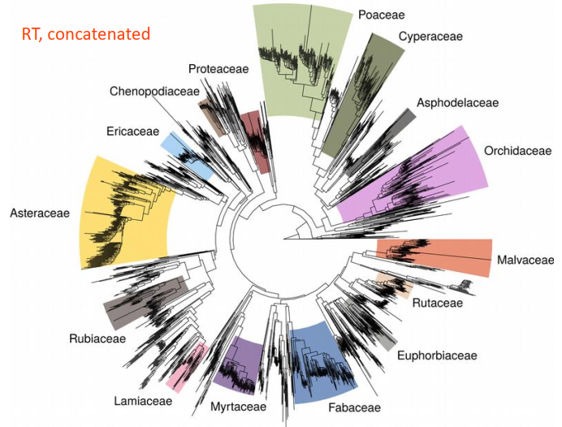
Theo Allnutt – Skills and Experience
RBGV – GAP project

Slide 6



Theo Allnutt – Skills and Experience
WEHI – ENDIA project – Environmental factors in development of T1D
Differential abundance analysis or metagenome – LIMMA and cytokine associations
Functional analysis and networks - Cytoscape

Slide 7
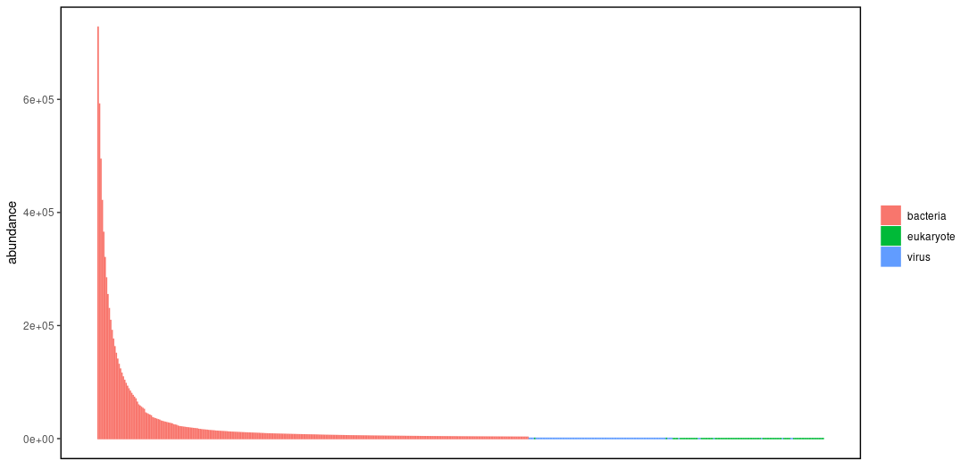
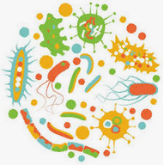
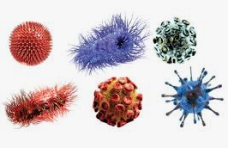

Theo Allnutt – Skills and Experience
WEHI – ENDIA project – Environmental factors in development of T1D
The dark matter in the gut metagenome
96% Bacteria and Archaea
3% human
0.75% viruses
0.25% eukaryote

Slide 8
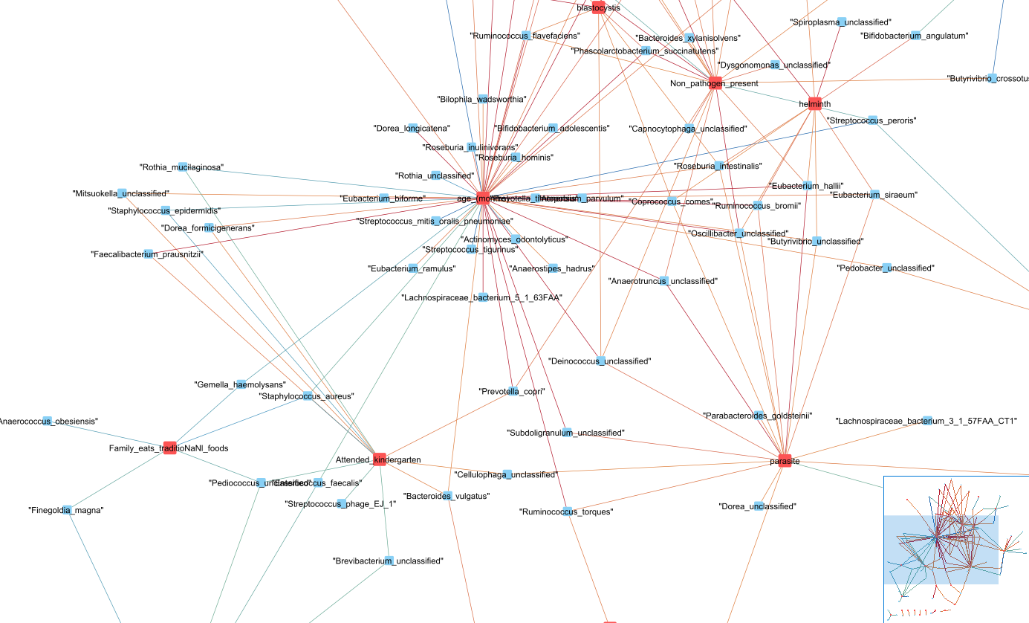
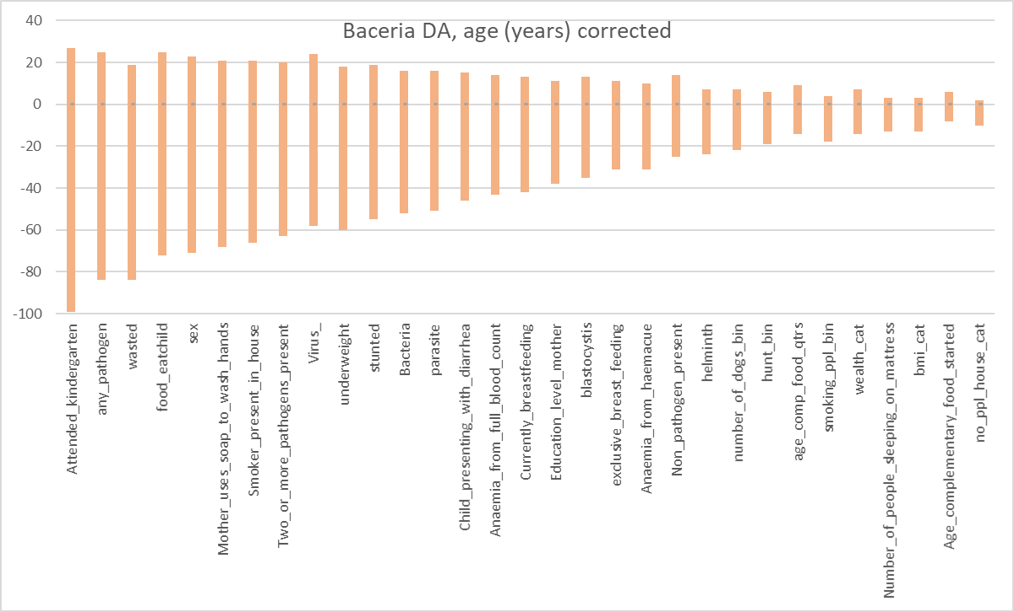
Theo Allnutt – Skills and Experience
WEHI – Elcho project – metagnomic factors affecting health of indigenous infants

Slide 9
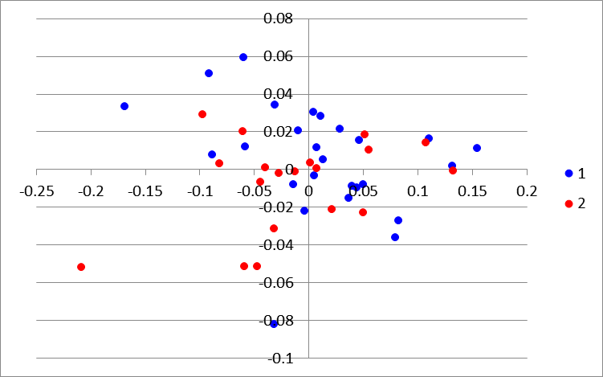
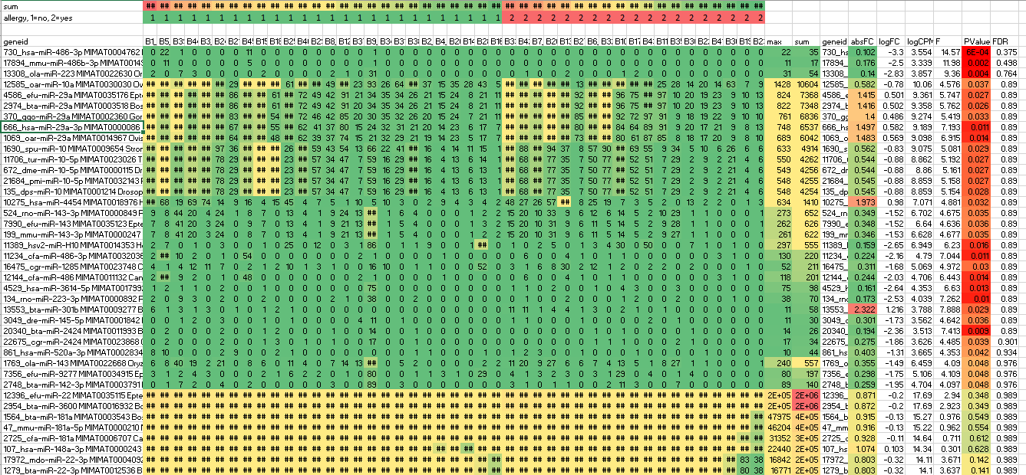
Theo Allnutt – Skills and Experience
Deakin / Barwon Health BIS
mirBASEdb miRNAs Vs allergy response in infants
No significant miRNAs could be found in DA analysis (LIMMA, Aldex2)
Sklearn classify – no result (Nearest Neighbors, Linear SVM, RBF SVM, Gaussian Process, Decision Tree, Random Forest, Neural Net, AdaBoost, Naive Bayes, QDA ) - problems with sampling / normalisation

