Slide 1
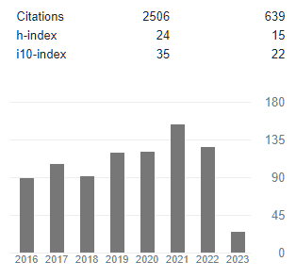

Theo Allnutt – Skills and Experience
Ph.D. Plant molecular genetics 1996
Post-doc University of Edinburgh – tree conservation genetics
Crop genetics – John Innes Centre: molecular mapping and transposons /GMO
Fera (DEFRA, UK) – molecular biologist / bioinformatics
CSIRO – bioinformatics / microbiology / metagenomics
Deakin University – bioinformatics
WEHI – metagenomics of T1D
RBGV – bioinformatics, GAP project

Slide 2
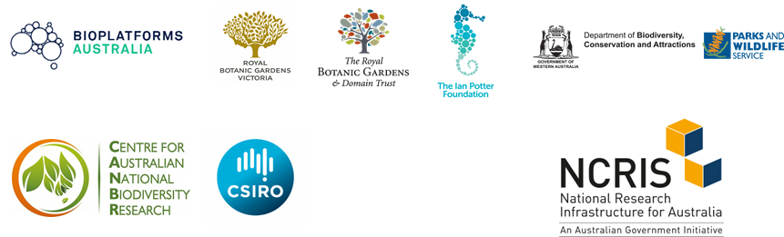

Theo Allnutt – Skills and Experience
RBGV – Principal Bioinformatician, GAP project
Australia – wide:

Slide 3


Theo Allnutt – Skills and Experience
RBGV – GAP project
~27 Reference genomes
2000 species in phylogenomics for AAToL (Angio353 target capture)
~8 species in conservation genetics (DARTseq, other reduced capture methods)

Slide 4
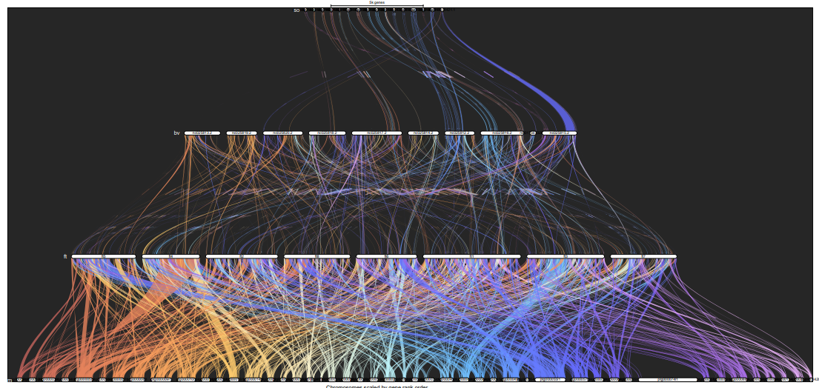
Theo Allnutt – Skills and Experience
RBGV – GAP project
Genespace
Spinacea oleracea
Beta vulgaris
Fagopyrum tataricum
Nepenthes mirabilis

Slide 5
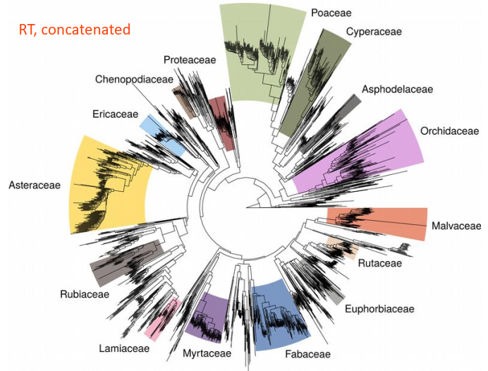
Theo Allnutt – Skills and Experience
RBGV – GAP project

Slide 6
Theo Allnutt – Skills and Experience
WEHI – ENDIA project
Massive longitudinal study of factors affecting T1D development in Australian infants.
Metagenomics of gut, milk, skin of parents and infants. To oidntify causal / mitigating factors.

