Slide 1


Ursula K. Le Guin’s The Left Hand of Darkness
Theodore Kim Informative speech

Slide 2

THE WORST SCIENCE FICTION NOVEL EVER

Slide 3

THE BEST SCIENCE FICTION NOVEL EVER

Slide 4
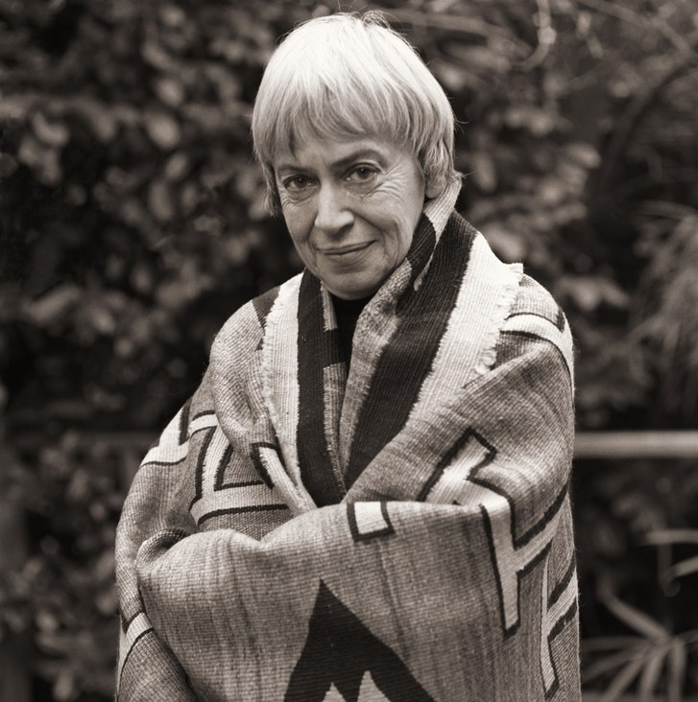
The Author:
Ursula K. Le Guin
1962 - 2018

Slide 5
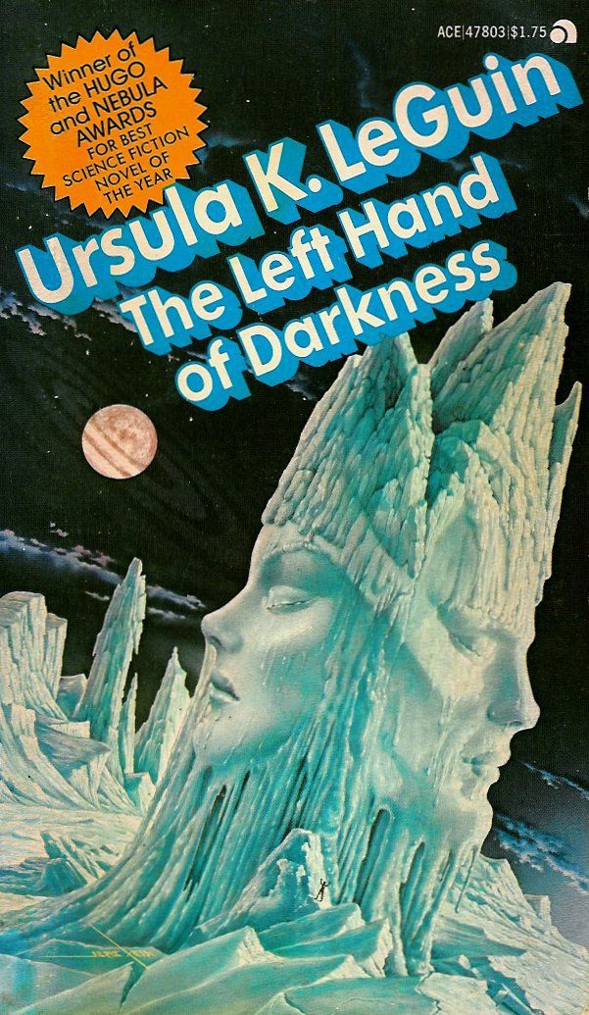

Light is the left hand of darkness,
and darkness the right hand of light.
Two are one, life and death, lying
together like lovers in kemmer,
like hands joined together,
like the end and the way.
- The Left Hand of Darkness (p. 164)

Slide 6
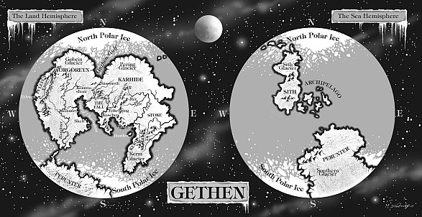

Slide 7
WHAT IF THERE WAS ONLY ONE GENDER?

Slide 8
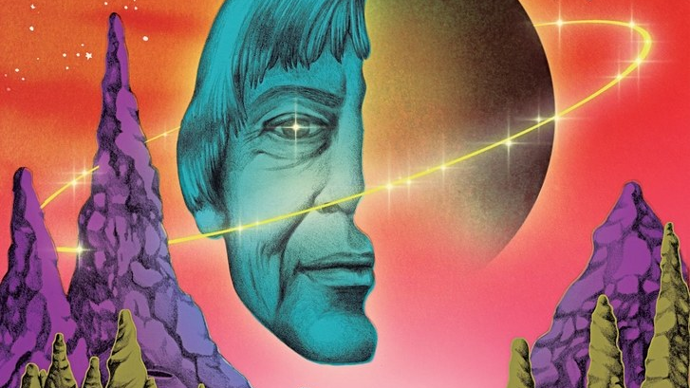
THEME: GENDER
I began to want to define and understand the meaning of sexuality and the meaning of gender, in my life and in our society… But I was not a theoretician, a political thinker or activist, or a sociologist. I was and am a fiction writer. The way I did my thinking was to write a novel
- “Is Gender Necessary,” Le Guin

Slide 9
WHAT IF A MAN VISITED EARTH AND CLAIMED TO BE AN ALIEN?

Slide 10
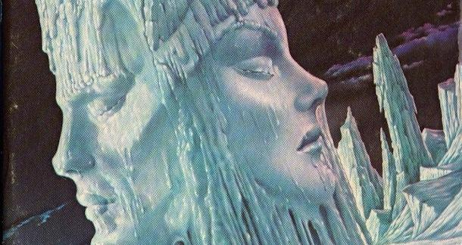
The fact is that the real subject of the book is not feminism or sex or gender or anything of the sort; as far as I can see, it is a book about betrayal and fidelity
- “The interpretative journey in Ursula K. Le Guin's The Left Hand of Darkness,” Cornell
THEME: LOYALTY

Slide 11
CAN REPUBLICANS AND DEMOCRATS EVER AGREE WITH ONE AND OTHER?

Slide 12
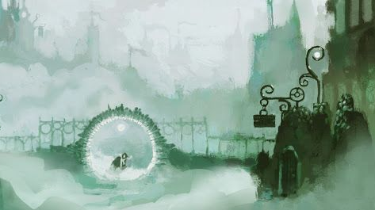
Light is the left hand of darkness,
and darkness the right hand of light.
Two are one, life and death…
THEME: DUALITY
- Left Hand of Darkness, Le Guin

Slide 13
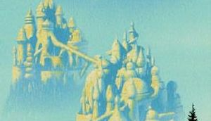
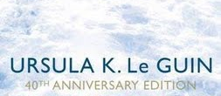
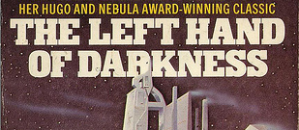
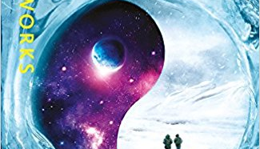
WHEN ARE YOU GOING TO READ IT?

