Slide 1
Music Recommendation System
By: Theodore Chidi-Maha

Slide 2
Problem Context
People's lives are too fast-paced and have too many distractions
They don’t have time to sift through Spotify’s extensive song library
Causing them to be dissatisfied with the product and cancel their subscriptions

Slide 3

Problem to Solve
Spotify relies on users continually engaging with their product to generate revenue.
we need a system that will enable users to engage with the platform more efficiently.
By discovering songs, they will enjoy even on a limited timeframe.
This Photo by Unknown Author is licensed under CC BY-SA

Slide 4
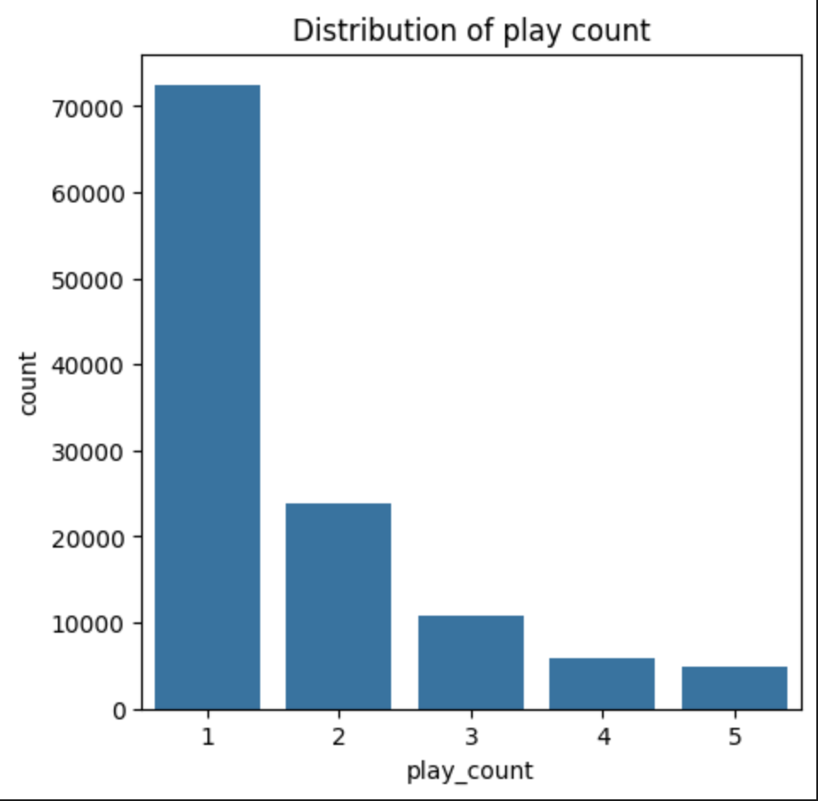
Data Insights
Data exploration led to a few key takeaways:
Song play counts is the best tool to identify how users how users rate the songs
More notably, there is a bias of 61% of users playing a song only 1 time
* This data comes from a filtered dataset

Slide 5
Recommendation models
Systems | Insights
Rank-Based | Recommends songs based on popularity. Useful only for brand new user.
User-User Collab | Used users' similarity Had the best perform both in metrics and in practice.
Item-Item Collab | Used items' similarity worse than user-user.
Content-Based | Used meta-data (similar titles, artists, and album names) gave rather middling results
Matrix Factor | Used latent factors in user-item interactions. Good performance in metrics; Poor performance in practice
Cluster-Based | Unsupervised grouping of users Poor performance both in metrics and in practice.

Slide 6
Final Solution
Hybrid (for existing users)
User-User Collab
Content-Based
Rank-based (for new users)

Slide 7
Algorithm performance metrics
Systems | RMSE | Precision (relevant recommendations) | Practical Error Margin
Hybrid | 0.9003 | 50.9% | 2%
User-User Collab | 1.0521 | 43.2% | 2%
Item-Item Collab | 1.0328 | 40.8% | 2%
Content | *N/A | 40% | *N/A
Matrix Factor | 1.0083 | 43.2% | 28.5%
Cluster | 1.0532 | 40.8% | 45%

Slide 8
Recommendations/Action items
adding a 5-star ratings system for songs
Add song Genres to dataset
Also, Add User data [Age, country, etc.]
Performing quarterly re-analysis of data and models

Slide 9
Risks/Challenges
Risks:
Increasing the amount of personal data we collect, will require us to increase data security
Challenges:
Data concerns may cause user to desire the ability to opt-out of the recommendation system.
We also need to be careful of the content we recommend to our users (ex. recommend explicit songs to minors)

Slide 10
Thank You

Slide 11
APPENDIX

Slide 12
Datasets Description
song_data:
song_id: A unique id given to every song
title: Title of the song
Release: Name of the released album
Artist_name: Name of the artist
year: Year of song release
count_data:
user _id: A unique id given to the user
song_id: A unique id given to the song
play_count: Number of times the song was played

Slide 13
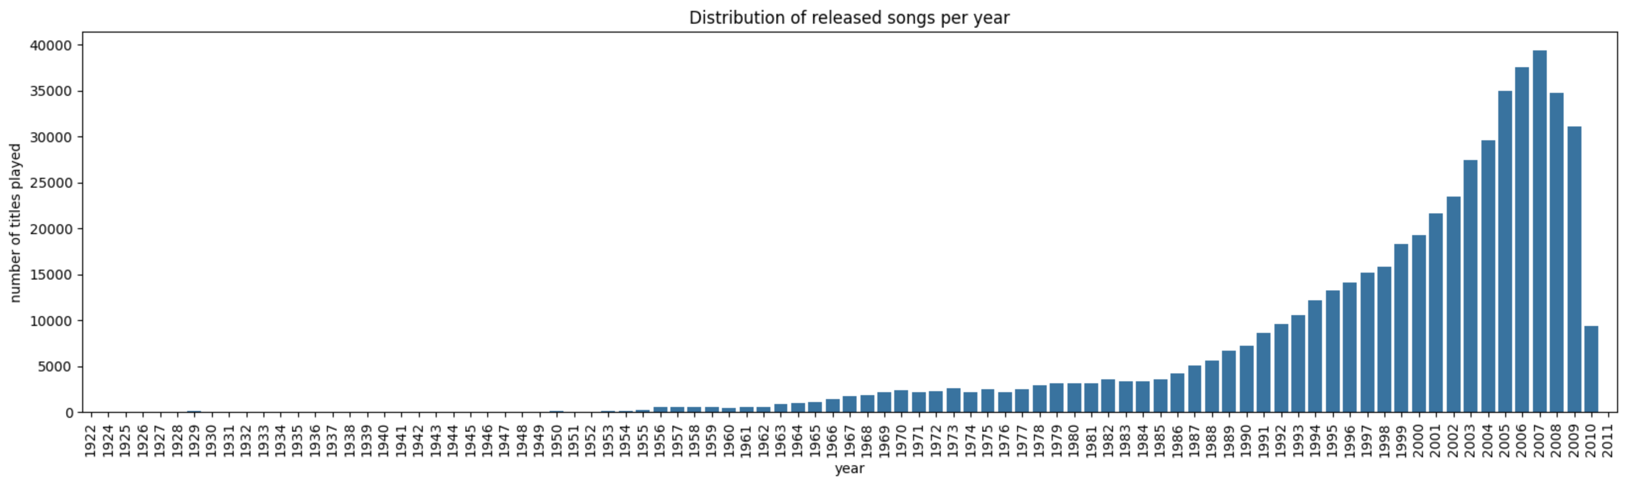
Additional data trends (Yearly Releases)

Slide 14
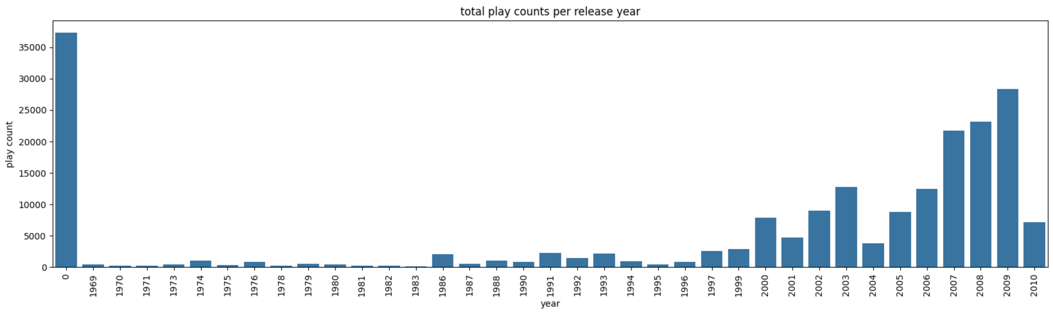
Additional data trends (Yearly play counts)

