Slide 1

Medical Appointments Management System
Teodora Ion
Mihai Calitescu
Petre-Antica Eduard-Dominic

Slide 2
Index
Introduction
Project Overview
Technologies (backend + frontend + database)
Structure
Achieved Goals
Further Work
Blockers
Demo

Slide 3
Introduction
Our system presents itself as a basic system for managing medical appointments, for both patients and doctors

Slide 4


Structure
Http
Requests
Frontend Server
(Vue-CLI)
Backend Server
(FLASK)
user
PostgreSql Database

Slide 5
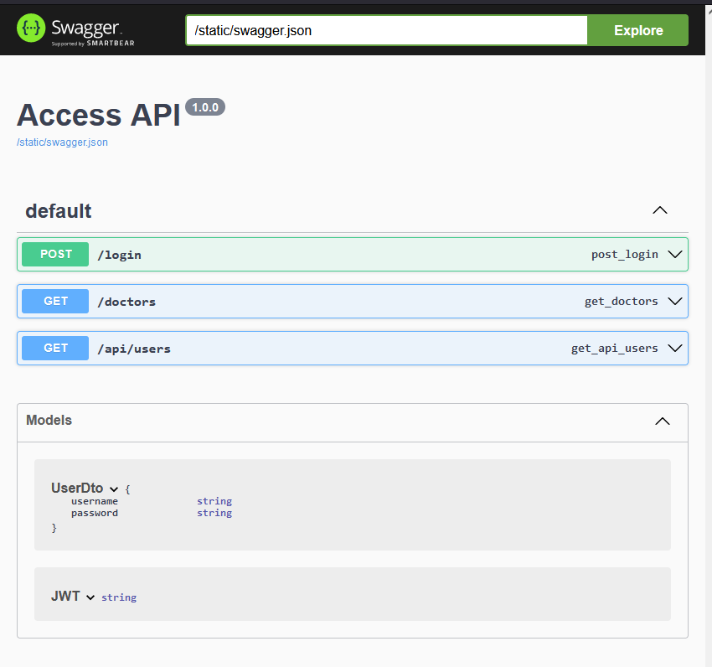
Technologies - Backend -
Python w/ Flask
RESTful API w/ HTTP requests
Authorization + Authentication
JWT tokens
Documentation
Swagger files
flask_swagger_ui – library

Slide 6
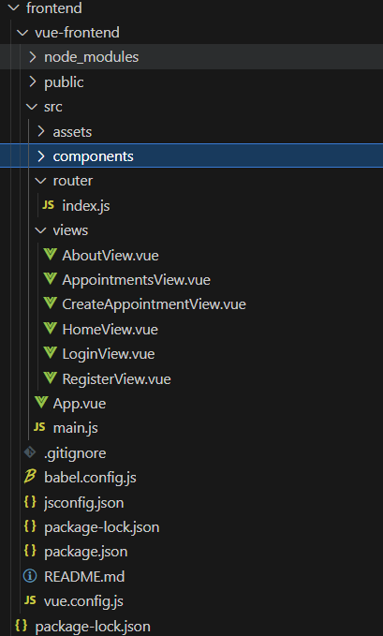
Technologies - Frontend -
Vue w/ Vue-cli (see image)
Intuitive framework
Easy-to-use
Scalable
Styling
Local CSS configuration
bootstrap

Slide 7
Technologies - Database -

Slide 8
Achieved Goals
Backend
Created basic Flask mini-framework
Added basic routes for 4 CRUD operations
Frontend
Created 3 skeleton web pages
Added support for connectivity to the Flask server
Database
Created basic database
Added connectivity between backend server and database
Implemented swagger file
Added JWT authorization + authentication support
Created vue-cli framework support
Added support in pgAdmin for easier visualization of the tables

Slide 9
Further Work
1
Add support in the backend server for the rest of the CRUD operations in the database
2
Add the swagger documentation for the operations mentioned before
3
Create the rest of the web pages in the vue-cli framework
4
Generate the rest of the necessary endpoints in both the backend and frontend server

Slide 10
DEMO

