Slide 1
Obesity Dataset
Patrick
Théophane
Andréas
ESILV - Python for data analysis - project 2023

Slide 2
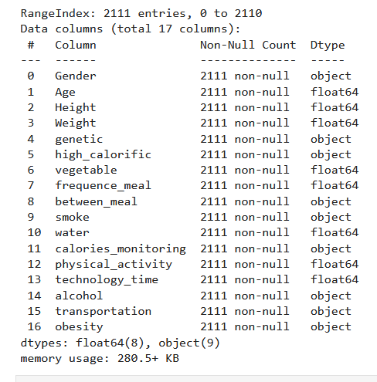
The Dataset

Slide 3
OUR DATAS
DataViz and Biais

Slide 4
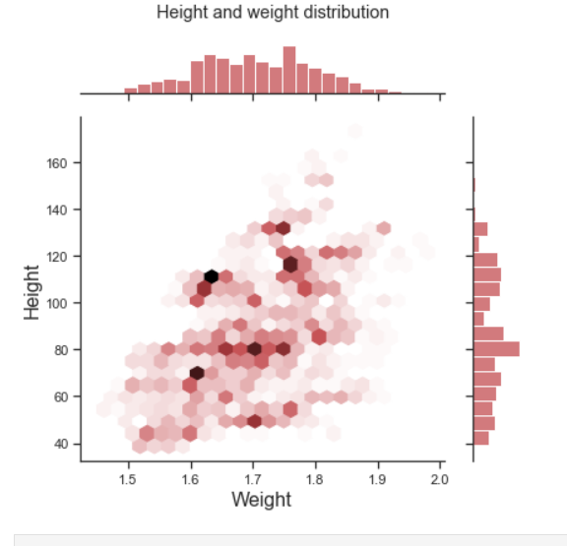
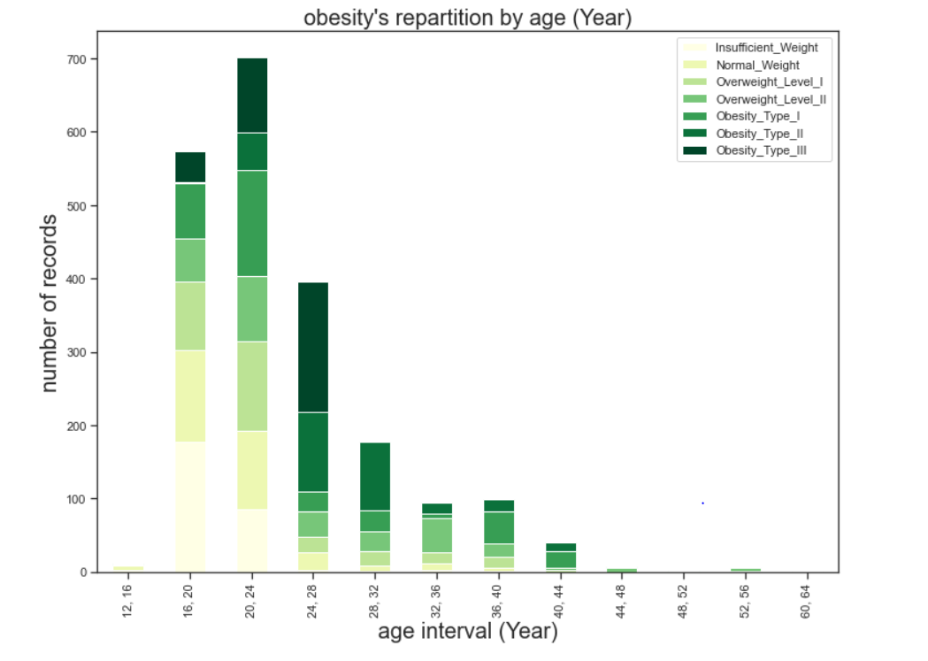
Correlation and biais

Slide 5
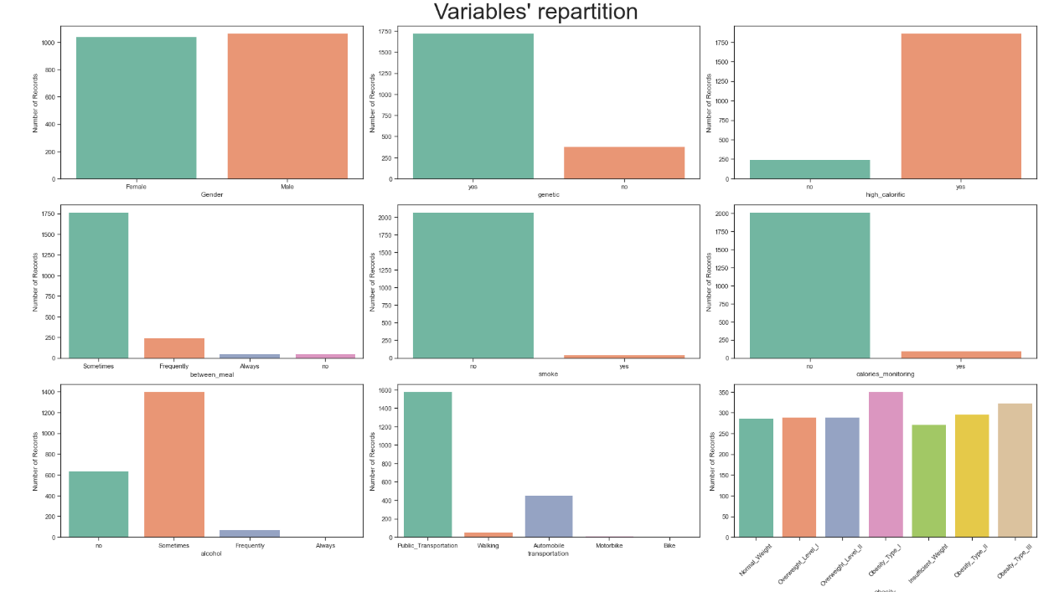

Slide 6
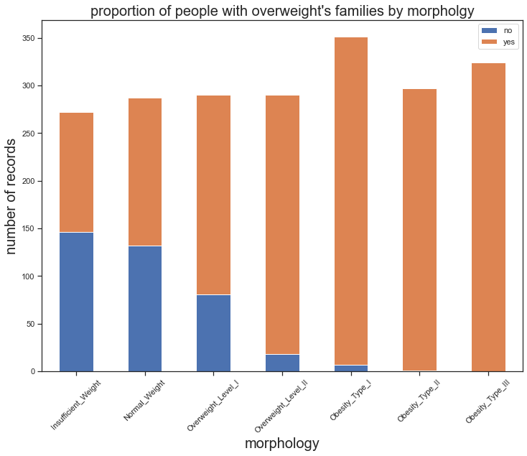
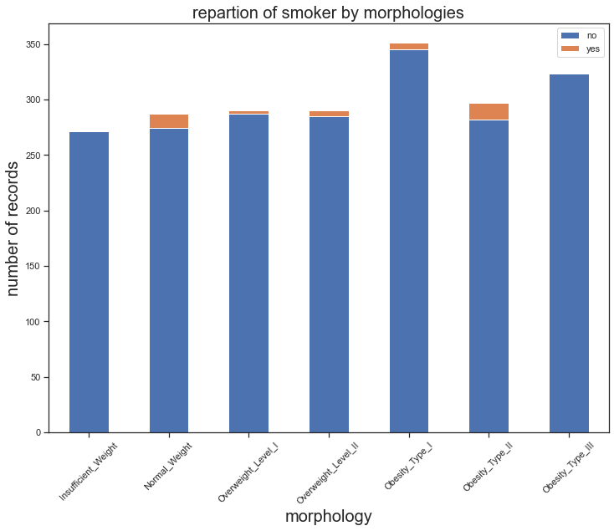
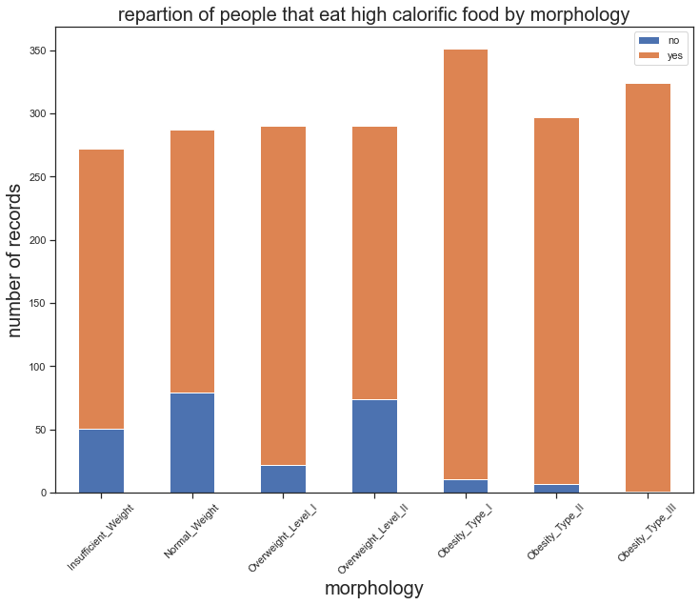
Repartition per Obesity type

Slide 7
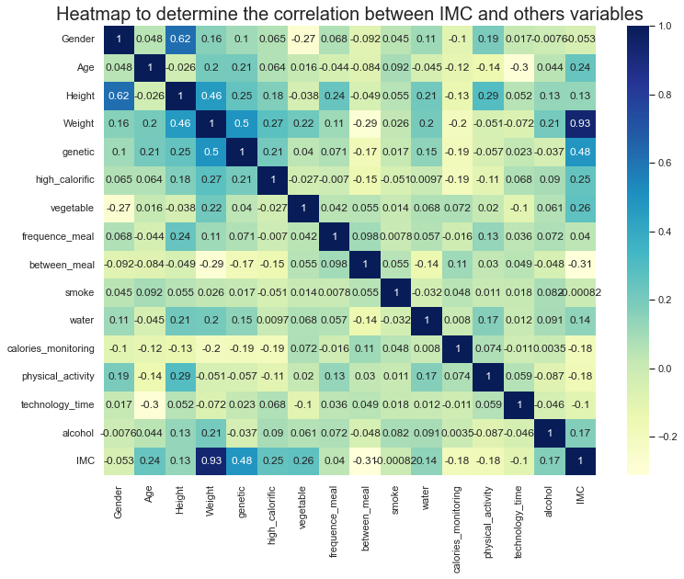
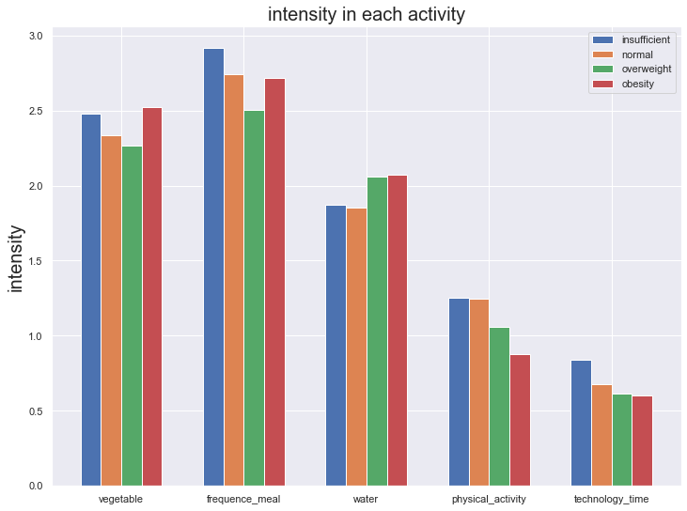

Slide 8
PREDICTING OBESITY TYPE ?
Machine Learning and Preprocessing

Slide 9
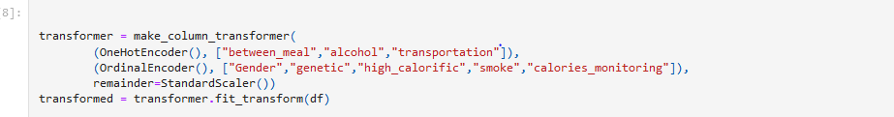
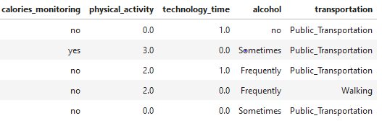
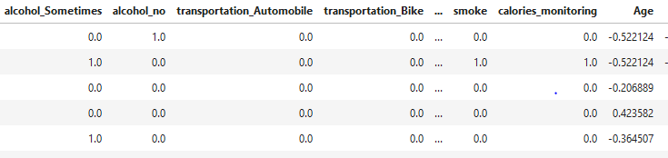
Preprocessing

Slide 10
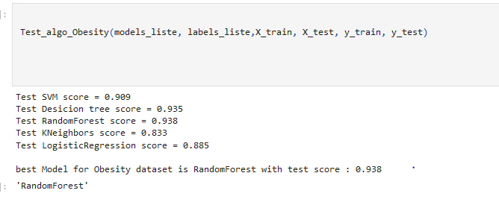
Comparing Machine Learning Performance

Slide 11
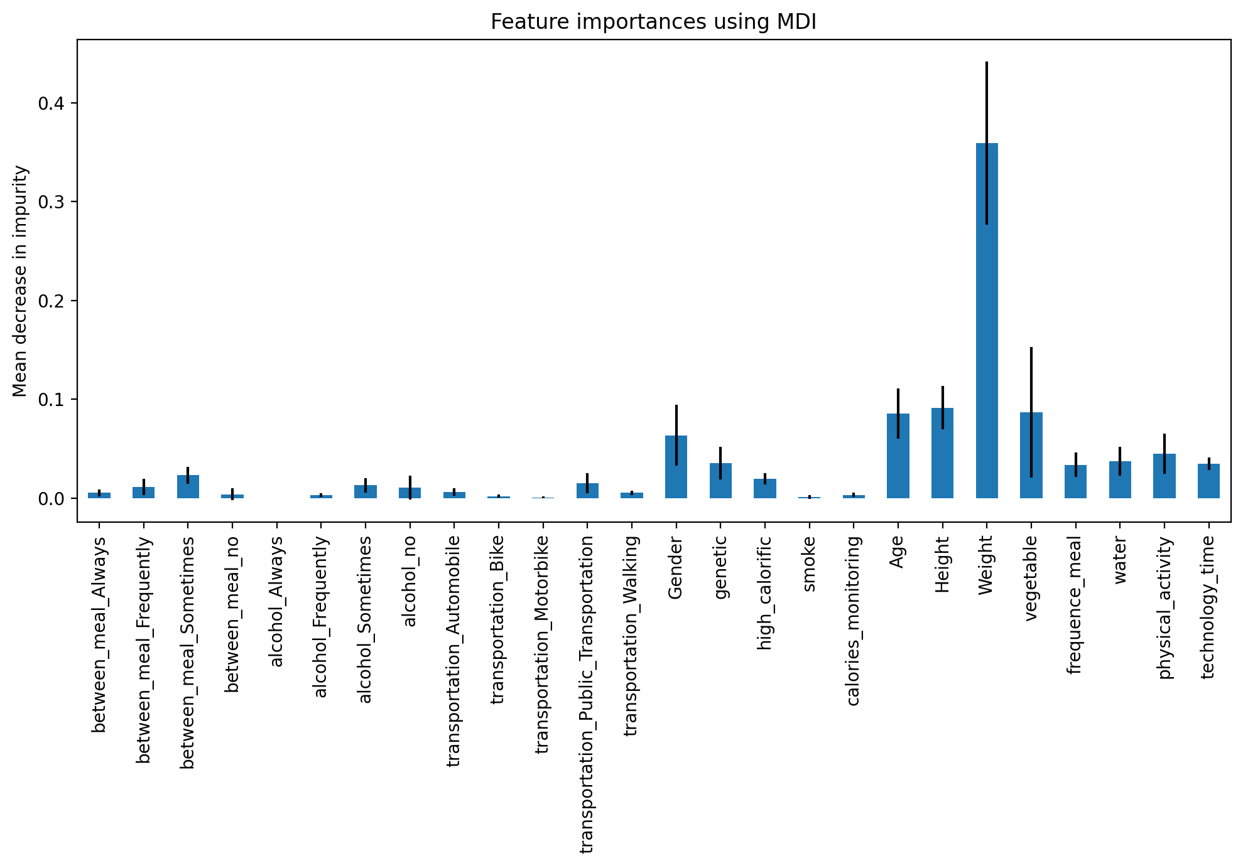
Comparing Machine Learning Performance

Slide 12
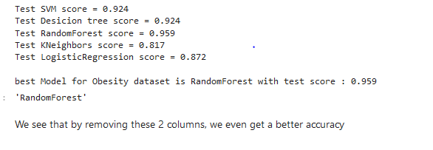
Improving Machine Learning Performance

Slide 13
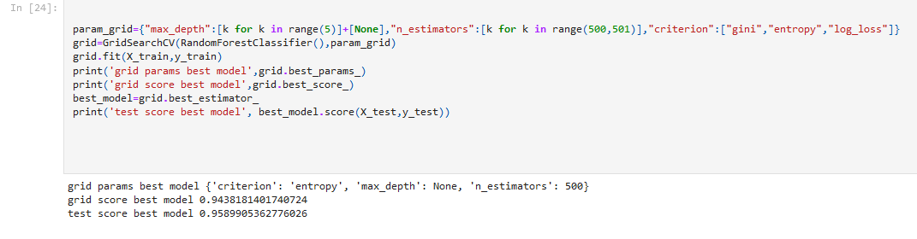
Improving Machine Learning Performance

Slide 14
Scaling and deploying
API & Django & Virtual Environnemnt

Slide 15
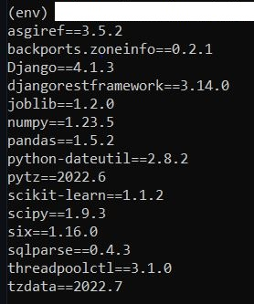

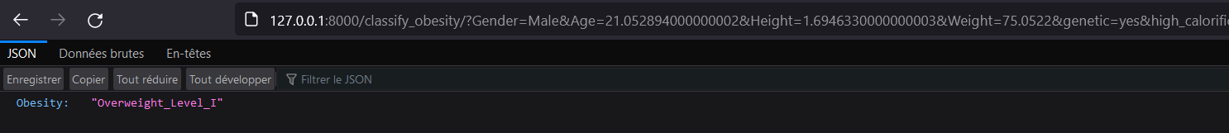
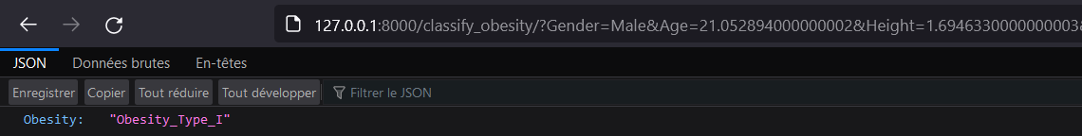
API & Venv

Slide 16




Merci

