Slide 1
Hello World With Xamarin.Forms
Aditya Oberai

Slide 2


What Is Xamarin.Forms?
Xamarin.Forms is an open source cross-platform framework from Microsoft for building iOS, Android, & Windows apps with .NET from a single shared codebase.

Slide 3
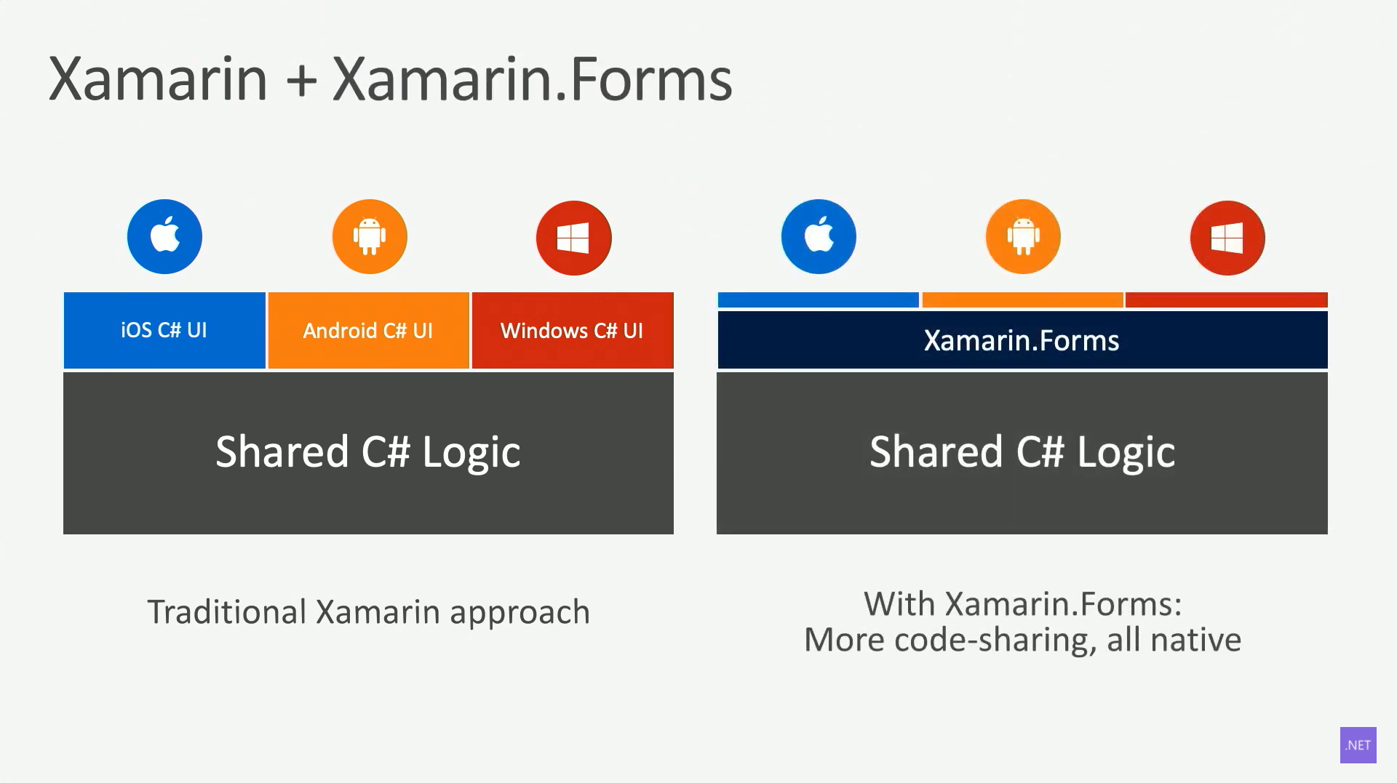
How Xamarin.Forms Works

Slide 4
Let’s Get Coding!

Slide 5
Step 1: Download Visual Studio IDE

Slide 6
Step 2: Install the “Mobile development with .NET” workload

Slide 7
Step 3: Develop the App

Slide 8
Congratulations!!!

Slide 9
Resources
GitHub Repo
https://github.com/adityaoberai/xamarin-forms-helloworld
Learn More About Xamarin.Forms
https://dotnet.microsoft.com/learn/xamarin
https://docs.microsoft.com/en-us/learn/paths/build-mobile-apps-with-xamarin-forms/

