Slide 1

AWS Cloud Infrastructure
Capstone Project
Theo Boyesen
Terraform
AWS EC2
ALB
CloudWatch
GitHub Actions
Cloud Infrastructure · Security · Automation · Monitoring

Slide 2





Project Overview
Goal: Build a scalable, highly available system using AWS best practices — load balancing, private networking, and monitoring
Infrastructure as Code
Load Balancing
Auto Scaling
Private Network
Monitoring
Terraform
App LB (ALB)
EC2 ASG
Subnet arch.
CloudWatch
Built on AWS · Managed with Terraform · Automated via GitHub Actions

Slide 3
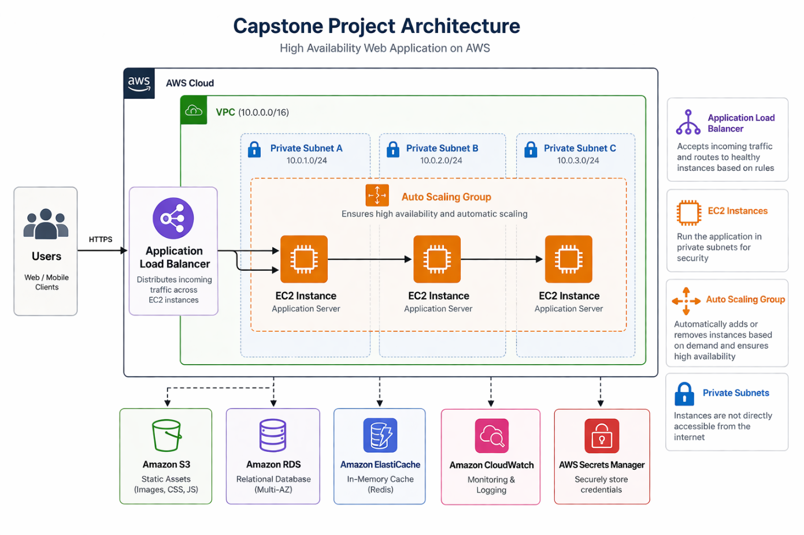
Architecture Overview
Traffic enters via ALB, distributed across EC2 instances in Auto Scaling Group
EC2 in private subnets — no direct public access · NAT Gateway for outbound

Slide 4
Networking & Security
Internet
Private Subnets
NAT Gateway
No direct public access
EC2 not internet-exposed
Isolated from external threats
Outbound internet for EC2
No inbound exposure
Updates & dependencies
↓
Application Load Balancer
↓
Security Group (ALB→EC2 port 3000)
↓
Security Groups
Traffic Flow
EC2 Instances (Private Subnet)
ALB → EC2 port 3000 only
Principle of least privilege
Strict inbound rules
User → ALB (public)
ALB → EC2 (private)
EC2 → NAT (egress only)
↓
NAT Gateway (Outbound Only)
IAM
IAM roles and groups used to enforce least privilege access

Slide 5
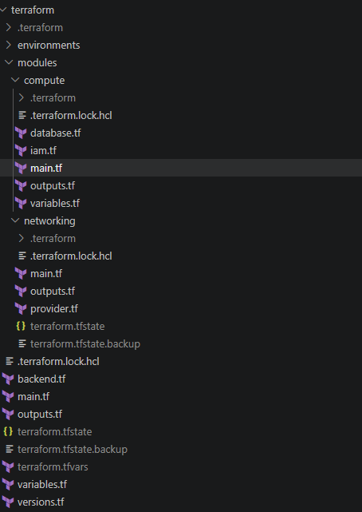
Infrastructure as Code · Terraform
Terraform
Modular Structure
Networking + compute modules
Reusable Components
Consistent patterns across envs
Fully Reproducible
No manual config, no drift
State Management
Remote state for consistency

Slide 6
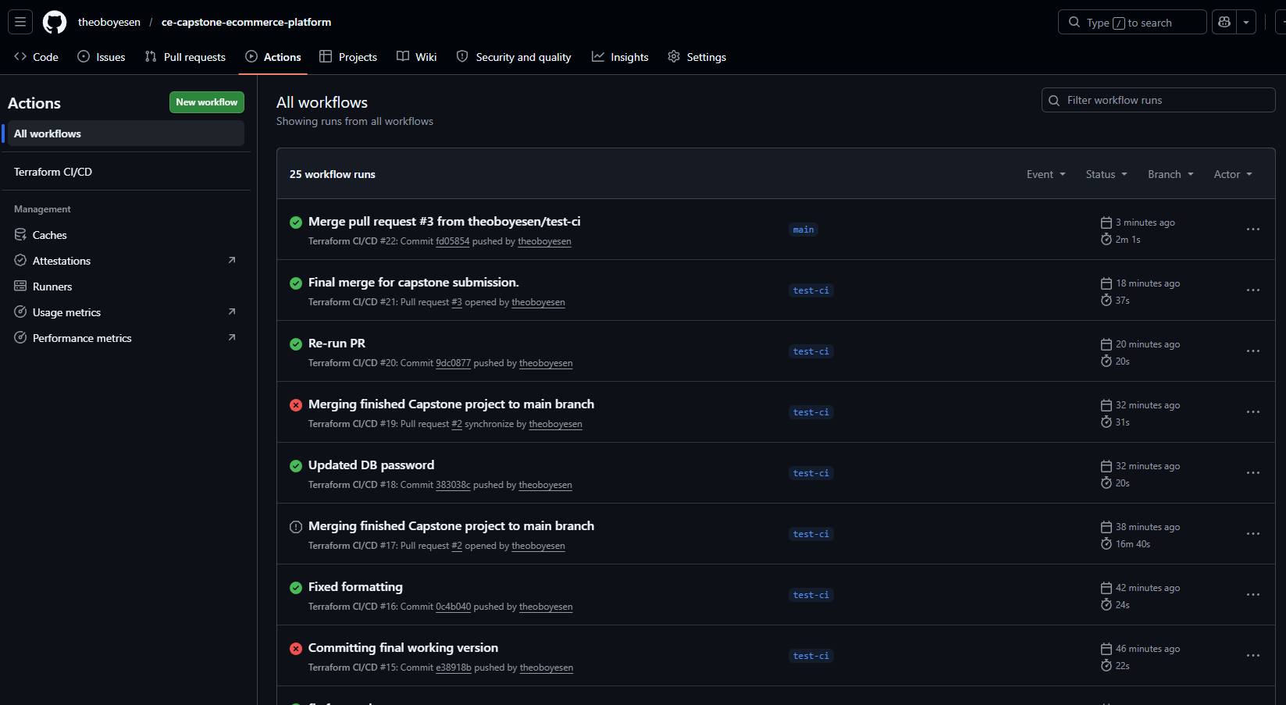
CI/CD Pipeline · GitHub Actions
Automated Validation
Controlled Deployments
Full Auditability
Every PR runs terraform plan — changes previewed before merge
terraform apply only on main — no accidental infrastructure changes
All changes tracked via Git commits and GitHub Actions logs

Slide 7
Application · Node.js HTTP Server
Node.js Server
API Endpoints
Runtime
Node.js (v16)
GET /
Returns instance metadata
Port
3000
instance_id, hostname, timestamp
Protocol
HTTP
Purpose: Demonstrates load balancing — instance_id changes on refresh
Deployment
EC2 User Data script
GET /health
ALB Health Check endpoint
Returns: { status: 'ok' }
Purpose: Required for ALB to route traffic to the instance

Slide 8
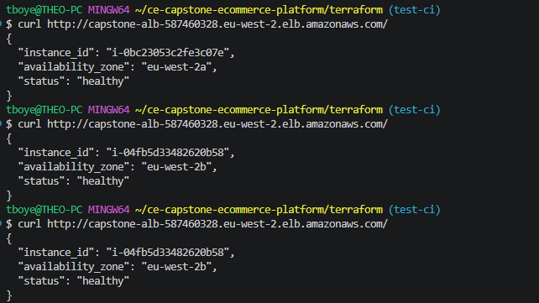
Live Demo · Load Balancing in Action
Each page refresh returns a DIFFERENT instance_id — proving traffic is distributed across multiple EC2 instances
1
User hits the ALB endpoint in browser
2
ALB distributes using round-robin to EC2 instances
3
Server returns its own instance metadata as JSON
4
Refreshing routes to a DIFFERENT instance
5
instance_id changes — load balancing confirmed!

Slide 9
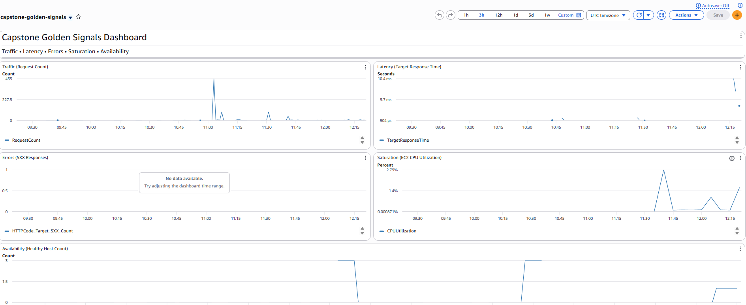
Monitoring & Alerts · CloudWatch
🚨 High CPU Alert
🚨 Unhealthy Instances
🚨 High Latency
🚨 Request Count
CPU > 80% for 5 min → scale needed
Healthy host count < 2 → app crash
p99 latency > 1s → perf degradation
Track traffic spikes across instances

Slide 10
Cost Optimisation
t3.micro
~$30
~$45
EC2 Instance Type
(×3 instances)
Estimated Monthly Cost
(when running)
NAT Gateway Cost
(per month running)
Cost Savings
Trade-offs Considered
Cost vs. Security
t3.micro instances (lowest cost)
Fixed scaling — no over-provisioning
Destroy infra when not in use
No reserved instances for dev env
Lower cost vs. higher performance
NAT Gateway cost vs. security benefit
Fixed scaling vs. dynamic (less flexible)
t3.micro limits under heavy load
NAT Gateway required for private subnets
Cost is justified by security posture
VPC endpoints as cheaper alternative
Reviewed AWS pricing calculator

Slide 11
Challenges & Solutions
PROBLEM
✅ SOLUTION
Node.js Installation Failure
Switched to Node.js v16 via NodeSource repository
Cause: Incompatibility with Amazon Linux default repo
PROBLEM
✅ SOLUTION
Application Startup Timing
Added sleep & proper startup order in user data script
Cause: App not ready before health checks began
PROBLEM
✅ SOLUTION
Unhealthy Targets / 502 Errors
Fixed port binding and startup sequence; validated with CloudWatch logs
Cause: App not listening on port before ALB health checks ran

Slide 12


Key Learnings
Debugging with Logs
Infra vs App Issues
CloudWatch Logs and EC2 system logs were essential for diagnosing startup and health check failures.
Learned to clearly separate infrastructure problems (Terraform, networking) from application issues (Node.js, ports).
Real-World Complexity
AWS Architecture Design
Simple-looking deployments have many failure points — startup timing, port binding, health checks, security groups.
Private subnets, ALB, ASG, NAT Gateway — understanding how these work together in a production-like setup.
"This project helped me understand how to debug real systems and design reliable cloud infrastructure." — Theo Boyesen

