Slide 1

What Is an HDB Flat Really Worth?
Predicting Singapore resale flat prices with an end-to-end machine-learning workflow
THET HTUT ZAW · Theme: Smart cities & urban analytics · Data: HDB resale prices, Jan 2025 – Oct 2026 (data.gov.sg)
GitHub Repository Link: https://github.com/theochan440-Giddy/New-Generation-Data-Science-.git
Notes:
[0:00–0:25]
Hello, I'm THET HTUT ZAW. My project asks a question many Singaporeans care about: what is an HDB flat really worth?
I used HDB's official resale data — about 46,000 sales from January 2025 to October 2026 — and built a full machine-learning workflow: data cleaning, EDA, PCA, a pipeline, three types of model, AutoML, tuning, and explainable AI.

Slide 2



The problem: estimate a fair resale price
Who needs it
46,307
22
S$630k
Buyers and sellers want a fair price; planners want to understand what drives housing costs.
resale sales
months: Jan 2025 – Oct 2026
median price
ML task
Regression: predict a number (the price in S$) from the flat's features.
How success is measured
Metric | Why
MAE (main) | Average error in S$: "we are $X off"
MAPE | Error as %: fair for cheap and expensive flats
RMSE | Penalises a few very big misses
R² | Share of price differences explained
Target variable
resale_price, using town, flat type, size, floor, flat model and remaining lease.
Notes:
[0:25–1:10]
Housing is a core smart-city topic. Buyers and sellers want a fair price, and planners want to know what drives housing costs.
This is a regression problem: I predict the resale price in dollars from the flat's town, type, size, floor, model and remaining lease.
My main metric is MAE — the average error in dollars — because it's easy to explain. I also report MAPE, the error as a percentage, which is fairer across cheap and expensive flats, plus RMSE and R².
Before modelling I set success criteria: R-squared of at least 0.9, an average error under 8%, and no overfitting.

Slide 3








Workflow: eight steps, test set used once
1
2
3
4
Data check
EDA
80/20 split
PCA
No blanks; text → numbers
Charts, ANOVA, correlations
Before anything is fitted
Finds duplicate information
5
6
7
8
Pipeline
AutoML
Tuning
Test & explain
Scale, one-hot, log target
FLAML, 4 model families
Optuna, 20 trials
One test, then SHAP
No leakage: scaling, PCA, AutoML and tuning all learn from the training set only, using 5-fold cross-validation.
Notes:
[1:10–1:35]
Here's the workflow. The key step is number 3: I set aside 20% of sales as a test set before fitting anything. Everything that learns from data — scaling, PCA, AutoML and tuning — only sees the training set, using 5-fold cross-validation. The test set is used once, at the end, so the final score is honest.

Slide 4
Data preparation: numbers hidden in text
"07 TO 09"
8
No blank values
Pipeline still fills blanks, so it won't break on new data.
storey_range → middle floor
22 duplicates kept
"61 years 04 months"
61.33
Likely two flats in the same block and floor range sold for the same price.
remaining_lease → years
1,086 price outliers kept
Real million-dollar flats in central towns, not errors.
"4 ROOM"
4
Rare flat models grouped
flat_type → number of rooms
Types with under 50 sales (e.g. Terrace) become "infrequent".
Converting text row by row learns nothing from the data, so it is safe before the split.
Log of price
Skew drops from 0.92 to 0.03; models learn % effects.
Notes:
[1:35–2:20]
The data has no blank values, but useful numbers were hidden in text. For example "07 TO 09" becomes floor 8, and "61 years 04 months" becomes 61.33 years. This only reshapes each row, so it's safe before the split.
On the right are my other decisions: I kept the 22 duplicates because they're likely different flats; I kept the 1,086 price outliers because they're real million-dollar flats; I grouped very rare flat models; and I model the log of price, which removes the skew and lets the model learn percentage effects.

Slide 5
Size is the biggest driver of price
η² = 0.53
flat type explains 53% of the price variation (ANOVA)
ρ = 0.69
correlation of floor area with price (Spearman)
Flat
prices changed only −1% to +5% over the 22 months
Notes:
[2:20–3:00]
The first EDA finding: size matters most. The median price climbs from about 444 thousand for a 3-room flat to over 900 thousand for an Executive flat.
I tested this with ANOVA on log price: flat type alone explains 53% of the variation. Floor area has a Spearman correlation of 0.69 with price.
And prices were stable over these 22 months — only minus 1 to plus 5 percent — so the month of sale should matter little.

Slide 6
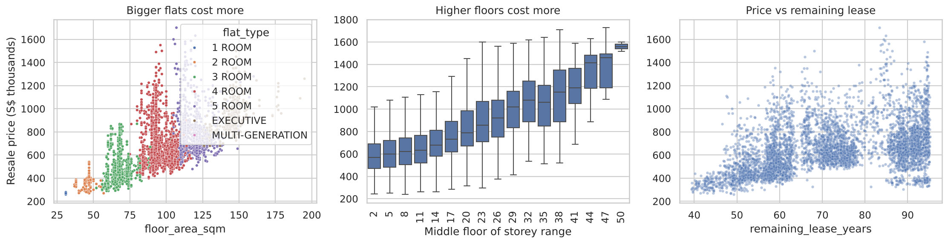



Location, floor and lease also matter
Town
Floor
Remaining lease
Bukit Timah S$974k vs Ang Mo Kio S$510k median, but town medians mix flat sizes and ages.
Median rises from ~S$570k on low floors to over S$1M above the 28th floor.
Not a straight line: young flats (85+ years left) carry a clear premium.
Notes:
[3:00–3:40]
Location matters too: Bukit Timah's median is almost twice Ang Mo Kio's. But careful — Ang Mo Kio is a mature estate with many old 3-room flats, so a town median mixes size and age together. That's why we need a model that looks at everything at once.
Higher floors cost more, and remaining lease is not a straight line: flats with 85 or more years left carry a clear premium. Curves like this are hard for linear regression, which is a hint that tree models will do better.

Slide 7
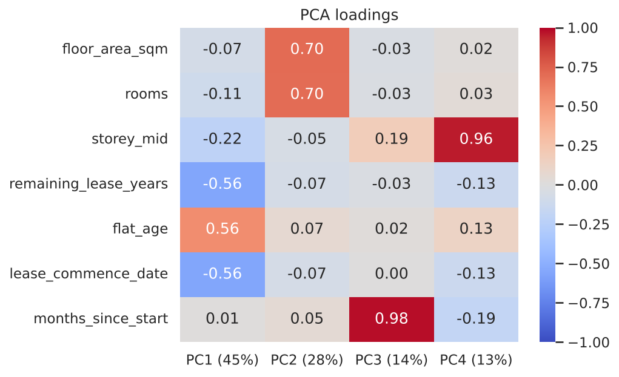
PCA: seven numbers, only four ideas
PC1 · 45%
PC2 · 28%
Flat age (lease, age, start year)
Size (floor area, rooms)
PC3 · 14%
PC4 · 13%
Time of sale
Floor height
So what?
4 components keep 99.4%: lease start and flat age copy remaining lease, so we dropped them.
PCA + linear regression was worse (S$58k vs S$48k error), so PCA guides us but is not a model step.
Notes:
[3:40–4:30]
Before modelling I ran PCA on the seven numeric columns, scaled and fitted on training data only. Four components keep 99.4% of the information, so the seven numbers really hold four ideas: flat age, size, time of sale and floor height.
This led to two decisions. First, lease start year and flat age are copies of remaining lease, so I dropped them. Second, I tested PCA plus linear regression: it was worse, because PCA keeps variance, not what predicts price. So PCA helped me understand the data, but it isn't part of the final model.

Slide 8



Tree models beat linear regression clearly
Baseline
Always guessing the average price is S$163k off (27%).
Why trees win
They capture curves and combinations, e.g. lease and size work differently by town.
Overfitting check
Linear: train = CV (too simple). Random Forest is 2× better on training data (memorising).
Notes:
[4:30–5:10]
I compared models of different types, all with the same 5-fold cross-validation. The baseline — always guessing the average — is 163 thousand dollars off.
Linear regression gets to 48 thousand; PCA plus linear regression is worse at 58. The tree models are clearly best: Random Forest at 30 thousand and LightGBM at 34.
I also compared training and validation error to check for overfitting. Linear regression scores the same on both — it's too simple. Random Forest is about twice as accurate on its training data, so it partly memorises.

Slide 9
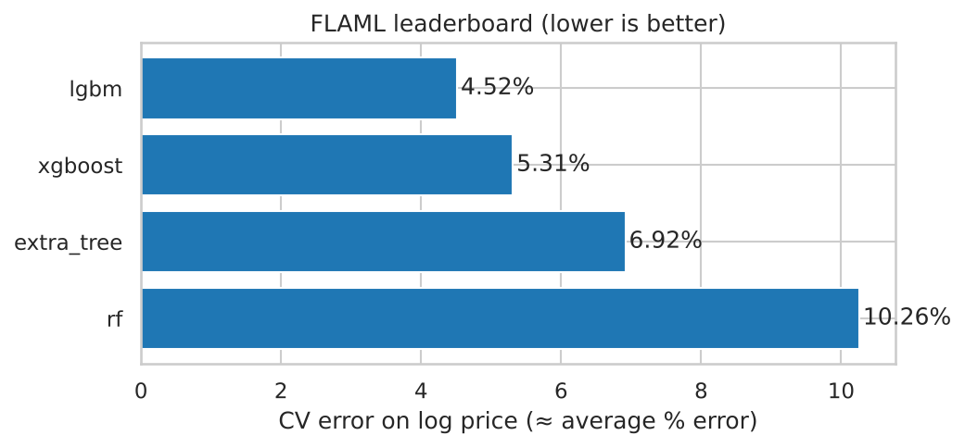
AutoML (FLAML): LightGBM comes out on top
S$30.1k
CV MAE of FLAML's best LightGBM: better than default LightGBM (S$33.7k). 50 trials in about 70 seconds.
It confirms our plan
Read it critically
Limitations
Boosted trees are the right family, so we tune LightGBM next.
FLAML ranked Random Forest last (10%), but our own Random Forest reached 4.5%: it just got few trials.
Optimises one number; depends on budget; reuses folds; cannot prepare the data.
Notes:
[5:10–5:50]
Next I used FLAML, an AutoML tool, to search four model families automatically, using the same training data, log price target and 5-fold CV. I chose FLAML because it's fast and runs on current Colab; PyCaret doesn't support Colab's Python version.
LightGBM wins clearly, and FLAML's best model is about 30 thousand dollars off, better than default LightGBM. So it confirms my plan to tune LightGBM.
But I read it critically: FLAML ranked Random Forest last, yet my own Random Forest did very well. With only 50 trials, it barely explored Random Forest. So the leaderboard reflects the search budget, not just the models.

Slide 10
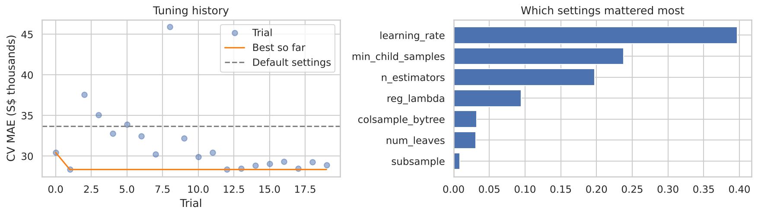
Optuna tuning cut the error by 15.8%
−S$5,332
CV MAE: S$33.7k (default) → S$28.4k (tuned)
Strategy
Best settings
What mattered
Bayesian TPE search, 20 trials, each scored by 5-fold CV. Grid search over 7 settings would need ~2,000 runs.
900 trees, learning rate 0.06, 68 leaves, small leaves (6 flats): a richer model than the default.
Learning rate, minimum leaf size and number of trees. The best trial came early (trial 2).
Notes:
[5:50–6:25]
I tuned LightGBM with Optuna's TPE sampler, which is Bayesian optimisation: it learns from earlier trials instead of trying every combination like grid search.
In 20 trials it cut the error by 5,300 dollars, or 15.8%, far more than the fold-to-fold noise of about 350 dollars. The best model is bigger and learns more slowly than the default — 900 trees and 68 leaves — because HDB prices have a lot of detail, like town and size combinations.

Slide 11
Final test: about 4% off on unseen flats
Model (test set, 9,262 flats) | MAE | MAPE | R²
LightGBM, Optuna-tuned | S$27,714 | 4.16% | 0.963
FLAML best (LightGBM) | S$29,088 | 4.37% | 0.959
Random Forest | S$29,136 | 4.37% | 0.959
LightGBM, default | S$32,772 | 4.87% | 0.950
Linear regression | S$47,236 | 7.08% | 0.901
PCA → linear regression | S$57,508 | 8.46% | 0.846
Baseline (average price) | S$161,745 | 27.00% | 0.000
4.2%
average error (MAPE)
0.963
R²: explains 96% of price differences
Overfitting check: every model's test error is within 4% of its cross-validation error, so the CV scores were honest.
S$19.7k
Success criteria met: R² ≥ 0.90 ✓ MAPE ≤ 8% ✓ beats baseline and linear regression ✓ no overfitting ✓
half of flats priced within this
Notes:
[6:25–7:10]
Every model was retrained on the full training set and tested once on 9,262 flats it had never seen.
The tuned LightGBM is best: on average 27,700 dollars off, which is about 4.2%, and an R-squared of 0.963. Half of all flats are priced within about 20 thousand dollars. It also beats the AutoML model.
The test errors are all within 4% of the cross-validation errors, so there's no overfitting, and all my success criteria are met.

Slide 12
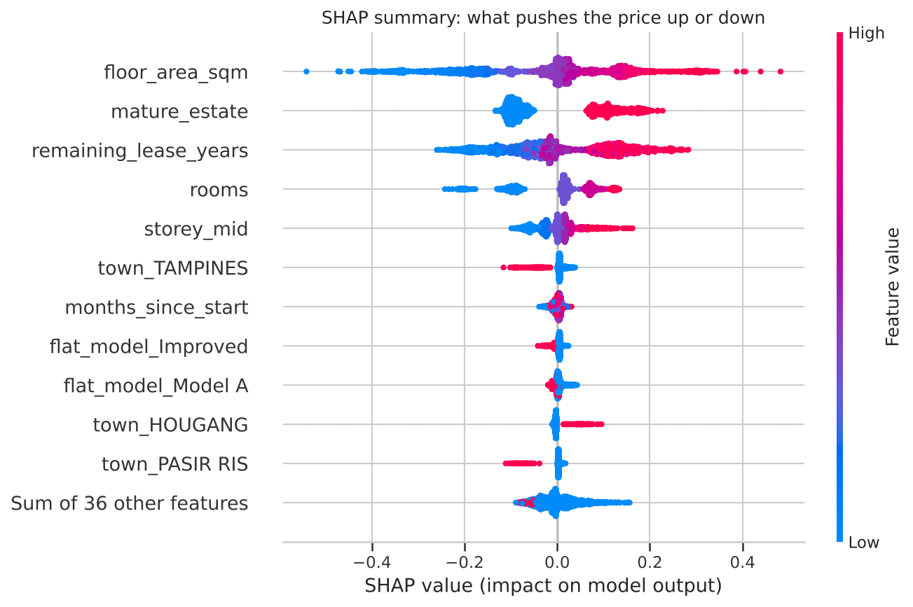


SHAP: size, location and lease set the price
Floor area
Each extra 10 sqm adds about 6% to the price.
Mature estate
Adds about 10–20%; non-mature towns about −10%.
Remaining lease
Slow rise, then a clear premium above 85 years left.
Floor height
Low floors about −8%, the highest about +15%.
Cross-checked: permutation importance and linear-regression effects rank the same top three.
Notes:
[7:10–7:55]
To explain the model I used SHAP. Each dot is a flat; red is a high value; dots to the right push the price up. Because the model predicts log price, a SHAP value of 0.1 is roughly plus 10%.
The three biggest drivers are floor area, being in a mature estate and remaining lease. In plain terms: each extra 10 square metres adds about 6%, a mature estate adds 10 to 20%, and flats with more than 85 years of lease left carry a clear premium. Floor height adds up to about 15%.
Permutation importance and the linear regression's coefficients rank the same top three, so I trust these explanations.

Slide 13
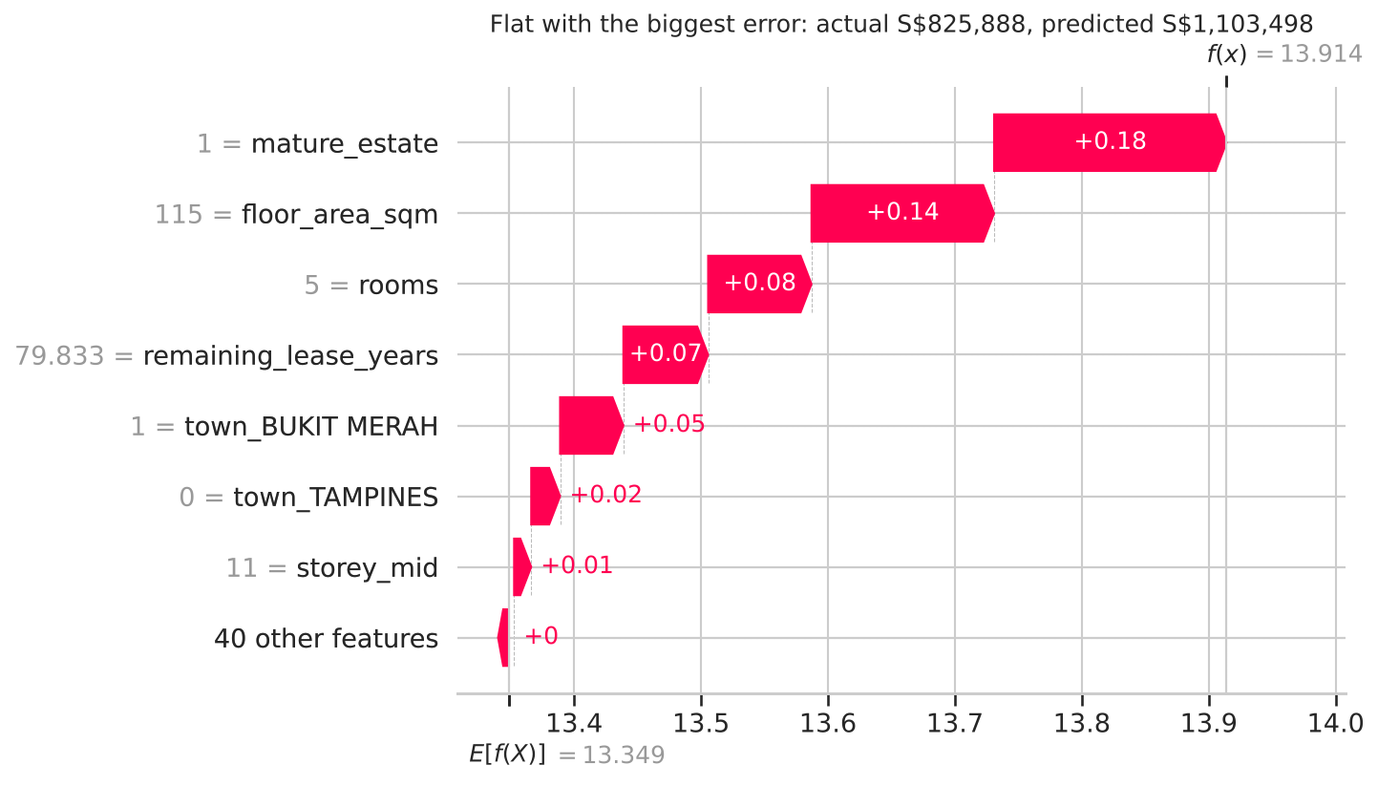


One flat at a time, and what the data cannot see
A typical flat
4-room in Woodlands, 90 sqm: sold S$536,888, predicted S$520,431 (3% off). Main reason it's below average: not a mature estate (about −10%).
Limitations
Missing: MRT distance, condition, view, exact location.
SHAP shows what the model uses, not what causes prices.
Size features overlap, so they share credit.
Biggest error: a 5-room Improved flat in Bukit Merah, 115 sqm. Sold for S$825,888; predicted S$1,103,498.
Notes:
[7:55–8:35]
SHAP also explains single flats. A typical 4-room flat in Woodlands was predicted within 3%; the main reason it's below average is that Woodlands isn't a mature estate.
The biggest error was a 5-room flat in Bukit Merah: everything about it looks expensive — mature estate, large, long lease — so the model predicted 1.1 million, but it sold for 826 thousand. The cause is probably something the data doesn't include, like its exact location, condition or view.
That's the main limitation: no MRT distance or condition data. And SHAP shows what the model uses, not what causes prices.

Slide 14
Reflection: challenges and lessons learned
CHALLENGE
CHALLENGE
CHALLENGE
Numbers hidden in text
Three columns said the same thing
My rare-category rule merged expensive towns
LESSON
LESSON
LESSON
Check every column's format, not just for blanks.
Use correlations and PCA to find and remove copies.
Check what each preprocessing step really does.
CHALLENGE
CHALLENGE
CHALLENGE
AutoML ranked Random Forest last
Runs were too slow for a demo
A few flats are badly mispriced
LESSON
LESSON
LESSON
Use AutoML as a guide; confirm with your own tests.
Fewer trials gave the same accuracy in 7 minutes.
The data's limits matter more than the model's.
Notes:
[8:35–9:20]
Some reflections. First, the important numbers were hidden in text, so I learned to check every column's format.
Second, three columns said the same thing, and PCA helped me spot and remove the copies.
Third, my first rule for rare categories accidentally merged small but expensive towns like Bukit Timah, so I learned to check what each step really does.
Fourth, AutoML ranked Random Forest last only because it gave it few trials — AutoML is a guide, not the final answer.
And finally, a few flats are badly mispriced because of what the data can't see; better data would help more than a better model.

Slide 15


Size, location and lease set the price
What drives price
How well we predict
Next steps
+6% per 10 sqm, +10–20% in a mature estate, a premium above 85 years of lease.
Tuned LightGBM: 4.2% average error, R² 0.963 on unseen flats.
Add MRT distance, test on the latest months, add 2020–2024 to learn trends.
Thank you. Questions?
Notebook, data and code: see the GitHub repository in the submission
Notes:
[9:20–9:45]
To conclude: size, location and remaining lease set an HDB flat's price. The tuned LightGBM predicts unseen flats with about 4% error, and its explanations make sense.
Next, I would add distance to MRT stations, test on the most recent months only, and add earlier years so the model learns price trends.
Thank you — I'm happy to take questions.

