Slide 1
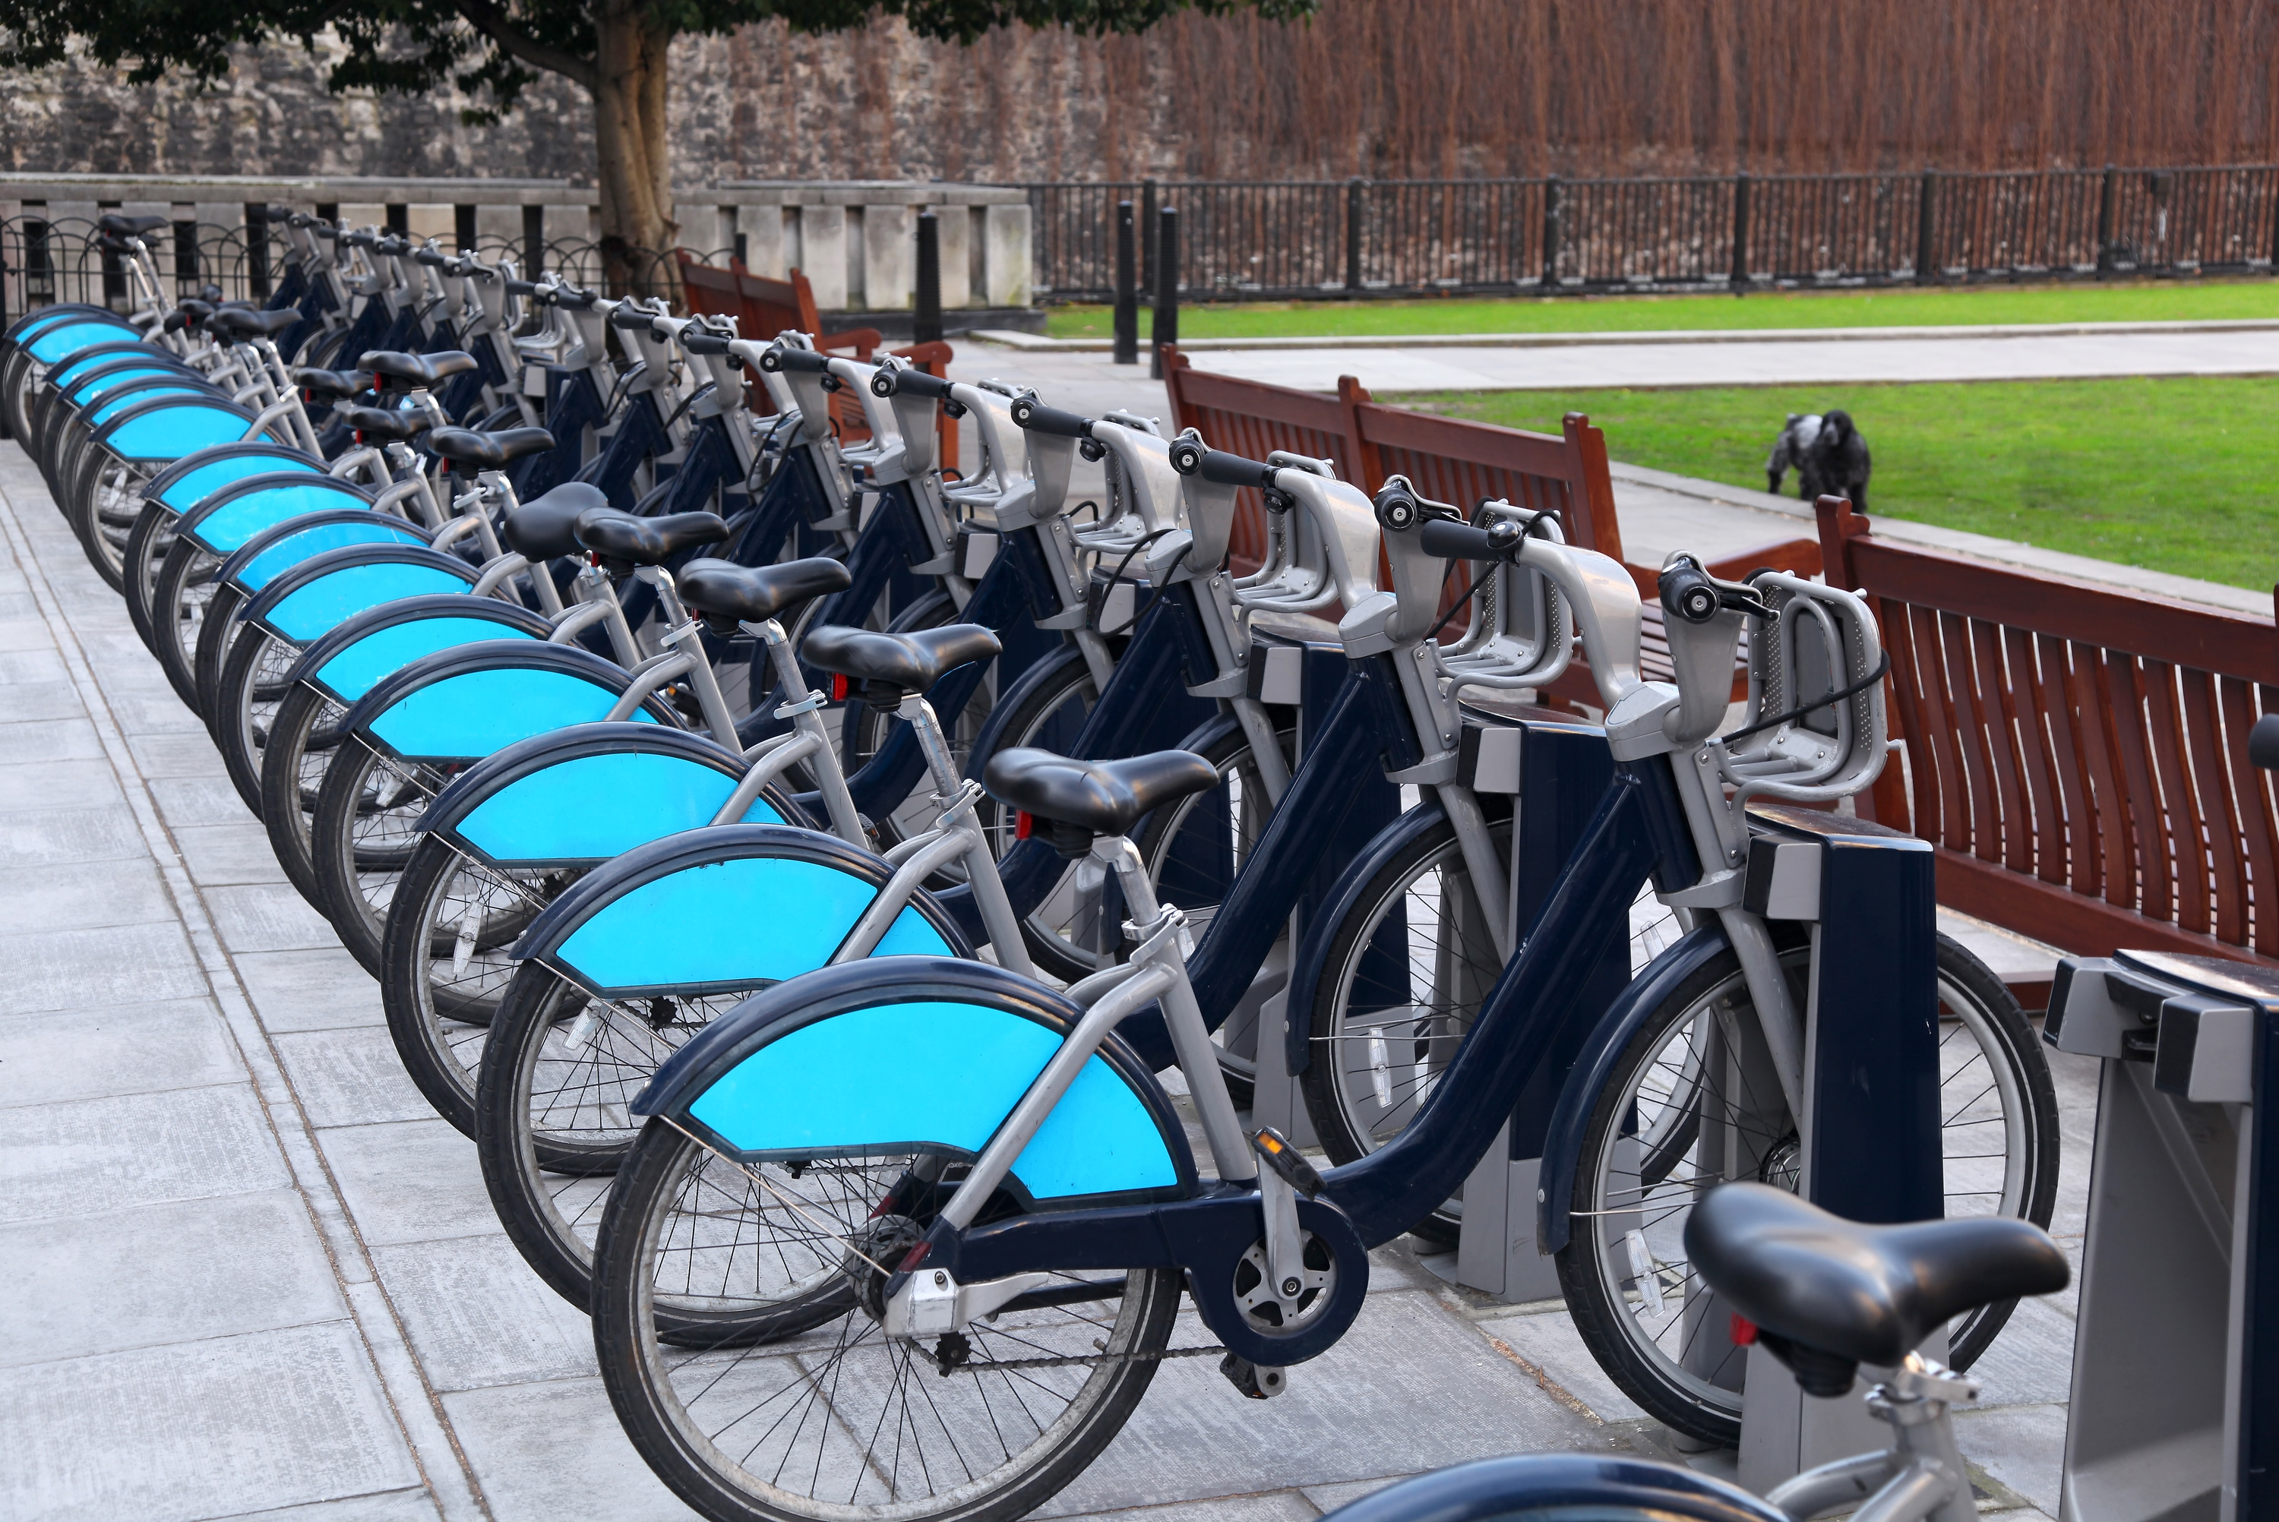
Predicting & Modeling Bicycle Rentals
Theo Clark
Data Analyst

Slide 2
Business Task
Predict & model rental bike counts (demand) for the newly implemented bike sharing system
Assumptions/Notes
Weather will play an important role in bike demand
Rental counts represent total bikes rented per hour on a given day
This is an example of my work for demonstrative purposes only
This business task is theoretical and the data is not real-world data

Slide 3
Analytical Goals
Accurately predict demand using statistical modeling
Determine which variables impact demand the most
Variable | Description
Count | Rented bike counts
Date | Date
Hour | Hour of the day
Temperature | Temperature in Celsius
Humidity | Humidity (%)
Wind | Wind speed (m/s)
Visibility | Visibility (10m)
Dew | Dew point temperature in Celsius
Solar | Solar Radiation (MJ/m2)
Rainfall | Rainfall(mm)
Snowfall | Snowfall (cm)
Seasons | Winter, Spring, Summer, Autumn
Holiday | Holiday/No holiday
Functioning | NoFunc(Non Functional Hours), Fun(Functional hours)
ID | Unique identifier

Slide 4
Diving into the Data
No missing values or any particular oddities
Theoretical dataset
Removed variables ‘ID’ & ‘Functioning’
Transformed the ‘Date’ variable ‘Weekend’

Slide 5
Exploratory Analysis
Rentals by Month
Hourly Bike Rental Summary Statistics
Month | Total Bike Rentals
June | 671,676
September | 542,731
July | 532,006
October | 523,971
May | 499,469
August | 476,317
April | 401,157
November | 377,911
March | 225,092
December | 132,319
January | 116,437
February | 106,306
Average | Standard Deviation | Minimum | Maximum
730 | 647.38 | 2 | 3,556
Fluctuations of bike rentals shows the importance of accurate predictions to properly balance supply at any given time
Warmer months tend to have more bike rentals

Slide 6
Model Selection
8 Models considered to compare predictive accuracy
6 Supervised Learning
2 Machine Learning
Model selected based on predictive accuracy (selected a machine learning approach)- Bagged Decision Tree

Slide 7
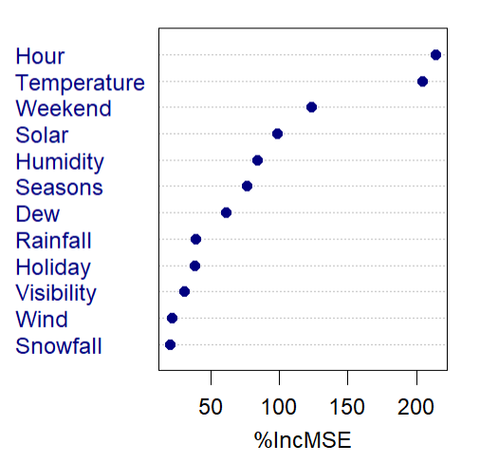
What are the most important variables?
Importance Measure:
Mean Decrease Accuracy (%IncMSE)- This shows how much our model accuracy decreases if we leave out that variable
Takeaways:
Most important variables are Hour, Temperature & Weekend
Least important variables are Snowfall, Wind & Visibility

Slide 8
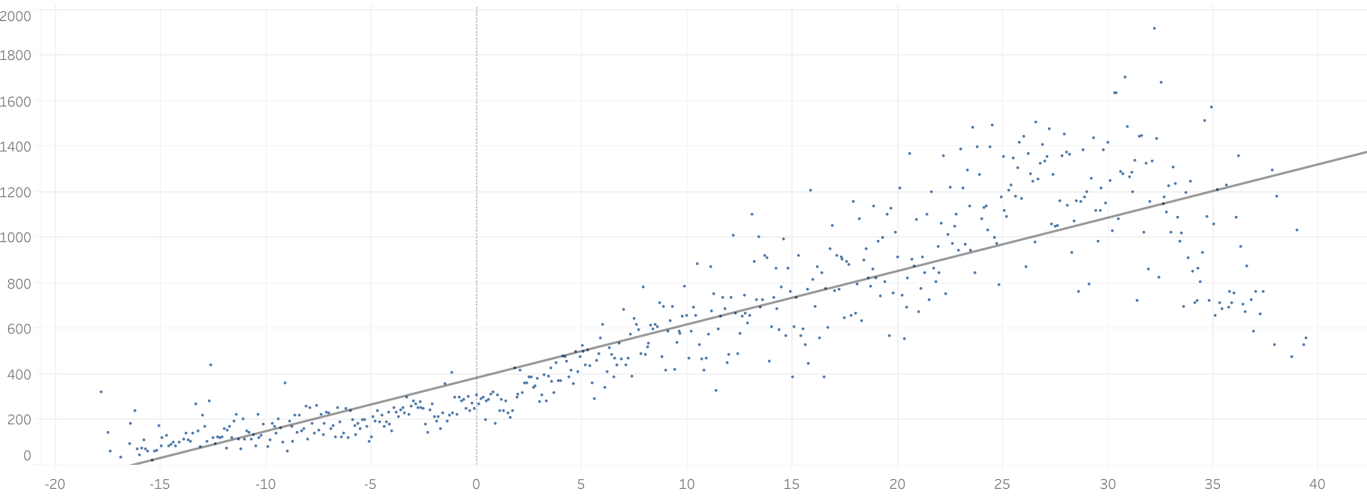
What role does temperature play?
Correlation: 0.76
Average Bike Rental Count/Hr
Temperature (ºC)
Positive Correlation suggests moderate relationship between variables
Supports model’s variable importance insight

Slide 9
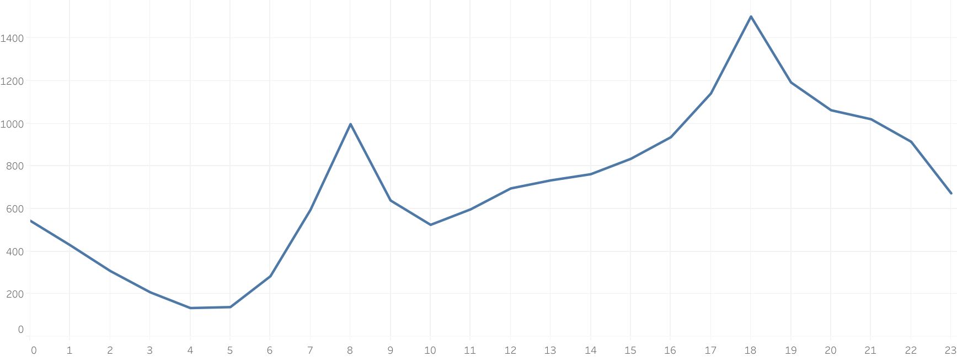
When do people rent bikes?
6pm
8am
Avg Rental Count Per Hour
10am
]
4-5am
Time of Day (Hour)
Times of peak average rental counts suggest customers are using the bikes to commute to their 9-5 jobs within the city
Supports model’s variable importance insight (with a correlation of 0.42)

Slide 10
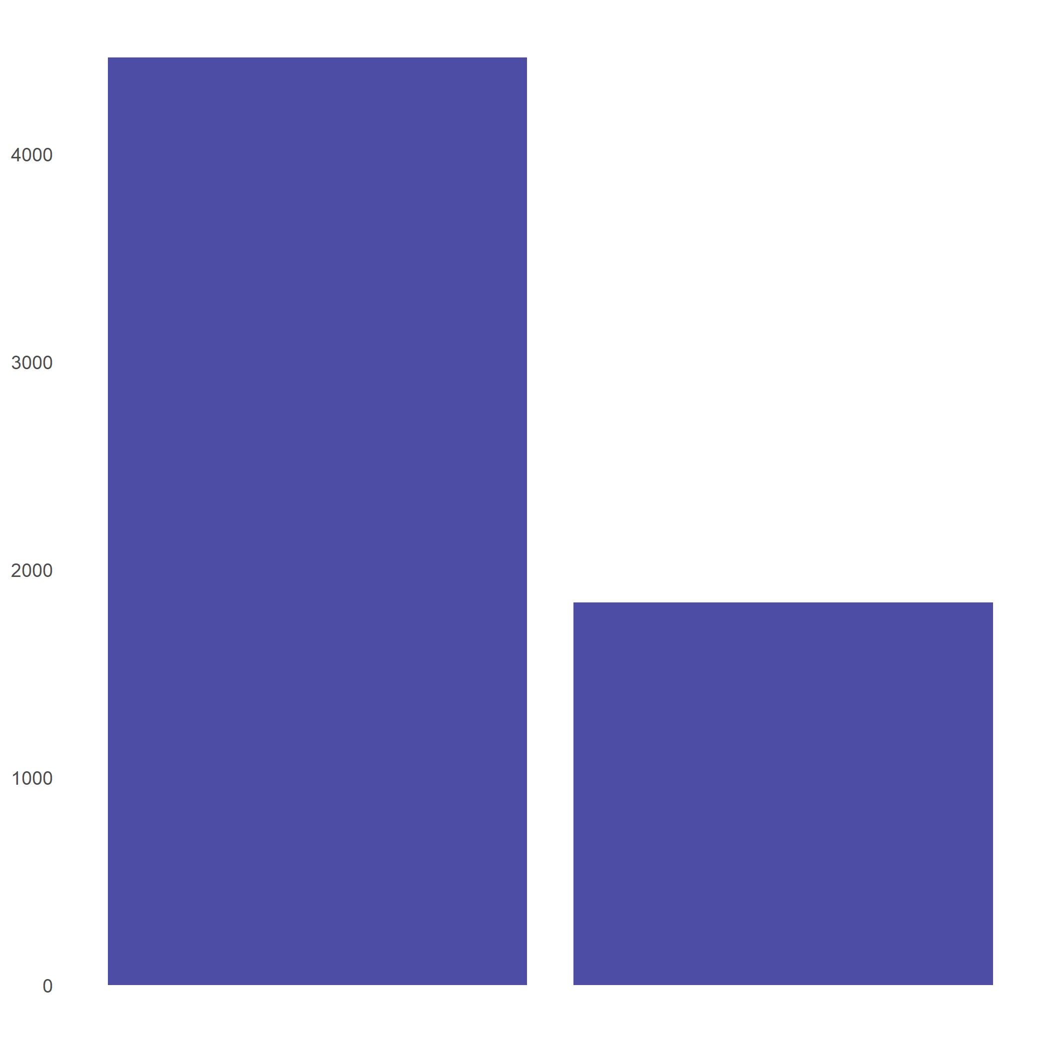
Weekend or Weekday?
More bikes rented on weekdays rather than on weekends (over 2 times as many)
Commuting more common than joy rides
Suggests bikes are rented mainly for commuting
Total Bike Rental Count
Weekday
Weekend

Slide 11
Key Takeaways
Demand is higher for bike rental during the warmer months of the year
Bikes are rented more often during the week
Possibly to commute to work
Weather, time of day, and day are most important variables to monitor

Slide 12
Limitations
Due to time constraints, I was only able to consider eight models
Looking at different models (specifically different kinds of random forests) could be beneficial in finding more reliable predictions

Slide 13
Conclusion
I recommend that the city provides more bikes during the warmer months of the year
Looking at the future, catering to the commuters and their needs will likely increase customer satisfaction

Slide 14
Thank you!
Link to the full project & code: Bike Share Project

