Slide 1
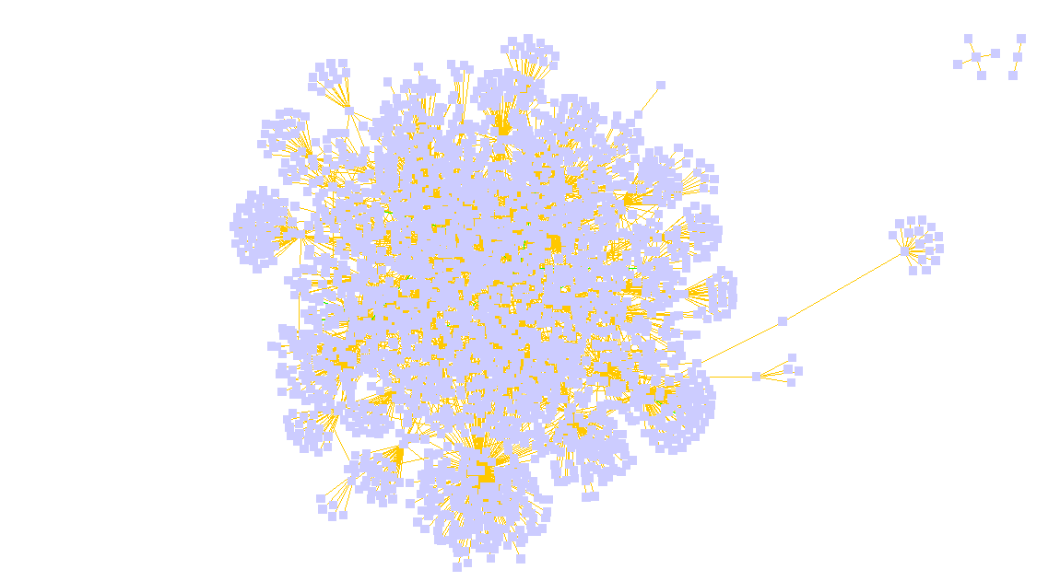
Hereditary Spastic Paraplegia

Slide 2
Background
Term used for a group of rare inherited disorders that cause weakness and stiffness in the leg muscles.
Often misdiagnosed; estimated 3 in 100,000 people affected.
Symptoms are mainly confined to lower limb weakness and involuntary spasms and muscle stiffness (spasticity)
About 90% of people with hereditary spastic paraplegia have a pure form; the remaining 10% have a complicated or complex form of the condition.

Slide 3
PanelApp genes
SPART KIF1A B4GALNT1 SERAC1 KIDINS220 WASHC5 KIF5A BSCL2
SLC16A2 ADAR L1CAM C12orf65 SLC1A4 AFG3L2 NIPA1 C19orf12 SLC25A46 AIMP1 NKX6-2 CAPN1 SPAST ALDH18A1 OPA3 CYP2U1 SPG11 ALS2 PLP1 CYP7B1 SPG21 AP4B1 PNPLA6 DDHD1SPG7 AP4E1 POLR3A DDHD2 TUBB4A AP4M1 REEP1 ERLIN2 WDR45B AP4S1 RTN2 FA2H ZFYVE26 ATL1 SACS GBA2 HSPD1
CDK16 REEP2
AMPD2 MTPAP ZEB2 AP5Z1 NT5C2 ZFYVE27 ARL6IP1 PCDH12 ARSI PGAP1
CCT5 PSEN1 DSTYK SLC33A1 ENTPD1 TECPR2 GAD1 TFG GJC2 USP8 KIF1C VAMP1 MARS VPS37A MARS2 WDR48
ATXN10 ATXN1 ATXN2 ATXN3 ATXN7 CACNA1A FXN HTT PPP2R2B

Slide 4
CytoScape: BIOGRID
BIOGRID is a well-defined, well-audited dataset of protein-protein interactions.
BIOGRID plugin used to add primary interactions and exclude self interactions within the network.
Optimum no. of nodes for analysis between 600-2500.

Slide 5
ModuLand Analysis

Slide 6
ModuLand
Determines and visualises overlapping network modules.
Calculates the assignment strength of each node to each discovered module.
The plug-in also builds the hierarchy of network modules

Slide 7

Stevens et al. (2018) “Interactome comparison of human embryonic stem cell lines with the inner cell mass and trophectoderm”

Slide 8
Hierarchy of modules
Top 15 modules
ATXN3 | HSPD1 | USP8 | ATXN1 | HTT | UBC | KIF1C | VCP | BSCL2 | OPA3
USP8 | KIF1C | KIF1A | TUBB4A | SPG7 | EGFR | AFG3L2 | ADAR | CAPN1 | CDK16
WDR48 | USP1 | USP12 | RAD51AP1 | PHLPP2 | CAPN1 | ATAD5 | NTRK1 | FANCI | ADAR
HSPD1 | MTPAP | SLC33A1 | AFG3L2 | MARS2 | BCL11B | TUBB4A | ADAR | ALDH18A1 | TFG
ERLIN2 | ERLIN1 | SLC33A1 | HSPA5 | AMFR | TFG | SYVN1 | ZFYVE27 | TUBB4A | AFG3L2
AIMP1 | MARS | AIMP2 | RARS | QARS | IARS | KARS | LARS | TFG | AFG3L2
HTT | BSCL2 | TUBB4A | SPG7 | SLC33A1 | ZDHHC17 | CREBBP | HAP1 | KIF1A | ATXN10
CCT5 | PPP2R2B | CAPN1 | TUBB4A | SPG7 | BCL11B | AFG3L2 | ADAR | TFG | PPP2R2C
ATXN2 | ATXN1 | SH3GL3 | SH3GL2 | ADAR | CCNDBP1 | ALDH18A1 | HTT | CELA2B | NTRK1
CDK16 | KIF1C | TFG | BRCA1 | CCNYL1 | YWHAZ | APP | AFG3L2 | OPA3 | CSNK2A2
ATXN1 | ATXN2 | RBFOX2 | COIL | CLASRP | UBQLN4 | RBPMS | UBE2E1 | ZHX1 | TRAF2
PSEN1 | NCSTN | CTNNB1 | PSENEN | APH1A | TRAF6 | ERLIN2 | UBQLN1 | PSEN2 | CDH1
ATXN7 | USP22 | ATXN7L3 | TRRAP | SUPT3H | FXN | CRX | PICK1 | ACTN1 | ACTN4

Slide 9
Functional analysis
Module | Pathway Description | Observed Gene Count | False Discovery Rate
ATXN3 | Response to misfolded protein | 3 | 5.26E-04
ERLIN2 | Response to organic substance | 7 | 1.07E-02
AIMP1 | Aminoacyl-tRNA biosynthesis | 6 | 3.59E-12
HTT | Anterograde axon cargo transport | 3 | 1.17E-03
ATXN2 | Citrulline metabolic process | 2 | 2.22E-02
PSEN1 | Cellular response to indole-3-methanol | 2 | 1.21E-03
ATXN7 | Proteolysis | 6 | 4.78E-03
POLR3A | Defense response to virus | 4 | 9.98E-04
WDR45B | Ubiquitin-dependent protein catabolic process via the multivesicular body sorting pathway | 4 | 1.21E-06

Slide 10
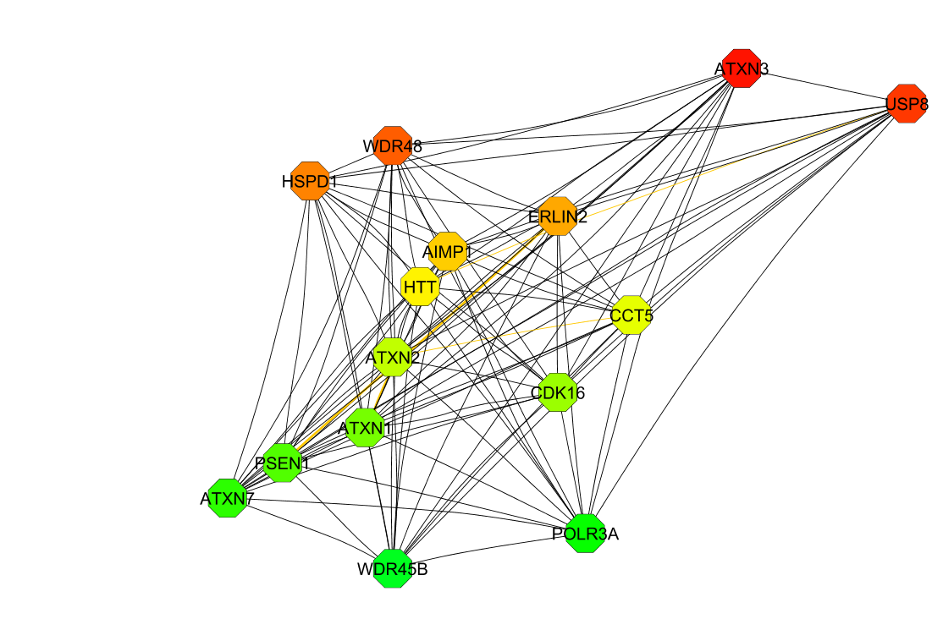
Hierarchy Network
Genes at the centre of the top 15 modules represented within a hierarchy.

Slide 11
Matrix Analysis

Slide 12
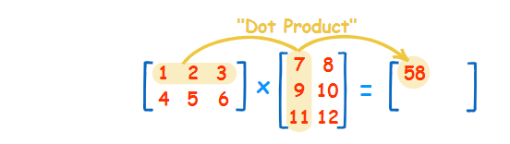
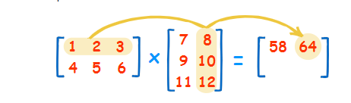
Method
Obtain list of OMIM codes related to HSP.
Fetch all HPO terms using OMIM codes (phizz)
Create a matrix of genes and HPO terms.
Fill with 1/0 based on gene-HPO association
Multiply matrix by its transpose and subtract 1.
This gives a symmetrical gene:gene matrix where each value represents the number of genes with a shared HPO term.
Johnson, J. (n.d.). Hypernetworks in the science of complex systems.

Slide 13
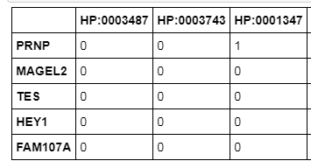
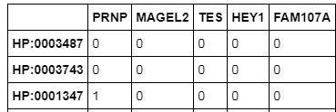
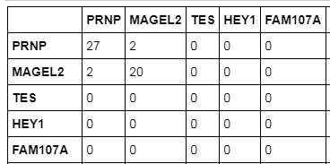
Method
X

Slide 14
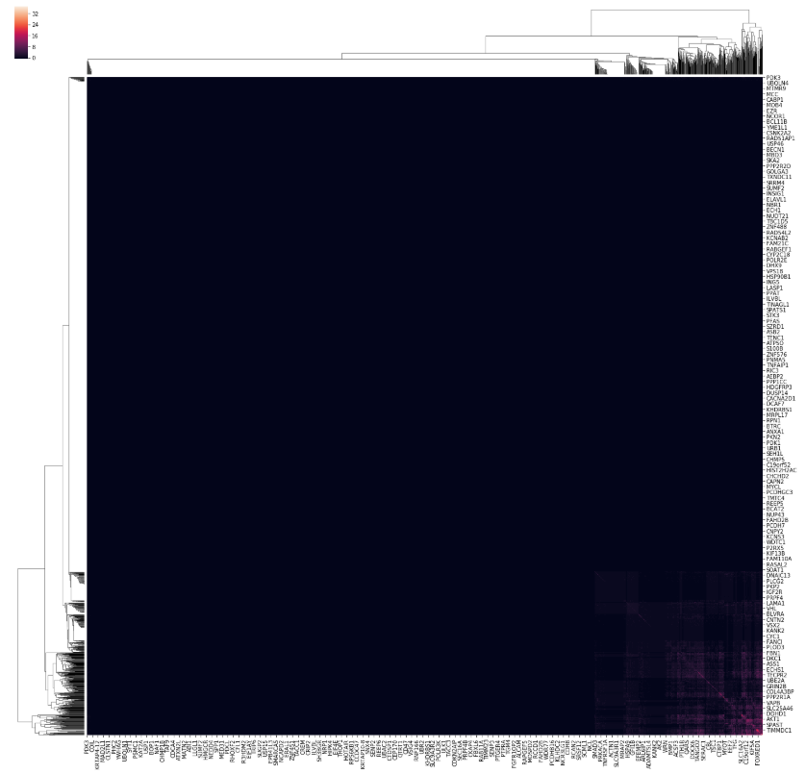
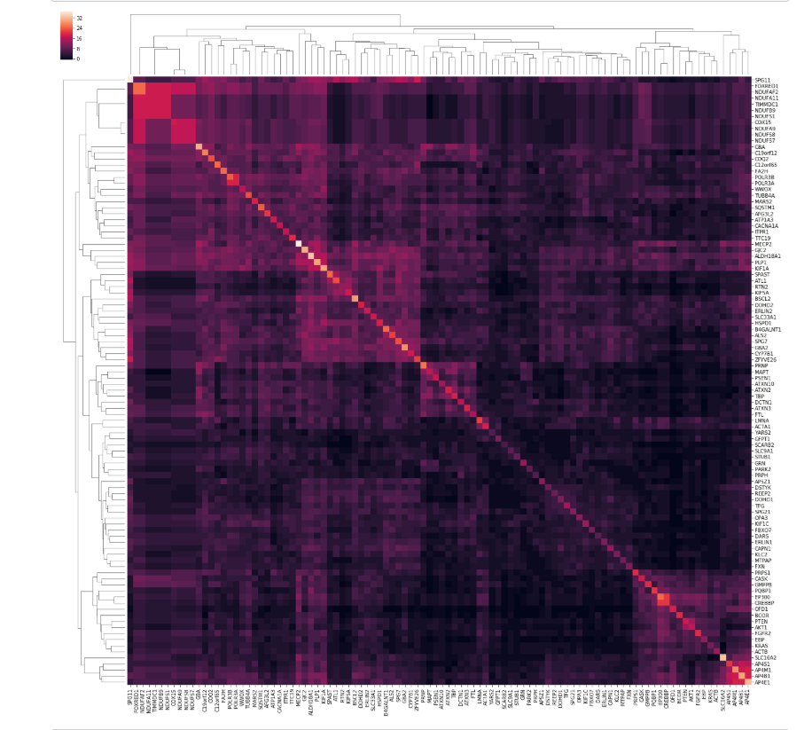
Method
Cluster the gene:gene matrix to identify a list of genes which each share a large number of HPO term.
Johnson, J. (n.d.). Hypernetworks in the science of complex systems.

Slide 15
Gene ranking
nodeID | log_bc_ratio | Module Appearance Score | Cluster Y/N | Average Shortest Path Length | overall_score
TFG | 0.292506728 | 230 | 1 | 3.02773312 | 320.2895
TUBB4A | 0.267779746 | 234 | 1 | 3.27893891 | 319.2167
SLC33A1 | 0.342858809 | 147 | 1 | 3.5028135 | 307.0421
AFG3L2 | 0.193167334 | 243 | 1 | 3.23392283 | 302.2046
CAPN1 | 0.258389663 | 164 | 1 | 3.25803859 | 287.5656
KIF1A | 0.372792644 | 85 | 1 | 3.29019293 | 286.2445
SPG7 | 0.218653143 | 135 | 1 | 3.6840836 | 271.6106
BSCL2 | 0.246726874 | 104 | 1 | 3.81310289 | 268.3943
LMNA | 0.278007308 | 46 | 1 | 3.83038585 | 253.1862
MTPAP | 0.261561689 | 48 | 1 | 3.95699357 | 251.5704

Slide 16
Executive Summary
PanelApp
Obtain a list of gene names in HSP panel.
BioGrid
Use the list of genes to create interaction network
ModuLand
Centrality Vs Bridgeness
Module Hierarchy
STRING
Matrix Analysis
Functional Analysis
Top 15 modules only
Biological Function and KEGG
Correlate HPO terms to genes.
Generate list of highly correlated genes within the network
Stevens, A., De Leonibus, C., Hanson, D., Dowsey, A., Whatmore, A., Meyer, S., Donn, R., Chatelain, P., Banerjee, I., Cosgrove, K., Clayton, P. and Dunne, M. (2013). Network analysis: a new approach to study endocrine disorders. Journal of Molecular Endocrinology, 52(1), pp.R79-R93.

Slide 17
Executive Summary
Staff Training Costs
Relatively new approach to diagnostics.
Difficult fit into current clinical practice.
Might be a challenge to explain concept to the clinical team.

