Slide 1
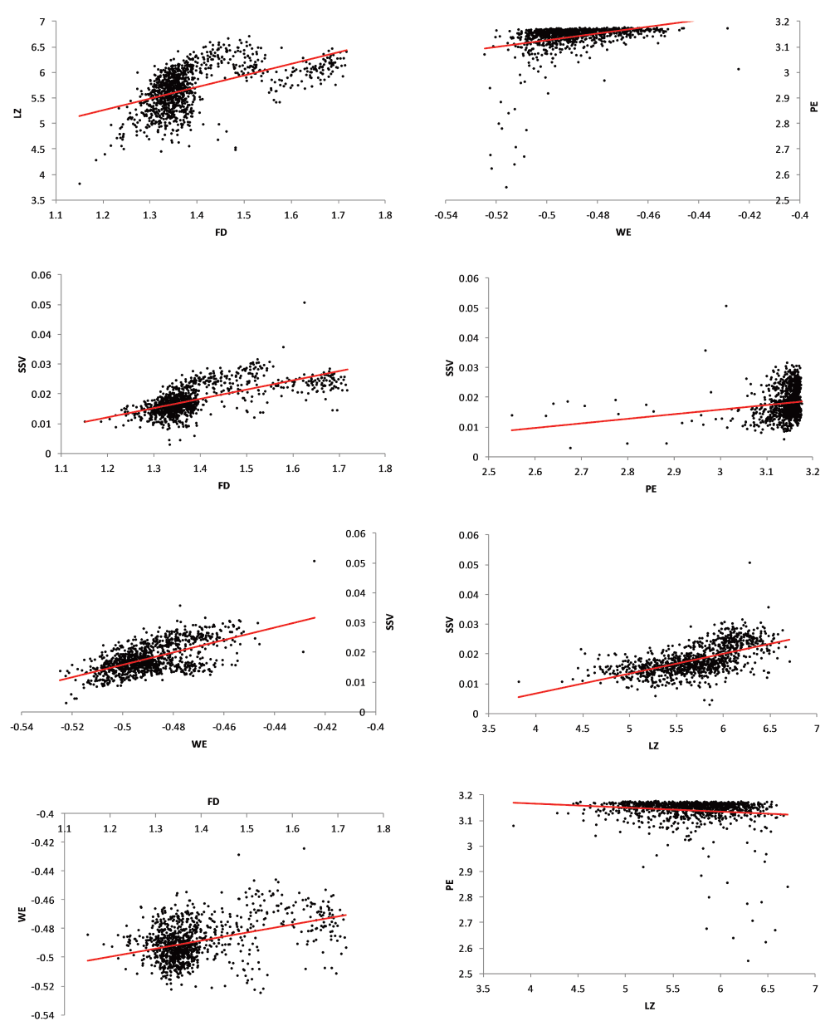

Figure 1. Scatter plots with linear trendlines for pairs of significantly-correlated complexity measures.
Burns T and Rajan R 2015 [version 1; referees: 2 approved] F1000Research 2015, 4:137 (doi: 10.12688/f1000research.6590.1)
Notes:
Figure 1. Scatter plots with linear trendlines for pairs of significantly-correlated complexity measures. Eight pairs of complexity measures of the EEG signals had a significant (p<0.0001) correlation. Although the relationships are significant, high degrees of spread are noticeable and some of the relationships may have non-linear components. EEG = electroencephalogram; LZ = Lempel-Ziv algorithmic complexity; FD = fractal dimension estimate (Higuchi method); PE = permutation entropy; SSV = spectral structure variability; WE = Wiener entropy (also known as spectral flatness).
How to cite: Burns T and Rajan R 2015 Combining complexity measures of EEG data: multiplying measures reveal previously hidden information [version 1; referees: 2 approved] F1000Research 2015, 4:137 (doi: 10.12688/f1000research.6590.1)

