Slide 1
an introduction to KoboToolbox
00
Derrick Theophille

Slide 2
About this course
The objective: introduce you to KoboToolbox and help you get started with using it for data collection
Structure: 2 half-day sessions
Presentations
Discussions
Hands-on learning (building e-forms, etc.)
Quizzes (maybe)

Slide 3
Course CONTENTS
A comparison of paper-based and electronic field data collection
Basics of surveys and questionnaire development
An overview of the KoboToolbox
Building a basic e-form in KoboToolbox
Getting your form onto a mobile device
Using a mobile device to capture data in the field using an e-form
Viewing and accessing your data from the KoboToolbox repository

Slide 4
INTRODUCTION
At Krypto Logics, we empower investors to maximize their portfolios to help them meet their financial goals responsibly. By offering customized and sophisticated strategies, we help clients' portfolios grow organically and foster a trusted consumer-consultant relationship.

Slide 5
TRADING & INVESTING
Crypto can be complicated but getting started doesn’t have to be

Slide 6
GLOBAL CURRENCY MARKETS
 | $USD | £EUR | ¥JPY | ₿BTC
Q1 | 4.5 | 2.3 | 1.7 | 5.0
Q2 | 3.2 | 5.1 | 4.4 | 3.0
Q3 | 2.1 | 1.7 | 2.5 | 2.8
Q4 | 4.5 | 2.2 | 1.7 | 7.0

Slide 7
WEALTH IS THE ABILITY TO FULLY EXPERIENCE LIFE.
-Henry David Thoreau

Slide 8
TYPES OF TOKENS
Payment
Utility
Security
NFT
Gaming
Used to complete transactions anywhere crypto is accepted
These tokens have a specific use within a blockchain
Tokens backed by securities
Authenticates ownership of specific assets
Used as in-game currency and traded with real world value

Slide 9





PORTFOLIO BUILDUP
Step 1
Step 2
Step 3
Step 4
Step 5
Choose a cryptocurrency exchange
Purchase preferred coins & create "wallet"
Research investment and trading options
Stake preferred coins in chosen company
Set exponential growth goals

Slide 10
AREAS OF FOCUS
Portfolio diversification
Short and long-term goals
Develop winning combinations to stay ahead of the market
Capitalize on direct ownership of digital coins
Invest in multiple blockchains​
Create an emergency fund
Add a second stream of income
Buy a house
Supplement retirement fund

Slide 11
HOW TO GET THERE
Strategize
Minimize risk
Utilize resources
Do your research and develop a plan with goals
Diversify your portfolio through coin ownership​
Follow the markets closely​
Be cautious of scams and "too good to be true" scenarios
Avoid "all-in" strategies
Apps and platforms help streamline user experience
Seek expert guidance from Krypto Logics team members​

Slide 12

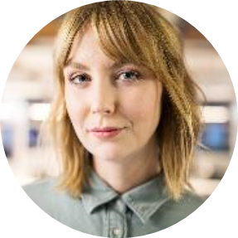
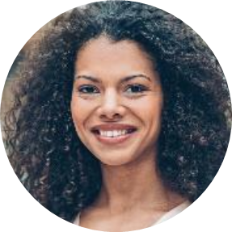
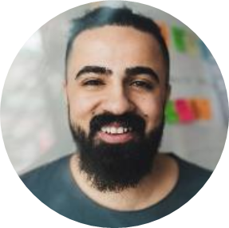
MEET OUR TEAM
Takuma Hayashi​
Mirjam Nilsson​
Flora Berggren​
Rajesh Santoshi​
President
Chief Executive Officer
Chief Operations Officer
VP Marketing

Slide 13
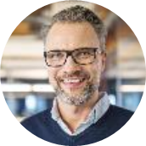
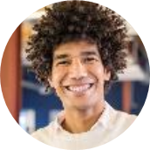
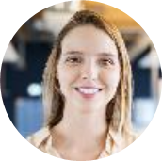

MEET OUR EXTENDED TEAM
Takuma Hayashi​
Mirjam Nilsson​
Flora Berggren​
Rajesh Santoshi​
President
Chief Executive Officer
Chief Operations Officer
VP Marketing
Graham Barnes
Rowan Murphy
Elizabeth Moore
Robin Kline
VP Product
SEO Strategist
Product Designer
Content Developer

Slide 14
SUMMARY
At Krypto Logics, we believe in giving 110%. By using our next-generation data architecture, we help investors virtually manage their portfolios. We thrive because of our market knowledge and great team. As our CEO says, "Efficiencies will come from proactively transforming how we do business."

Slide 15
THANK YOU
Derrick Theophille​
theophilled@dominica.gov.dm

