Slide 1

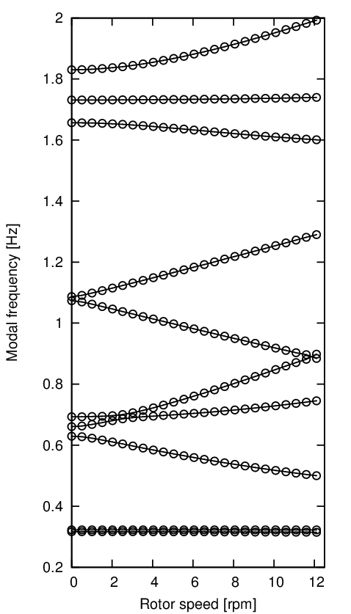
Wind turbine standstill modes.
Slide credit: Hansen
(1st fore-aft twr)
1st yaw
1st tilt
1st sym. flap
1st vert. edge
1st horiz. edge

Slide 2
Wind turbine operating modes.
Slide credit: Hansen
1st fore-aft twr
1st side-side twr
1st BW flap
1 sym. flap
1st FW flap
1st BW edge
1st FW edge
1st drivetrain

