Slide 1
Similitude
Advait Trivedi (MUN # : 201892202)
Supervised by Prof. Theodore Norvell

Slide 2
Aim of the project
The aim of the project was to create a digital logic simulation system, that allows students and professors.
It helps take off the overhead and problems of using physical ICs.
This attempt at the project focuses n streamlining the code and ensuring the code is structured in a robust and scalable fashion along with tackling a few of it’s use cases.

Slide 3
What will we see today?
The basic structure of the Project.
The Command structure (Undos and redos).
Event structure and processing.
Model manipulation sub-layer.
Controller States.
The Normalisation process.
The Attribute system.
The Value system.

Slide 4
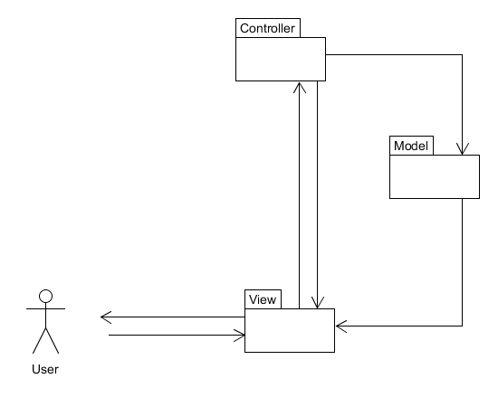
The basic structure of the Project
2. The controller on request from the view makes changes to the model.
The arrows depict
flow of information.
The View depends on the underlying GUI library. Thus, the controller and model can be tested separately or together without any browser.
1. An action in the view triggers it to contact the controller
3. The model can spontaneously trigger view changes through the observer pattern

Slide 5
The basic structure of the Project
The structure of the project still follows largely the MVC pattern from the 980A part of the project, albeit, with a little bit of changes.
It was edited a bit to include what we will see as the “Model Manipulation sublayer”, as a part of the controller.
It is supported by a lot of modified and added parts in the model layer that we will see further on.

Slide 6
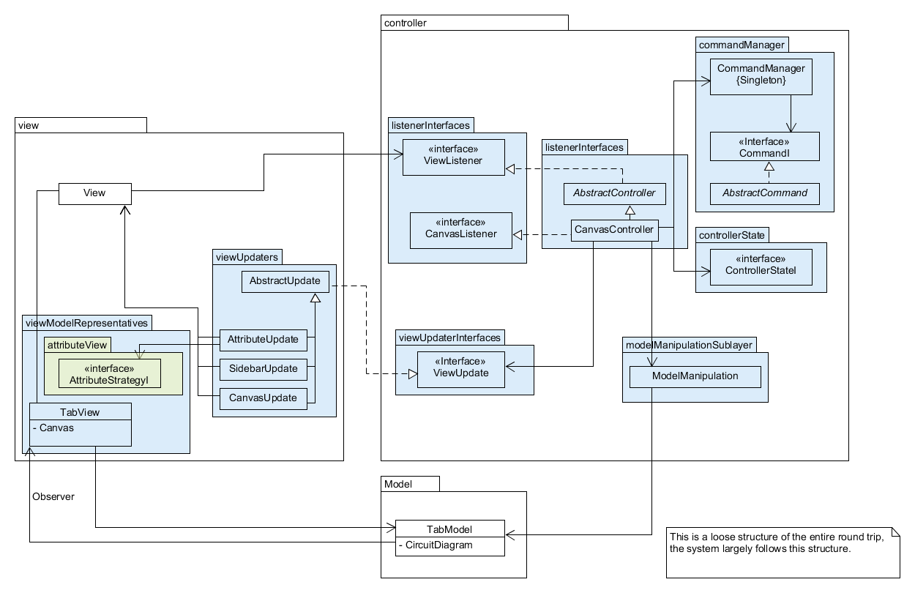
The basic structure of the controller-view interactions

Slide 7
The Command structure (Undos and redos)
Command structure, or the command pattern is a part of the controller.
It enables the user to undo and redo a set of actions for which various commands are defined in the code.
The way it works is that, each time the user performs an action,
  a command object is pushed onto the undo-stack,
  if he clicks on the undo button, then the same object is popped off the undo-stack and pushed onto the redo-stack
  And vice versa, for the Redo operation.

Slide 8
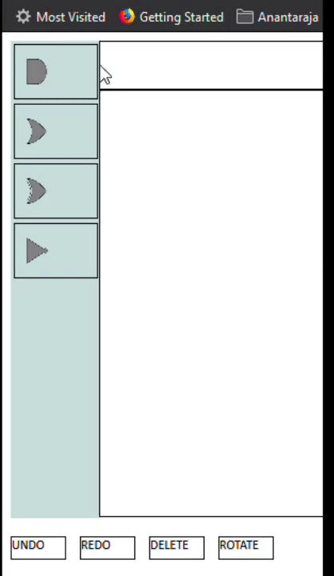
The undo and redo operations

Slide 9
Event structure and processing
The system now has a UI powered by events.
Each significant UI action performed by the user is packed as an event and fed to the controller.
These events are then processed accordingly, by the system, looking at what state it is in.
In a way the system reacts to the events performed by the user.

Slide 10
<<Event Producer>>
View
Events generally created and manifested in the view package.
The controller states resemble an Event bus. But, this is not a completely event driven architecture.
<<Event Consumer>>
Controller
How the event system works

Slide 11
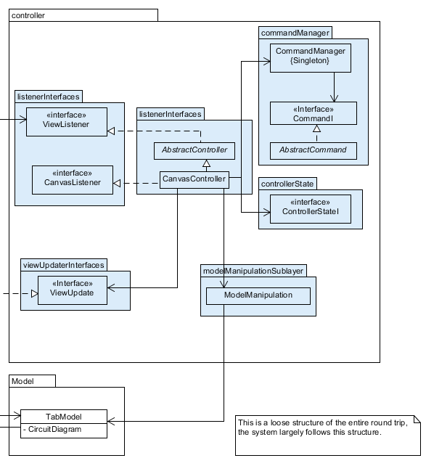
Model manipulation sub-layer
The model manipulation sub-layer, was not charted to be made, but, arose out of the need for streamlining model interactions in the system.
This means that the controller layer, was given a lot of responsibility of managing stored data in the model, as per user events.

Slide 12
Controller States
As looked at before, the system essentially keeps track of what is happening in the UI, i.e. the user actions.
It does so by maintaining an internal state, which is affected by events performed by the User.
These are predefined states, which follow a certain flow/path. Any undefined action, ensures that nothing happens.

Slide 13
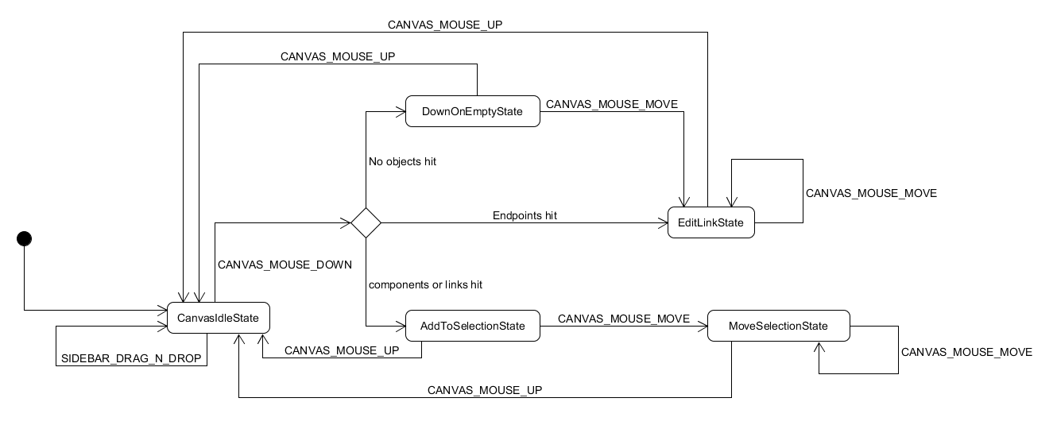
The state transition of the current system

Slide 14
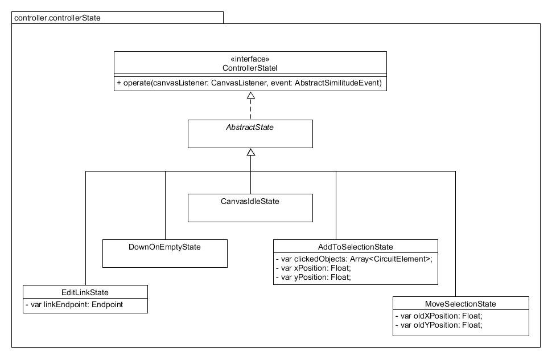
Controller States
The state design pattern used to create the controller states.

Slide 15
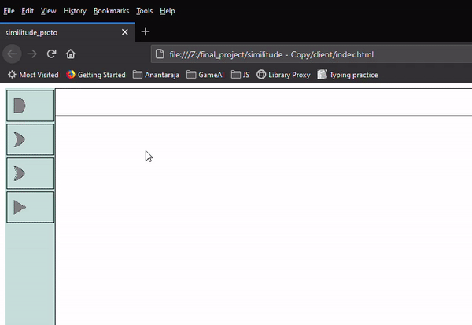
The Normalisation Process

Slide 16
The Normalisation process
It consists of the post-processing that happens when the circuit is edited by the user, each time.
Normalization adjusts the model so that it is the way the user expects based on its appearance
For example, drawing a link close to a port, but not connecting it, or spliting links etc.

Slide 17
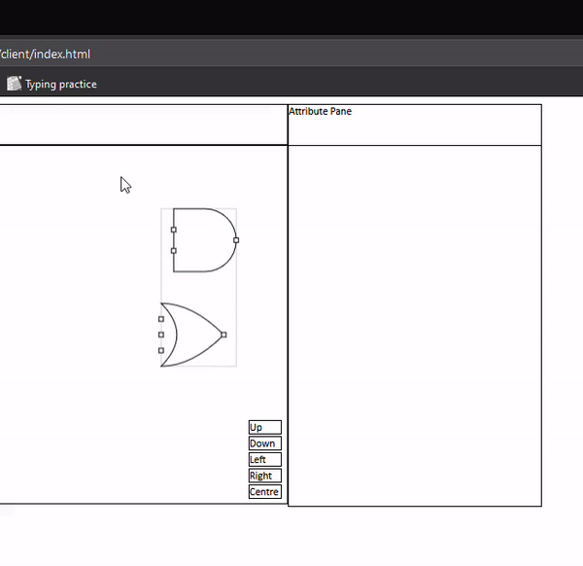
The attribute system

Slide 18
The Attribute system
The whole system is data driven. Thus new attributes and constraints on attributes can be added just by changing the model with no change to the view and controller.
Components are editable and can be configured now using the attribute system.
It allows real time updates, to components, as the user changes the attribute value.
It also provides feedback to the user on setting invalid values for a given attribute.
Uses a Strategy pattern.

Slide 19
The value system
The value system signifies the signal and digital logic that can be fed to gates as inputs or can be used in the simulation procedure.
There are 2 types of values, complete signals and instantaneous values.
There are 2 types of instantaneous values, scalars and vectors.
Uses a 2 layered strategy pattern residing in the model for the base of it’s UI.

Slide 20
Future work
The implementation of discrete users in a web based system will also cover a good use case.
Multiple tab creation, which the current structure already supports.
The further design and building of the simulation system, along with it’s view and controller portions.

Slide 21
Conclusion
This project was all in all a learning experience. It taught me how to meld multiple software designs into 1 large system.
Taught me task-management in a real life project and how to work together with a senior.
Refined analytical and logical skills used to write complex algorithms like normalisation and many other caveats of software engineering.

Slide 22
What I would do if I had to start again?
I would work on the UI and make it more dynamic, and more polished.
I would like to put a bit more thought on the 2-layered display strategy pattern in the value system.

Slide 23
Thank You

