Slide 1
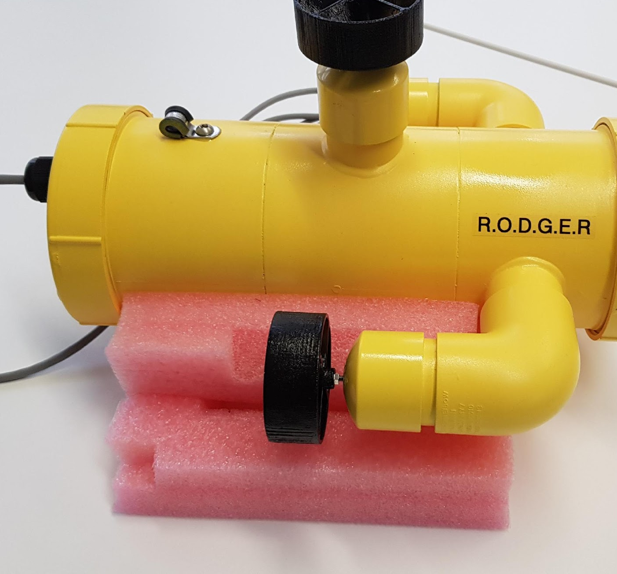
Remote Operated Drone Geared at Exploring Rivers (R.O.D.G.E.R) Michael Kirkpatrick 99127906 Simon Mackay 11049412 Jaspreet Panesar 12582072 Theodore Xavier 12604120 Tristan Hopper 11725645 Joel Meredith 12577829
IOT Python
Team One

Slide 2
Mission Statement
R.O.D.G.E.R (Remote Operated Drone Geared at Exploring Rivers) is a versatile and capable underwater craft priced at a fraction of the cost of high-end, commercial ROVs.
It is equally adept at inspection tasks in tanks, pools and pipes as it is in dams and rivers.

Slide 3
Requirements Analysis
Requirement |  | Features Implemented
Ease of use | operable by moderately trained user | PS4 controller
 | real-time status display | Web based camera feed
 | collision avoidance | Image processing/Ultra-sonic sense
Physical Construction | Waterproof to 20m | PVC construction/silicon sealant
 | Moderate maneuverability | 3 thruster configuration
 | Variable ballast | Excess space in main cavity
 | Maximum vehicle length 500mm
Safety | Low voltage | Battery powered
 | Able to be reteived manually | Tethered
 | Easily visible | Brightly coloured (yellow)
 | Collision avoidance | Ultra-sonic/visual object detection
Software/Hardware | Innexpensive | Raspberry Pi platform
 | Open source | Open source software (python)
 |  | Web-based dashboard
 | Reliable connectivity | Wired (ethernet) connection

Slide 4
Team Member Allocation of Tasks
Team Member | Initial Allocation | Final Contribution
Mike | Sensor integration, documentation | Project documentation (presentation and initial sensor diagrams) Team collaboration management and allocation of tasks. Cloud based persistant data management.
Jaspreet | Database implementation, | SQLite Database, Connected Temperature Sensor with Simon, created persistant data by saving temperature data to SQL database, connected gyro sensor to web interface webgl model, connected temperature sensor to web interface
Joel | Motor control, camera integration | Motor integration, GUI interface, camera server, object detection, networking
Tristan | Motor control, camera integration | Controller integration, lighting control, camera integration
Theodore | Dashboard design | Networking, front-end dashboard design, object detection
Simon | Sensor integration, physical model | Ultra-sonic sensor integration, battery monitor design & construction, physical model & construction, LED driver circuit, documentation

Slide 5
Specifications
Physical:
Length: 370mm
Width: 320mm
Height: 200mm
Weight without ballast: TBD
Material: PVC
Depth Rating: 10-15m
Tether Length: 20m
Electrical:
Thruster configuration: 2 vectored, 1 vertical
Thrusters: 140W, 700Kv(rpm/v)
Battery: Lipoly, 2250mAh, 3S, 11.1V, 40C
Controller: Raspberry Pi x 2

Slide 6
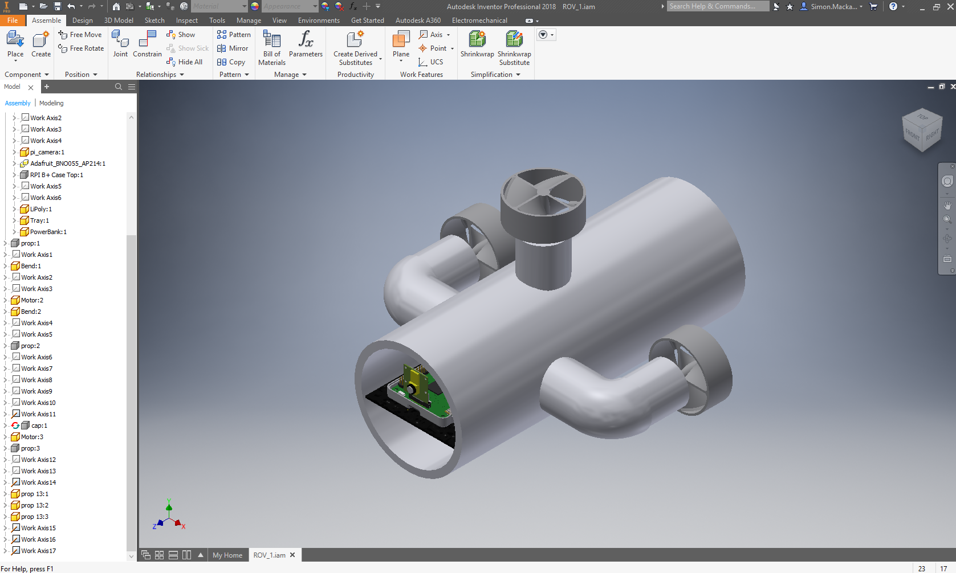
Prototype CAD Image

Slide 7
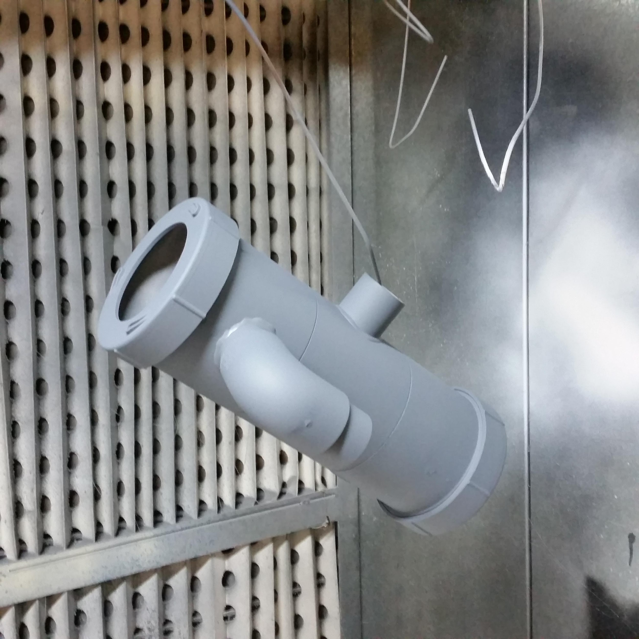
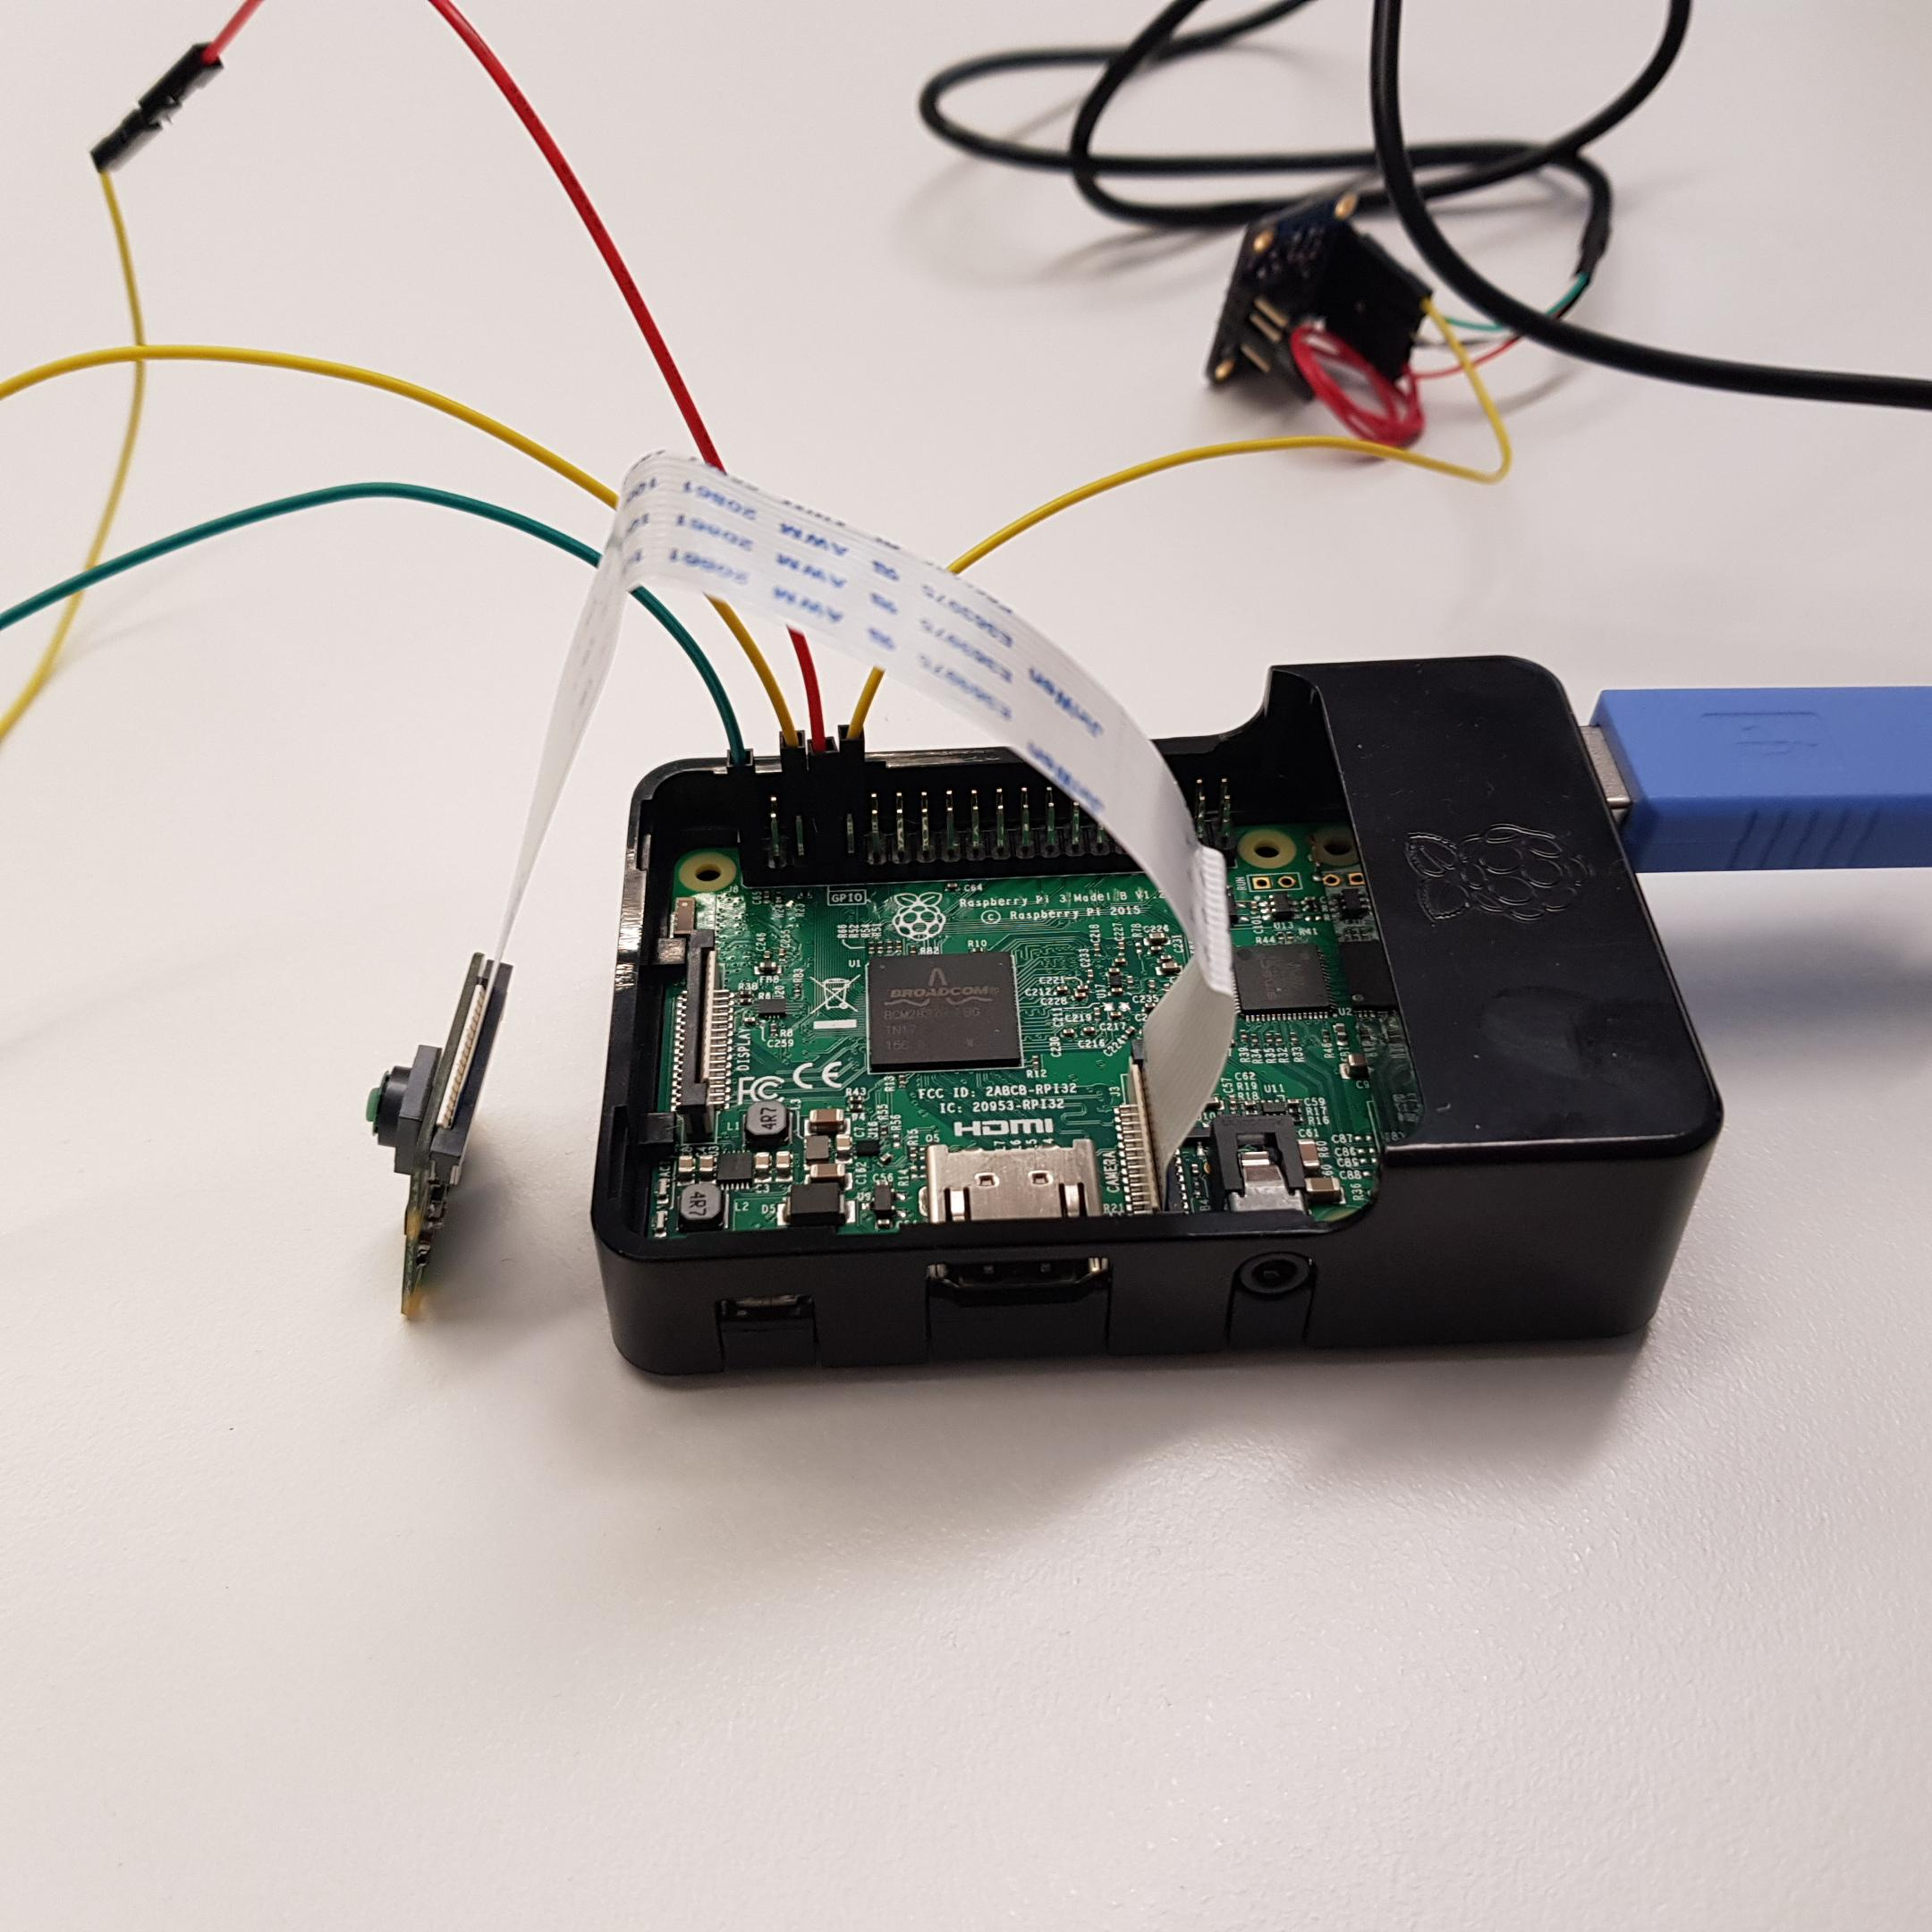
Prototype Build

Slide 8
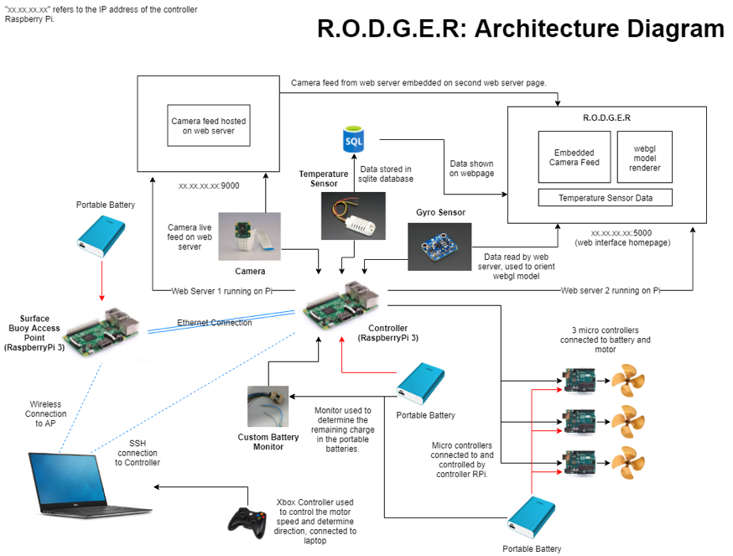

Slide 9
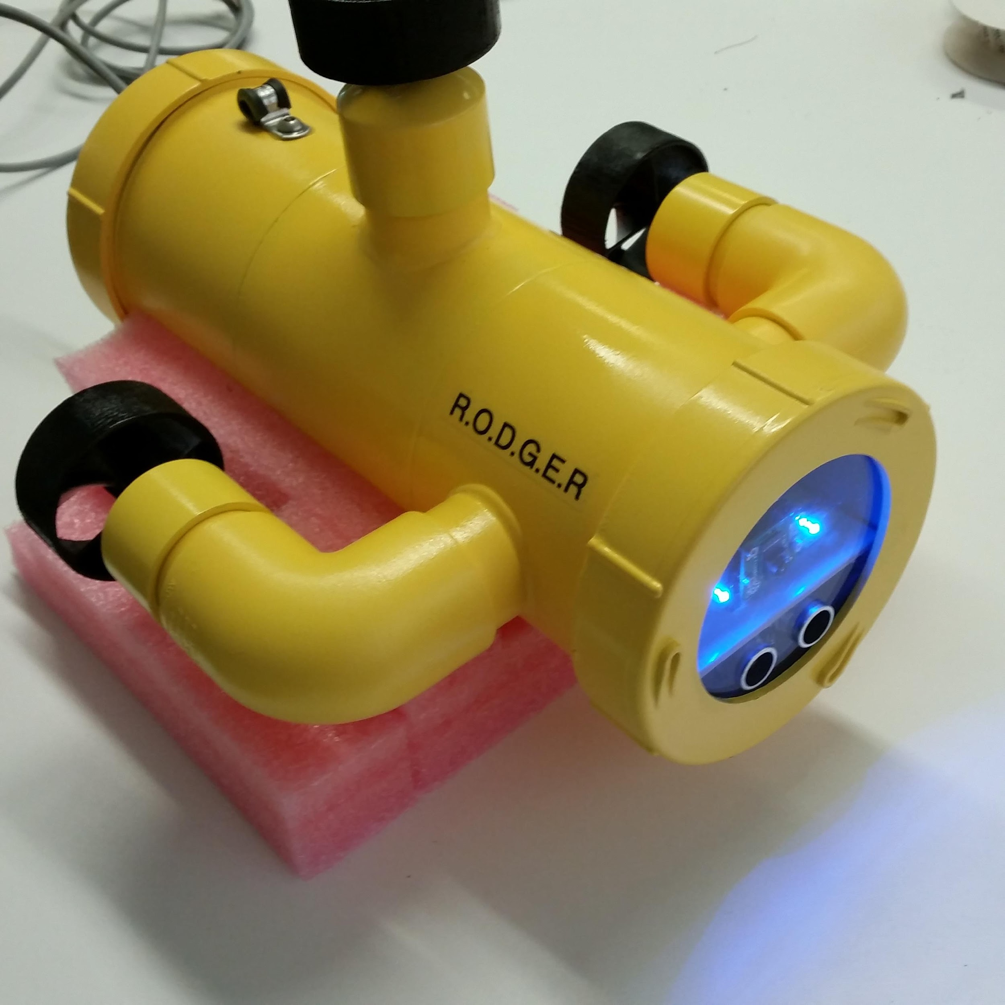
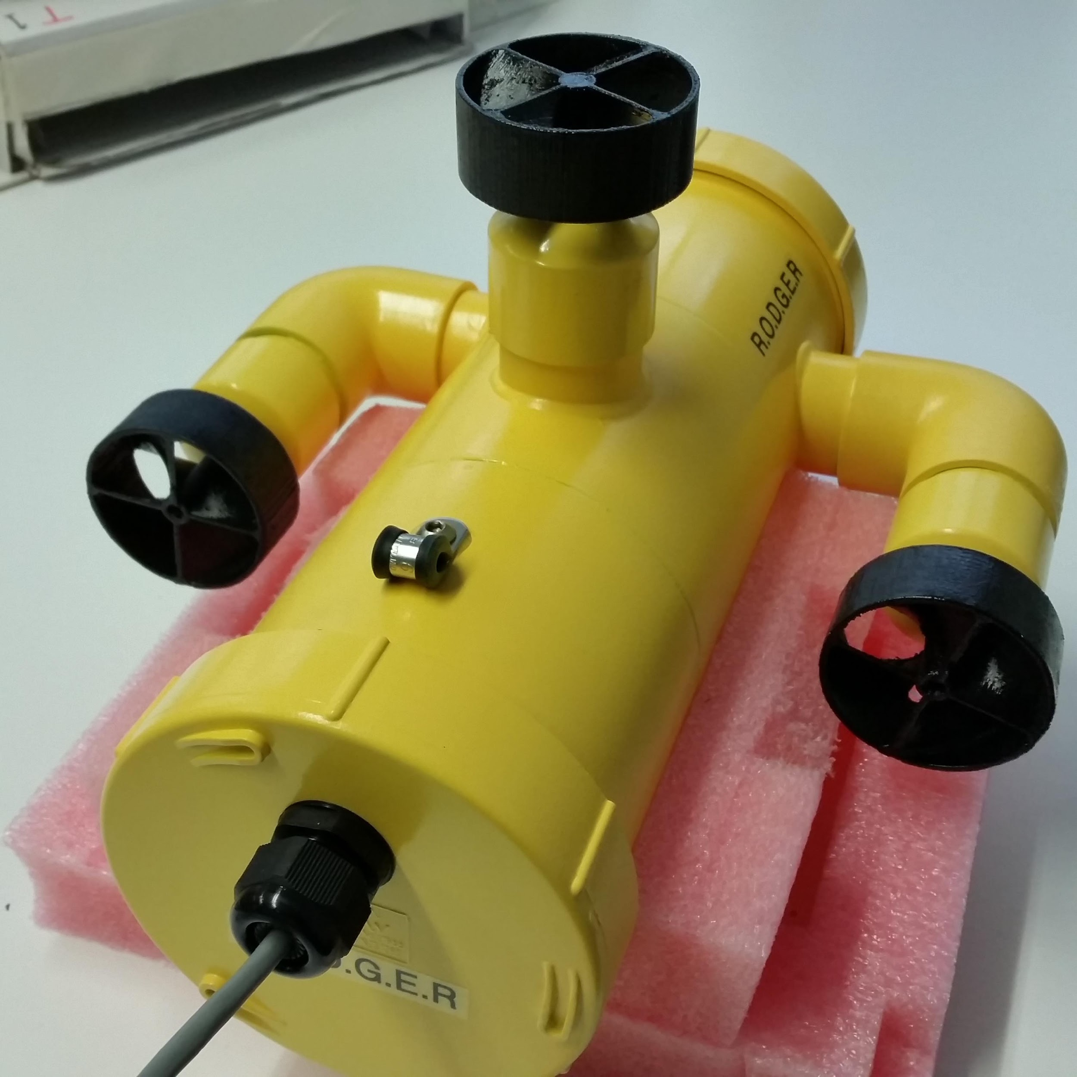
Final Prototype

Slide 10
Demo
http://172.19.16.150:5000

