Slide 1
Welcome!
Bingo to do list
(if you have a better name, bonus points)

Slide 2
Teams
Get into two groups
If you want smaller groups, then get into groups of 3 or 4

Slide 3
How to win
In your groups get the longest line on the board

Slide 4
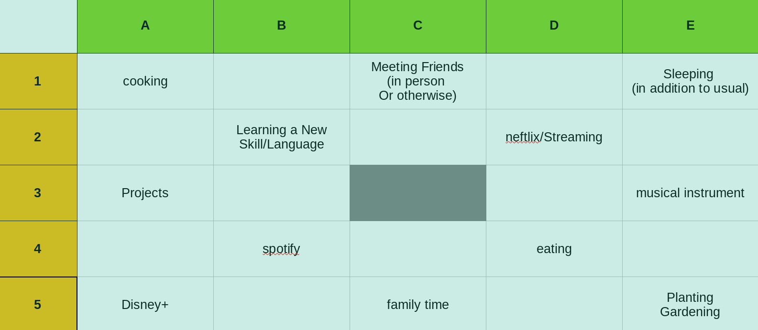
How to win
In your groups get the longest line on the board (an incomplete board is shown here)

Slide 5
How to win
Center box is free

Slide 6
How to win
How to fill?
  Find out among yourselves what are the three things you spent the most time on this week
  Write it down first (don’t change your answers okay? I trust you)
  eg. if you have 2 people having ‘eating’ on their top 3 list, and 3 people having ‘learning a new skill’ on their top 3 list

Slide 7
How to win
Fill your boxes like this (use paint, gimp, annotate or whatever):
3
2

Slide 8
How to win
And basically you have three boxes in a row:
  The central box is free to take
3
2

Slide 9
How to win
What happens if another team has 3 in a row?
  Sum up the numbers in your line
3
2

Slide 10
How to win
What happens if another team has 3 in a row?
  Most score along that will win
3
2

Slide 11
How to win
What about those empty boxes?
  Wait! Before showing you the full board, you must discuss in your groups first:
  What are your top three things keeping you busy this week?
  Write it down/Share in chat, don’t change your answer!

Slide 12
Questions?

Slide 13
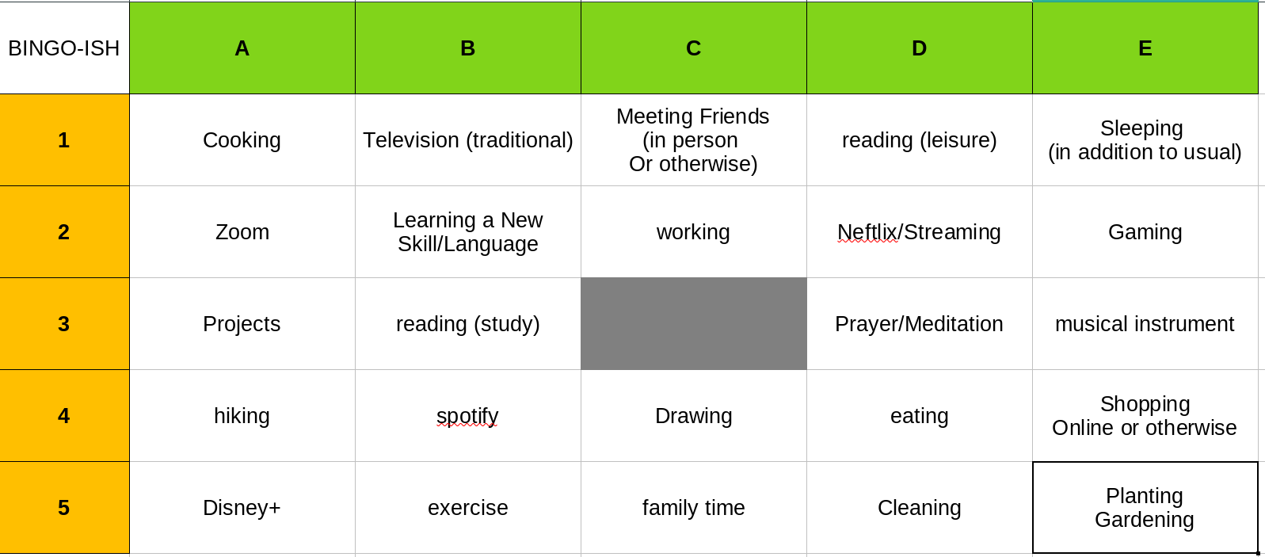
The Full Board
Annotate this board, or copy and paste on paint etc.

