Slide 1

CampusFinder: A Secure Mobile Lost-and-Found Platform for University Campuses
BSc Computer Science Project Defence
Presented by: Theodore Abbey Gyaqueh ([INSERT student number])
Supervisor: Mr. Julius Ludu
College of Basic and Applied Sciences (CBAS)
School of Physical and Mathematical Sciences (SPMS)
Department of Computer Science
[INSERT defence month and year]
Notes:
Good morning. My name is Theodore Abbey Gyaqueh, student number [INSERT student number], and this is my BSc Computer Science project defence, supervised by Mr. Julius Ludu.
My project is CampusFinder: a mobile lost-and-found application for university campuses. It lets a student report a lost or found item, search what others have reported, and arrange the return through a private, encrypted chat.
I will take about fifteen minutes, then I welcome your questions. (~30 s)

Slide 2
Presentation Outline
1
Introduction & Background
7
Requirements
2
Problem Statement
8
System Architecture & Design
3
Aim & Objectives
9
Implementation, Security & Demo
4
Research Questions & Scope
10
Evaluation Plan
5
Related Work & Current Practice
11
Objectives Revisited
6
Design Science Methodology
12
Limitations & Conclusion
Notes:
Here is the route through the talk. I start with the problem and why it matters, then the aim, objectives and research questions. After that I look at related systems and how CampusFinder compares with the informal way students recover items today. Then come the methodology, requirements, architecture and design, followed by the implementation: reporting and browsing, the path from report to reunion, the security layers, and a demonstration. I finish with the evaluation plan, where each objective stands, the limitations and the conclusion. (~30 s)

Slide 3
Introduction & Background
Context: student ID cards, phones, keys and bags are regularly left behind in lecture halls, libraries and halls of residence.
Current practice: owners and finders post in WhatsApp groups, pin notes on notice boards or ask around; posts are soon buried.
Why now: smartphones are common among students, and cloud services such as Firebase let one developer build a real-time app without a server.
Motivation: existing lost-and-found products serve staffed lost-property offices or rely on tracking tags, not student-to-student recovery.
HOW AN ITEM IS RECOVERED TODAY
1 Post in a WhatsApp group
2 Pin a note on a notice board
3 Share a phone number publicly
4 Wait and hope the owner sees it
No search, no record, no privacy.
Notes:
A university campus is a place where thousands of people move between lecture halls, libraries and halls of residence every day, and things get left behind: student ID cards, phones, keys, bags and books.
Today, recovering an item is informal. The owner or the finder posts in a WhatsApp group, pins a note on a notice board or simply asks around. The post is soon buried under other messages, it cannot be searched, and it often exposes a personal phone number to a large group of strangers.
What has changed is the technology available. Smartphones are common among students, and cloud services such as Firebase make it possible for one developer to build a real-time application without running a server. Existing lost-and-found products are aimed at organisations with a staffed lost-property office, or they depend on tracking tags. That left room for a student-to-student solution. (~90 s)

Slide 4



Problem Statement
PROBLEM STATEMENT
Students who lose or find an item on campus have no single, trusted place to report it, search for it and contact the other person without exposing their phone number to strangers.
Evidence
Affected users
Impact
Recovery runs on WhatsApp group posts, notice boards and word of mouth. [INSERT: survey figure or citation]
Students who lose ID cards, phones, keys or bags, and the students and staff who find them.
Posts get buried, finders cannot reach owners, phone numbers are shared publicly and items stay unclaimed.
Notes:
Stated plainly: a student who loses or finds an item on campus has no single, trusted place to report it, search for it and contact the other person without exposing a phone number to strangers.
The evidence is the way recovery works today, through group chats, notice boards and word of mouth. [INSERT: one sentence of evidence from your survey or literature.]
The people affected are students who lose things and the students and staff who find them. The cost of leaving the problem unsolved is that posts get buried, finders cannot reach owners, personal contact details are shared publicly, and items stay unclaimed. (~60 s)

Slide 5
Aim & Objectives
AIM To design, develop and evaluate a cross-platform mobile application that lets university students report, search for and securely arrange the return of lost and found items, and to assess whether it improves on the informal channels students use today.
OBJECTIVE
PART OF THE AIM IT SERVES · EVIDENCE
Understand the baseline
How students report and recover lost items today: literature review and a short survey.
“…improves on the informal channels”
Literature + survey
O1
Secure access and communication
Verified accounts, database access rules and encrypted one-to-one chat.
“…securely arrange the return”
FR-01 to FR-03, FR-09; security rules
O2
Build the platform
Reporting with photos, live browsing, search and filters, a chat inbox and message alerts.
“…report, search for and arrange the return”
FR-04 to FR-12; the working app
O3
Evaluate against informal channels
Time on task (RQ1), usability (RQ2) and trust in the safeguards (RQ3), plus functional testing.
“…assess whether it improves”
RQ1 to RQ3 results; test log
O4
Notes:
The aim has two halves: build an application that lets students report, search for and securely arrange the return of items, and find out whether it actually improves on the informal channels.
Each objective serves a named part of that aim. O1 sets the baseline: how students recover items today. O2 covers the word secure: verified accounts, database access rules and encrypted chat. O3 is the platform itself: reporting with photos, live browsing, search, the chat inbox and message alerts. O4 is the comparison and the evaluation.
The right-hand column shows the part of the aim each objective serves and the evidence that will demonstrate it. (~60 s)

Slide 6



Research Questions, Scope & Significance
Research Questions
Scope
Significance
RQ1: Can students report and locate an item faster in one app than through WhatsApp groups?
RQ2: How do students rate CampusFinder on the System Usability Scale?
RQ3: Which safeguard matters most: verified accounts, private chat or encryption?
Users: University of Ghana students
Features: reports with photos, search, filters, private chat, alerts
Platform: Android and iOS through Expo; Firebase, Cloudinary
Out of scope: claim approval, admin moderation, automatic matching
Users: one private, searchable place to recover belongings
Campus: a base that security or hall offices could adopt
Knowledge: a serverless pattern for private peer-to-peer reporting
Notes:
There are three research questions. RQ1 asks whether students can report and locate an item faster in one application than through WhatsApp groups, measured by time on task. RQ2 asks how usable the application is, measured with the System Usability Scale. RQ3 asks which safeguard users value most: verified accounts, private chat or message encryption.
On scope: the users are University of Ghana students, the features are the ones listed, and the application runs on Android and iOS from one Expo codebase, with Firebase and Cloudinary behind it. Deliberately out of scope for this version are a formal claim approval step, administrator moderation and automatic matching of lost and found reports.
On significance: students get one private, searchable place to recover belongings, the campus gets a base that security or hall offices could adopt, and the project documents a serverless pattern for private peer-to-peer reporting. (~75 s)

Slide 7
Related Work & Research Gap
Study / System | Approach / Technology | Strengths | Limitations
Chargerback (2010) | Cloud lost-property database run by an organisation, with owner notifications and shipping | Proven in airlines, resorts and public venues | Needs staff to log every item; no contact between finder and owner
Crowdfind (2012) | Image-based lost and found software; each found item starts with a photo | Photo-first records are quick to log and search | Run by an organisation, not by students; commercial product
Apple AirTag (2021) | Bluetooth tag located through the Find My network | Owner sees the location; no office needed | Tag must be bought and attached before the loss; Apple devices only
CampusFinder (this project) | Expo + Firebase; verified accounts, photo reports, live search, encrypted chat | Report, search and private chat between students in one free app | Prototype scale; no claim step or moderation yet; any email accepted
RESEARCH GAP
Among the systems reviewed, none gives students a peer-to-peer place to report, search and privately arrange the return of an item, tied to verified accounts and built for a campus.
Notes:
I reviewed three existing systems. Chargerback is a cloud lost-property system used by airlines, resorts and public venues. It is proven at scale, but it assumes an organisation with staff who log every item. Crowdfind takes an image-based approach, where each found item starts with a photo. It is quick to log and search, but again it is run by an organisation rather than by the finders and owners themselves. Apple's AirTag solves the problem with hardware: a tag located through the Find My network. It works well, but the tag has to be bought and attached before the item is lost, and it needs an Apple device.
The gap is the bottom row. Among the systems I reviewed, none gives students a peer-to-peer place to report, search and privately arrange a return, tied to verified accounts. I state the limits of my own system openly: it is at prototype scale, and it has no formal claim step or moderation yet. (~90 s)

Slide 8
CampusFinder vs Informal Channels
Need | Informal channels today | CampusFinder
Announcing an item | A post in a WhatsApp group or a note on a board | Structured report: type, name, description, location, photo
Finding a match | Scroll back through old messages; ask around | Live list with keyword search and Lost / Found filters
Knowing who posted | An unknown group member or phone number | An account with a confirmed email address
Making contact | Phone number visible to the whole group | Private in-app chat; no phone number shared
Keeping a record | Posts are buried within hours | Reports and chats are stored with the time and reporter
WHAT WE KEEP
Recovery still depends on goodwill between students. The finder and the owner still talk and agree where to meet. CampusFinder gives that conversation one searchable, private place.
CLAIMS TO TEST, NOT RESULTS
RQ1 times reporting and finding an item against a described WhatsApp scenario. RQ3 asks which of these safeguards users actually rely on.
Notes:
A fair question is what makes this better than a WhatsApp group. The informal way works because students are willing to help each other. But a post in a group is unstructured, it is quickly buried, it cannot be searched, and the poster's phone number is visible to everyone.
CampusFinder does not replace that goodwill. The finder and the owner still talk to each other and still agree where to meet. What changes is that the report is structured and searchable, the account behind it has a confirmed email address, and the conversation happens in a private chat without sharing a phone number.
I am presenting these as claims, not results. RQ1 and RQ3 are designed to test exactly these rows. (~60 s)

Slide 9
Methodology: Design Science Research
Peffers et al. (2007): an artefact is designed, built and evaluated to solve a real problem.
1
2
3
4
5
6
Problem identification & motivation
Define objectives of a solution
Design & development
Demonstration
Evaluation
Communication
IN THIS PROJECT
IN THIS PROJECT
IN THIS PROJECT
IN THIS PROJECT
IN THIS PROJECT
IN THIS PROJECT
Literature review and a review of three systems
Objectives O1 to O4 and 12 functional requirements
Architecture, data model, 5 service modules, 10 screens
Walkthrough: sign up, report, search, chat
Manual testing on a phone; SUS study planned
Project report and this defence
Iteration: built in cycles: core screens and navigation, then the Firebase services, then a redesign of the interface and a move of photo storage to Cloudinary. [INSERT: supervisor feedback cycle]
Notes:
The project follows design science research as set out by Peffers and colleagues: an artefact is designed, built and evaluated to solve a real problem.
Problem identification came from the literature and the review of three systems. The objectives became O1 to O4 and twelve functional requirements. Design and development produced the architecture, the Firestore data model, five service modules and ten screens. The demonstration is the walkthrough you will see shortly. Evaluation so far is manual functional testing on a phone, and the usability study is planned. Communication is the report and this defence.
The work was iterative. I built the core screens and navigation first, then the Firebase services, and then redesigned the interface and moved photo storage to Cloudinary. [INSERT: any change made after supervisor feedback.] (~60 s)

Slide 10



Requirements
Literature review
Review of 3 systems
12 functional requirements
Functional Requirements
Non-functional Requirements
FR-01/02 Register, log in and verify email by link
FR-03 Stay signed in across restarts; log out
FR-04/05 Report a lost or found item, with an optional photo
FR-06 Browse all reports live, with Lost and Found counts
FR-07 Search by keyword; filter All, Lost or Found
FR-08 Open an item to see its details
FR-09 Chat privately with the reporter; text is encrypted
FR-10 See every conversation in a Chats inbox
FR-11/12 New-message alerts; account and my report count
Usability one-screen report form; consistent icons; clear empty and error states
Performance live updates through Firestore listeners; photos compressed before upload
Security verified email, database rules, encrypted chat, no secret keys in the app
Reliability a failed message is restored for resending; chat errors offer a retry
Portability Android and iOS from one Expo codebase
Notes:
The requirements came from the literature and the review of existing systems, and I wrote them as twelve numbered functional requirements. They follow the user's path: register and verify, report an item with an optional photo, browse and search, open the details, chat privately with the reporter, and receive alerts for new messages.
On the right are the qualities the system is judged by: usability, performance, security, reliability and portability. Each one is tied to something concrete in the code. For example, reliability means a message that fails to send is put back in the input box so that nothing is lost, and security means verified email, database rules and encrypted chat. (~75 s)

Slide 11
System Architecture
Screens and navigation
10 screens: stack + 3 bottom tabs
Service modules
auth, items, chat, storage, notifications
Presentation layer
React Native screens on Expo, with React Navigation
Firebase JS SDK · HTTPS · real-time listeners
Firebase (serverless backend)
Authentication · Cloud Firestore · Security Rules
Application layer
Five service modules that call the cloud SDKs directly
Firestore collections
users
profile, verified flag
items
lost and found reports
chats / messages
encrypted text
Data layer
Firestore documents; photo addresses from Cloudinary
OTHER SERVICES
Cloudinary
item photos
Verification email
sent by Firebase
Expo Notifications
local alerts
Cloud and device services
Firebase, Cloudinary, camera, gallery, notifications
Notes:
The architecture is serverless. There is no custom backend server. The Expo application contains the screens and five service modules, and those modules talk directly to cloud services through their SDKs over HTTPS.
Firebase Authentication handles accounts and email verification. Cloud Firestore stores three collections, users, items and chats, with messages held in a sub-collection under each chat. Firestore's real-time listeners are what make the Browse list and the chat update live. Security rules on the database decide who can read and write each document.
Item photos go to Cloudinary through an unsigned upload preset, and only the resulting HTTPS address is saved in Firestore. Notifications are local to the device, using Expo Notifications. I chose this design deliberately: for one developer it removes the cost of building, hosting and securing a server. (~75 s)

Slide 12
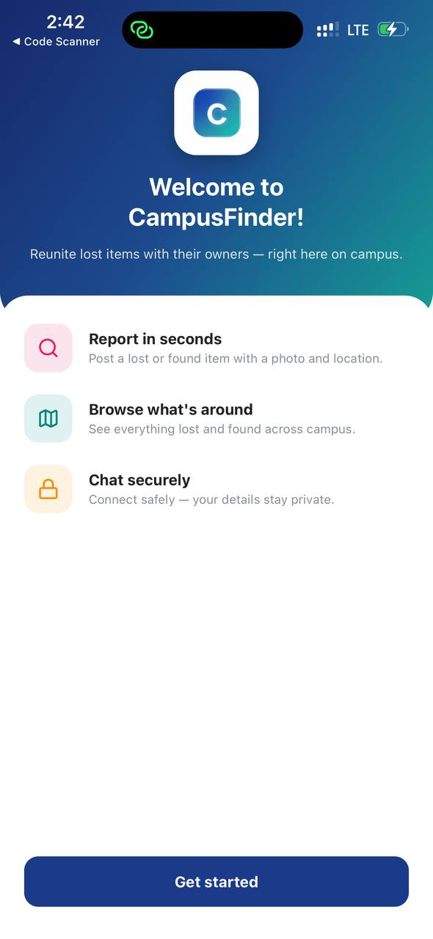
System Design
Visitor
Firebase Auth account
email, password, emailVerified
Sign up with name, email and password
Log in
1 : 1
users
uid, name, email, createdAt
Unverified user
1 : N (reportedBy)
Receive the verification link by email
Resend the link
Confirm and enter the app
items
name, description, location, type, imageUrl
1 : N (itemId)
Verified student
chats
participants[2], itemId, lastMessage
Report a lost or found item, with a photo
Browse, search and filter all reports
Open an item's details
Chat privately with the reporter
See all chats; get new-message alerts
View account and log out
1 : N (sub-collection)
messages
encrypted text, senderId, timestamp
Firestore is a document store, so links are held as ids. Each chat joins exactly two users and one item.
Use cases by actor
Data model (Firestore)
User interface
Who does what in the system
Collections, fields and links
Welcome screen, one of 10
Notes:
Here are three views of the design. On the left are the use cases by actor. A visitor can only sign up or log in. A user whose email is not yet verified can only request the link again and confirm. A verified student can report, browse, search, chat and manage the account.
In the middle is the data model. A Firebase Authentication account has one profile document in users. A user can report many items, an item can have many chats, and each chat has exactly two participants and many messages. Because Firestore is a document database, these links are stored as identifiers such as reportedBy and itemId.
On the right is the Welcome screen, one of the ten screens, which shows the visual style used throughout: a navy to teal header, white cards and line icons. (~75 s)

Slide 13


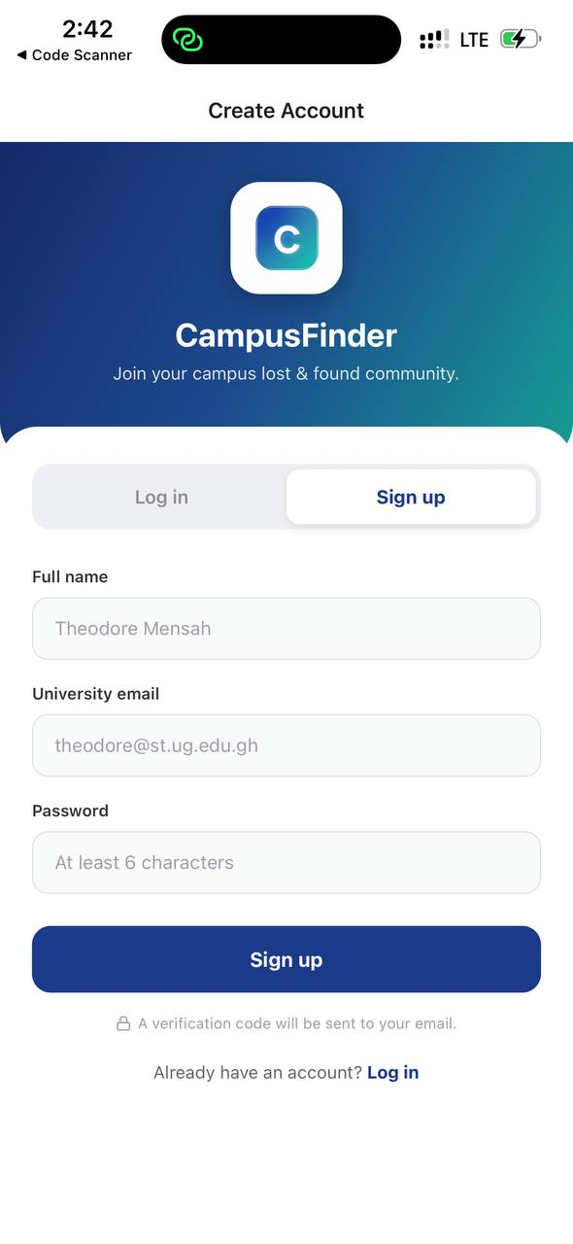
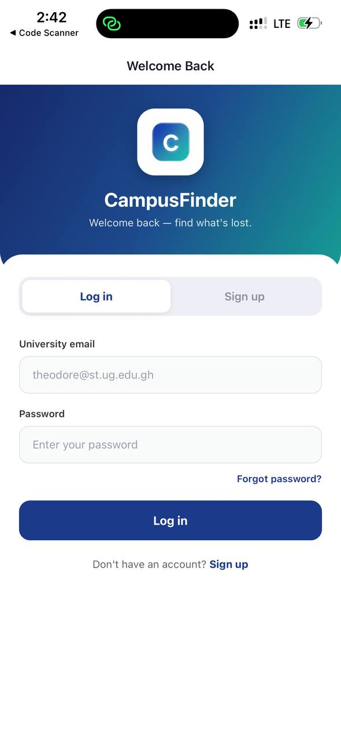


Implementation
Frontend
Backend services
React Native 0.86, Expo 57, JavaScript, React Navigation 7
Firebase 12: Authentication, Cloud Firestore, security rules
Data & media
Tools & libraries
Firestore documents; item photos on Cloudinary
Git, Expo Go, crypto-js, Lucide icons, expo-image-picker
Sign up and Log in: one screen with a sliding tab, captured on a phone through Expo Go
Notes:
The client is React Native 0.86 with Expo 57, written in JavaScript, with React Navigation 7 for the stack and the bottom tabs. The backend is Firebase version 12: Authentication and Cloud Firestore, protected by security rules. Item photos are stored on Cloudinary.
Two engineering points. First, all access to Firebase and Cloudinary goes through five small service modules, so the screens never query the database directly. Second, the root of the app listens to the authentication state and shows only the screens that state allows: the login screen, the verification screen or the full application.
The screenshots on the right are the Sign up and Log in views, which are one screen with a sliding tab, captured on a phone running the app through Expo Go. (~60 s)

Slide 14
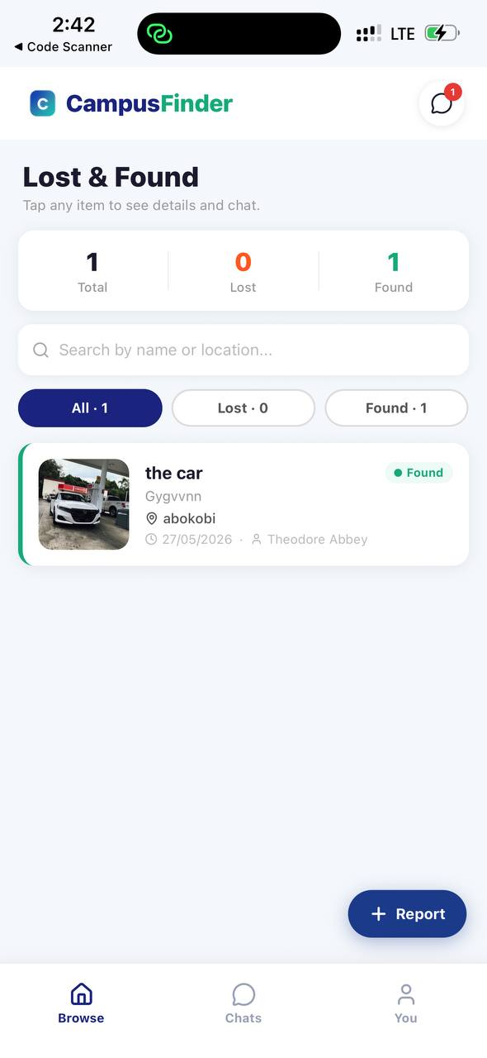
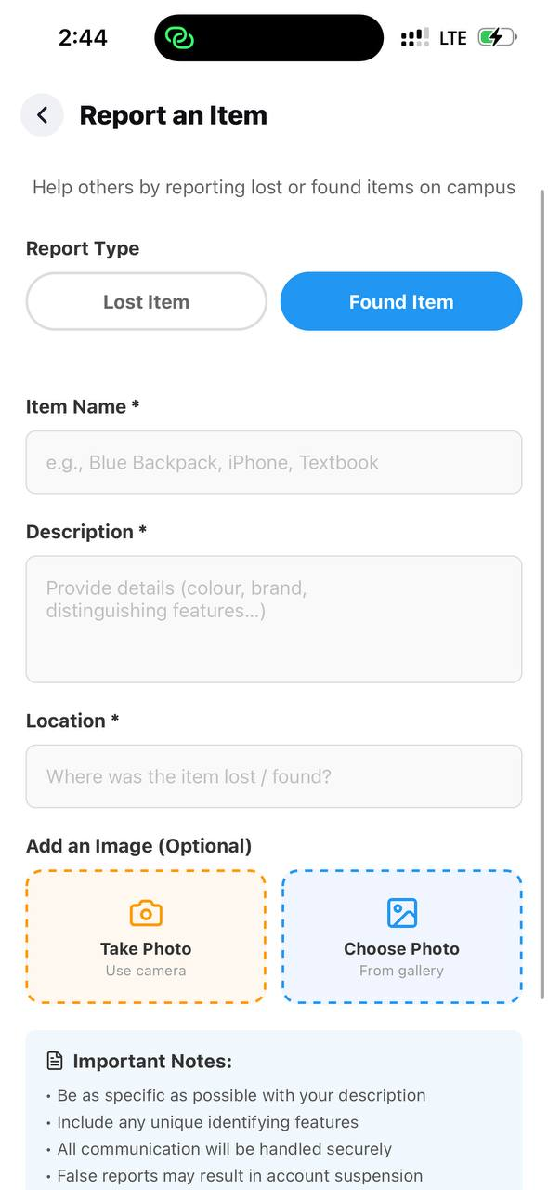
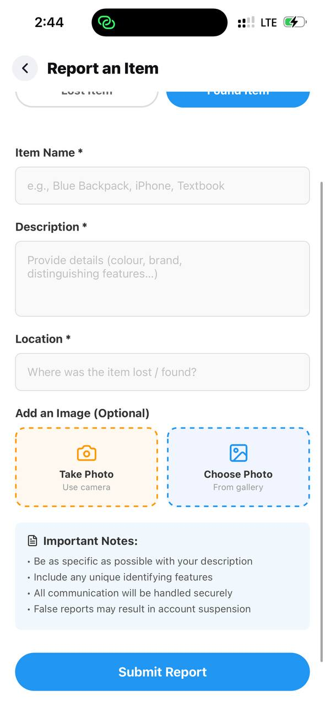
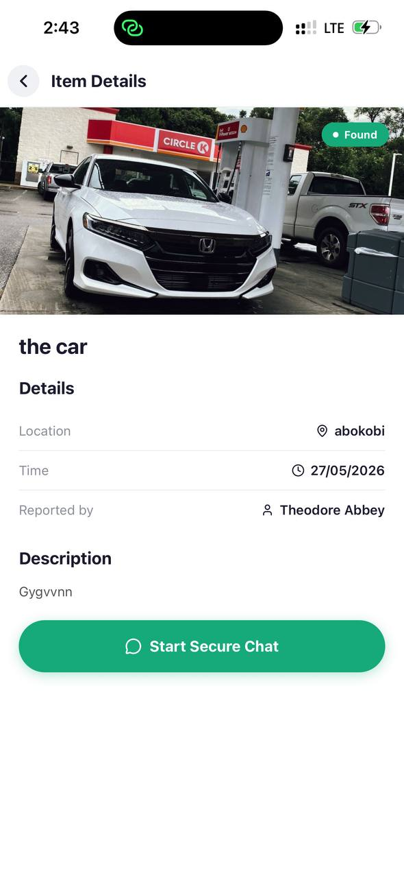
Implementation: Reporting and Browsing
Browse: live counts, search, filters
Report: type, name, description
Report: photo options and submit
Details: start a secure chat
Screenshots from the current build, captured on a phone through Expo Go with test data.
Notes:
These are the four screens a student uses most. Browse shows live totals of lost and found items, a search box that matches the name, location and description, and filters for all, lost or found. A report that is less than an hour old carries a NEW badge.
Reporting an item means choosing lost or found, then entering a name, a description and a location. A photo is optional and can come from the camera or the gallery. On submit, the photo is uploaded first and the report is then saved, and it appears on every user's list immediately.
Tapping an item opens its details, with the location, the time, the reporter's name and a button to start a secure chat. (~60 s)

Slide 15
From Report to Reunion
reported
listed
matched
in chat
handed over
Finder or owner submits a report, photo optional
It appears on every Browse list in real time
The other student finds it by search or filter
They open Details and start a private chat
They agree a public place on campus and meet
Not built yet: a claim step, proof of ownership and a Returned status · ownership is settled in the chat
WHAT THE CODE ENFORCES ALONG THE WAY
A report needs a name, a description and a location; the photo is optional
Each report stores the reporter's user id, and the rules let only that user change or delete it
A user cannot open a chat about their own report
One chat per item and pair of users, so reopening it resumes the same thread
“End Chat & Report” closes with safety tips; it does not yet mark the item as returned
Notes:
This slide follows one item from report to reunion. A student reports it. It is listed for everyone in real time. The other student finds it through search or a filter, opens the details and starts a private chat, and the two agree on a public place on campus to hand it over.
Along the way the code enforces a few rules. A report needs a name, a description and a location. Each report stores the reporter's user identifier, and the database rules allow only that user to change or delete it. A user cannot open a chat about their own report. And there is one chat per item and pair of users, so reopening it resumes the same thread.
I want to be clear about what is not built yet. There is no formal claim step, no proof of ownership question and no returned status. Today the two students settle ownership in the chat. That is the first item in my future work. (~75 s)

Slide 16
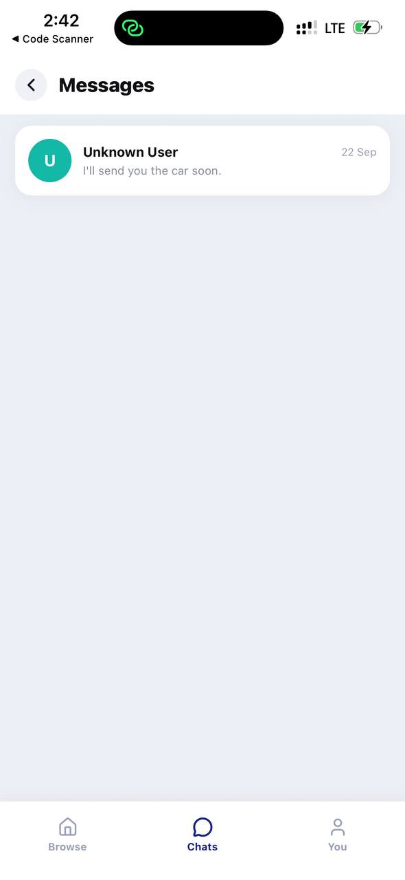
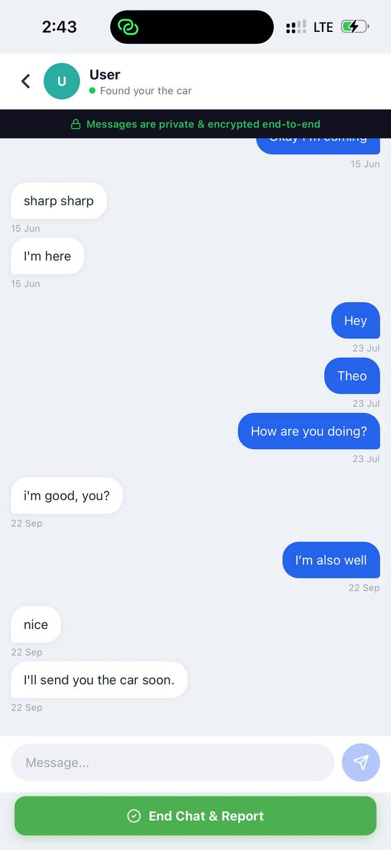

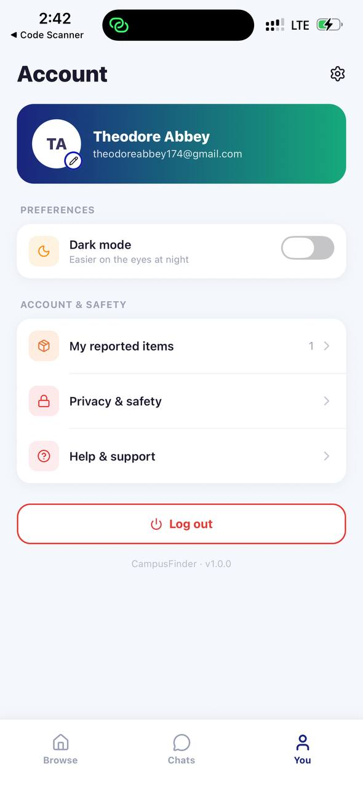
Implementation: Chats, Alerts & Account
Chats inbox: latest message per conversation
Chat: live messages and encryption notice
New-message banner and notification
Account: profile, my reports, log out
Screenshots from the current build with test data. Dark mode, My reported items, Privacy & safety and Help & support are placeholders in this version; there is no administrator side yet.
Notes:
The remaining screens. The Chats tab is an inbox that lists every conversation with the latest message and its time, newest first. The chat screen shows messages live, with a notice that they are encrypted. When a new message arrives while the app is open, a banner slides down from the top. When the app is in the background, a local notification is shown instead.
The Account tab shows the profile, the number of items I have reported and the log out button.
Some entries on that screen are placeholders in this version: dark mode, the list of my reported items, privacy and safety, and help and support. They are laid out in the interface but not yet implemented, and there is no administrator or moderation side yet. (~60 s)

Slide 17

Protecting Access: Four Layers
1
Account authentication
Firebase email and password login; session kept on the device; repeated failures are locked out
Working
2
Email verification gate
A link is emailed at sign-up; until it is opened the user sees only the Verification screen
App-side only
3
Database security rules
Reporter-only item edits; participant-only chats; messages cannot be changed
Working
Verification screen: check your email, resend the link
Encrypted chat messages
AES encryption with crypto-js before a message is saved; the inbox preview is encrypted too
PRIVACY BY DESIGN
No phone number is shown; contact happens only in the in-app chat
Photos go to Cloudinary through an unsigned preset, so no secret key is in the app
Passwords are handled by Firebase Authentication, never stored by the app
4
Working
Honest gaps: the rules check sign-in, not email verification; any email domain is accepted; the chat key is derived from the chat id and a constant in the app.
Notes:
Security is layered. First, account authentication through Firebase with an email and password. The session is kept on the device, and Firebase locks out repeated failed attempts.
Second, email verification. A link is emailed at sign-up, and until it is opened the user sees only the verification screen. I mark this as app-side, because the check is made in the application and not yet in the database rules.
Third, the Firestore security rules. Only the reporter can edit or delete an item, only the two participants can read or write a chat, and messages cannot be edited or deleted once sent.
Fourth, chat messages are encrypted with AES before they are saved, so the database holds ciphertext.
The honest gaps are in the gold box: the rules check that a user is signed in, not that the email is verified, any email domain is accepted, and the chat key is derived from the chat identifier and a constant in the app. On privacy, the app never shows a phone number, and it holds no secret keys. (~90 s)

Slide 18
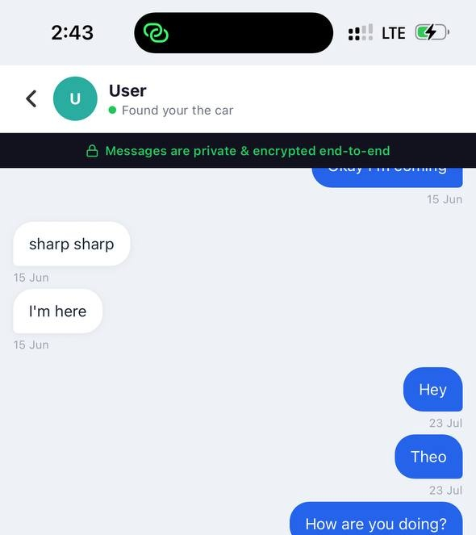
How a Chat Message Is Protected
Encrypted on the sender's phone, so the database holds ciphertext, not text:
Typed on the phone
Key from the chat id (SHA-256)
AES encryption (crypto-js)
Stored and synced by Firestore
3
Immutable
Messages cannot be edited or deleted; chats cannot be deleted
2
Restricted
Rules limit reading and sending to the two participants
1
Encrypted
AES with a per-chat key before upload
Encryption notice at the top of every chat
“Encrypted in the app, but not yet true end-to-end.”
The key can be rebuilt from the chat id and a constant in the code. Per-user keys are future work.
0
Plain text
Only on the two phones
Notes:
This slide shows how one chat message is protected. The message is typed on the phone. A key is derived for that chat by hashing the chat identifier with SHA-256, and the text is encrypted with AES using the crypto-js library. Only the ciphertext is sent to Firestore, and the inbox preview is encrypted in the same way.
The steps at the bottom show the protection building up. Plain text exists only on the two phones. In the database the message is encrypted, it is restricted by the rules to the two participants, and it is immutable: it cannot be edited or deleted.
The limit is stated in the box. The application calls this end-to-end encryption, but it is not truly end-to-end yet, because the key can be rebuilt by anyone who has the chat identifier and the application code. It does protect the messages from being read directly in the database. Real end-to-end encryption needs per-user keys, and that is future work. (~75 s)

Slide 19

Demonstration
Demo script
1
Sign up with an email address, open the verification link and reach the Welcome screen
2
Report a found item with a photo; it appears on the Browse list at once
LIVE DEMO
3
On a second phone, search for the item, open its details and start a secure chat
Switch to the running system
4
Exchange messages in real time; show the stored ciphertext in the Firestore console
Backup: a screen recording of the four scenarios, in case the network fails. [INSERT: confirm it is recorded] The demo uses test accounts.
Notes:
I will now show four scenarios, which take about four minutes.
One: I sign up with an email address, open the verification link and reach the Welcome screen. Two: I report a found item with a photo, and it appears on the Browse list at once. Three: on a second phone, another user searches for the item, opens its details and starts a secure chat. Four: the two users exchange messages in real time, and I show the stored ciphertext in the Firestore console.
If the network fails, I have a screen recording of the same four scenarios. [INSERT: confirm the recording is ready.] (~60 s plus demo)

Slide 20
Evaluation Plan
USABILITY STUDY · PLANNED, NOT YET RUN
SYSTEM TESTING · MANUAL SO FAR
Time to report and find an item
Time on task in CampusFinder vs a described WhatsApp group scenario
→ O4
[INSERT]
manual test cases run on a physical phone through Expo Go, and how many passed
RQ1
Usability
System Usability Scale questionnaire (Brooke, 1996) after the tasks
→ O4
RQ2
[INSERT]
devices and operating system versions the app was tested on
Trust in the safeguards
Rating items + open questions on email verification, private chat and the encryption notice
→ O2, O4
RQ3
0
automated tests in the repository so far; unit tests for the five service modules are planned
Participants: [INSERT: number] University of Ghana students; think-aloud on a phone
Before the study: [INSERT: consent and ethics steps]; the O1 survey sets the baseline
Notes:
This is the evaluation plan, and I want to be clear about what is done and what is not.
So far the system has been tested by hand on a physical phone through Expo Go. [INSERT: number of manual test cases, the devices used and the results.] There are no automated tests in the repository yet, and unit tests for the five service modules are planned.
The usability study has not been run yet. Participants will carry out representative tasks while I time them. Time on task against a described WhatsApp scenario answers RQ1. The System Usability Scale answers RQ2. Rating questions and open questions about the safeguards answer RQ3. [INSERT: number of participants and how they will be recruited.] (~75 s)

Slide 21
Objectives Revisited
Objective | Where it stands | Evidence | Status
O1 | Related systems reviewed; survey of University of Ghana students still to run | Related work review; [INSERT: survey instrument] | Survey pending
O2 | Email verification gate, Firestore security rules and AES-encrypted chat implemented | FR-01 to FR-03, FR-09; rules file and chat service | Built; key handling to harden
O3 | Reporting with photos, live browsing, search, filters, chat inbox and alerts running on a phone | 12 requirements; 10 screens, 5 service modules | Built; claim step not yet
O4 | Functional testing by hand so far; usability study (RQ1 to RQ3) planned | [INSERT: test log]; study protocol | Study pending
Contribution: a working, serverless reference design for a campus lost-and-found service that combines verified accounts, database access rules, photo reports, live search and encrypted private chat in one mobile application.
Notes:
Here is where each objective stands. O1: the related systems are reviewed, and the survey of students still has to run. O2: the verification gate, the database rules and the encrypted chat are implemented, with key handling still to be hardened. O3: reporting, browsing, search, chat and alerts are built and running on a phone, and the claim step is not built yet. O4: testing so far is manual, and the usability study is planned.
The contribution is a working, serverless reference design for a campus lost-and-found service that combines verified accounts, database access rules, photo reports, live search and encrypted private chat in one mobile application. (~60 s)

Slide 22


Limitations & Future Work
Limitations
Future Work
Claims: no claim approval, proof of ownership or Returned status
Moderation: no admin role; no way to report a user or a false post
Security: chat key derivable from the app; verification checked app-side
Evaluation: no automated tests; usability study not yet run
Add a claim workflow with proof questions and a Returned status
Add an admin console and user reporting for moderation
Per-user key exchange; rules that require a verified university email
Finish My reported items, password reset and dark mode; add tests, run the study
Notes:
The honest limits. There is no claim approval, no proof of ownership and no returned status, so reports stay listed. There is no administrator role and no way to report a user or a false post. On security, the chat key can be derived from the application, and email verification is checked in the app rather than in the database rules. And on evaluation, there are no automated tests and the usability study has not been run.
Each limit has a next step: a claim workflow with proof questions and a returned status, an administrator console with user reporting, per-user key exchange together with rules that require a verified university email, and then finishing the placeholder features, adding tests and running the study. (~60 s)

Slide 23
Conclusion
01
02
03
The problem
The artefact
The evidence
Lost items on campus are chased through WhatsApp posts and notice boards that get buried.
A mobile app taking an item from report, through live search, to a private encrypted chat.
12 requirements built across 10 screens and 5 service modules. Usability study to come.
CampusFinder shows that verified accounts, access rules, live search and encrypted chat can be delivered in one serverless mobile app, and leaves a documented base the Department can extend with claims and moderation.
Notes:
To close. The problem: lost items on campus are chased through WhatsApp posts and notice boards that quickly get buried. The artefact: a mobile application that takes an item from a report, through live search, to a private encrypted chat between two verified accounts. The evidence so far: twelve requirements built across ten screens and five service modules, running on a phone, with the usability study still to come.
CampusFinder shows that verified accounts, access rules, live search and encrypted chat can be delivered in one serverless mobile application, and it leaves a documented base that the Department can extend with claims and moderation. Thank you. (~45 s)

Slide 24
References
Apple Inc. (2021, April 20). Apple introduces AirTag [Press release]. https://www.apple.com/newsroom/2021/04/apple-introduces-airtag/
Brooke, J. (1996). SUS: A 'quick and dirty' usability scale. In P. W. Jordan, B. Thomas, B. A. Weerdmeester, & I. L. McClelland (Eds.), Usability evaluation in industry (pp. 189-194). Taylor & Francis.
Chargerback. (n.d.). About the company. https://www.chargerback.com/the-company.asp
Cloudinary. (n.d.). Upload API reference. https://cloudinary.com/documentation/image_upload_api_reference [VERIFY page title]
Crowdfind. (n.d.). Lost and found software. https://www.crowdfind.com [VERIFY page title]
Google. (n.d.). Get started with Cloud Firestore Security Rules. Firebase documentation. https://firebase.google.com/docs/firestore/security/get-started
Hevner, A. R., March, S. T., Park, J., & Ram, S. (2004). Design science in information systems research. MIS Quarterly, 28(1), 75-105.
National Institute of Standards and Technology. (2001). Advanced Encryption Standard (AES) (FIPS PUB 197). https://doi.org/10.6028/NIST.FIPS.197
Peffers, K., Tuunanen, T., Rothenberger, M. A., & Chatterjee, S. (2007). A design science research methodology for information systems research. Journal of Management Information Systems, 24(3), 45-77.
Republic of Ghana. (2012). Data Protection Act, 2012 (Act 843). Accra: Assembly Press.
Tan & Chong. An effective lost and found system in university campus. [VERIFY: initials, year, journal and pages before citing]
Notes:
The full reference list is in the project report. These are the sources that shaped the design and the evaluation method: Peffers and Hevner for the methodology, Brooke for the System Usability Scale, the Data Protection Act for the handling of personal data, the Firebase and Cloudinary documentation for the implementation, and the existing systems I reviewed. (~15 s)

Slide 25
Thank You
Questions & Comments
Theodore Abbey Gyaqueh ([INSERT student number])
Supervisor: Mr. Julius Ludu
College of Basic and Applied Sciences (CBAS)
School of Physical and Mathematical Sciences (SPMS)
Department of Computer Science
[INSERT defence month and year]
Notes:
Thank you for listening. I am happy to take questions on the architecture choices, the security layers and their limits, the evaluation plan, or anything you saw in the demonstration. (~15 s)

