Slide 1

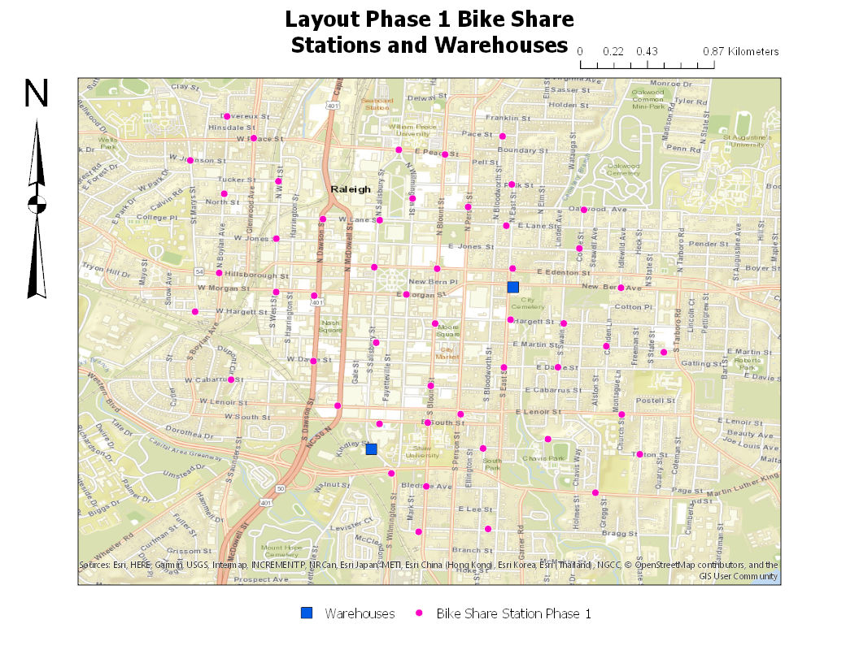
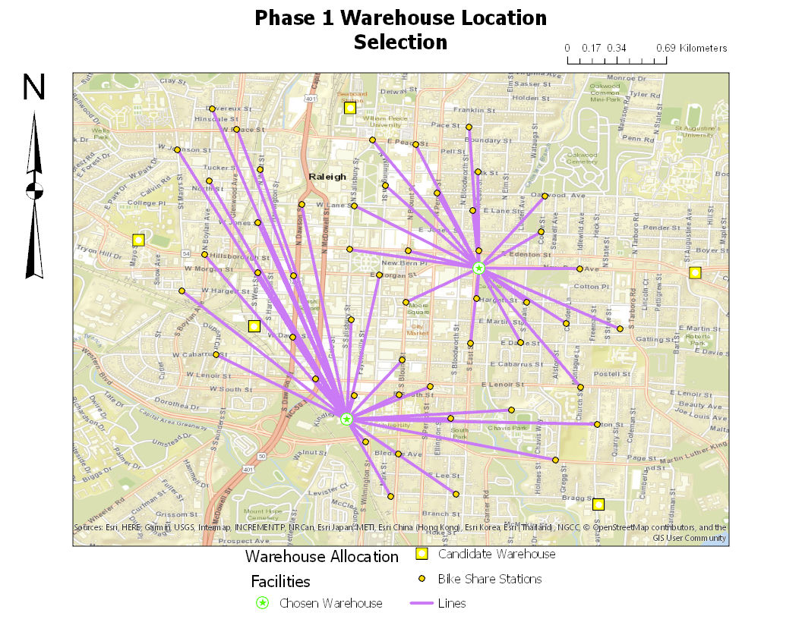
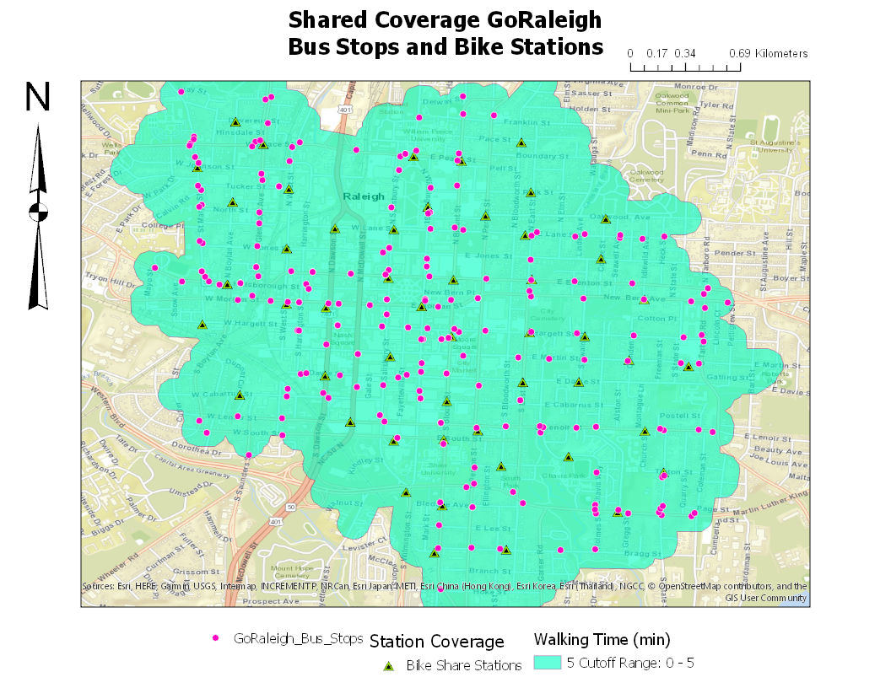
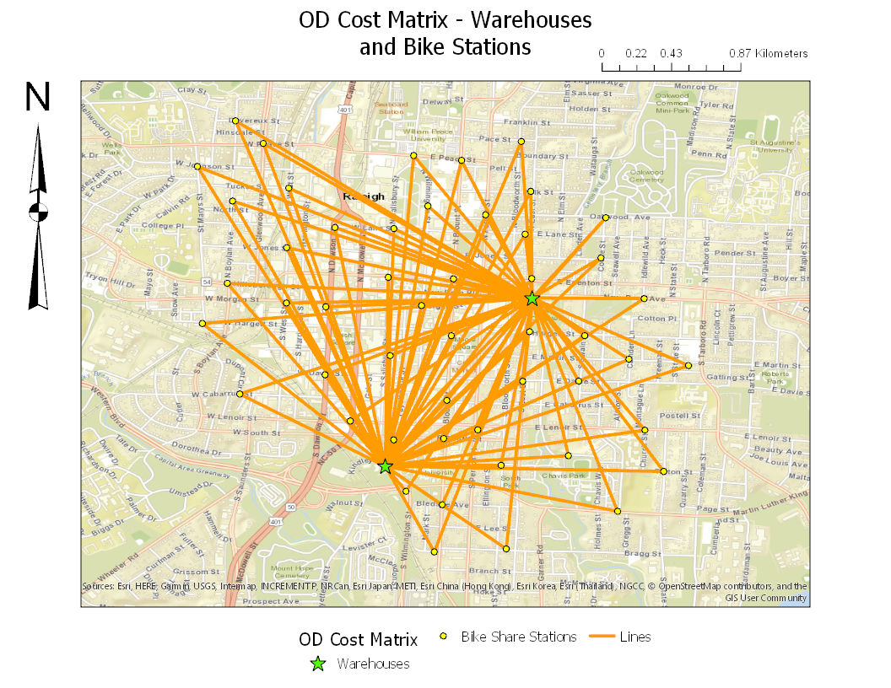
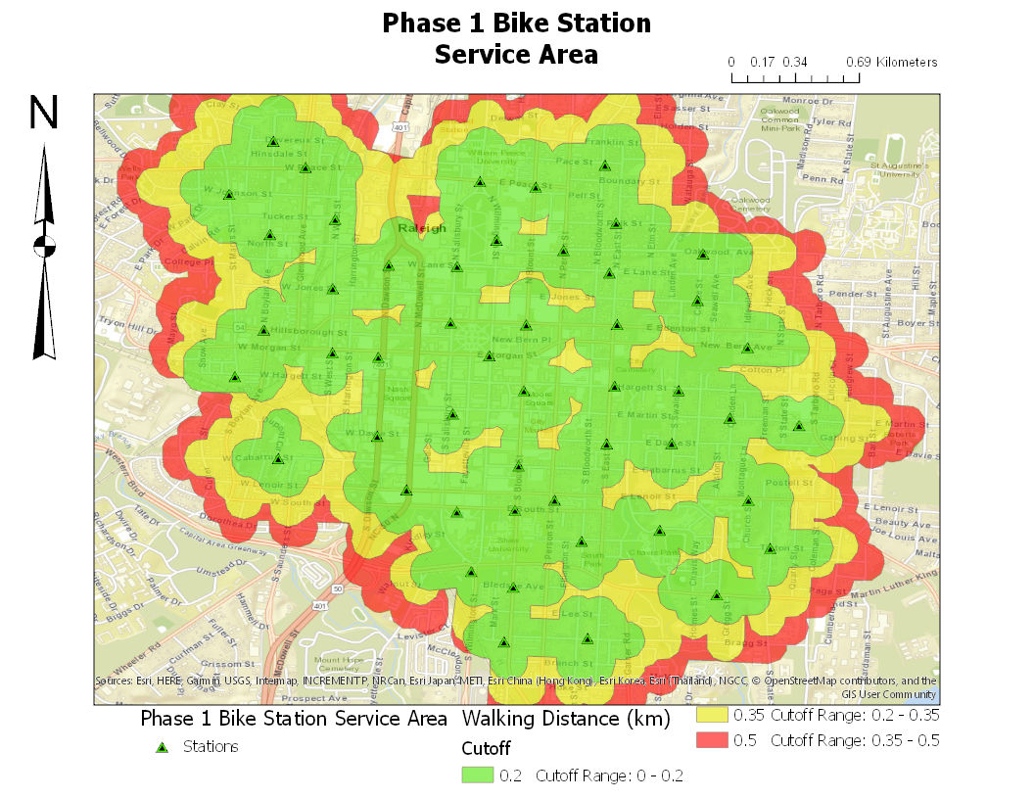
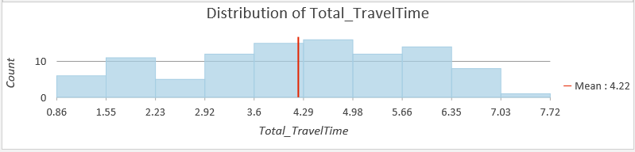
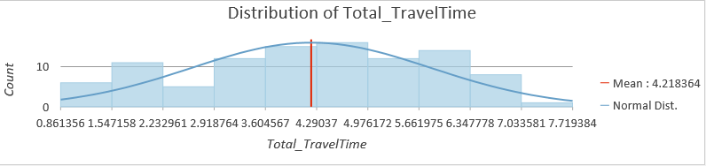
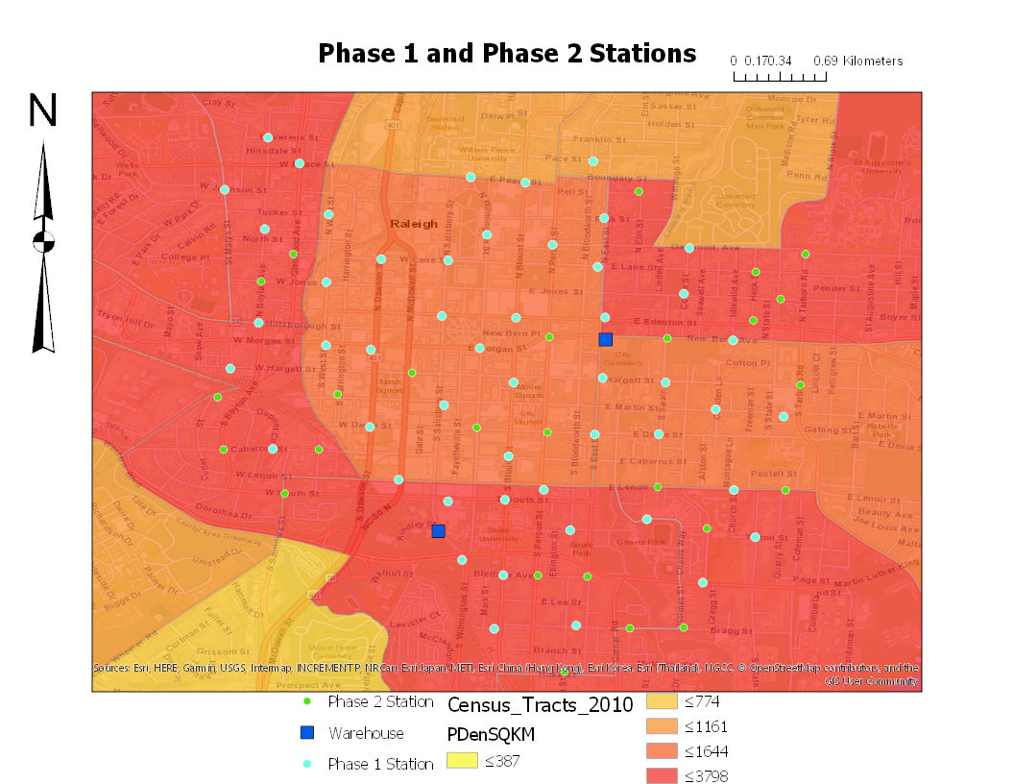
Raleigh Unleashed: A Proposal for a Bike Sharing System in Raleigh, North Carolina
GEOG 653
By Theodore Reuter
Abstract
This poster is a proposal for Phase 1 of a bike sharing network in Raleigh, NC. Bike share programs have exploded across the world in the last 10 years, fleshing out transit networks in urban environments, and creating more opportunities for citizens to use more environmentally friendly means of transportation. A bike sharing system needs to cover enough space to be useful while having a high enough station density to be convenient to travel to a wide range of city locations and require minimal walking to find a docking space. Raleigh was chosen as a candidate due a number of factors: it is a sizeable city, with over 1 million people in the metropolitan area, and a densely populated, developed core. It also has a well developed bus system that a bike share system will complement. Network analysis tools available in ArcGIS Pro were used to assist in planning station locations along with choosing warehouse locations. Census data is used to assess potential ridership and areas for expansion of the program.
Map #2: Service Area map of bike stations
Design Goals For Phase 1
A key parameter of bike sharing programs is station density - to be as useful as possible, the system needs to be convenient and reliable. In terms of a system design, CONVIENIENCE means there are multiple stations within short walking distance (~350m) of a user's start and finish locations. People will not use the system if stations are dispersed, and have to walk a long distance to start, or get to their final destination to and from a station. RELIABILITY means there must be significantly more docks than bikes to accommodate the daily rhythm of city transportation networks and natural temporary uneven distribution of bikes. It is desirable to minimize the distance users need to walk to find an empty docking space. As well, phase 1 must be large enough to encourage use and be able to support a significant amount of daily use over a significant area. There are specific design parameters that have been shown to lead to systems that are enthusiastically used and create the opportunity for future expansion. There will be 50 stations, 300 bikes, and 500 docking spots. These goals will be as follows:
Area covered: about 10 square kilometers Station/Population: 2+ stations/1000 people
Bike to dock ratio: 1.5-2.5 Station Density: 10 stations/square kilometer
Fig. 1
Fig. 4
Bike SHARING AND POPULATION
BIKE SHARING CONNECTIVITY
Tools Used
Service area – Used to determine how close stations are to one another, to ensure the system retains convenience across the network. If stations are too far apart what if a user arrives at their destination and the station closest is full? How far will they have to walk just to find a place to put away their bike? Anything more than a few minutes will reduce ease of use and usage. At least 2 stations should be within 350m of any one station. Once the 50 stations were placed, a service area analysis was run with breaks at .2km, .35 kilometers (the limit we would like users to walk if one station is full), and .5 (if stations are too far apart).
Location Allocation: Used to determine 2 optimal warehouse locations among 7 candidate locations, with the goal of minimizing driving time from warehouses to stations. A bike sharing system needs warehouses to hold extra bikes, provide a space for maintenance on bikes, as well as vehicles that will travel around to pick up damaged bikes, replace stolen or broken bikes, or redistribute bikes throughout the system as needed. Locations were focused on placing them in areas that were not residentially zoned, were close to the clusters of stations (not on the edge of the city in other words). Minimizing travel time between warehouses and stations is a key factor.
OD Cost matrix – Used post location allocation to determine driving time from warehouses to stations. Examining results of this analysis will tell us if selected warehouse locations are appropriate.
Fig. 2
Fig. 5
Tbl. 1
Tbl. 2
Results
Phase 1 Areal Station Coverage: 8 square km Bike Share Stations: 50
Bikes: 300 Warehouses: 2
Docks per bike: 1.6 Total Number docks: 500
Mean time warehouse to station: 4.22 minutes % of Bus stops in coverage area: 376/1642 = 23%
Over 20% stations reachable from warehouse in under 2.5 minutes
Service area is not as broad as desired due to limiting the number of stations while maintaining effective station density. Station density, as seen in Fig 3, is not quite as dense as desired, but is a tradeoff in gaining the service coverage needed to foster usefulness in Phase 1. This smaller Phase 1 coverage is acceptable due to Raleigh being smaller than major metropolises like DC or Paris. A significant portion of the bus network exists within the coverage area along with over half the stations being placed in the immediate vicinity of a bus stop, connecting the networks, and expanding the transportation network with the other half of stations. As seen in Tables 1 and Table 2, the distribution of driving times from the warehouses is almost a normal distribution which leads us to conclude that the warehouse placement is appropriate and there are also no major outliers in terms of station placement relative to the warehouse locations. The density of stations per 1000 people ranged from 0.92-6 stations/1000 people. There are areas that would certainly benefit from increasing station density in a Phase 2, which can be seen in Figure 6. Phase 2 adds 26 stations and increases the coverage area over the densely populated heart of the city to 9 square kilometers while simultaneously increasing station density from 6.25 stations/sqkm to 8.44. This is still lower than desired and further increasing station density is advised.
Fig. 3
References
2010 Wake County US Census Tract Data
https://data-ral.opendata.arcgis.com/datasets/Wake::census-tracts-2010
GoRaleigh Bus Stops
https://data-ral.opendata.arcgis.com/datasets/goraleigh-stops
Raleigh Roads and Intersections
https://data-ral.opendata.arcgis.com/datasets/roads
https://data-ral.opendata.arcgis.com/
Institute For Transportation and Development Policy Bike Shar Planning Guide
https://www.itdp.org/wp-content/uploads/2014/07/ITDP_Bike_Share_Planning_Guide.pdf
Raleigh Zoning Blocks
https://data-ral.opendata.arcgis.com/datasets/raleigh-zoning?page=11
Fig. 6

