Slide 1
CS2100
Tutorial #5
MIPS Processor:
Datapath and control
(Prepared by: Aaron Tan)

Slide 2
Generating ALUControl Signal
From lecture slide:
Opcode | ALUop | Instruction Operation | Funct field | ALU action | ALU control
lw |  | load word |  | add
sw |  | store word |  | add
beq |  | branch equal |  | subtract
R-type |  | add |  | add
R-type |  | subtract |  | subtract
R-type |  | AND |  | AND
R-type |  | OR |  | OR
R-type |  | set on less than |  | set on less than
Instruction Type | ALUop
lw / sw | 00
beq | 01
R-type | 10
00
xxxxxx
0010
00
xxxxxx
0010
01
xxxxxx
0110
10
10 0000
0010
10
10 0010
0110
10
10 0100
0000
ALUcontrol | Function
0000 | AND
0001 | OR
0010 | add
0110 | subtract
0111 | slt
1100 | NOR
10
10 0101
0001
10
10 1010
0111
Generation of 2-bit ALUop signal will be discussed later

Slide 3
Design of ALU Control Unit (1/2)
From lecture slide:
Input: 6-bit Funct field and 2-bit ALUop
Output: 4-bit ALUcontrol
Find the simplified expressions
ALUcontrol3 = 0
ALUcontrol2 = ?
ALUop0 + ALUop1⋅ F1
 | ALUop |  | Funct Field ( F[5:0] == Inst[5:0] ) |  |  |  |  |  | ALU control
 | MSB | LSB | F5 | F4 | F3 | F2 | F1 | F0
lw
sw
beq
add
sub
and
or
slt
0
0
X
X
X
X
X
X
0 0 1 0
0
0
X
X
X
X
X
X
0 0 1 0
X
0
1
X
X
X
X
X
X
0 1 1 0
1
0
1
0
0
0
0
0
0 0 1 0
X
X
X
1
0
1
0
0
0
1
0
0 1 1 0
X
X
X
1
0
1
0
0
1
0
0
0 0 0 0
X
X
X
1
0
1
0
0
1
0
1
0 0 0 1
X
X
X
1
X
X
X
0
1
0
1
0
1
0
0 1 1 1

Slide 4
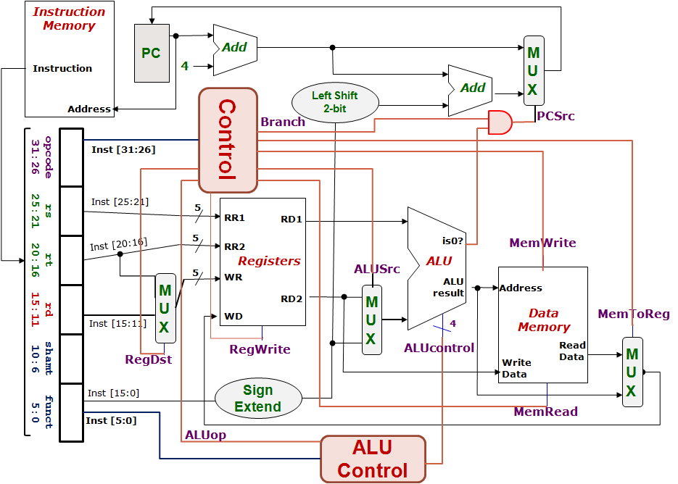
Control Design: Outputs
From lecture slide:
 | RegDst | ALUSrc | MemToReg | Reg Write | Mem Read | Mem Write | Branch | ALUop
 |  |  |  |  |  |  |  | op1 | op0
R-type
lw
sw
beq
1
0
0
1
0
0
0
1
0
0
1
1
1
1
0
0
0
0
X
1
X
0
0
1
0
0
0
X
0
X
0
0
0
1
0
1
0
1
0
1
0
1
1
0

Slide 5
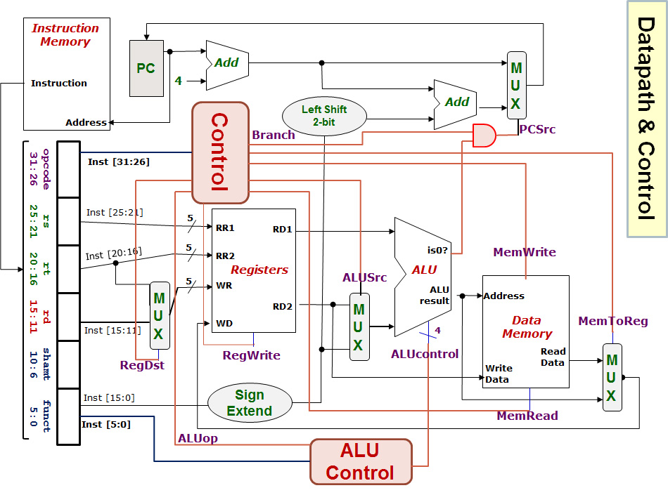
lw $24, 0($15)
R[rt] = M[R[rs]+SignExtImm]
100011 01111 11000 0000000000000000
Registers File |  |  |  | ALU |  | Data Memory
RR1 | RR2 | WR | WD | Opr1 | Opr2 | Address | Write Data
Q1(i)
Red means the data is actually used.
Blue means the data is not used.
$15
$24
$24
MEM([$15]+0)
[$15]
0
[$15]+0
[$24]
Next PC value = PC + 4
0
1
RegDest
RegWrite
ALUSrc
MemRead
MemWrite
MemToReg
Branch
ALUop
ALUcontrol
0
Easy, just copy from tables in previous slides.
1
0
1
100011
1
01111
0
Opr1
1
11000
0
0
1
0
00000 00000 000000
0
1
00
Opr2
1
0010
1
0
1

Slide 6
beq $1, $3, 12
If (R[rs]==R[rt]) PC=PC+4+BrAddr
000100 00001 00011 0000000000001100
Registers File |  |  |  | ALU |  | Data Memory
RR1 | RR2 | WR | WD | Opr1 | Opr2 | Address | Write Data
Q1(ii)
$1
$3
$3 or $0
[$1]-[$3] or MEM([$1]-[$3])
[$1]
[$3]
[$1] – [$3]
[$3]
0
1
Next PC value = PC + 4
or (PC+4) + (12×4)
RegDest
RegWrite
ALUSrc
MemRead
MemWrite
MemToReg
Branch
ALUop
ALUcontrol
X
0
1
0
000100
0
00001
0
Opr1
X
00011
0
0
1
1
00000 00000 001100
0
1
01
Opr2
X
0
0110
1
0
X
0

Slide 7
sub $25, $20, $5
R[rd] = R[rs] – R[rt]
000000 10100 00101 11001 00000 100010
Registers File |  |  |  | ALU |  | Data Memory
RR1 | RR2 | WR | WD | Opr1 | Opr2 | Address | Write Data
Q1(iii)
$20
$5
$25
[$20] – [$5]
[$20]
[$5]
[$20] – [$5]
[$5]
0
1
Next PC value = PC + 4
RegDest
RegWrite
ALUSrc
MemRead
MemWrite
MemToReg
Branch
ALUop
ALUcontrol
1
1
0
0
000000
0
10100
0
Opr1
0
00101
0
0
1
0
11001
0
1
10
Opr2
1
0110
00000
1
0
100010
0

Slide 8
Critical Path Analysis
a
b
c
Duration = a + b + c
4
5
Sequence/Series
2
8
a
5
3
6
b
5
c
Critical path duration = 5 + 4 + 8 + 6 = 23
Duration = max(a,b,c)
Parallel

Slide 9
SUB instruction
Inst-Mem (400)
Reg.File (200)
MUX (ALUSrc)
(30)
ALU
(120)
MUX (MToR)
(30)
Reg.File
(200)
Control (100)
Q2(a)
Not critical path
Inst-Mem
400ps
-------------
Adder
100ps
-------------
MUX
30ps
-------------
ALU
120ps
-------------
Reg-File
200ps
-------------
Data-Mem
350ps
-------------
Control/ALUControl
100ps
-------------
Lshft/signext/AND
20ps
400+200+30+120+30+200 = 980ps
0
1
0
1
0
1
0
1
1
0

Slide 10
LW instruction
Inst-Mem (400)
Reg.File (200)
ALU
(120)
DataMem
(350)
MUX (MToR)
(30)
Reg.File
(200)
Control (100)
Q2(b)
Not critical path
Inst-Mem
400ps
-------------
Adder
100ps
-------------
MUX
30ps
-------------
ALU
120ps
-------------
Reg-File
200ps
-------------
Data-Mem
350ps
-------------
Control/ALUControl
100ps
-------------
Lshft/signext/AND
20ps
400+200+120+350+30+200 = 1300ps
0
1
0
1
0
1
1
0
Why is MUX (ALUSrc) not included this time?

Slide 11
BEQ instruction
Inst-Mem (400)
Reg.File (200)
MUX (ALUSrc)
(30)
ALU
(120)
AND
(20)
MUX (PCSrc)
(30)
Control (100)
Q2(c)
Not critical path
Inst-Mem
400ps
-------------
Adder
100ps
-------------
MUX
30ps
-------------
ALU
120ps
-------------
Reg-File
200ps
-------------
Data-Mem
350ps
-------------
Control/ALUControl
100ps
-------------
Lshft/signext/AND
20ps
400+200+30+120+20+30 = 800ps
0
1
How about the green path: PC → Adder → MUX (PCSrc)?
How about the purple path: Inst.Mem → SignExt → LeftShift → Adder → MUX(PCSrc)?
0
1
0
1
1
0

Slide 12
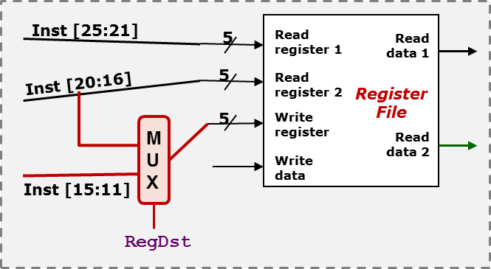

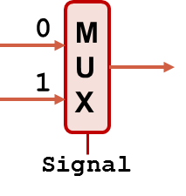
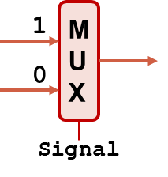
Q3(a)
add instruction
(i) One example where the incorrect processor still gives the right execution result.
Many possible answers.
Make RT = RD.
RegDst = 1
Example: add $t0, $t1, $t0
(ii) One example where the incorrect processor gives the wrong execution result.
Example: add $t0, $t1, $t2
$t2 instead of $t0 is picked as write register.
Correct
Wrong!
R[rd] = R[rs] + R[rt]
opcode
rs
rt
rd
shamt
funct

Slide 13
Q3(b)
lw instruction
(i) One example where the incorrect processor still gives the right execution result.
Make the left-most 5 bits of immediate value the same as the register number of RT.
RegDst = 0
Example: lw $a0, 8192($t0)
8192 = 0x2000
0 | 0 | 1 | 0 | 0 | 0 | 0 | 0 | 0 | 0 | 0 | 0 | 0 | 0 | 0 | 0
$a0 = $4
(ii) One example where the incorrect processor gives the wrong execution result.
Correct
Wrong!
R[rt] = M[R[rs] + SignExtImm]
Anything other than (i).
opcode
rs
rt
immed

Slide 14
Q3(b)
beq instruction
(i) One example where the incorrect processor still gives the right execution result.
Anything will work, since error has no impact on branch instructions.
RegDst = X
(ii) One example where the incorrect processor gives the wrong execution result.
None.
Correct
Wrong!

Slide 15
Tutors: A spare diagram for your use.
0
1
Opr1
0
1
0
1
Opr2
1
0

Slide 16
END OF FILE

