Slide 1
Cs1231S tutorial #3
Sets

Slide 2
Learning objectives of this tutorial
Sets
Roster, set-builder, replacement notation
Membership, subset, set equality
Power sets, Cartesian products
Set operations
Partition of a set
Proving using set identities and element method

Slide 3
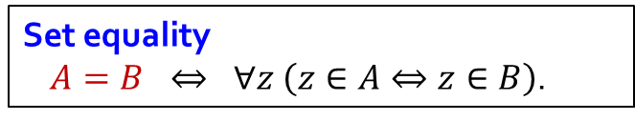
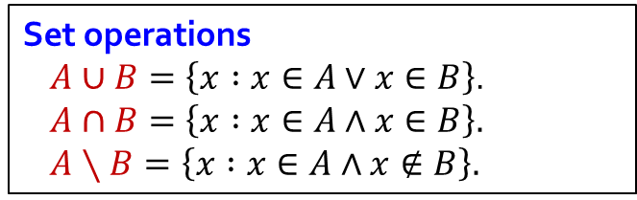
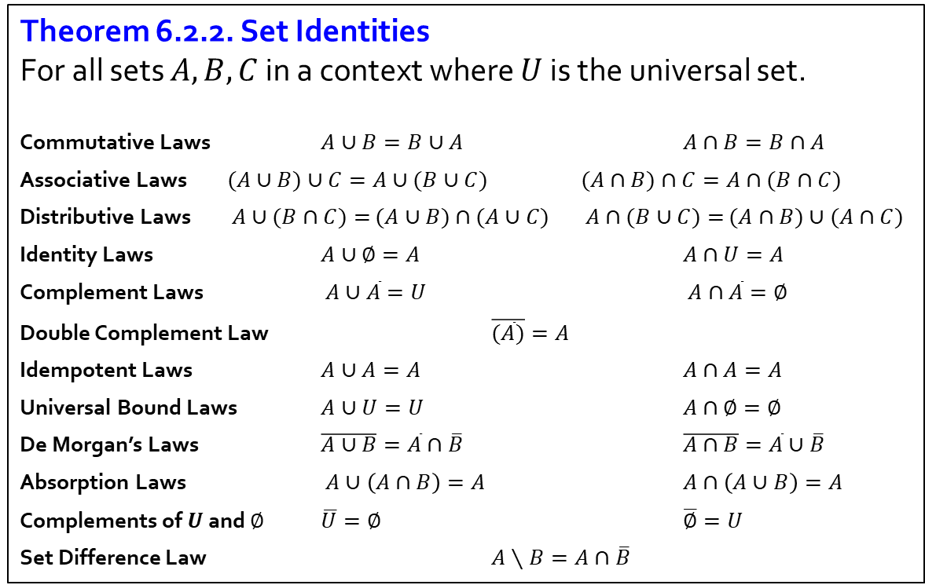
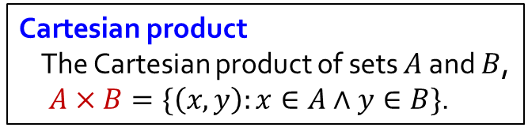
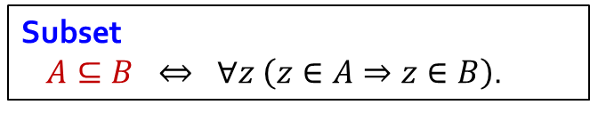
Sets
Set equality
$A=B ⇔ ∀z \left(z∈A⇔z∈B\right)$.
Theorem 6.2.2. Set Identities
For all sets $A,B,C$ in a context where $U$ is the universal set.
Commutative Laws $A∪B=B∪A$ $A∩B=B∩A$
Associative Laws $(A∪B)∪C=A∪(B∪C)$ $(A∩B)∩C=A∩(B∩C)$
Distributive Laws $A∪(B∩C)=$ $(A∪B)$ $∩$ $(A∪C)$ $A∩(B∪C)=$ $(A∩B)∪(A∩C)$
Identity Laws $A∪∅=A$ $A∩U=A$
Complement Laws $A∪\overline{A}=U$ $A∩\overline{A}=∅$
Double Complement Law $\overline{(\overline{A})}=A$
Idempotent Laws $A∪A=A$ $A∩A=A$
Universal Bound Laws $A∪U=U$ $A∩∅=∅$
De Morgan’s Laws $\overline{A∪B}=\overline{A}∩\overline{B}$ $\overline{A∩B}=\overline{A}∪\overline{B}$
Absorption Laws $A∪\left(A∩B\right)=A$ $A∩\left(A∪B\right)=A$
Complements of $U$ and $∅$ $\overline{U}=∅$ $\overline{∅}=U$
Set Difference Law $A∖B=A∩\overline{B}$
Subset
$A⊆B ⇔ ∀z \left(z∈A⇒z∈B\right)$.
Cartesian product
The Cartesian product of sets $A$ and $B$,
$A×B=\{\left(x,y\right):x∈A∧y∈B\}$.
Set operations
$A∪B=\left\{x :x∈A∨x∈B\right\}$.
$A∩B=\left\{x :x∈A∧x∈B\right\}.$
$A∖B=\left\{x :x∈A∧x∉B\right\}.$

Slide 4








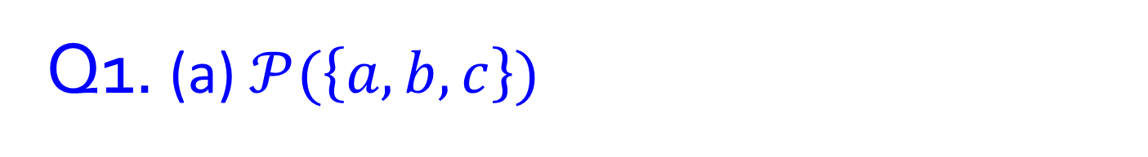












Q1. (a) $𝒫(\left\{a,b,c\right\})$
a
b
c
$$∅$$
$$\{a\}$$
$$\{b\}$$
$$\{c\}$$
a
b
c
a
b
a
b
a
b
$$𝒫\left(\left\{a,b,c\right\}\right)=$$
c
c
c
$$\{$$
$$∅$$
$$\{a\}$$
$$\{b\}$$
$$\{c\}$$
,
,
,
,
$$\{a,b\}$$
$$\{a,c\}$$
$$\{b,c\}$$
$$\{a,b,c\}$$
$$\{a,b\}$$
$$\{a,c\}$$
$$\{b,c\}$$
,
,
,
$$\{a,b,c\}$$
$$\}$$

Slide 5
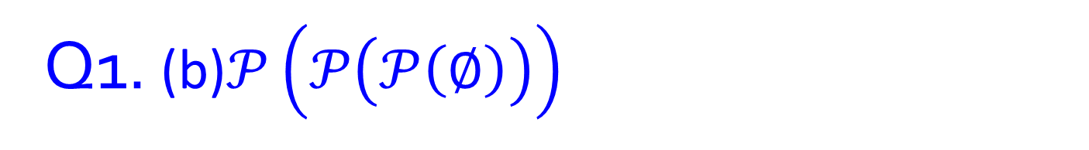
Q1. (b)$𝒫\left(𝒫\left(𝒫\left(∅\right)\right)\right)$

Slide 6
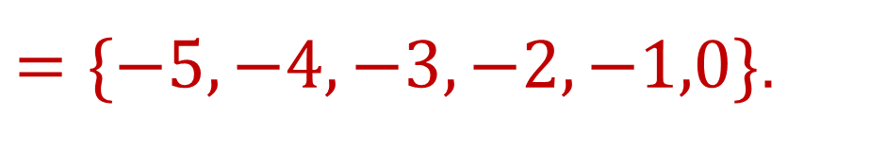
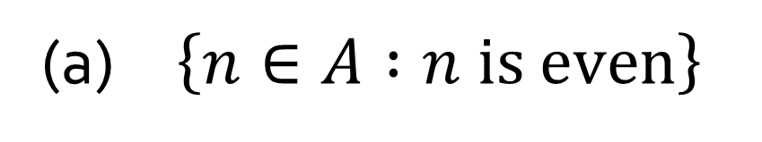
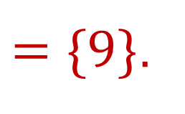
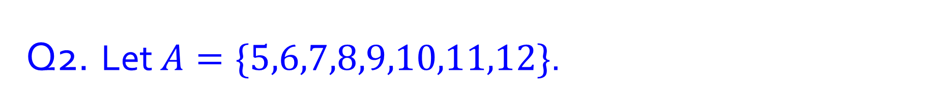
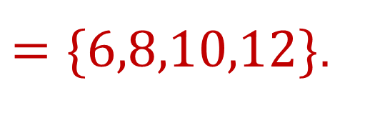
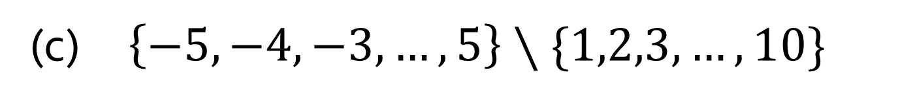

Q2. Let $A=\{5,6,7,8,9,10,11,12\}$.
(a) $\left\{n∈A :n is even\right\}$
$=\{6,8,10,12\}$.
(b) $\left\{n∈A :n=m^{2} for some m∈ℤ\right\}$
$=\{9\}$.
(c) $\left\{−5, −4, −3,…,5\right\}∖\{1,2,3,…,10\}$
$=\{−5,−4,−3,−2,−1,0\}$.

Slide 7
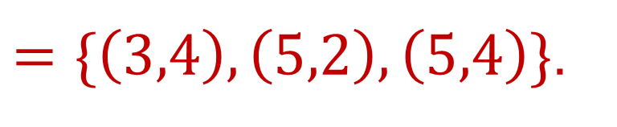
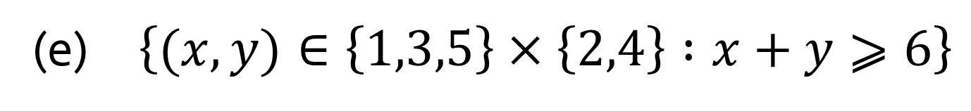
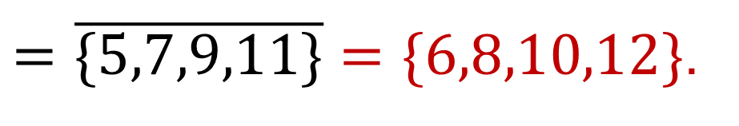
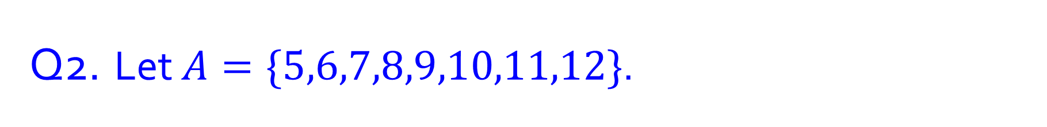
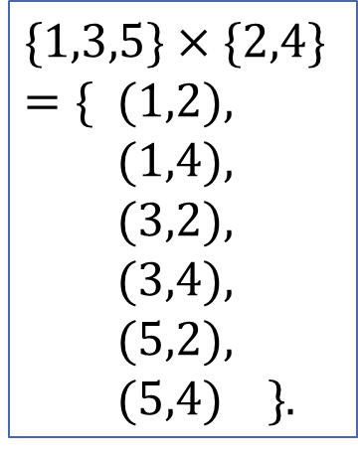
Q2. Let $A=\{5,6,7,8,9,10,11,12\}$.
(d) $\overline{\left\{5,7,9\right\}∪\{9,11\}}$ where $A$ is the universal set
$=\overline{\{5,7,9,11\}}=\{6,8,10,12\}$.
What is this called?
$$\{1,3,5\}×\{2,4\}$$
$=\{$ $(1,2),$
$(1,4),$
$(3,2),$
$(3,4),$
$(5,2),$
$(5,4) \}$.
(e) $\left\{(x, y)∈\left\{1,3,5\right\}×\left\{2,4\right\} :x+y⩾6\right\}$
$=\{\left(3,4\right),\left(5,2\right),\left(5,4\right)\}$.
Ordered pairs

Slide 8
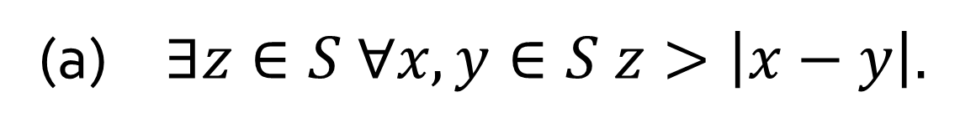
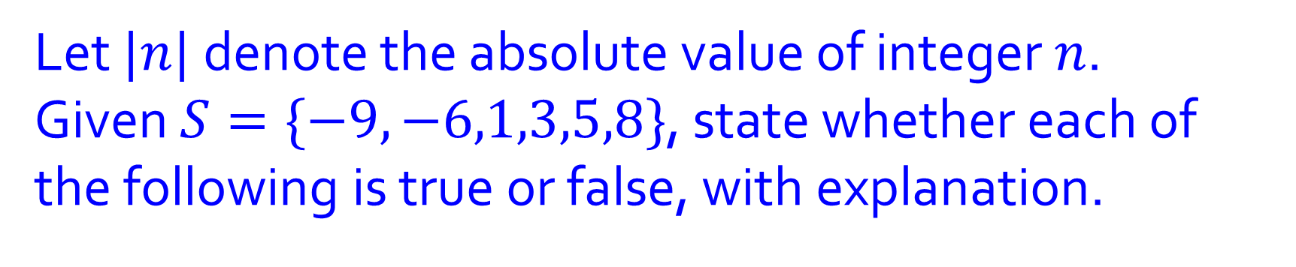

Q3.
Let $|n|$ denote the absolute value of integer $n$.
Given $S=\{−9,−6,1,3,5,8\}$, state whether each of the following is true or false, with explanation.
(a) $∃z∈S ∀x,y∈S z>\left|x−y\right|.$
False
(b) $∃z∈S ∀x,y∈S z<\left|x−y\right|.$
True

Slide 9
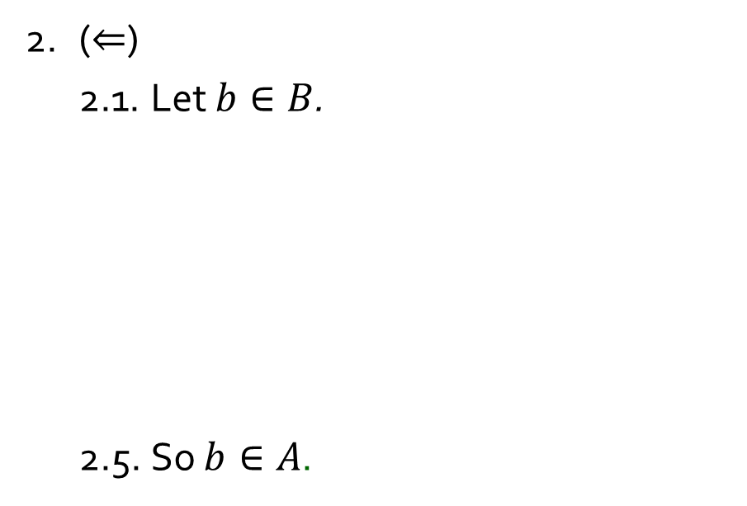
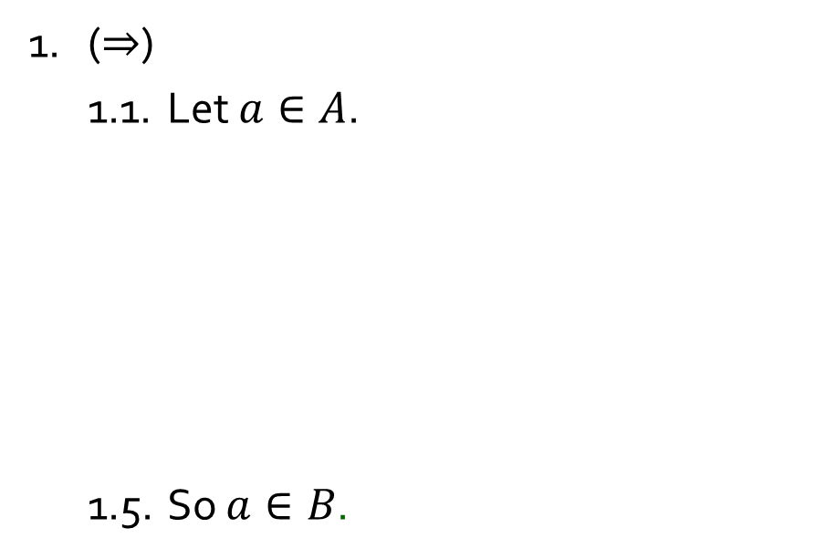
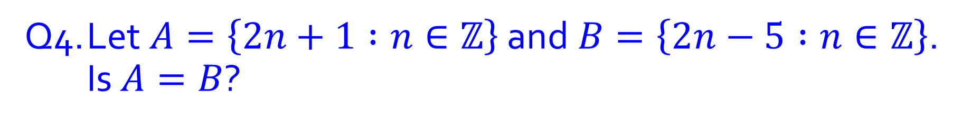
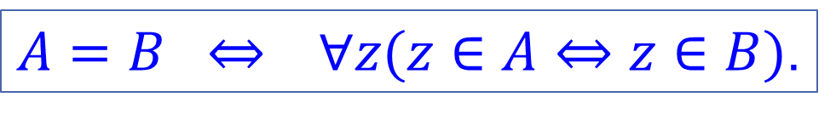
Q4. Let$A=\left\{2n+1 :n∈ℤ\right\}$ and$B=\left\{2n−5 :n∈ℤ\right\}$. Is $A=B$?
Yes or no?
$A=B ⇔ ∀z(z∈A⇔z∈B)$.
1. ($⇒$)
1.1. Let $a∈A$.
1.5. So $a∈B$.
2. ($⇐$)
2.1. Let $b∈B$.
2.5. So $b∈A$.
3. Hence $A=B$ by the definition of set equality.

Slide 10
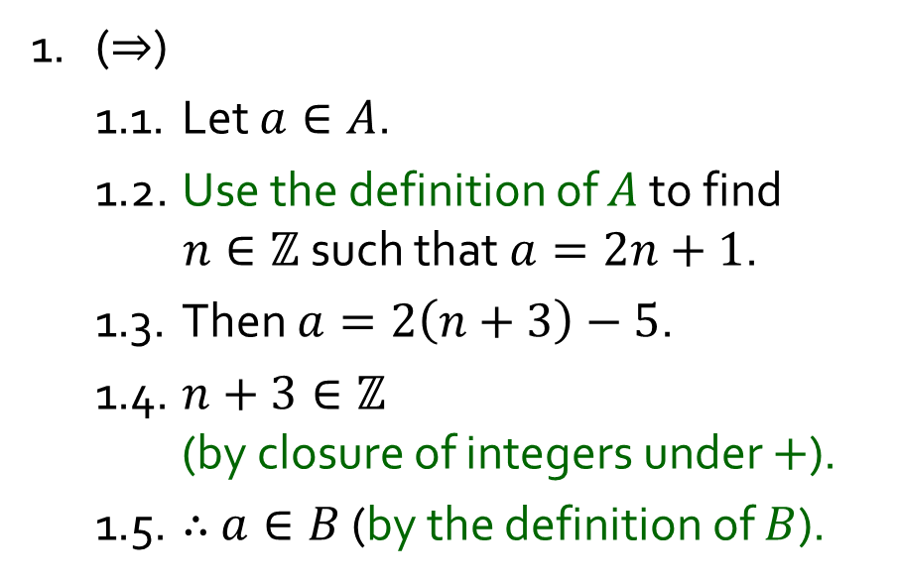
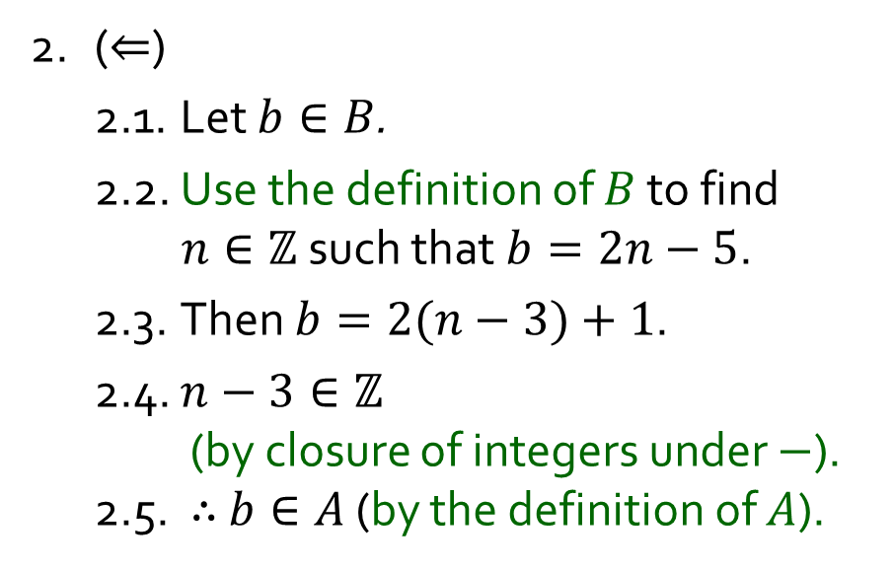
Q4. Let$A=\left\{2n+1 :n∈ℤ\right\}$ and$B=\left\{2n−5 :n∈ℤ\right\}$. Is $A=B$?
Yes or no?
$A=B ⇔ ∀z(z∈A⇔z∈B)$.
1. ($⇒$)
1.1. Let $a∈A$.
1.2. Use the definition of $A$ to find $n∈ℤ$ such that $a=2n+1$.
1.3. Then $a=2\left(n+3\right)−5$.
1.4. $n+3∈ℤ$ (by closure of integers under $+$).
1.5. $∴$ $a∈B$ (by the definition of $B$).
2. ($⇐$)
2.1. Let $b∈B$.
2.2. Use the definition of $B$ to find $n∈ℤ$ such that $b=2n−5$.
2.3. Then $b=2(n−3)+1$.
2.4. $n−3∈ℤ$ (by closure of integers under $−$). 2.5. $∴$ $b∈A$ (by the definition of $A$).
3. $∴$ $A=B$ (by the definition of set equality).

Slide 11
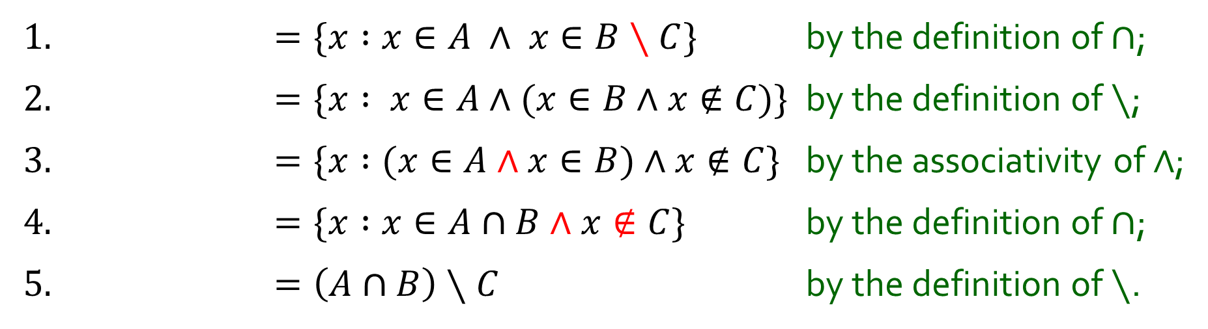
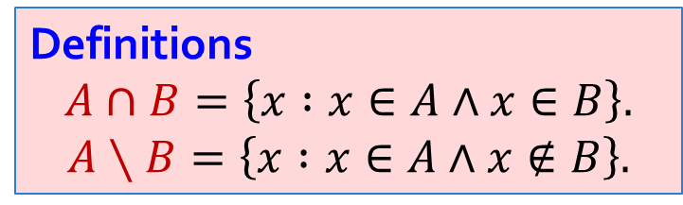
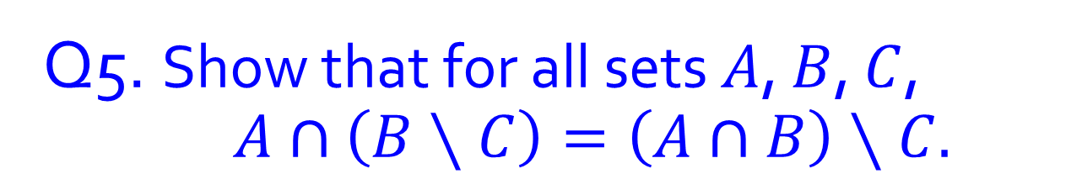

Q5. Show that for all sets $A$, $B$, $C$, $A∩\left(B∖C\right)=\left(A∩B\right)∖C.$
Definitions
$$A∩B=\left\{x :x∈A∧x∈B\right\}.$$
$$A∖B=\left\{x :x∈A∧x∉B\right\}.$$
1. $=\{x :x∈A ∧ x∈B∖C\}$ by the definition of $∩$;
2. $=\{x : x∈A∧(x∈B∧x∉C$)} by the definition of $∖$;
3. $=\{x :(x∈A∧x∈B)∧x∉C$} by the associativity of $∧$;
4. $=\{x :x∈A∩B∧x∉C$} by the definition of $∩$;
5. $=\left(A∩B\right)∖C$ by the definition of $∖$.
$$A∩\left(B∖C\right)=$$

Slide 12
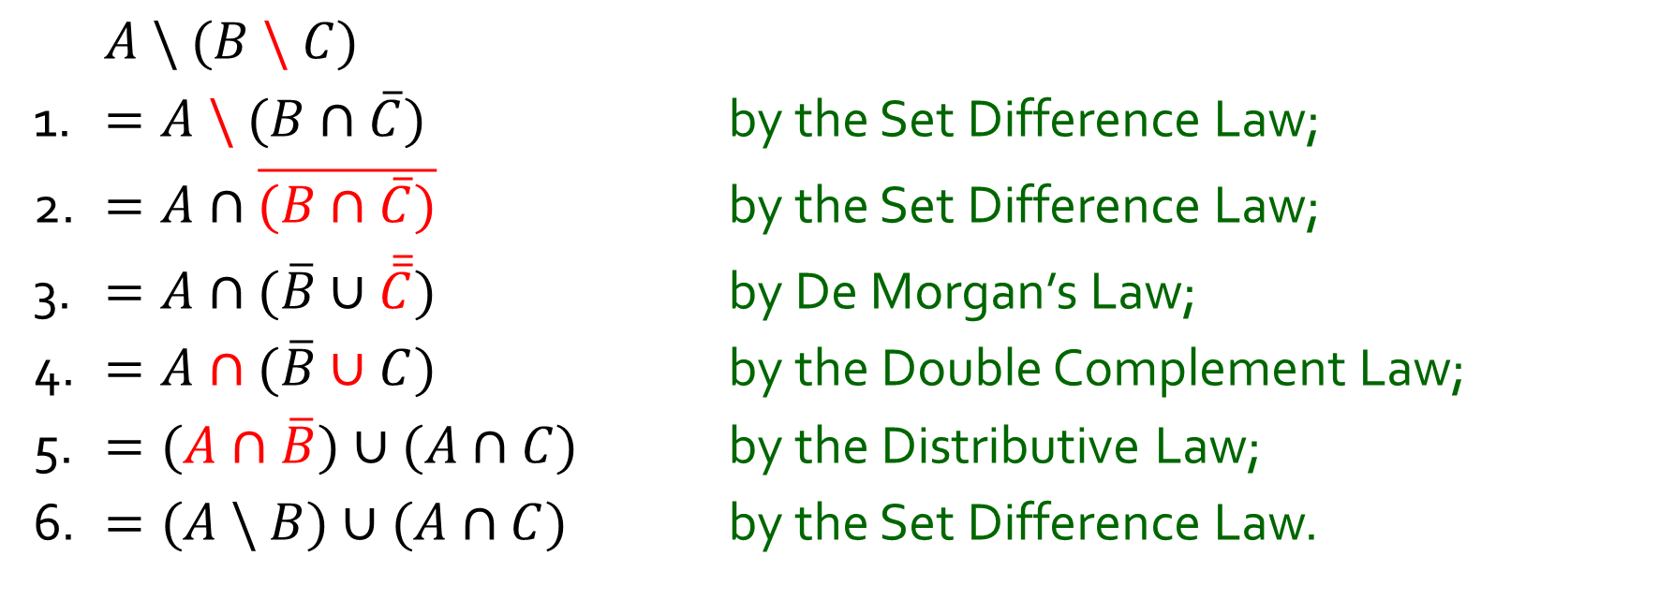

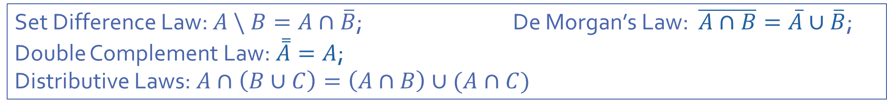
Q6. Prove that for all sets $A,B$ and $C$, $A \backslash (B \backslash C)=(A \backslash B)∪(A∩C)$.
$A \backslash (B \backslash C)$
1. $=A \backslash (B∩\overline{C})$ by the Set Difference Law;
2. $=A∩\overline{(B∩\overline{C})}$ by the Set Difference Law;
3. $=A∩(\overline{B}∪\overline{\overline{C}})$ by De Morgan’s Law;
4. $=A∩(\overline{B}∪C)$ by the Double Complement Law;
5. $=(A∩\overline{B})∪(A∩C)$ by the Distributive Law;
6. $=(A \backslash B)∪(A∩C)$ by the Set Difference Law.
Set Difference Law: $A \backslash B=A∩\overline{B}$; De Morgan’s Law: $\overline{A∩B}=\overline{A}∪\overline{B}$;
Double Complement Law: $\overset{̿}{A}=A$;
Distributive Laws: $A∩\left(B∪C\right)=\left(A∩B\right)∪(A∩C)$

Slide 13
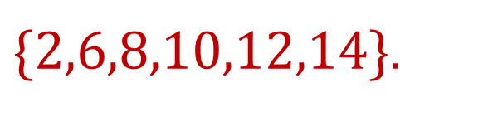
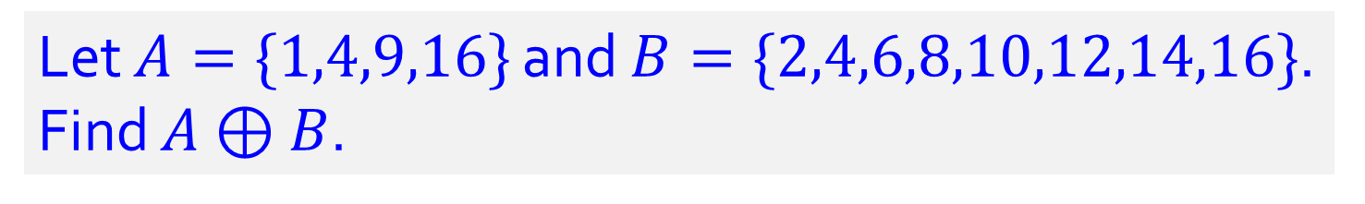
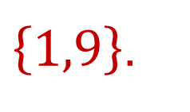
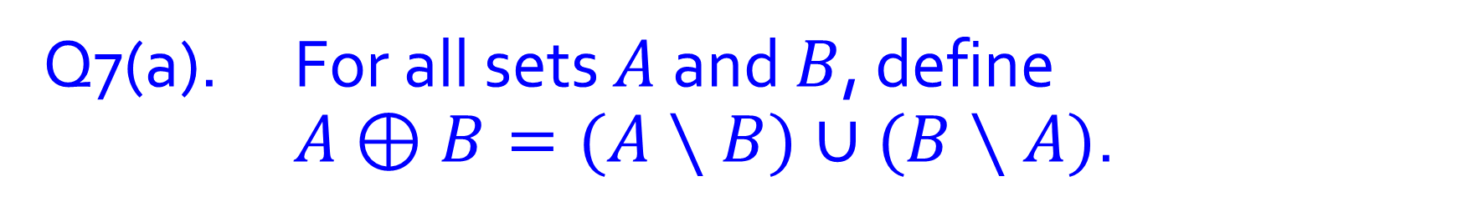
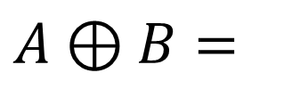
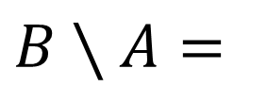
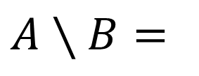
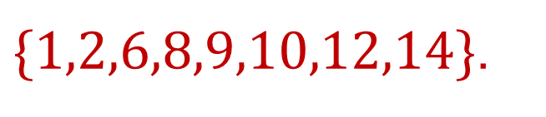
Q7(a). For all sets $A$ and $B$, define $A⊕B=(A∖B)∪(B∖A)$.
Let $A=\{1,4,9,16\}$ and $B=\{2,4,6,8,10,12,14,16\}$. Find $A⊕B$.
$$A∖B=$$
$\left\{1,9\right\}$.
$$B∖A=$$
$\{2,6,8,10,12,14\}$.
$$A⊕B=$$
$\{1,2,6,8,9,10,12,14\}$.

Slide 14
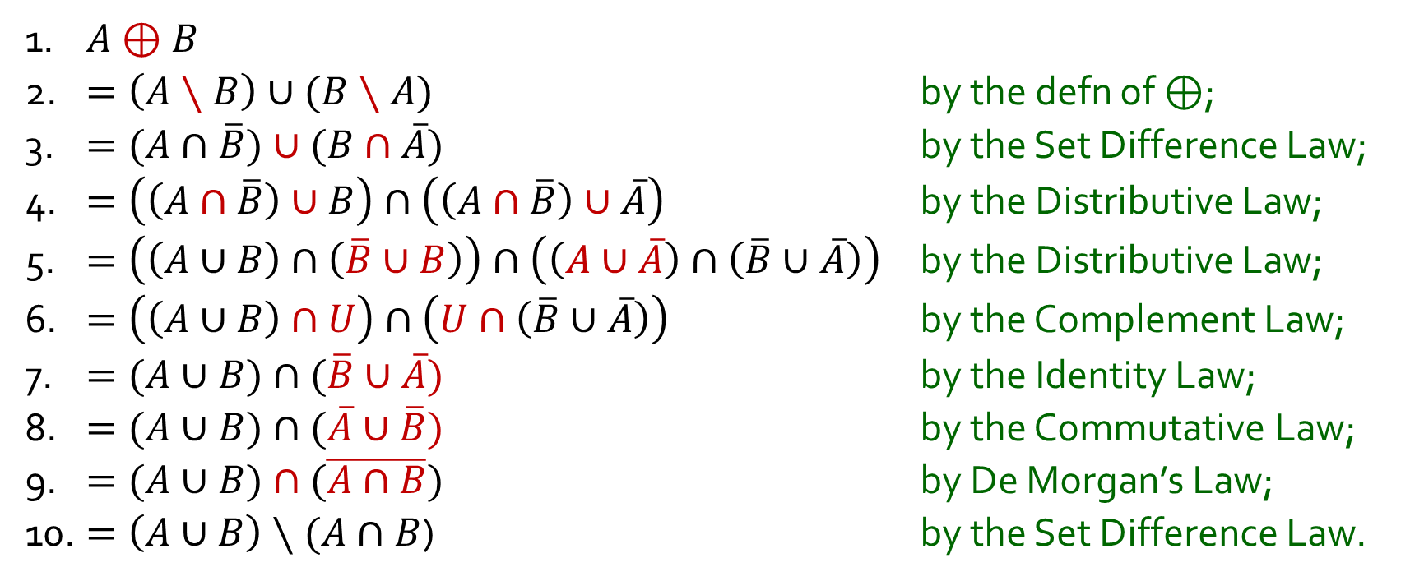
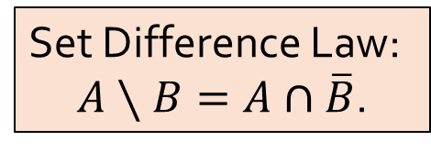
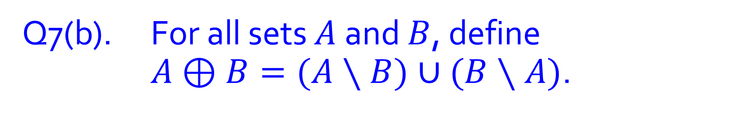
Q7(b). For all sets $A$ and $B$, define $A⊕B=(A∖B)∪(B∖A)$.
Set Difference Law:
$A∖B=A∩\overline{B}$.
Show that $A⊕B=\left(A∪B\right)∖(A∩B)$ for all sets $A$, $B$.
1. $A⊕B$
2. $=\left(A∖B\right)∪(B∖A)$ by the defn of $⊕$;
3. $=(A∩\overline{B})∪(B∩\overline{A})$ by the Set Difference Law;
4. $=\left(\left(A∩\overline{B}\right)∪B\right)∩\left(\left(A∩\overline{B}\right)∪\overline{A}\right)$ by the Distributive Law;
5. $=\left(\left(A∪B\right)∩\left(\overline{B}∪B\right)\right)∩\left(\left(A∪\overline{A}\right)∩\left(\overline{B}∪\overline{A}\right)\right)$ by the Distributive Law;
6. $=\left(\left(A∪B\right)∩U\right)∩\left(U∩\left(\overline{B}∪\overline{A}\right)\right)$ by the Complement Law;
7. $=(A∪B)∩(\overline{B}∪\overline{A})$ by the Identity Law;
8. $=(A∪B)∩(\overline{A}∪\overline{B})$ by the Commutative Law;
9. $=(A∪B)∩(\overline{A∩B})$ by De Morgan’s Law;
10. $=\left(A∪B\right)∖(A∩B$) by the Set Difference Law.

Slide 15
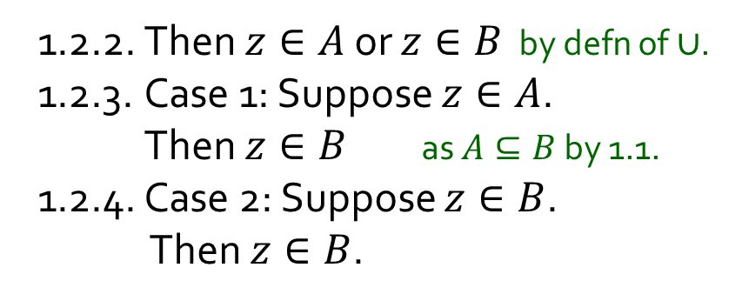
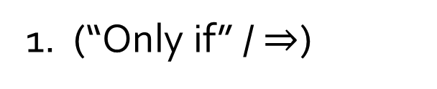
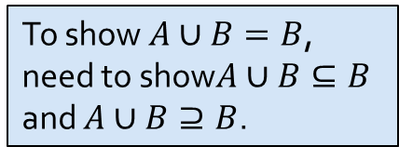

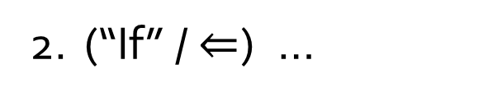
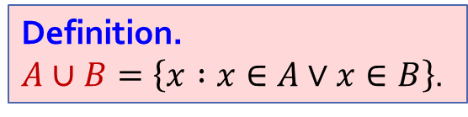
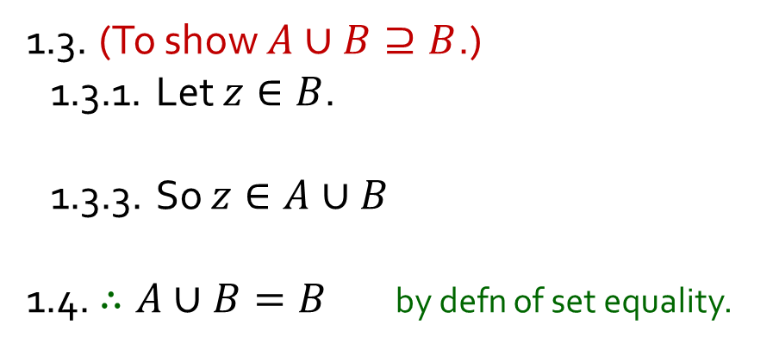
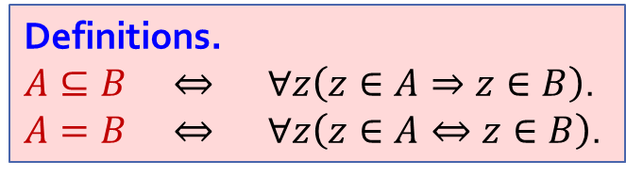


Q8. Let $A$, $B$ be sets. Show that $A⊆B$ if and only if $A∪B=B$.
Definition.
$A∪B=\left\{x :x∈A∨x∈B\right\}$.
1. (“Only if” / $⇒$)
To show $A∪B=B$, need to show$A∪B⊆B$ and $A∪B⊇B$.
1.1. Suppose $A⊆B$.
1.2. (To show $A∪B⊆B$.)
1.2.1. Let $z∈A∪B$.
1.2.5. In all cases, $z∈B$.
1.3. (To show $A∪B⊇B$.)
1.3.1. Let $z∈B$.
1.3.3. So $z∈A∪B$
1.4. $∴A∪B=B$ by defn of set equality.
1.3.2. Then $z∈A∨z∈B$ by generalization.
by defn of$∪$.
1.2.2. Then $z∈A$ or $z∈B$ by defn of $∪$.
1.2.3. Case 1: Suppose $z∈A$.
Then $z∈B$ as $A⊆B$ by 1.1.
1.2.4. Case 2: Suppose $z∈B$.
Then $z∈B$.
Definitions.
$A⊆B ⇔ ∀z\left(z∈A⇒z∈B\right)$.
$A=B ⇔ ∀z\left(z∈A⇔z∈B\right)$.
2. (“If” / $⇐$) …

Slide 16


Q8. Let $A$, $B$ be sets. Show that $A⊆B$ if and only if $A∪B=B$.
Definition.
$A∪B=\left\{x :x∈A∨x∈B\right\}$.
1. (“Only if” / $⇒$) …
2. (“If” / $⇐$)
2.1. Suppose $A∪B=B$.
2.2. Let $z∈A$.
2.2.3. So $z∈B$
2.2.1. Then $z∈A$ $∨$ $z∈B$ by definition of$∨$.
2.2.2. So $z∈A∪B$ by definition of $∪$.
as $A∪B=B$ by 2.1.
3. $∴$ $A⊆B$ if and only if $A∪B=B$ by lines 1 & 2.
Definitions.
$A⊆B ⇔ ∀z\left(z∈A⇒z∈B\right)$.
$A=B ⇔ ∀z\left(z∈A⇔z∈B\right)$.

Slide 17


Q9. HSWW is the set of students in the Hogwarts School of Witchcraft and Wizardry, and G,H,R,S are the sets of students in the 4 houses. What are the necessary conditions for $\{G,H,R,S\}$ to be a partition of $HSWW$?
Every student is in exactly one of the four houses.
Each house has at least one student.
$$G∩H=G∩R=G∩S=H∩R=H∩S=R∩S=∅$$
$$G∪H∪R∪S=HSWW$$
$$G≠∅ ∧R≠∅∧H≠∅∧S≠∅$$

Slide 18



Q10-12. For sets $A_{m},A_{m+1},…,A_{n}$, define
$$\bigcup_{i=m}^{n}{A_{i}}=A_{m}∪A_{m+1}∪…{∪A}_{n}$$
and
$$\bigcap_{i=m}^{n}{A_{i}}=A_{m}∩A_{m+1}∩…∩A_{n}$$

Slide 19





Q10. Let $A_{i}=\left\{x∈ℤ :x⩾i\right\}$ for all integers $i$. Write down $\bigcup_{i=2}^{5}{A_{i}}$ and $\bigcap_{i=2}^{5}{A_{i}}$ in roster notation.
$$\bigcup_{i=2}^{5}{A_{i}}=$$
$$\bigcap_{i=2}^{5}{A_{i}}=$$
$$\left\{2,3,4,…\right\}.$$
$$\left\{5,6,7,…\right\}.$$

Slide 20






Q11. Let $V_{i}=\left\{x∈ℝ :−\frac{1}{i}≤x≤\frac{1}{i}\right\}=\left[−\frac{1}{i},\frac{1}{i}\right]$ for all positive integers $i$.
$$\bigcup_{i=1}^{4}{V_{i}}=$$
$$\bigcap_{i=1}^{4}{V_{i}}=$$
(a)
(b)
$$\bigcup_{i=1}^{n}{V_{i}}=$$
$$\bigcap_{i=1}^{n}{V_{i}}=$$
(c)
(d)
(e)
Are $V_{1},V_{2},$ $V_{3},$… mutually disjoint?

Slide 21


Q12. Let $B_{1},B_{2},…,B_{k},C_{1},C_{2},…,C_{ℓ}$ be sets such that $\bigcup_{i=1}^{k}{B_{i}}⊆$ $\bigcap_{j=1}^{ℓ}{C_{j}}$.
For sets $A_{m, }A_{m+1},…,A_{n}$, define $\bigcup_{i=m}^{n}{A_{i}}=A_{m}∪A_{m+1}∪…{∪A}_{n}$ and $\bigcap_{i=m}^{n}{A_{i}}=A_{m}∩A_{m+1}∩…∩A_{n}$.
Show that $B_{i}⊆C_{j}$ for all $i∈\left\{1,2,…,k\right\} and all j∈\{1,2,…,ℓ\}$.
$$B_{2}$$
$$B_{1}$$
$$C_{1}$$
$$C_{2}$$
$$C_{3}$$
…
$$C_{l}$$
…
$$B_{3}$$
$$B_{k}$$

Slide 22











Q12. Let $B_{1},B_{2},…,B_{k},C_{1},C_{2},…,C_{ℓ}$ be sets such that $\bigcup_{i=1}^{k}{B_{i}}⊆$ $\bigcap_{j=1}^{ℓ}{C_{j}}$.
Show that $B_{i}⊆C_{j}$ for any
$i∈\left\{1,2,…,k\right\} and any j∈\{1,2,…,ℓ\}$.
$$B_{2}$$
$$C_{1}$$
$$C_{2}$$
$$C_{3}$$
…
$$C_{l}$$
$$B_{1}$$
$$B_{3}$$
…
$$B_{k}$$
1. Let $r∈\left\{1,2,…,k\right\} \text{and} s∈\{1,2,…,ℓ\}$.
2. Take any $z∈B_{r}$.
2.5. In particular, $z∈C_{s}$
3. $∴$ $B_{i}⊆C_{j}$ for any $i∈\left\{1,2,…,k\right\} and any j∈\{1,2,…,ℓ\}$.
2.1. Then $z∈B_{1}$ or $z∈B_{2}$ or … or $z∈B_{k}$ as $r∈\left\{1,2,…,k\right\}$.
2.2. So $z∈B_{1}∪B_{2}∪…∪B_{k}=\bigcup_{i=1}^{k}{B_{i}}$ by defn of $∪$.
2.3. Hence $z∈\bigcap_{j=1}^{ℓ}{C_{j}=C_{1}∩C_{2}∩…∩C_{ℓ}}$ as we are given $\bigcup_{i=1}^{k}{B_{i}}⊆\bigcap_{j=1}^{ℓ}{C_{j}}$.
2.4. Thus $z∈C_{1}$ and $z∈C_{2}$ and $…and z∈C_{ℓ}$ by defn of $∩$.
as $s∈\left\{1,2,…,ℓ\right\}$.

Slide 23
THE END

