Slide 1
Cs1231s tutorial #4
Relations & Equivalence relations
with contents by Goh Siau Chiak and Aaron Tan

Slide 2
Learning objectives of this tutorial
Equivalence relations
Tell whether a relation is reflexive, symmetric, and transitive.
Work with equivalence relations and equivalence classes.
Understand partitions.

Slide 3

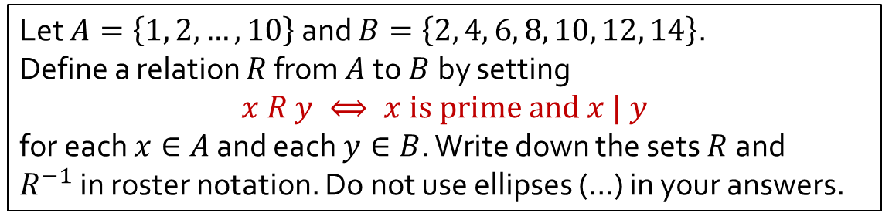



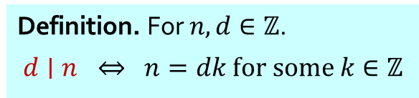


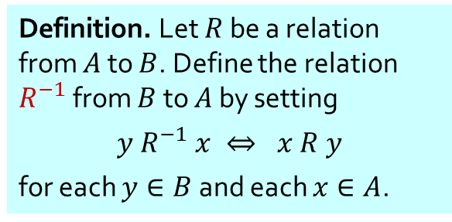


Q1
Let $A=\left\{1, 2, …, 10\right\}$ and $B=\left\{2, 4, 6, 8, 10, 12, 14\right\}$.
Define a relation $R$ from $A$to $B$by setting
$$x R y ⟺ x is prime and x | y$$
for each $x∈A$ and each $y∈B$. Write down the sets $R$and $R^{−1}$in roster notation. Do not use ellipses (…) in your answers.
Definition. A positive integer is prime if it has exactly two positive divisors.
Definition. For $n,d∈ℤ$.
$$d∣n ⇔ n=dk for some k∈ℤ$$
$$R^{−1}$$
Definition. Let $R$ be a relation from $A$ to $B$. Define the relation $R^{−1}$ from $B$ to $A$ by setting
$$y R^{−1} x ⇔ x R y$$
for each $y∈B$ and each $x∈A$.
$$A$$
$$R$$
$$B$$
$$A$$
$$B$$
(Arrow diagrams shown for illustration purpose only.)
1
2
3
4
5
6
7
8
9
10
2
4
6
8
10
12
14
1
2
3
4
5
6
7
8
9
10
•
•
•
•
•
•
•
•
•
•
2
4
6
8
10
12
14
•
•
•
•
•
•
•
•
•
•
$$R=$$
$$\{\text{(2,2), (2,4), (2,6), (2,8), (2,10), (2,12), }\text{(2,14),}\text{(3,6), (3,12), (5,10), (7,14)}\text{\}}\text{.}$$
$$R^{−1}=$$
$\{\text{(2,2), (4,2), (6,2), (8,2), (10,2), (12,2),}\text{(14,2),}\text{ (6,3), (12,3), (10,5), (14,7)}\text{\}}$.

Slide 4

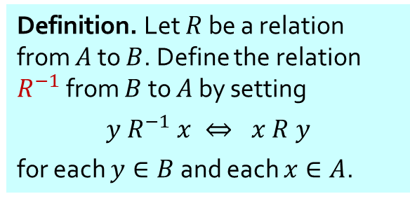

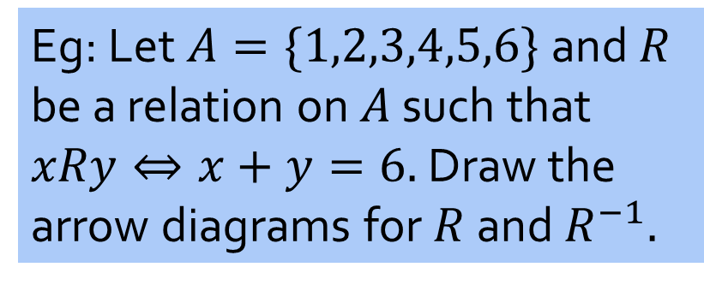
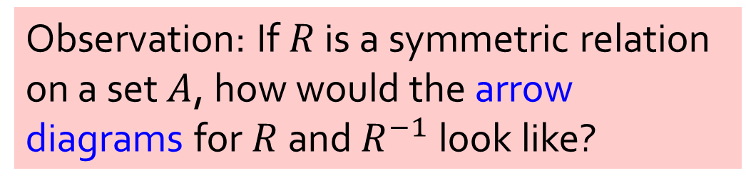
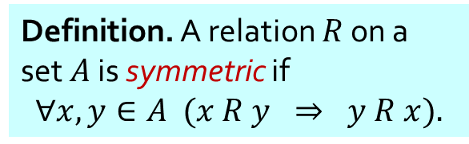
Observation: If $R$ is a symmetric relation on a set $A$, how would the arrow diagrams for $R$ and $R^{−1}$ look like?
Definition. A relation $R$ on a set $A$ is symmetric if
$$∀x,y∈A (x R y ⇒ y R x).$$
Definition. Let $R$ be a relation from $A$ to $B$. Define the relation $R^{−1}$ from $B$ to $A$ by setting
$$y R^{−1} x ⇔ x R y$$
for each $y∈B$ and each $x∈A$.
Eg: Let $A=\{1,2,3,4,5,6\}$and $R$ be a relation on $A$ such that $xRy⇔x+y=6.$Draw the arrow diagrams for $R$ and $R^{−1}.$
$$R$$
$$R^{−1}$$
• 6
• 6
• 1
• 1
• 5
• 5
• 2
• 2
• 4
• 4
• 3
• 3

Slide 5
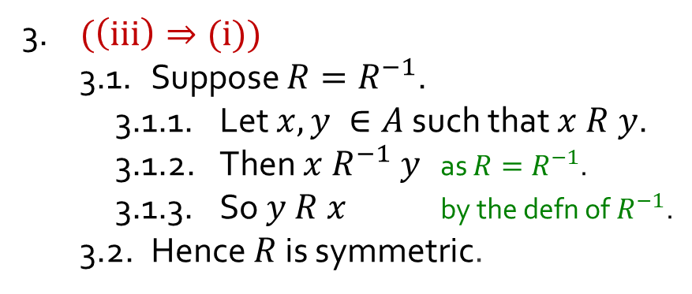
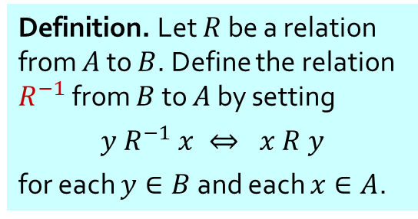
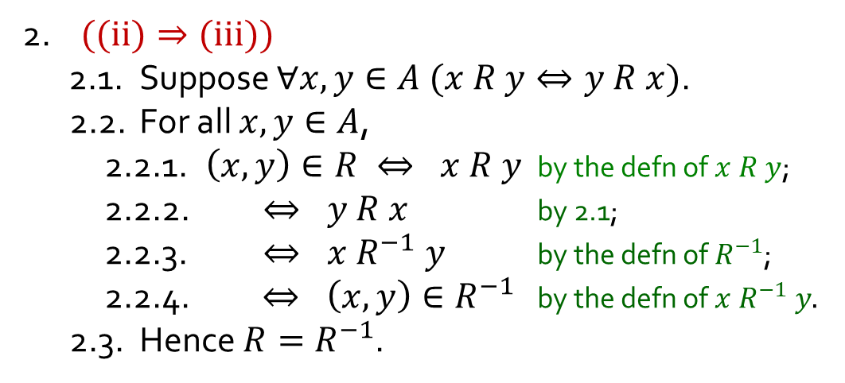

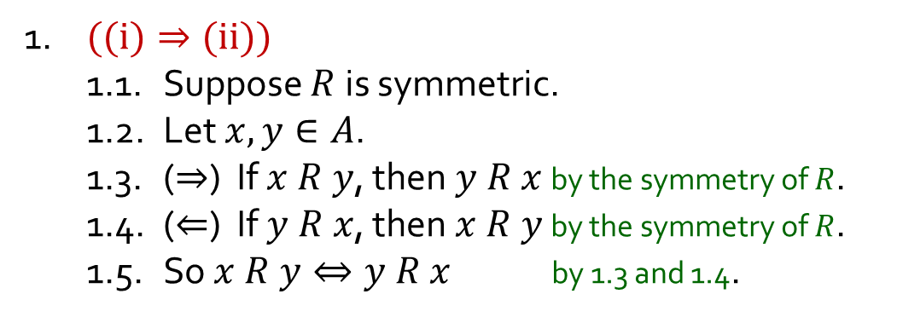
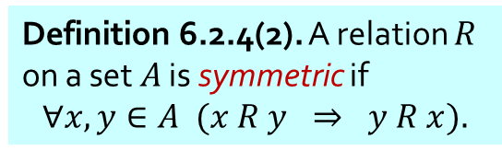

Q2
Let $R$be a relation on set $A$. Show that the following are logically equivalent.
(i) $R$ is symmetric; (ii) $∀x,y∈A (x R y⇔y R x)$; (iii) $R=R^{−1}.$
1. $((i)⇒(ii))$
1.1. Suppose $R$ is symmetric.
1.2. Let $x,y∈A$.
1.3. ($⇒$) If $x R y$, then $y R x$ by the symmetry of $R$.
1.4. ($⇐$) If $y R x$, then $x R y$ by the symmetry of $R$.
1.5. So $x R y⇔y R x$ by 1.3 and 1.4.
Definition 6.2.4(2). A relation $R$ on a set $A$ is symmetric if
$$∀x,y∈A (x R y ⇒ y R x).$$
To show (i) $⇒\text{(}\text{ii}\text{)}⇒\text{(}\text{iii}\text{)}⇒\text{(}\text{i}\text{)}$
Definition. Let $R$ be a relation from $A$ to $B$. Define the relation $R^{−1}$ from $B$ to $A$ by setting
$$y R^{−1} x ⇔ x R y$$
for each $y∈B$ and each $x∈A$.
2. $((ii)⇒(iii))$
2.1. Suppose $∀x,y∈A (x R y⇔y R x)$.
2.2. For all $x,y∈A$,
2.2.1. $\left(x,y\right)∈R ⇔ x R y$ by the defn of $x R y$;
2.2.2. $⇔ y R x$ by 2.1;
2.2.3. $⇔ x R^{−1} y$ by the defn of $R^{−1}$;
2.2.4. $⇔ \left(x,y\right)∈R^{−1}$ by the defn of $x R^{−1} y.$
2.3. Hence $R=R^{−1}$.
3. $(\left(iii\right)⇒(i))$
3.1. Suppose $R=R^{−1}$.
3.1.1. Let $x,y ∈A$ such that $x R y$.
3.1.2. Then $x{ R}^{−1} y$ as $R=R^{−1}$.
3.1.3. So $y R x$ by the defn of$R^{−1}$.
3.2. Hence $R$ is symmetric.
4. $∴$ (i), (ii) and (iii) are equivalent.

Slide 6

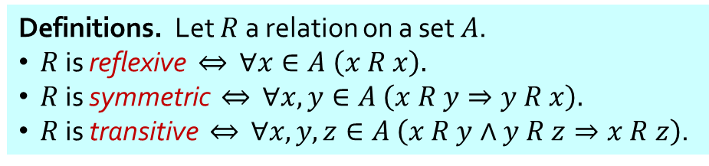
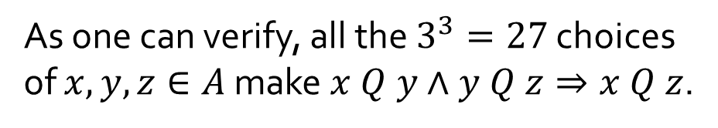
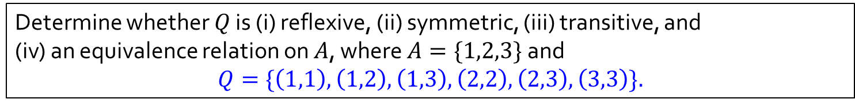
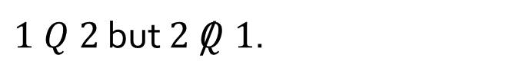

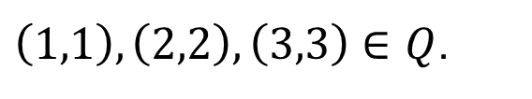

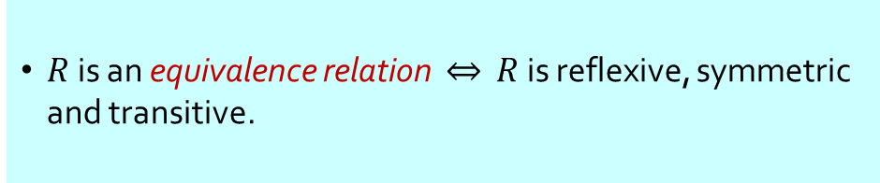

Q3(a)
Determine whether $Q$ is (i) reflexive, (ii) symmetric, (iii) transitive, and
(iv) an equivalence relation on $A$, where $A=\{1,2,3\}$ and $$Q=\{\left(1,1\right),\left(1,2\right),\left(1,3\right),\left(2,2\right),\left(2,3\right),\left(3,3\right)\}.$$
Definitions. Let $R$ a relation on a set $A$.
$R$ is reflexive $⇔$ $∀x∈A \left(x R x\right).$
$R$ is symmetric $⇔$ $∀x,y∈A \left(x R y⇒y R x\right).$
$R$ is transitive $⇔$ $∀x,y,z∈A \left(x R y∧y R z⇒x R z\right)$.
$R$ is an equivalence relation $⇔$ $R$ is reflexive, symmetric and transitive.
✓
Reflexive?
$\left(1,1\right),\left(2,2\right),\left(3,3\right)∈Q$.
$$1$$
✘
Symmetric?
$1 Q 2$ but $2 /Q 1$.
✓
Transitive?
As one can verify, all the $3^{3}=27$ choices of $x,y,z∈A$ make $x Q y∧y Q z⇒x Q z$.
$$2$$
$$3$$
✘
Equivalence relation?
$Q$ is not symmetric.

Slide 7
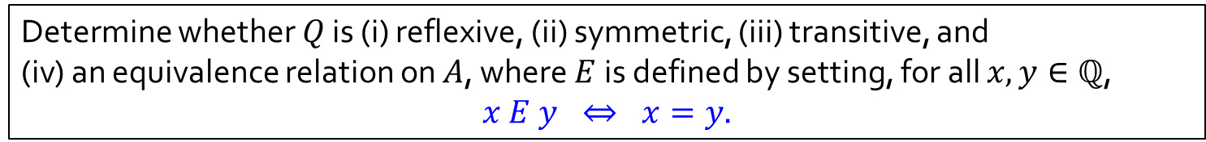

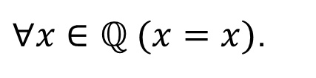

Q3(b)
Determine whether $Q$ is (i) reflexive, (ii) symmetric, (iii) transitive, and
(iv) an equivalence relation on $A$, where $E$ is defined by setting, for all $x,y∈ℚ$, $$x E y ⇔ x=y.$$
Definitions. Let $R$ a relation on a set $A$.
$R$ is reflexive $⇔$ $∀x∈A \left(x R x\right).$
$R$ is symmetric $⇔$ $∀x,y∈A \left(x R y⇒y R x\right).$
$R$ is transitive $⇔$ $∀x,y,z∈A \left(x R y∧y R z⇒x R z\right)$.
$R$ is an equivalence relation $⇔$ $R$ is reflexive, symmetric and transitive.
✓
Reflexive?
$∀x∈ℚ (x=x)$.
✓
Symmetric?
$$∀x, y∈ℚ (x=y ⇒y=x)$$
✓
Transitive?
$$∀x,y,z∈ℚ\left(x=y∧y=z⇒x= z\right)$$
✓
Equivalence relation?
Yes.

Slide 8

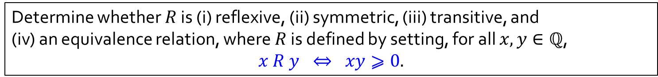
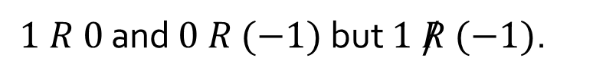
Q3(c)
Determine whether $R$ is (i) reflexive, (ii) symmetric, (iii) transitive, and
(iv) an equivalence relation, where $R$ is defined by setting, for all $x,y∈ℚ$, $$x R y ⇔ xy⩾0.$$
Definitions. Let $R$ a relation on a set $A$.
$R$ is reflexive $⇔$ $∀x∈A \left(x R x\right).$
$R$ is symmetric $⇔$ $∀x,y∈A \left(x R y⇒y R x\right).$
$R$ is transitive $⇔$ $∀x,y,z∈A \left(x R y∧y R z⇒x R z\right)$.
$R$ is an equivalence relation $⇔$ $R$ is reflexive, symmetric and transitive.
✓
Reflexive?
$$∀x∈ℚ \left(x∙x=x^{2}⩾0\right).$$
✓
Symmetric?
$∀x, y∈ℚ (xy⩾0 ⇒yx=xy⩾0)$ (by commutativity of multiplication)
✘
Transitive?
$1 R 0$ and $0 R (−1)$ but $1 /R (−1)$.
✘
Equivalence relation?
$R$ is not transitive.

Slide 9
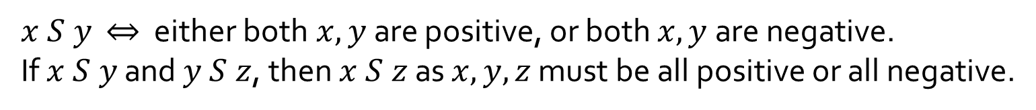

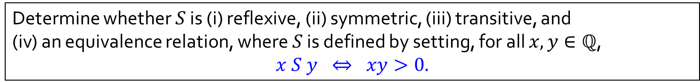

Q3(d)
Determine whether $S$ is (i) reflexive, (ii) symmetric, (iii) transitive, and
(iv) an equivalence relation, where $S$ is defined by setting, for all $x,y∈ℚ$, $$x S y ⇔ xy>0.$$
Definitions. Let $R$ a relation on a set $A$.
$R$ is reflexive $⇔$ $∀x∈A \left(x R x\right).$
$R$ is symmetric $⇔$ $∀x,y∈A \left(x R y⇒y R x\right).$
$R$ is transitive $⇔$ $∀x,y,z∈A \left(x R y∧y R z⇒x R z\right)$.
$R$ is an equivalence relation $⇔$ $R$ is reflexive, symmetric and transitive.
✘
Reflexive?
$$0 /S 0.$$
✓
Symmetric?
$∀x, y∈ℚ (xy>0⇒yx=xy>0)$ (by commutativity of multiplication)
$x S y$ $⇔$ either both$x,y$are positive, or both $x,y$are negative.
If $x S y$ and $y S z$, then $x S z$ as $x,y,z$ must be all positive or all negative.
✓
Transitive?
✘
Equivalence relation?
$S$ is not reflexive.

Slide 10
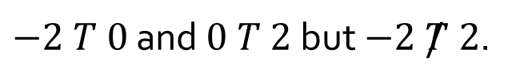

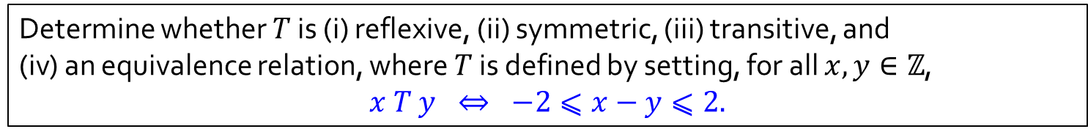

Q3(e)
Determine whether $T$ is (i) reflexive, (ii) symmetric, (iii) transitive, and
(iv) an equivalence relation, where $T$ is defined by setting, for all $x,y∈ℤ$, $$x T y ⇔ −2⩽x−y⩽2.$$
Definitions. Let $R$ a relation on a set $A$.
$R$ is reflexive $⇔$ $∀x∈A \left(x R x\right).$
$R$ is symmetric $⇔$ $∀x,y∈A \left(x R y⇒y R x\right).$
$R$ is transitive $⇔$ $∀x,y,z∈A \left(x R y∧y R z⇒x R z\right)$.
$R$ is an equivalence relation $⇔$ $R$ is reflexive, symmetric and transitive.
✓
Reflexive?
$$∀x∈ℤ (−2⩽x−x⩽2).$$
✓
Symmetric?
$∀x∈ℤ (−2⩽x−y⩽2 ⇒ −2⩽y−x⩽2)$.
✘
Transitive?
$−2 T 0$ and $0 T 2$ but $−2 /T 2$.
✘
Equivalence relation?
$T$ is not transitive.

Slide 11
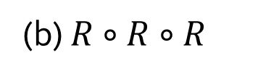



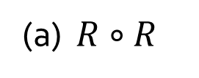



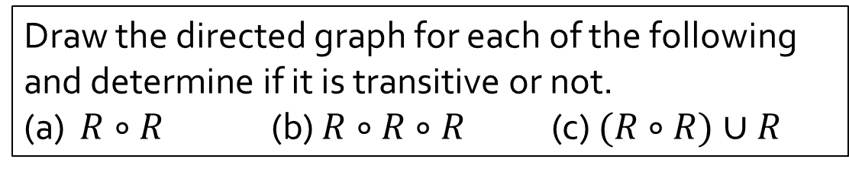





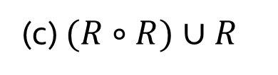

Q4
The directed graph of a binary relation $R$ on a set $A=\{a,b,c\}$ is shown below.
$$a$$
$$b$$
Draw the directed graph for each of the following and determine if it is transitive or not.
(a) $R∘R$ (b) $R∘R∘R$ (c) $(R∘R)∪R$
$$c$$
$$a$$
$$b$$
$$a$$
$$b$$
$$a$$
$$b$$
$$c$$
Not transitive
$$c$$
Not transitive
$$c$$
Transitive
(a) $R∘R$
(b) $R∘R∘R$
(c) $(R∘R)∪R$

Slide 12
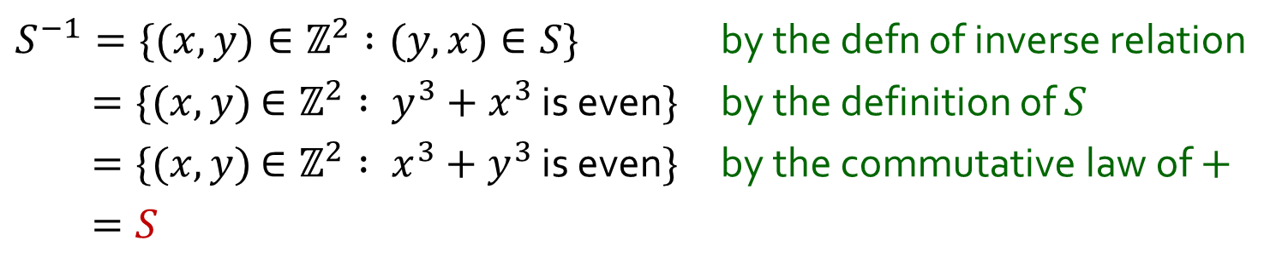
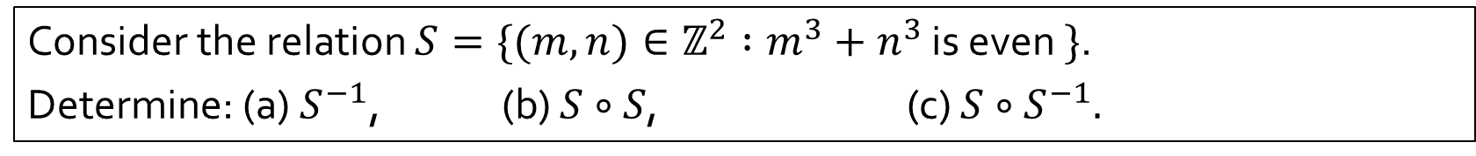
Q5
Consider the relation $S=\{(m,n)∈ℤ^{2} :m^{3}+n^{3}$ is even $\}$.
Determine: (a) $S^{−1}$, (b) $S∘S$, (c) $S∘S^{−1}.$
(a)
$S^{−1}=\{(x,y)∈ℤ^{2} :(y,x)∈S\}$ by the defn of inverse relation
$=\{(x,y)$ $∈ℤ^{2} : y^{3}+x^{3}$ is even$\}$ by the definition of $S$
$=\{(x,y)$ $∈ℤ^{2} : x^{3}+y^{3}$ is even$\}$ by the commutative law of $+$
$=S$

Slide 13
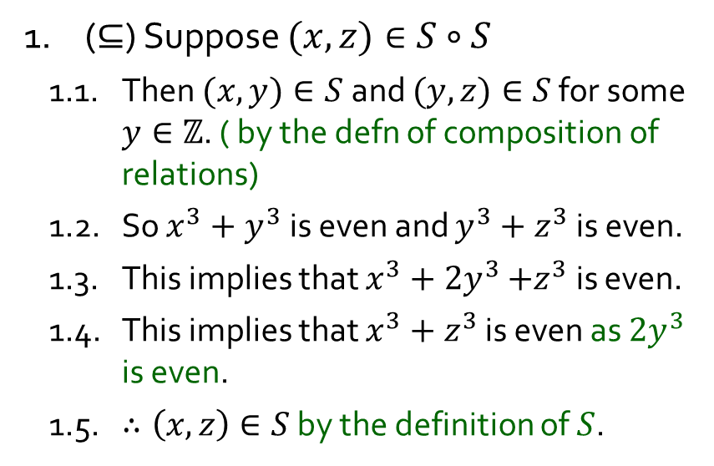

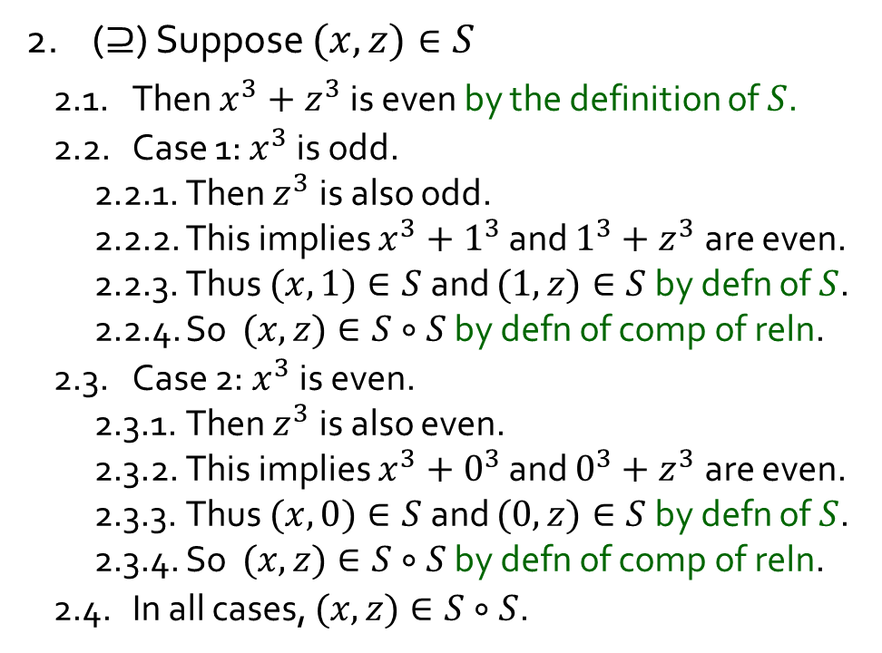

Q5
Consider the relation $S=\{(m,n)∈ℤ^{2} :m^{3}+n^{3}$ is even $\}$.
Determine: (a) $S^{−1}$, (b) $S∘S$, (c) $S∘S^{−1}.$
(b)
$$S∘S=S$$
2. ($⊇$) Suppose $(x,z)∈S$
2.1. Then $x^{3}+z^{3}$ is even by the definition of $S$.
2.2. Case 1: $x^{3}$ is odd.
2.2.1. Then $z^{3}$ is also odd.
2.2.2. This implies $x^{3}+1^{3}$ and $1^{3}+z^{3}$ are even.
2.2.3. Thus $(x,1)∈S$ and $(1,z)∈S$ by defn of $S$.
2.2.4. So $(x,z)∈S∘S$ by defn of comp of reln.
2.3. Case 2: $x^{3}$ is even.
2.3.1. Then $z^{3}$ is also even.
2.3.2. This implies $x^{3}+0^{3}$ and $0^{3}+z^{3}$ are even.
2.3.3. Thus $(x,0)∈S$ and $(0,z)∈S$ by defn of $S$.
2.3.4. So $(x,z)∈S∘S$ by defn of comp of reln.
2.4. In all cases, $(x,z)∈S∘S$.
1. ($⊆$) Suppose $(x,z)∈S∘S$
1.1. Then $(x,y)∈S$ and $(y,z)∈S$ for some $y∈ℤ$. ( by the defn of composition of relations)
1.2. So $x^{3}+y^{3}$ is even and $y^{3}+z^{3}$ is even.
1.3. This implies that $x^{3}+{2y}^{3}$ $+z^{3}$ is even.
1.4. This implies that $x^{3}+z^{3}$ is even as ${2y}^{3}$ is even.
1.5. $∴\left(x,z\right)∈S$ by the definition of $S$.
3. Therefore $S∘S=S.$

Slide 14
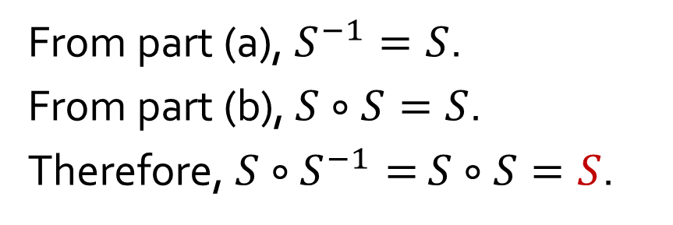
Q5
Consider the relation $S=\{(m,n)∈ℤ^{2} :m^{3}+n^{3}$ is even $\}$.
Determine: (a) $S^{−1}$, (b) $S∘S$, (c) $S∘S^{−1}.$
(c)
From part (a), $S^{−1}=S$.
From part (b), $S∘S=S$.
Therefore, $S∘S^{−1}=$ $S∘S=S$.

Slide 15


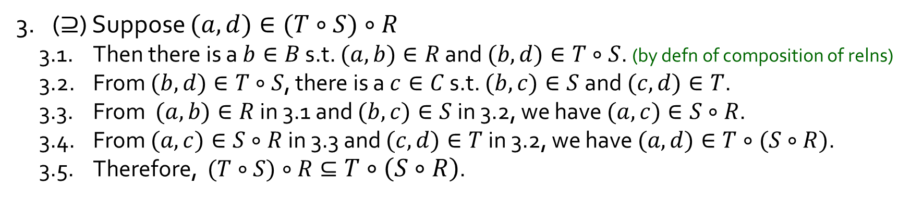
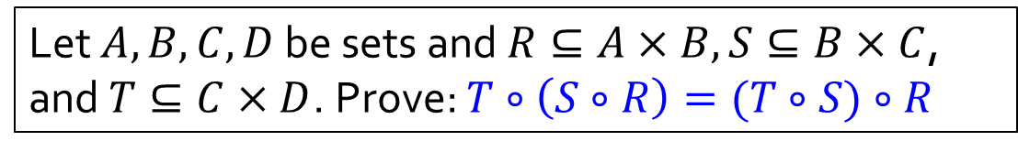

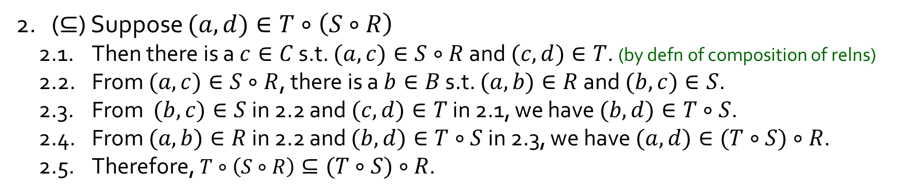




Q6
Let $A,B,C,D$ be sets and $R⊆A×B, S⊆B×C$, and $T⊆C×D$. Prove: $T∘\left(S∘R\right)=(T∘S)∘R$
$$A$$
$$B$$
$$C$$
$$D$$
$$R$$
$$S$$
$$T$$
1. Note that $S∘R⊆A×C$ and $T∘S⊆B×D$.
2. ($⊆$) Suppose $(a,d)∈T∘\left(S∘R\right)$
2.1. Then there is a $c∈C$ s.t. $(a,c)∈S∘R$ and $(c,d)∈T$. (by defn of composition of relns)
2.2. From $(a,c)∈S∘R$, there is a $b∈B$ s.t. $(a,b)∈R$ and $(b,c)∈S$.
2.3. From $(b,c)∈S$ in 2.2 and $(c,d)∈T$ in 2.1, we have $(b,d)∈T∘S$.
2.4. From $(a,b)∈R$ in 2.2 and $(b,d)∈T∘S$ in 2.3, we have $(a,d)∈(T∘S)∘R$.
2.5. Therefore, $T∘\left(S∘R\right)⊆(T∘S)∘R$.
3. ($⊇$) Suppose $(a,d)∈(T∘S)∘R$
3.1. Then there is a $b∈B$ s.t. $(a,b)∈R$ and $(b,d)∈T∘S$. (by defn of composition of relns)
3.2. From $(b,d)∈T∘S$, there is a $c∈C$ s.t. $(b,c)∈S$ and $(c,d)∈T$.
3.3. From $(a,b)∈R$ in 3.1 and $(b,c)∈S$ in 3.2, we have $(a,c)∈S∘R$.
3.4. From $(a,c)∈S∘R$ in 3.3 and $(c,d)∈T$ in 3.2, we have $(a,d)∈T∘(S∘R)$.
3.5. Therefore, $(T∘S)∘R⊆T∘\left(S∘R\right)$.
4. $∴ T∘\left(S∘R\right)=(T∘S)∘R$.

Slide 16
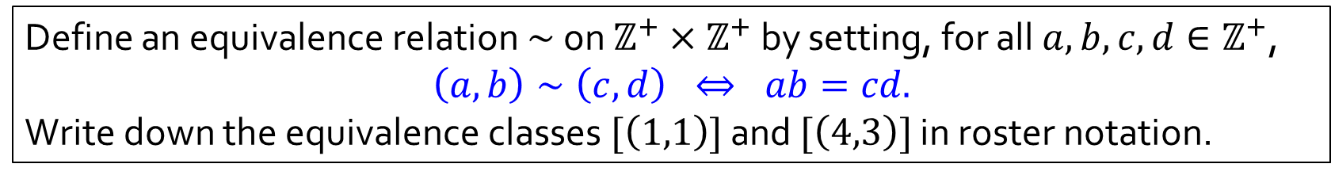

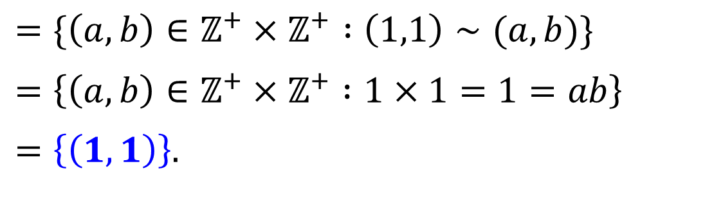

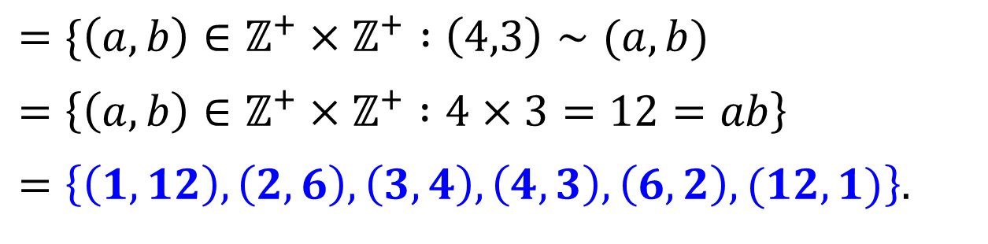
Q7
Define an equivalence relation $∼$ on $ℤ^{+}×ℤ^{+}$ by setting, for all $a,b,c,d∈ℤ^{+}$,
$$\left(a,b\right)∼\left(c,d\right) ⇔ ab=cd.$$
Write down the equivalence classes $[\left(1,1\right)]$ and $[\left(4,3\right)]$ in roster notation.
Definition. Let $∼$ be an equivalence relation on a set $A$, and $x∈A$. Then $\left[x\right]=\{y∈A :x∼y\}$.
$$\left[\left(1,1\right)\right]$$
$$=\{\left(a,b\right)∈ℤ^{+}×ℤ^{+} :\left(1,1\right)∼(a,b)\}$$
$$=\left\{\left(a,b\right)∈ℤ^{+}×ℤ^{+} :1×1=1=ab\right\}$$
$$=\left\{\left(1,1\right)\right\}.$$
$$\left[\left(4,3\right)\right]$$
$$=\{\left(a,b\right)∈ℤ^{+}×ℤ^{+} :\left(4,3\right)∼(a,b)$$
$$=\left\{\left(a,b\right)∈ℤ^{+}×ℤ^{+} :4×3=12=ab\right\}$$
$$=\left\{\left(1,12\right),\left(2,6\right),\left(3,4\right),\left(4,3\right),\left(6,2\right),(12,1)\right\}.$$

Slide 17
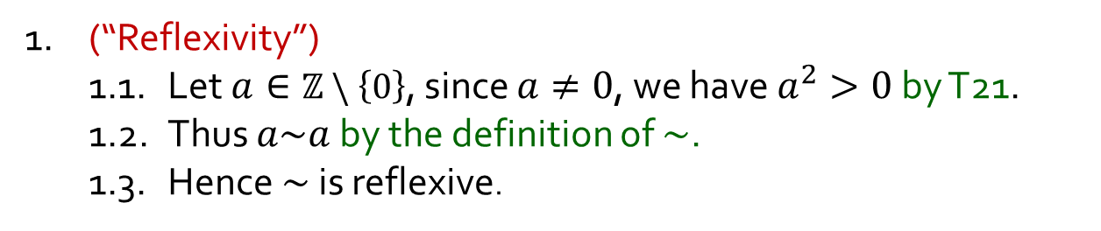
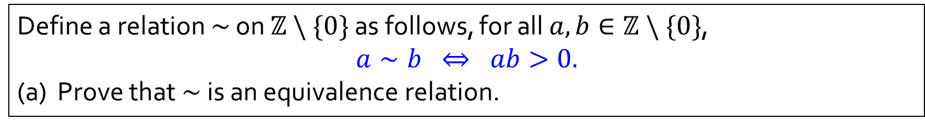

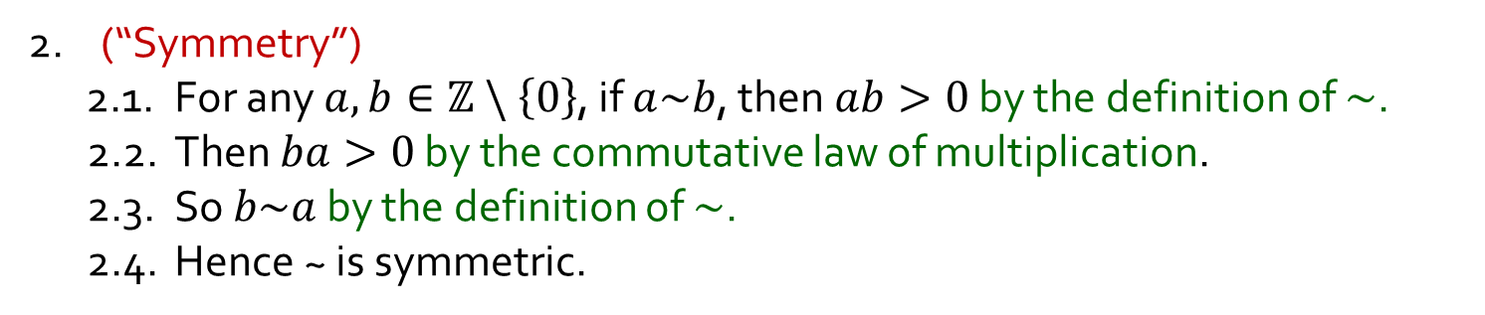
Q8
Define a relation $∼$ on $ℤ \backslash \{0\}$ as follows, for all $a,b∈ℤ \backslash \{0\}$,
$$a∼b ⇔ ab>0.$$
(a) Prove that $\sim$ is an equivalence relation.
1. (“Reflexivity”)
1.1. Let $a∈ℤ \backslash \left\{0\right\}$, since $a≠0$, we have $a^{2}>0$ by T21.
1.2. Thus $a\sim a$ by the definition of $\sim$.
1.3. Hence $\sim$ is reflexive.
T21. If $a≠0$, then $a^{2}>0$.
2. (“Symmetry”)
2.1. For any $a,b∈ℤ \backslash \left\{0\right\}$, if $a\sim b$, then $ab>0$ by the definition of $\sim$.
2.2. Then $ba>0$ by the commutative law of multiplication.
2.3. So $b\sim a$ by the definition of $\sim$.
2.4. Hence ~ is symmetric.

Slide 18
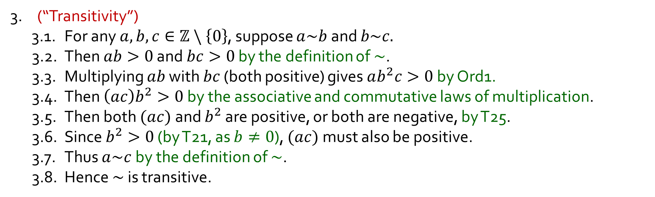
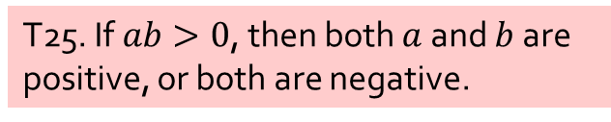
Q8
Define a relation $∼$ on $ℤ \backslash \{0\}$ as follows, for all $a,b∈ℤ \backslash \{0\}$,
$$a∼b ⇔ ab>0.$$
(a) Prove that $\sim$ is an equivalence relation.
1. (“Reflexivity”)
2. (“Symmetry”)
T21. If $a≠0$, then $a^{2}>0$.
3. (“Transitivity”)
3.1. For any $a,b,c∈ℤ \backslash \left\{0\right\}$, suppose $a\sim b$ and $b\sim c.$
3.2. Then $ab>0$ and $bc>0$ by the definition of $\sim$.
3.3. Multiplying $ab$ with $bc$ (both positive) gives $ab^{2}c>0$ by Ord1.
3.4. Then $\left(ac\right)b^{2}>0$ by the associative and commutative laws of multiplication.
3.5. Then both $(ac)$and $b^{2}$ are positive, or both are negative, by T25.
3.6. Since $b^{2}>0$ (by T21, as $b≠0$), $(ac)$must also be positive.
3.7. Thus $a\sim c$by the definition of $\sim$.
3.8. Hence $\sim$ is transitive.
Ord1. If $a$and $b$ are positive, so are $a+b$ and $ab$.
T25. If $ab>0$, then both $a$and $b$ are positive, or both are negative.
4. Therefore, ~ is an equivalence relation.

Slide 19
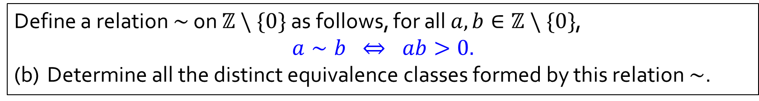
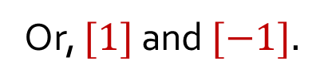
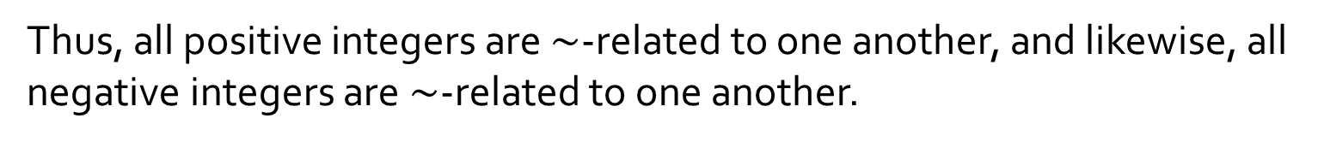
Q8
Define a relation $∼$ on $ℤ \backslash \{0\}$ as follows, for all $a,b∈ℤ \backslash \{0\}$,
$$a∼b ⇔ ab>0.$$
(b) Determine all the distinct equivalence classes formed by this relation $\sim$.
T25. If $ab>0$, then both $a$and $b$ are positive, or both are negative.
Thus, all positive integers are $\sim$-related to one another, and likewise, all negative integers are $\sim$-related to one another.
Equivalence classes: $\{a∈ℤ \backslash \left\{0\right\}:a>0\}$ and $\left\{a∈ℤ \backslash \left\{0\right\}:a<0\right\}.$
Or, $[1]$ and $[−1].$

Slide 20


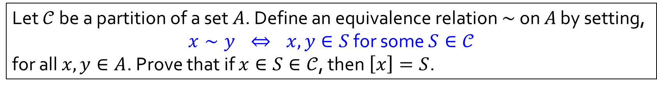






Q9(a)
Let $𝒞$ be a partition of a set $A$. Define an equivalence relation $∼$ on $A$ by setting,
$x∼y$ $⇔$ $x,y∈S$ for some $S∈𝒞$
for all $x,y∈A$. Prove that if $x∈S∈𝒞$, then $\left[x\right]=S$.
1. Let $x∈S∈𝒞$.
2. (“$⊇$”) If $y∈S$, then
definition of $∼$, as $x,y∈S∈𝒞$;
2.2. $∴y∈[x]$ by the definition of $[x]$.
3. (“$⊆$”)
3.1. Let $y∈[x]$.
3.5. Hence $y∈\hat{S}=S$.
4. Thus $\left[x\right]=S$.
$$𝒞$$
2.1. $x∼y$ by the definition of $∼$, as $x,y∈S∈𝒞$
by the definition of $[x]$.
$$S$$
$$x$$
3.2. Then $x∼y$ by the definition of $[x]$.
3.3. Use the definition of $∼$ to find a component $T∈𝒞$ such that $x,y∈T$.
3.4. Since $x∈S∩T$, we deduce that $S=T$ as $S, T$ are components in the partition $𝒞$.
$$T=$$
Definition. Call $𝒞$ a partition of a set $A$ if
(1) $𝒞$ is a set of which all elements are nonempty subsets of $A$; and
(2) every element of $A$ is in exactly one element of $𝒞$.
Definition. Let $∼$ be an equivalence relation on a set $A$, and $x∈A$. Then $\left[x\right]=\{y∈A :x∼y\}$.

Slide 21









Q9(b)
Let $𝒞$ be a partition of a set $A$. Define an equivalence relation $∼$ on $A$ by setting,
$x∼y$ $⇔$ $x,y∈S$ for some $S∈𝒞$
for all $x,y∈A$. Prove that $A/\sim =𝒞$.
Q9(a). If $x∈S∈𝒞$, then $\left[x\right]=S$.
1. (“$⊆$”) Let $\left[x\right]∈A/\sim$.
1.2. Then $\left[x\right] ∈𝒞$.
2. (“$⊇$”) Let $S∈𝒞$.
2.3. Then $S ∈A/\sim$.
3. Hence $A/\sim =𝒞$.
1.1. Use the assumption that $𝒞$ is a partition of $A$ to find $S∈𝒞$
such that $x∈S$.
$$𝒞$$
part (a) implies
$$=S$$
$$S$$
2.1. Then $S≠∅$ as $S$ is a component in a partition.
2.2. Take $x∈S$.
$$x$$
part (a) implies
$$=\left[x\right]$$
Definition . Call $𝒞$ a partition of a set $A$ if
(1) $𝒞$ is a set of which all elements are nonempty subsets of $A$; and
(2) every element of $A$ is in exactly one element of $𝒞$.
Definition. If $∼$ is an equivalence relation on a set $A$, then
$$A/\sim =\left\{\left[x\right] :x∈A\right\}.$$
Definition. Let $∼$ be an equivalence relation on a set $A$, and $x∈A$. Then $\left[x\right]=\{y∈A :x∼y\}$.

Slide 22
END OF FILE

