Slide 1
Cs1231S tutorial #10
Counting 2 & Graphs 1

Slide 2
Learning objectives of this tutorial
Counting
Using Combinations.
Applying Binomial Theorem.
Calculating Expected Value.
Using Conditional Probability and Bayes’ Theorem.
Counting number of reflexive and symmetric relations.
Graphs
Graph, Matrix representation and Counting #Walks.
Graphs and pigeonhole principle.
Application of graphs to solving real world problems.

Slide 3
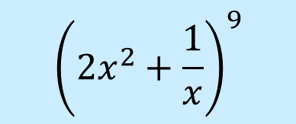

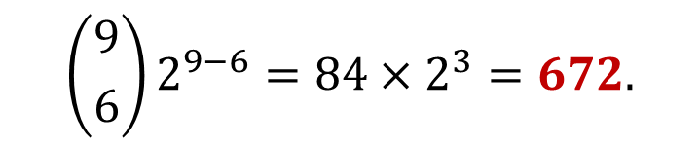
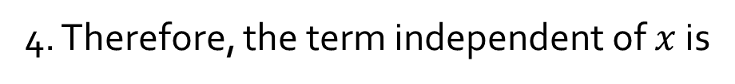
Q1.
Find the term independent of $x$ in the expansion of
$${\left(2x^{2}+\frac{1}{x}\right)}^{9}$$
Recall the Binomial Theorem:
$${\left(a+b\right)}^{n}=a^{n}+\left({n \atop 1}\right)a^{n−1}b^{1}+\left({n \atop 2}\right)a^{n−2}b^{2}+⋯+\left({n \atop n−1}\right)a^{1}b^{n−1}+b^{n}$$
1. We have $a=2x^{2},b=\frac{1}{x},n=9.$
2. The general term in the expansion of ${(a+b)}^{2}$ is given by:
$$\left({n \atop r}\right)a^{n−r}b^{r}=\left({9 \atop r}\right){(2x^{2})}^{9−r}{\left(\frac{1}{x}\right)}^{r}=\left({9 \atop r}\right)2^{9−r}x^{18−2r}x^{−r}=\left({9 \atop r}\right)2^{9−r}x^{18−3r}$$
3. For this term to be independent of $x$, we must have $18−3r=0,$ or $r=6$.
4. Therefore, the term independent of $x$ is
$$\left({9 \atop 6}\right)2^{9−6}=84×2^{3}=672.$$

Slide 4


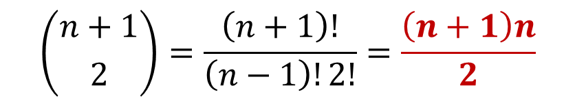

Q2.
Given n boxes numbered 1 to n, each box to be filled with a white ball or a blue ball. At least one box contains a white ball and boxes containing white balls must be consecutively numbered.
What is the total number of ways this can be done?
$$\sum_{k=1}^{n}{k}=\frac{n\left(n+1\right)}{2}$$
X
X
X
X
…
X
X
1 2 3 … n
The task is similar to choose $2$ out of the $n+1$ crosses to mark the start and end of the consecutively numbered boxes that contain the white balls.
$$\left({n+1 \atop 2}\right)=\frac{\left(n+1\right)!}{\left(n−1\right)!2!}=\frac{\left(n+1\right)n}{2}$$

Slide 5
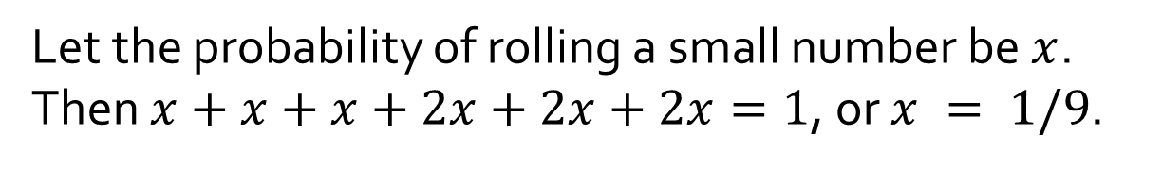
Q3.
[AY2020/21 Semester 2 Exam Question]
On a die there are 6 numbers. We call 4, 5, 6 the big numbers and 1, 2, 3 the small numbers. Given a loaded die in which the probability of rolling any fixed big number is twice the probability of rolling any fixed small number,
(i) What is the probability of rolling a 6?
(i)
Let the probability of rolling a small number be $x$.
Then $x+x+x+2x+2x+2x=1$, or $x = 1/9$.
Therefore, probability of rolling a 6 = $2/9$.

Slide 6
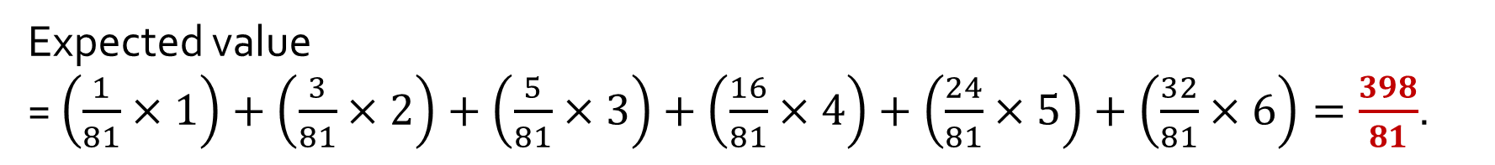
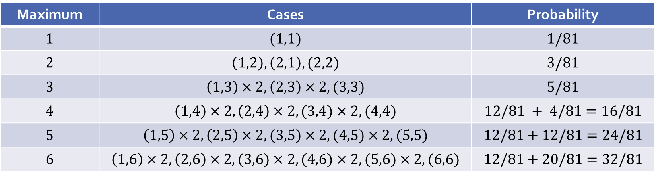
Q3.
On a die there are 6 numbers. We call 4, 5, 6 the big numbers and 1, 2, 3 the small numbers. Given a loaded die in which the probability of rolling any fixed big number is twice the probability of rolling any fixed small number,
(ii) If two such loaded dice are rolled, what is the expected value of the maximum of the two dice?
(ii)
Maximum | Cases | Probability
$$1$$ | $$(1,1)$$ | $$1/81$$
$$2$$ | $$\left(1,2\right),\left(2,1\right),(2,2)$$ | $$3/81$$
$$3$$ | $$\left(1,3\right)×2,\left(2,3\right)×2,(3,3)$$ | $$5/81$$
$$4$$ | $$\left(1,4\right)×2,\left(2,4\right)×2,(3,4)×2,(4,4)$$ | $$12/81 + 4/81=16/81$$
$$5$$ | $$\left(1,5\right)×2,\left(2,5\right)×2,(3,5)×2,(4,5)×2,(5,5)$$ | $$12/81+12/81=24/81$$
$$6$$ | $$\left(1,6\right)×2,\left(2,6\right)×2,(3,6)×2,(4,6)×2,(5,6)×2,(6,6)$$ | $$12/81+20/81=32/81$$
Expected value
= $\left(\frac{1}{81}×1\right)+\left(\frac{3}{81}×2\right)+\left(\frac{5}{81}×3\right)+\left(\frac{16}{81}×4\right)+\left(\frac{24}{81}×5\right)+\left(\frac{32}{81}×6\right)=\frac{398}{81}$.

Slide 7
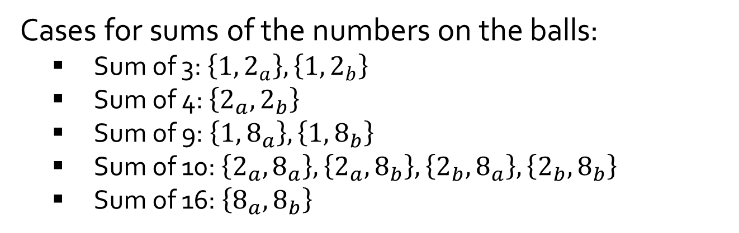
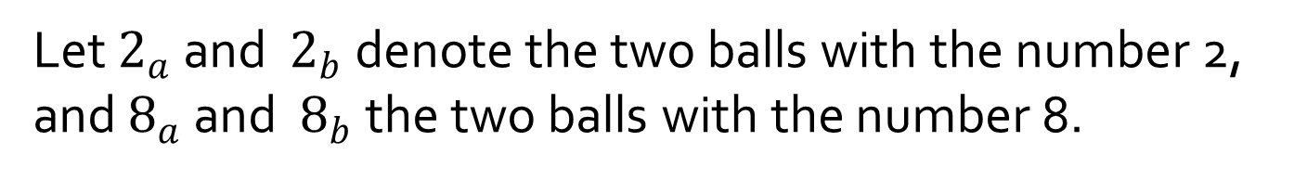

Q4.
An urn contains five balls numbered 1, 2, 2, 8 and 8. If a person selects a set of two balls at random, what is the expected value of the sum of the numbers on the balls?
Let $2_{a}$ and $2_{b}$ denote the two balls with the number 2, and $8_{a}$ and $8_{b}$ the two balls with the number 8.
Cases for sums of the numbers on the balls:
Sum of 3: $\left\{1,2_{a}\right\}, \left\{1,2_{b}\right\}$
Sum of 4: $\left\{2_{a},2_{b}\right\}$
Sum of 9: $\left\{1,8_{a}\right\}, \left\{1,8_{b}\right\}$
Sum of 10: $\left\{2_{a},8_{a}\right\}, \left\{2_{a},8_{b}\right\},\left\{2_{b},8_{a}\right\}, \left\{2_{b},8_{b}\right\}$
Sum of 16: $\left\{8_{a},8_{b}\right\}$
Expected sum
$=3∙\left(\frac{2}{10}\right)+$ $4∙\left(\frac{1}{10}\right)+9∙\left(\frac{2}{10}\right)+$ $10∙\left(\frac{4}{10}\right)+16∙\left(\frac{1}{10}\right)$
$$=8.4$$

Slide 8

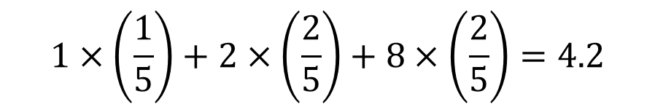
Q4.
An urn contains five balls numbered 1, 2, 2, 8 and 8. If a person selects a set of two balls at random, what is the expected value of the sum of the numbers on the balls?
Alternatively, compute the expected value of the number when one ball is picked:
$$1×\left(\frac{1}{5}\right)+2×\left(\frac{2}{5}\right)+8×\left(\frac{2}{5}\right)=4.2$$
Apply linearity of expected value:
$$2×4.2=8.4$$

Slide 9
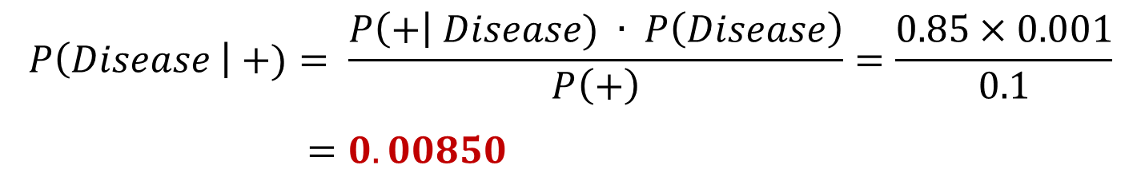
Q5.
[AY2021/22 Semester 2 Exam Question]
A rare disease broke out in a city with a prevalence of 0.1%, that is, it affects 1 out of every 1000 persons. A quick test kit has been developed that has a sensitivity of 85%, which is the probability that a person with the rare disease is tested positive. Among those who took the test, 10% of the time it came out positive. Write your answers correct to 3 significant figures.
(a) Divoc has shown symptoms of the disease. Should he be tested positive, what is the probability that he actually has the disease?
$$P(Disease) = 0.001; P(+|Disease) = 0.85; P(+) = 0.1.$$
$$P\left(Disease \right| +)= \frac{P\left(+\right| Disease) ∙ P\left(Disease\right)}{P\left(+\right)}=\frac{0.85×0.001}{0.1}$$
$=0.00850$

Slide 10
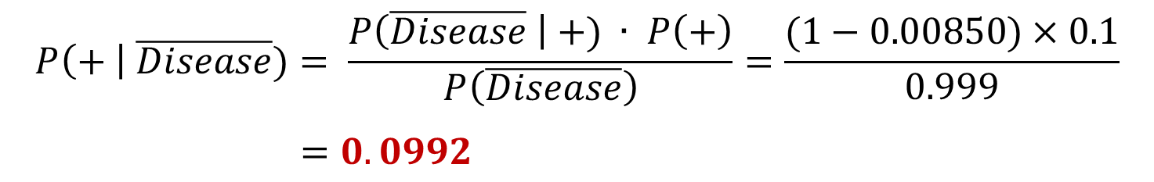
Q5.
[AY2021/22 Semester 2 Exam Question]
A rare disease broke out in a city with a prevalence of 0.1%, that is, it affects 1 out of every 1000 persons. A quick test kit has been developed that has a sensitivity of 85%, which is the probability that a person with the rare disease is tested positive. Among those who took the test, 10% of the time it came out positive. Write your answers correct to 3 significant figures.
(b) What is the probability of a false positive result, that is, a person is tested positive given that he does not have the disease?
$$P(Disease) = 0.001; P(+|Disease) = 0.85; P(+) = 0.1.$$
$$P\left(+ \right| \overline{Disease})= \frac{P\left(\overline{Disease} \right| +) ∙ P\left(+\right)}{P\left(\overline{Disease}\right)}=\frac{(1−0.00850)×0.1}{0.999}$$
$=0.0992$

Slide 11
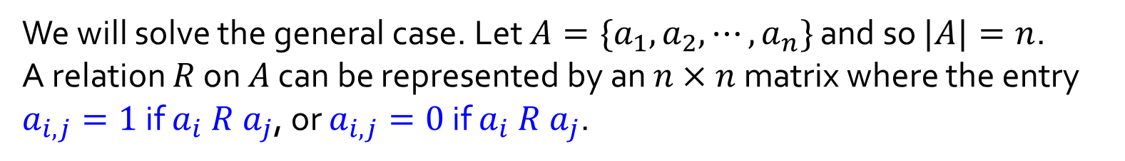
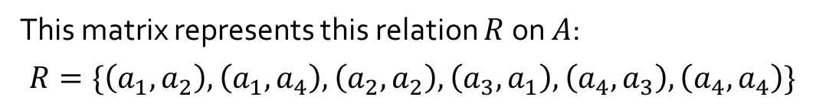
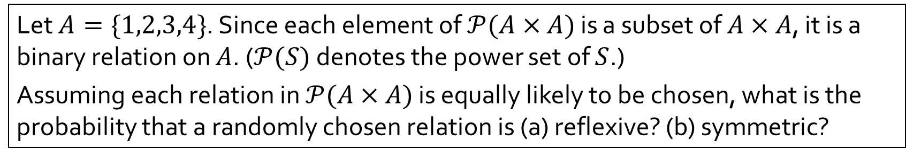


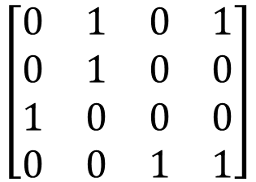
Q6.
Let $A=\{1,2,3,4\}$. Since each element of $𝒫(A×A)$ is a subset of $A×A$, it is a binary relation on $A$. ($𝒫(S)$ denotes the power set of $S$.)
Assuming each relation in $𝒫(A×A)$ is equally likely to be chosen, what is the probability that a randomly chosen relation is (a) reflexive? (b) symmetric?
We will solve the general case. Let $A=\{a_{1},a_{2},⋯,a_{n}\}$ and so $|A|=n$.
A relation $R$ on $A$ can be represented by an $n×n$ matrix where the entry $a_{i,j}=1$ if $a_{i} R a_{j}$, or $a_{i,j}=0$ if $a_{i} R a_{j}$.
Example:
$$a_{1}{ a}_{2} a_{3} a_{4}$$
$$a_{1}$$
$$a_{2}$$
$$a_{3}$$
$$a_{4}$$
$$\left[\begin{matrix}0 & 1 & 0 & 1 \\ 0 & 1 & 0 & 0 \\ 1 & 0 & 0 & 0 \\ 0 & 0 & 1 & 1\end{matrix}\right]$$
This matrix represents this relation $R$ on $A$:
$$R=\{\left(a_{1},a_{2}\right),\left(a_{1},a_{4}\right),\left(a_{2},a_{2}\right),\left(a_{3},a_{1}\right),\left(a_{4},a_{3}\right),\left(a_{4},a_{4}\right)\}$$

Slide 12
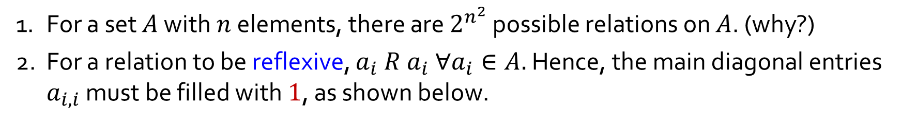
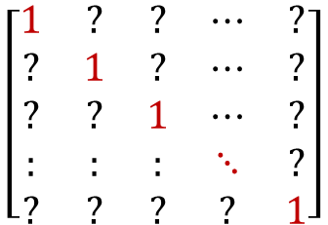
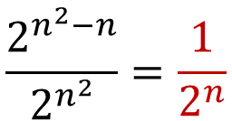
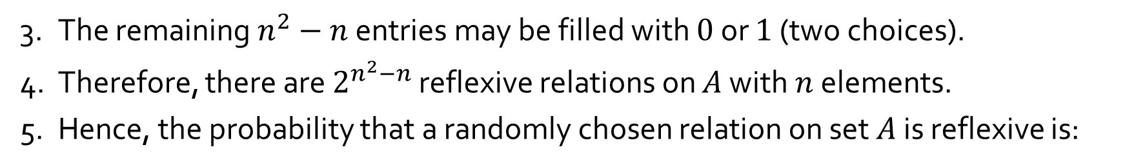
Q6.
(a) Reflexive relations
1. For a set $A$ with $n$ elements, there are $2^{n^{2}}$ possible relations on $A$. (why?)
2. For a relation to be reflexive, $a_{i} R a_{i} ∀a_{i}∈A.$ Hence, the main diagonal entries $a_{i,i}$ must be filled with $1$, as shown below.
$$\left[\begin{matrix}1 & ? & ? & ⋯ & ? \\ ? & 1 & ? & ⋯ & ? \\ ? & ? & 1 & ⋯ & ? \\ : & : & : & ⋱ & ? \\ ? & ? & ? & ? & 1\end{matrix}\right]$$
3. The remaining $n^{2}−n$ entries may be filled with $0$ or $1$ (two choices).
4. Therefore, there are $2^{n^{2}−n}$ reflexive relations on $A$ with $n$ elements.
5. Hence, the probability that a randomly chosen relation on set $A$ is reflexive is:
$$\frac{2^{n^{2}−n}}{2^{n^{2}}}=\frac{1}{2^{n}}$$
In particular, when $n=4$, the probability is $\frac{1}{2^{4}}$ or $\frac{1}{16}.$

Slide 13
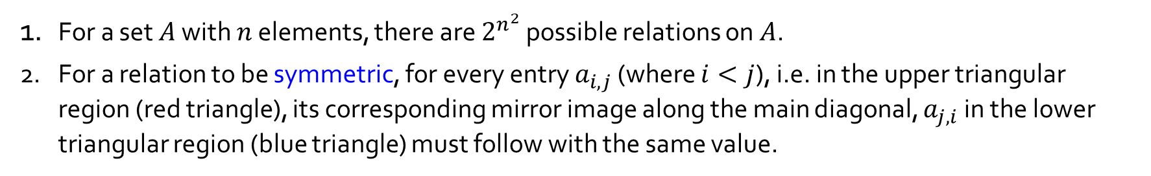


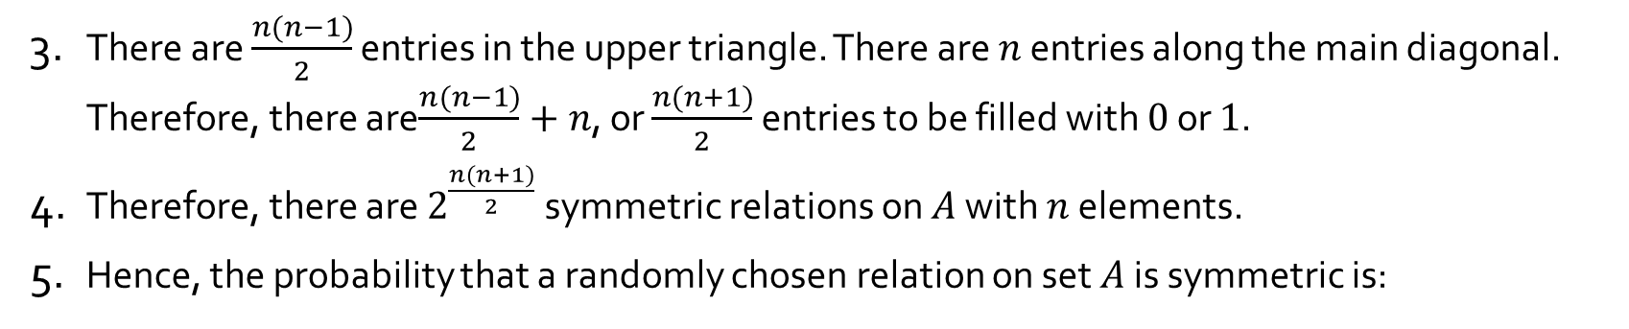
Q6.
(b) Symmetric relations
1. For a set $A$ with $n$ elements, there are $2^{n^{2}}$ possible relations on $A$.
2. For a relation to be symmetric, for every entry $a_{i,j}$ (where $i<j$), i.e. in the upper triangular region (red triangle), its corresponding mirror image along the main diagonal, $a_{j,i}$ in the lower triangular region (blue triangle) must follow with the same value.
$$\left[\begin{matrix}? & ? & ? & ⋯ & ? \\ ? & ? & ? & ⋯ & ? \\ ? & ? & ? & ⋯ & ? \\ : & : & : & ⋱ & ? \\ ? & ? & ? & ? & ?\end{matrix}\right]$$
3. There are $\frac{n(n−1)}{2}$ entries in the upper triangle. There are $n$ entries along the main diagonal. Therefore, there are$\frac{n(n−1)}{2}+n$, or $\frac{n(n+1)}{2}$ entries to be filled with $0$ or $1$.
4. Therefore, there are $2^{\frac{n(n+1)}{2}}$ symmetric relations on $A$ with $n$ elements.
5. Hence, the probability that a randomly chosen relation on set $A$ is symmetric is:
$$\frac{2^{\frac{n(n+1)}{2}}}{2^{n^{2}}}=\frac{1}{2^{\frac{n^{2}−n}{2}}}$$
In particular, when $n=4$, the probability is $\frac{1}{2^{6}}$ or $\frac{1}{64}.$

Slide 14
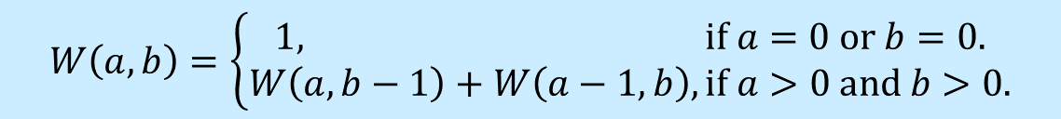
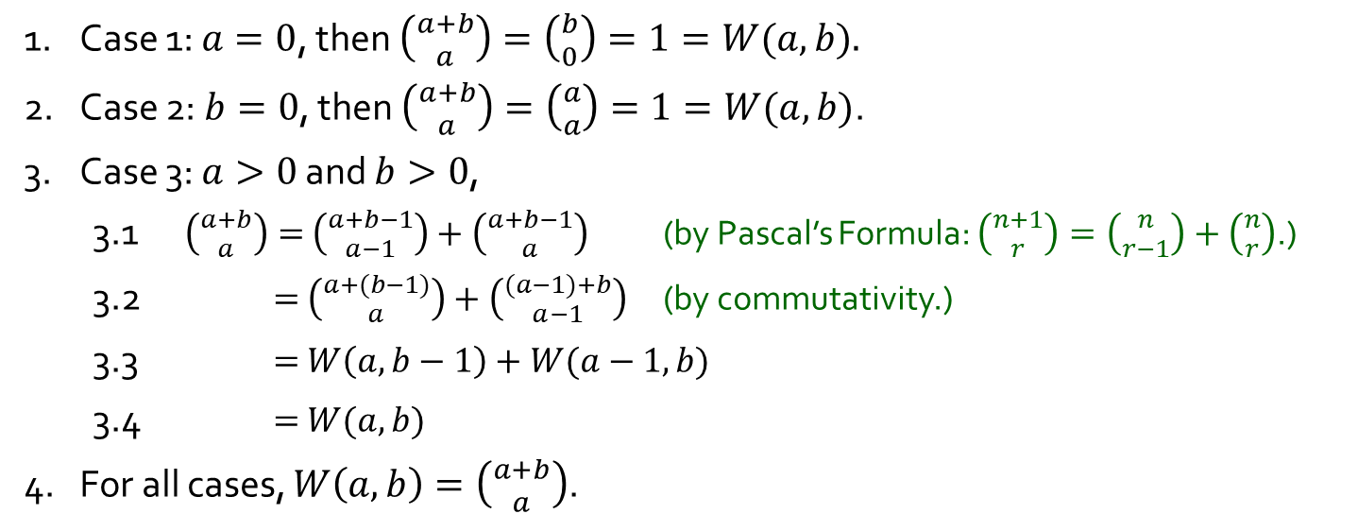
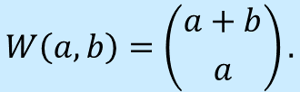
Q7.
Let us define a function $W(a,b)$ to be the number of ways the tournament can be completed if team $A$ has to win $a$ more games to win, while team $B$ has to win $b$ more games to win.
$$W\left(a,b\right)=\left\{\begin{aligned}1, if a=0 or b=0. \\ W\left(a,b−1\right)+W\left(a−1,b\right), if a>0 and b>0.\end{aligned}\right.$$
Verify that $W(a,b)$ may be expressed as follows:
$$W\left(a,b\right)=\left({a+b \atop a}\right).$$
1. Case 1: $a=0$, then $\left({a+b \atop a}\right)=\left({b \atop 0}\right)=1=W(a,b).$
2. Case 2: $b=0$, then $\left({a+b \atop a}\right)=\left({a \atop a}\right)=1=W(a,b)$.
3. Case 3: $a>0$ and $b>0$,
3.1 $\left({a+b \atop a}\right)=$ $\left({a+b−1 \atop a−1}\right)+\left({a+b−1 \atop a}\right)$ (by Pascal’s Formula: $\left({n+1 \atop r}\right)=\left({n \atop r−1}\right)+\left({n \atop r}\right)$.)
3.2 $=$ $\left({a+(b−1) \atop a}\right)+\left({(a−1)+b \atop a−1}\right)$ (by commutativity.)
3.3 $=$ $W\left(a,b−1\right)+W(a−1,b)$
3.4 $=$ $W(a,b)$
4. For all cases, $W\left(a,b\right)=\left({a+b \atop a}\right)$.

Slide 15
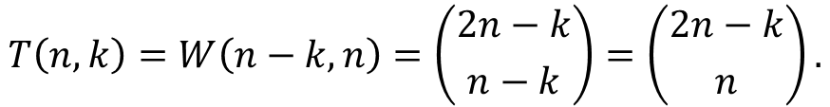
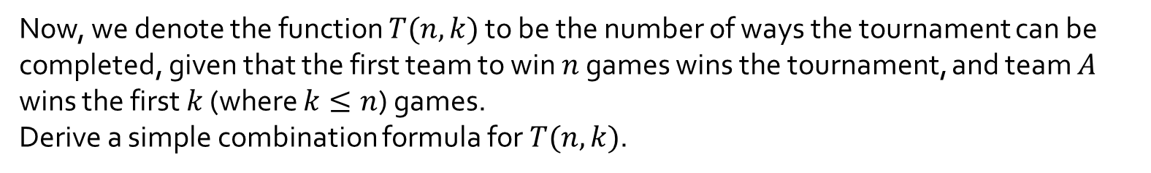



Q7.
$$W\left(a,b\right)=\left({a+b \atop a}\right).$$
Now, we denote the function $T(n,k)$ to be the number of ways the tournament can be completed, given that the first team to win $n$ games wins the tournament, and team $A$ wins the first $k$ (where $k≤n$) games.
Derive a simple combination formula for $T(n,k)$.
$$T\left(n,k\right)=W\left(n−k,n\right)=\left({2n−k \atop n−k}\right)=\left({2n−k \atop n}\right).$$
(by lecture 12 example 8: $\left({n \atop r}\right)=\left({n \atop n−r}\right)$.)
Therefore, $T\left(4,2\right)=\left({6 \atop 4}\right)=15.$

Slide 16
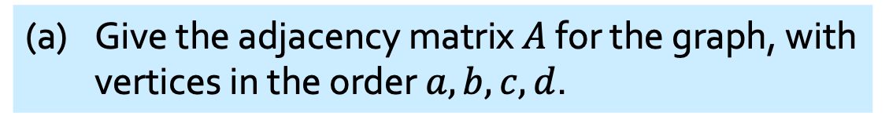
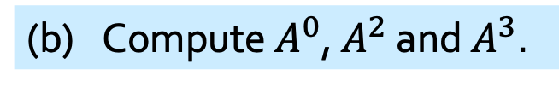
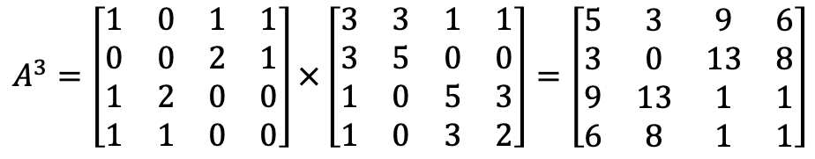
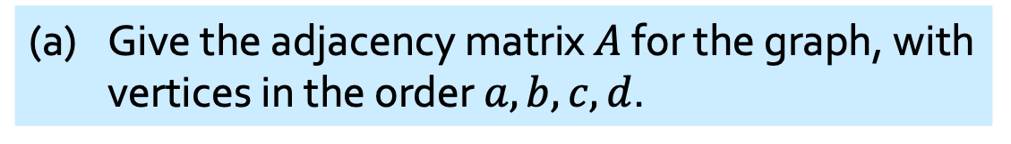

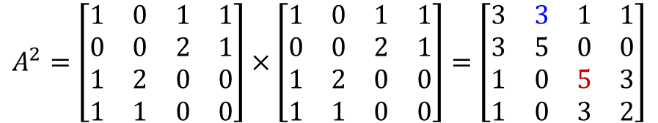
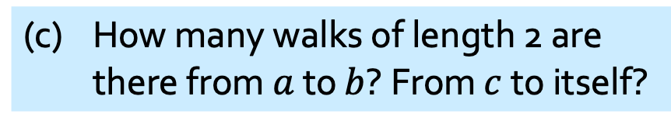
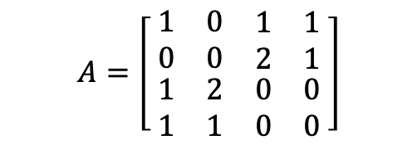
Q8.
(a) Give the adjacency matrix $A$ for the graph, with vertices in the order $a,b,c,d$.
Given this graph
(a) Give the adjacency matrix $A$ for the graph, with vertices in the order $a,b,c,d$.
a
e₄
b
(b) Compute $A^{0}$, $A^{2}$ and $A^{3}$.
$$A^{0}=I_{4}$$
e₂
e₃
e₆
e₅
$$A=\left[ \begin{matrix}\begin{matrix}1 & 0 \\ 0 & 0\end{matrix} & \begin{matrix}1 & 1 \\ 2 & 1\end{matrix} \\ \begin{matrix}1 & 2 \\ 1 & 1\end{matrix} & \begin{matrix}0 & 0 \\ 0 & 0\end{matrix}\end{matrix} \right]$$
$$A^{2}=\left[\begin{matrix}1 & 0 & 1 & 1 \\ 0 & 0 & 2 & 1 \\ 1 & 2 & 0 & 0 \\ 1 & 1 & 0 & 0\end{matrix}\right]×\left[\begin{matrix}1 & 0 & 1 & 1 \\ 0 & 0 & 2 & 1 \\ 1 & 2 & 0 & 0 \\ 1 & 1 & 0 & 0\end{matrix}\right]=\left[\begin{matrix}3 & 3 & 1 & 1 \\ 3 & 5 & 0 & 0 \\ 1 & 0 & 5 & 3 \\ 1 & 0 & 3 & 2\end{matrix}\right]$$
e₁
e₄
d
c
$$A^{3}=\left[\begin{matrix}1 & 0 & 1 & 1 \\ 0 & 0 & 2 & 1 \\ 1 & 2 & 0 & 0 \\ 1 & 1 & 0 & 0\end{matrix}\right]×\left[\begin{matrix}3 & 3 & 1 & 1 \\ 3 & 5 & 0 & 0 \\ 1 & 0 & 5 & 3 \\ 1 & 0 & 3 & 2\end{matrix}\right]=\left[\begin{matrix}5 & 3 & 9 & 6 \\ 3 & 0 & 13 & 8 \\ 9 & 13 & 1 & 1 \\ 6 & 8 & 1 & 1\end{matrix}\right]$$
(c) How many walks of length 2 are there from $a$ to $b$? From $c$ to itself?
3 walks from $a$ to $b$: $〈a→c\underset{→}{e_{5}} b〉$, $〈a→c\underset{→}{e_{6}} b〉$, $〈a→d→b〉$.
5 walks from $c$ to $c$: $〈c→a→c〉, 〈c \underset{→}{e_{5}} b \underset{→}{e_{5}} c〉, 〈c \underset{→}{e_{5}} b \underset{→}{e_{6}} c〉, 〈c \underset{→}{e_{6}} b \underset{→}{e_{5}} c〉, 〈c \underset{→}{e_{6}} b \underset{→}{e_{6}} c〉$.

Slide 17
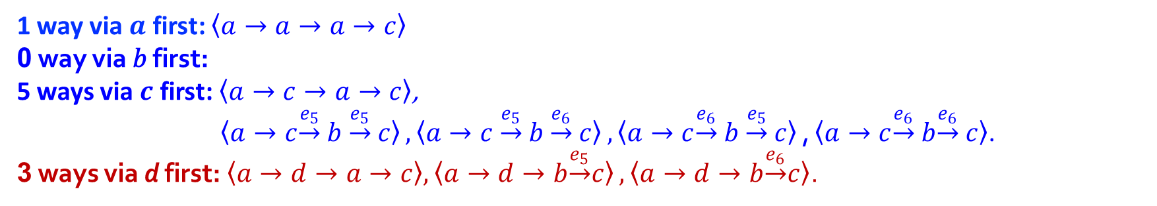
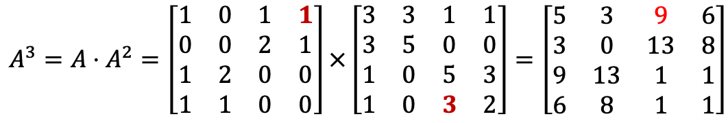
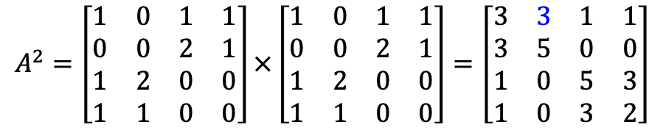
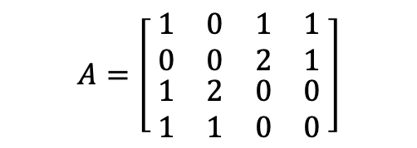


Q8.
a
e₄
b
e₂
e₃
$$A=\left[ \begin{matrix}\begin{matrix}1 & 0 \\ 0 & 0\end{matrix} & \begin{matrix}1 & 1 \\ 2 & 1\end{matrix} \\ \begin{matrix}1 & 2 \\ 1 & 1\end{matrix} & \begin{matrix}0 & 0 \\ 0 & 0\end{matrix}\end{matrix} \right]$$
$$A^{2}=\left[\begin{matrix}1 & 0 & 1 & 1 \\ 0 & 0 & 2 & 1 \\ 1 & 2 & 0 & 0 \\ 1 & 1 & 0 & 0\end{matrix}\right]×\left[\begin{matrix}1 & 0 & 1 & 1 \\ 0 & 0 & 2 & 1 \\ 1 & 2 & 0 & 0 \\ 1 & 1 & 0 & 0\end{matrix}\right]=\left[\begin{matrix}3 & 3 & 1 & 1 \\ 3 & 5 & 0 & 0 \\ 1 & 0 & 5 & 3 \\ 1 & 0 & 3 & 2\end{matrix}\right]$$
e₅
e₆
e₁
e₄
d
c
$$A^{3}=A⋅A^{2}=\left[\begin{matrix}1 & 0 & 1 & 1 \\ 0 & 0 & 2 & 1 \\ 1 & 2 & 0 & 0 \\ 1 & 1 & 0 & 0\end{matrix}\right]×\left[\begin{matrix}3 & 3 & 1 & 1 \\ 3 & 5 & 0 & 0 \\ 1 & 0 & 5 & 3 \\ 1 & 0 & 3 & 2\end{matrix}\right]=\left[\begin{matrix}5 & 3 & 9 & 6 \\ 3 & 0 & 13 & 8 \\ 9 & 13 & 1 & 1 \\ 6 & 8 & 1 & 1\end{matrix}\right]$$
(d) How many walks of length 3 are there from $a$ to $c$?
from $A_{xc}^{2}$ in $A^{2}$
9 walks of length 3 from $a$ to $c$:
from $A_{ax}^{1}$ in $A^{1}$
1 way via $a$ first: $〈a→a→a→c〉$
0 way via 𝑏 first:
5 ways via $c$ first: $〈a→c→a→c〉$,
$〈a→c\underset{→}{e_{5}} b \underset{→}{e_{5}} c〉,〈a→c \underset{→}{e_{5}} b \underset{→}{e_{6}} c〉,〈a→c\underset{→}{e_{6}} b \underset{→}{e_{5}} c〉\text{,}〈a→c\underset{→}{e_{6}} b\underset{→}{e_{6}} c〉$.
3 ways via d first:$〈a→d→a→c〉, 〈a→d→b\underset{→}{e_{5}}c〉, 〈a→d→b\underset{→}{e_{6}}c〉$.
1 edge
2 edges
a
x
c
Notes:
To Tutors: Illustrate with x=d

Slide 18
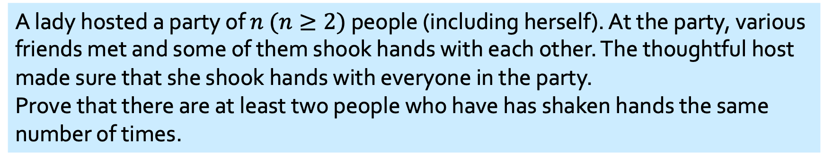
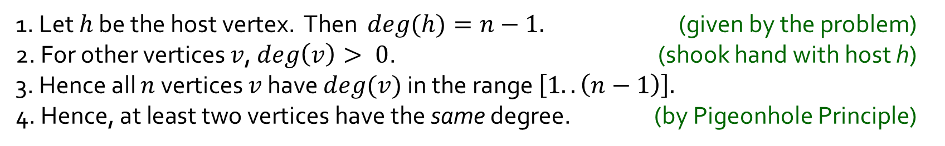
Q9.
A lady hosted a party of $n$ $(n≥2)$ people (including herself). At the party, various friends met and some of them shook hands with each other. The thoughtful host made sure that she shook hands with everyone in the party.
Prove that there are at least two people who have has shaken hands the same number of times.
Model this with a graph $G=(V,E$) where each person is a vertex in $V$, and there is an undirected edge {$x,y\}∈E$ whenever $x$ and $y$ shook hand at the party.
1. Let $h$ be the host vertex. Then $deg(h)=n−1.$ (given by the problem)
2. For other vertices $v$, $deg\left(v\right)> 0$. (shook hand with host h)
3. Hence all $n$ vertices $v$ have $deg(v)$ in the range $\left[1..\left(n−1\right)\right].$
4. Hence, at least two vertices have the same degree. (by Pigeonhole Principle)
Hence, at least two people has the same number of handshakes.
Remark:
Also OK if answer did not model problem as a graph problem.

Slide 19

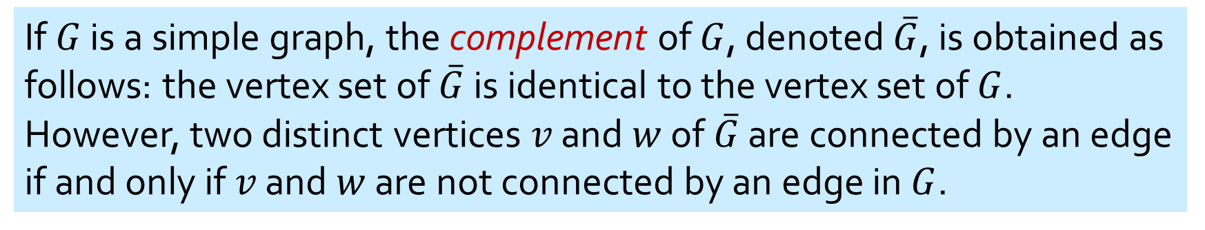
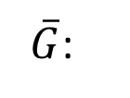
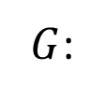
If $G$ is a simple graph, the complement of $G$, denoted $\overline{G}$, is obtained as follows: the vertex set of $\overline{G}$ is identical to the vertex set of $G$. However, two distinct vertices $v$ and $w$ of $\overline{G}$ are connected by an edge if and only if $v$ and $w$ are not connected by an edge in $G$.
$G$:
$\overline{G}$:
A graph $G$ and its complement $\overline{G}$.

Slide 20


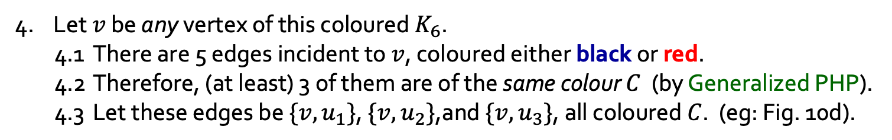

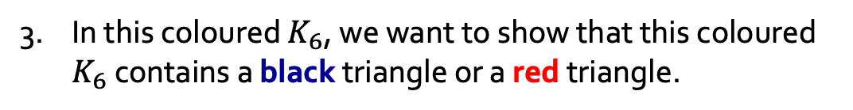



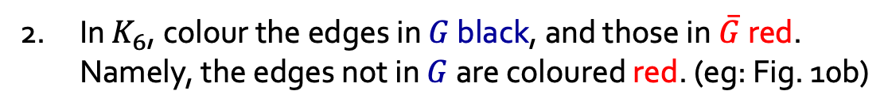



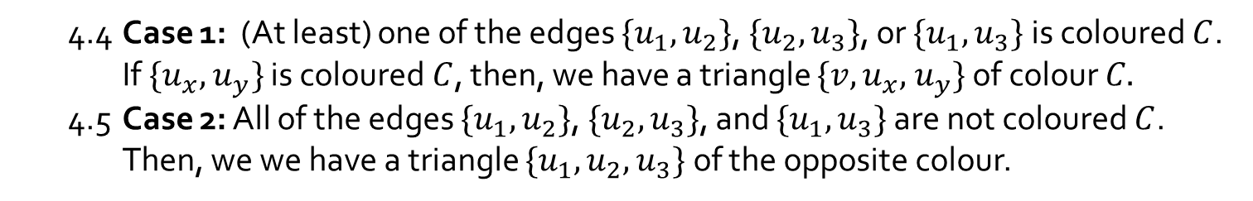

Q10.
Let $G$ be a simple graph with 6 vertices. Prove that $G$ or its complementary graph $\overline{G}$ contains a triangle (cycle of length 3).
1. Consider any simple graph $G$ on 6 vertices. (eg: Fig 10a)
In $K_{6}$, colour the edges in $G$ black, and those in$\overline{G}$ red. Namely, the edges not in $G$ are coloured red. (eg: Fig. 10b)
3. In this coloured $K_{6}$, we want to show that this coloured $K_{6}$ contains a black triangle or a red triangle.
Graph $G$
Coloured $K_{6}$
$$u_{1}$$
4. Let $v$ be any vertex of this coloured $K_{6}$.
4.1 There are 5 edges incident to $v$, coloured either black or red.
4.2 Therefore, (at least) 3 of them are of the same colour $C$ (by Generalized PHP).
4.3 Let these edges be ${\{v,u}_{1}\}$, $\{v,u_{2}\}$,and $\{v,u_{3}\}$, all coloured $C$. (eg: Fig. 10d).
$$u_{2}$$
$$v$$
$u_{3}$u
Figure 10d
4.4 Case 1: (At least) one of the edges ${\{u}_{1},u_{2}\}$, ${\{u}_{2},u_{3}\}$, or ${\{u}_{1},u_{3}\}$ is coloured $C$.
If $\{u_{x},$ $u_{y}\}$ is coloured $C$, then, we have a triangle $\{v,u_{x},$ $u_{y}\}$ of colour $C.$
4.5 Case 2: All of the edges ${\{u}_{1},u_{2}\}$, ${\{u}_{2},u_{3}\}$, and ${\{u}_{1},u_{3}\}$ are not coloured $C$.
Then, we we have a triangle $\{u_{1},u_{2},$ $u_{3}\}$ of the opposite colour.
$$u_{1}$$
$$u_{2}$$
5. In all cases, there is a triangle of the same colour.
$$v$$
$u_{3}$u
Figure 10e

Slide 21





Q10.
Variant using WLOG
Prove that for any simple graph $G$ with 6 vertices, $G$ or its complementary graph $\overline{G}$ contains a triangle.
1. Consider any simple graph $G$ on 6 vertices.
In $K_{6}$, colour the edges in $G$ black, and those in$\overline{G}$ red. Namely, the edges not in $G$ are coloured red.
3. Call this graph $G’$. We want to show that $G’$contains a black triangle or a red triangle.
Graph $G$
Coloured $K_{6}$
$$u_{1}$$
4. Let $v$ be any vertex of $G’$.
4.1 There are 5 edges incident to $v$, coloured either black or red.
4.2 Therefore, (at least) 3 of them are of the same colour $C$ (by Generalized PHP).
4.3 WLOG let $C$ be red. Let the red edges be ${\{v,u}_{1}\}$, $\{v,u_{2}\}$, $\{v,u_{3}\}$. (eg: Fig. 10d).
$$u_{2}$$
$$v$$
$u_{3}$u
Figure 10d
4.4 Case 1: (At least) one of the edges ${\{u}_{1},u_{2}\}$, ${\{u}_{2},u_{3}\}$, or ${\{u}_{1},u_{3}\}$ is red.
If $\{u_{x},$ $u_{y}\}$ is red, then we have a red triangle $\{v,u_{x},$ $u_{y}\}.$
4.5 Case 2: All of the edges ${\{u}_{1},u_{2}\}$, ${\{u}_{2},u_{3}\}$, and ${\{u}_{1},u_{3}\}$ are all black.
Then, we we have a black triangle $\{u_{1},u_{2},$ $u_{3}\}$.
$$u_{1}$$
$$u_{2}$$
5. In all cases, there is a triangle of the same colour.
Optional DIY: WLOG let $C$ be black.
$$v$$
$u_{3}$u
Figure 10e

Slide 22



Q11.
Definitions:
A relation $≺$ on a set $A$ is said to be irreflexive, if and only if, $∀a∈A, \left(a⊀a\right).$
Alternative definition of anti-symmetry:
$∀x,y (x≠y)⇒((x,y)∈R)⇒((y,x)∉R)$.
A relation is a strict partial order if and only if it is irreflexive, antisymmetric and transitive.
Let $≺$ be a strict partial order on a set $A$. A subset $C$ of $A$ is called a chain if and only if each pair of distinct elements in $C$ is comparable, that is, $∀a,b∈C \left(a≠b\right)⇒\left(a≺b∨b≺a\right)$.
A maximal chain is a chain $M$ such that $t∉M⇒M∪\{t\}$ is not a chain.

Slide 23


Q11.
You are given a set of $n$ jobs $J=\left\{J_{1},J_{2},J_{3},…,J_{n}\right\}$. Each job $J_{k}$ is represented by the interval $I_{k}=\left[s_{k},e_{k}\right),$ $s_{k}$ is the start time and $e_{k}$ (where $s_{k}<e_{k}$) is the end time of the job, for $k=1,2,…,n$. An instance of this problem with $n=8$ is shown below.
Define a relation $≺$ on $J$ by $\left(J_{x}≺J_{y}\right) ⇔ (e_{x}≤s_{y})$
Namely, $J_{x}≺J_{y}$ means that the job $J_{x}$ is to the left of the job $J_{y}$.
(a)
Show that the relation $≺$ is a strict partial order.
To show irreflexive:
1. Consider any job $J_{k}∈J$ with interval $I_{k}=\left[s_{k}, e_{k}\right)$.
2. Then $e_{k}>s_{k}$ (by definition of the jobs $J_{k}$)
3. Hence ${(J}_{k} ⊀J_{k})$. (by definition of $≺$)
4. Hence, $≺$ is irreflexive. (by definition of irreflexivity)

Slide 24



Q11.
You are given a set of $n$ jobs $J=\left\{J_{1},J_{2},J_{3},…,J_{n}\right\}$. Each job $J_{k}$ is represented by the interval $I_{k}=\left[s_{k},e_{k}\right),$ $s_{k}$ is the start time and $e_{k}$ (where $s_{k}<e_{k}$) is the end time of the job, for $k=1,2,…,n$. An instance of this problem with $n=8$ is shown below.
Define a relation $≺$ on $J$ by $\left(J_{x}≺J_{y}\right) ⇔ (e_{x}≤s_{y})$
Namely, $J_{x}≺J_{y}$ means that the job $J_{x}$ is to the left of the job $J_{y}$.
(a)
Show that the relation $≺$ is a strict partial order.
Use alternate definition of anti-symmetry: $∀x,y \left(x≠y\right)⇒\left(\left(x,y\right)∈R\right)⇒\left(\left(y,x\right)∉R\right)$
To show $≺$ is anti-symmetric:
1. For any 2 distinct jobs $J_{x}, J_{y}$ $with interval I_{x}=\left[s_{x}, e_{x}\right)$ and $I_{y}=\left[s_{y}, e_{y}\right)$, respectively
2. Suppose $\left(J_{x}≺J_{y}\right).$ Then ${(e}_{x}≤s_{y}).$ (by definition of $≺$)
3. We have ${(e}_{y}>s_{y})$ and $(e_{x}>s_{x})$. (by definition of the jobs $J_{x},J_{y}$)
4. Then, $e_{y}>s_{y}≥e_{x}>s_{x}⇒e_{y}>s_{x}⇒e_{y}≰s_{x}$. (by 2 and 3)
5. Hence $\left(J_{y}⊀J_{x}\right)$. (by definition of $≺$)
6. And the relation $≺$is antisymmetric. (by alt. definition of antisymmetry)

Slide 25

Q11.
You are given a set of $n$ jobs $J=\left\{J_{1},J_{2},J_{3},…,J_{n}\right\}$. Each job $J_{k}$ is represented by the interval $I_{k}=\left[s_{k},e_{k}\right),$ $s_{k}$ is the start time and $e_{k}$ (where $s_{k}<e_{k}$) is the end time of the job, for $k=1,2,…,n$. An instance of this problem with $n=8$ is shown below.
Define a relation $≺$ on $J$ by $\left(J_{x}≺J_{y}\right) ⇔ (e_{x}≤s_{y})$
Namely, $J_{x}≺J_{y}$ means that the job $J_{x}$ is to the left of the job $J_{y}$.
(a)
Show that the relation $≺$ is a strict partial order.
To show that $≺$ is transitive:
1. For any jobs $J_{x}, J_{y},J_{z}∈J,$suppose $\left(J_{x}≺J_{y}\right)$ and $\left(J_{y}≺J_{z}\right)$.
2. Then $(e_{x}≤s_{y})$ and $(e_{y}≤s_{z})$. (by definition of $≺$)
3. We have ${(s}_{y}<e_{y})$. (by definition of the jobs$J_{y}$)
4. Then, $e_{x}≤s_{y}<e_{y}≤s_{z}⇒e_{x}≤s_{z}$. (by 2 and 3)
5. Hence $\left(J_{x}≺J_{z}\right)$. (by definition of $≺$)
6. And the relation $≺$is transitive. (by definition of transitivity)

Slide 26























Q11.
You are given a set of $n$ jobs $J=\left\{J_{1},J_{2},J_{3},…,J_{n}\right\}$. Each job $J_{k}$ is represented by the interval $I_{k}=\left[s_{k},e_{k}\right),$ $s_{k}$ is the start time and $e_{k}$ (where $s_{k}<e_{k}$) is the end time of the job, for $k=1,2,…,n$. An instance of this problem with $n=8$ is shown below.
Instance: $n=8$, and $\left\{J_{1},J_{2},J_{3},…,J_{8}\right\}$, and
$I_{1}=\left[0, 3\right)$, $I_{2}=\left[11, 19\right)$, $I_{3}=\left[14, 20\right)$, $I_{4}=\left[4, 9\right)$, $I_{5}=\left[8, 12\right)$, $I_{6}=\left[6, 10\right)$, $I_{7}=\left[1, 5\right)$, $I_{8}=\left[12, 16\right)$,
(b)
Draw the graph $G=(J, ≺)$ of the relation $≺$ for this instance given above.
$$J_{4}$$
$$J_{2}$$
$$I_{1}$$
$$I_{2}$$
$$I_{5}$$
$$I_{3}$$
$$J_{1}$$
$$I_{7}$$
$$I_{6}$$
$$J_{6}$$
$$J_{8}$$
$$I_{4}$$
$$I_{8}$$
$$J_{7}$$
$$0$$
$$4$$
$$8$$
$$12$$
$$16$$
$$20$$
$$J_{5}$$
$$J_{3}$$

Slide 27











Q11. (continued)
You want to assign all the jobs to workers so as to minimize the number of workers deployed. Each worker can only work on one job at a time. Each worker can do any number of jobs as long as the jobs do not overlap in time.
$$I_{1}$$
$$I_{2}$$
$$J_{4}$$
$$J_{2}$$
$$I_{5}$$
$$I_{3}$$
$$I_{7}$$
$$J_{1}$$
$$I_{6}$$
$$I_{8}$$
$$J_{6}$$
$$J_{8}$$
$$I_{4}$$
$$J_{7}$$
$$0$$
$$4$$
$$8$$
$$12$$
$$16$$
$$20$$
$$J_{5}$$
$$J_{3}$$
(c)
Give a maximal chain $C$ in the graph $G$. Argue that all the jobs in $C$ can be assigned to a single worker.
Maximal chain: $C=\{ J_{1},J_{4},J_{2} \}$
Let $≺$ be a strict partial order on a set $A$. A subset $C$ of $A$ is called a chain if and only if each pair of distinct elements in $C$ is comparable, that is, $∀a,b∈C (a≺b∨b≺a)$. A maximal chain is a chain $M$ such that $t∉M⇒M∪\{t\}$ is not a chain.
(Other answers possible.)
Every chain consists of jobs that do not overlap in time, and therefore, can be assigned to a single worker.

Slide 28




















Q11. (continued)
$$J_{4}$$
$$J_{2}$$
$$I_{1}$$
$$I_{2}$$
$$J_{1}$$
$$I_{5}$$
$$I_{3}$$
$$J_{6}$$
$$J_{8}$$
$$I_{7}$$
$$I_{6}$$
$$I_{8}$$
$$J_{7}$$
$$I_{4}$$
$$0$$
$$4$$
$$8$$
$$12$$
$$16$$
$$20$$
$$J_{5}$$
$$J_{3}$$
(d)
Partition vertices in $G$ into a minimum number of vertex-disjoint chains. For each chain, we assign a worker to do all the jobs in that chain. What is the minimum number of workers needed, and show for each worker, (W1, W2, etc) the list of jobs assigned to him.
Partition: $\left\{ \left\{ J_{1},J_{4},J_{2}\right\},\left\{ J_{7},J_{6},J_{8}\right\},\left\{ J_{5},J_{3}\right\} \right\}.$
3 workers are needed. W1: $\left\{ J_{1},J_{4},J_{2}\right\}$ W2: $\left\{ J_{7},J_{6},J_{8}\right\}$ W3: $\left\{ J_{5},J_{3}\right\}$

Slide 29
THE END

